Slide 1
CBSC13
27-29 May 2015 (Mexico City, Mexico)
Progress Report on the IHO GIS including C-55
IHB

Slide 2
References
IRCC7-05B - Report of the IHO Secretariat
(paragraphs 12 to 16)
IRCC7-08D - Report of the WEND WG
(paragraph 16)
IRCC7-09B - Update on the IHO ENC Catalogue
IRCC7-12A - Update on the INToGIS Project

Slide 3
Contents
Scope of the IHO GIS
IHO Country Information System
IHO ENC Catalogue
C-55 Development
INToGIS Project
Way ahead

Slide 4
Contents
Scope of the IHO GIS
IHO Country Information System
IHO ENC Catalogue
C-55 Development
INToGIS Project
Way ahead

Slide 5
Scope of the IHO GIS
Two components:
Country Information Database (to support Yearbook, etc.)
Regional Information Database
Progressive implementation of an Esri-based GIS
provide a more efficient environment for development work
facilitate access to various layers of information through:
the IHO website
various sophisticated cloud-based on-line GIS options

Slide 6
Contents
Scope of the IHO GIS
IHO Country Information Database
IHO ENC Catalogue
C-55 Development
INToGIS Project
Way ahead

Slide 7
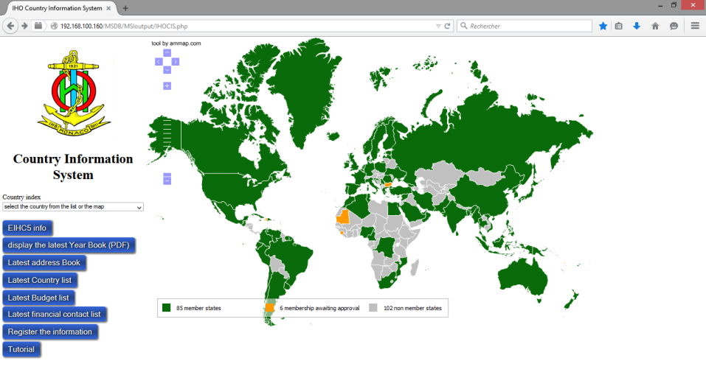
IHO Country Information Database

Slide 8
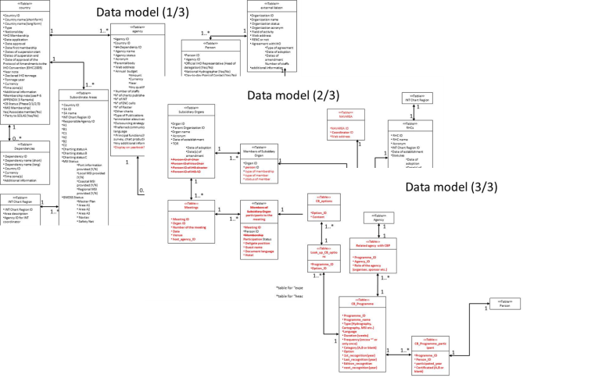
IHO Country Information Database
Reported to Member States in IHO CL 23/2014
In-house system based on PostgreSQL

Slide 9
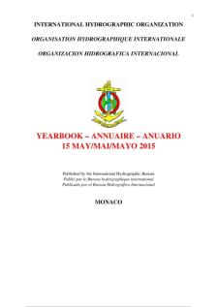
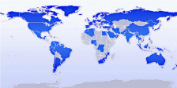
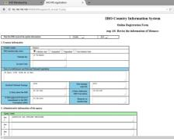
IHO Country Information Database
Collates information on IHO Member States (MS) and other coastal States
Automated production of the IHO Yearbook (P-5) and related lists
Access limited to IHB staff through the IHB internal network
Future developments
Interactive format for consulting P-5
Production of GIS layers
Internet interface for updating the data

Slide 10
Contents
Scope of the IHO GIS
IHO Country Information System
IHO ENC Catalogue
C-55 Development
INToGIS Project
Way ahead

Slide 11
Objectives of the IHO ENC Catalogue
Draft IMO MSC Circular on ECDIS – Guidance for Good Practice
(HTW 2/19 – Annex 8)
“The IHO provides an online chart catalogue that details the coverage of ENCs together with references to coastal State guidance on any requirements for paper charts (where this has been provided). The catalogue also provides links to IHO Member States’ websites where additional information may be found. The IHO online chart catalogue can be accessed from the IHO website.”
IHO Strategic Performance Indicator No.2
“Growth in ENC coverage worldwide, as reported in the IHO on-line catalogue, relative to the existing gap in adequate coverage (as defined by IMO/NAV) from the benchmark 01 Aug. 2008”

Slide 12
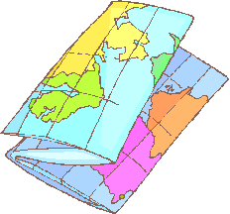
Outline of the current system .
web page based on
ArcGIS online
Browse and search
ENC coverage
User
WFS
upload
The catalogue can be accessed from the IHO web site at:
www.iho.int > ENCs & ECDIS >
ENC Availability.
AVCS
Metadata
IHB
ENC metadata extracted from AVCS and stored on IHB server
WFS uploaded to ArcGIS online for external consultation

Slide 13
Information flow in the future
web page based on
ArcGIS online
Browse and search
ENC coverage
User
WFS
upload
Metadata
IHB
ENC metadata will be accumulated from all relevant sources
WFS uploaded to ArcGIS online for external consultation

Slide 14
Demonstration - Simple interface
Side bar
(legend, layer select, base map select and print)

Slide 15
Contents
Scope of the IHO GIS
IHO Country Information System
IHO ENC Catalogue
C-55 Development
INToGIS Project
Way ahead

Slide 16
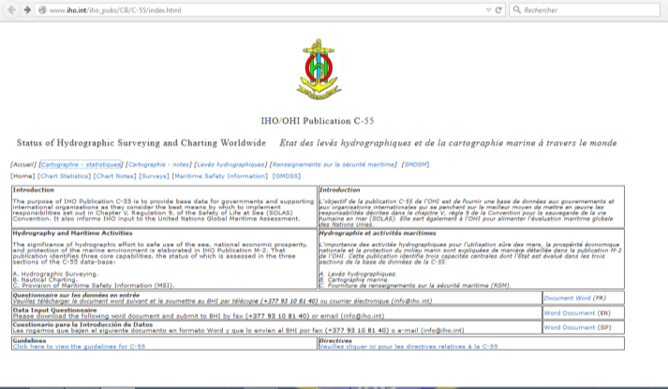
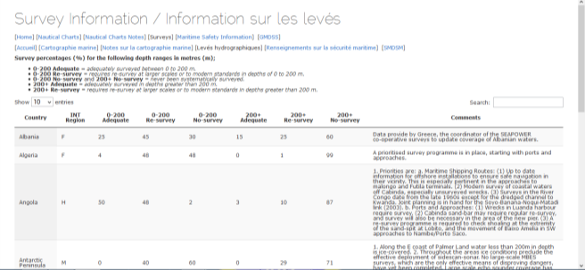
C-55 Development
www.iho.int > Standards & Publications > Download > C-55

Slide 17
C-55 Development
Transfer of the current content of C-55 (composite indicators) into a database structure
Assessment of spatial analysis and graphical displays
pick report,
colour overlays associated with significant features (EEZ, coastline, etc.)
Revision of the update procedure (user friendly interface)
Future developments:
inclusion of CATZOC polygons to provide an initial geo-referenced quality layer (as discussed at IRCC-4)
RENCs are invited to seek the consent of their members to provide CATZOC information to the IHB for inclusion in C-55

Slide 18
Contents
Scope of the IHO GIS
IHO Country Information System
IHO ENC Catalogue
C-55 Development
INToGIS Project
Way ahead

Slide 19
Background, Objectives
Transfer of the S-11 Part B (all INT Chart Regions) into the IHO GIS Environment and provision of associated web services to IHO MS
From pdf versions …to web services (maintenance tools, search functions, possibility of queries and statistical analysis, uploading/downloading functions, track history…)
For who? IHO MS, International Charting Coordination WGs / INT Chart Coordinators, IHB
More dynamic and straightforward updating process… but iaw S-11 Part A “policy” and rights management
Foundation: Version-controlled of Regional Databases (... Region B, version 3.0.2, March 2016,.. ), S-100-compliant model

Slide 20
Contents
Scope of the IHO GIS
IHO Country Information System
IHO ENC Catalogue
C-55 Development
INToGIS Project
Way ahead

Slide 21
Way ahead: towards the IHO GIS…
Interfacing / full integration of the components into the IHO GIS environment
Overlay with other information(INT charts, RHC areas, Maritime Shipping Routes, Ports, etc.)
Generation of Regional GIS (i.e.: Antarctica GIS)
Generation of SPI, WPI…
GIS portal for all the IHO geospatial information

Slide 22
Questions?

