Slide 1
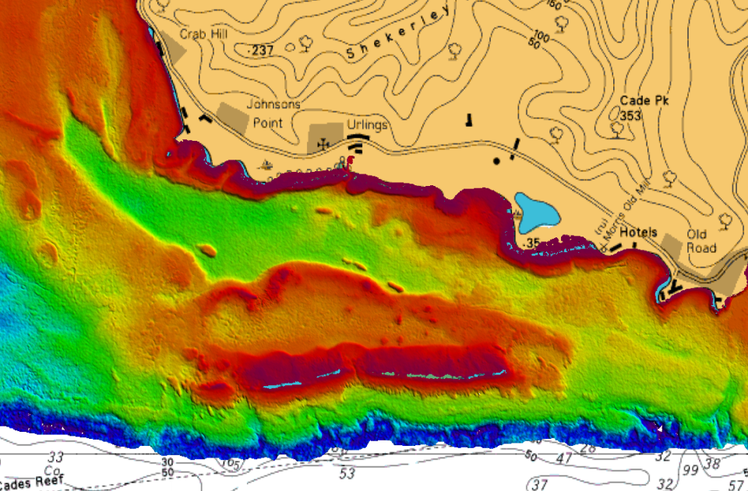
Satellite Derived Bathymetry
Report to NCWG1 – April 2015
Andy Talbot – UKHO Bathymetry Advisor
DQWG – July 2015
Presented by Edward Hosken
Bathymetry, Geodesy & Imagery Centre (BGIC)

Slide 2
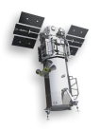
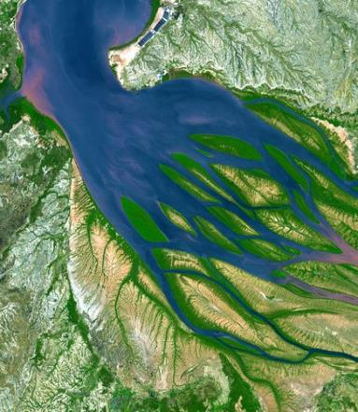
Contents
What is Satellite Derived Bathymetry (SDB)?
The Antigua trial
Method
Results
Conclusions
Representation on Charts
Options considered
Proposed method
Notes:
This is summarising a +140 page report.
The image here is from the North west coast of Madagascar

Slide 3
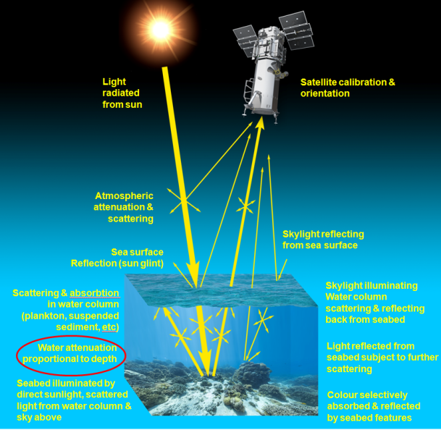
What is Satellite derived Bathymetry (SDB)?
Shallow=bright
Deep=dark
…but dark patches may also be shallow
Notes:
SDB refers to depths processed from optical satellite imagery
deeper water will appear darker and shallower water will appear lighter
But a shallow black rock can appear dark and a deeper sandy seabed can appear light
Complex mathematical algorithms attempt to account for these and estimate the average depth in a pixel
SDB is a very different type of technology compared to established hydrographic tools such as MBES or Lidar.
Unlike “active” depth measurement techniques such as MBES or Lidar, where controlled signals are transmitted and received, SDB is a “passive” technology and is simply measuring the reflected sunlight intensity.
SDB results are affected by many uncontrollable environmental factors all of which combine to add more uncertainty to the results obtainable from SDB.
Images can have errors introduced by: Sun Glint, refraction, angle of sun and satellite, atmosphere (clouds, scattering),
MBES system only has to deal with environmental conditions in the water column. SDB must also deal with 700km of atmosphere and the air/water interface. SDB also cannot control the source of light (the sun!) and therefore more ‘guess work’ is employed in the calculations.
Satellites imagery is like a complex photo from a digital camera. Satellites see in frequency bands normal cameras cannot and this can allow clever processing of the imagery provide improved results.

Slide 4
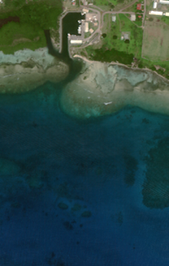
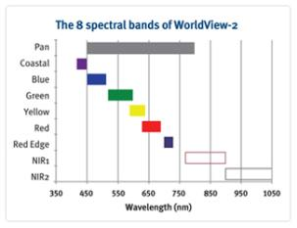
What is Satellite derived Bathymetry (SDB)?
Landsat 5
1982
30 metres
WorldView-2
2009
2 metres
Notes:
SDB refers to depths processed from optical satellite imagery
deeper water will appear darker and shallower water will appear lighter
But a shallow black rock can appear dark and a deeper sandy seabed can appear light
Complex mathematical algorithms attempt to account for these and estimate the average depth in a pixel
SDB is a very different type of technology compared to established hydrographic tools such as MBES or Lidar.
Unlike “active” depth measurement techniques such as MBES or Lidar, where controlled signals are transmitted and received, SDB is a “passive” technology and is simply measuring the reflected sunlight intensity.
SDB results are affected by many uncontrollable environmental factors all of which combine to add more uncertainty to the results obtainable from SDB.
Images can have errors introduced by: Sun Glint, refraction, angle of sun and satellite, atmosphere (clouds, scattering),
MBES system only has to deal with environmental conditions in the water column. SDB must also deal with 700km of atmosphere and the air/water interface. SDB also cannot control the source of light (the sun!) and therefore more ‘guess work’ is employed in the calculations.
Satellites imagery is like a complex photo from a digital camera. Satellites see in frequency bands normal cameras cannot and this can allow clever processing of the imagery provide improved results.

Slide 5
Background
Limited to shallow depths and clear water
SDB is a potential low cost source of data.
Though it has been around since late 1970’s, recent developments have increased its potential.
Early examples of SDB didn’t give confidence in the data.
Industry depth accuracy claims seemed optimistic.
Notes:
Echo sounders error sources are well understood and largely compensated for. E.g. vessel motion, SVP.
The Uncertainties of SDB are not fully understood in the way they are for established hydrographic tools.
Different algorithms for SDB will give different results. Some are available in software like Envi, but others come as part of a service provided by a company and we are not able to get ‘hands on’ with them.
Application of mathematical algorithms are closely guarded IP of individual companies. They have libraries of data for how SDB works in different areas and can apply this data to get improved results. They know how coral and rock reflect in different areas. These libraries are key to the way external companies work.
Industry making bold claims of 10% depth accuracy. No real evidence.
It still needs correcting for tide. This is often the hardest part and is not fully appreciated by many of the SDB companies.

Slide 6
Background
SDB can offer:
Good coverage - not as good as MBES - better than SBES and leadline.
Better object detection than leadline, but not as good as SBES used with side scan sonar or a MBES.
Good positional accuracy. Similar to MBES and SBES. Better than historic leadline.
Lesser depth accuracy than MBES, SBES and leadline.
Notes:
Echo sounders error sources are well understood and largely compensated for. E.g. vessel motion, SVP.
The Uncertainties of SDB are not fully understood in the way they are for established hydrographic tools.
Different algorithms for SDB will give different results. Some are available in software like Envi, but others come as part of a service provided by a company and we are not able to get ‘hands on’ with them.
Application of mathematical algorithms are closely guarded IP of individual companies. They have libraries of data for how SDB works in different areas and can apply this data to get improved results. They know how coral and rock reflect in different areas. These libraries are key to the way external companies work.
Industry making bold claims of 10% depth accuracy. No real evidence.
It still needs correcting for tide. This is often the hardest part and is not fully appreciated by many of the SDB companies.

Slide 7
Background
Questions considered by UKHO:
How accurate is it really?
How can this data be depicted on charts to ensure that the depth accuracy limitations are understood and it is used appropriately by the mariner? Is existing symbology enough or is something new required? Are standards needed to ensure consistency throughout the IHO?
Notes:
Echo sounders error sources are well understood and largely compensated for. E.g. vessel motion, SVP.
The Uncertainties of SDB are not fully understood in the way they are for established hydrographic tools.
Different algorithms for SDB will give different results. Some are available in software like Envi, but others come as part of a service provided by a company and we are not able to get ‘hands on’ with them.
Application of mathematical algorithms are closely guarded IP of individual companies. They have libraries of data for how SDB works in different areas and can apply this data to get improved results. They know how coral and rock reflect in different areas. These libraries are key to the way external companies work.
Industry making bold claims of 10% depth accuracy. No real evidence.
It still needs correcting for tide. This is often the hardest part and is not fully appreciated by many of the SDB companies.

Slide 8
UKHO SDB trial
In 2013 a trial was devised to allow UKHO to assess the suitability of SDB and determine its accuracy and reliability.
Notes:
Echo sounders error sources are well understood and largely compensated for. E.g. vessel motion, SVP.
The Uncertainties of SDB are not fully understood in the way they are for established hydrographic tools.
Different algorithms for SDB will give different results. Some are available in software like Envi, but others come as part of a service provided by a company and we are not able to get ‘hands on’ with them.
Application of mathematical algorithms are closely guarded IP of individual companies.
Industry making bold claims of 10% depth accuracy.

Slide 9
The Antigua Trial - Methodology
Antigua chosen due to clear water and good mix of sand and complex coral.
To remove any ambiguity, collect:
The best multi-beam data possible
The best SDB data possible
Data was acquired concurrently
2m Imagery captured to specific requirements.
Notes:
A MBES survey of English and Falmouth Harbours was already planned in partnership with the local government. With there agreement we extended the survey to cover an excellent test area called Cades Reef.
Clear water with a mixture of sand and coral seabed and varying depth ranges to show the range of abilities of SDB.
Maximum acceptable satellite angles specified and cloud cover.
During the tasking period of nearly 4 months only 1 image was close to the spec. Off-Nadir angle was good but the Satellite-to-target azimuth was out of spec.

Slide 10
The Antigua Trial - Methodology
The SDB data was processed using several different methods.
Small parts of the MBES survey were used to improve the SDB data (ground truth).
The MBES data was used as the benchmark
Notes:
5 solutions to test the different processing methods.
3 iterations to test the need for providing ground truthing and at what level.
Proteus were the main contractor. They usually sub contract to EOMAP but for the trial they also provided 2 other solutions for no extra fee.
The supply of ground truth data was controlled to ensure the integrity of the data.

Slide 11
The Antigua Trial - Results
Results were looked at in terms of both overall accuracy (compared to MBES dataset) and SDB’s ability to define critical soundings.
Notes:
5 solutions to test the different processing methods.
3 iterations to test the need for providing ground truthing and at what level.
Proteus were the main contractor. They usually sub contract to EOMAP but for the trial they also provided 2 other solutions for no extra fee.
The supply of ground truth data was controlled to ensure the integrity of the data.

Slide 12
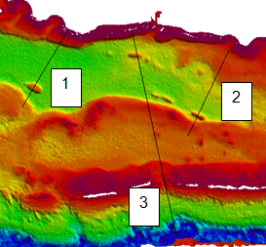
Results
Notes:
Showing all SDB 3rd iteration results and the improvement that ground truthing makes to the SDB result.
Notice how it tends to fail shoal

Slide 13
Results
Notes:
Showing all SDB 3rd iteration results and the improvement that ground truthing makes to the SDB result.
Notice how it tends to fail shoal

Slide 14
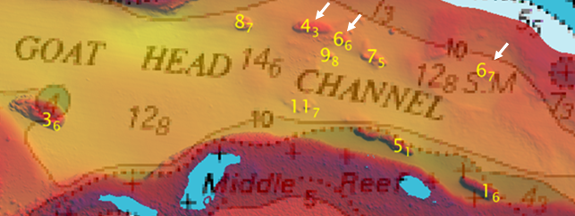
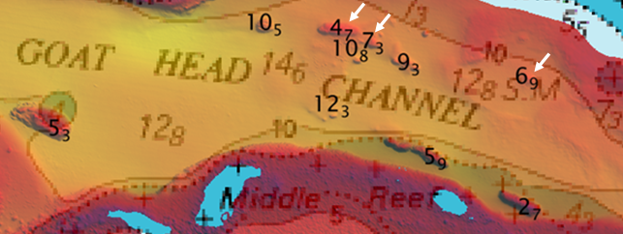
Results
Significant depths
Multi-Beam depths
SDB depths
Notes:
These are the significant depths from the MBES and SDB data.
The chart is based on lead line data.
Quite a few new shoal features have been picked up outside the 10m contour.

Slide 15
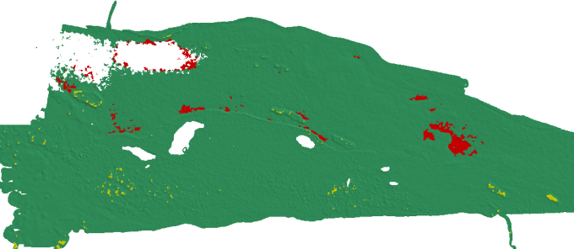
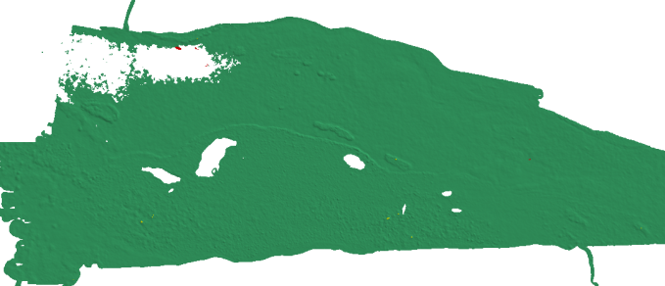
Results
±2m
= SDB is deeper
= SDB is shoaler
±3m
Notes:
EOMAP iteration 3, Cades Reef area,
Green = EOMAP within the range,
Yellow = EOMAP is deeper,
Red = EOMAP is shoaler

Slide 16
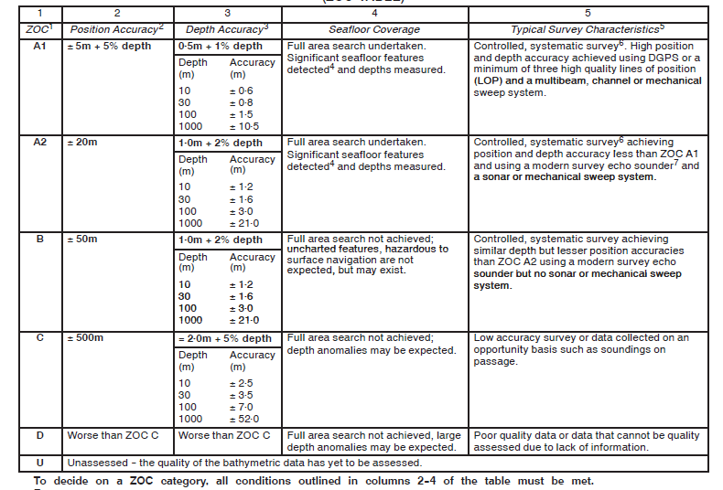
Results - Catzoc
Notes:
EOMAP iteration 3, Cades Reef area,
Green = EOMAP within the range,
Yellow = EOMAP is deeper,
Red = EOMAP is shoaler

Slide 17
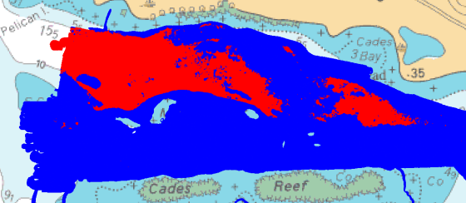
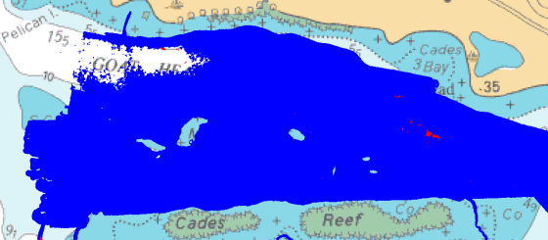
Results - Catzoc
No-ground truth applied
ground truth applied
(Blue = data passes CATZOC C, Red = data fails CATZOC C)
Notes:
EOMAP iteration 3, Cades Reef area,
Green = EOMAP within the range,
Yellow = EOMAP is deeper,
Red = EOMAP is shoaler

Slide 18
Results - Catzoc
Percentages of SDB data meeting Catzoc C requirements:
 | Company 1 | Company 2 | Company 3
Without ground truth | 78.6% | 78.5% | 46.5%
With ground truth | 97.7% | 92.1% | 91.6%
Notes:
EOMAP iteration 3, Cades Reef area,
Green = EOMAP within the range,
Yellow = EOMAP is deeper,
Red = EOMAP is shoaler

Slide 19
The Antigua Trial - Conclusions
Processing methods make a difference.
Ground truth data improved the SDB results.
SDB limited to ~ 16m depth.
Ground truthed data met Catzoc C requirements for more than 90% of the data.
In this case SDB data was capable of making the chart safer and within its limitations it can provide useful information for the mariner.
Notes:
The trial was a definite success and has allowed us to understand the absolute accuracy of SDB, which is not as industry often claims, 10% of depth.
We have gained confidence in SDB data.
Though SDB technology is not able to match echo sounders for accuracy, it can give an indication of the shape of the seabed if collected in a controlled manner with quality control.
It is likely that some features will be missed, but at least some features will be picked up.
It is another hydrographic tool that can be used accordingly.
Though MBES ground truthing was slightly better than SBES. When considering the costs, good quality SBES data is enough to control SDB.

Slide 20
Representation on Charts
UKHO considered many options e.g.:
Normal soundings / Upright soundings
Magenta boundary
Magenta soundings
And consulted mariners for their opinions.
They would like to know where SDB data is but don’t want further complexity on the chart.
Preference for use of source diagram and chart note.
Notes:
SDB will always have an extinction depth and it is expected that this will be different for different images and areas.
This is the depth beyond which the results are no longer stable and become very inaccurate. SDB data will be computed deeper but we shouldn’t use the results.
It will very much depend on water clarity.
Ground truthing is the only way to determine this extinction depth for quality data for each dataset.
Not meeting an IHO survey standard should not prevent data from being used to update a chart. Passage data is often used which does not meet IHO survey standards.
High quality SDB data is able to add value to navigational products.

Slide 21
Representation on Charts
And concluded that…….
New symbology is not required.
S-4 needs updating to include guidance on SDB depths depiction.
Notes:
SDB will always have an extinction depth and it is expected that this will be different for different images and areas.
This is the depth beyond which the results are no longer stable and become very inaccurate. SDB data will be computed deeper but we shouldn’t use the results.
It will very much depend on water clarity.
Ground truthing is the only way to determine this extinction depth for quality data for each dataset.
Not meeting an IHO survey standard should not prevent data from being used to update a chart. Passage data is often used which does not meet IHO survey standards.
High quality SDB data is able to add value to navigational products.

Slide 22
Representation on Charts
SDB data should be ground truthed - maximum of CATZOC C - standard italic black soundings.
Ground truth data should be at least IHO S44 order 1b – to include data at extents and min/max depth range of the SDB data.
Caution given to any SDB data where the provenance of the imagery is not known and ground truthing has not been conducted.
SDB data should not be used to disprove existing charted shoal depths, but it may be used to improve the position of shoals derived from surveys based on old positioning methods.
Notes:
SDB will always have an extinction depth and it is expected that this will be different for different images and areas.
This is the depth beyond which the results are no longer stable and become very inaccurate. SDB data will be computed deeper but we shouldn’t use the results.
It will very much depend on water clarity.
Ground truthing is the only way to determine this extinction depth for quality data for each dataset.
Not meeting an IHO survey standard should not prevent data from being used to update a chart. Passage data is often used which does not meet IHO survey standards.
High quality SDB data is able to add value to navigational products.

Slide 23
Representation on Charts
Any dangers discovered by SDB should be charted but it should not be implied that further dangers do not exist.
Source diagrams should identify where SDB data has been used and reference the date of the imagery acquisition (not the date the bathymetry was computed).
Notes should be added to charts explaining the shortcomings of SDB data.
Notes:
SDB will always have an extinction depth and it is expected that this will be different for different images and areas.
This is the depth beyond which the results are no longer stable and become very inaccurate. SDB data will be computed deeper but we shouldn’t use the results.
It will very much depend on water clarity.
Ground truthing is the only way to determine this extinction depth for quality data for each dataset.
Not meeting an IHO survey standard should not prevent data from being used to update a chart. Passage data is often used which does not meet IHO survey standards.
High quality SDB data is able to add value to navigational products.

Slide 24
Representation on Charts
Areas containing mainly SDB data may exceptionally be identified on the face of the chart by a limit if: there is no source diagram or it is considered that the Source Diagram cannot depict it accurately enough; where the provenance of the imagery is not known; where the vertical accuracy cannot be assessed because ground truth data has not been obtained.
Boundary: INT1 I25
Notes:
SDB will always have an extinction depth and it is expected that this will be different for different images and areas.
This is the depth beyond which the results are no longer stable and become very inaccurate. SDB data will be computed deeper but we shouldn’t use the results.
It will very much depend on water clarity.
Ground truthing is the only way to determine this extinction depth for quality data for each dataset.
Not meeting an IHO survey standard should not prevent data from being used to update a chart. Passage data is often used which does not meet IHO survey standards.
High quality SDB data is able to add value to navigational products.

Slide 25
Representation on Charts
UKHO have proved that good quality SDB data can fit into current IHO standards and symbology, but it is important that it is represented consistently on charts to avoid confusion to the mariner.
If used appropriately, SDB added to a chart can reduce the risk of navigating a certain area, whereas SDB used inappropriately could increase the risk of navigating the same area.
Notes:
SDB will always have an extinction depth and it is expected that this will be different for different images and areas.
This is the depth beyond which the results are no longer stable and become very inaccurate. SDB data will be computed deeper but we shouldn’t use the results.
It will very much depend on water clarity.
Ground truthing is the only way to determine this extinction depth for quality data for each dataset.
Not meeting an IHO survey standard should not prevent data from being used to update a chart. Passage data is often used which does not meet IHO survey standards.
High quality SDB data is able to add value to navigational products.

Slide 26
Thank you for listening
andrew.talbot@ukho.gov.uk
Notes:
SDB will always have an extinction depth and it is expected that this will be different for different images and areas.
This is the depth beyond which the results are no longer stable and become very inaccurate. SDB data will be computed deeper but we shouldn’t use the results.
It will very much depend on water clarity.
Ground truthing is the only way to determine this extinction depth for quality data for each dataset.
Not meeting an IHO survey standard should not prevent data from being used to update a chart. Passage data is often used which does not meet IHO survey standards.
High quality SDB data is able to add value to navigational products.

