Slide 1
Development of a Data Quality checklist DQWG-13
Hydrographic Services and Standards Committee

Slide 2
Why a DQ Checklist?
Quality requires that rich and meaningful metadata be used
Fitness for use requires the involvement of technical arrangements that ensure interoperability
A lack of quality that manifests as incompatibility, incomparability and different levels of accuracy of data may jeopardize interoperability
Lack of shared terminology for the documentation of Data Quality
Original quality and usability + transformation to S1xx data model -> final reported data quality in metadata
DQ is intermediate between Data Product Specification and Interoperability Specification (data supplier/user)
HSSC requires DQWG to provide advice on data quality aspects to all Working Groups and Project Teams developing S-100 based product specifications
Objective: to ensure that the data quality aspects are addressed in an appropriate and harmonized way for all S-100 based product specifications

Slide 3
Data production specification
Classical process of geo-information acquisition is defined by rigorous workflows that can be divided into five distinct phases:
Study of user requirements
Development of specifications
Production
Conformance testing
Metadata publication
Each of these phases should be accompanied by a quality assurance procedure, which documents each step as metadata

Slide 4
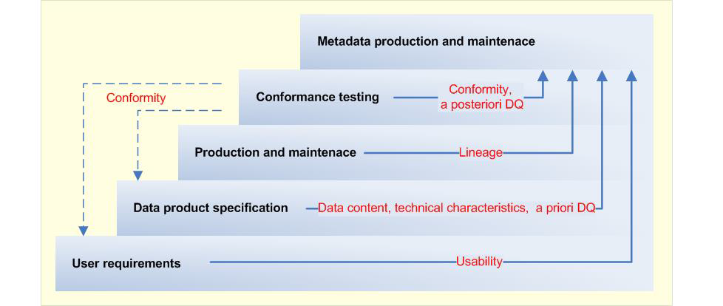
Supplier side of data product
The data product specification translates user requirements into data content and technical characteristics.

Slide 5
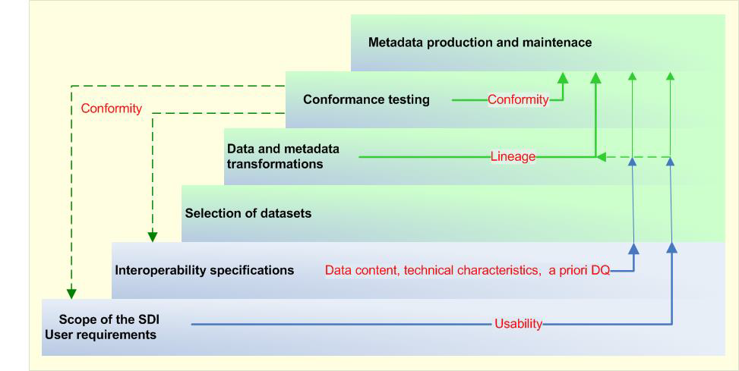
User side of data product (SDIs)
Over-ambitious interoperability requirements may lead to excessive costs or the impossibility of data sharing.

Slide 6
Data Quality dilemma in SDIs
Interoperability adds the value of coherent representation of spatial data

Slide 7
Data quality model
Definition of the DQ units
DQ measures and their parameters
A priori DQ result targets
Value types of the results
Methods for aggregating DQ results
Scope of the data quality evaluation procedure
Accepted evaluation methodologies
Metadata always reports a-posteriori values.
Quality at dataseries level, dataset level and spatial object type

Slide 8
Data quality elements
Completeness
Logical consistency
Positional accuracy
Temporal quality
Thematic accuracy
Aggregation measures
Usability
The final result is conformity: fully conformant, not conformant or not evaluated.

Slide 9
Outcome
A data quality checklist for other WG/PT
Initial check of S-1xx product specifications by DQWG
Report to other WG/PT as input for HSSC10
Feedback from other WG/PT on DQ checklist
Improvement of the DQ checklist
Final DQ checklist to be used by WG/PT

