Slide 1
DQWG14-10J Data integrity, marine boundaries from a MSDI perspective Submitted by the MSDIWG Chair

Slide 2
Security and Integrity
Concepts
Security:
Unauthorised use (e.g. stealing a car, downloading a pirate movie)
To demonstrate "authorised use" some form of "permission" is required.
Integrity
Who sent me this? Is it complete?
Different from "is it correct?"

Slide 3
Security and Integrity
In MSDI often integrity has a higher priority than security.
Why?
Because often MSDI is built with the express purpose of promulgating data so most (not all) use is "authorised"

Slide 4
Security and Integrity
Conclusion
"Integrity" relies on the knowledge of:
who issued a data set; and
the data set has not changed in its journey to the end user.
This is also dealt with by IHO S-63 in the form of its digital signatures.

Slide 5
Security and Integrity - The issue within the MSDI community
Where are the risks?
Much MSDI data relates to boundaries, administrative, legal, cadastral etc.
Impact of incorrect reproduction or attribution can be very large.
Is there a ready-made solution?
Ongoing developments need to consider this matter outside ENCs
Consider existing mechanisms
Stream based may not be suitable for "data centric" models
IHO S-63 relies on a specific end user system
Other standards exist but may need adaptation
All require a "trust network" to define identity.
Notes:
Example Treaty Limit
Red is treaty

Slide 6
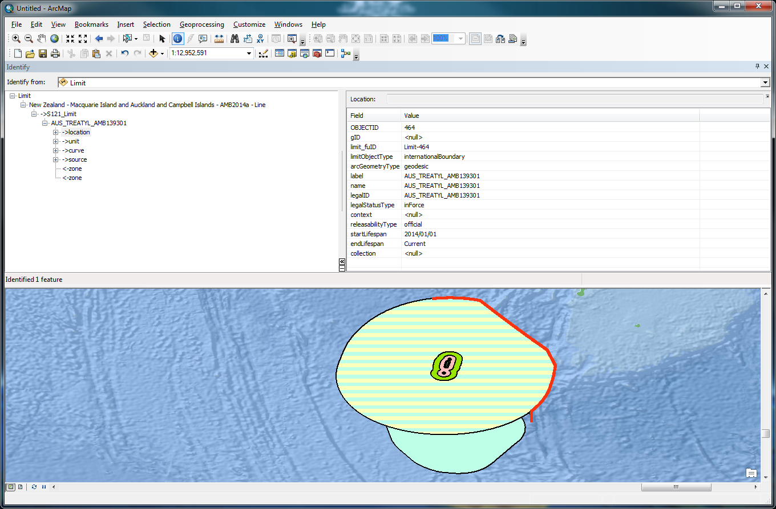
Security and Integrity - The issue within the MSDI community
Consider that one of the fundamental datasets recently under consideration are UNCLOS maritime limits and boundaries. These datasets are simple, by comparison with the complex geospatial data which make up ENC but their economic and political weight are enormous and the impact of their incorrect reproduction through an MSDI environment is of concern.
UNCLOS official limits and boundaries are often promulgated alongside other official boundaries such as marine protected areas, fishing zones and many others which define rights and responsibilities as part of a harmonised marine cadastral system.
The challenge, technically, is to provide means and mechanisms to protect the data integrity and assure the end user of the provenance of the data they are receiving.
Notes:
Example Treaty Limit
Red is treaty

Slide 7
Other matters for the DQWG regarding IRCC
Cybersecurity
e-Navigation
Autonomous ships
IHO DCDB
C-55 (harmonized criteria across the IHO)
Depth limits: 30, 50, 200, others?
Objective parameters: CATZOC, S-101 successor, others?
Use of the appropriate chart scale
Cooperation work on quality beyond S-101
IMO, IALA, WMO, IOC-IODE, ICA Committee on Standards and SDI
Notes:
Example Treaty Limit
Red is treaty

Slide 8
Other matters for the DQWG regarding IRCC
Other stakeholders
UN-GGIM/WGMGI and OGC Marine DWG
IRCC Meetings
Broad coordination with IRCC bodies and RHCs
RHC Meetings
Coordination and harmonization at regional and national levels
CBSC Meetings and CB Work Programme
Bring developing Member States and other coastal States to speed on data quality and integrity assurance
Awareness, Assessment, Analysis, Action (4As)
Notes:
Example Treaty Limit
Red is treaty

Slide 9
Other matters for the DQWG regarding IRCC
Standards of Competence
S-5A mentions quality 23 times,
S-5B 15 times,
S-8A 19 times, and
S-8B 19 times.
Education and awareness aspects for the surveyors and nautical cartographers
Notes:
Example Treaty Limit
Red is treaty

