Slide 1
Re-scheming Plan NOAA's Electronic Navigational Chart Coverage
Megan Bartlett
Office of Coast Survey
ENCWG3
Contact info: Megan.Bartlett@noaa.gov

Slide 2
Motivation
Feedback from the Mariners on the ENC:
Too many alarms on caution areas
•Need more detailed depth areas in key locations
•Need accurate least depths on wrecks and obstructions-we are training our users to ignore the magenta Xs.
•ENCs are not standalone products-they are components of a seamless suite. There are too many discontinuities.
•Symbology is not good for recreational mariners

Slide 3
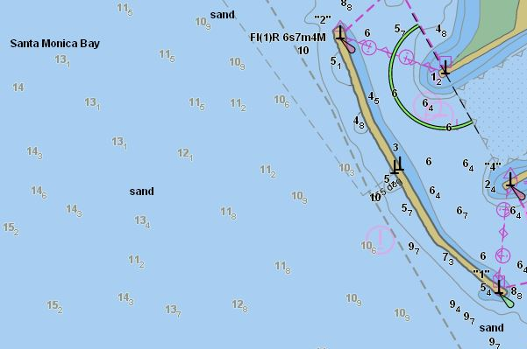
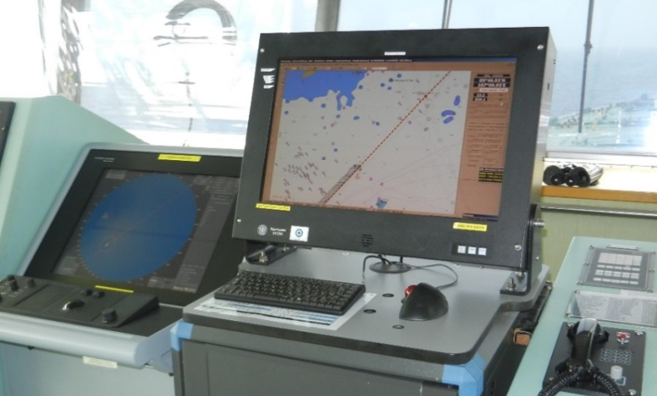
In addition – ECDIS manufacturers (ECDIS - Electronic Chart Display and Information System)
Displays ENC’s and integrates a variety of real-time information
Meets IHO regulations and is an alternative to paper charts
Vector database of chart features
Built to IHO’s S-57 standard

Slide 4
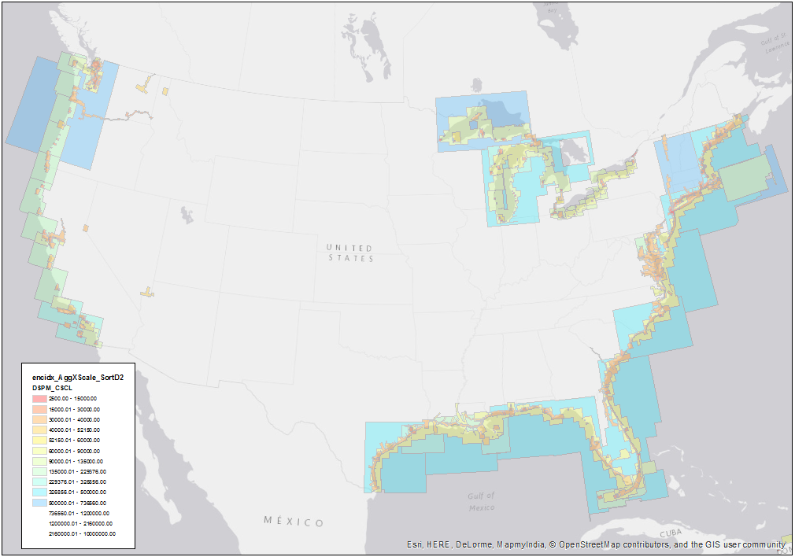
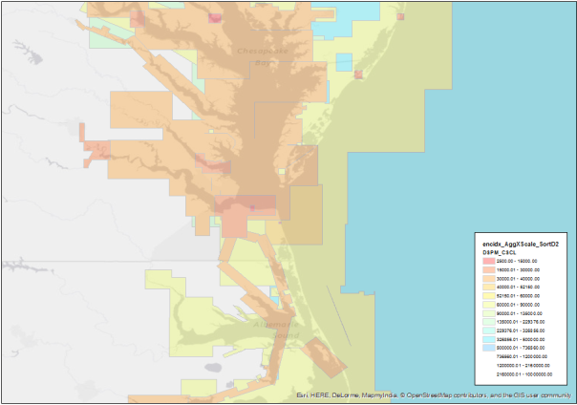
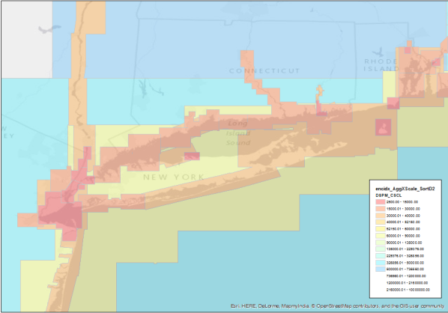
Current US ENC coverage
Norfolk
New York

Slide 5
Current ENC footprints
Legacy data from raster charts (131 RNC scales and 120 ENC scales)
ENC limits copied directly from raster chart boundaries
Easy interim solution
Ex: The English channel/ UKHO & SHOM

Slide 6
Legacy data issues
Too many scales
Scales don’t conform to IHO (S-57 & S-101) recommended scales
Duplication of coverage
Lacking uniformity, consistency, and coherence
Not a smooth transition from scale to scale while navigating on ECDIS systems

Slide 7
Standards are common grounds for argument!

Slide 8
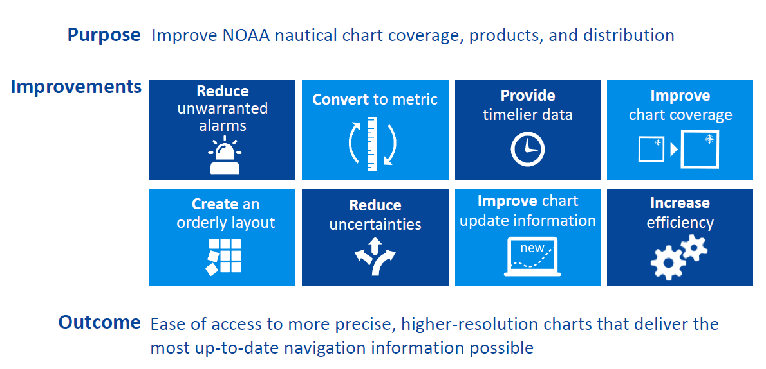
Vision for the future: Nautical Charting Plan

Slide 9
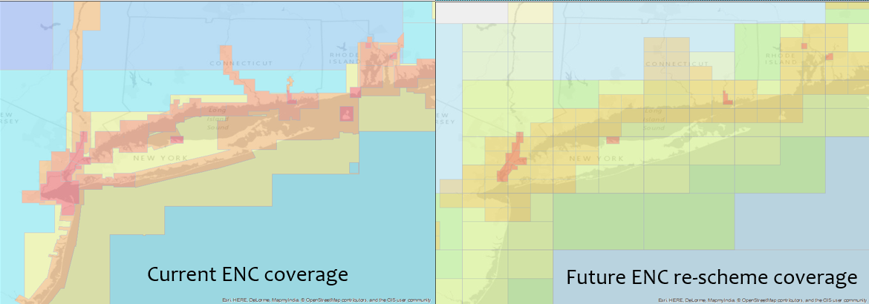
Rescheming

Slide 10
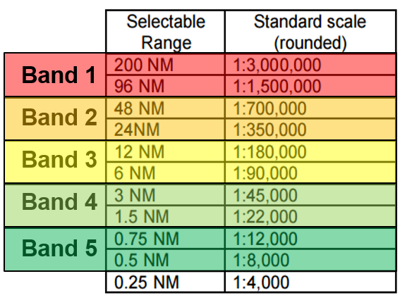
Based on RADAR range
Not compatible for web-services
Requires “re-scaling” current features that are not with ~10% of the proposed scales.

Slide 11
Scale band | Standard Scale (rounded)
Band 1 | 1:5,120,000
 | 1:2,560,000
Band 2 | 1:1,280,000
 | 1:640,000
Band 3 | 1:320,000
 | 1:160,000
Band 4 | 1:80,000
 | 1:40,000
Band 5 | 1:20,000
 | 1:10,000

Slide 12
Calculating ENC cell width and height
Scale band | Standard Scale (rounded) | Width | Height
Band 1 | 1:5,120,000 | 38.4 | 38.4
 | 1:2,560,000 | 19.2 | 19.2
Band 2 | 1:1,280,000 | 9.6 | 9.6
 | 1:640,000 | 4.8 | 4.8
Band 3 | 1:320,000 | 2.4 | 2.4
 | 1:160,000 | 1.2 | 1.2
Band 4 | 1:80,000 | 0.6 | 0.6
 | 1:40,000 | 0.3 | 0.3
Band 5 | 1:20,000 | 0.15 | 0.15
 | 1:10,000 | 0.075 | 0.075

Slide 13
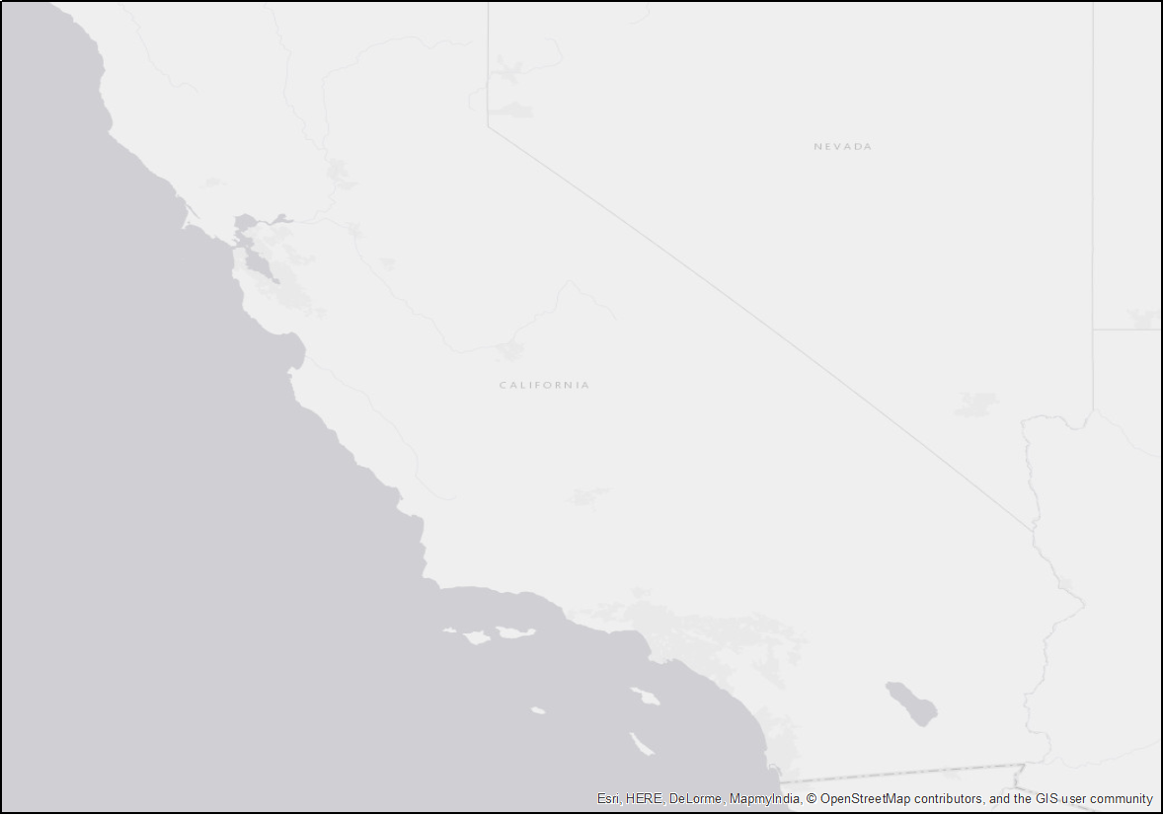
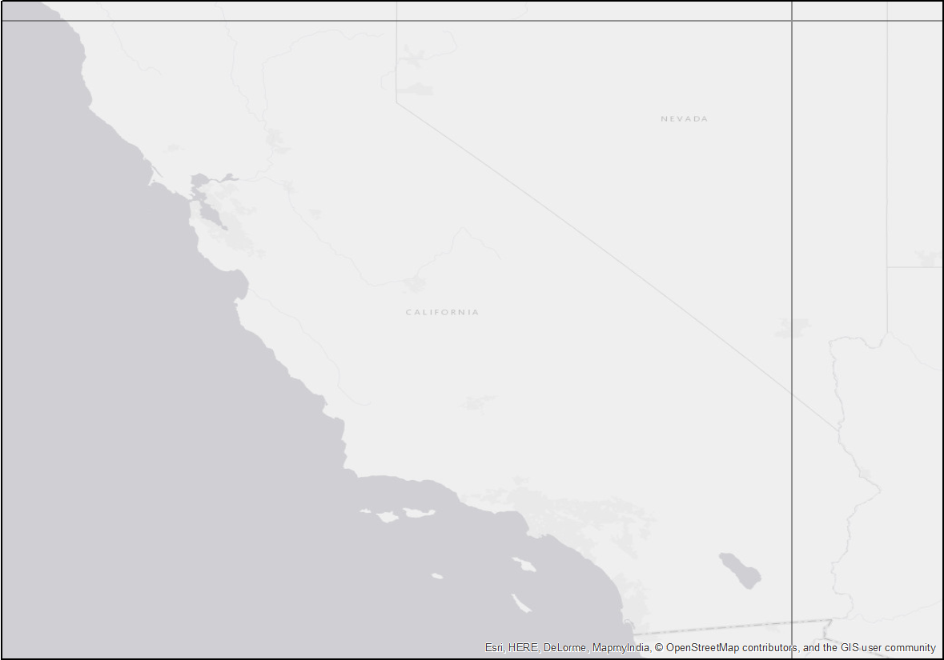
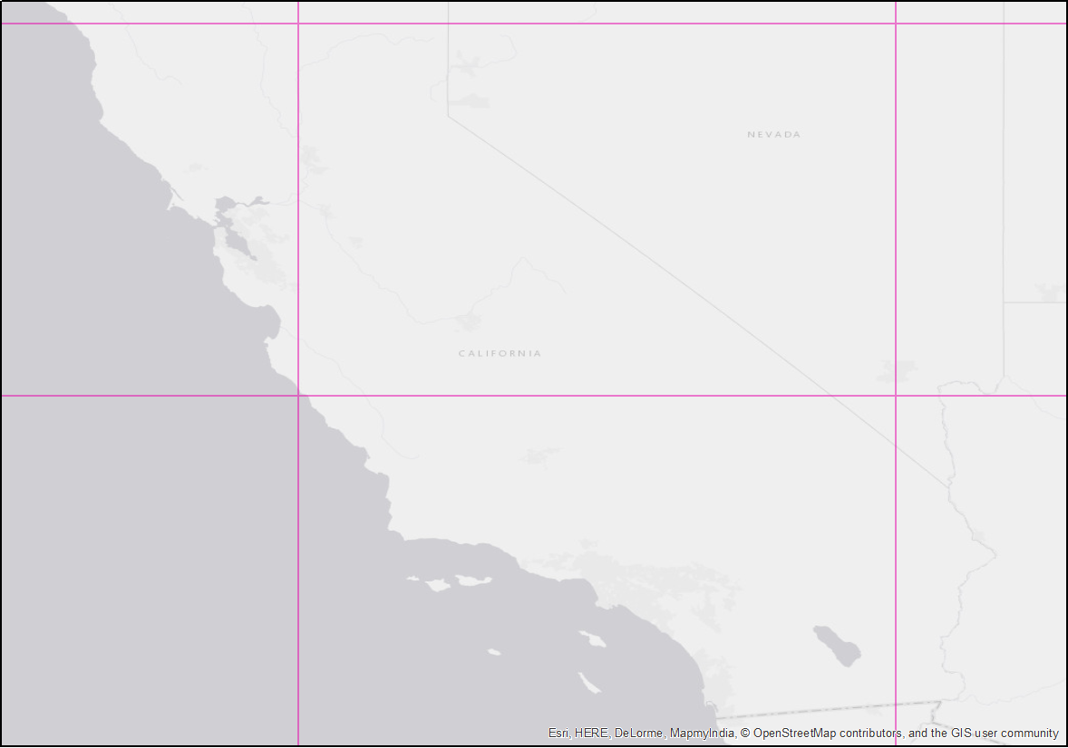
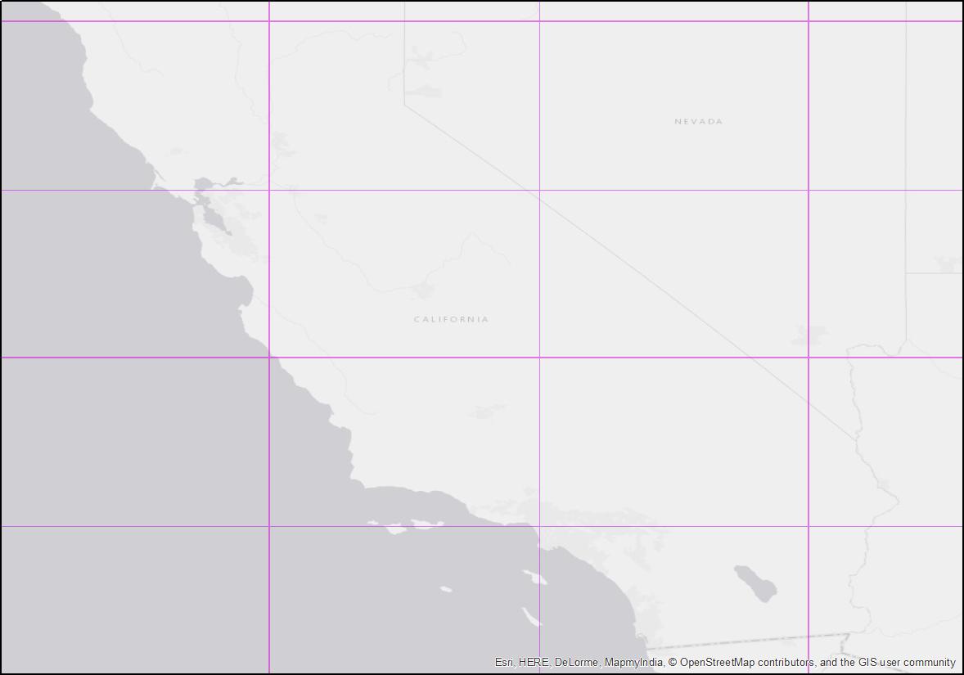
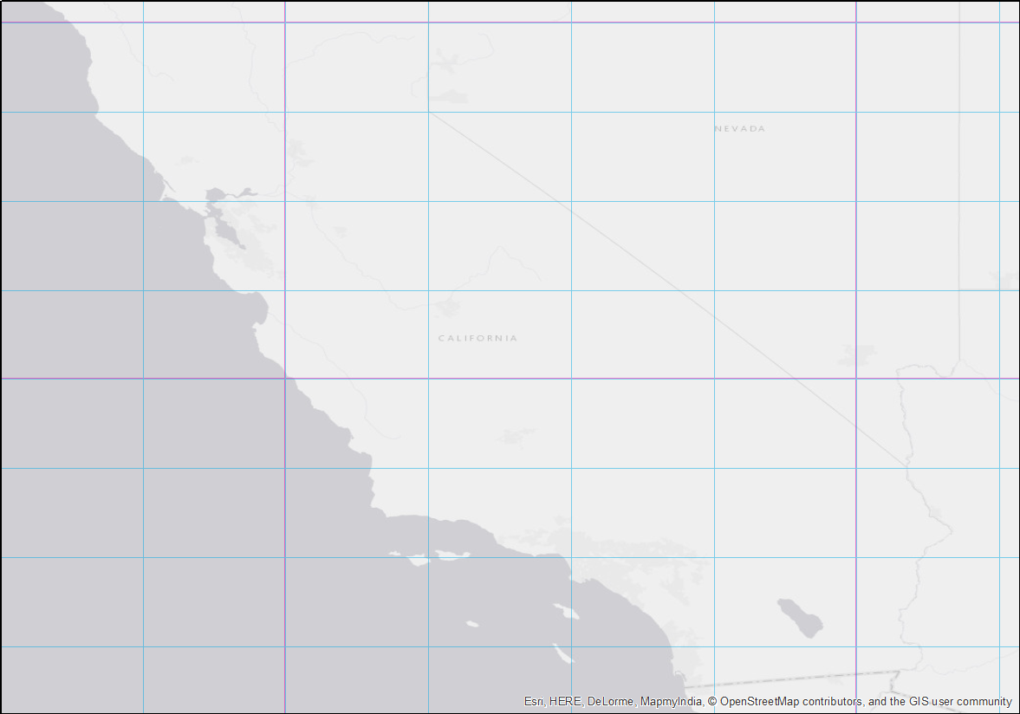
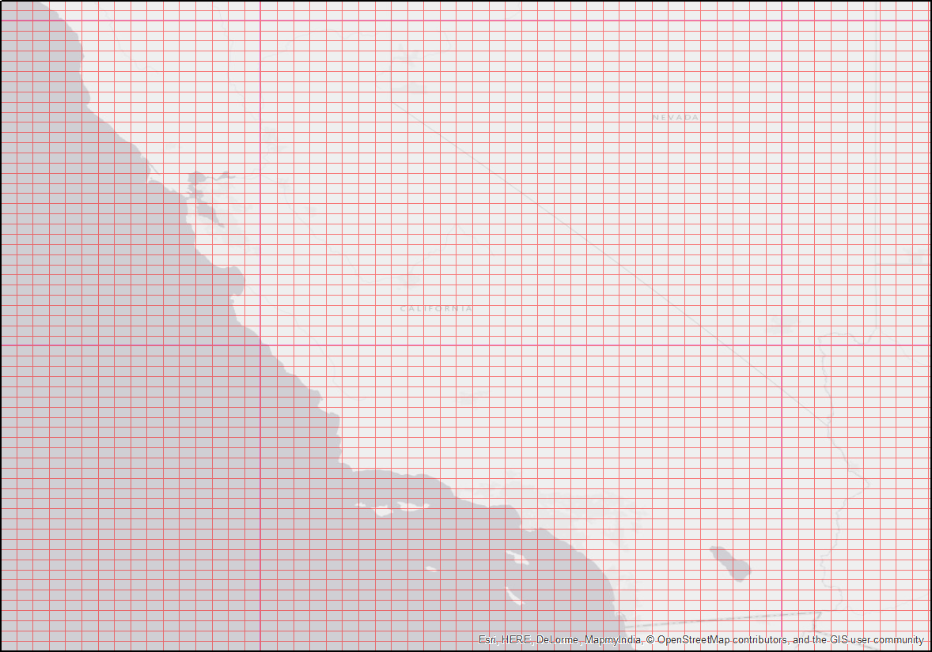
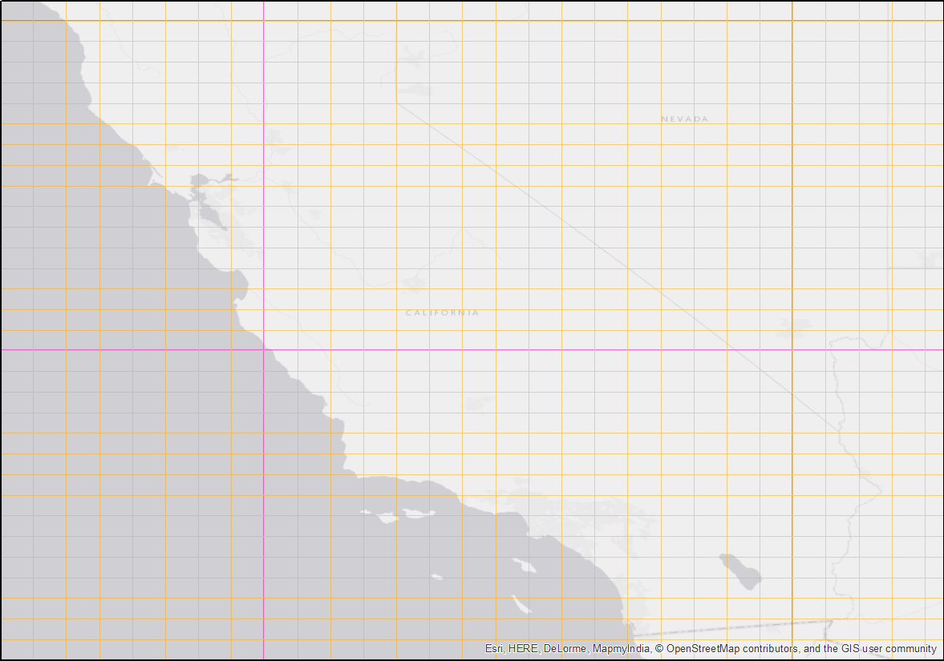
Fishnet tool:

Slide 14
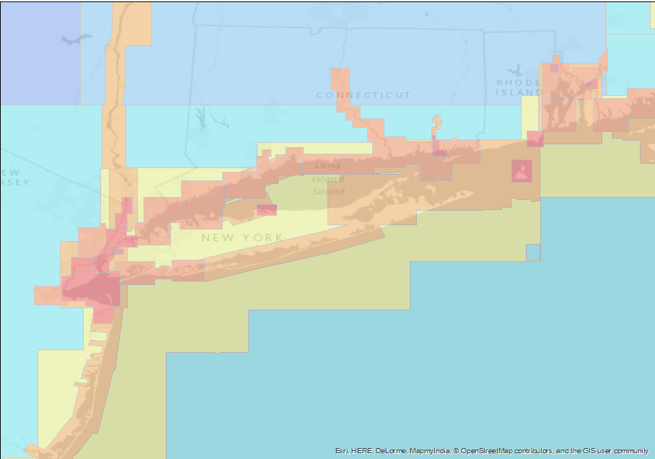
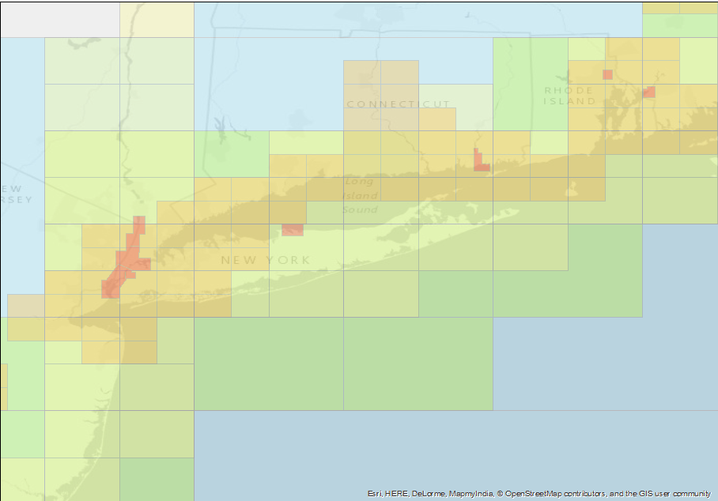
New York
Current ENC coverage
Future ENC re-scheme coverage

Slide 15
Great Lakes
Current ENC coverage
Future ENC re-scheme coverage

Slide 16
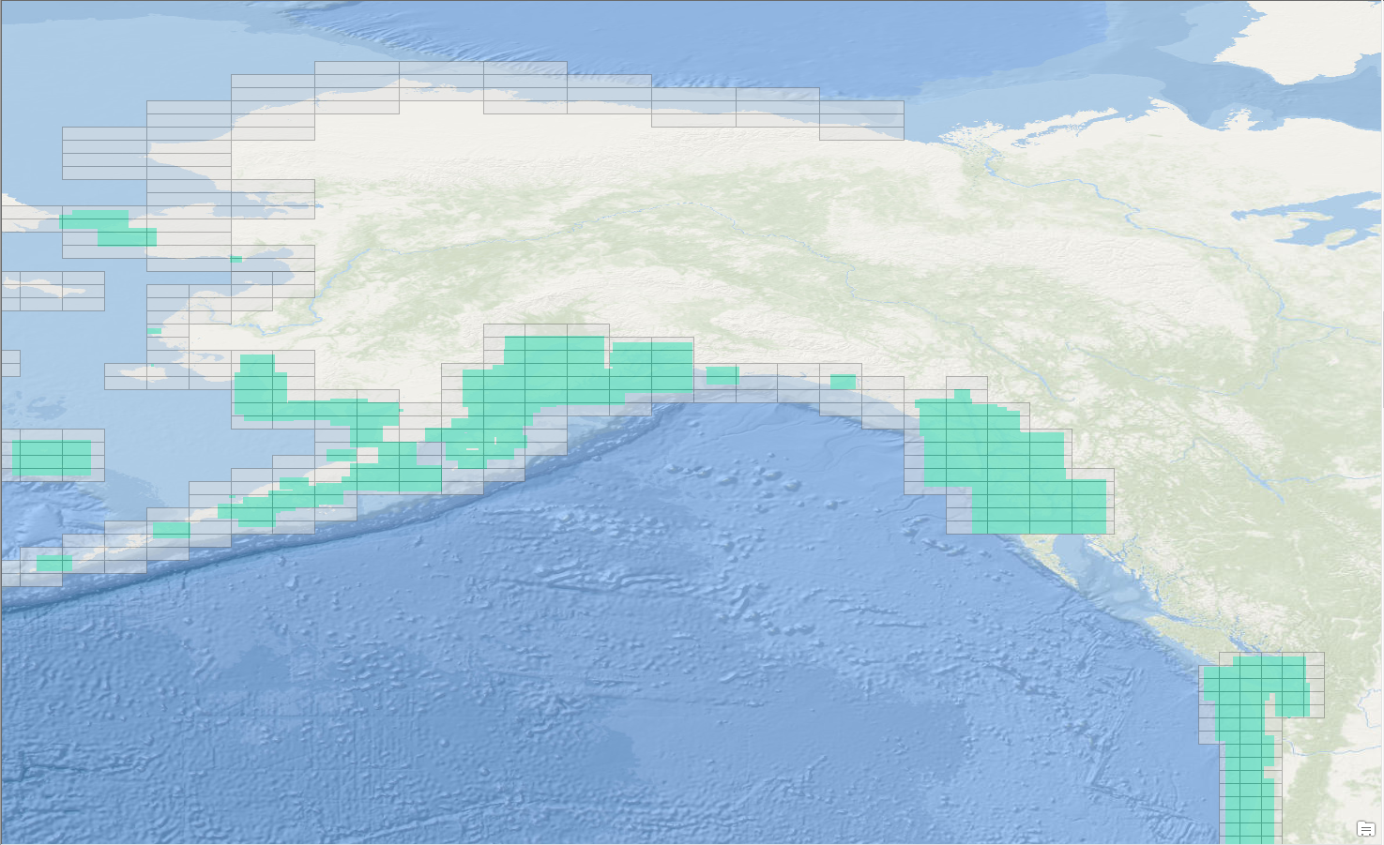
Re-scheming at high latitudes
Band 4
80k

Slide 17
Discussion
Benefits of re-scheming
Meeting more international standards (IHO S-4):
Depth Contours
Feature as a function of scale
Polar charting
“Rasterization” of the ENC

Slide 18
Benefits of re-scheming
Smooth transition from scale to scale while navigating
Smooth transition from old to new ENC compilation
Simplified naming convention
Splitting in 4 in case of too much data in one cell
Ease of planning for extending coverage

Slide 19
BEFORE

Slide 20
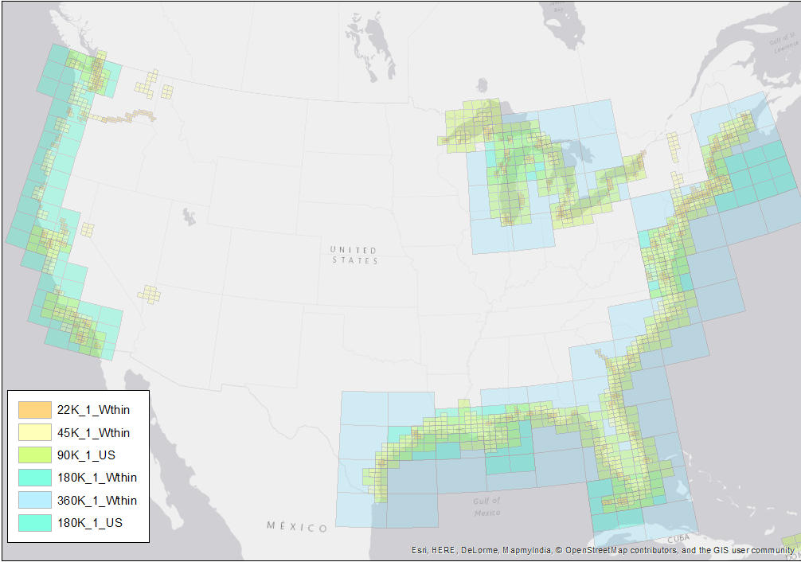
AFTER

Slide 21
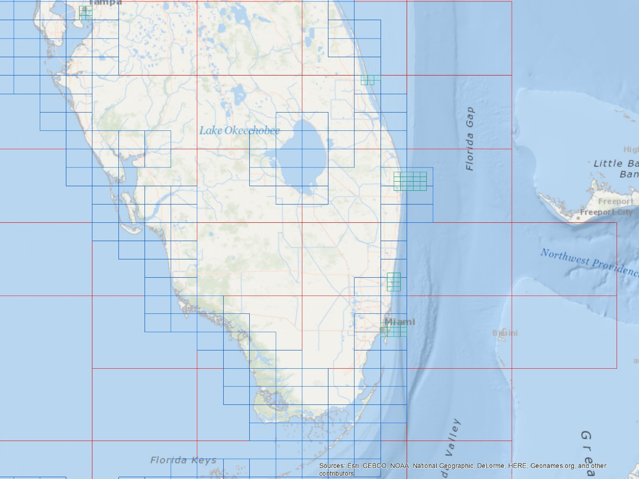
In to the weeds (See the next slides)

Slide 22
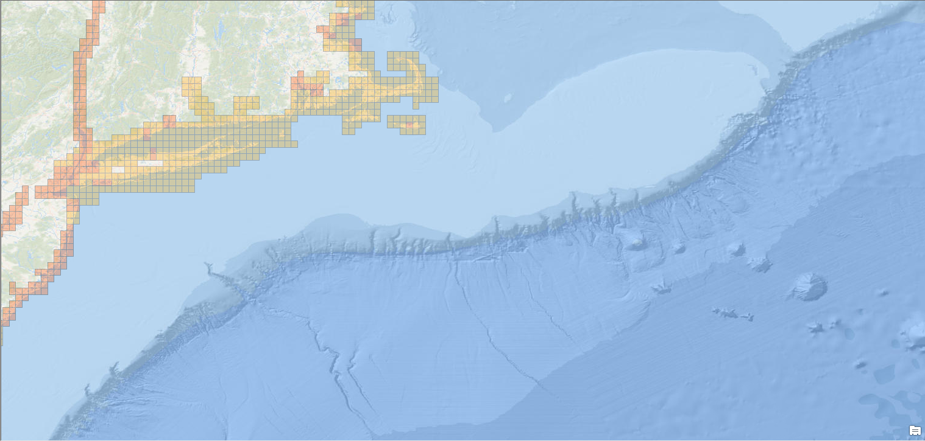
Coverage: Band 5
Scale

Slide 23
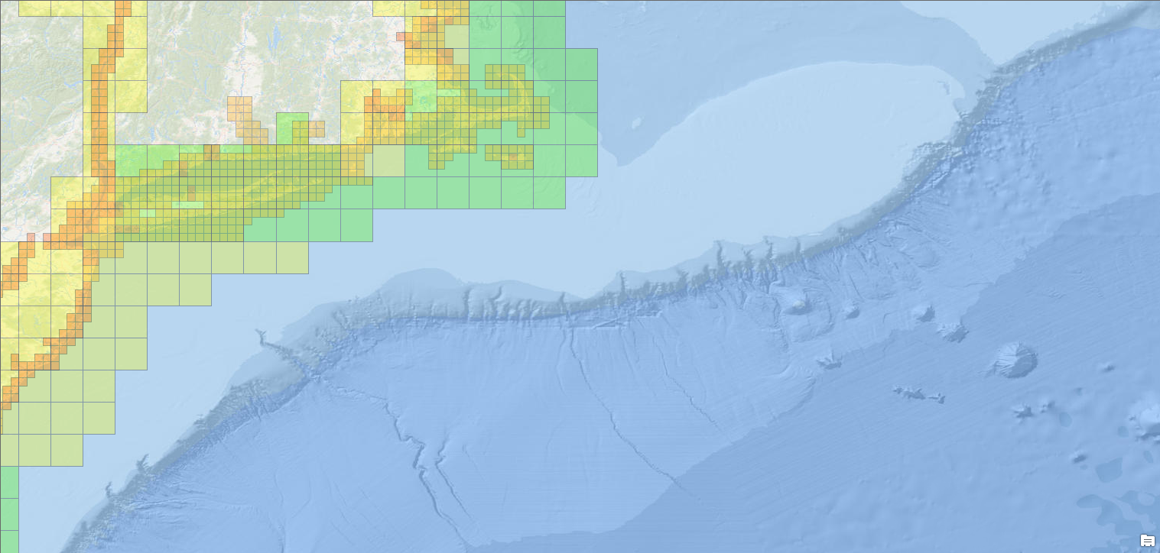
Coverage: Band 4
Scale

Slide 24
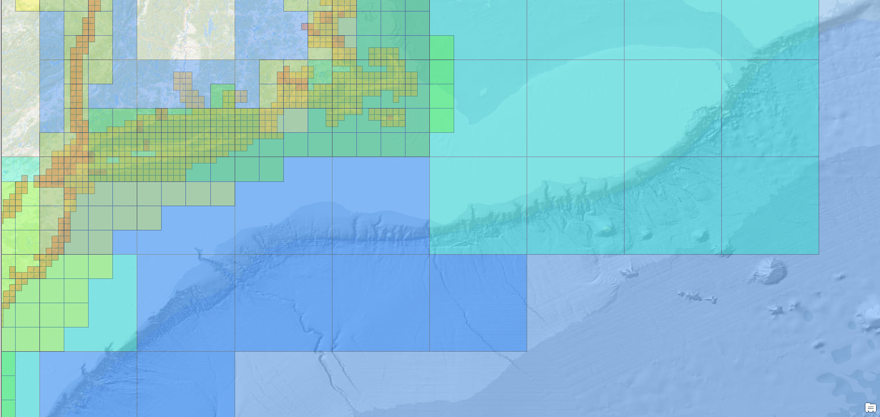
Coverage: Band 3
Scale

Slide 25
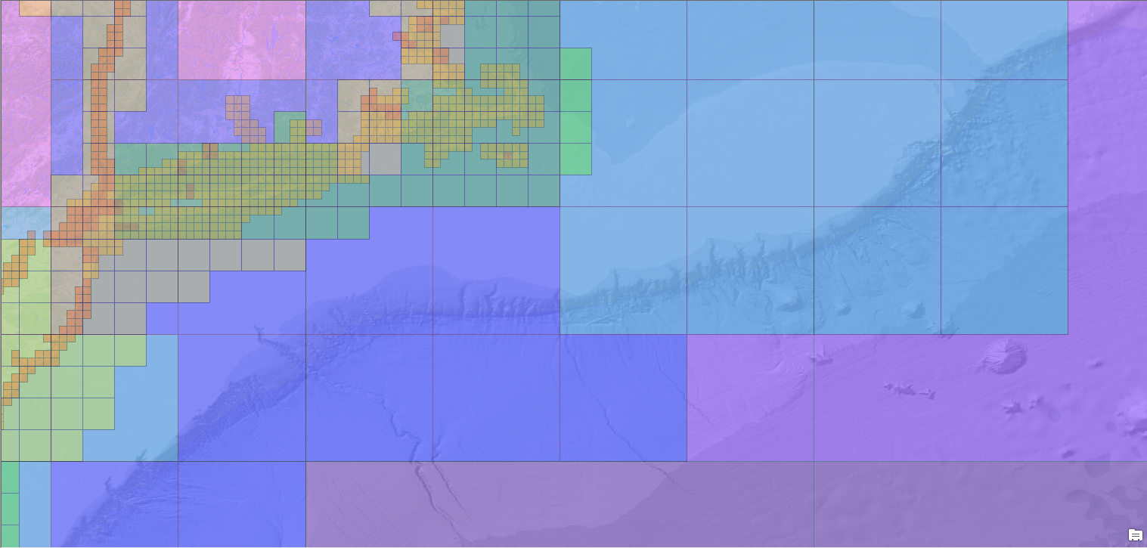
Coverage: Band 2
Scale

Slide 26
Naming convention:
Geographic location
Production code
US 5 SEA EK
Cell Location
Note: We will make sure that a similar name exists in the current ENC suite (especially, cells that end with “M”).
Usage band

Slide 27
Naming convention: Production code and usage band
The first two characters in the ENC cell name are the production code (IHO S-62). In the case of NOAA (“US”).
The first digit after “US” is the scale band (usage band).

Slide 28
Naming convention: Principle ports versus standard state coverage
Standard State coverage - In the re-scheming plan, naming convention will utilize the fourth and fifth characters represent the U.S. state, and sixth character represents a zone within the state.
Principle Ports - In order to differentiate the US Principle Ports from the rest of the re-schemed ENC cells at the same scale band, a three-character port identifier is obtained from the UN/LOCODE Code List 2017-1 for each country (current version was published in July 2017): http://www.unece.org/cefact/locode/service/location.html.

Slide 29
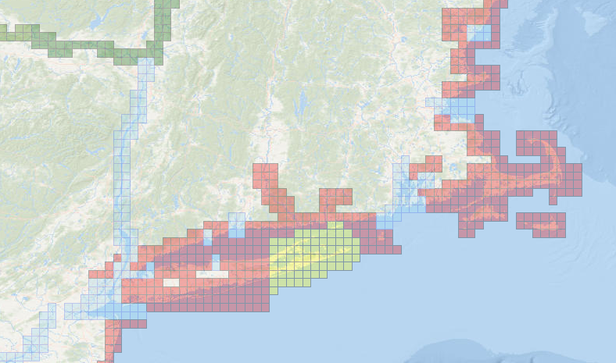
Naming convention
PSM – Portsmouth, NH
BOS – Boston, MA
PVD – Providence, RI
HVN – New Haven, CT
BDR – Bridgeport, CT
PTJ – Port Jefferson, NY
NYC – New York City, NY
PHL – Philadelphia, PA
ME1
NH1
PSM
NY3
MA1
BOS
MA1
MA1
HVN
PVD
BDR
CT1
MA1
CT1
RI1
PTJ
NY2
NYC
NY1
PHL
NJ1

Slide 30
Naming convention: Cell location
The last two characters (i.e., seventh and eighth) are the cell location with respect to a given reference. The southwestern corner of the ENC cell grid is the center of origin (“AA”), where the seventh character represents distance from the center of origin in latitude and the eighth character represents distance from the center of origin in longitude.
CA
BA
AA
AB
AC
…
AX
AY
AZ

Slide 31
Naming convention: Summary
Geographic location
Production code
US 5 SEA EK
Cell Location
Note: We will make sure that a similar name exists in the current ENC suite (especially, cells that end with “M”).
Usage band

Slide 32
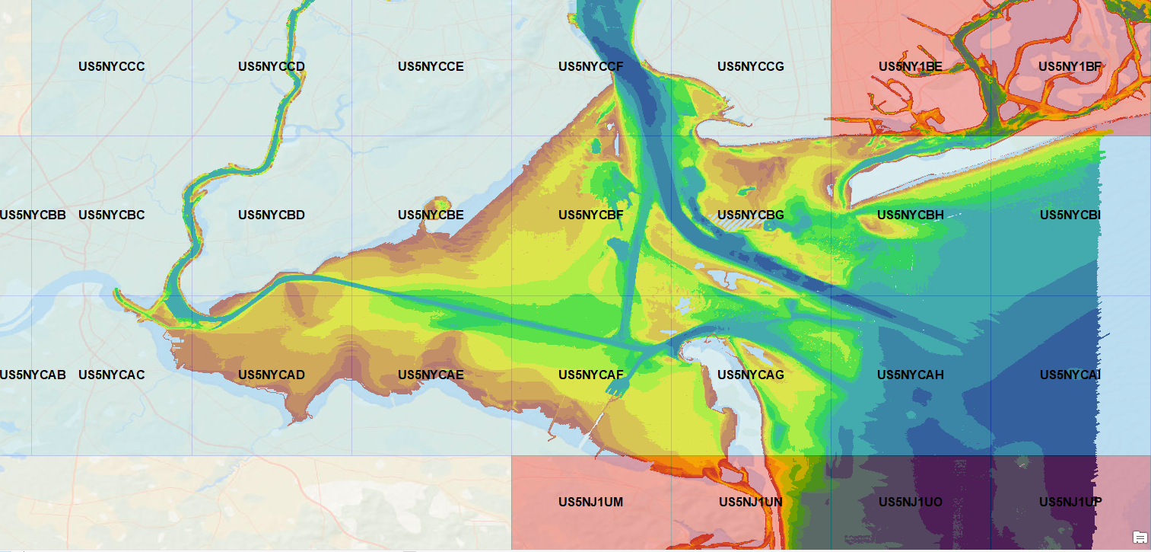
Although most features at similar scale can be copied, bathymetry will need to be recompiled!
Depth (m)

Slide 33
Recommended depth contours per scale band
Scale band | Standard Scale (rounded) | Width | Height
Band 1 | 1:5,120,000 | 38.4 | 38.4 | 100, 200,…
 | 1:2,560,000 | 19.2 | 19.2 | 50,100,150,200,…
Band 2 | 1:1,280,000 | 9.6 | 9.6 | 50,100,150,200,…
 | 1:640,000 | 4.8 | 4.8 | 20 ,50,100,150,200,…
Band 3 | 1:320,000 | 2.4 | 2.4 | 20,30,50,100,150,200,…
 | 1:160,000 | 1.2 | 1.2 | 10, ,20,30,50,100,150,200,…
Band 4 | 1:80,000 | 0.6 | 0.6 | 5, 10, ,20,30,50,100,150,200,…
 | 1:40,000 | 0.3 | 0.3 | 2, 5, 10, ,20,30,50,100,150,200,…
Band 5 | 1:20,000 | 0.15 | 0.15 | 2, 5, 8,10,15,20,30,50,100,150,200,…
 | 1:10,000 | 0.075 | 0.075 | 2,3,4,5,6,7,8,10,15,20,30,50,100,150,200,…
IHO S-4 (B-411)

Slide 34
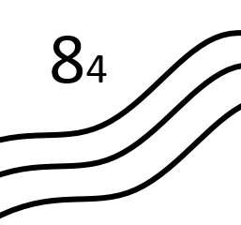
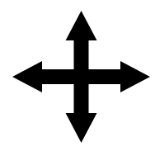
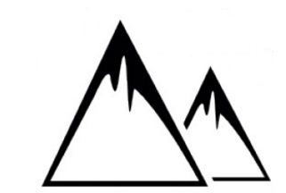
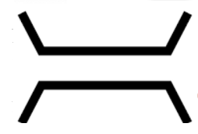
Recommended feature per scale band
Scale band | Standard Scale (rounded) | Width | Height
Band 1 | 1:5,120,000 | 38.4 | 38.4
 | 1:2,560,000 | 19.2 | 19.2
Band 2 | 1:1,280,000 | 9.6 | 9.6
 | 1:640,000 | 4.8 | 4.8
Band 3 | 1:320,000 | 2.4 | 2.4
 | 1:160,000 | 1.2 | 1.2
Band 4 | 1:80,000 | 0.6 | 0.6
 | 1:40,000 | 0.3 | 0.3
Band 5 | 1:20,000 | 0.15 | 0.15
 | 1:10,000 | 0.075 | 0.075
Hydro
S.L.
Traffic
Lanes
Lights
Buoys
air-gaps
MPA
Topo
Channels

