Slide 1
Activities affecting HSSC
Michael Bergmann
Director CIRM
May 2018

Slide 2
Overview
ECDIS Aspects
Cyber Risk Management
S-Mode

Slide 3
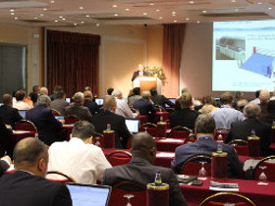
Who are CIRM?
CIRM (Comité International Radio-Maritime) is a non-profit trade association
We are an NGO in consultative status to the International Maritime Organisation
More than 100 members from across marine electronics industry
Our technical scope is navigation and radiocommunication equipment and systems

Slide 4
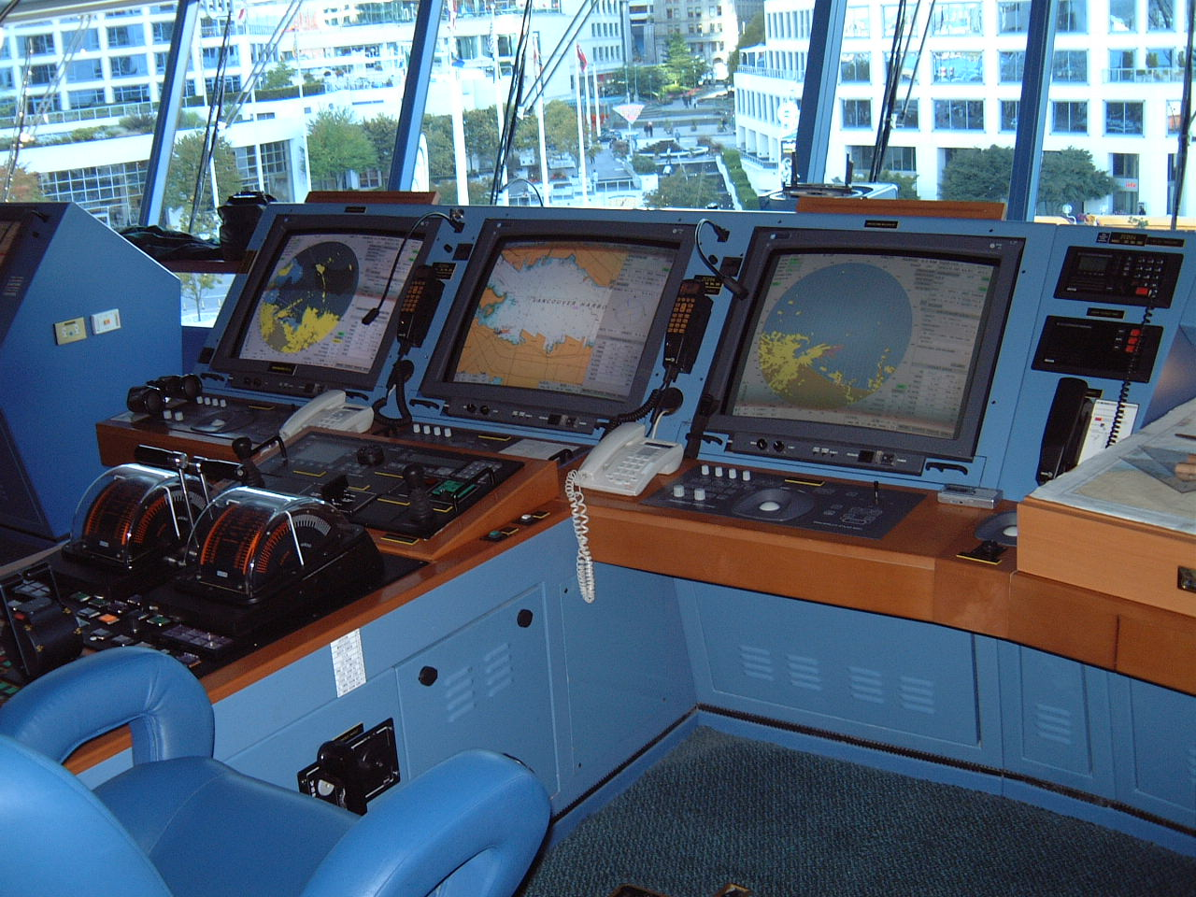
ECDIS Aspects

Slide 5
Software Maintenance Industry Standard
BIMCO initially approached CIRM in 2013
CIRM/BIMCO Joint Working Group (JWG) established 2014
The Industry Standard has been validated in sea trials and been accepted
The Industry Standard has been published and presented to IMO

Slide 6
The software maintenance process flow
Event initiation
Preventative maintenance
Corrective maintenance
Planning
Who, what, where and when
Onboard software log
Execution
Execution and control
Cyber security
After service
Service report and onboard software log
Evaluation and feedback
An Event can be categorised as preventative and/or corrective software maintenance, and may or may not involve a software update.
The Event must be properly planned before it is executed in order to optimise arrangements and ensure the best possible outcome.
The Execution process is when maintenance is actually carried out, and it is critical that this is conducted in accordance with the Planning process.
Following completion it is important that communication continues in order to monitor the success of the Event, and to provide information which can be used to increase the effectiveness of future Planning processes

Slide 7
CIRM Guideline on Performance Test Procedure for ECDIS
Principles have been derived from the work done on earlier project called ECDIS APT
Decision was made to make this a CIRM industry guideline
Data has been collected and consolidated
Final discussions took place during CIRM Annual Conference this year
Guideline is in final preparation

Slide 8
Cyber Risk Management
CIRM is developing a „CIRM Cyber Risk Code of Practice’”
Focus will be on the manufacturer and service provider aspects of Cyber Risk Management, rather than procedural aspects of user groups
CIRM is monitoring and cooperating in activities of other groups like BIMCO, ICS and IACS
Cyber Risk was a key focus of the CIRM Annual Conference 2018

Slide 9
S-Mode
and has been provisionally accepted for further development by the CG ahead of NCSR 6
CIRM is working actively on the S-Mode topic
CIRM has submitted a proposal to the IMO S-Mode Correspondance group
Focus is on standardization of terminology, icons, feature access and other items rather than on an „S-Mode Button“
The proposal was accepted and integrated in the proposal of the working group „Guidelines on standardized modes of operation, S-Mode”
The proposal has been presented to IMO at NSCR5 (NCSR 5/7) and and has been provisionally accepted for further development by the CG ahead of NCSR 6

Slide 10
Overview of the CIRM S-Mode proposal
Drafted by CIRM S-Mode Working Group…
Four appendices contain practical requirements covering:
Standard & user settings
Terminology, abbreviations, icons (Hot Keys & Shortcuts)
Logical grouping of related information
Access requirements for essential information and functions

Slide 11
Thank you
Michael Bergmann
michael.bergmann@bergmann-marine.com

