Slide 1
Summary of the Activities of the IHO Geospatial Information (GI) Registry HSSC10 Warnemünde, Germany – 14-17 May 2018 IHO Secretariat
International Hydrographic Organization

Slide 2
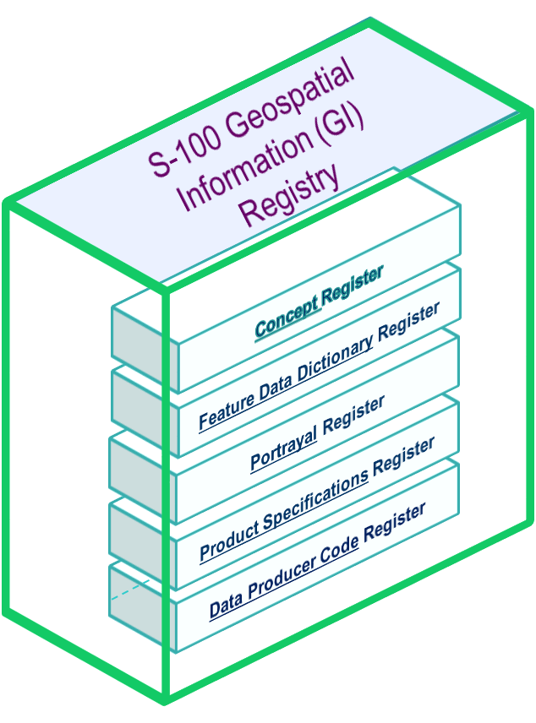
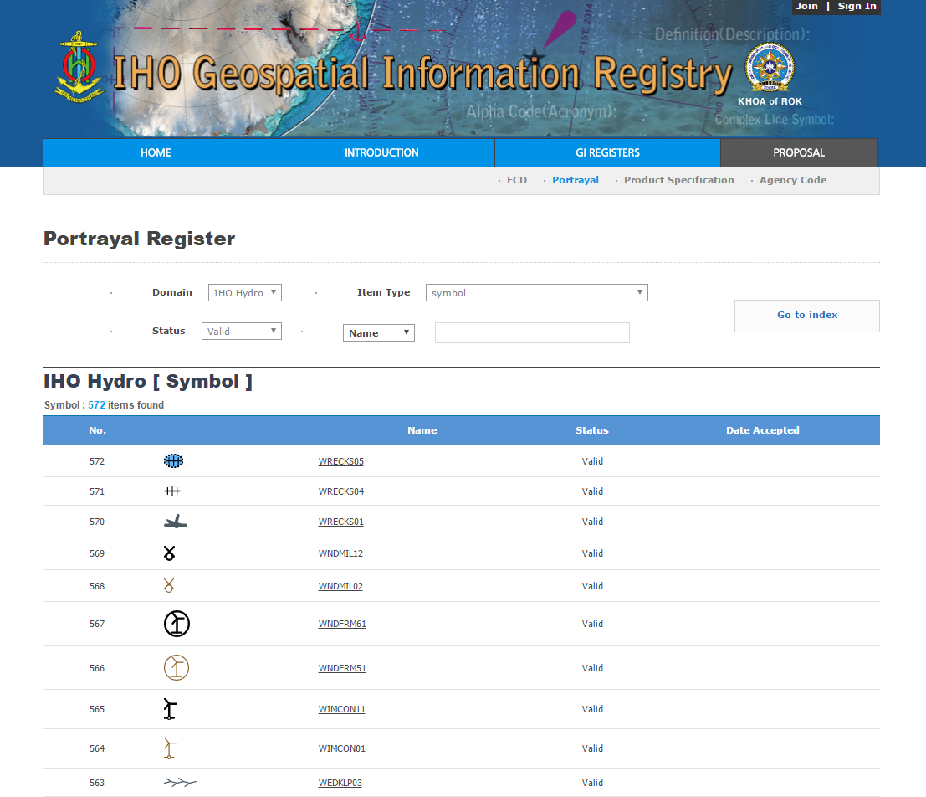
Introduction
IHO Geospatial Information(GI) Registry is the entire information system in which the collection of hydrographic-related Registers are located.
Current Registers: Feature Concept Dictionary; Portrayal; [Metadata]; Product Specification; and Data Producer Code.
Other Components: Feature Catalogue Builder (FCB); Portrayal Catalogue Builder (BCB).
KHOA has continued to support the development of the new Registry
http://registry.iho.int/

Slide 3
Summary of Activities of the IHO GI Registry

Slide 4
Summary of Activities of the IHO GI Registry
Some statistics:
Total number of items = 6371
Features (Geo/Meta) = 860
Information = 18
Simple Attributes = 908
FCD Register
Enumerates = 4237
FCD Register:
Complex Attributes = 154
Valid items = 4610
Codelists = 20
Superseded items = 1190
Codelist Values = 174
Retired items = 571
Portrayal Items = 658
No. of proposals Apr 17 – Apr 18 = 624

Slide 5
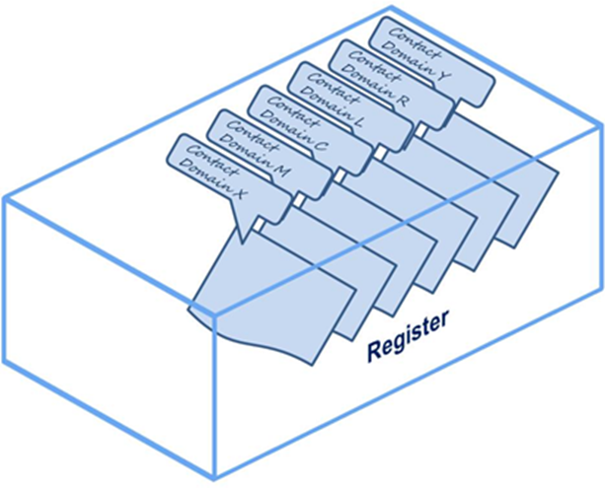
Summary of Activities of the IHO GI Registry
Domains (FCD Register):
IHO Hydrographic – (IHO Working Groups (S-100WG, NIPWG, S101PT, TWCWG, WWNWS Sub-WG, ….))
Inland ENCs – (IEHG)
Sea Ice – (WMO)
Weather – (WMO)
IALA AtoNs – (IALA)
IALA VTS – (IALA)
IALA AIS – (IALA)
IEC – (IEC)
Under Keel Clearance Management – (UKCM Project Team)

Slide 6
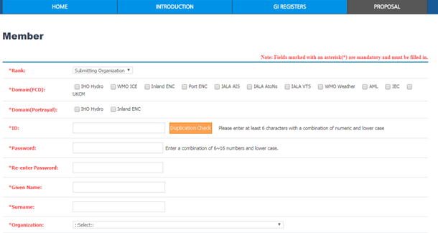
Summary of Activities of the IHO GI Registry
Submitting Organizations (FCD Register):
Domain Control Body (FCD Register):
IHO, IEC, IALA, WMO, IEHG
S-100WG (KHOA, NOAA, SMA, Spanish HO)
NIPWG (BSH, UNH)
UKCMPT (AMSA)
IHO, IEC, IALA, WMO, IEHG
S-100WG, NIPWG
Executive Control Body?
Submitting Organizations (Portrayal Register):
Domain Control Body (Portrayal):
IHO, IALA, IEHG
S-100WG (KHOA, NOAA, SMA, Spanish HO)
NIPWG (BSH)
IHO, IEHG
S-100WG, NIPWG

Slide 7
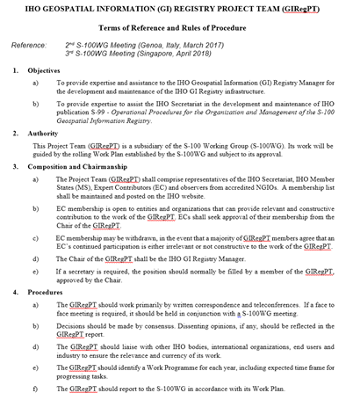
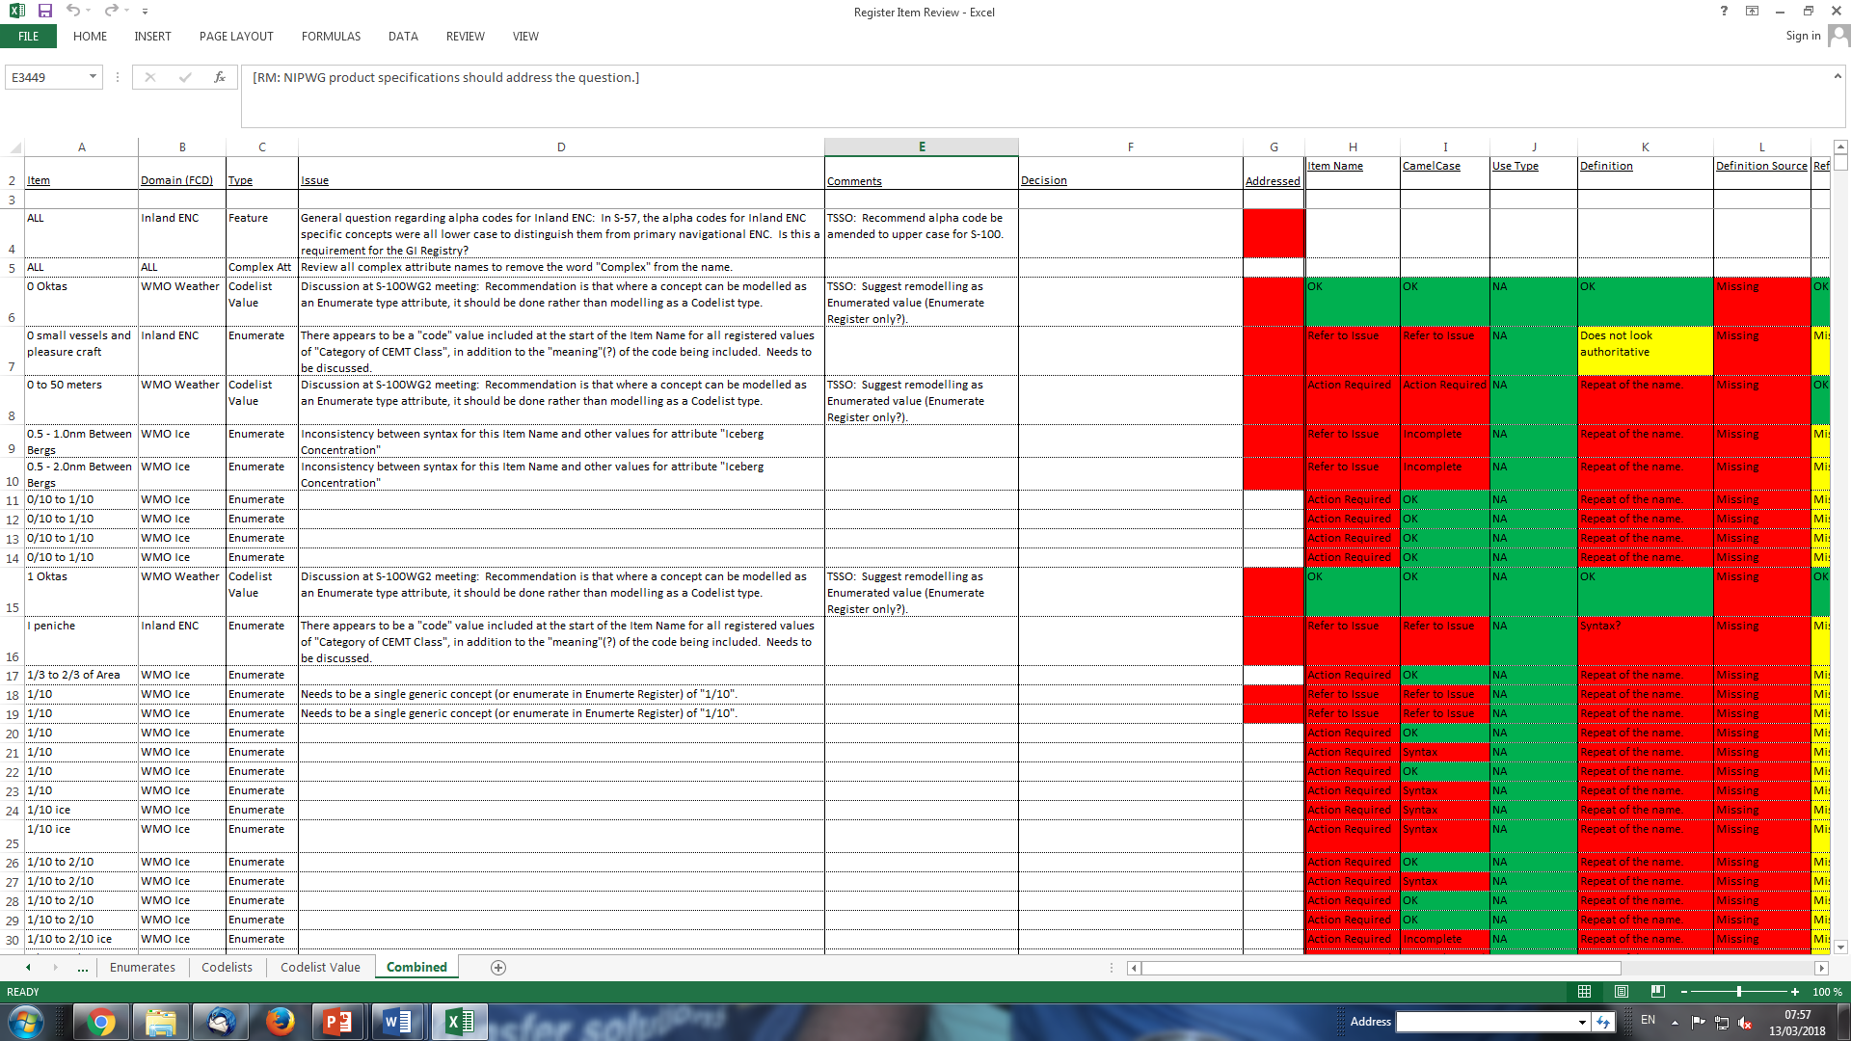
Summary of Activities of the IHO GI Registry
The “IHO GI Registry Project Team”:
S-100WG2 Action 22 – ToRs Approved S-100WG3
Registry structure and management
Registry Content
Conventions and Guidelines

Slide 8
Proposed Structure of the IHO GI Registry

Slide 9
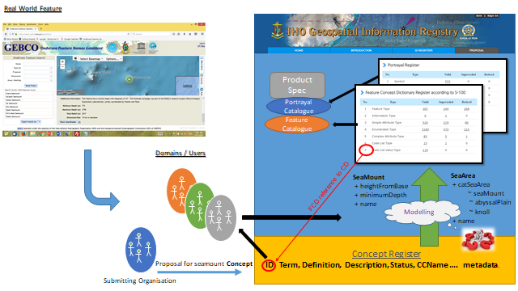
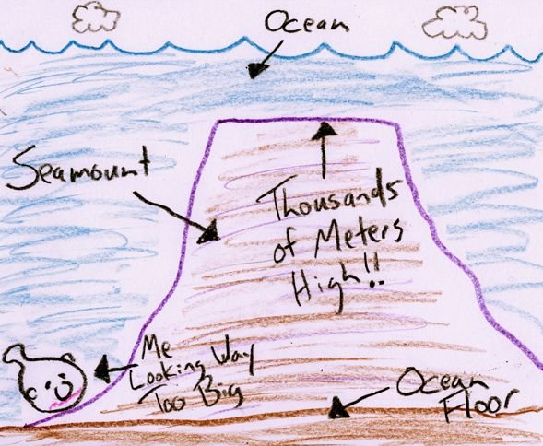
Proposed Structure of the IHO GI Registry

Slide 10
Guidelines for Proposals to the IHO GI Registry
S-99 - Operational Procedures for the Organization and Management of the S-100 Geospatial Information Registry
Provides high level operational guidance for the IHO GI Registry.
S-100WG2 Action 21:
Develop draft guidelines for submission of proposals to the IHO GI Registry for Submitting Organizations, Domain Control Bodies and the Register Manager, for consideration of the S-100WG.
Provisionally assigned S-99 Annex A – S-100WG3

Slide 11
Review of IHO GI Registry Content
S-100WG2 Action 23:
Initial review conducted 2017*
Sub-WG to be formed to review the content of the IHO GI Registry.
Initial results reviewed by GIRegPT December 2017
* Review criteria used were draft Guidelines and Conventions document

Slide 12
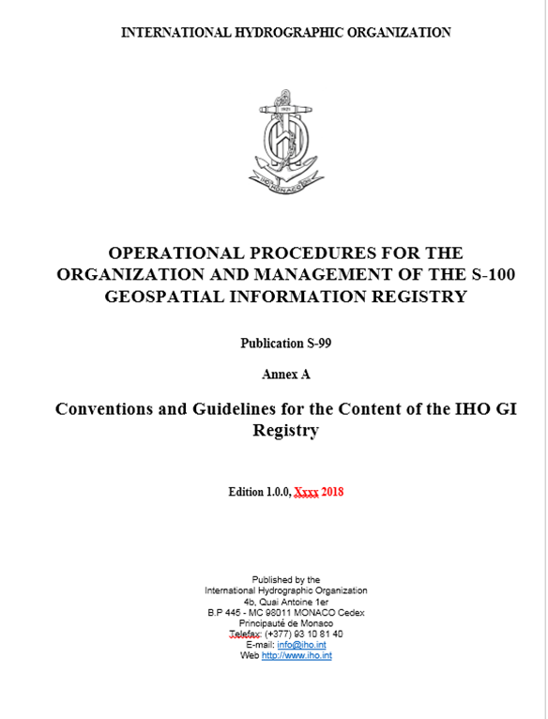
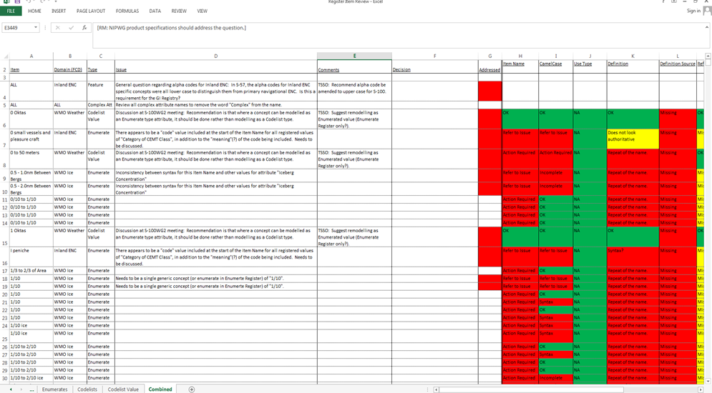
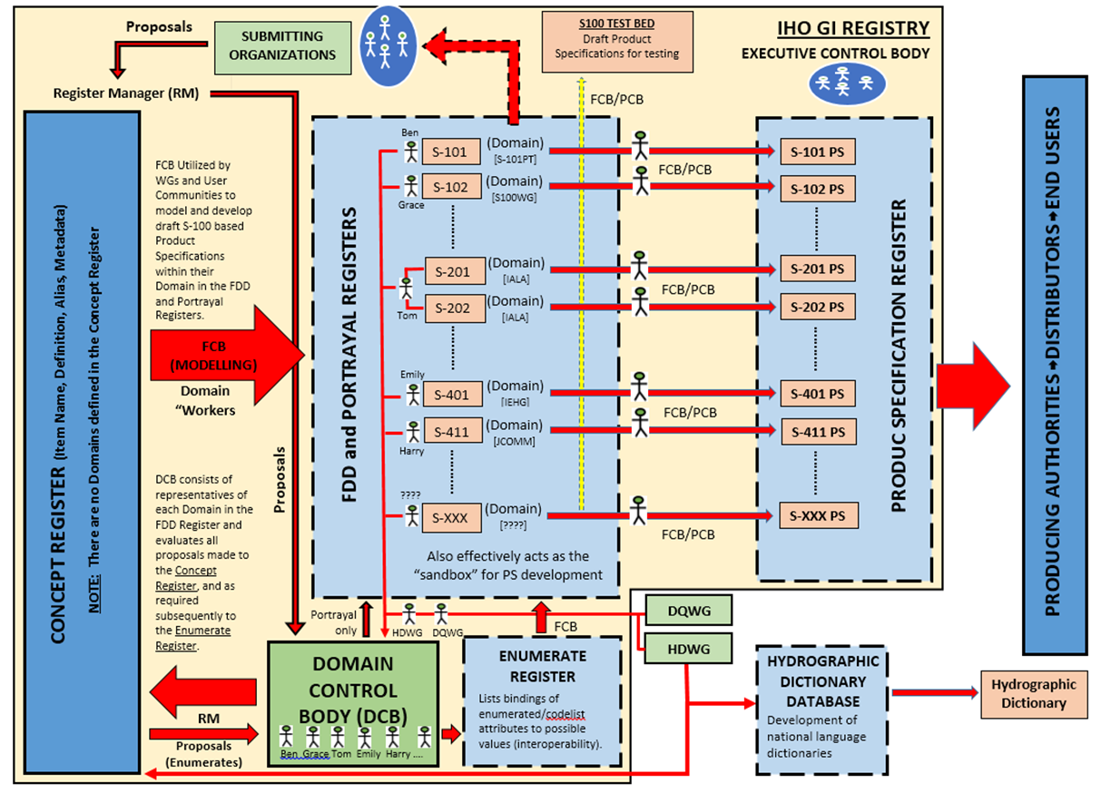
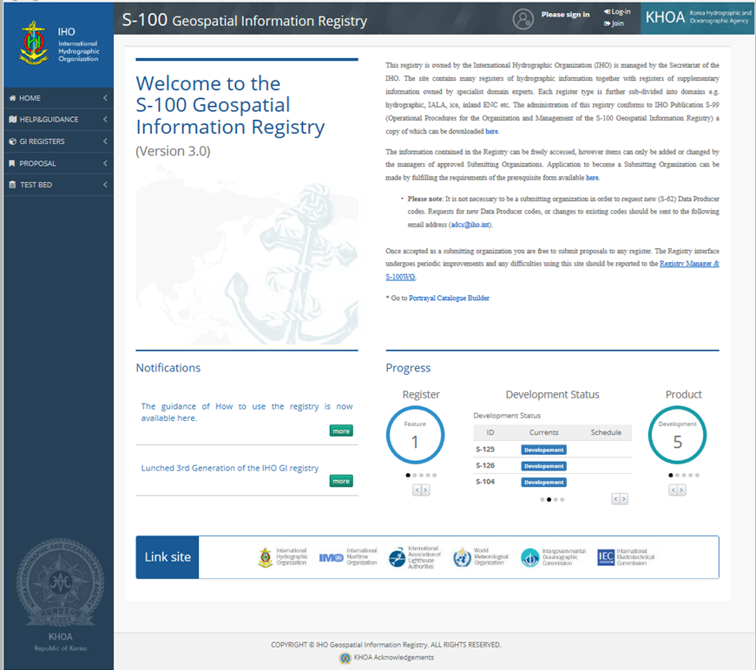
GI Registry – Way Forward
Progressive improvement:
Complete Conventions and Guidelines document;
Consultation – GI Registry Workshop
Apply guidelines and conventions to content review spreadsheet;
Populate “new” Concept Register and Enumerate/Codelist Registers with consistent, “clean” concepts.
Minimum impact on Product Specifications in development

Slide 13
Activities of the IHO GI Registry
Actions for HSSC10:
Note the activities of the IHO GI Registry since April 2017.
HSSC Working Group Chairs and Stakeholders to Note the intention to conduct a “IHO GI Registry Workshop” in conjunction with S-100WG4 (tentatively March 2019) and encourage any members of their WG that have been involved in the activities of the Registry to attend.

Slide 14
Activities of the IHO GI Registry
THANK YOU

Slide 15
Activities of the IHO GI Registry
For more information: https://www.iho.int
IHO Secretariat Contact: jeff.wootton@iho.int

