Slide 1
Hydrographic Services and Standards Committee Report of the ENCWG
Presented by Tom Mellor
Chairman of IHO ENC Standards Maintenance Working Group
HSSC-10, Rostock, Germany 15-17 May 2018

Slide 2
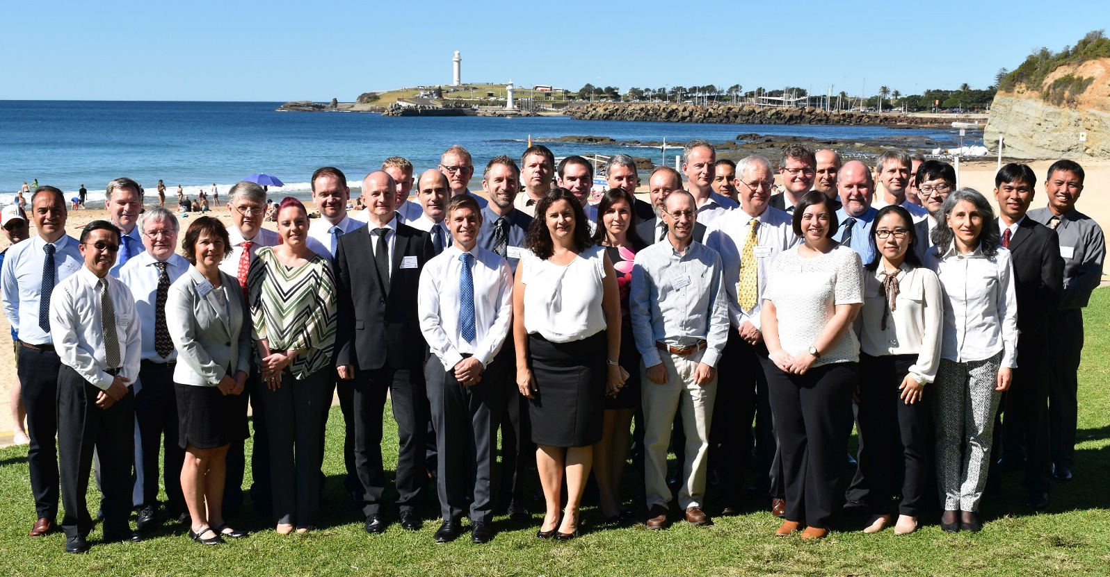
Activities and Achievements
ENCWG3 Meeting, Wollongong, Australia, April 2018
HSSC-10, Rostock, Germany 15-17 May 2018

Slide 3
Principal activities for 2018
S-52 Presentation Library edition 4.0.3 Clarifications
Remove M_QUAL from ECDIS Chart 1 ENCs
Incorrect SYMINS attribute TX('MANUFACTURE'S FEATURES',3,2,2,'14109',0,0,CHBLK,11)
Incorrect light descriptions displayed in screen shots
HSSC-10, Rostock, Germany 15-17 May 2018

Slide 4
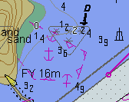
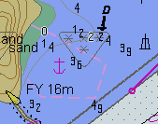
Principal activities for 2018
S-64 IHO Test Data Sets for ECDIS edition 3.0.3 Clarifications
Correct screen shots and poor quality images
Incorrect presentation
Correct presentation
HSSC-10, Rostock, Germany 15-17 May 2018

Slide 5
Principal activities 2018
S-58 edition 6.1.0
S-58 Edition 6.0.0 has errors and requires a correction
S-58 edition 6.0 implementation date has been cancelled CL30
S-58 edition 6.1.0 has been prepared by the ENCWG for HSSC
HSSC-10, Rostock, Germany 15-17 May 2018

Slide 6
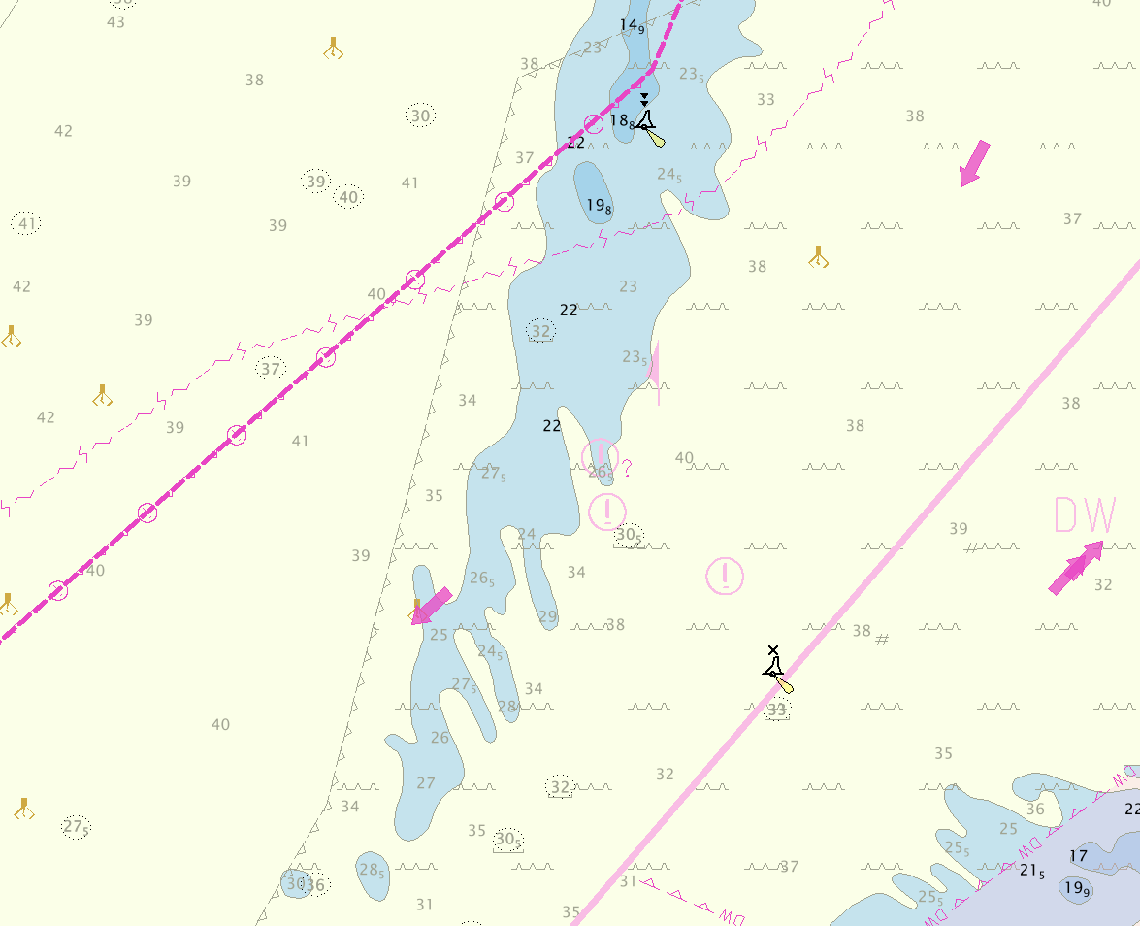
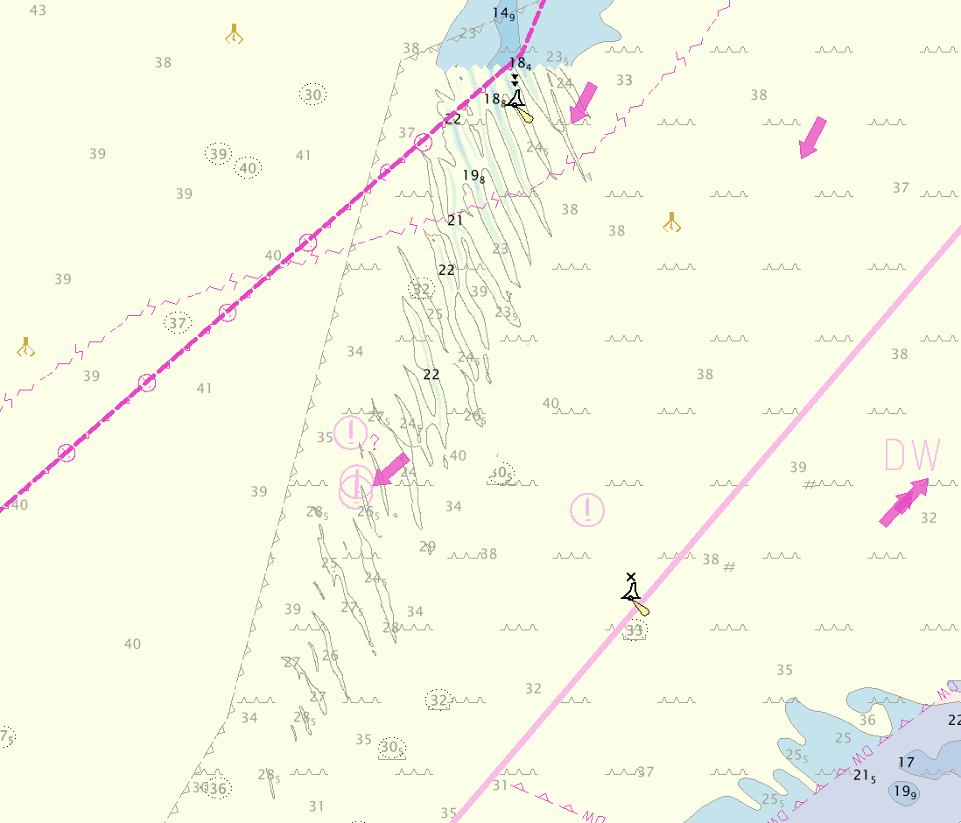
Principal activities for 2018
Formation of the high density contour ENC Sub WG
ECDIS with original ENC defaults to 30m contour
ECDIS with Band 6 high density ENC defaults to 22 m contour
HSSC-10, Rostock, Germany 15-17 May 2018

Slide 7
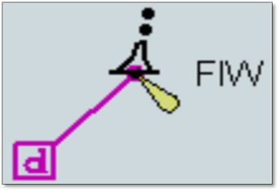
Problems or outstanding issues
HSSC 8/28 T&P NMs in ENC
New guidance document for PSC Inspectors and Mariners
IHO to provide examples of encoding to encourage HOs to encode T&P information as ENC updates
HSSC-10, Rostock, Germany 15-17 May 2018

Slide 8
Problems or outstanding issues
Cyber Security New edition of S-63
Proposed new edition of S-63 IHO Data Protection Scheme to address Cyber Security concerns with ENC exchange sets
IEC TC80 has initiated drafting a new standard, IEC 63154 Cyber security, the new standard will cover mitigation measures the equipment on-board shall provide against cyber risks. The current draft of the new standard IEC 63154 is based on the principle that all data files and executables should be authenticated for their source and integrity
The current version of S-63 only provides digital signatures for the ENC data and updates. No other files in an encrypted ENC exchange set have a digital signatures.
It is proposed that the following additional files in an encrypted ENC exchange set have their own digital signature files.
CATALOG.031 | MEDIA.TXT
README.TXT | PERMIT.TXT
PRODUCTS.TXT | SERIAL.TXT
STATUS.TXT
HSSC-10, Rostock, Germany 15-17 May 2018

Slide 9
Future work programme
Large Format Monitors
Proposed new edition of S-52 and S-64 for Large Format Monitors
S-64 tests are designed for monitors 270mmx270mm
Proposal to add clarifications which will permit large format monitors Full HD
Circulate proposal to CIRM ECDIS WG for comment
HSSC-10, Rostock, Germany 15-17 May 2018

Slide 10
Action requested of HSSC
Approve S-58 edition 6.1.0 and recommend adoption by MS
Consider the updating of S-63 to take account of the cyber risk
Endorse the continued activity of the ENCWG
HSSC-10, Rostock, Germany 15-17 May 2018

