Slide 1
SSDM and OISDM models
May 9th, 2019
IHO HSSC 11: Cape Town

Slide 2
Introduction – What is SSDM?
Generally used by offshore O&G Operators to manage survey data for:
Platform and Drilling Hazard Surveys
Sweep Debris Surveys
Environmental Surveys
Bathymetric Surveys
Geotechnical
Pipeline Route Surveys
Pipeline Pre-lay Surveys
Maintenance Surveillance
Side scan sonar
Geotechnical Sampling
ROV
Sub-bottom profilers
Multi-beam echosounders
Adopted by:
O&G Operators: internal data standard
Survey Contractors: survey data delivery standard
Notes:
Today IOGP SSDM model ( officially launched in April 2011) and version 2 released in 2017 is the IOGP Industry template and standard for how seabed survey data is delivered to and managed by oil and gas companies.
The IOGP SSDM schema is applied for platform and drilling hazard site surveys; sweep surveys and, bathymetric surveys, platform and drilling hazard site surveys using side scan sonar (SSS) and, singlebeam/multibeam echosounder (MBES), sub-bottom profiler (SBP) and high-resolution seismic (HR2D). It also captures the offshore pipeline route survey, pre-lay and maintenance surveillance surveys using SSS and MBES, but excludes the ROV based (video) pipeline surveys for as-built/inspection surveys.
This gap is currently being addressed by newly formed IOGP Offshore Infrastructure Survey Data Model (OISDM) Task Force.

Slide 3
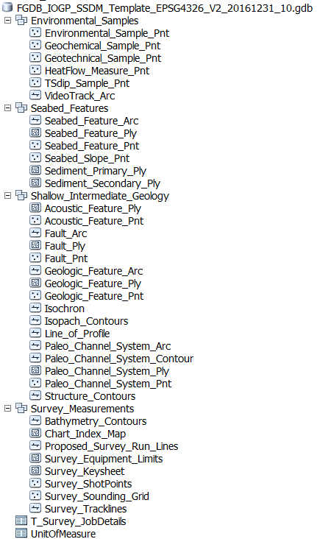
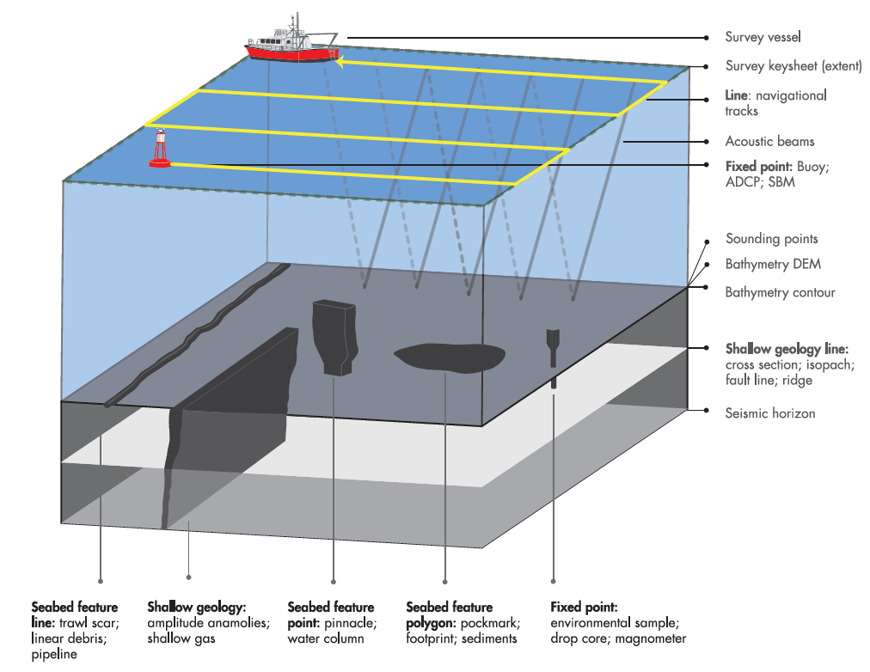
Introduction – What is SSDM?
SSDM Includes:
Change Log
Data Dictionary
Data Model Template (ESRI File GDB & SeabedML)
Data Model Guidelines
Standardized Symbology (ESRI *.style & CAD)
Metadata Template
FAQ

Slide 4
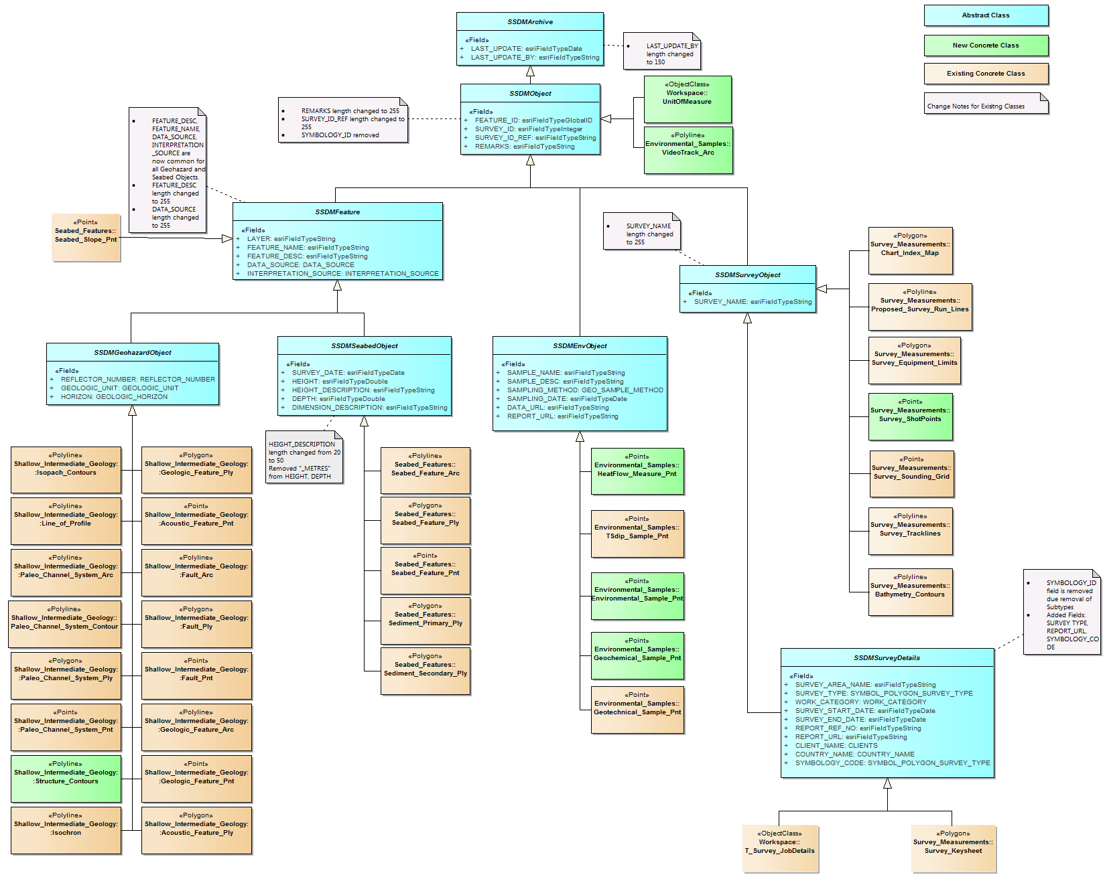
SSDM UML Model
Notes:
Focus of SSDM v 2 development
UML design of the model in Enterprise Architect for both ArcGIS implementation and GML encoding.
Compliance with EPSG and consistency with other IOGP Standards
All coordinates in SSDM now reference a single horizontal and vertical Coordinate Reference System.
The identification of indirect (EPSG - full OGC URN string) and direct description (Well-known text (WKT)) of CRS for the whole model will be defined as string text in the attribute fields of T_Survey_JobDetails table.
Well-known Text (WKT) format will follow the requirements specified in ISO 19162.
Direct description of CRS will be required only in cases where indirect citation to EPSG code is not possible.
SSDM v2 includes a centralized reference table for units of measure (‘UnitOfMeasure’) for all of the objects in SSDM.
Measurement units in ‘UnitOfMeasure’ Table should reference the Energistics Unit Symbols (http://w3.energistics.org/uom/poscUnits22.xml).
Closing the gap in defining more seabed and subsurface features
Completing CAD Template and GIS Symbology stylesheet for SSDM Features
Integration of environmental/benthic survey and geotechnical surveys

Slide 5
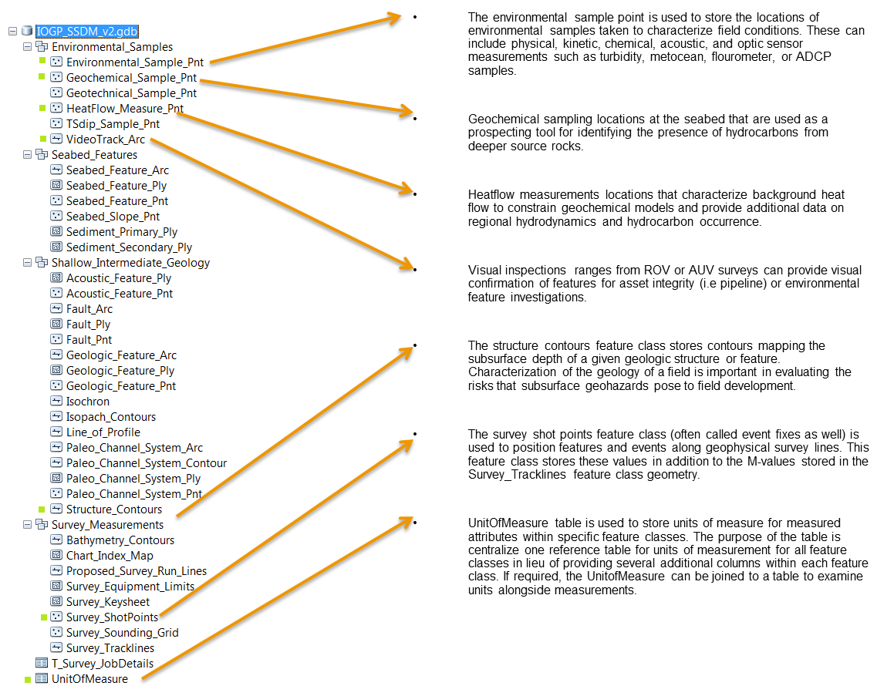
NEW SSDM Objects

Slide 6
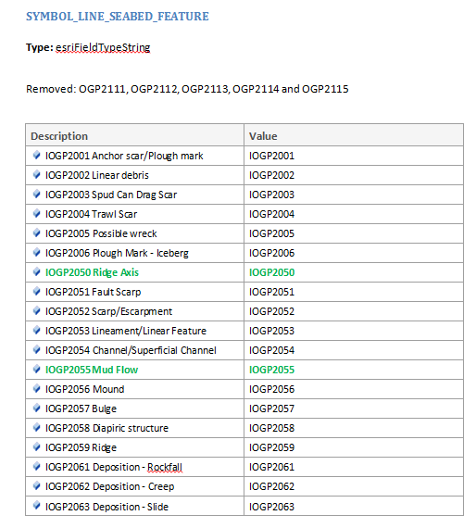
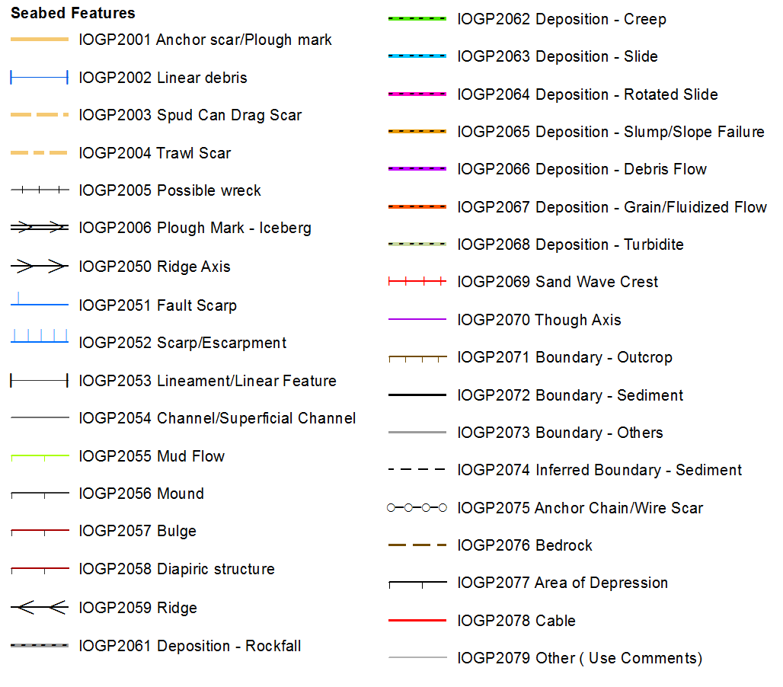
SSDM Symbology Codes
Symbology Codes have been extended to close the gap in defining more seabed and subsurface features.
Changes and Additions to SSDMv2 symbology domain codes are presented in the Change Log as per below, with changes and/or additions highlighted in green:

Slide 7
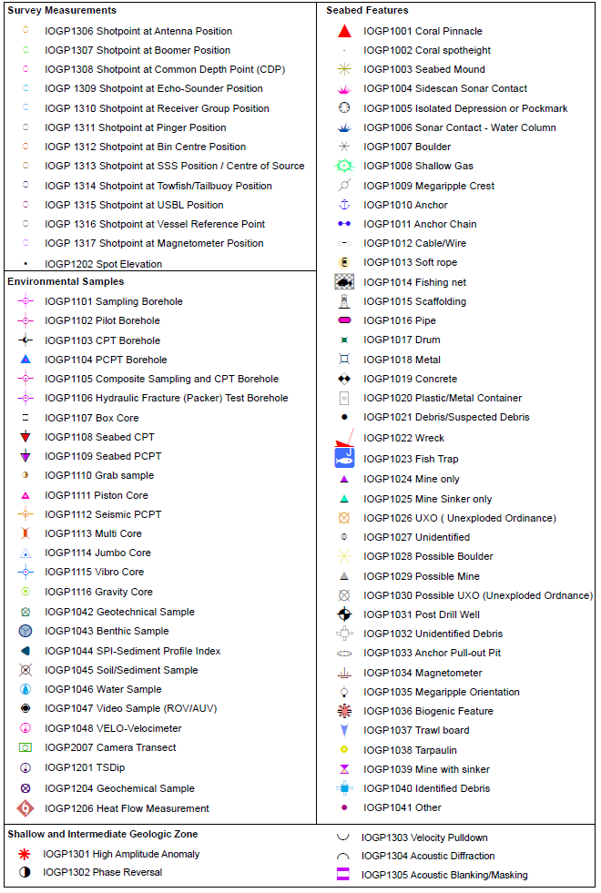
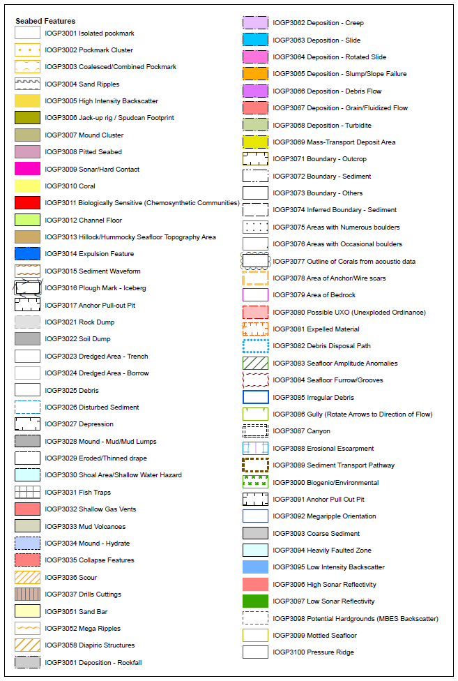
SSDM Symbology Codes

Slide 8
SSDM as OGC Community Standard
A Community standard is an official position of the OGC endorsing a specification or standard developed external to the OGC. A Community standard is considered to be a normative standard by OGC membership and part of the OGC Standards Baseline. The key consideration for a Community standard is that there must be strong evidence of implementation. OGC does not take over the maintenance of the work, rather a Community standard is a “snapshot” of a mature standard for which the originator has either shared the Intellectual Property Rights with the OGC or granted unlimited free use of the Intellectual Property to all implementers.
Community standards can serve two purposes:
to bring de facto standards from the larger geospatial community to be a stable reference point that can normatively referenced by governments and other organizations; and
to bring new, but implemented, standards to the OGC to form the basis for further refinement and development of interoperability between other OGC standards.

Slide 9
SSDM as OGC Community Standard
Motion was put forward at the Singapore OGC TC meeting in March
Voting by OGC members was open until April 29th
SSDM will be adopted as a community standard

Slide 10
OISDM Terms of Reference
IOGP Offshore Infrastructure Survey Data Model (OISDM) Task Force Terms of reference agreed April 2018
Build on the success of the Seabed Survey Data Model (SSDM)
Create an industry standard data model for the delivery and exchange of geographic features representing oil and gas infrastructure mapped during the course of offshore engineering and inspection surveys
Will be implemented in GIS (ESRI File Geodatabase/GML) and CAD (template) formats
Objectives:
Standardise IRM survey data deliverables
Maximise flexibility
Complement existing SSDM data model
Simplify asset charting
Reduce reporting costs

Slide 11
OISDM Industry Collaboration
Oil and Gas Operators
Survey and Engineering Contractors

Slide 12
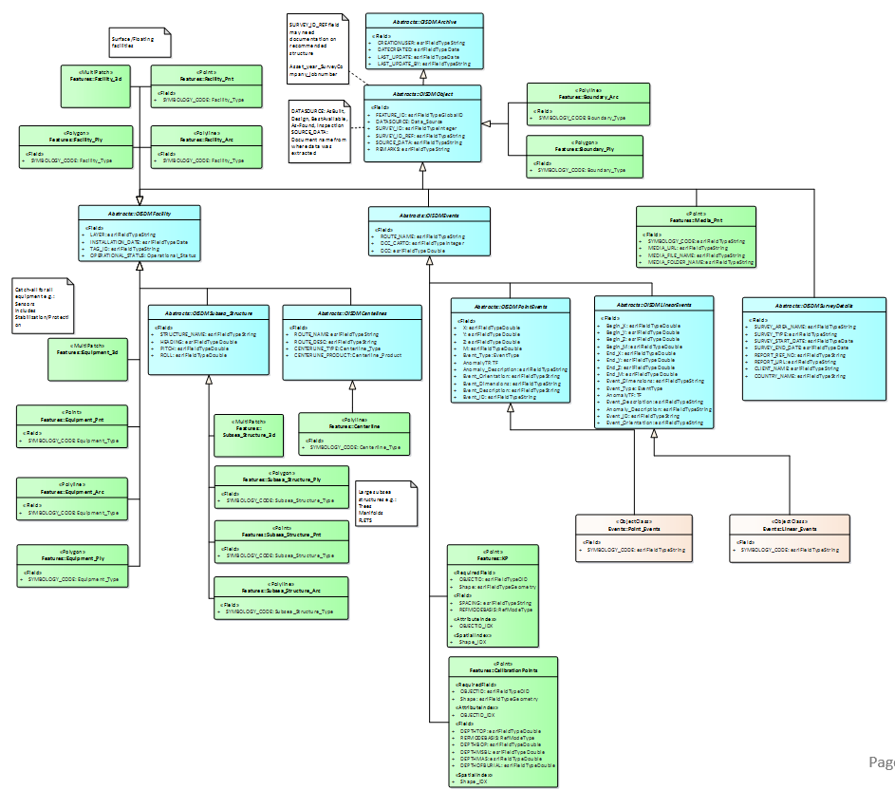
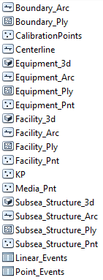
OISDM Data Model progress
Design in progress:
18 physical classes (Pnt, Arc, Ply, 3D)
2 event tables
Use measures or absolute X/Y

Slide 13
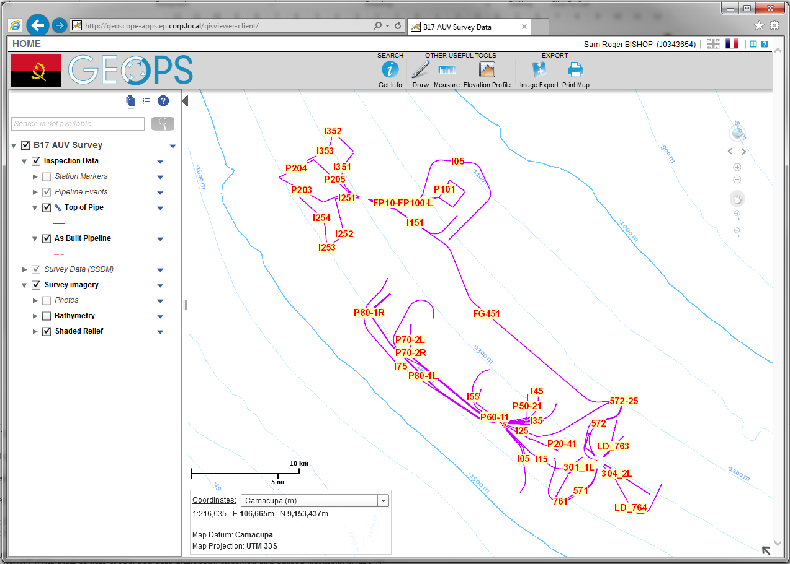
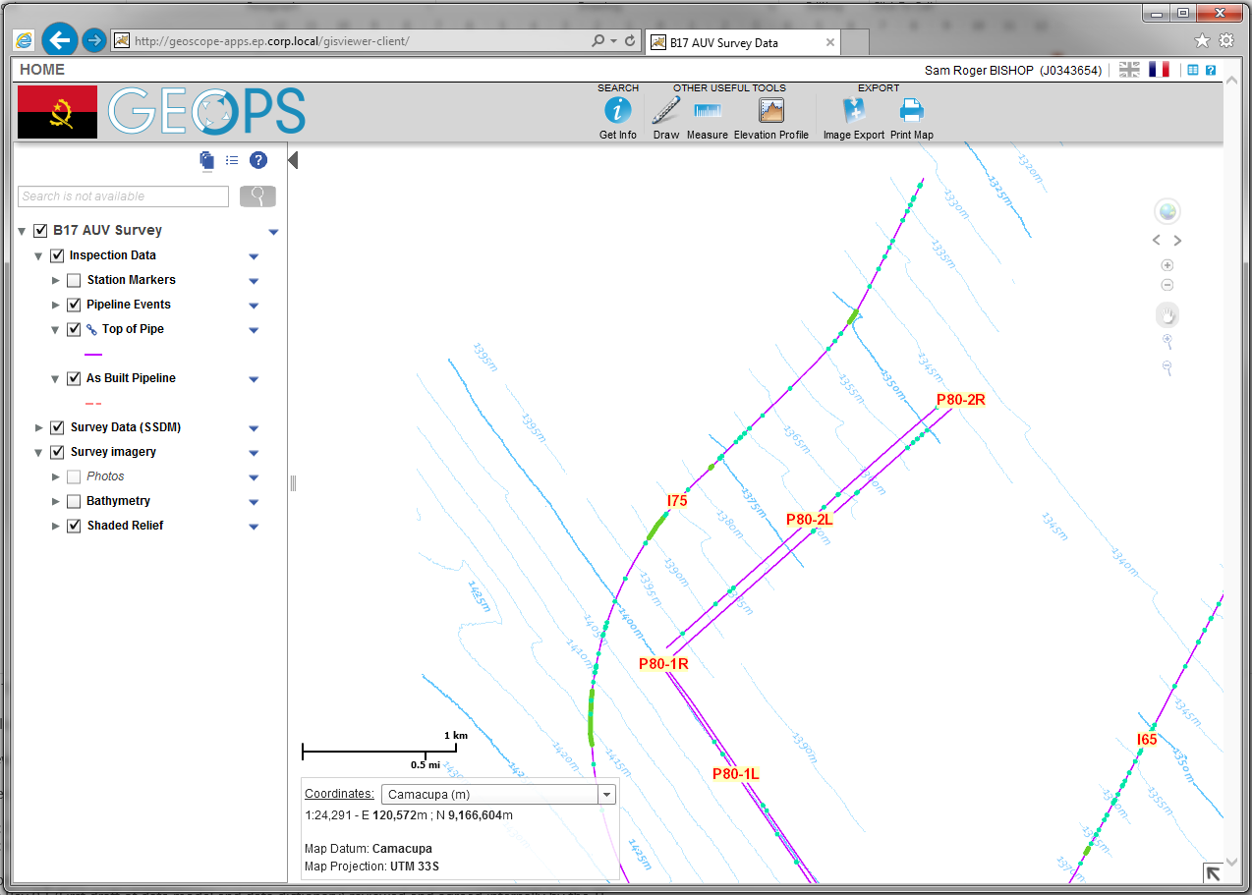
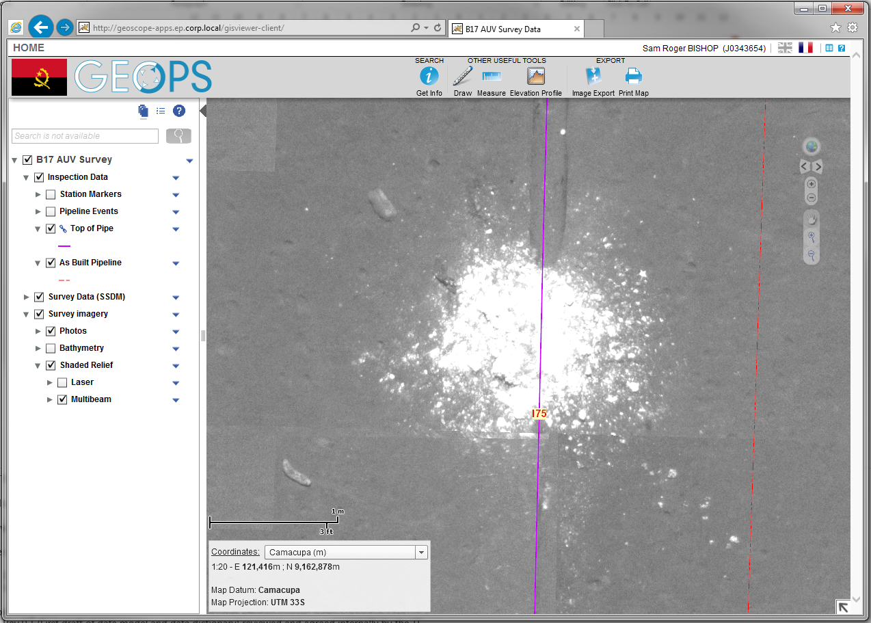
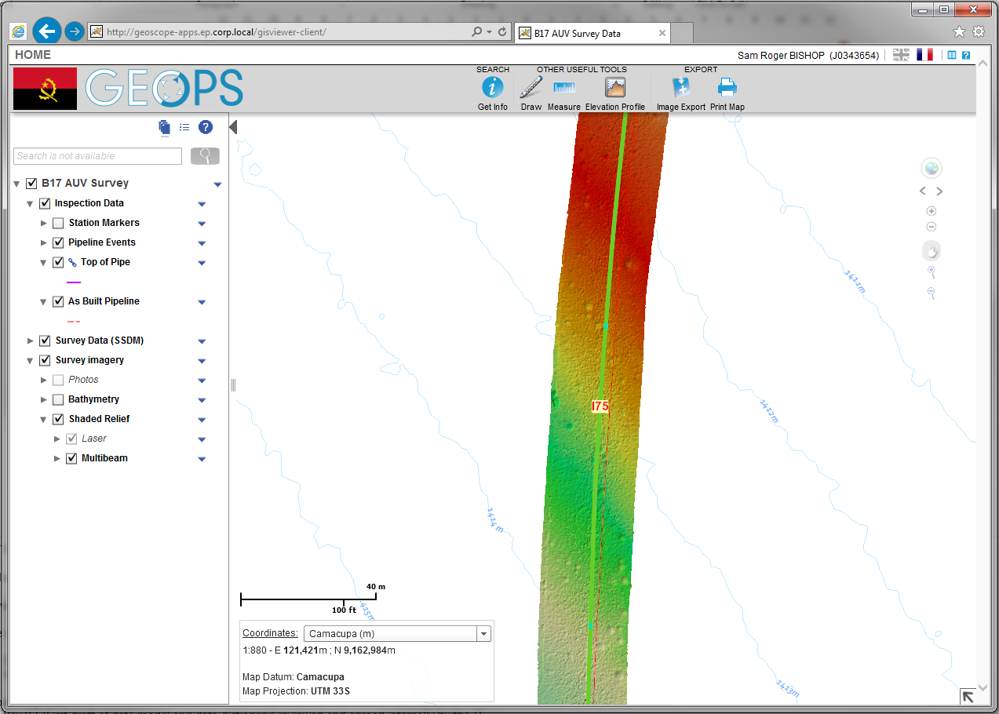
IMR Survey Data

Slide 14
OISDM Schedule
Rev 0 release ~Q4 2019

Slide 15
Lucyna Kryla
lks@iogp.org

