Slide 1
Report of the S-100WG
Hydrographic Services and Standards Committee

Slide 2
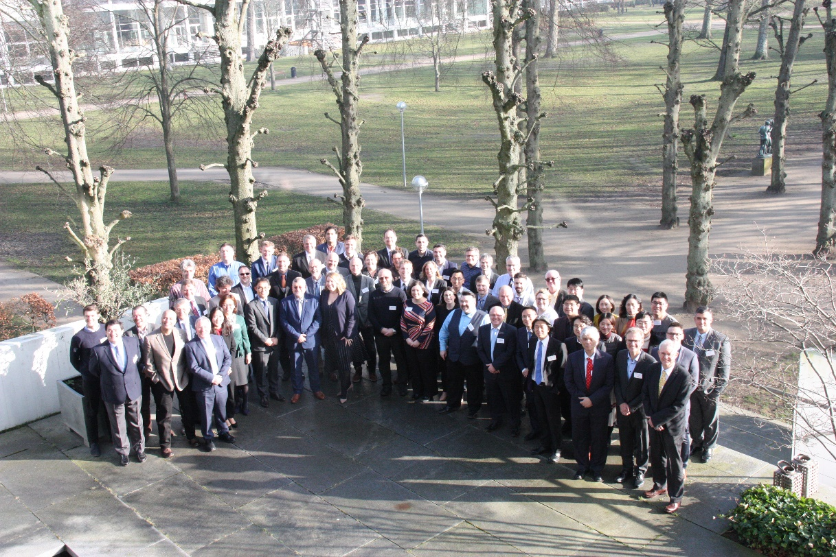
Activities and achievements
Membership
23 member states, 15+ industry members
Meetings
Test Strategy Meeting – Sept 2018 (Busan, ROK)
Working Group 4 – Feb 2019 (Aalborg, DEN)
60+ delegates

Slide 3
Activities and achievements
S-100 Edition 4.0.0 → Edition 5.0.0
S-102 Edition 2.0.0
S-121 Status
S-129 Edition 1.0.0
S-97 Guidebook for S-100 Development
S-98 Interoperability Specification
S-100 Test Bed Development

Slide 4
S-100 Edition 4.0.0
Published December 2018
Continue to receive new proposals to improve S-100
Next scheduled release will be 2021
Proposal cutoff date will be S-100 Working Group 5 (early 2020)
S-100 Product Specifications baselined to Edition 3.0.0 should consider moving to edition 4.0.0
Encryption and Digital Signatures
Improvements to the Feature Catalogue Model
Refined Discovery Metadata

Slide 5
HSSC is requested:
HSSC11 is requested to note the deadlines for S-100 Edition 5.0.0 proposals

Slide 6
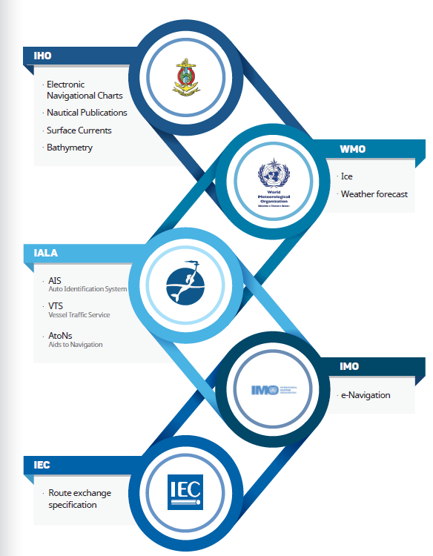
S-97 Product Specification Guidebook
S-100 is a framework for increased standardization
Difficult to decipher
Over 400 pages
14 parts and counting
HSSC-11, Capetown, South Africa 6-9 May 2019

Slide 7
Guidance Document
Contains Three Parts
Part A – In depth Description of the various components of S-100
Part B – Describes the typical steps and activities needed to create a product specification
Part C – Describes the data quality measures used in S-100 specifications
HSSC10/36 and HSSC10/37
S100WG4 endorsed S-97 Edition 1.0.0 for approval by HSSC11

Slide 8
HSSC is requested
Endorse Edition 1.0.0 of S-97 according to the revised approval process
Note that S-97 will undergo additional editing to improve readability as part of the iterative process for 2.0.0

Slide 9
S-98 Interoperability Specification
List of S-100 Specifications considered as part of front of bridge interoperability
Specification No. | Title
S-101 | Electronic Navigational Chart (ENC)
S-102 | Bathymetric Surface
S-104 | Water Level Information for Surface Navigation
S-111 | Surface currents
S-122 | Marine Protected Areas
S-124 | Navigational warnings
S-411 | Sea Ice
S-412 | Met-ocean forecasts

Slide 10
S-98 Interoperability Specification
S100WG recommends also adding S-129 Underkeel Clearance Management to the list of specifications for consideration
Specification No. | Title
S-101 | Electronic Navigational Chart (ENC)
S-102 | Bathymetric Surface
S-104 | Water Level Information for Surface
S-111 | Surface currents
S-122 | Marine Protected Areas
S-124 | Navigational warnings
S-129 | Underkeel Clearance Management
S-411 | Sea Ice
S-412 | Met-ocean forecasts (JCOMM)

Slide 11
Current Status
Q2 2018 -Incorporate the editorial changes into a revised draft
Q2 2018 -Create a red-line for any substantive comments
Q3 2018 Review redline at the S-100 Test Strategy Meeting
Address the need for a strong set of functional principles for S-98 as an executive summary of the document
Q3 2018 – Send S-98 for a second and final round of comments
Q1 2019 – S-100 agreed to move forward with S-98 edition 1.0.0 for HSSC endorsement
BUT

Slide 12
S-98 Interoperability
Still mainly a theoretical specification that needs more testing and development
Continue to develop the Interoperability Catalogue
Work on harmonizing portrayal across products intended to be used in navigation systems
Reserved Colours
Reserved Symbols
Development of test data and test cases

Slide 13
Proposed Next Steps
S-100 Test Strategy Meeting will further discuss and refine S-98
Present the outcome to S-100 Working Group in February 2020
Ask for HSSC approval for Edition 1.0.0 according to the newly revised TR 2/2007

Slide 14
HSSC is requested
Note the continued progress on S-98
Note the revised timeline for S-98 Edition 1.0.0 to 2020

Slide 15
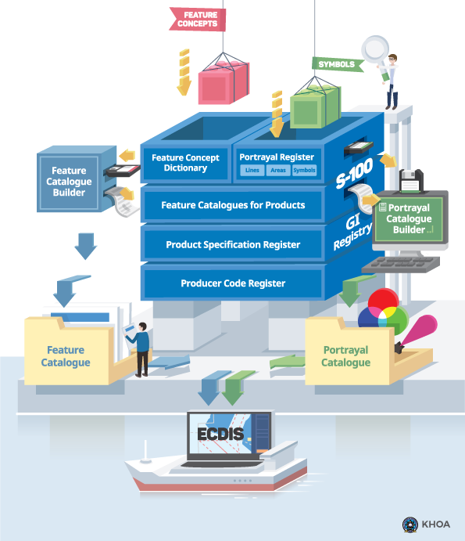
S-100 Infrastructure
Essential Framework for developing product specifications
Maintained by KHOA on behalf of the IHO

Slide 16
Status of S-100 Infrastructure
1.0
Developing Interface, Database …
GI registry
2.0
NEW Interface, Proposal process(PP), FCD, Portrayal (4types)
3.0
NEW Interface, PP, Concept, DD, Portrayal (4types), Product, Produce code, Test Bed
3.1
PP, Portrayal (19types), Meta, Product,(Doc.) Test Bed (S-100 Web viewer)
1.0
S-100(3.0.0)
FC builder
1.1
S-100(3.0.0), fix bug, FC DB
S-100 Infra
+
2.0
S-100(4.0.0), Association/Role(AR), AR Validation, Regi.3.0 connection, user feedbacks
PC builder
0.1
Beta
1.0
NEW GUI, S-10X XSLT, connected Regi.3.0
DCEG builder
0.1
Beta
Option
1.0
NEW GUI, connected Regi.3.0, Doc. export.
Symbol Gen.
Interoperability Catalogue builder
Exchange Set editor

Slide 17
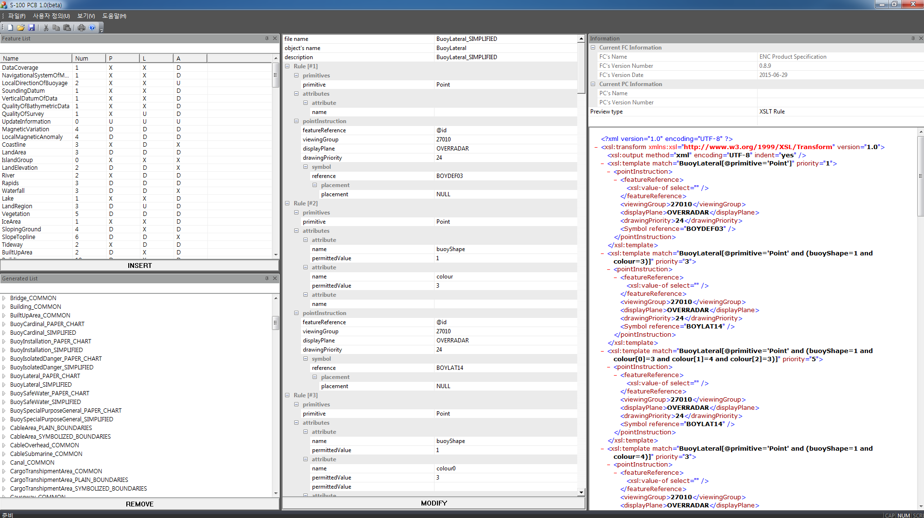
Use of IHO special project funds
HSSC9 approved funds for
Building S-101 Portrayal Catalogue
Status of funds
Contract for 31,500 EUROs
Build the S-101 Portrayal Catalogue using the ROK PCB
Portrayal Consultation
COMPLETED
Portrayal
Register
KHOA PCB(Portrayal Catalogue Builder)
DB Access
DB Access
Viewing Group
Display Plane
S-10X
FC
(XML)
S-10X
PC
(XSLT)
Drawing Priority
Symbol reference
(Point/Line/Pattern)

Slide 18
Progress on the S-100 Test bed
Currently two major test beds
ROK
SPAWAR
Iterative Process
Feeds into refinement of S-100 and associated product specifications
Testing Interoperability concepts

Slide 19
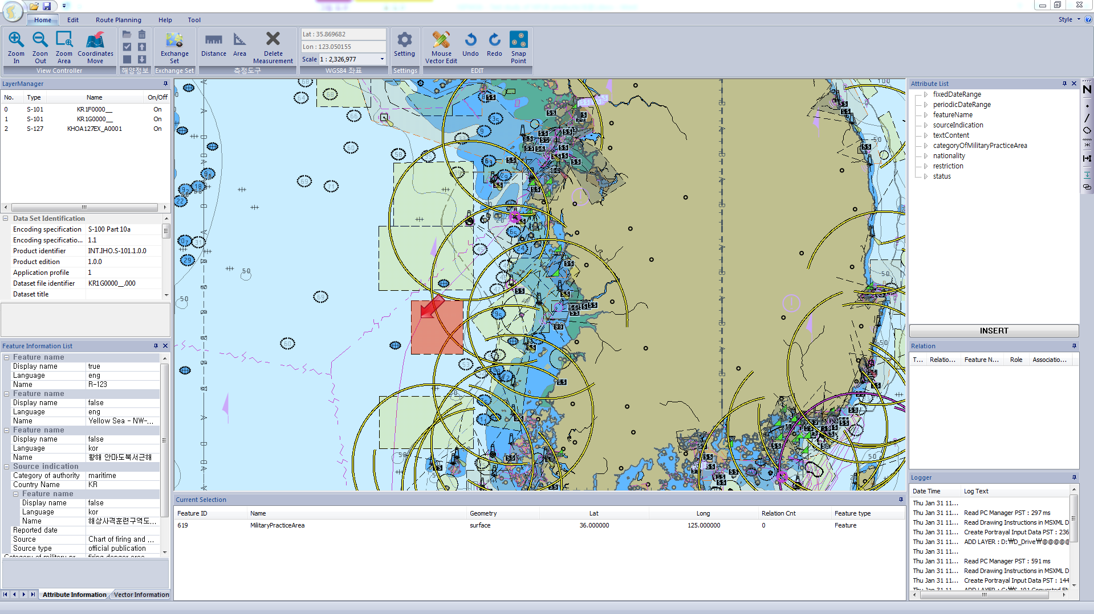
KHOA Test Bed
S-10X Feature Catalogue (XML)
S-10X Portrayal Catalogue (XSLT, Lua)
TDS in 8211 (S-101)
TDS in GML (S-122, S-123, S-124, S-127, S-128)
TDS in HDF-5 (S-102, S-104, S-111)
S-122
S-123
S-127
Notes:
KHOA Test Bed aims
to develop Phase 3 (Simple Viewer) and Phase 6 (shore based ECDIS) of S-100 test framework to support the S-100 Testbed project of the IHO
To validate the test bed program, KHOA focused to producing TDS for various S-100 based PSs such as S-101, S-122, S-123 and S-111.

Slide 20
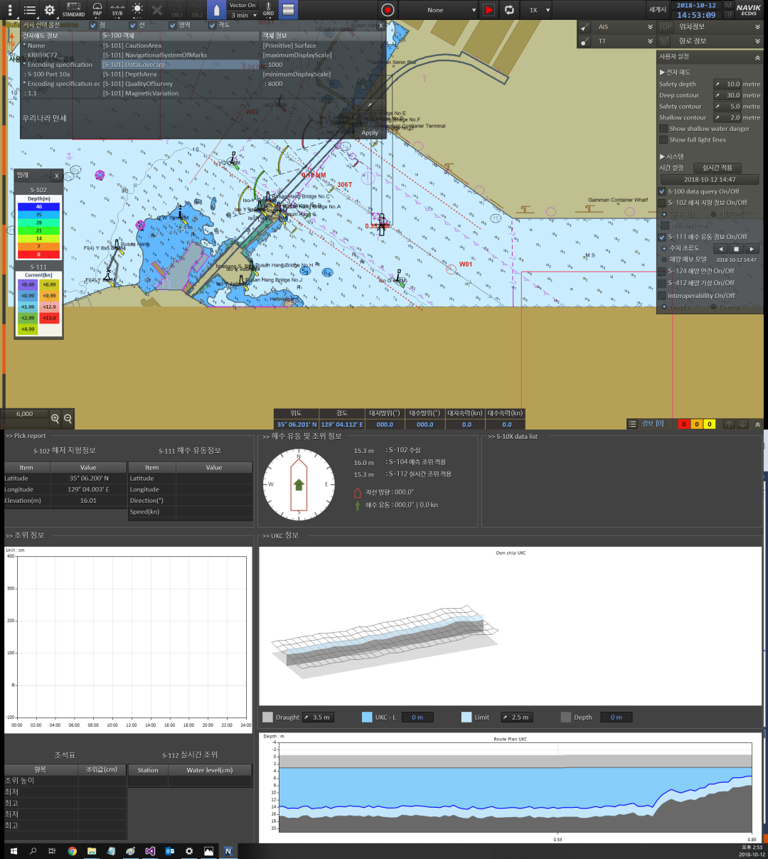
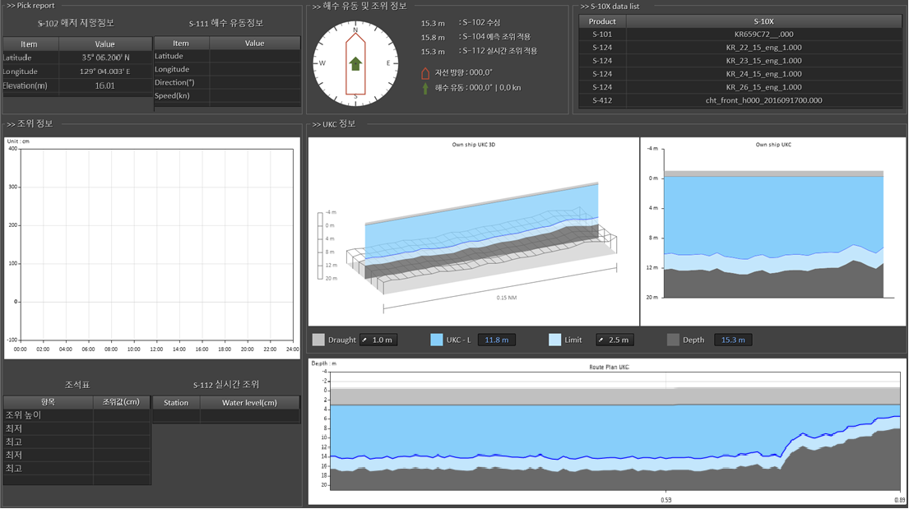
KHOA Test Bed
S-100 test system
<UCK 횡단 정보 표출 예시>
Notes:
They tested S-100 portrayal process, S-100 exchange catalogue, S-100 interoperability and Plug & Play concept with S-100 Test system.

Slide 21
INSERT SPAWAR SLIDE

Slide 22
S-102 Edition 2.0.0
Did not receive enough votes for HSSC10 endorsement via HSSC Letter
Held a Project Team Meeting in February 2019
Adjudicated comments from HSSC Letter 02/2018
Adjudicated comments from the S-102 Project Team
Developed a BAG to S-102 Convertor for test data
S100WG endorsed edition 2.0.0 to move to HSSC for approval

Slide 23
S-102 and TR 2/2007
Impact study conducted in 2016 that supported the update to S-102
Finland, Sweden, Norway and Primar have started to develop test data sets
US Navy is creating a convertor to continue to support the S-102 test bed
S-102 has undergone numerous rounds of stakeholder review and input

Slide 24
HSSC is requested
Endorse the publication of S-102 Edition 2.0.0
Ask the IHO Secretariat to send out a Circular Letter requesting Member State Approval with a target date of December 2019 for publication

Slide 25
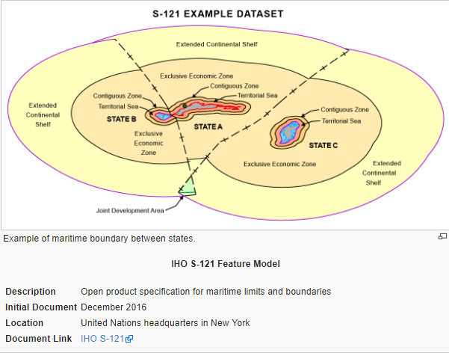
S-121 – Maritime Limits and Boundaries
Progress on Edition 1.0.0
Aligned to S-100 Templates
Registration of new features
Encoding Guidance
Feature Catalogue Developed

Slide 26
S-121 Progress
March 2019 – S100WG issued a letter asking for working group and member state comments (12 weeks)
July 2019 – S-121 project team adjudicates comments and any outstanding issues

Slide 27
S-121 – HSSC10 Decision
HSSC10 endorsed the publication of S-121 Edition 1.0.0 once the following conditions were met
Wider Stakeholder Review
Adjudication of Comments
The S100 Working Group also asked the Project Team for the following:
Alignment of documentation to S-100 Templates
Registration of Features
Feature Catalogue

Slide 28
HSSC is requested
Note the Stakeholder Review that is in progress
Post successful adjudication of comments received from the stakeholder review to publish Edition 1.0.0 of S-121

Slide 29
S-129 Under Keel Clearance Management
A Ship’s Master has an obligation under SOLAS regulation V/34 to plan and monitor their ship’s passage from berth to berth.
When implemented in a ship’s navigation system, and made use of by a UKCM service provider, S-129 enables UKCM information to be shown on a ship’s navigation system and so enable the ship’s crew to safely monitor a ship’s passage in a UKCM service area.
S-129 enables encoding the extent and nature of UKCM information products.

Slide 30
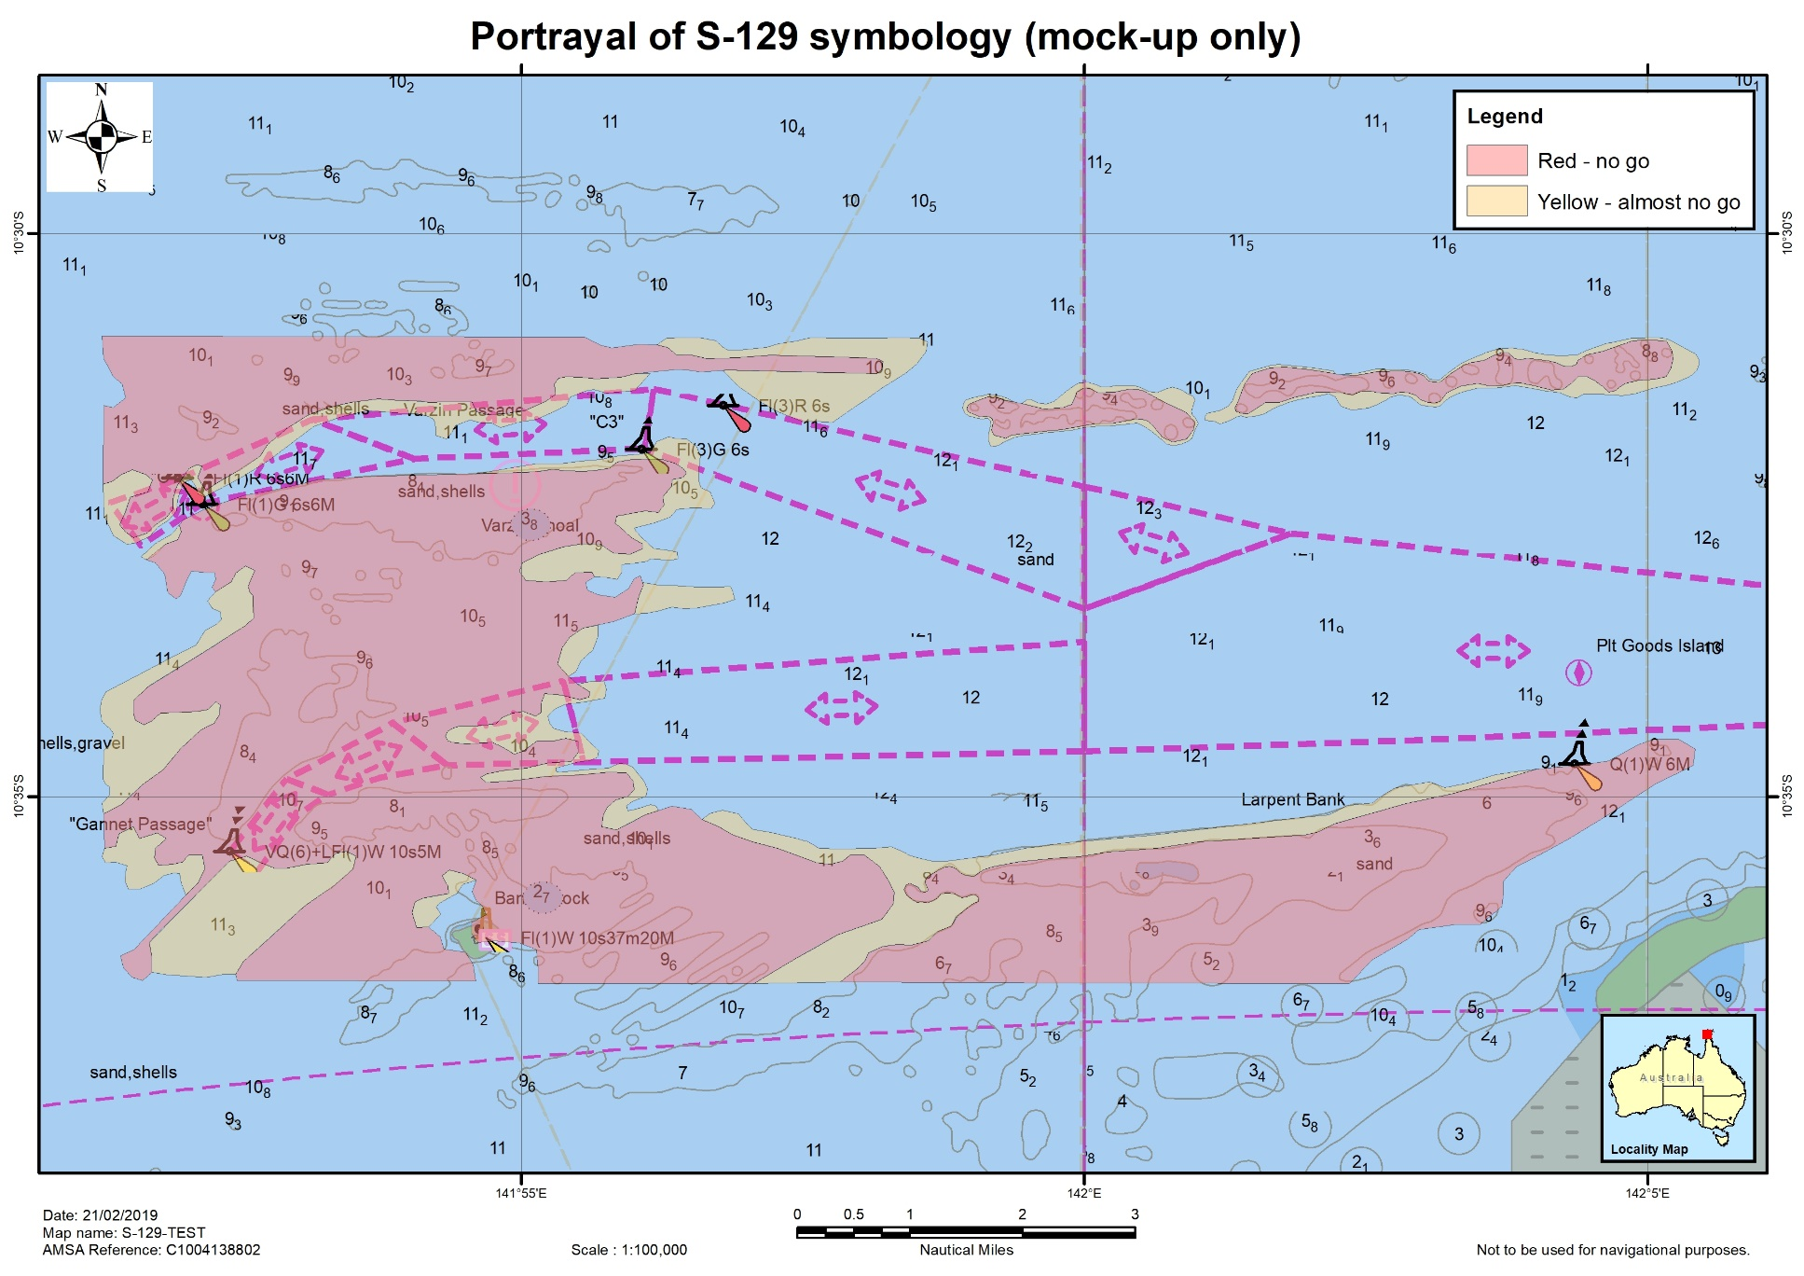
Example portrayal - no-go and almost no-go
mockup of S-129 portrayal based on an output from the UKCM system operating in Torres Strait

Slide 31
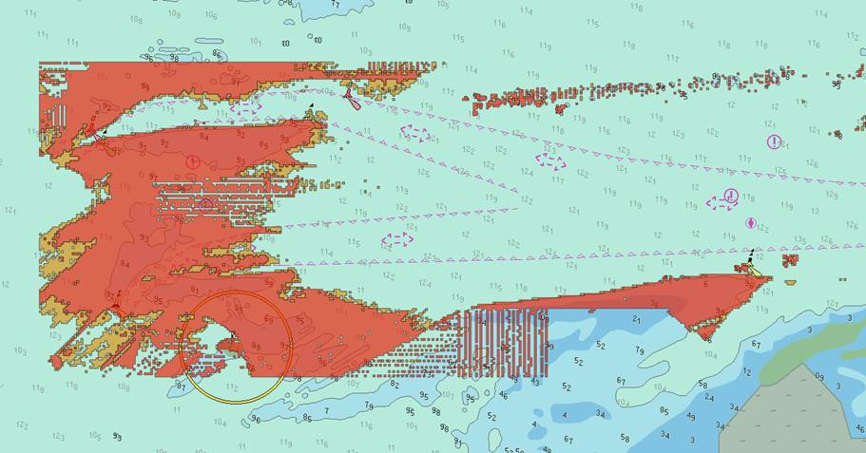
TS UKCM system output as displayed on a pilot’s PPU

Slide 32
S-129 UKC Progress
Finalized the Data Model
Finalized the Data Encoding
Presented draft Edition 1.0.0 at the S-100 Working Group meeting
No showstoppers were identified
S-100WG4 endorsed S-129 to move forward to HSSC

Slide 33
Action requested of HSSC:
Endorse S-129 Edition 1.0.0 for publication

Slide 34
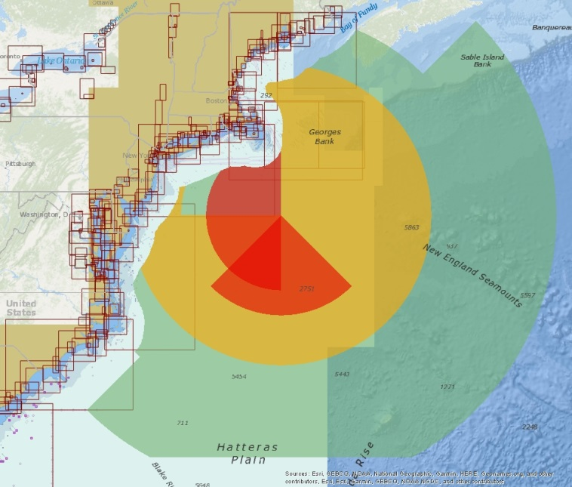
Liaison Activities
WMO
S-412 Re-scoping
Weather and Wave Hazards
Weather messages and systems
Requests two new S-4XX numbers for the following
S-4XX Weather and Wave Conditions
Atmospheric and oceanographic surface conditions
S-4XX Weather and Wave Observations
Marine and coastal land-based weather observations
HSSC is requested to establish two new S-4XX numbers for the WMO

Slide 35
Liaison Activities
IALA
Drafting joint guidance on how to utilize the Marine Resource Naming concept
Will incorporate into S-97
IEC
Continue to liaise on HSSC10/05 regarding the incorporation of S-100 into the current IMO performance standards

Slide 36
S-100 Working Group Priorities to the Council
Priority 1
Refine and enhance S-98 Interoperability Specification (2021)
Priority 2
Publication of S-100 Edition 5.0.0 (2021)
Priority 3
Continue to engage with Industry regarding the operationalization of S-100 and its associated product specifications (2020)

Slide 37
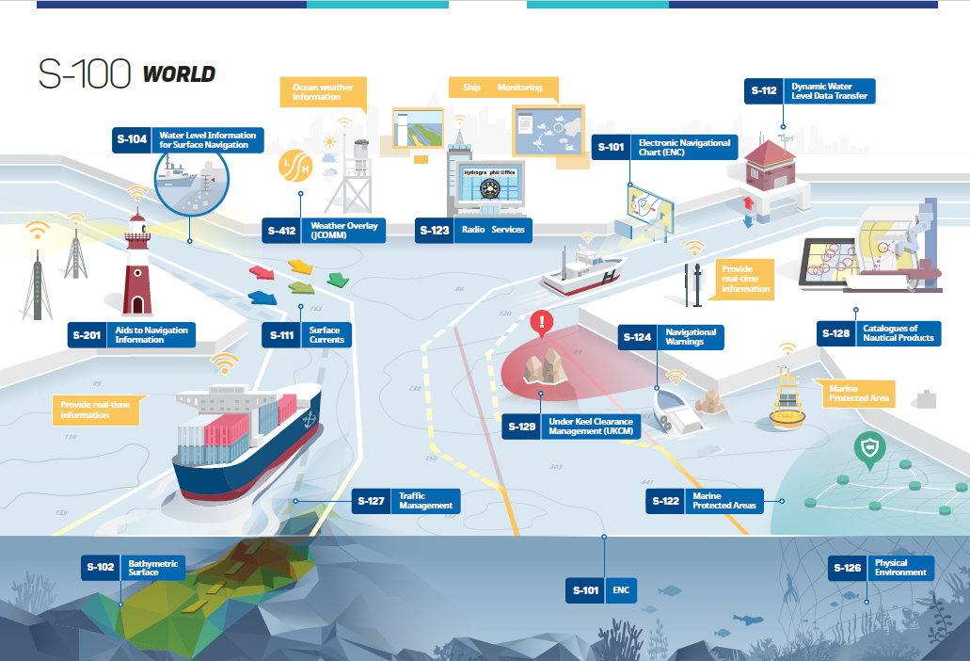

Slide 38
Action requested of HSSC
The HSSC is invited to
note this report and approve the continuance of the Work Plan.
Approve the actions requested with in this report

Slide 39
Actions Requested of HSSC
HSSC11 is requested to note the deadlines for S-100 Edition 5.0.0 proposals
Endorse Edition 1.0.0 of S-97 according to the revised approval process
Note that S-97 will undergo additional editing to improve readability as part of the iterative process for 2.0.0
Endorse the revised timeline of S-98 Edition 1.0.0 for 2020

Slide 40
Actions Requested of HSSC
S-102
Endorse the publication of S-102 Edition 2.0.0
Ask the IHO Secretariat to send out a Circular Letter requesting Member State Approval with a target date of December 2019 for publication
S-121
Note the Stakeholder Review that is in progress
Post successful adjudication of comments received from the stakeholder review publish Edition 1.0.0 of S-121

Slide 41
Actions requested of HSSC
Endorse S-129 Edition 1.0.0 for publication
HSSC is requested to establish two new S-4XX numbers for the WMO

