Slide 1
Identification of port, terminal, berth and berth position
Why
How
Definitions
Result
Next steps forward

Slide 2
Why?
If you don’t know to which berth you’re going, how can you make a berth to berth passage plan?
Number one complaint today: terminal, berth and berth position not known to mariners

Slide 3
Why?
Regulation 19, Chapter V
2018 last implementation phase for ECDIS
Resolution A893-21
Berth to berth passage planning with increasing ship sizes
Resolution A960
More disconnect between pilot and bridge team by use of ECS in PPU vs ENC in ECDIS
Ambition 50% reduction CO2 in 2050
Just In Time arrivals as short term measure – more need for efficient passage planning

Slide 4
Why?
The user expects ENC and digital products to be more accurate
Updates from ports to Hydrographic Offices are still the same as for paper charts and products
Need to provide frequent digital updates from ports

Slide 5
Why?
Semi autonomous docking: today
Autonomous docking: some day
The Last Nautical Mile is very busy

Slide 6
How?
For a migration to common, globally defined standards requires both investment in culture change
Therefore, only robust, existing, global, cross industry standards have been selected, ensuring a sustainable investment decision

Slide 7
How
Port
Direct ref: WGS84
Indirect ref: ISO 3166
Attribute: Name
Terminal
Direct ref: WGS84
Indirect ref ISO/IEC 6523
Attribute: Name / GISIS / SMDG
Berth
Direct ref: WGS84
Indirect ref: ISO/IEC 6523
Attribute: Name
Berth position
Direct ref: WGS84
Indirect ref: ISO/IEC 6523 + Extension
Attribute: Name + Number of bollard / manifold/ramp
Hierarchical relationship between geographic areas in a port area

Slide 8
How
Example

Slide 9
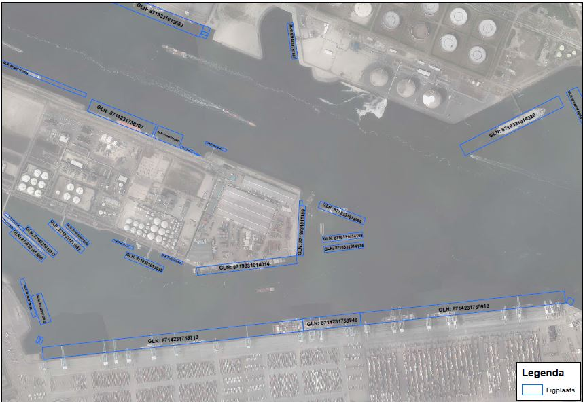
How
Example

Slide 10
Definitions
To be improved: exact definition of berth, to obtain exact data

Slide 11
Definitions
To be improved: exact definition of berth position, to obtain exact data

Slide 12
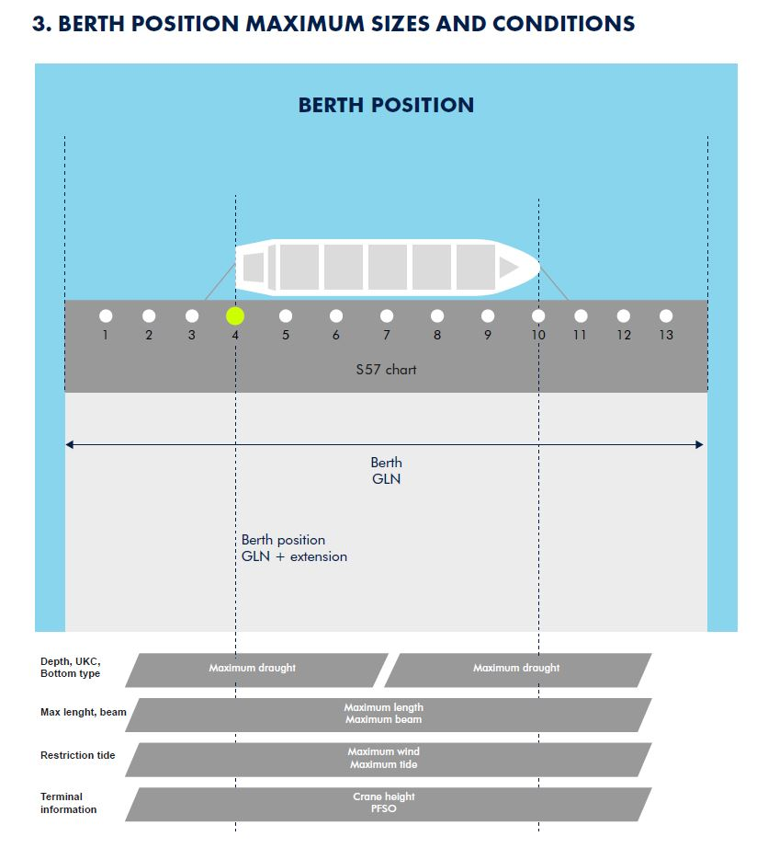
Result
Only with exact berth and berth position data it is possible to make a safe port passage plan, and a vessel-berth compatibility check

Slide 13
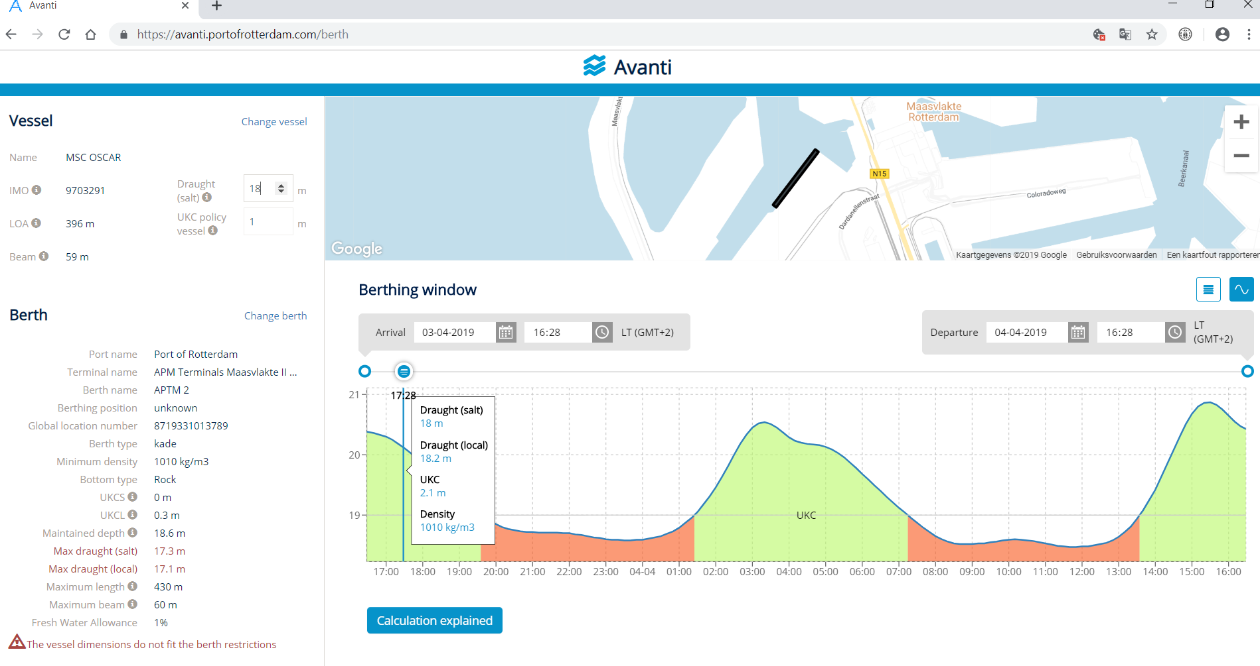
Result
Automated exact maximum draught calculations

Slide 14
Result
Automated exact Just In Time sailing planning

Slide 15
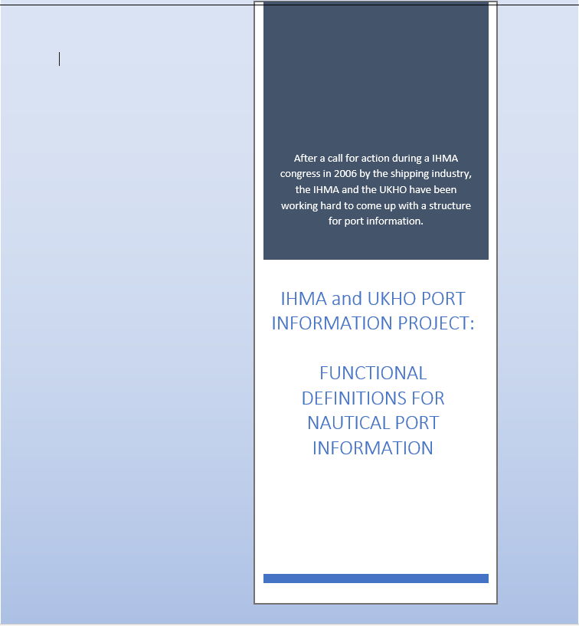
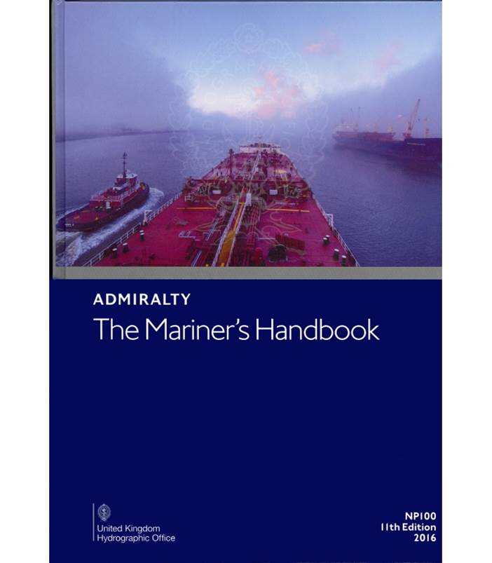
Next steps forward
Publication of standards December 2019

Slide 16
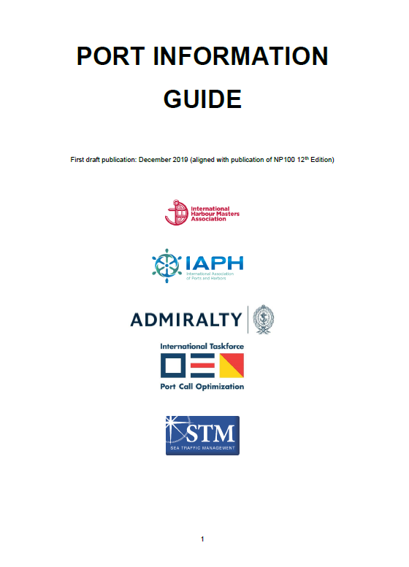
Next steps forward
Step by step guide for ports

Slide 17
Action to be considered by HSSC / IHMA
Noting the outcome of HSSC-8 (2016) “The HSSC Chair concluded the discussion stating that if a PS had to be developed, it should be done by the IHMA (or another appropriate body) as the IHO (or HOs) has a different remit and does not have the capacity to hold and maintain all the additional information required (that is not required for navigational charts). IHMA could have their own Domain in the Registry, administered by them”
HSSC to take note of the progress made on the development of Port Guide Information technical specifications
IHMA to consider the development of a Port Guide Information Product Specification under the S-100 framework, and to provide the management plan of governance mechanisms for ports database establishment, maintenance, etc.

Slide 18
Thank you

