Slide 1
Maritime Spatial Planning
EU MSP cross border projects
IHO-EU netweork WG, 5th meeting
27 September 2017

Slide 2
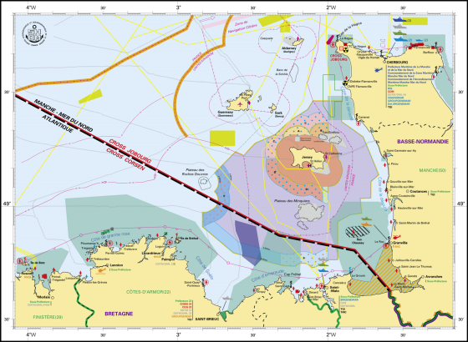
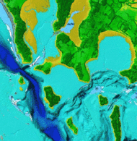
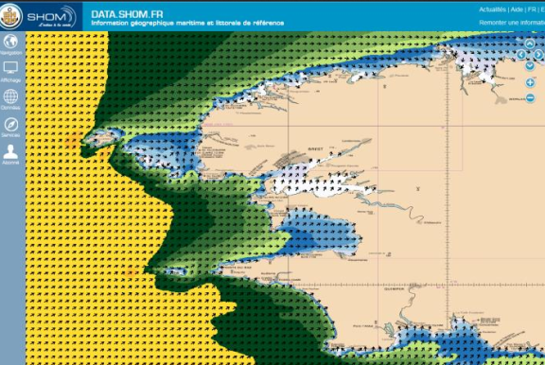
Maritime spatial planning
EUROPEAN DIRECTIVE 2014/89/UE 23 July 2014
establishing a framework for maritime spatial planning. (MSP Directive)
Competition for maritime space – for renewable energy equipment, aquaculture and other uses – has highlighted the need to manage our waters more coherently. Maritime spatial planning (MSP) works across borders and sectors to ensure human activities at sea take place in an efficient, safe and sustainable way.
MSP Directive implementation pillars
To develop the blue growth
To protect the marine environment
To avoid and reduce conflicts between sectors and develop synergies
To increase cross-border cooperation

Slide 3
Maritime spatial planning
EUROPEAN DIRECTIVE 2014/89/UE 23 July 2014
establishing a framework for maritime spatial planning. (MSP Directive)
2014: Adoption of the directive
2016: Deadline for transposition and designation of competent authorities
2021: Deadline for the establishment of maritime spatial plans

Slide 4
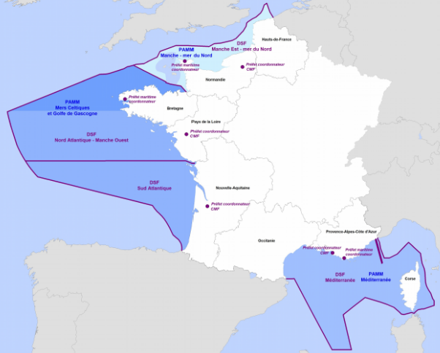
Maritime spatial planning
EUROPEAN DIRECTIVE 2014/89/UE 23 July 2014
establishing a framework for maritime spatial planning. (MSP Directive)
2014: Adoption of the directive
2016: Deadline for transposition and designation of competent authorities
2021: Deadline for the establishment of maritime spatial plans

Slide 5
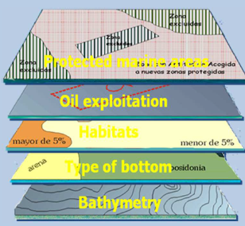
Maritime spatial planning
EUROPEAN DIRECTIVE 2014/89/UE 23 July 2014
establishing a framework for maritime spatial planning. (MSP Directive)
2014: Adoption of the directive
2016: Deadline for transposition and designation of competent authorities
2021: Deadline for the establishment of maritime spatial plans
Marine knowledge
Best data available

Slide 6
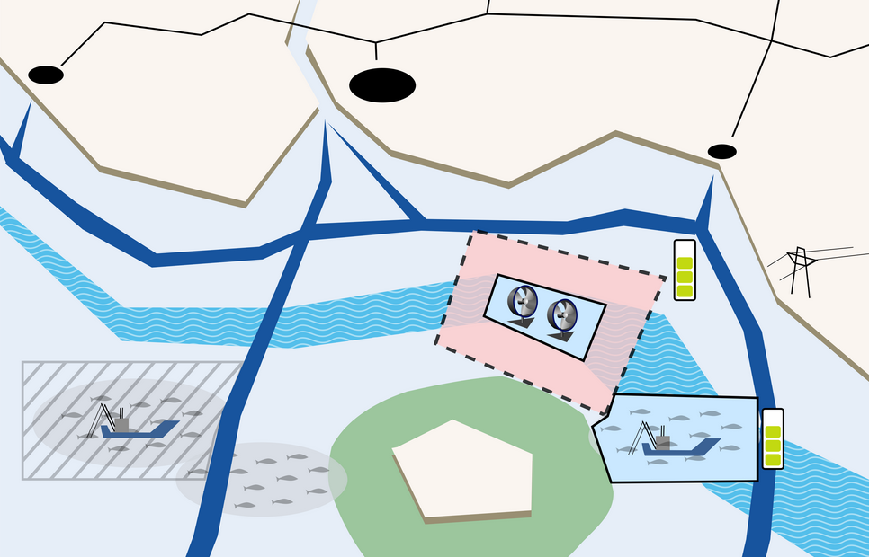
Maritime spatial planning
EUROPEAN DIRECTIVE 2014/89/UE 23 July 2014
establishing a framework for maritime spatial planning. (MSP Directive)
2014: Adoption of the directive
2016: Deadline for transposition and designation of competent authorities
2021: Deadline for the establishment of maritime spatial plans
Ecosystem Based Approach
Good ecological status
MSP approaches
Land/Sea interactions
Interactions between environment and uses or activities, impacts, pressures
Marine knowledge
Best data available
Future trends
deseasion: http://recherche.telecom-bretagne.eu/deseasion/

Slide 7
FUNDING MSP CROSS BORDER PROJECTS
DEALING WITH MS’S transboundary issues
MSs at different stages in the MSP process
Differences in methodologies, Tools
Need to take into account the transboundary issues and to increase cross border cooperation
FUNDING MSP CROSS BORDER PROJECTS
> To support the implementation of the MSP Directive in Member States waters
> To initiate a cross-border cooperation between EU countries on MSP issues

Slide 8
FUNDING MSP CROSS BORDER PROJECTS
DEALING WITH MS’S transboundary issues
Plan Bothnia - Preparatory action on maritime spatial planning in the Baltic Sea (2010-12)
BaltSeaPlan - Baltic Sea region programme "Introducing Maritime Spatial Planning in the Baltic Sea" (2009–12)
TPEA, Transboundary Planning in the European Atlantic – Project on maritime spatial planning in the Atlantic, including the Celtic Sea and Bay of Biscay (2012-14)
ADRIPLAN - ADRiatic Ionian maritime spatial PLANning (2013-15)
SIMCELT- promoting practical cross-border cooperation between EU countries on the implementation of the maritime spatial planning directive in the Celtic Seas (2016-17)
Baltic SCOPE - Cross-border solutions in Baltic maritime spatial plans (2015-17)
MARSPLAN – MSP in the Black Sea (2015-17)
SIMNORAT – Atlantic Sea (2017-18)
SIMWESTMED – Western Mediterranean (2017-18)
SUPREME – Eastern Mediterranean (2017-18)
FUNDING MSP CROSS BORDER PROJECTS
> To support the implementation of the MSP Directive in Member States waters
> To initiate a cross-border cooperation between EU countries on MSP issues

Slide 9
FUNDING MSP CROSS BORDER PROJECTS
DEALING WITH MS’S transboundary issues
Plan Bothnia - Preparatory action on maritime spatial planning in the Baltic Sea (2010-12)
BaltSeaPlan - Baltic Sea region programme "Introducing Maritime Spatial Planning in the Baltic Sea" (2009–12)
TPEA, Transboundary Planning in the European Atlantic – Project on maritime spatial planning in the Atlantic, including the Celtic Sea and Bay of Biscay (2012-14)
ADRIPLAN - ADRiatic Ionian maritime spatial PLANning (2013-15)
SIMCELT- promoting practical cross-border cooperation between EU countries on the implementation of the maritime spatial planning directive in the Celtic Seas (2016-17)
Baltic SCOPE - Cross-border solutions in Baltic maritime spatial plans (2015-17)
MARSPLAN – MSP in the Black Sea (2015-17)
SIMNORAT – Atlantic Sea (2017-18)
SIMWESTMED – Western Mediterranean (2017-18)
SUPREME – Eastern Mediterranean (2017-18)
> To support the implementation of the MSP Directive in Member States waters
> To initiate a cross-border cooperation between EU countries on MSP issues

Slide 10
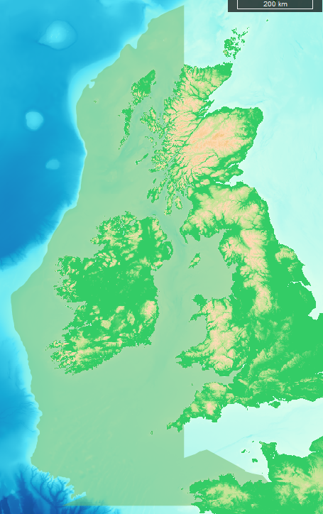
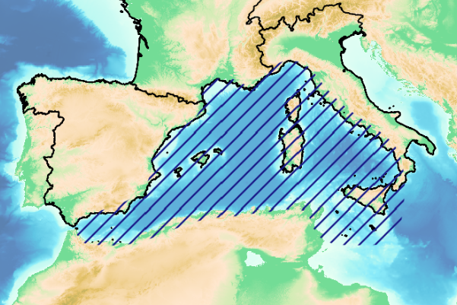
FUNDING MSP CROSS BORDER PROJECTS
Western Mediterranean
Celtic Seas
Northern Atlantic
2017 – 2018
Coordination : Shom ( France)
2016–2017
Coordination : UCC (Irlande)
2017 –2018
Coordination : Shom (France)
2018 – 2019 : SEANSE in the Channel and North Sea, Netherland coordination
* The projects areas are represented without prejudice to maritime claims of sovereignty or jurisdiction of the countries

Slide 11
CROSS BRODER PROJECTS PARTNERSHIP
Partnership built on public bodies involved in the MSP implementation process
States operators
Universities
International organisations (UNEP, CRPM)
National MSP competent authorities involved
Either directly in the partnership
or at the level of the Steering Commitee

Slide 12
CROSS BRODER PROJECTS PARTNERSHIP
Partnership built on public bodies involved in the MSP implementation process
States operators
Universities
International organisations (UNEP, CRPM)
National MSP competent authorities involved
Either directly in the partnership
or at the level of the Steering Commitee
>> Strong interactions needed with MSP national authorities, ministries and coordinating authorities
Interministerial Committee

Slide 13
FUNDING MSP CROSS BORDER PROJECTS
STRUCTURE
1.Initial evaluation of the project area (legal framework and policies, environment, uses and activities, transboundary issues)
2.Studies/tools
- Methodologies to establish plans
- Ospar/Barcelona convention in MSP process
- Transboundary issues integration in MSP process
- Spatial demands and scenarios
- Stakeholder engagement
- Data requirements for MSP
3.Case studies
- focus on sites where to apply /test the studies/tools
Results
Reports, methodologies, tools, recommandations
Stakeholders network building , including cross border networks of national authorities

Slide 14
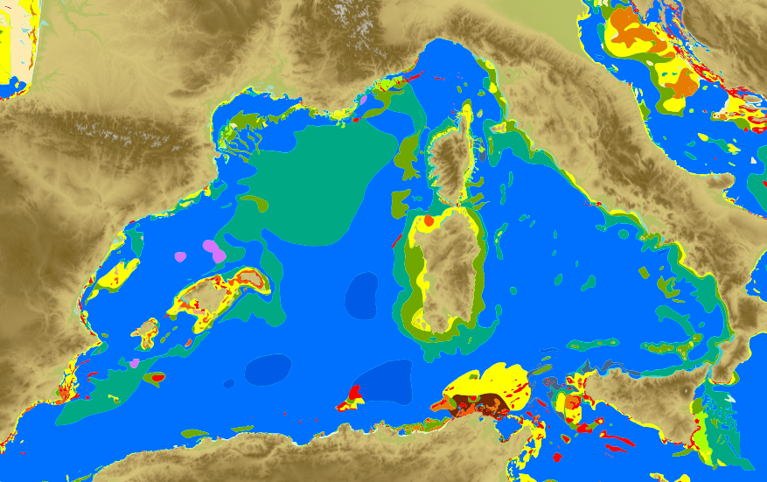
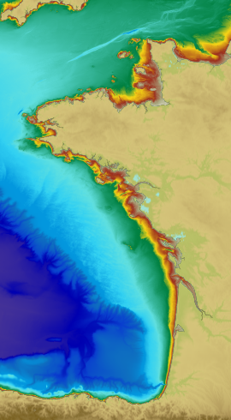
DATA REQUIREMENTS FOR MSP IN A TRANSBOUNDARY CONTEXT
Objectives:
Support access to and use of data in a transboundary context
Identify needs and gaps related to data and portals interoperability
Locks and initiate to address the needs and gaps in cooperation with the Task Group on Data

Slide 15
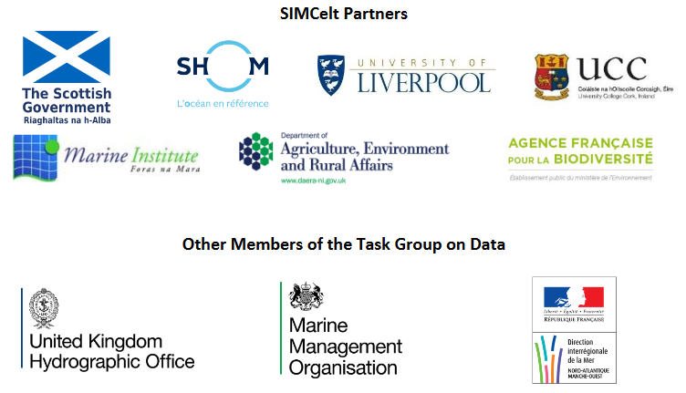
DATA REQUIREMENTS FOR MSP IN A TRANSBOUNDARY CONTEXT
TASK GROUP ON DATA
Objectives:
Support access to and use of data in a transboundary context
Identify needs and gaps related to data and portals interoperability
Locks and initiate to address the needs and gaps in cooperation with the Task Group on Data
Partners, MSP operators, planning authorities, GIS, data and portal experts, observers (hydrographic offices, …)

Slide 16
DATA REQUIREMENTS FOR MSP IN A TRANSBOUNDARY CONTEXT
Project area inventory and analyse
MSP relevant, availability, web services availability (data feeds: WMS, WFS,WMTS), openness, Inspire compliancy, multilingual metadata, quality, portals interoperability
Adress data needs and gaps
Actions undertaken in collaboration with the Task Group On Data (action plan)
Population of a data portal demonstrator
Data management guidance
Report on managing and publishing multisources data
Training workshop
« Collect once,
use many times »

Slide 17
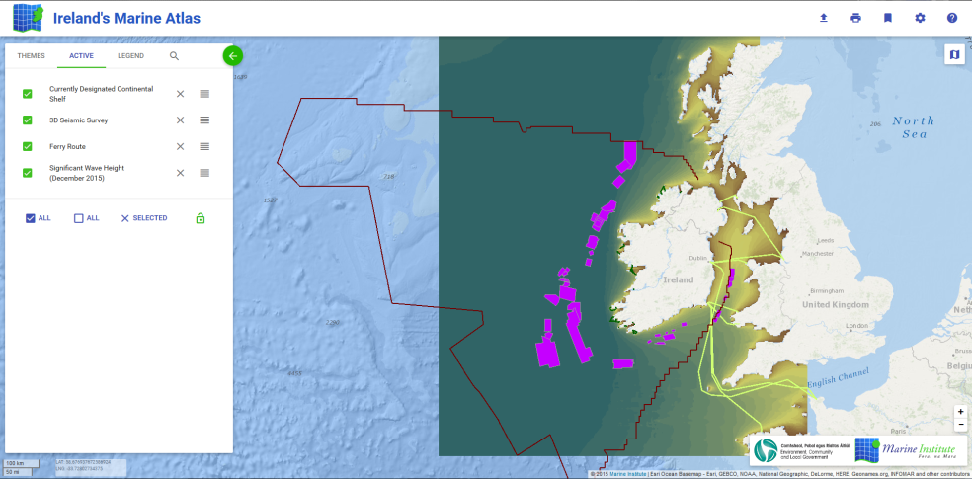
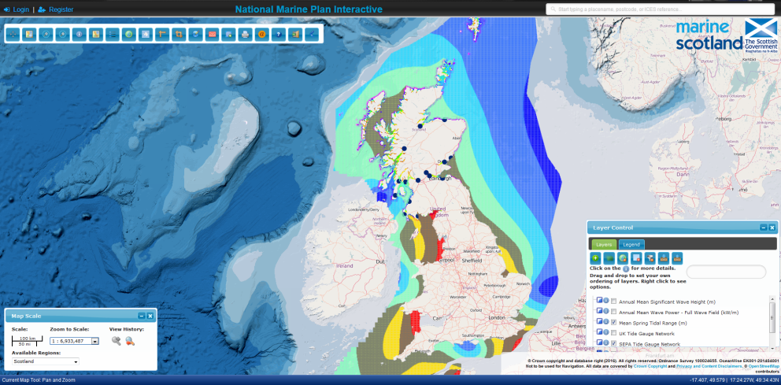
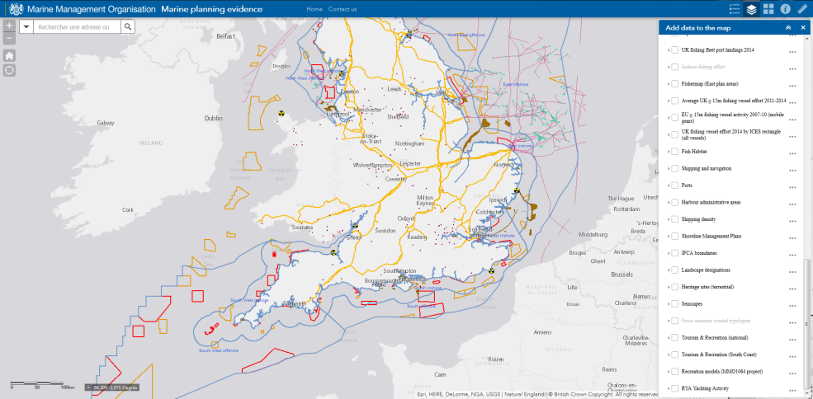
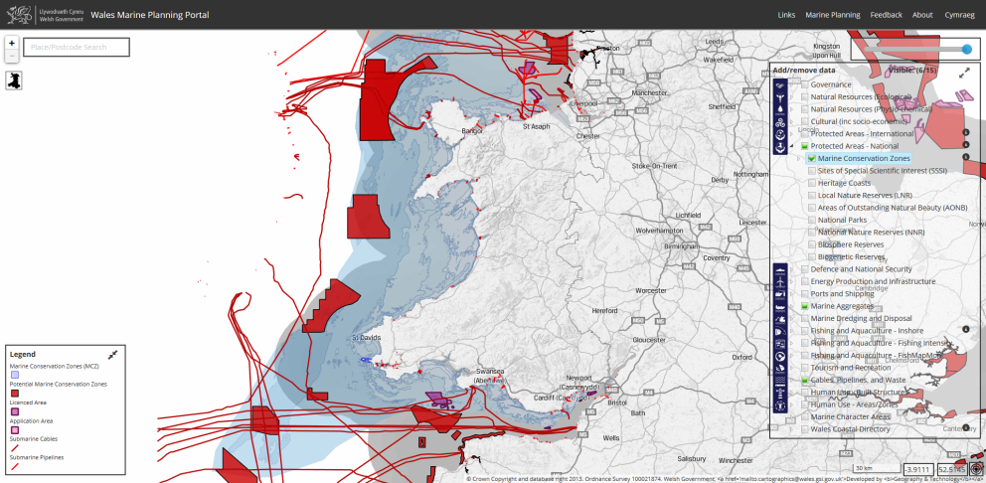
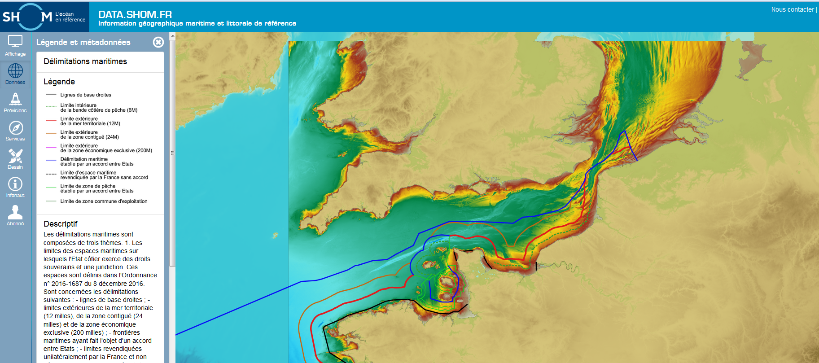
DATA REQUIREMENTS FOR MSP IN A TRANSBOUNDARY CONTEXT
Some SIMCelt marine Portals of interest…

Slide 18
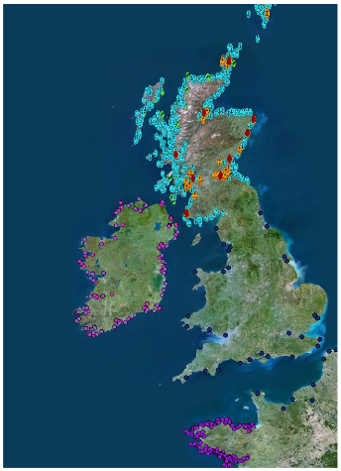
DATA REQUIREMENTS FOR MSP IN A TRANSBOUNDARY CONTEXT
SIMCelt report: Analysis of Data Needs and Existing Gaps specifically Relating to ransboundary Working
Ports
Absence of data covering England and Wales by webservices
Actions to undertake to improve interoperability:
- National webservices
- Portrayal harmonization
- Data model harmonization
Emodnet portal provides information at european level, harmonized, less details
http://www.simcelt.eu/wp-content/uploads/SIMCeltD4_DataAnalysisReport.pdf

Slide 19
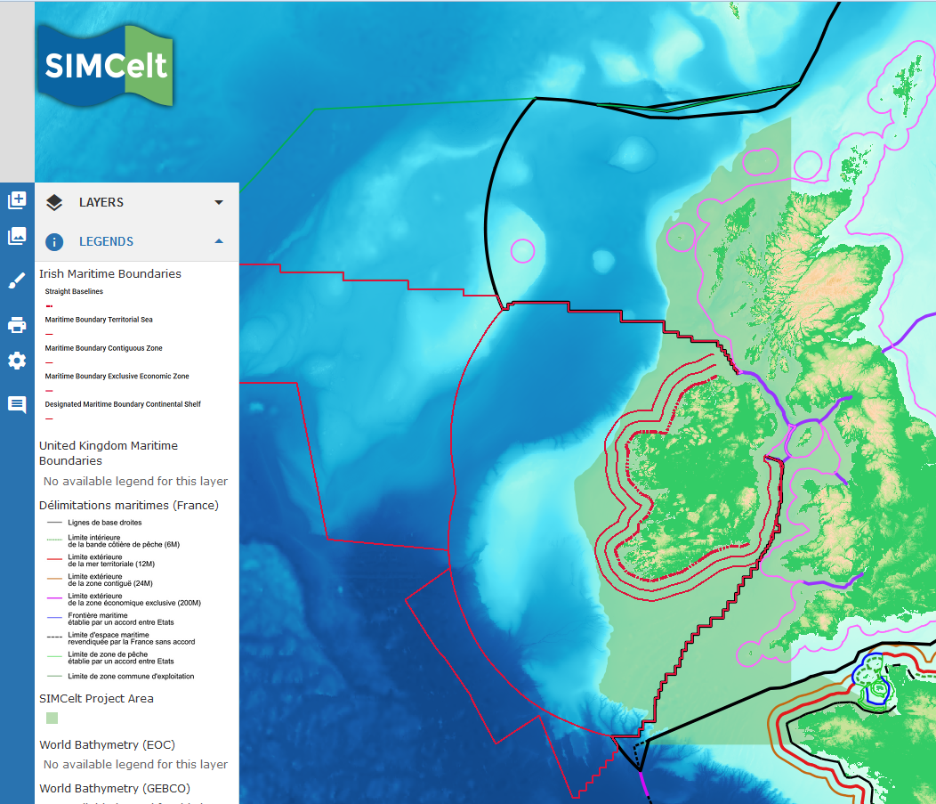
DATA REQUIREMENTS FOR MSP IN A TRANSBOUNDARY CONTEXT
SIMCelt report: Analysis of Data Needs and Existing Gaps specifically Relating to ransboundary Working
Maritime delimitations
http://www.data.simcelt.eu soon available

Slide 20
DATA REQUIREMENTS FOR MSP IN A TRANSBOUNDARY CONTEXT
SIMCelt report: Analysis of Data Needs and Existing Gaps specifically Relating to ransboundary Working
Maritime delimitations
INSPIRE Annex I, administrative units: metada and data model compliancy 23/11/2017
S121 definition in progress

Slide 21
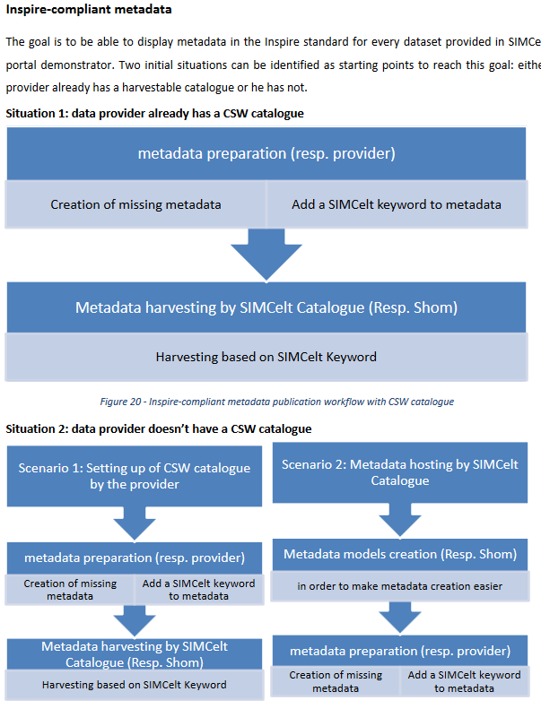
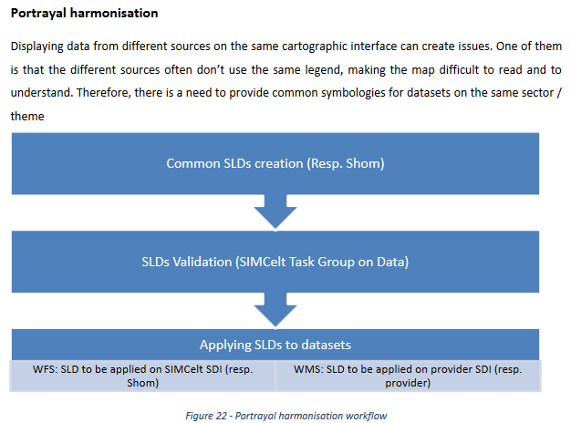
DATA REQUIREMENTS FOR MSP IN A TRANSBOUNDARY CONTEXT
Simcelt ACTION PLAN

Slide 22
The Task Groups on Data of SIMNORAT, SIMWESTMED and SEANSE are opened to Hydrografic Offices to contribute/be informed about the activity related to data and MSP
Contacts
Dominique Carval
SIMNORAT Coordinator
SIMWESTMED Coordinator
Shom SIMCelt project manager
dominique.carval@shom.fr
David Jestin
Administrative and Financial Project Assistant
david.jestin@shom.fr
Corine Lochet
European relationships manager
corine.lochet@shom.fr
Join SIMCelt data workshop on
28th of November 2017 at SIMCelt Conference, Liverpool

