Slide 1
Open Data An Economic Stimulus
IHO MSDIWG Open Forum 3rd March 2015
Building a Maritime Spatial Data Infrastructure
Les Rackham & Andrew Coote
ConsultingWhere Ltd
www.consultingwhere.com
Notes:
1

Slide 2
Overview
What is meant by open data?
Open data in UK and other countries
What are the benefits of open data?
Can the economic impact be measure quantitatively?
What approaches are used?
Geospatial data – some case studies of economic value

Slide 3
Definition of open data
Readily accessible
Available in an open format i.e. a format that has a freely available specification with no limitations on use
Available under an open licence:
Allows free use of the data, redistribution of the data, including sale, on its own or as part of a compilation
Allows the creation of derivatives and separation of data
All parties receiving the data should have the same rights
No restrictions on use or application for any purpose
Licence may impose certain conditions e.g.
Inclusion of attributions
Retention of copyright notices

Slide 4
Freely available not available free
Open does not necessarily mean free of charge
Open is primarily about access and transparency
In common parlance free at the point of access equates to free of charge
But
Charging more than a reasonable amount for processing and distribution might be construed as limiting access

Slide 5
Drivers for opening up data in UK
Maintaining competitive advantage through innovation and better and more accessible information
Greater efficiency in the public sector through improved data sharing
Government transparency agenda
Unlocking information available in public sector data
Giving access to the private sector and the citizen
Economic growth built on open public sector data
Growth of open data captured by communities such as OpenStreetMap
European Directive on INSPIRE

Slide 6
Exemplar National Initiatives

Slide 7
New Zealand
Treasury sponsored initiative based on policy-led analysis (using Investment Logic Mapping) rather than detailed economic analysis
Open to all and free (at the point of delivery)
Scope:
Central Government data
Excludes local government and research institutes (who hold a great deal of public sector information including geospatial)
Huge increase in usage
Large number and variety of case studies assembled¹
Limited quantification of benefits
Main exercise due in 2015/16, preliminary work by ConsultingWhere in progress
¹ https://data.govt.nz/
Notes:
See: http://ict.govt.nz/programmes-and-initiatives/open-and-transparent-government/open-government-information-and-data-work-programm/

Slide 8
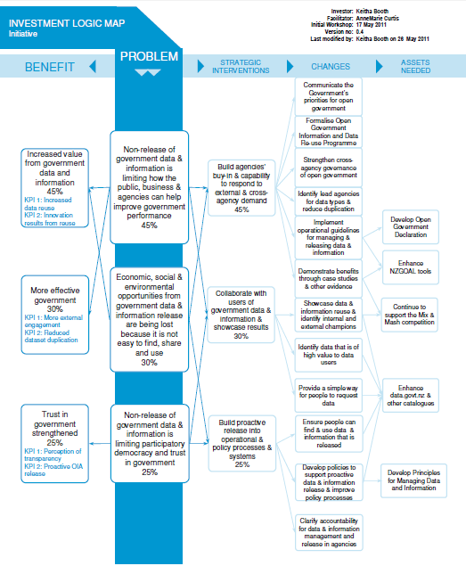
Investment Logic Map (ILM)

Slide 9
NZ Discovery Portal

Slide 10
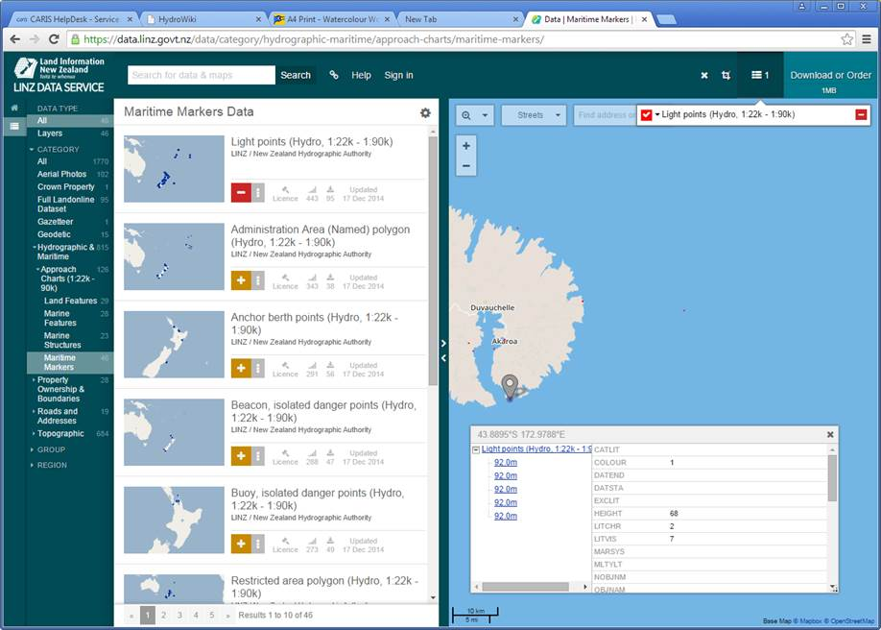
LINZ Data Service

Slide 11
Finland
Freedom of Information Act in 1766 in Sweden-Finland
Act:Openness of Government Activities 1999
EU open data policy directives
Directive on re-use of Public Sector Information 2003 and 2013
INSPIRE 2007
Government policy in 2011: increasing the availability and re-use of data assets in public sector with aim of:
positive economic impact on society as a whole
increasing democracy and promoting transparency
improving the data quality and efficiency of public sector
Major government agencies have opened up their data since 2012 e.g. National Land Survey

Slide 12
NLS Finland – Open Data File Service

Slide 13
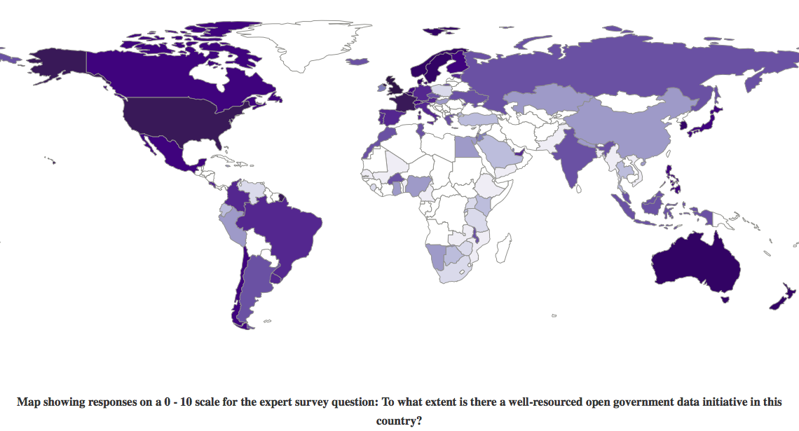
Open Data Barometer (ODB)
Degree to which a well-resourced open government data initiative exists in each country On a scale of 0-10, lightest to darkest.
Source: Open Data Barometer, Global Report, 2nd Edition
http://www.opendatabarometer.org

Slide 14
Country rankings – ODB top 20
Source: Open Data Barometer, Global Report, 2nd Edition http://www.opendatabarometer.org

Slide 15
Economic Case

Slide 16
Economic arguments for open data
Benefits to public and private sectors of open data:
drive efficiencies
increase innovation
lower barriers to entry
generate new insights into old problems
reduce public expenditure
promote economic growth
improve the lot of the citizen
But how can we establish the economic impacts of these benefits?

Slide 17
Assessing economic impacts
Most studies agree open data delivers greater benefit than the costs of providing it but:
Rigorous and robust methods needed to establish this
Data on costs and benefits required plus
An understanding of the demand side
Comparing:
What will happen or has happened after release of open data
With
Counterfactual – what would have happened anyway if data not available as open data

Slide 18
Assessing Economic Impacts
Need to distinguish between:
Direct value: i.e. revenue generated by government from selling access to public sector information
Commercial value - revenue generated by companies through the use of open data to develop products and services
Downstream value: value to users of products and services and the wider economic, social and environment benefits
Approaches have included:
Top down – value-added approach
Bottom up – based on multiplying up from specific case studies

Slide 19
Value of public sector information in UK
Taking into account:
direct value to producers and suppliers
indirect value deriving from production and supply i.e. the benefits accruing up the supply chain
direct use value to consumers: benefits to businesses, society, citizens and the public sector from directly using and re-using public sector information
wider societal value arising from the use and re-use of public sector information.
Estimated value of 1-3 is £1.8 billion (lower bound:£1.2 billion, and upper bound: £2.2 billion) at 2011 prices
Adding 4 at £5 billion gives total estimated value of public sector information £6.2 billion and £7.2 billion
Deloitte,Market Assessment of Public Sector Information 2013, BIS https://www.gov.uk/government/uploads/system/uploads/attachment_data/file/

Slide 20
Ordnance Survey Open Data
Study¹ undertaken in 2012 of benefits of OS OpenData™ to commercial organisations:
Datasets included small and medium scale topographic data
Excluded high revenue earning data MasterMap and Geoplace
Result of making OS OpenData free at point of delivery:
Net £13.0M - £28.5M increase in GDP after 5 years (in 2016)
Improved productivity in economy and higher levels of output
Dependent on continuing maintenance
Biggest benefits were to existing users
Importance of awareness programme for new users (Geovation)
¹Assessing the Value of OS OpenData™ to the Economy of Great Britain – Synopsis June 2013 https://www.gov.uk/bis-13-950-assessing-value-of-opendata-to-economy-of-great-britain.pdf

Slide 21
Marginal costing of GI and SME growth Study by Research Institute of the Finnish Economy¹
Examined use of public sector GI by commercial companies in 15 countries between 2000 - 2007
Findings were:
Commercial companies in countries using marginally priced or free data have grown on average 15% more per annum than those in countries where the price is based on cost recovery
Positive growth impact was found one year after switching to marginal costing with a stronger boost after two years
SME (Small to Medium Size Enterprises) benefit most, notable growth not evident amongst larger companies
Concluded that switching to marginal cost pricing substantially lowers barriers for SMEs
¹Koski,Does Marginal Cost Pricing of Public Sector Information Spur Firm Growth? ETLA
http://www.etla.fi/wp-content/uploads/2012/09/dp1260.pdf

Slide 22
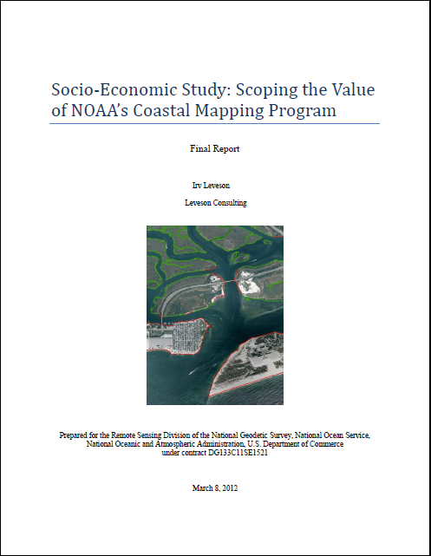
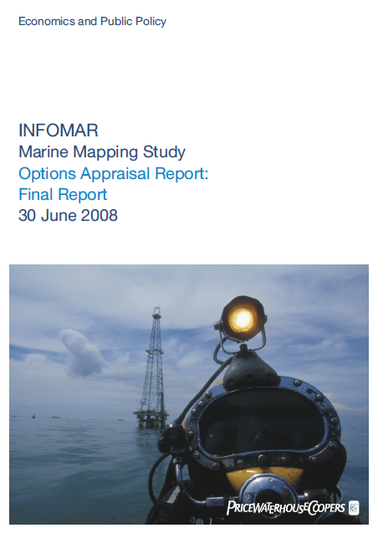
Economic value of hydrographic data

Slide 23
Case study of Vanuatu
Report on case for updated hydrographic surveys and electronic navigational charts for Vanuatu’s ports
Economy very dependent on international maritime trade – relies heavily on cruise tourism
SOLAS regulations required ECDIS from July 2014
Lack of such accurate charts meant that cargo and cruise ships traffic to these countries disrupted
Preliminary study confirmed that the benefits of complying with IMO Conventions far outweigh the costs
The benefit/cost ratio in “worst case scenario” was 91, for every Vatu spent, government can expect to receive 91 Vatu in return.
Put another way the net present value of implementing this project would be 37 billion Vatu (US$ 383 million) over 5 years

Slide 24
Summary
Increasing body of evidence on quantitative benefits
Range of methodologies makes direct comparison of results difficult
Nascent community of geospatial scientists and economists working on guidelines for preferred approaches
A lot can be learned from looking at the work of environmental and transport communities who have assembled good databases and standards for valuation
Economic benefits studies only useful when linked to effective “storytelling” aligned to political agenda

Slide 25
Further Information on economic benefits
ConsultingWhere - Return on Investment (RoI) Information Centre http://www.consultingwhere.com/resources/roi-information-centre.html
Environmental Valuation Reference Inventory (EVRI)
http://www.evri.ca
Spatial Information in the New Zealand Economy - Realising Productivity Gains
http://www.linz.govt.nz/about-linz/our-location-strategy/geospatial-projects/spatial-information-new-zealand-economy
Ordnance Survey: Case Studies Locator http://www.ordnancesurvey.co.uk/business-and-government/case-studies/index.html
Socio-economic Benefits Community website
http://www.socioeconomicbenefits.org
NASA: Measuring Socioeconomic Impacts of Earth Observation
http://www.nasa.gov/sites/default/files/files/SocioeconomicImpactsPrimer.pdf
Notes:
25

Slide 26
Contact Information:
Mobile: +44 7976852097 Email: les.rackham@consultingwhere.com
Skype: les.rackham Romsey, UK
Website: www.consultingwhere.com

