Slide 1
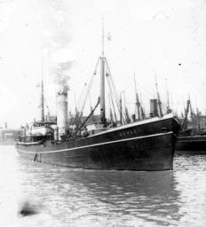
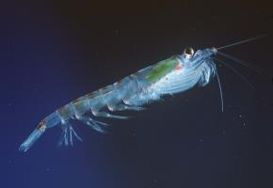
From Open towards Linking Marine Data? Geospatial Data Developments in UK
Dave Morris
(a marine biologist TEMPORARILY in a world of “surveyors”
Strictly – ALWAYS as next slide will show)
1902
Notes:
Very conscious IHO is a different beast to the ones I’m used to talking to; and probably vice versa. Your logo has the world and stability in the form of an anchor, ours a fish and movement. However we beat you by some 20 years in founding data. The RV Huxley. My World is the sea with 10 years working on Antarctic Krill amongst many other things.

Slide 2
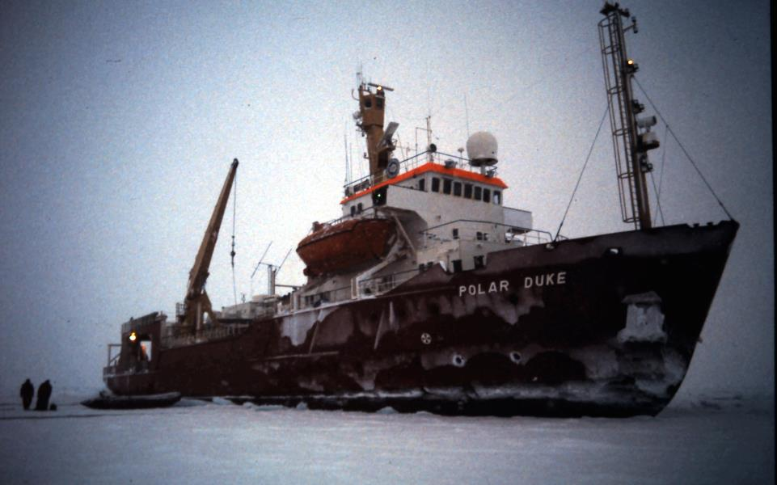
Having hit a Sea Mount I do understand the need for ‘HO’s’ - really

Slide 3
OUTLINE OF WHAT’S COMING
My Assumptions
My OPEN DATA
Your LINKS to the PAST
Our LINKS to the PRESENT
Everyone’s LINKS to the FUTURE

Slide 4
ASSUMPTION - I
“Open Forum” and “Principles & Strategies” and “at odds” means I can get away with providing a context and a user perspective on your data rather than a learned talk on Linked Data
When I say geospatial I mean something somewhere, usually in the sea
And I leave not hitting that something to the professionals

Slide 5
ASSUMPTION - II
You are probably not as far down the line as we are in the UK and maybe need a bit of convincing it’s a good idea (and some insights into re-use)
apologies if this is incorrect – just enjoy the pictures

Slide 6
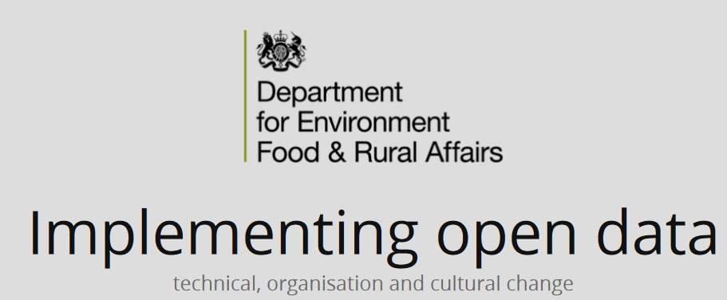
My OPEN DATA

Slide 7
WHY?

Slide 8
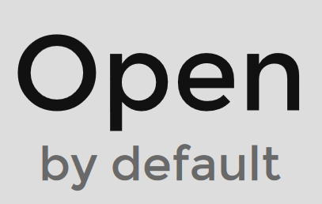
DEFRA and CEFAS will be:

Slide 9
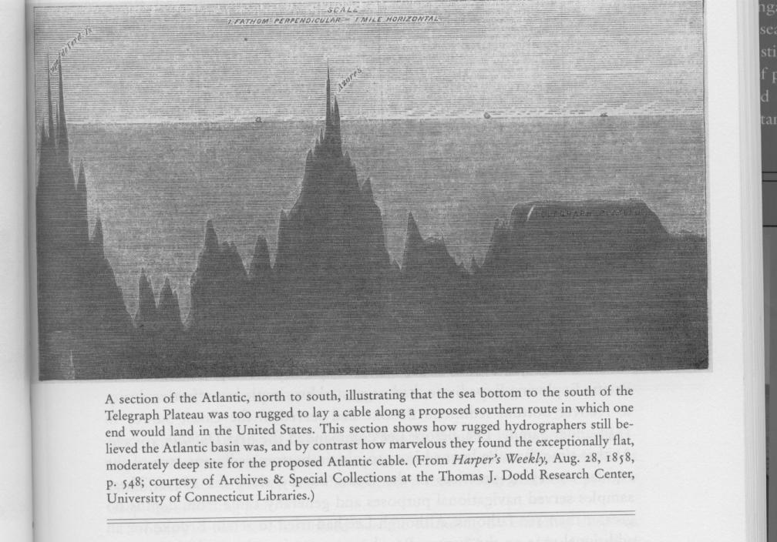
LINKS TO THE PAST – DATA USE Look at my exciting data sponsor me, lets explore!

Slide 10
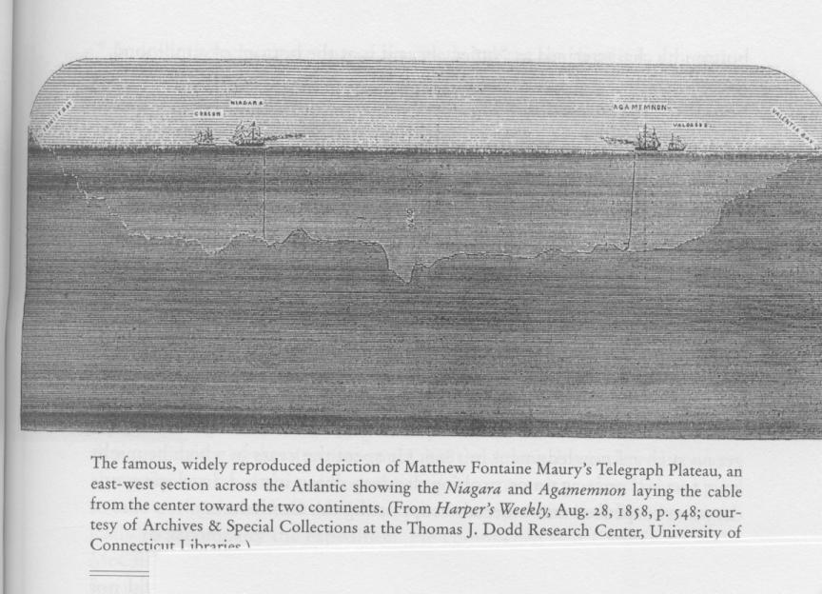
No wait – new data says its not a business risk! Honest!!
LINKS TO THE PAST – DATA
RE-USE

Slide 11
WHAT A SURVEYOR MADE OF THE DATA
“if art had prepared a bed for an oceanic cable, after full deliberation, it could not have devised any more complete arrangement than this profound recess of still water, paved beneath with smooth, impalpable powder”

Slide 12
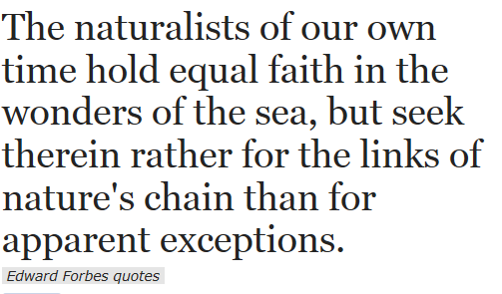
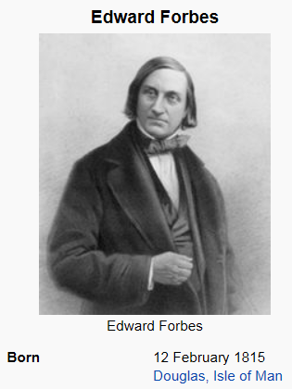
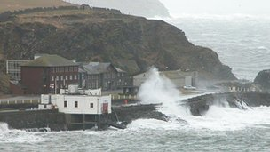
WHAT A MARINE BIOLOGIST MADE OF THE DATA

Slide 13
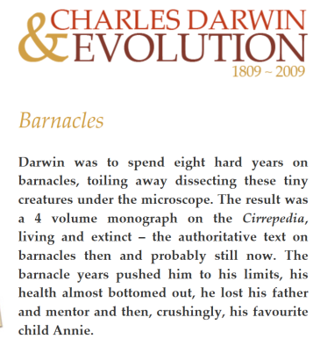
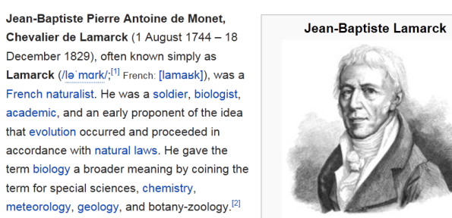
OTHER FAMOUS MARINE BIOLOGISTS

Slide 14
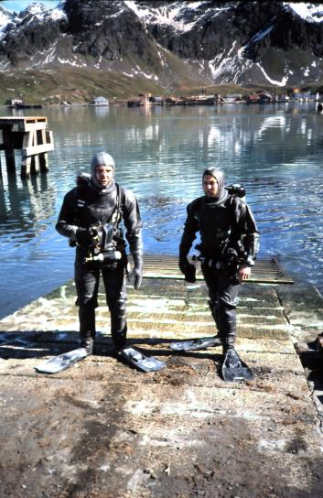
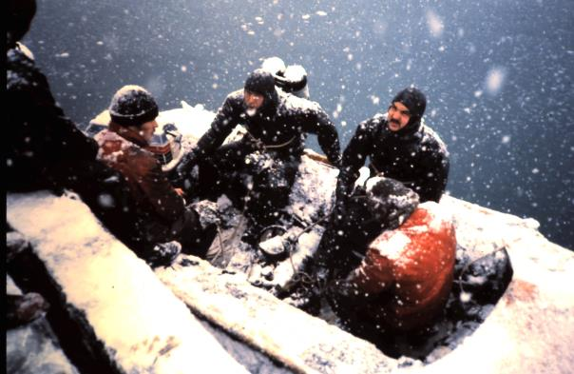
And not so famous ones

Slide 15
FAMOUS SURVEYORS? RESPECT!

Slide 16
LINKS TO THE PRESENT
WE ARE
ALL
OBSESSED
WITH DEPTH

Slide 17
And making YOUR depths OPEN is a really good idea
NOT because I want to make charts and steal your business
BUT because I am obsessed with depth for very different reasons to you

Slide 18
YOUR PROCESSED DEPTHS
Are no real use to numerical modelers – shoal bias is just (unintentionally) misleading
Don’t do much for chemists taking samples either (unless they go to sea in which case its probably slightly more than vital!)
And as for Marine Biologists – they just record depth because “its bound to be useful and significant” and +/- a metre (or ten) is fine, really
We’re really interested in…….

Slide 19
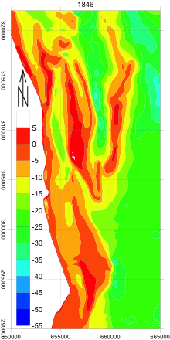
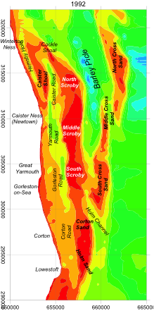
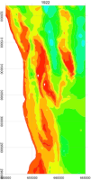
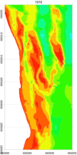
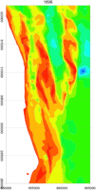
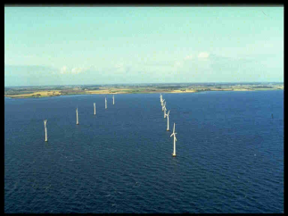
1846-1992

Slide 20
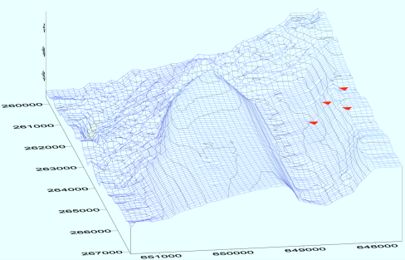
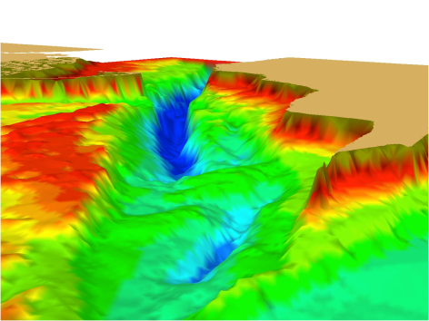
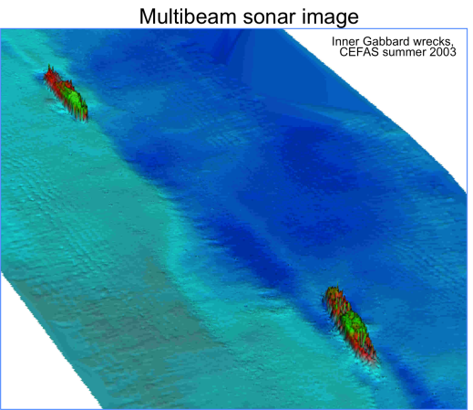
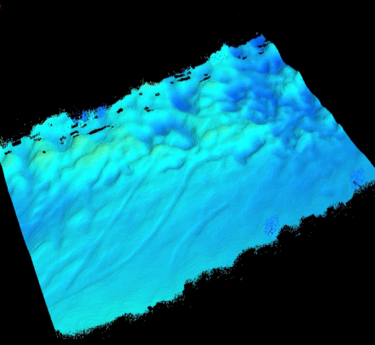

Slide 21
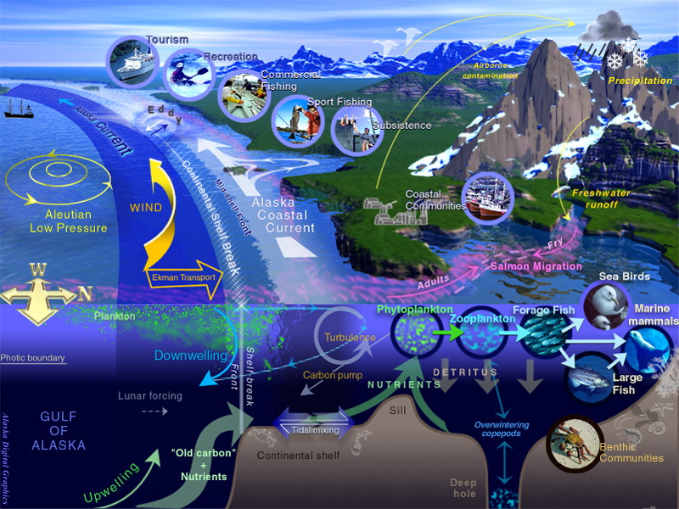

Slide 22
LINKS TO THE FUTURE
My seemingly (and actually) chaotic world doesn’t know what data it wants, apart from:
EVERYTHING (including depth, lots of depths, everywhere…..)
ALL IN ONE PLACE
ALL IN THE SAME FORMAT
FREE
NOW!
Please…..

Slide 23
BAD NEWS
So Open Data, is a great OPPORTUNITY
BUT its all in different formats….
AND masses of complicated bathymetry type stuff is all very well but…

Slide 24
GOOD NEWS
Linked (OPEN) Data provides SOLUTIONS
I can use the same “format” and look at all the ecosystem connections by connecting all my data using Linked Data (including depth)

Slide 25
BAD NEWS
AND, as far as I understand it, geo Linked Data is not the easiest thing in the world either.
A link to a single depth? So many to chose from…..
Still that’s OUR problem not YOURS

Slide 26
BACK TO THE PAST From the Good Old Days

Slide 27
FORWARD TO THE FUTURE

Slide 28
MSDI + LINKED (OPEN) DATA
Find me all the barnacles that live on rocky shores that have depths greater than 10m within 500 m of LAT and that are outside any Marine Protected Area on the the Welsh coast, as long as they have land buildings within 1 km.

Slide 29
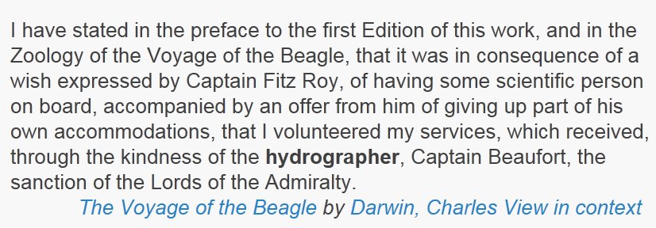
CHARLES DARWIN THANKS YOU ! his emphasis, not mine

