Slide 1
VORF: Vertical Offshore Reference Frame
Jonathan Iliffe
Civil, Environmental & Geomatic Engineering
University College London
Maritime SDI Open Forum. 3 March 2015

Slide 2
Outline
Datums are an essential component of any SDI.
Several initiatives around the world, including VDatum, BLAST, VORF.
UKHO-sponsored VORF project ran from 2005.
Reflection on key points from 10 years of work.

Slide 3
Land and marine height datums
H=0
H=0
D=0
h=0

Slide 4
Gridded datum surfaces
H=0
H=0
D=0
ETRF89
h=0

Slide 5
Unification of datums

Slide 6




Consistency of datums
Antenna offset
h_{a}
Tide
Chart Datum
D
hCD
Tide = h_{a} – antenna – h_{CD}
Ellipsoid
Consistency of datums – survey once, use many

Slide 7
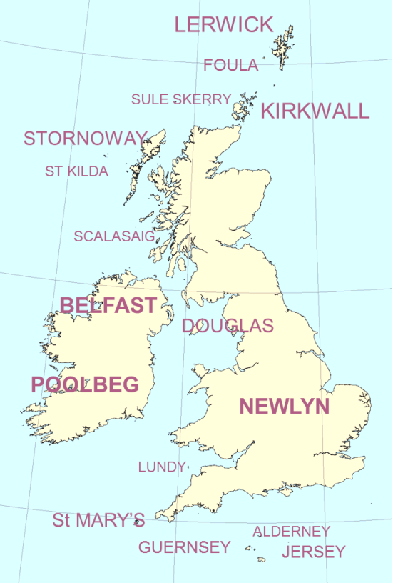
Integration of datums – UK & Ireland
Heights with respect to ETRF89 datum across UK and Irish waters
Heights of all land datums in the British Isles, within the coastal zone – 17 of them.
Heights of Chart Datum, LAT, MLWS, MSL, MHWS, HAT.

Slide 8
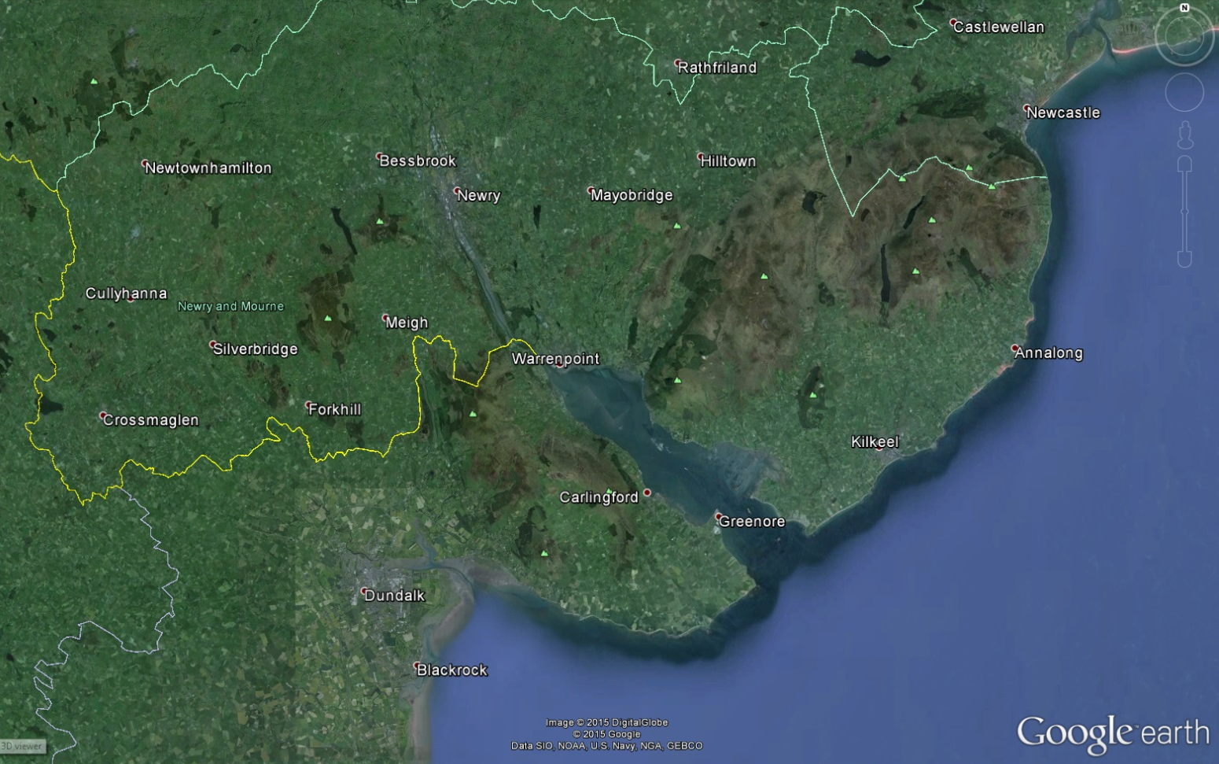
Coastal modelling
OD Belfast
Poolbeg Datum
& OD Malin
Marine datums (CD etc)

Slide 9
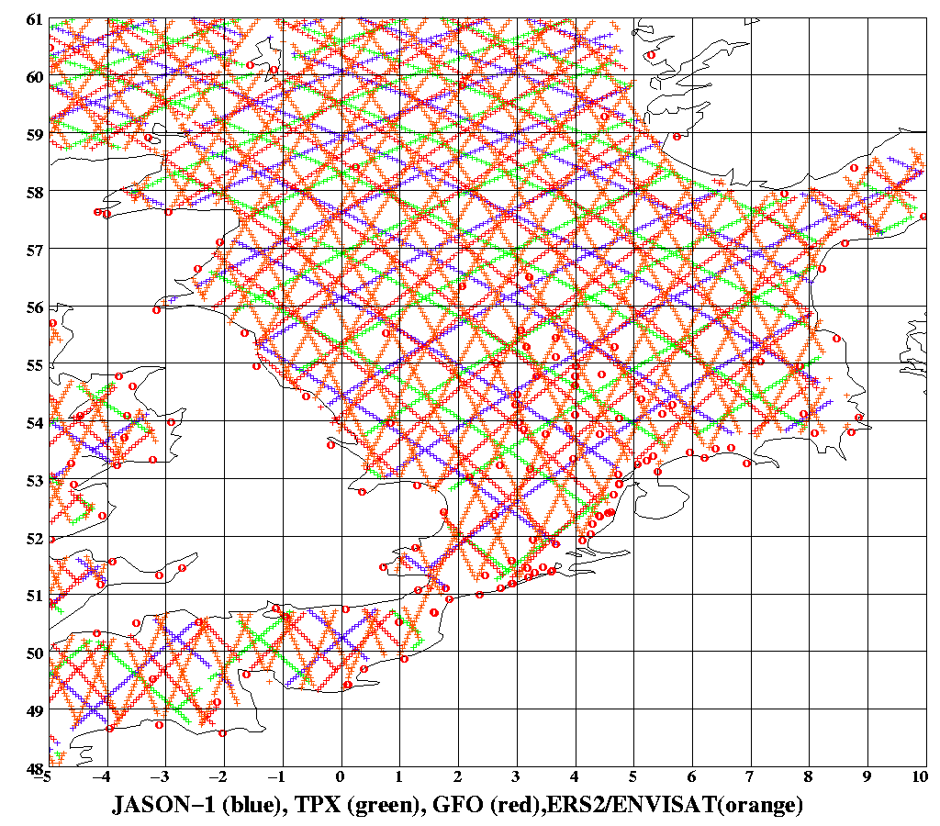
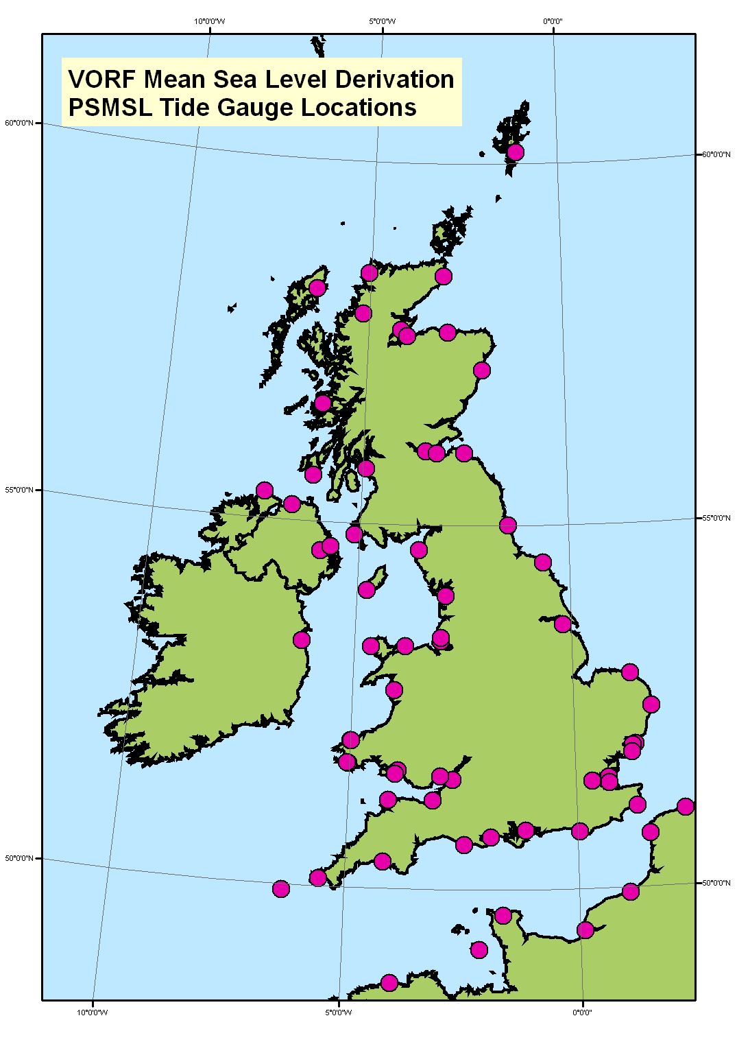
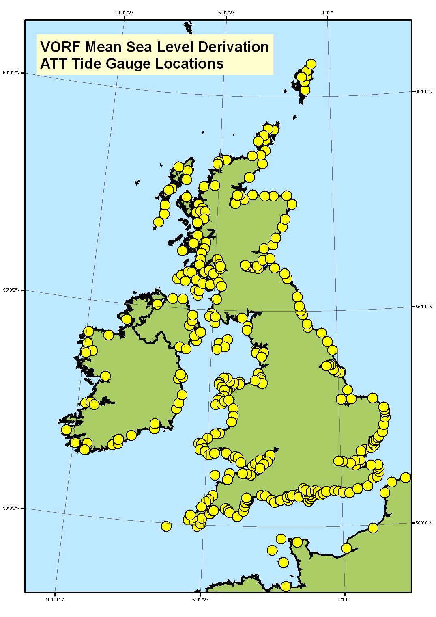
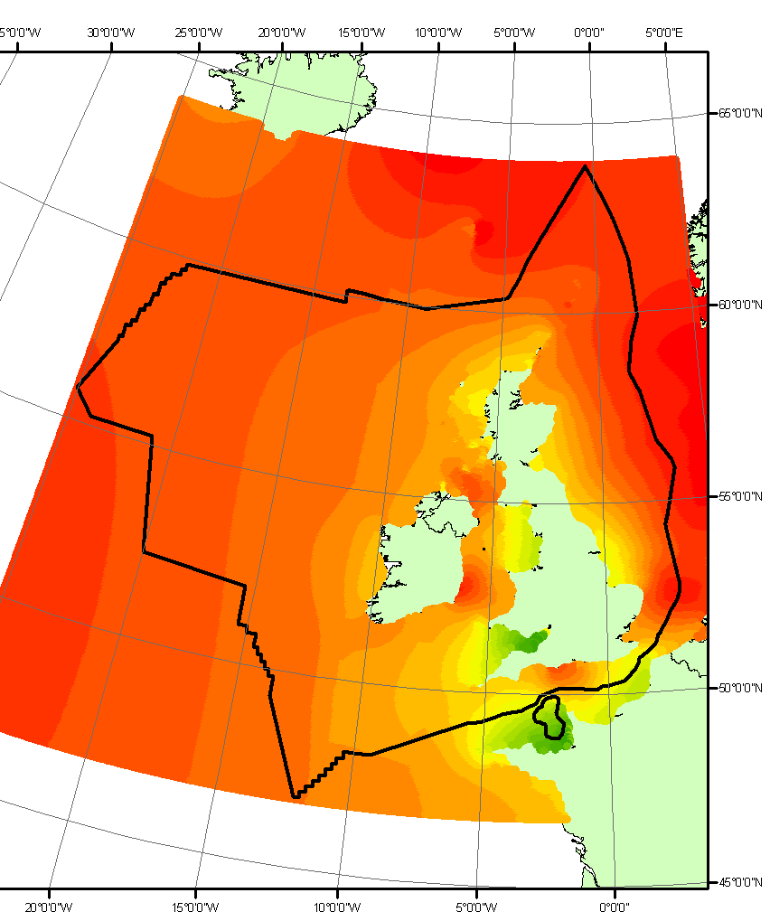
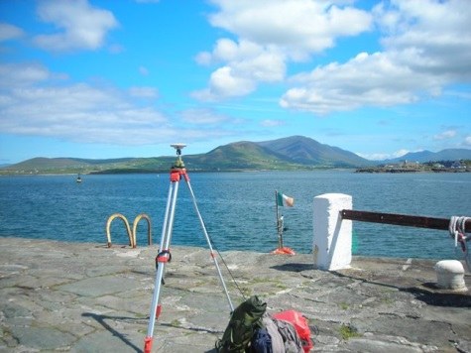
Methodology
Satellite altimetry
Tide gauge data
Tidal modelling
GNSS observations
Plus gravimetric geoid, OSGM02 datum correction model, UKHO meta-data, coastline polygons, river polygons, etc.

Slide 10
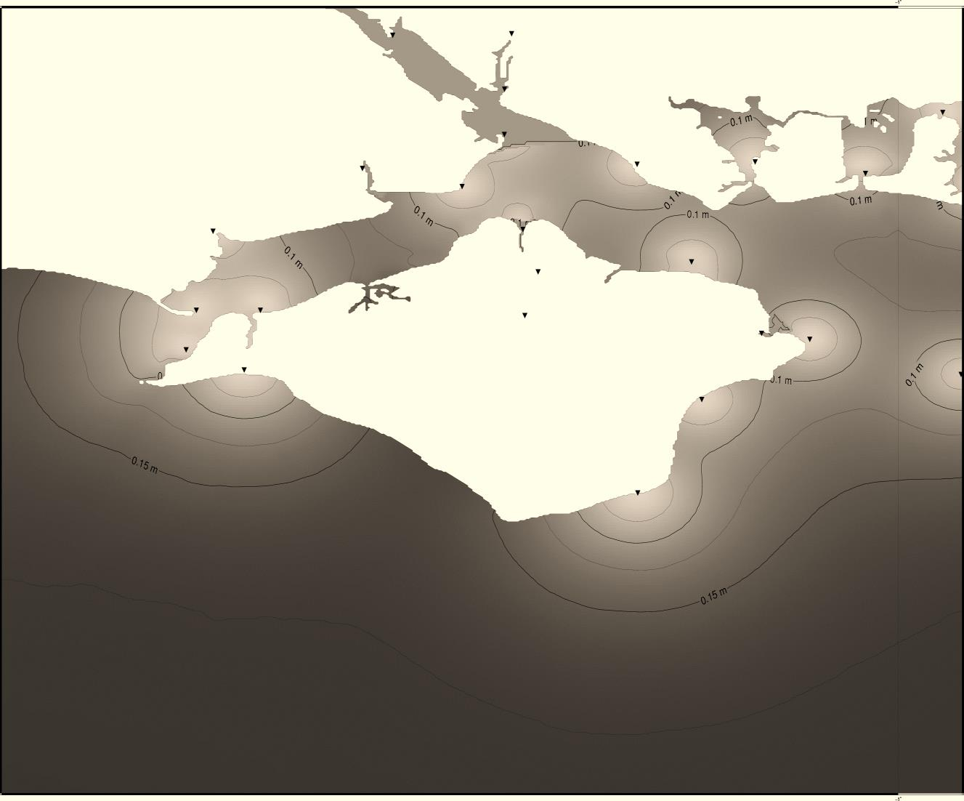
Error modelling and accuracy testing
Formal error modelling.
External accuracy tests and internal checks.
Almost all areas within the 10 cm inshore and 15 cm offshore (1σ) targets.
Some areas identified that will benefit from improved tidal modelling (eg off Portland Bill).

Slide 11
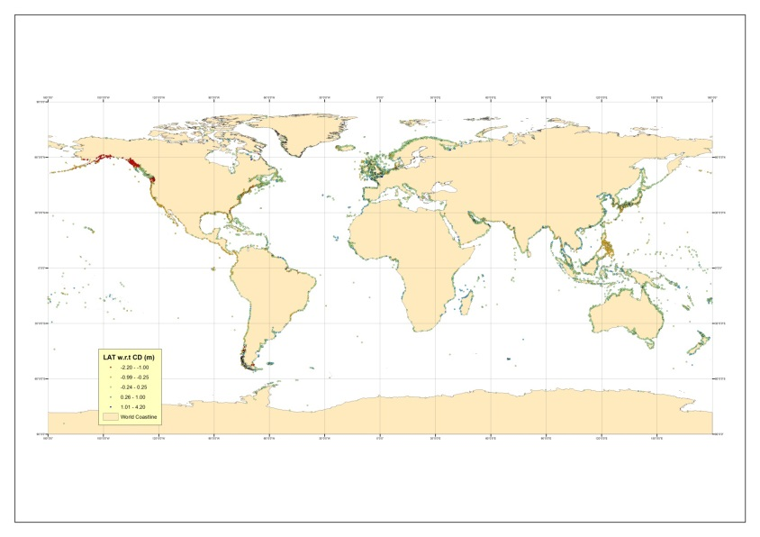
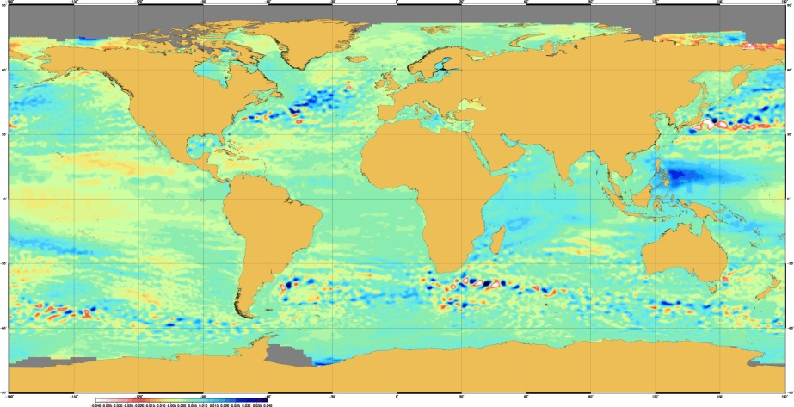
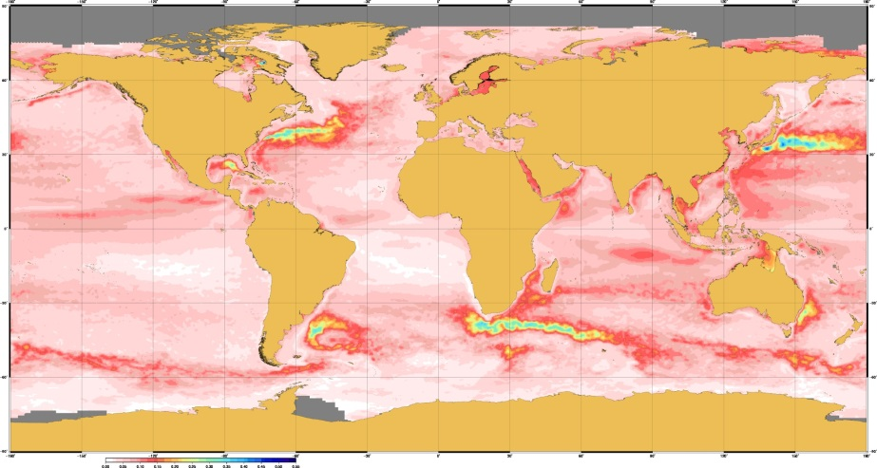
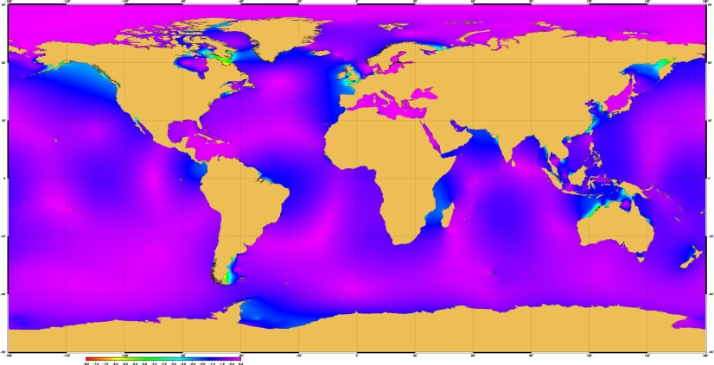
VORF Global
Worldwide, outside 12 nm from the coast.

Slide 12
Tidal modelling – a decade of improvements
Available for VORF
Available for VORF Global
Coast
12 nm

Slide 13
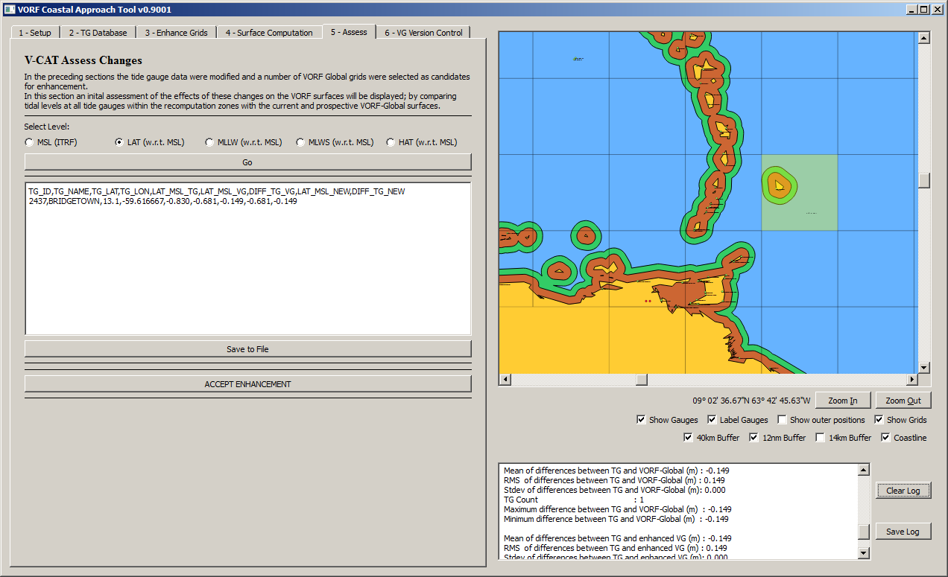
VORF Coastal Approach Tool
V-CAT (VORF Coastal Approach Tool) allows computations inside 12 nm where coastal data is made available.

Slide 14
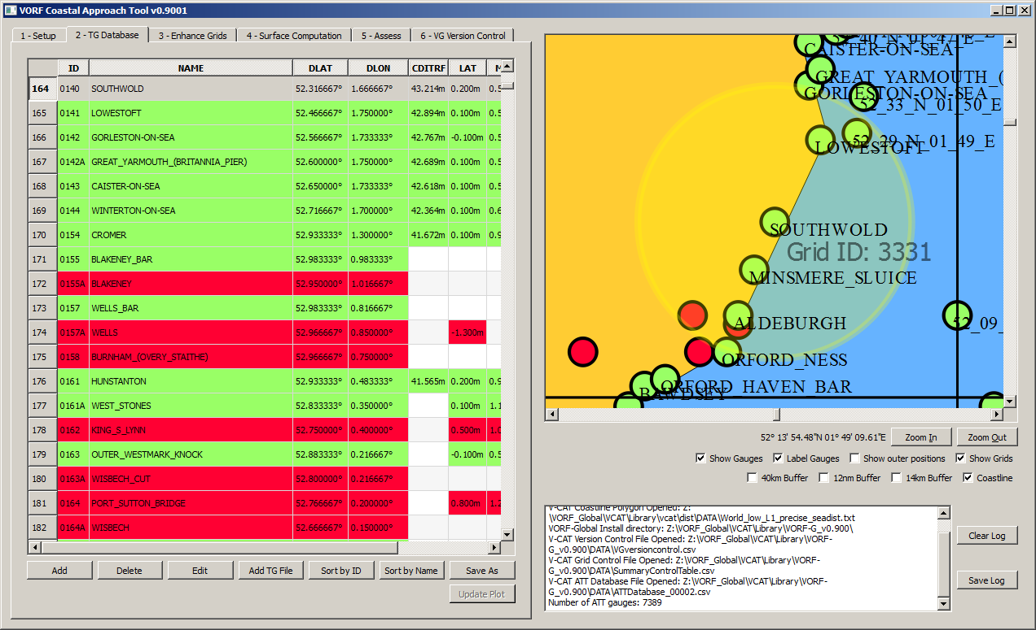
VORF Coastal Approach Tool
Edit database of tide gauge data.
Add acquired data, assess regions impacted.
Compute enhanced surfaces.

Slide 15
VORF Coastal Approach Tool
Tide gauge
Geo-located TG

Slide 16
Conclusions
Vertical datums are a key element of a marine SDI.
Can be modelled, with different challenges in the coastal and offshore zones.
Errors can be quantified spatially.
VORF profited from data richness, but improved altimetry in coastal areas will impact global application.

Slide 17
Some references
Iliffe, J. C., Ziebart, M. K. and Turner, J. F. (2007) 'A New Methodology for Incorporating Tide Gauge Data in Sea Surface Topography Models', Marine Geodesy, 30:4, 271 – 296
Iliffe, J. C., M.K. Ziebart, J.F. Turner, A.J. Talbot and A.P. Lessnoff. 2013. Accuracy of vertical datum surfaces in coastal and offshore zones. Survey Review, Volume 45, Number 331, pp. 254-262(9).
Turner J.F., J.C. Iliffe, M.K. Ziebart, and C. Jones. 2013. Global Ocean Tide Models: Assessment and Use within a Surface Model of Lowest Astronomical Tide. Marine Geodesy, Volume 36, Issue 2.
Turner J.F., J.C. Iliffe, M.K. Ziebart, C. Wilson and K.J. Horsburgh. 2010. Interpolation of Tidal Levels in the Coastal Zone for the Creation of a Hydrographic Datum. Journal of Atmospheric and Oceanic Technology, 27(3), pp. 605-613.

