Slide 1
Building a Maritime Spatial Data Infrastructure
March 2015
Measure once,
use many times
The Hub for UK Marine Data
Clare Postlethwaite

Slide 2
What is MEDIN?
Open partnership
Funded by 15 sponsors
Budget ~£500K
Sponsors

Slide 3
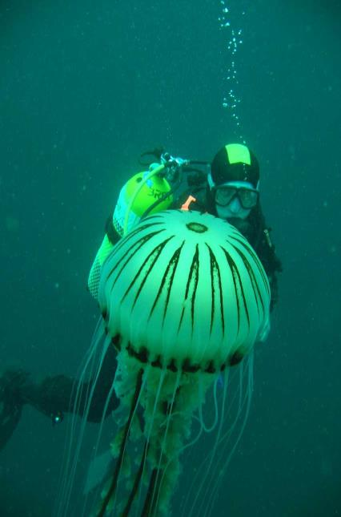
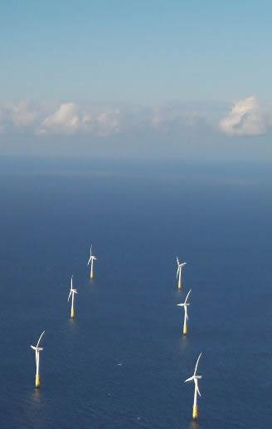
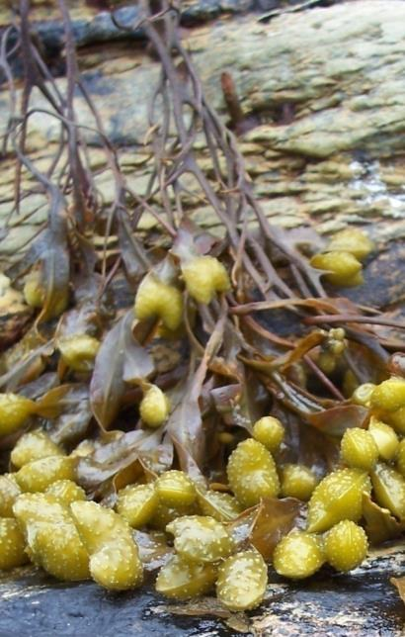
Objective:
“improve access to, and management of, UK marine data and information”
Hub for UK Marine Data
Marine Standards
Expertise
Easier data sharing

Slide 4
Hub for UK Marine Data
MEDIN Portal
Metadata
Data
7 Data Archive Centres

Slide 5
Data Archive Centres (DACs)
Objective:
Curate
Upload and Retrieve Data
Searchable
Expertise
The MEDIN DAC Network
Seabed and sub-seabed geology, geophysics
Marine meteorology (metocean)
Water column oceanography
Bathymetry
Marine flora, fauna and habitats
Marine historic environment
Marine fisheries

Slide 6
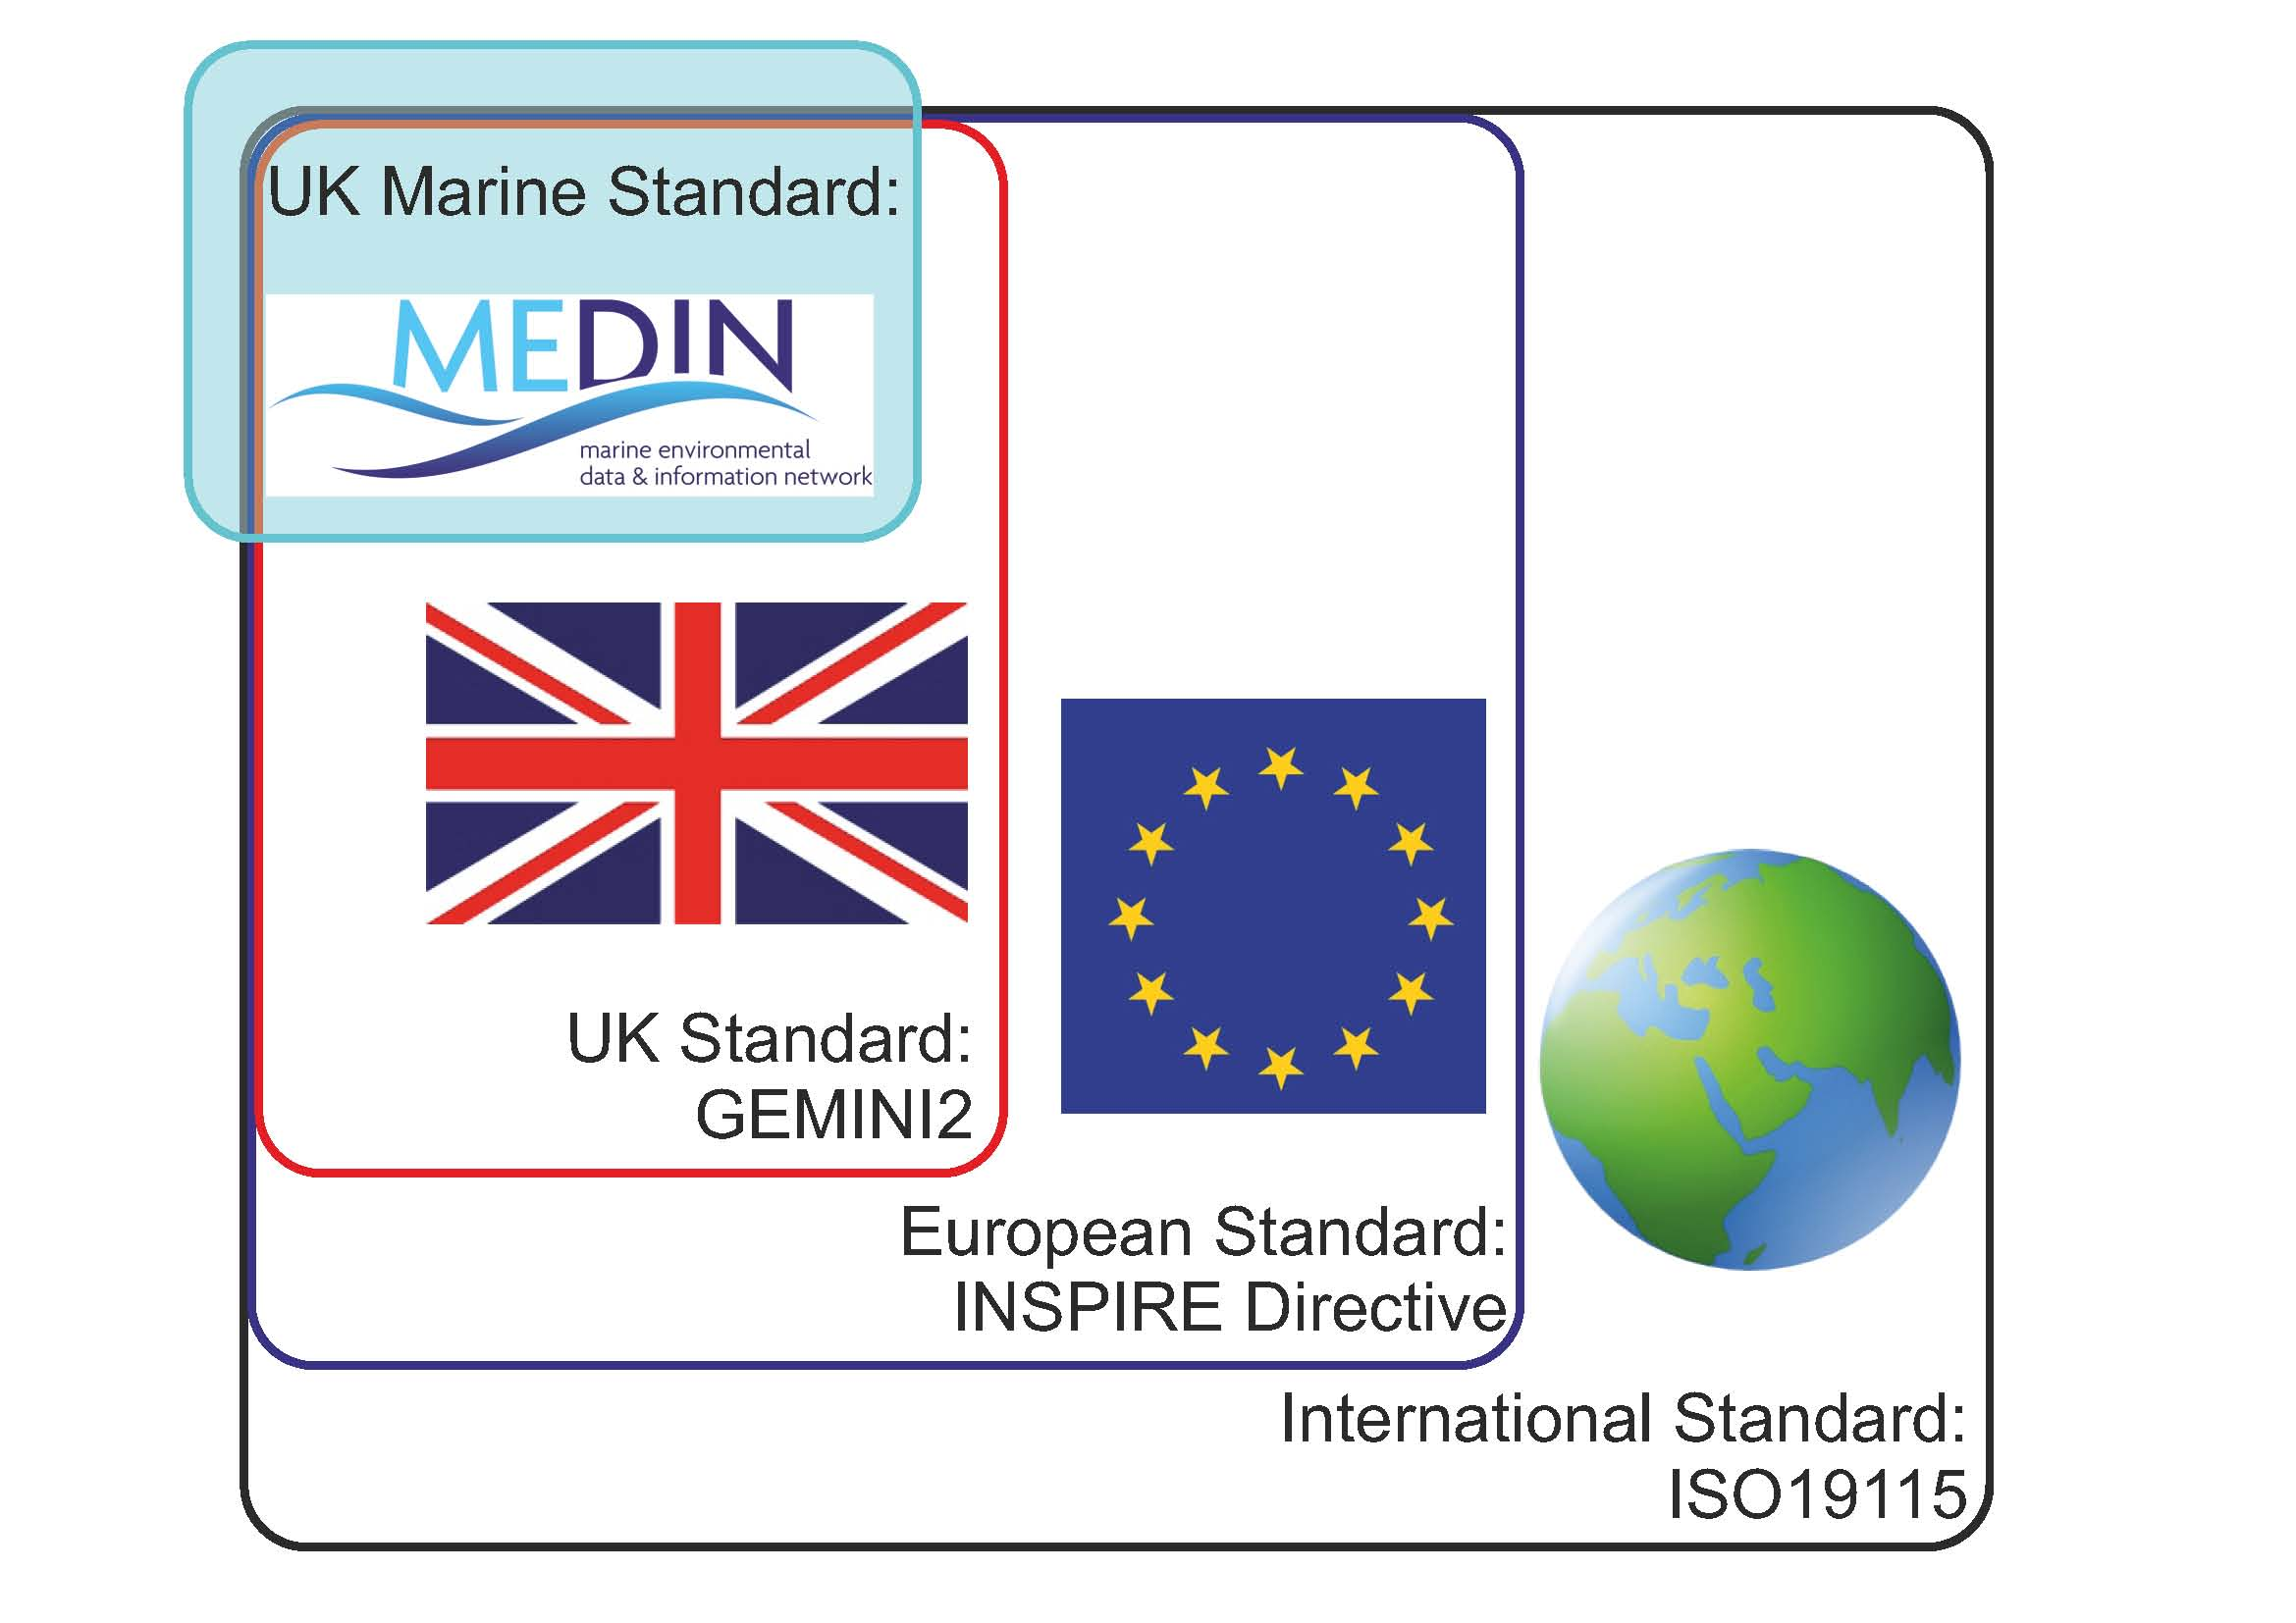
Marine Metadata Standard

Slide 7
Marine Metadata Standard
Metadata Maestro
Online Tool
Stand alone Tool
What fields?
Puts metadata into computer readable format (xml)
Validate Metadata

Slide 8
Is it working? Good coverage?
>9,200 datasets

Slide 9
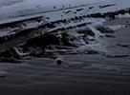
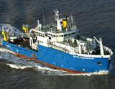
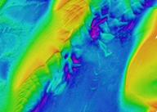
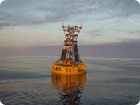
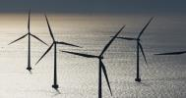
Is it working? Data in?
Dynamic – All DACs archiving new data each year.
Use
Data used?
> 50% increase in requests for data from 2013 – 2014.

Slide 10
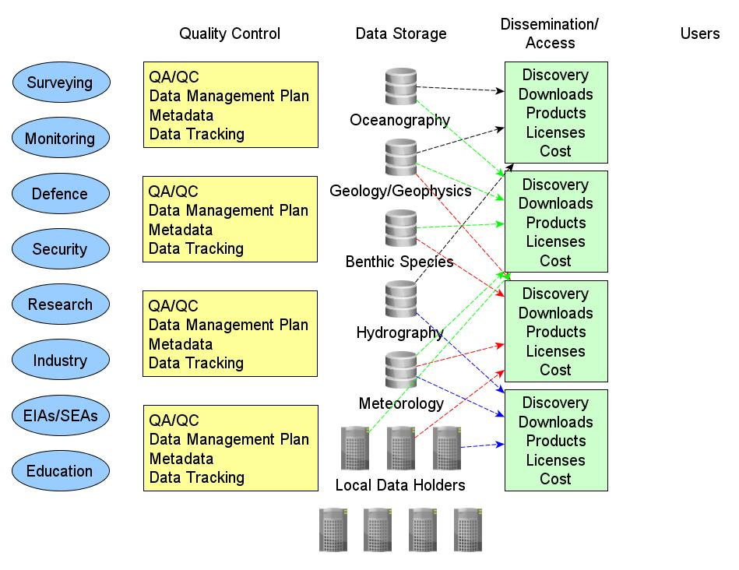
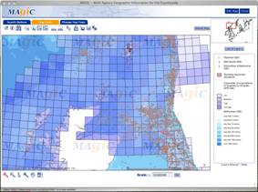
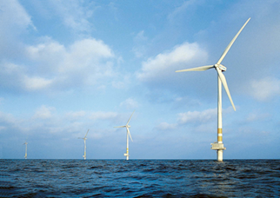
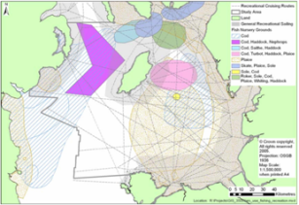
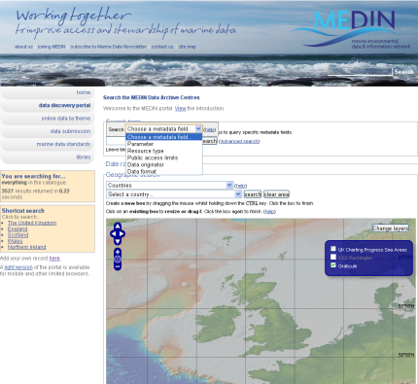
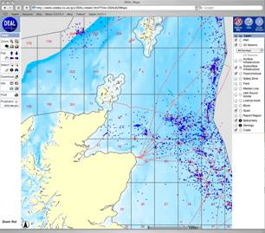
Life before MEDIN
OCEANOGRAPHY
?
?
?
> 100 holders of marine data and information in the UK

Slide 11
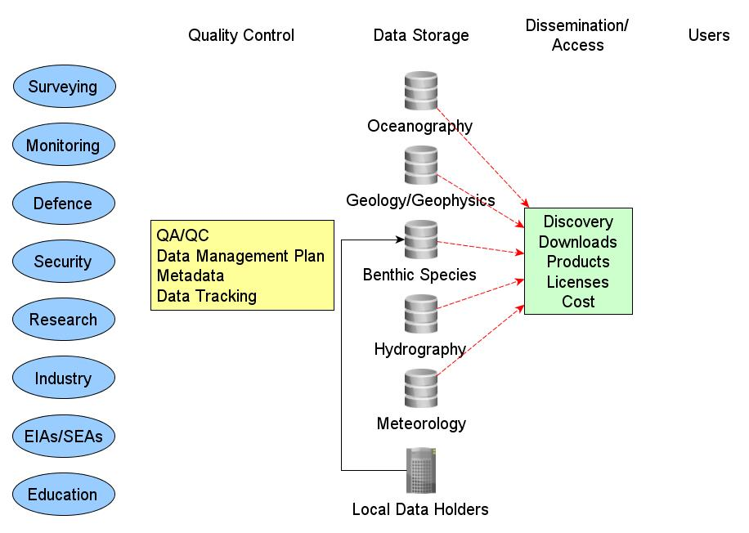
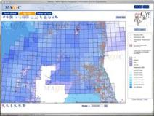
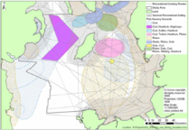
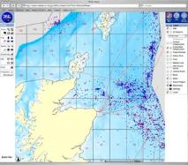
Life after MEDIN
OCEANOGRAPHY
MEDINData Archive Centres
?
?
?

Slide 12
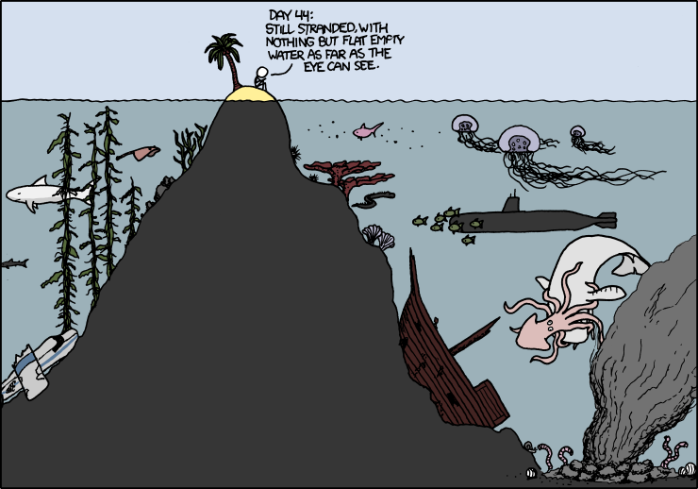
There’s data out there, but we can’t always see it
http://xkcd.com/

Slide 13
DAY 45
ESCAPE AT LAST
http://xkcd.com/ + Clare P

