Slide 1
Delivering Marine Information Infrastructure (SDI) to Ports
Dr Mike Osborne OceanWise Ltd

Slide 2
Contents
What is a Maritime Information Infrastructure
Importance of Data Management
Role of GIS
Focus on Workflow
Some Use Cases
Notes:
Last year I explained the term interoperability and how it can be achieved, reinforced the importance of data management and introduced the concept of a MII.
This year I will look at MII in detail, how it can implemented and provide examples of where it is delivering tangible benefits.
The presentation acts an introduction to some of the talks later in the day.
Oh – and bang on about the importance of data management but what else did you expect!

Slide 3
Open Standards & Common Data Management Systems
Shared Technologies & Services
SDI Domains:
Usually thought to operate at global regional and national levels
No reason why SDI principles cannot operate at organisational or enterprise level with many benefits
SDI participants build SDI from ground up
Global
Regional
National
Enterprise

Slide 4
Maritime Information Infrastructure
Shared Technologies & Services
Definition:
A framework to connect disparate systems, data and data types, and make these readily accessible
Data can be linked using location as the common factor
Built around SDI components i.e. People, Standards, ICT and Data
Requires open standards & systems
Implements core data management principles
Instills ‘lean’ processes & workflows
Open Systems / Programmable Interfaces
ADO Interfaces / Web & Proxy Services
Open Standards & Common Data Management System
Notes:
ADO – ActiveX Data Objects

Slide 5
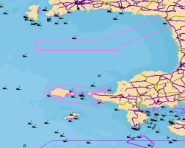
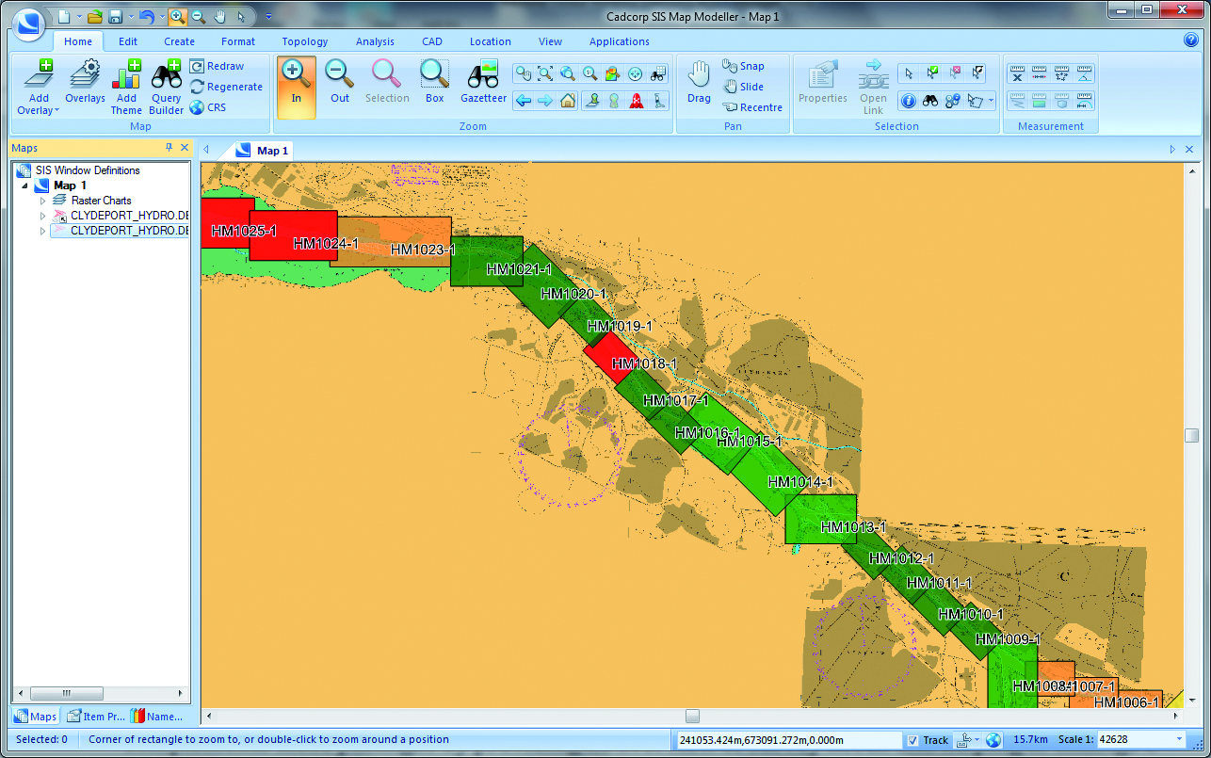
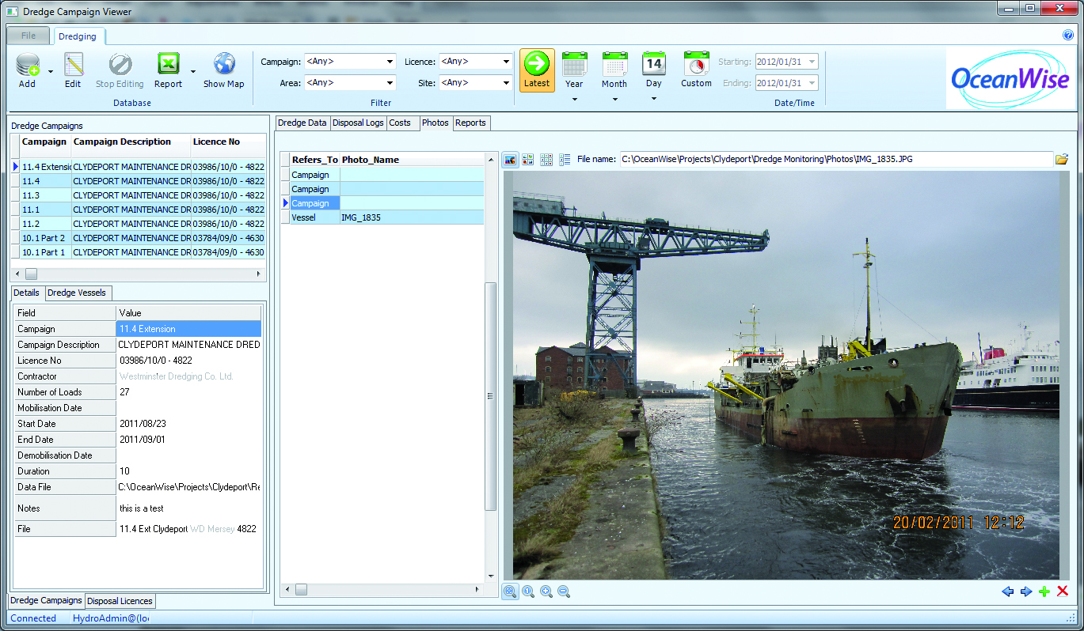
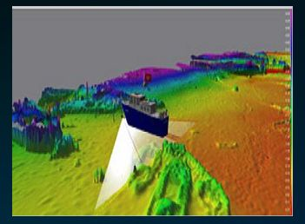
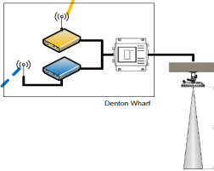
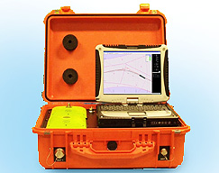
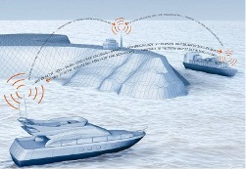
Maritime Information Infrastructure
Base Mapping
Shared Technologies & Services
Situation Awareness
Operational Data
Productivity Tools
Hydrographic Survey
Compliance & Reporting
Open Systems / Programmable Interfaces
ADO Interfaces / Web & Proxy Services
Tidal & Env. Monitoring
Portable Pilot Unit
Vessel Tracking
Open Standards & Common Data Management System
VTS Display
Notes:
ADO – ActiveX Data Objects

Slide 6
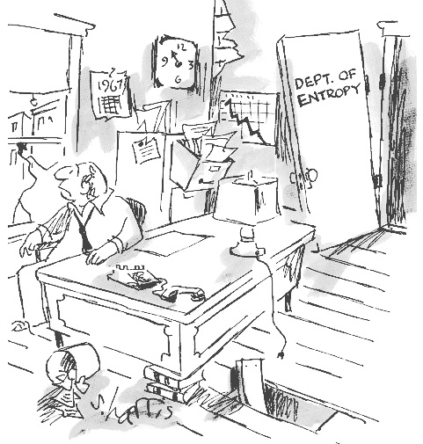
Importance of Data Management
Ensures the effective running of business functions and processes by providing ready access to fit for purpose data and information
Implements principles and processes that identify, controls and maintains the supply of data and information in accordance with current industry best practice
And is a prerequisite for all SDIs
Requires constant vigilance and effort:
Source: sciphilos.info

Slide 7
The Role of GIS
GIS is an essential enabler within the information infrastructure
Has to be ‘open’ and part of a wider data strategy and management system to be effective
Provides a platform on which to build functionality
Should be integral to everyday workflows and processes
GIS is not a monster – make it work for you!
GIS
Notes:
Avoid the cartoon – GIS works for you, not the other way round, although this is often how it is perceived.

Slide 8
Focus on Workflow
Base Mapping
Shared Technologies & Services
Situation Awareness
Operational Data
Productivity Tools
Hydrographic Survey
Compliance & Reporting
Open Systems / Programmable Interfaces
ADO Interfaces / Web & Proxy Services
Tidal & Env. Monitoring
Portable Pilot Unit
Vessel Tracking
Open Standards & Common Data Management System
VTS Display
Notes:
ADO – ActiveX Data Objects

Slide 9
Example 1 – Digital Base Map
Base Mapping
Situation Awareness
Productivity Tools
Ocean Database
Load and maintain digital land mapping in spatial database
Add and maintain local geographic features (commonly found in CAD)
Use digital base map as common factor to link other datasets e.g. asset maintenance records
Essential input to multiple applications
Compliance & Reporting
Portable Pilot Unit
Maintenance Records
VTS Display
Notes:
ADO – ActiveX Data Objects

Slide 10
Example 2 – ENC Production
Hydrographic Survey
Situation Awareness
Productivity Tools
Ocean Database
Add ENC required attributes to base map in spatial database
Use DEM from surveys natively (e.g. in PDS 2000 format) to create depth areas/contours
Derive ENC meta features from chart areas included in base map
Create S-57 topology and export to Bathymetric / Port ENC for use on PPUs
Compliance & Reporting
Portable Pilot Unit
VTS Display
Notes:
ADO – ActiveX Data Objects

Slide 11
Example 3 – Dredging
Operational Data
Situation Awareness
Tidal & Env. Monitoring
Productivity Tools
Ocean Database
Use seabed DEM and channel areas in base map to plan dredging needs
Confirm licensing requirements and plan seabed monitoring if needed
Exchange survey specifications with contractors and import results
Acquire dredging records and load to database & report to regulator as required
Compliance & Reporting
Portable Pilot Unit
VTS Display

Slide 12
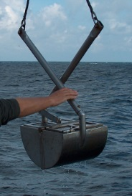
Example 4 – Environmental Monitoring
+
Tidal and Environmental Monitoring & Sampling
Situation Awareness
Productivity Tools
Ocean Database
Tide, weather and current data acquired and displayed in real-time
Upload environmental samples, tidal predictions and modelled data
Available for situation awareness, maritime operations and reporting
Historic record for analysis, predictions and input to engineering & environmental studies
Compliance & Reporting
Portable Pilot Unit
VTS Display
Notes:
Environmental samples include benthic analysis – Unicorn data model – Thomson Ecology

Slide 13
More Port Applications
Activity | Task | Outputs
Planning and Communication | Appraisal and Consultation | Situation awareness (maps) Access to reference data and associated policy, compliance and operational information Information, marketing and public relations material
 | Licensing | Works licence (owns seabed / responsible for navigation) Estates licence (owns sea bed only) Navigation licence (responsible for navigation only) Vessel licensing Boatman / Boatmaster licensing Other licensing (e.g. metal detecting / digging)
 | Regulation | License application (external to MMO etc) Environmental impact assessment (EIA) Environmental reporting
Maritime Operations | Weather and Tides | Predicted tidal heights and currents e.g. to pilots Observed water levels and currents Times for vessel entry and exit Access to berths / docks
 | Logistics | Operational planning and optimisation e.g. berthing
 | Simulations and Scenarios | Input to simulator Communication and analysis of results
Notes:
Numerous port applications benefit from information facilitated by MII

Slide 14
More Port Applications (2)
Activity | Task | Outputs
Asset Management | Facilities | Situational awareness (maps) Planning and planning applications Buildings and infrastructure maintenance
 | Estate Management | Planning and maintenance Lettings
 | Navigational Aids | Location and maintenance Notices to Mariners Data exchange with UKHO
 | Berthing | Assigning visiting vessels to berths Tracking berth holders
 | Moorings | Tracking, assigning and maintaining boat moorings
Engineering | Dredging | Dredging plans and maintenance schedule Capital dredging Spoil disposal Licence applications
 | Facilities | Planning, design and communication of new wharves etc Maintenance of bridges

Slide 15
More Port Applications (3)
Activity | Task | Outputs
Environment Protection | Monitoring and Sampling | Instrument location and maintenance Data-basing and publishing data Submission of data to regulator / local authority
 | Modelling | Preparing input to environmental models Analysis and display of model output (e.g. to pilots)
 | Conservation | Designated and sensitive area mapping Licensing assessment incl. cumulative impacts
Safety | Navigation | Wrecks and obstructions maintenance Exchange of data with UKHO and local archeological dept AtoN positioning and alignment
 | Emergency Response | Situation awareness (maps) Location and availability of equipment Sensitive areas and disposal sites Contingency planning (e.g. oil spill)
Security | ISPS Code | Ship and port facility security plans Location and maintenance of equipment Monitoring activities and controlling access Communications planning and monitoring
 | Boundary | CCTV optimisation / monitoring Vessel and vehicle monitoring
 | Protection | Secure locations, access points and routes

Slide 16
Maritime Information Infrastructure Summary
OW is delivering enterprise SDIs (hence efficiencies) to Peel Ports, ABP and PLA
SDI benefits are realised at the enterprise level but includes external stakeholders
Connects disparate datasets and systems (contractors, regulators and potentially HOs)
Supports multiple maritime applications and allows ports to participate in e-navigation

