Slide 1
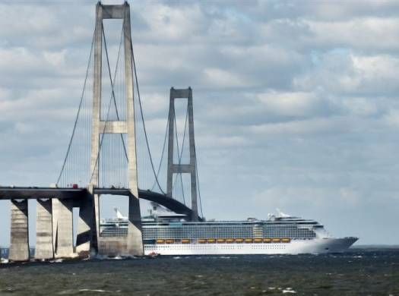
MSDI OPEN FORUM
MSDI in the Baltic
London, Tuesday 3rd March 2015
Jens Peter Hartmann
Chair BSMSDIWG
Denmark

Slide 2
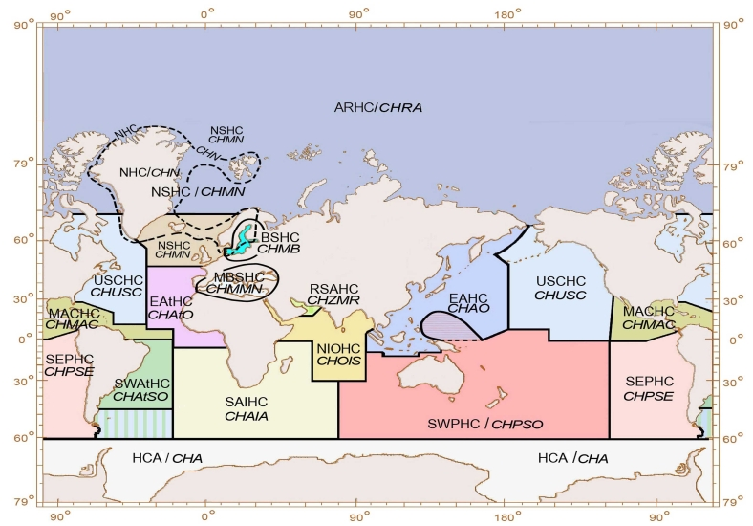
MSDI from a regional approach
Baltic Sea MSDI WORKING GROUP (BSMSDIWG)
Regional Hydrographic Commissions

Slide 3
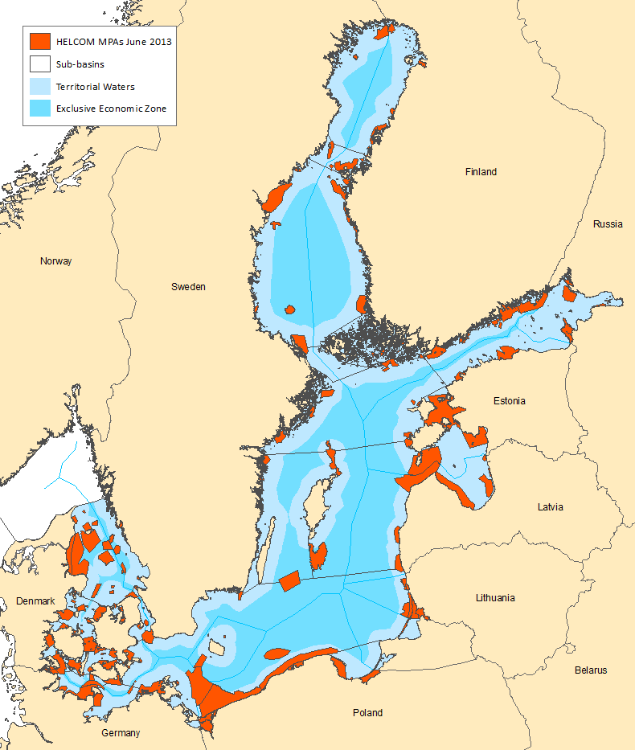
The Baltic Sea MSDI Working Group should:
Identify and analyse the current status of individual MS MSDI implementation
Consider MSDI policies within the related international project
Analyse how maritime authorities can contribute their spatial information and the necessary updates, so information can easily be collated with other information to a current overall picture for the region.
Focus on how BSHC in the future can benefit from a regional approach
Monitoring MSDI and marine- related initiatives, as well as more general geospatial developments with relevance for the Baltic Sea.

Slide 4
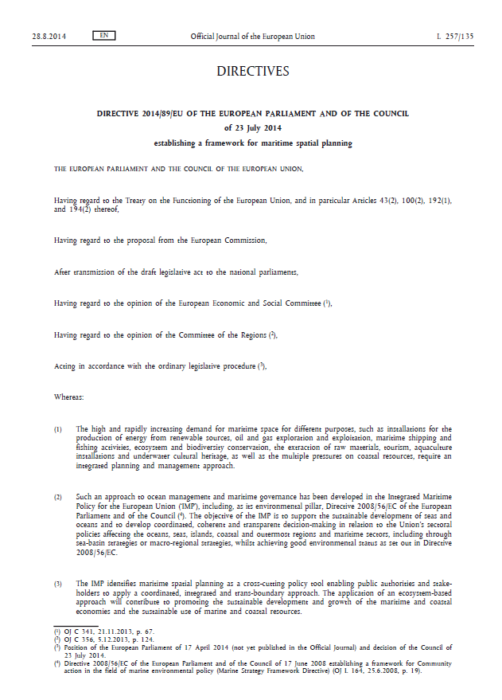
Maritime spatial planning
Article 6
Minimum requirements for maritime spatial planning
Member States shall establish procedural steps to contribute to the objectives listed in Article 5, taking into account relevant activities and uses in marine waters:
(e) Organise the use of the best available data in accordance with Article 10.
(f) Ensure trans-boundary cooperation between Member States in accordance with Article 12.
(g) Promote cooperation with third countries in accordance with Article 13.

Slide 5
Article 8 (new)
Set-up of maritime spatial plans
1. When establishing and implementing maritime spatial planning, Member States shall set up maritime spatial plans which identify the spatial and temporal distribution of relevant existing and future activities, uses in the marine waters in order to contribute to the objectives set out in Article 5.
2. In doing so and in accordance with Article 2(3), Member States shall take into consideration relevant interactions of activities and uses. Without prejudice to Member States' competences, possible activities and uses and interests may include:
aquaculture areas;
fishing areas;
installations and infrastructures for the exploration, exploitation and extraction of oil, gas, mineral and aggregates, and other energy resources and the production of renewable energy;
maritime transport routes and traffic flows;
military training areas;
nature and species conservation sites and protected areas;
raw material extraction areas;
scientific research;
submarine cable and pipeline routes;
tourism;
underwater cultural heritage.
What are the data-sets needed for maritime spatial plans?
- Planning - Overview/Charting

Slide 6
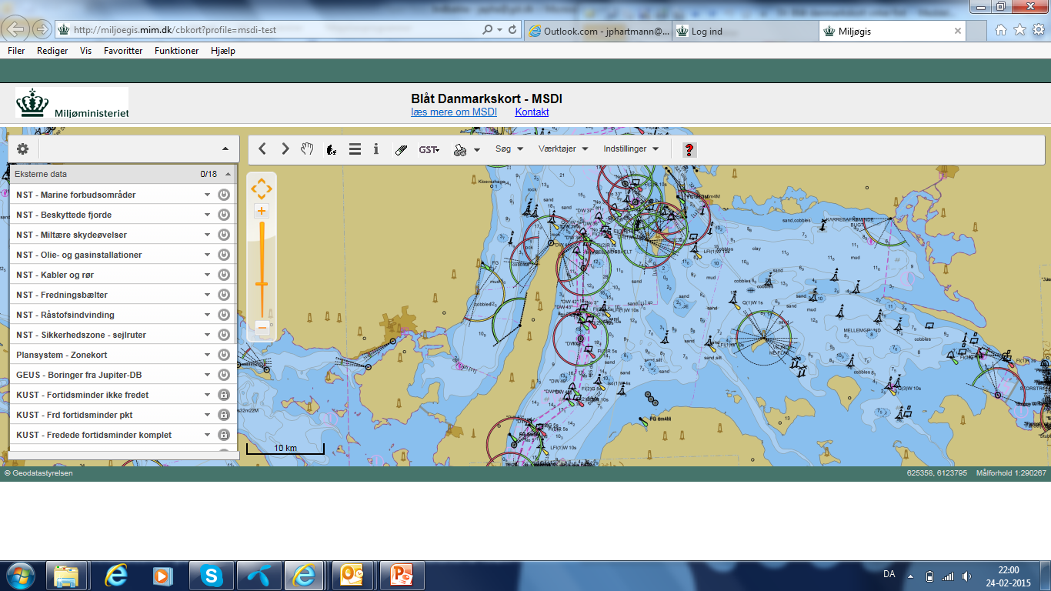
MSDI and MSP – seen from a Danish perspective

Slide 7
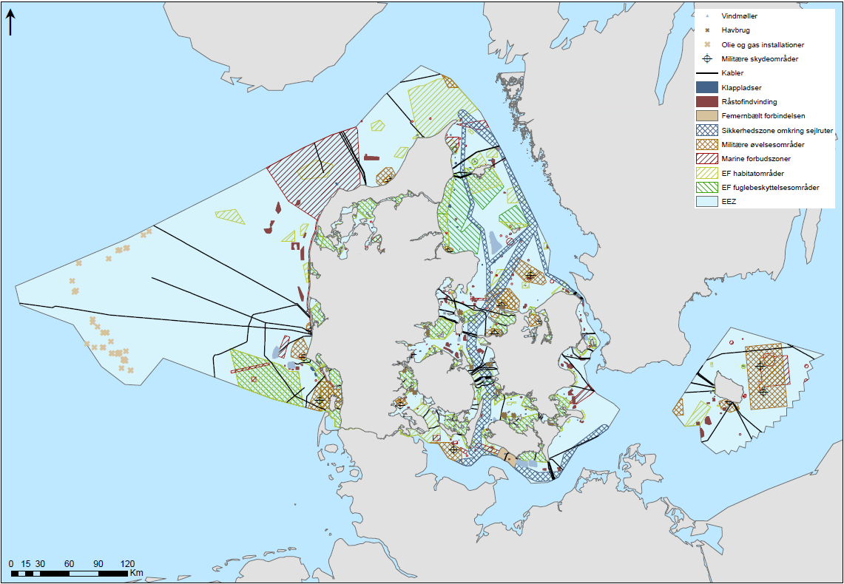
MSDI – seen from a Danish perspective
Planning across borders
MSP data set used for:
Overview/Charting
Planning

Slide 8
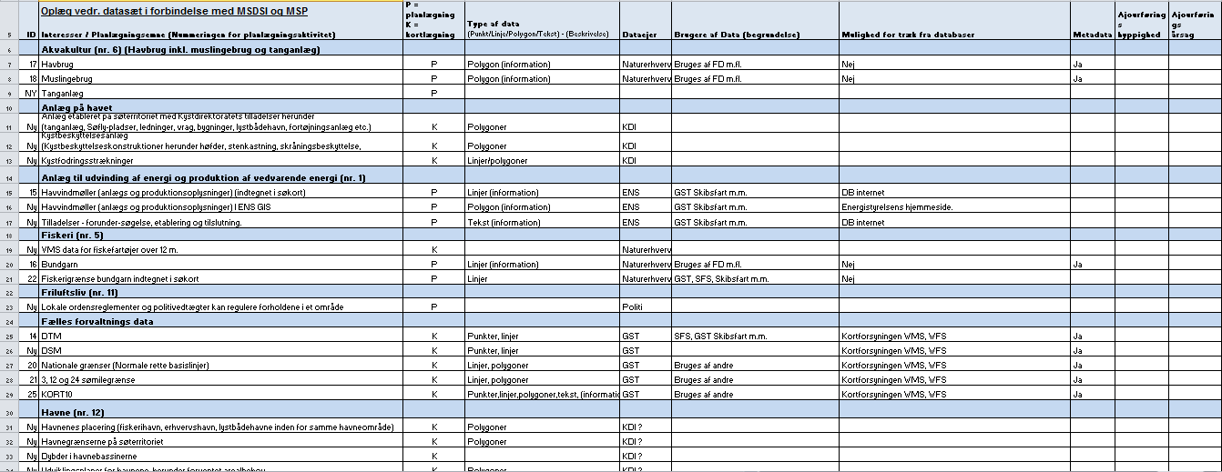
Presentations of data sets associated with MSDI and MSP
Gives an overview of dataset needed for MSP
Almost 100 datasets identified

Slide 9
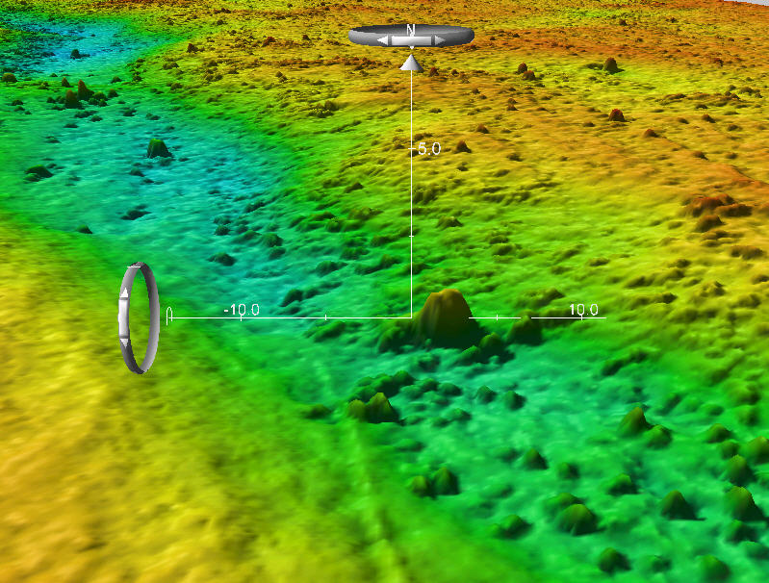
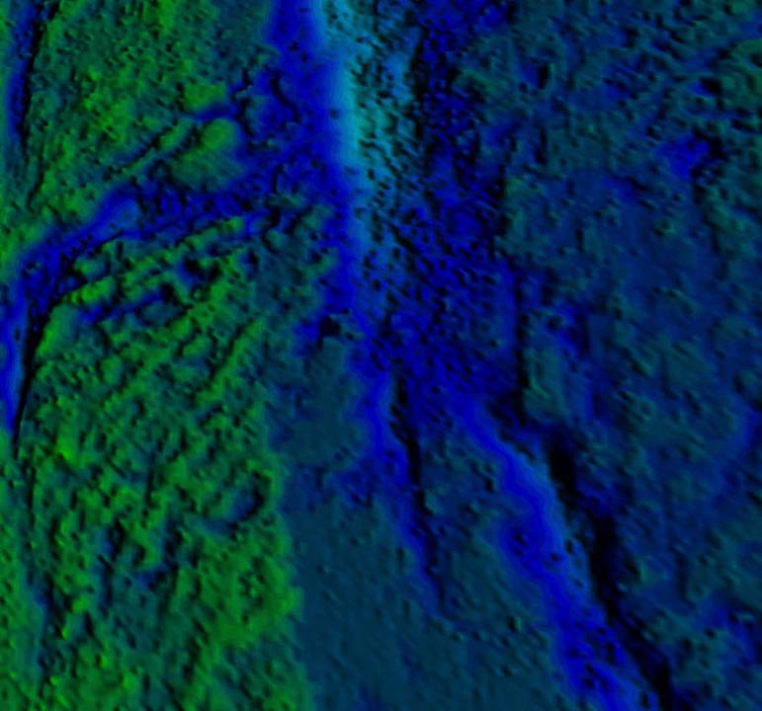
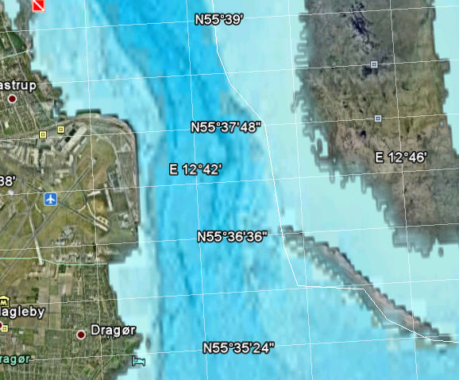
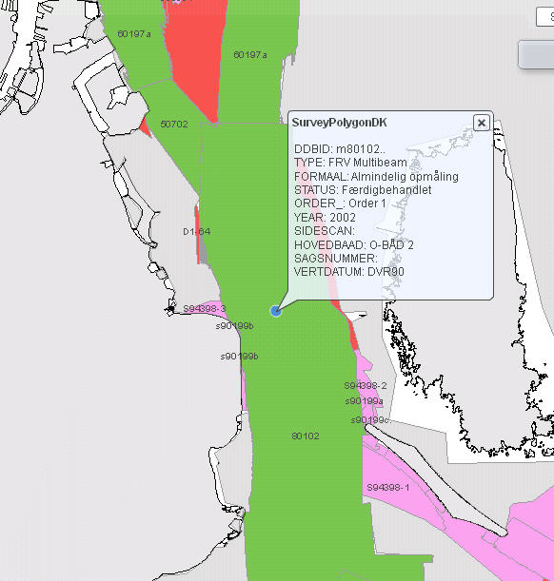
Surveying
Papercharts
25 cm model
5 m. model
50 m model
Challenges:
- Storages (Raw data)
- Quality (Metadata)
- Harmonisation
Metadata

Slide 10
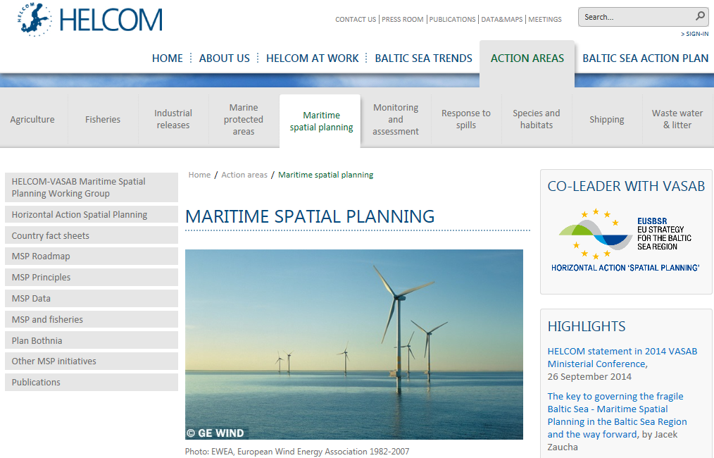
MSDI and MSP – seen from a Regional perspective

Slide 11
The BSMSDI new Work plan 2015 - 2020:
Theme | Subject | Responsible
Task 1. Work item: Hydrographic data and legal aspects | - Definition of HO role in MSDI - Study on status on implementation and responsibility with relevance to MSDI in the Baltic countries | Denmark
Task 2. Work item: Liaison with external projects | - Scanning of projects relevant for BSMSDI | Germany
Task 3. Work item: S 100 | - Conduct S 100 pilot project - Evaluate on how to promote S 100 in the Baltic | Germany
Task 4. Work item INSPIRE | - Study on IHO standard S 57 in relation to INSPIRE - The difference between S 57 and S 100 | Netherland/ France
Task 5. Work item: Common understanding | - Establish a framework for common understanding of MSDI | Denmark/ Finland
Task 6. Work item: Pilot projects/demonstration | -Study on the possibility to establish a BSMSDI WEB page - Demonstration project S100 - WEB GIS demonstrator with BS HO datasets | Denmark Germany Denmark

Slide 12
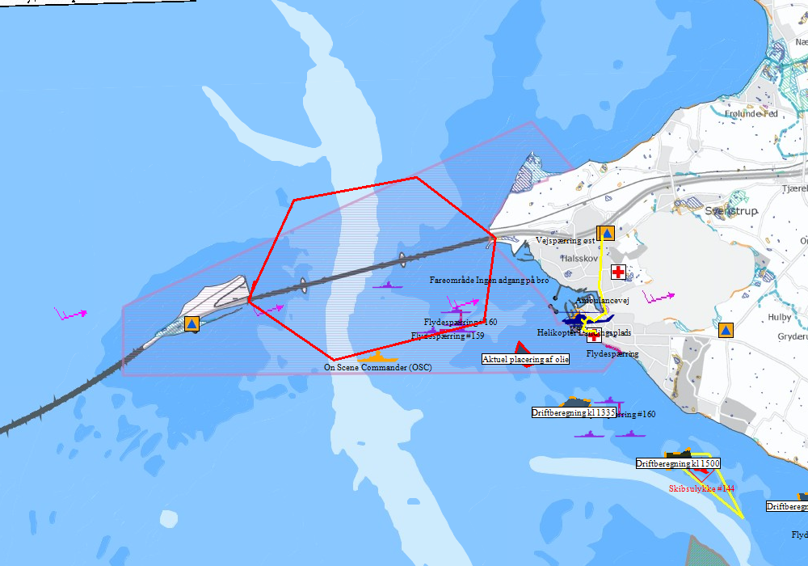
MSDI - Creating a Common Operational Picture MSP - SAR - ICM – Environmental protection - Surveillances - VTS - MAS
Environ-mental protection vessels
Fire station
Orthophoto
Hospital
Nautical maps
Bird Protection Area
Oil spill
Emergency road
Weather data
Focus areas
Environ- mental data
Maps

Slide 13
Developing your marine spatial data infrastructure
Creating a MSDI for a Common Operational Picture:
Definition of different use cases
Knowledge about data and data providers/owners
The right Information => dataset
Knowledge about dataset => metadata
Access to data when needed
Quality of data
Specific datasets should be updated, by the data owner
Governances

Slide 14
MSDI – seen from a regional perspective
Consideration – the need for:
Planning across borders:
Planning across sectorial interests
Planning across sea/land (coastal zone)
Focus on establishing a Common Operational Picture : (E.g. MSP, Nature and environment, SAR)
Accessibility for citizens, firms and organizations
Supporting digitisation among maritime authorities
The challenges:
Governance:
Agree on the data-sets that should be exchanged, quality and standards
Agree on the technical aspects, enabling the exchange of data-sets
The organisation of regional MSDI, e.g. rules, and agreements
Ensure coordination between, different regions and initiatives
Economy and finical model
Establishing Metadata

Slide 15
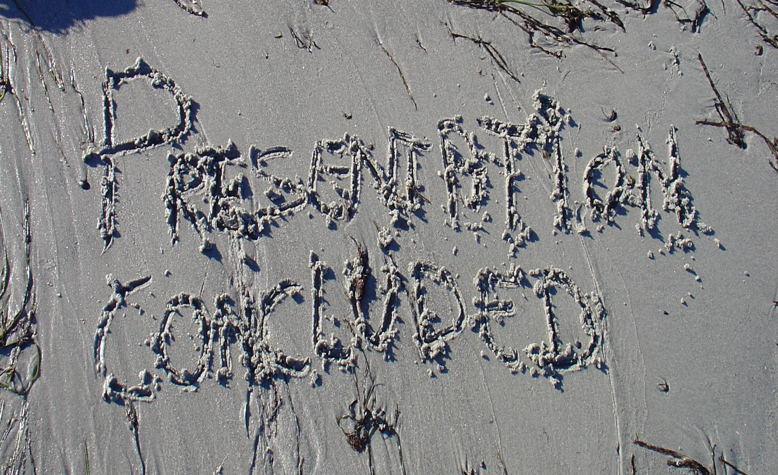
Questions

