Slide 1
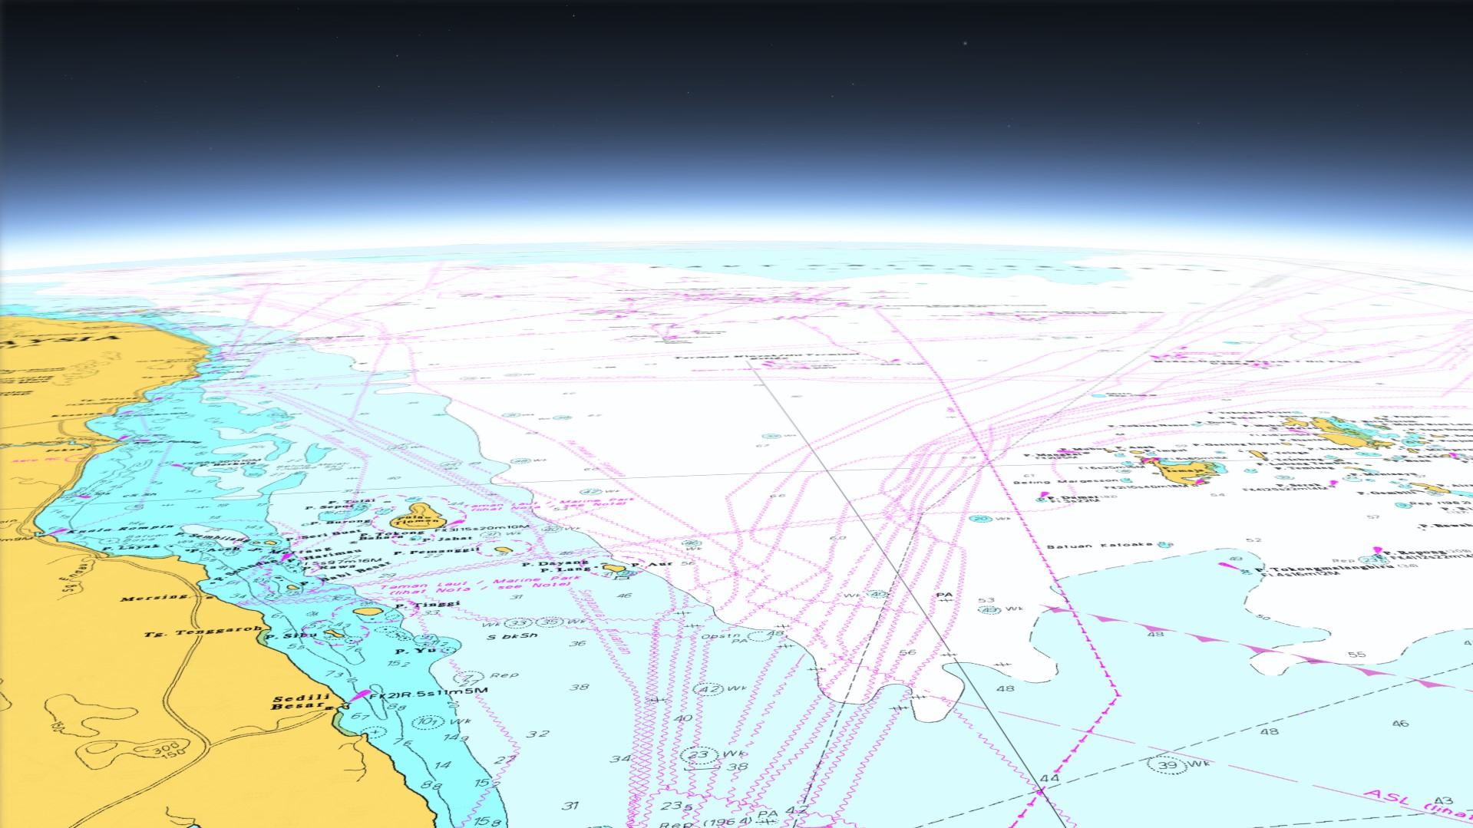
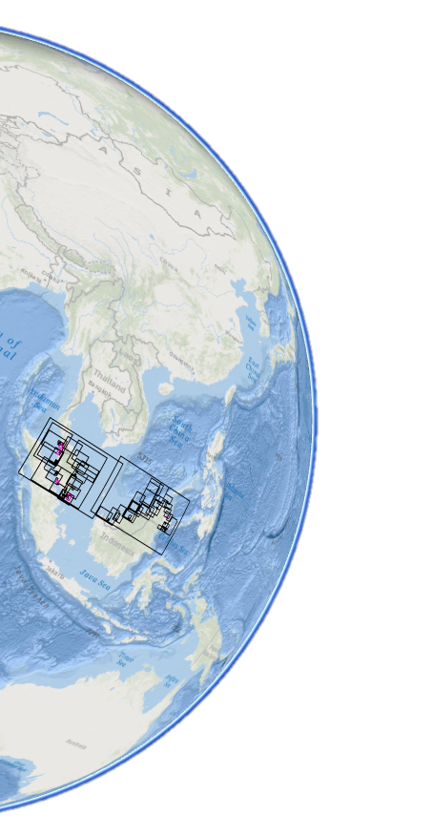






8th MSDI Working Group
National Report (MALAYSIA)
31 Jan 2017
Vancouver, Canada
Notes:
BISMILLAHIRRAHMANIRRAHIM.
ASSALAMU’ALAIKUM WARAHMATULLAHI WABARAKATUH and A very good afternoon LADIES AND GENTLEMEN,
I am Cdr Kamaruddin Yusoff RMN, Head of Section Meteorology and Oceanography , National Hydrographic Centre, Malaysia. First of foremost, I would like to thanks ………… for giving me opportunity to share with all of you regarding the planning and progress, of our initiative to develop Marine Spatial Data Infrasturcture in Malaysia, , in order to support our national programs, which is MyGDI. The topic of my presentation today is ‘Marine SDI supporting MyGDI.
Geospatial data and GIS technology are increasingly fitting and rightfully used as widespread tools because of the capability to improve development and planning of a nation.

Slide 2

Malaysia Geospatial Data Infrastructure (MyGDI)
MyGDI as a National Spatial Data Infrastructure (NSDI)
Malaysian Center for Geospatial Data Infrastructure(MaCGDI) is a center under Ministry of Natural Resources and Environment (NRE)
MaCGDI was formed in 2002 to promote the development and implementation of MyGDI
MaCGDI plays crucial roles to spearhead the geospatial industry in Malaysia.
Notes:
Malaysia Geospatial Data Infrastructure (MyGDI) is an initiative by the government of MALAYSIA to develop a geospatial data infrastructure to enhance the awareness about data availability and improve access to geospatial information. This can be fulfilled by facilitating data sharing among participating agencies. MyGDI, as the National Spatial Data Infrastructure (NSDI) for Malaysia, is a geospatial data infrastructure that comprises of policies, standards, technology research and development and skilled human resources.
MaCGDI was established under the Ministry of Natural Resources and Environment (NRE) in Dec 2002 to replace the Secretariat for National Infrastructure for Land Information System (NaLIS). It is responsible for the development of the Malaysia Geospatial Data Infrastructure (MyGDI). MaCGDI is also responsible for coordinating access and delivery of the geospatial information held by all government agencies. The main role of the MaCGDI, is to continuously make available and accessible current and accurate geospatial data that promotes, a sustainable living environment, economic growth and social progress for public.
Through this infrastructure, smart partnership among agencies is continuously being developed to produce and share geospatial information. Thus, providing customer-focused, cost effective and timely delivery of geospatial data for the purpose of facilitating the sharing and dissemination of geospatial information among all levels of government, the private and non-profit sectors, and the academic community.
“ Malaysia Geospatial Data Infrastructure (MyGDI) enables people to discover, share and use geospatial information and services. ”
.

Slide 3
Key MSDI Components
Policy & Governance
(People)
Technical Standards
(Standards)
Information Systems
(ICT)
Geographic Content
(Data)
Notes:
What constitutes an MSDI? Or key components of MSDI.
Policy and Governance
A policy must be define clearly, in order the information that is interoperable. As I mentioned before, policy and governance under MaCGDI.
People & Organisations
Functional MSDI requires willingness and practical co-operation between the various organisations that create, share and use information to implement the overall policy. There should also be a clearly defined governance structure and transparency in decision-making and reporting to foster a shared sense of working towards a common goal.
Standards: International Standards for geographic information exist or are being developed and, in many areas, sector-based standards are being put in place that depend on these over-arching standards. For example; IHO S-57; and also S-100 relies in turn on the ISO 19100 series of geographic standards. The standards work of the Open Geospatial Consortium (OGC) especially in the areas of data content modelling, data transport, and web services are critical to developing a robust SDI approach;
Technology: The provision of technical infrastructure will enable the delivery of data and services to allow the viewing, transformation and downloading of information. As the technical infrastructure matures, development can include the ability to work within various geodetic systems and transform data between such systems; and
Metadata: At its simplest, metadata is “data about data” and describes the characteristics of a dataset (i.e. content, value and limitations) and is normally held in a metadata management system or clearinghouse to provide mechanisms of search and retrieval. It is a vital component in “discovering” data and information and understanding how the data can be used.

Slide 4
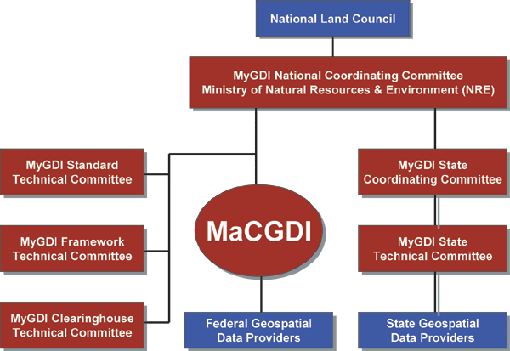
MyGDI GOVERNANCE
New
MyGDI Marine
Technical Committee
Policy & Governance
(People)
Notes:
I would like to stress that the MyGDI governance/components is the real driving for for the success of MyGDI Programme.
MyGDI Governance
In order to manage the development and operation of MyGDI, a MyGDI National Coordinating Committee (MNCC) was formed with the role of a central policy and decision making body on matters pertaining to the implementation, development and operations of the MyGDI programmes and initiatives. Besides the coordinating committees, there are three Technical Committees - Framework Technical Committee, Standard Technical Committee and Clearinghouse Technical Committee. The MaCGDI activities are mainly driven by these three technical committee. Complementing to these committees is the MyGDI State Coordinating Committees (MSCC) and the MyGDI State Technical Committee (MSTC).
MNCC is responsible to the Government of Malaysia in:
Specifying the principles and guidelines for the development and implementation of MyGDI;
Establishing working committees as periodically required;
Coordinating and monitoring the development and implementation of MyGDI through committees that are established under MNCC;
Ensuring the requirements for financial, manpower and technological resources for MyGDI activities are prepared.
MyGDI Framework Technical Committee (MFTC)
MFTC responsible to the MyGDI National Coordinating Committee (MNCC) in:
Formulating policies and guidelines to ensure effective sharing of geospatial data through MyGDI;
Coordinating the development and utilization of data framework in MyGDI;
Monitoring the implementation of policies and guidelines; and
Creating the awareness and commitment among the agencies in the development of data framework.
Functions:
To assist in the establishment and development of MyGDI Data Framework;
To provide policies and guidelines to ensure the effectiveness of MyGDI Data Framework;
To coordinate the activities of the framework members; and
To coordinate training and human resource development.
MSTC responsible to the MyGDI National Coordinating Committee (MNCC) in:
Developing standards for geographic information/geomatics in MyGDI;
Coordinating and monitoring the usage of standards for geographic information/geomatics in MyGDI for the purpose of data sharing; and
Collaborating with SIRIM Technical Committee for Geographic information/Geomatics Standards and other standards technical committees in the development and updating of the Malaysian Standards.
Objective:
The main objective of this committee is to develop standards for sharing geospatial data, including metadata;
Functions:
to design MyGDI Metadata Standard based on ISO/TC211
to design standards for geospatial data exchange based on MS1759 and ISO/TC211
to coordinate the use of MyGDI data exchange and metadata standard
MyGDI Clearinghouse Technical Committee Responsible to the MNCC in:
Formulating policies and guidelines related to the operation of MyGDI Clearinghouse;
Specifiying the resource requirements for the development and operation of MYGDI Clearinghouse;
Ensuring current and complete publication of metadata and geospatial data; and
Coordinating and monitoring the activities related to the operation and usage of MyGDI Clearinghouse.
Functions:
To develop MyGDI Clearinghouse;
To specify the method of data production;
To outline the procedure of data production; and
To encourage data providers to use MyGDI Clearinghouse
Marine Geospatial (Marine SDI) Coordinating Committee

Slide 5

MyGDI National Coordinating Committee (MNCC)
MyGDI Framework Technical Committees
MyGDI Clearinghouse Technical Committee
MyGDI Standard Technical Committee
MyGDI Marine Technical Committee
National Hydrographic Committee
Port Management and Information Working Committee
Hydrographic Surveyors Competency Working Committee
Underwater Object Information Working Committee
Presentation Outline
Policy & Governance
(People)
MyGDI
GOVERNANCE
Notes:
MyGDI National Coordinating Committee (MNCC) Meeting
MyGDI National Coordinating Committee (MNCC) is responsible to the Government of Malaysia in:
Specifying the principles and guidelines for the development and implementation of MyGDI;
Establishing working committees as periodically required;
Coordinating and monitoring the development and implementation of MyGDI through committees that are established under MNCC;
Ensuring the requirements for financial, manpower and technological resources for MyGDI activities are prepared
MyGDI Framework Technical Committee (MFTC) Meeting
MFTC Responsible to the MyGDI National Coordinating Committee (MNCC) in:
Formulating policies and guidelines to ensure effective sharing of geospatial data through MyGDI;
Coordinating the development and utilization of data framework in MyGDI;
Monitoring the implementation of policies and guidelines; and
Creating the awareness and commitment among the agencies in the development of data framework.
MyGDI Standards Technical Committee (MSTC) Meeting
MSTC responsible to the MyGDI National Coordinating Committee (MNCC) in:
Developing standards for geographic information/geomatics in MyGDI;
Coordinating and monitoring the usage of standards for geographic information/geomatics in MyGDI for the purpose of data sharing;
and Collaborating with SIRIM Technical Committee for Geographic information/Geomatics Standards and other standards technical committees in the development and updating of the Malaysian Standards
The National Hydrographic Committee was created to unify the hydrography community in the Malaysia under a guiding body. It serves the purpose of monitoring and coordinating activities related to hydrography in Malaysia.

Slide 6
MyGDI Marine Technical Committee
a. Lead Agency : National Hydrographic Centre
Secretariat : Malaysian Centre for Geospatial Data Infrastructure (MaCGDI)
c. Permanent Members (Data Provider/ Ownership)
  Department of Survey and Mapping Malaysia (JUPEM)
  Minerals and Geoscience Department Malaysia (JMG)
  Malaysian Meteorological Department (MMD)
  Marine Department Malaysia (JLM)
  Department of Irrigation and Drainage (DID)
  Department of Environment (DOE)
  Department of Fisheries Malaysia (DoF)
  Department of Marine Park Malaysia (DMPM)
  Department of National Heritage (DNH)
  Strategic Technology and S & T Application Division (formerly NOD), MOSTI.
  Ministry of Energy, Green Technology and Water (KeTTHA)
  National Water Services Commission (SPAN)
  Malaysian Communications and Multimedia Commission (MCMC)
  Malaysia Petroleum Management (MPM)
  Tenaga Nasional Berhad (TNB)
  Telekom Malaysia Berhad (TM)
d. Supporting Agencies
  (1) National Security Council (MKN)
  Malaysia Remote Sensing Agency (MRSA)
  Ministry of Domestic Trade, Cooperatives and Consumerism (KPDNKK)
Policy & Governance
(People)
21
Notes:
a. Lead Agency : National Hydrographic Centre
b. Secretariat : Malaysian Centre for Geospatial Data Infrastructure (MaCGDI)
c. Permanent Members (Data Provider/ Ownership)
Department of Survey and Mapping Malaysia (JUPEM)
Minerals and Geoscience Department Malaysia (JMG)
Malaysian Meteorological Department (MMD)
Marine Department Malaysia (JLM)
Department of Fisheries Malaysia (DoF)
Department of Marine Park Malaysia (DMPM)
Department of National Heritage (DNH)
Strategic Technology and S & T Application Division (formerly NOD), MOSTI.
Ministry of Energy, Green Technology and Water (KeTTHA)
National Water Services Commission (SPAN)
Malaysian Communications and Multimedia Commission (MCMC)
Malaysia Petroleum Management (MPM)
Tenaga Nasional Berhad (TNB)
Telekom Malaysia Berhad (TM)
Supporting Agencies
(1) Majlis Keselamatan Negara (MKN)
(2) Agensi Remote Sensing Negara (ARSM)
(3) Kementerian Perdagangan Dalam Negeri, Koperasi dan Kepenggunaan (KPDNKK)

Slide 7
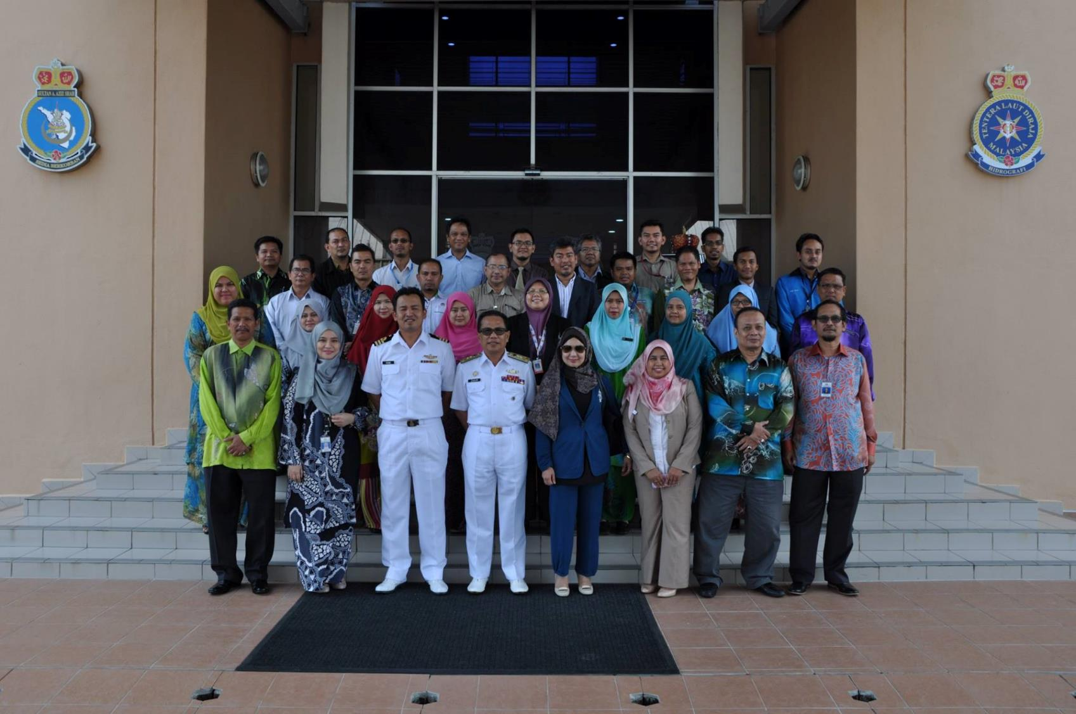
MyGDI Marine Technical Committee
6th Oct 2016
Policy & Governance
(People)

Slide 8
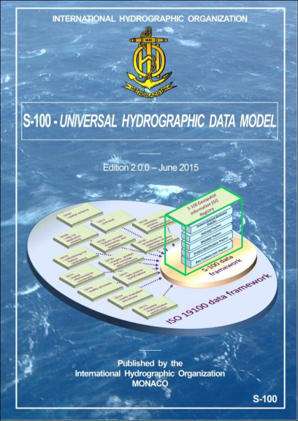
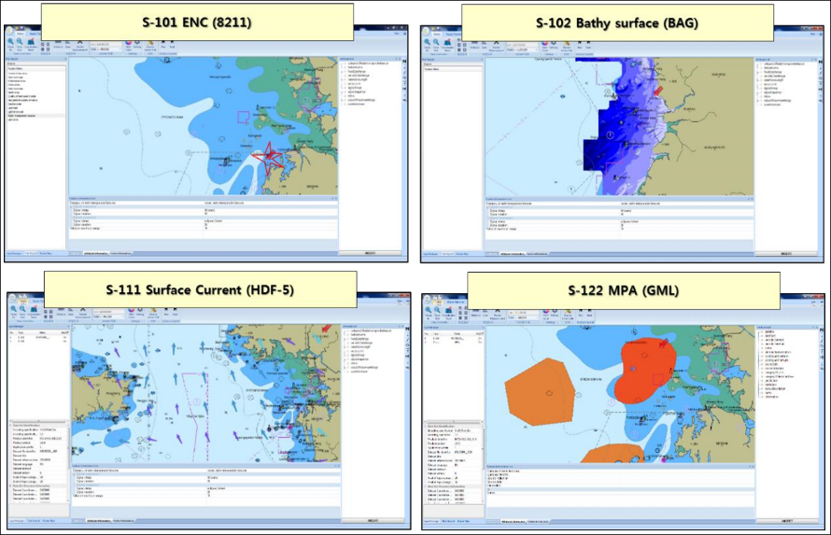

Technical Standards
(Standards)
S-57 / S-100 and others product specification
Data dissemination through OGC Web Service …….WMS/WMTS/WFS/WCS etc….

Slide 9
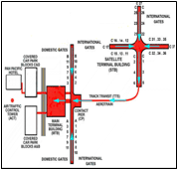

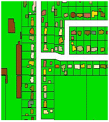
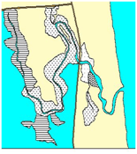
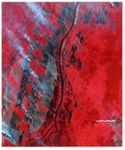
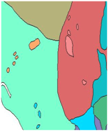
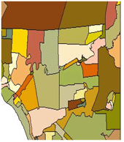
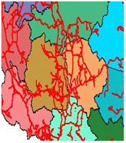
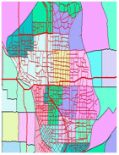
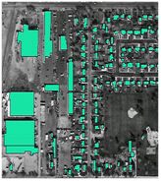
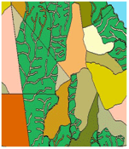
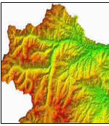
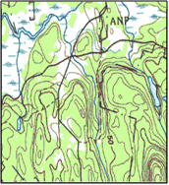
Framework Data Categories
Aeronautical
Vegetation
DCA
DOA
Built Environment
Demarcation
Geology
Hydrography
Hypsography
Soil
Transportation
Utility
JUPEM
JUPEM
JMG
NHC
JUPEM
DOA
JKR
JUPEM
Special Use
General
JUPEM
JUPEM
CATEGORIES
LEAD AGENCIES
Geographic Content (Data)
Notes:
Framework Data Categories
Geodata refers to a well defined fundamental geospatial data categories set up mutually among participating stakeholders. It's represented by customary data categories that users require, as well as environment to support the development and usage of this data on which agencies can create by overlaying their own information and thematic data with framework dataset. Through the mutual conception several government agencies or geospatial industry groups can define reliable data categories to accomplish their common objectives.
12 Catagories/Theme
Aeronautical This category contains geospatial information related to air transportation such as air space, aerodrome and airport.
Built Environment This category contains building, property or place designated for use as premises for residential, commercial, industrial, institutional, educational, religious, recreational, cemetery and built-up structures.
Demarcation This category holds information on delimitation/delineation of topographic, maritime and cadastral features.
Geology This category includes all geological mapping information and the related geoscience geospatial data including geolithology, mineral, fossils, mining, exploration, and geological features.
Hydrography This category includes geospatial data on coastal hydrography, shoreline structures, fishing facilities, ports and harbours, navigation aids, danger and hazard, depth information, inland water, river structure, offshore information.
Hypsography This category contains the geospatial information related to spot heights, contours, altimetric data and gravity data.
Soil This category contains geospatial information related to soil classification such as Histosols, Spodosols, Andisols, Oxisols, Vertisols, Ultisols, Mollisols, Alfisols, Inceptisols and Entisols.
Transportation This category contains both land and water transportation geospatial information such as road network, rail line, water route and jetty terminal.
Utility This category contains the geospatial information related to electricity, telecommunication, water supply, oil and gas, broadcasting, sewerage and waste management.
Vegetation This category includes geospatial data on agricultural land use activities, boundaries and areas of vegetation such as forest, mangrove, wetland, dryland and cropland.
Special Use (Specific Dataset) This category contains the geospatial information related to terrain analysis dataset, meteorological dataset such as temperature and rainfall isoline, orthorectified images, digital elevation model and geoid surface.
General This category includes monumented control points such as geodetic control station, benchmarks, tide station, standard traverse marks, ground control point, gravity station and remote sensing imagery such as aerial photography and satellite imagery

Slide 10
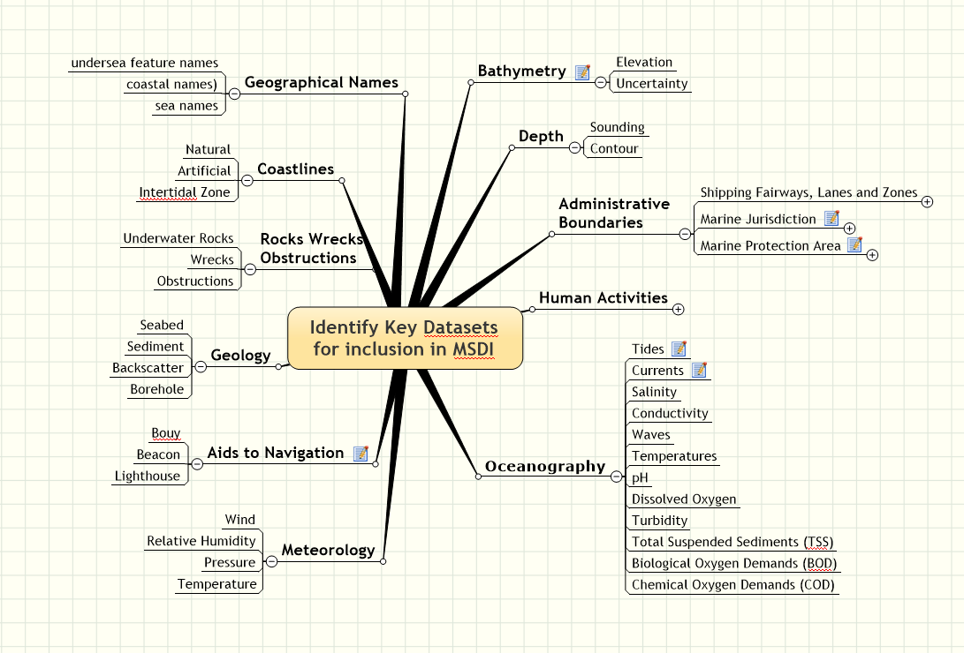
Geographic Content (Data)
…plus Meta data

Slide 11
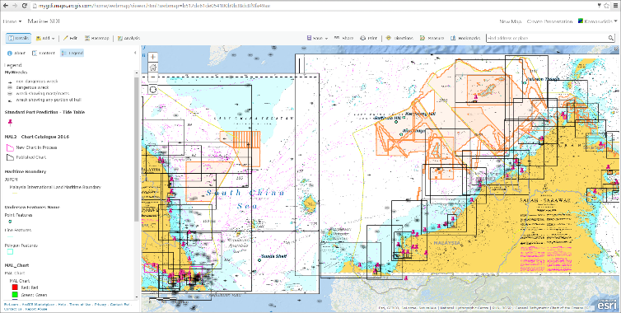
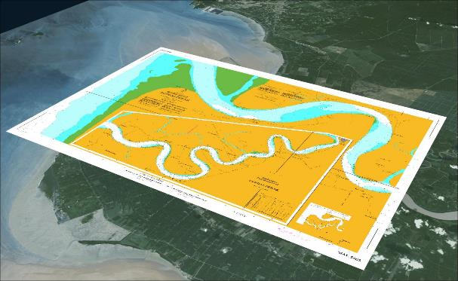
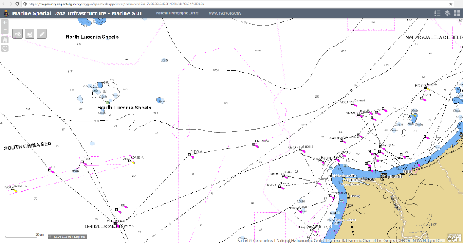
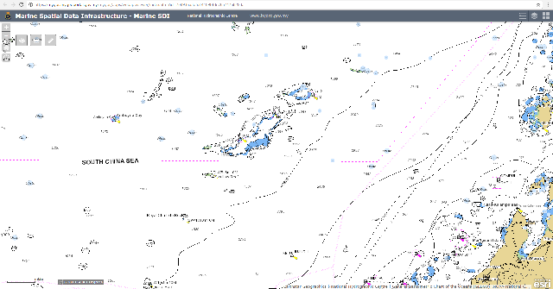
Hydrographic data and its role in MSDI
Raster charts as
basemap
Geographic Content (Data)
ENC - S57 data as
operational /additional layer
Hydrographic data sets and data infrastructure

Slide 12
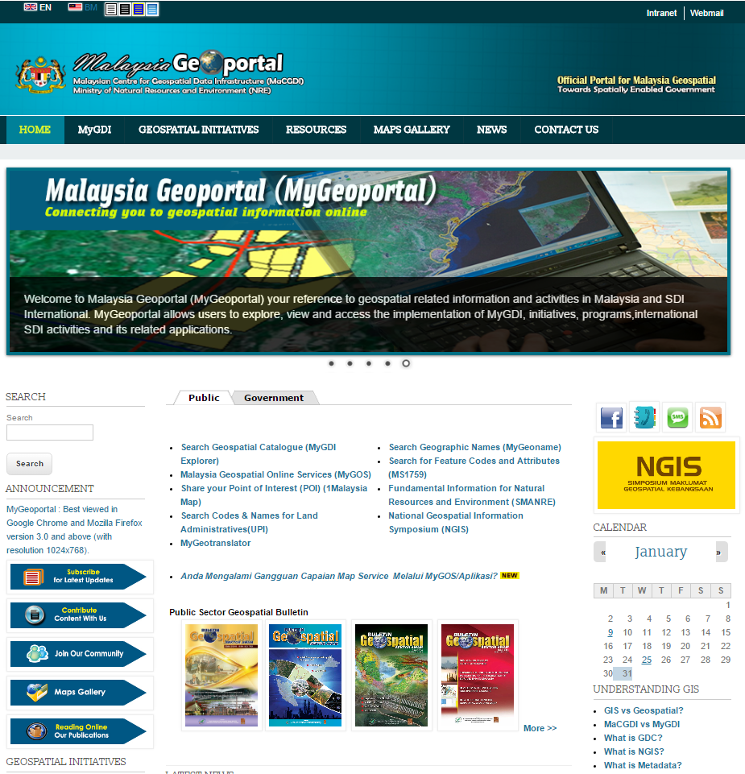

MyGEOPORTAL
Malaysia Geoportal is the visible front-end to MyGDI, the gateways through which users access the geospatial information services
Access and distribution of geospatial information is at the heart of MyGDI project.
This portal allows Users to explore, view and access the implementation of MyGDI, initiatives and its related applications
Information Systems (ICT)
www.mygeoportal.gov.my
Notes:
Malaysia Geoportal is the visible front-end to MyGDI, the gateways through which users access the geospatial information services
Access and distribution of geospatial information is at the heart of MyGDI project.
The success of MyGDI Data Explorer is the ease of use which it allows users to locate and access geospatial resources

Slide 13
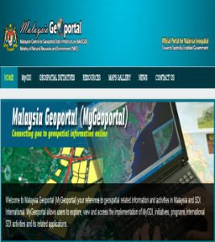

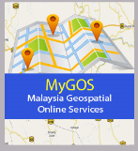
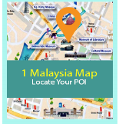
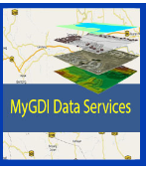
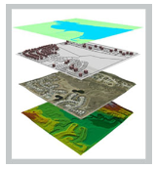
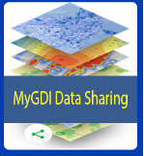
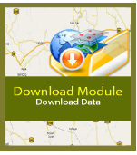
MyGDI Applications
Information Systems (ICT)
MyGeotranslator
http://www.mygeoportal.gov.my/data-services
Notes:
This slide, shown the Geospatial Initiatives page of the Malaysia Geoportal identifying the types of information available

Slide 14
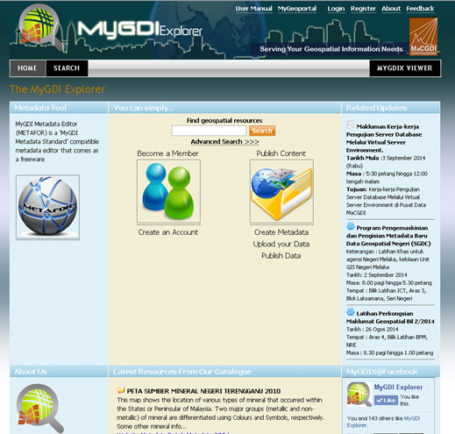
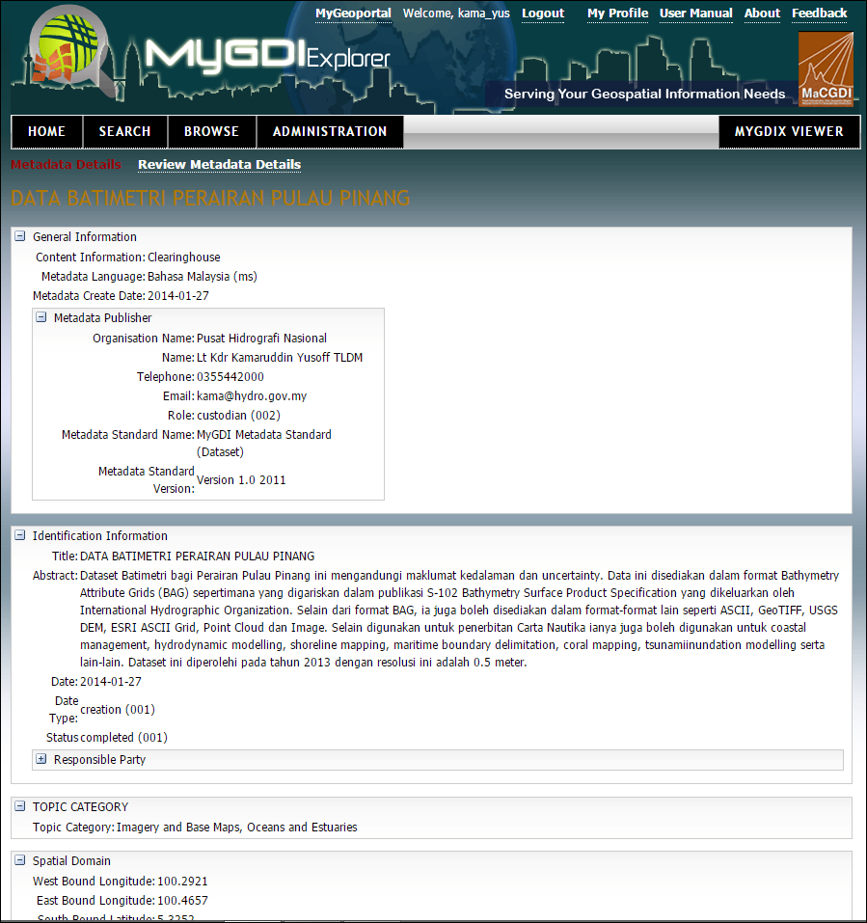
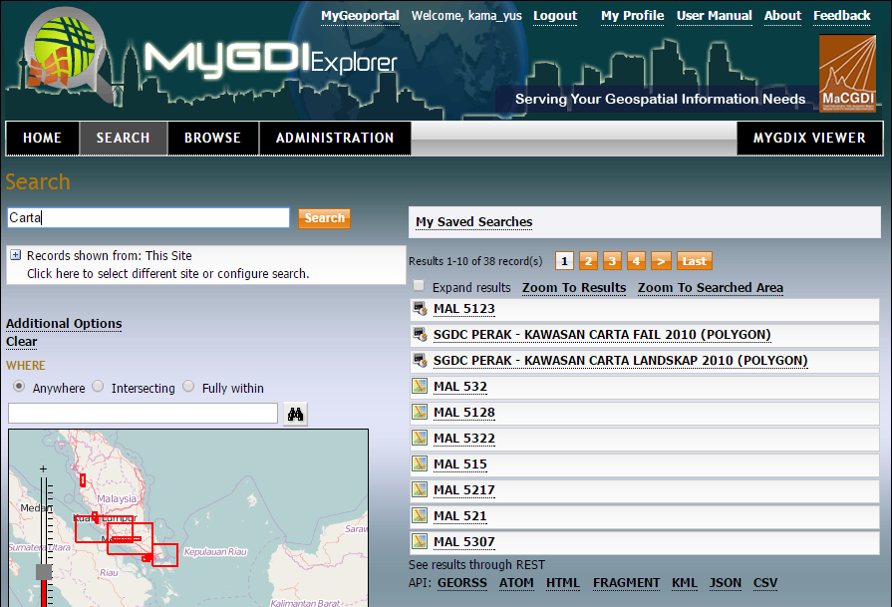
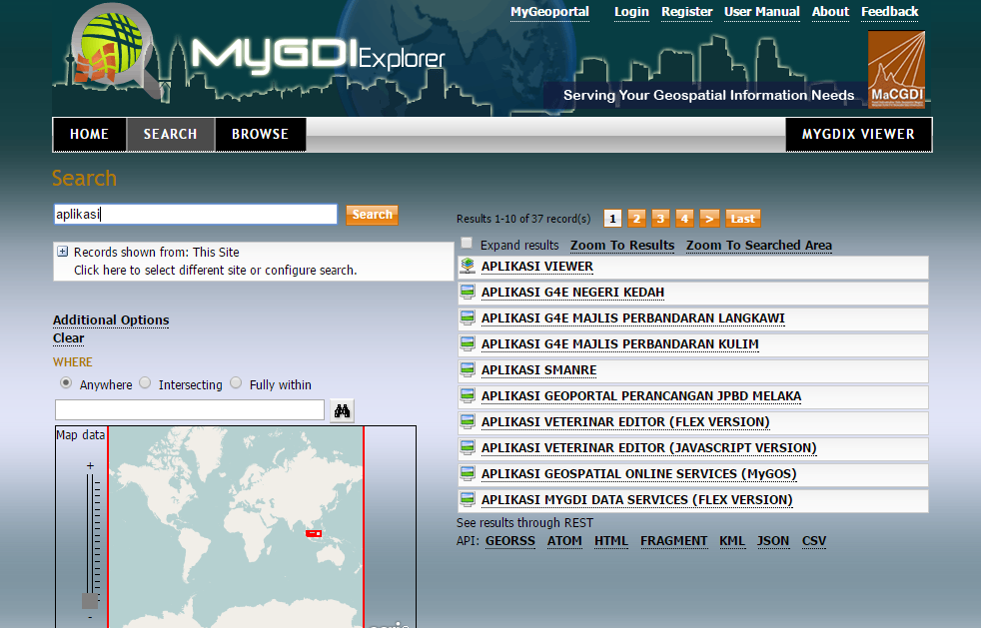
MyGDI EXPLORER
Information Systems (ICT)
MyGDI Explorer is a metadata catalogue services which enables user to explore, discover, view and evaluate geospatial data from anywhere and at anytime.
Notes:
MyGDI Explorer is a metadata catalogue services which enables user to explore, discover, view and evaluate geospatial data from anywhere and at anytime. MyGDI Explorer simplifies access to geospatial information, promotes better integration, and avoids duplication of efforts and encourages sharing of geospatial information across users and agencies in Malaysia.
MyGDI Exporer contains records describing the contents of materials and information on how to access the materials. In other words, it enables users to find the GIS resources, view its description and make assessment on it. The metadata records in MyGDI Explorer are provided by various data providers with a common objective – to make their resources available to users in Malaysia as well as over the world. It is the linkage that connects the data provider with the users of geospatial information via the internet. The growing availability of data of all kinds from many different sources has made GIS technology become more useful and widely adopted. Information published in metadata by data providers enables users to search the required data.

Slide 15
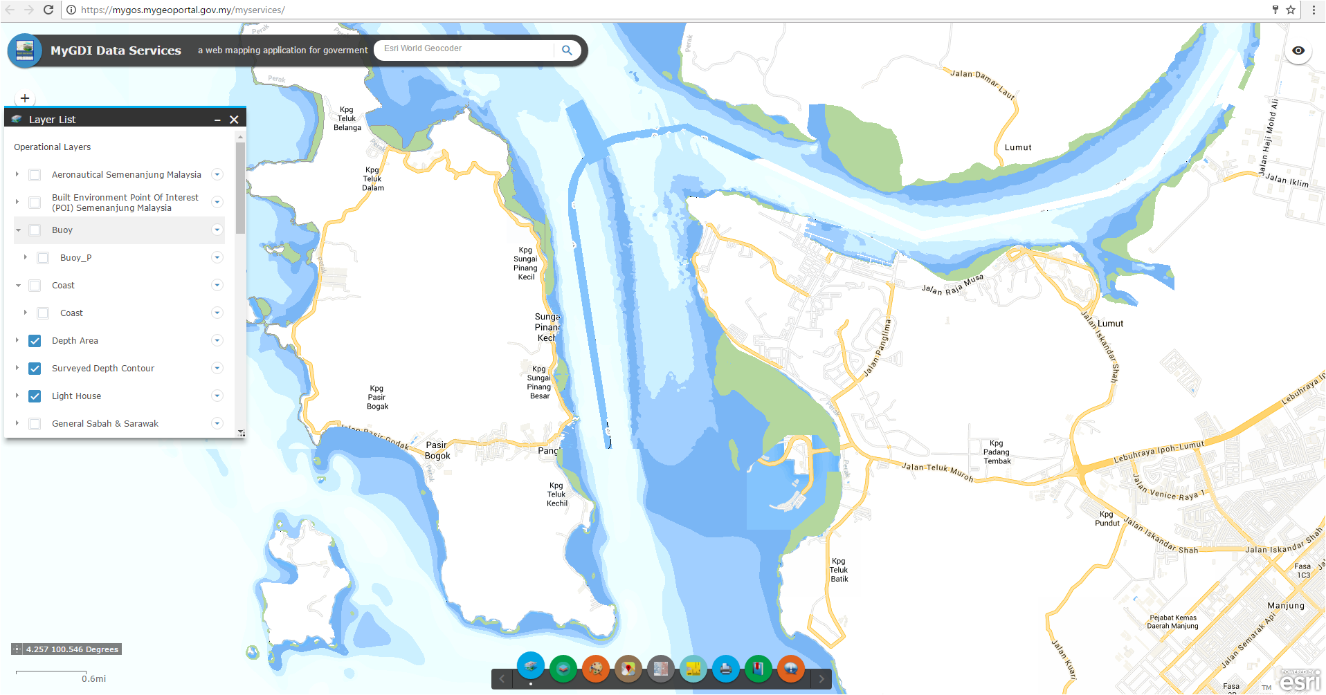
MyGDI Data Services
MyGDI Data Services menyediakan mekanisme perkongsian maklumat di antara agensi-agensi kerajaan bagi data-data utama (fundamental datasets) geospatial terutamanya data daripada projek National Geospatial Data Center (NGDC). Platform ini juga boleh digunakan untuk agensi Kerajaan yang lain berkongsi data mereka.
Notes:
MyGDI Data Services is one of an application exclusively develop for government staff only. This application is one of platform that provide data sharing between government agencies (G2G). Currently, only basic data geospatial (Fundamental) especially data from NGDC, National Geospatial Data Centre (NGDC) Project have done in this application

Slide 16
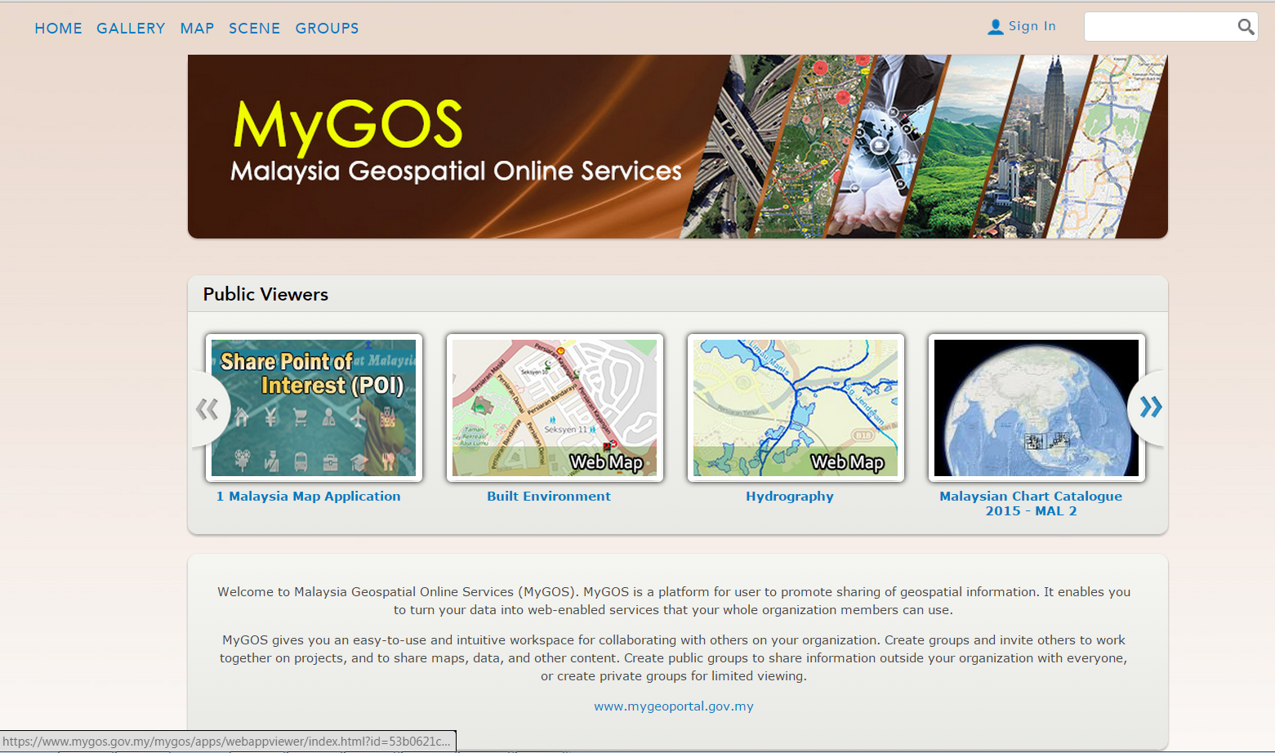
Malaysia Geospatial Online Services (MyGOS)
Information Systems (ICT)
Malaysia Geospatial Online Services (MyGOS) A platform for user to promote sharing of geospatial information. It enables you to turn your data into web-enabled services that your whole organization members can use.
  Online mapping platform
  Content management platform
  Collaborative and sharing platform
Notes:
Dear Ladies and Gentleman,
Let me first introduce you to MyGOS : Malaysia Geospatial Online Services, A Platform for user to promote sharing of geospatial information.
It is An Online Geospatial Services;
A Content Development Platform
A Platform for sharing and collaboration
Established in 2014, the Malaysia Geospatial Online Services (MyGOS) promoted coordination and alignment of geospatial data collection, maintenance, and access among all levels of government. GOS served as an interoperable, Internet-based portal and repository for spatial data and Web services to support cross-government collaboration. Developed in response to agency mission-specific drivers -- including support for government business processes, decision making, and the service needs of citizens . The coordination of government geospatial data and services through GOS improved efficiency while enabling easier, faster, and less expensive discovery and access to geospatial data.

Slide 17
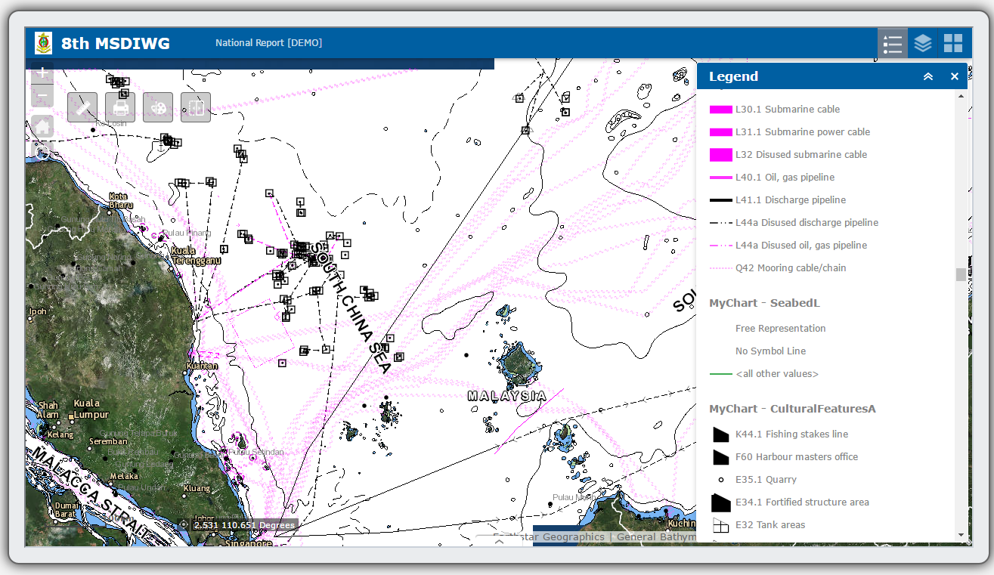
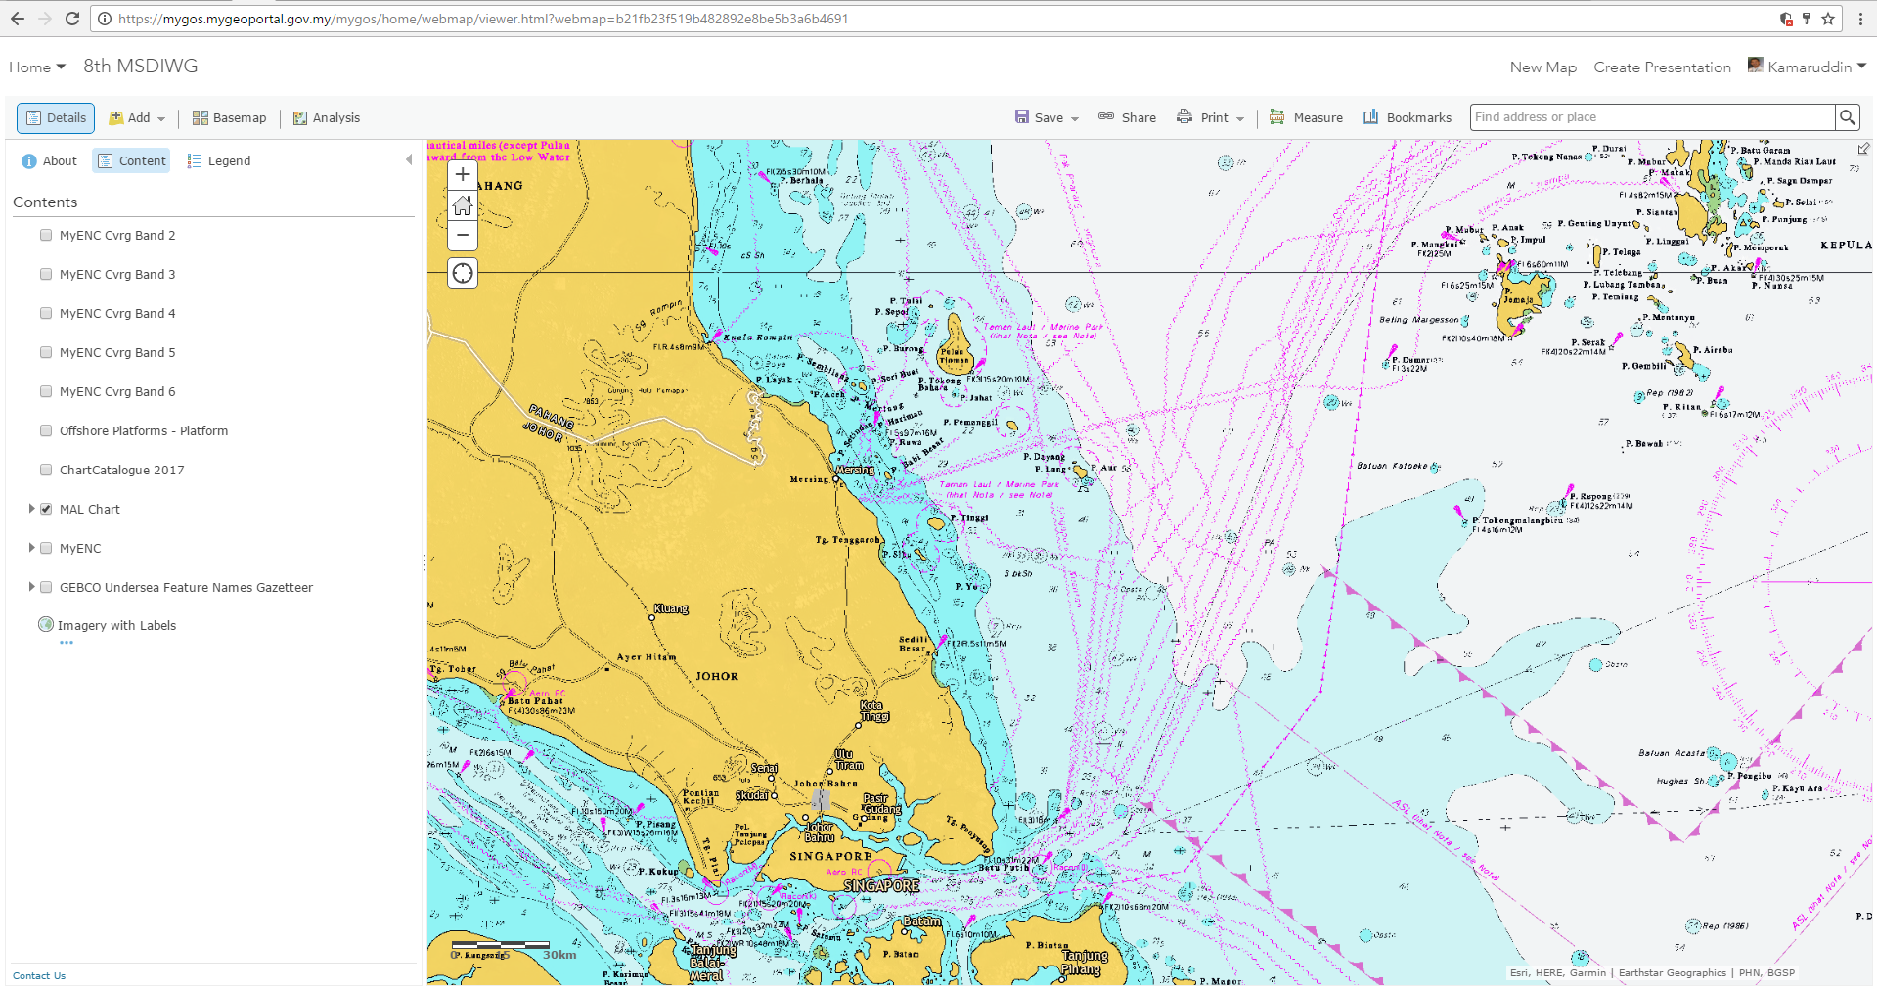
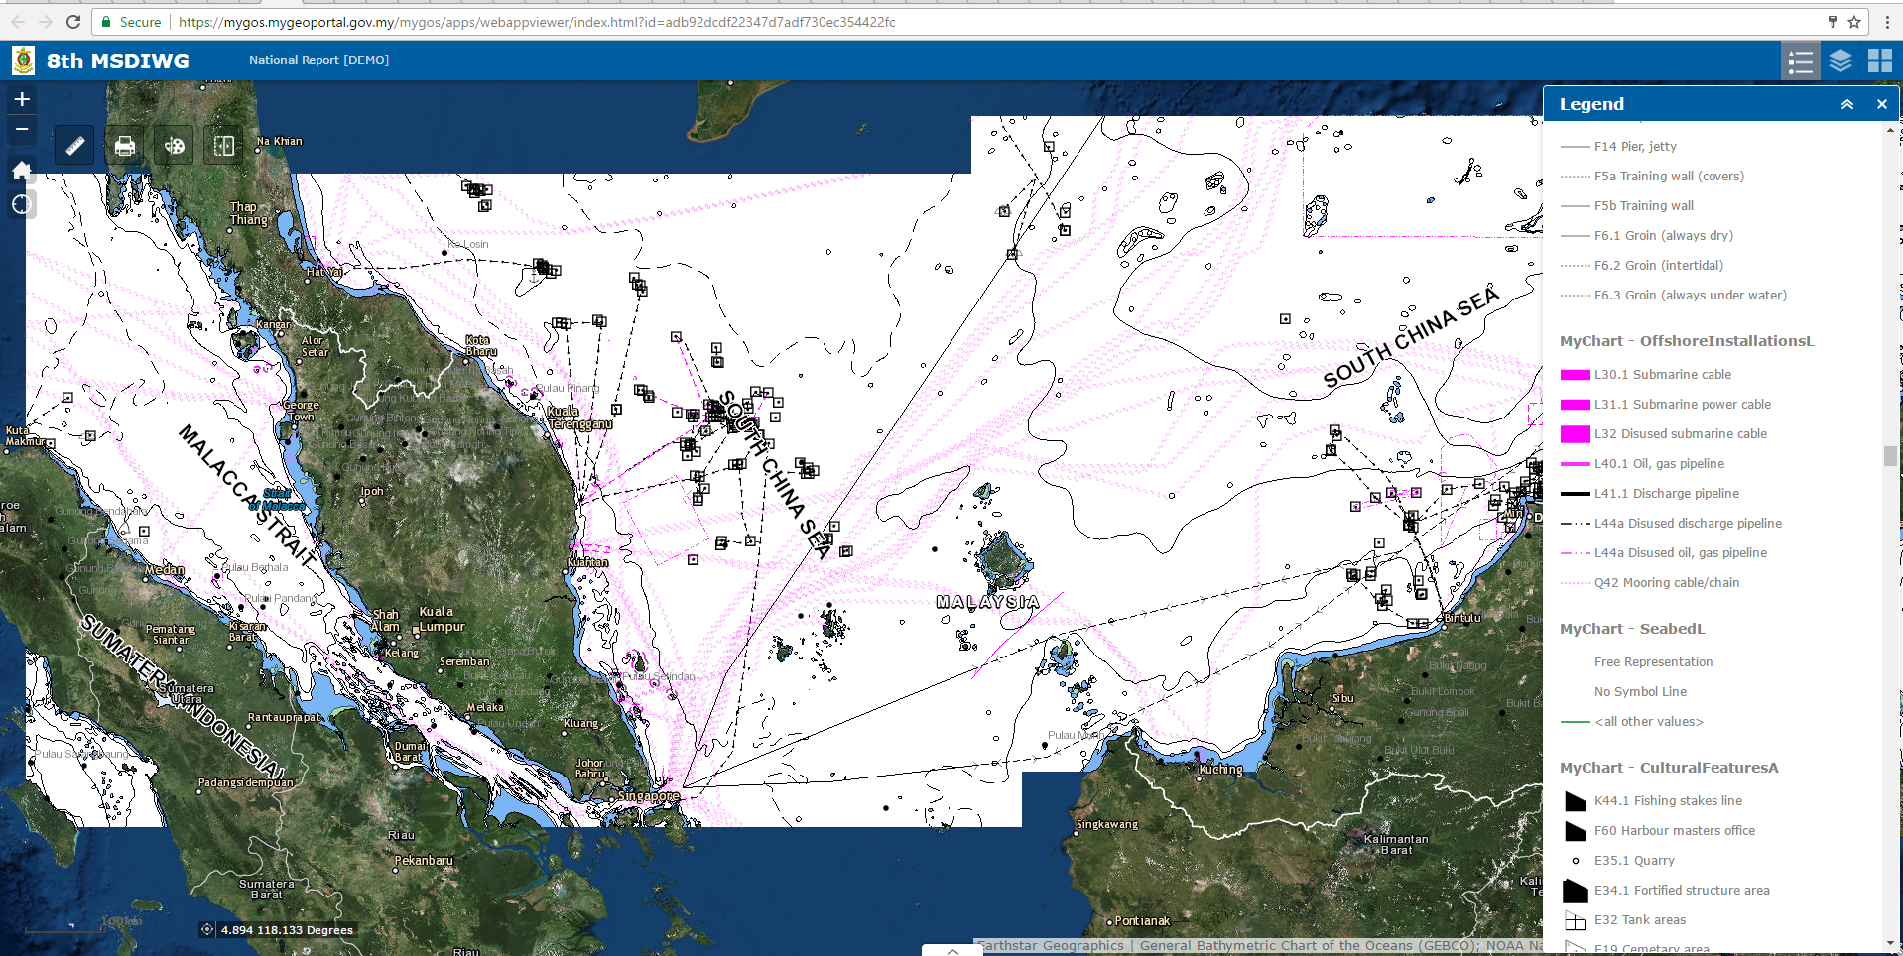
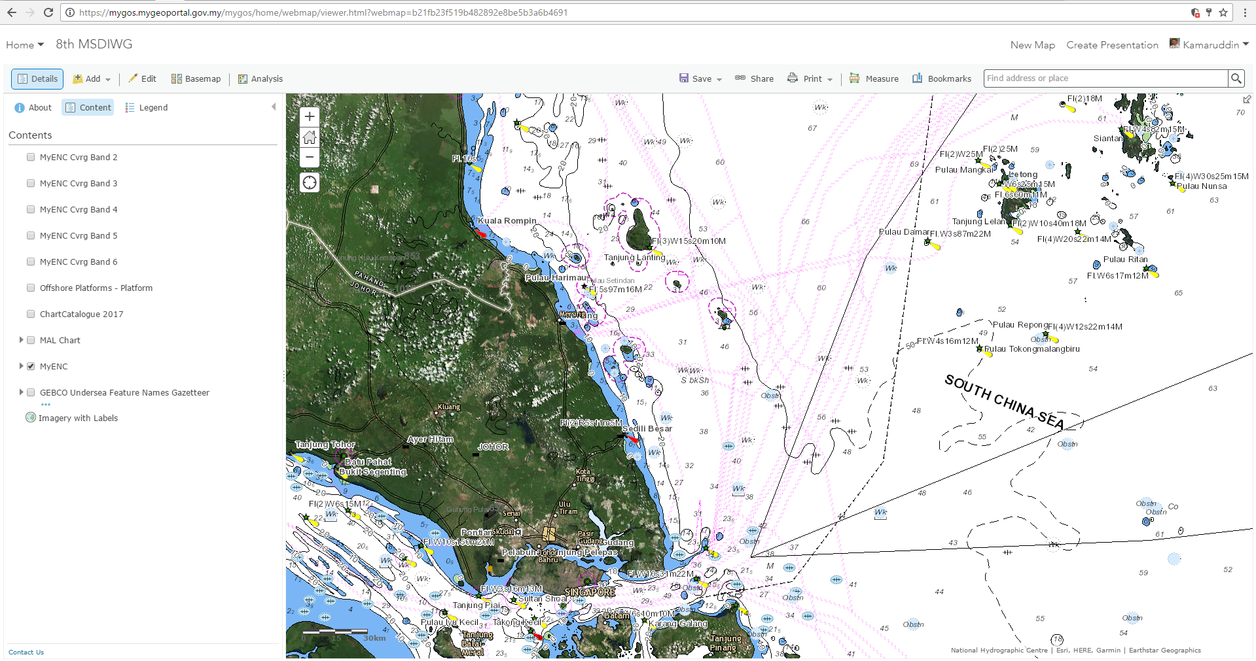

Slide 18





Hydrographic Data Management Workflow
DATA
ACQUISITION
DATA
PROCESSING
DATA QC/
MANAGEMENT
My BATYMETRY
SERVER
My BATHYMETRY
DATABASE
WMS
WMTS
Spatial Fusion Server
Desktop
Source Editor
1
WFS
WCS
Paper Chart Editor
Paper Chart
MyGOS
Source Editor
2
Web
My HPD
SERVER
ENC
WCS
My HPD
DATABASE
Product Editor
OGC Service Layers
Source Editor
3
Product Editor
AML
Device
Source Editor
4
SECONDARY
DATA
DATA EDITING/QC/
MANAGEMENT
VPN
ArcMap
Geodatabase
ArcGIS Server

Slide 19
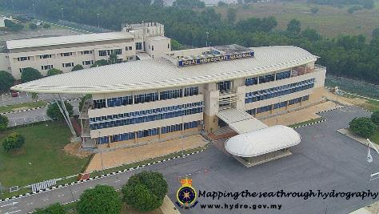
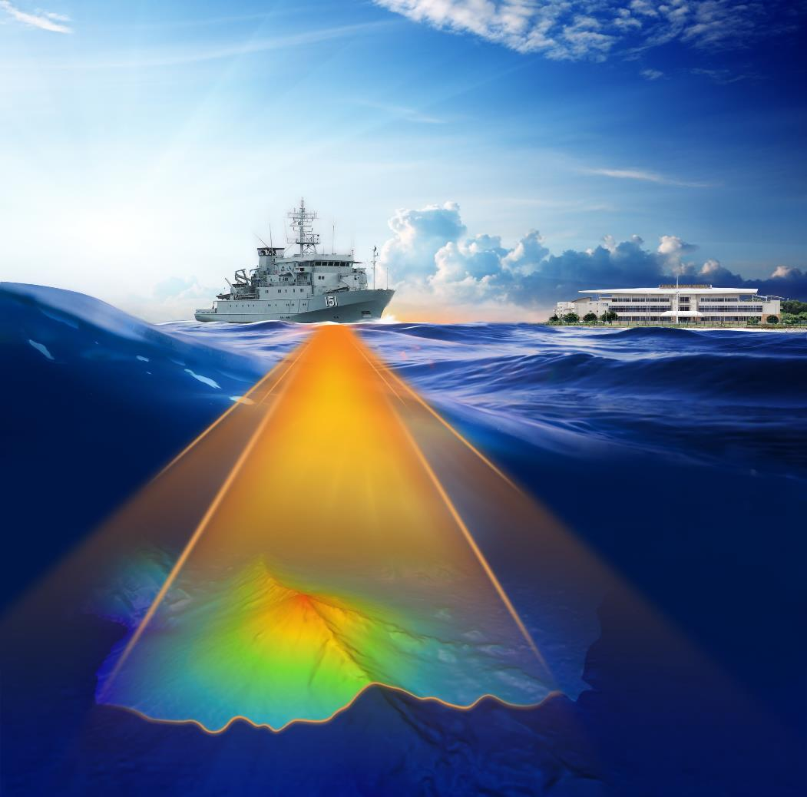
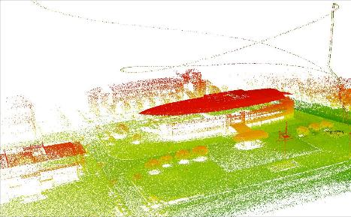
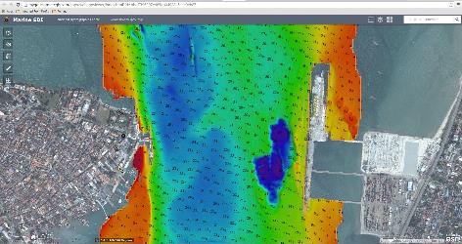
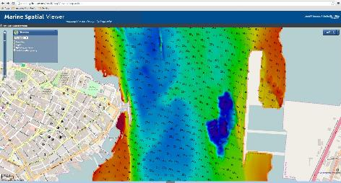
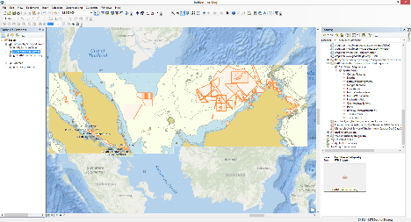
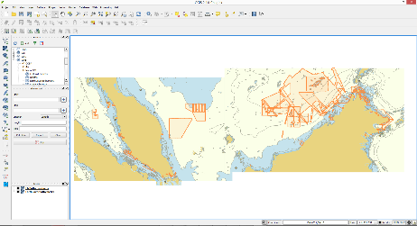
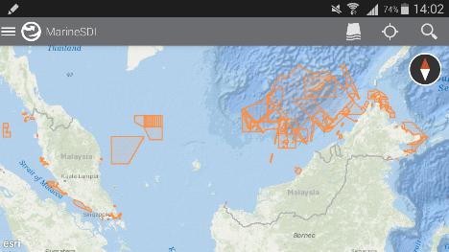
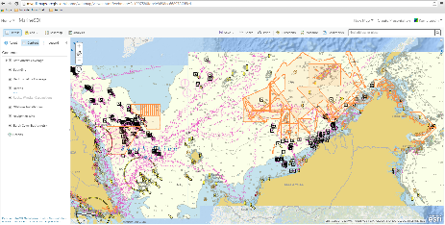
Thank you for your attention
Notes:
Sekian terima kasih

Slide 20






CONCLUSIONS
Stay tuned with MSDI WG and OGC Marine WG
Leverages collaborative relationships with stakeholders
The biggest challenge is “people” and “organisations” (culture)
There are many benefits to be realised from MSDI
National Hydrograhic Centre – important part of the MSDI
  Hydrography data - provides the fundamental backdrop
  The IHO standards are aligned with ISO and OGC standards
  ICT ready
  Good governance
Notes:
Hydrography provides the fundamental backdrop, for almost everything that happens in, on or under the sea
The NHC is an important part of the National GeoSpatial Data Infrastructure (MSDI)

