Slide 1
INTernational Chart Web Catalogue is ready for USE

Slide 2
Workflows

Slide 3
Practical Exercise Example with Region K
Scenario 1 : Modify an INT Chart
Scenario 2 : Insert a NEW INT chart

Slide 4
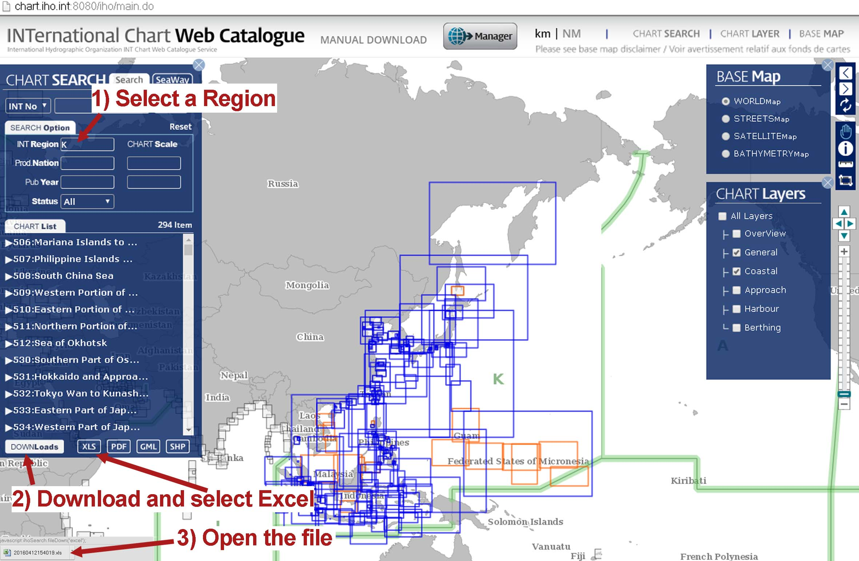
Download charts & create an Excel spreadsheet…

Slide 5
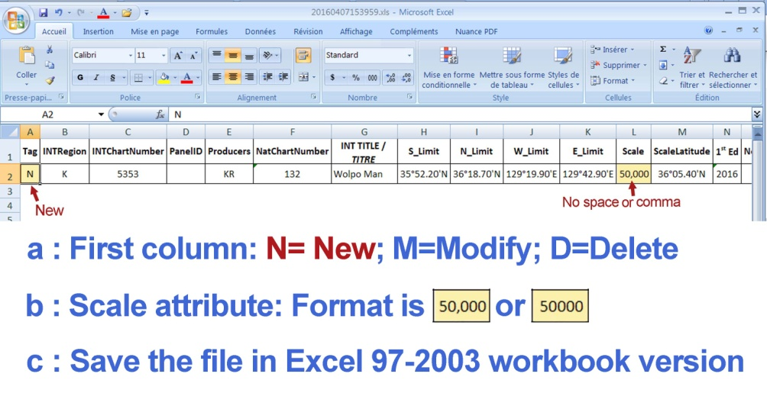
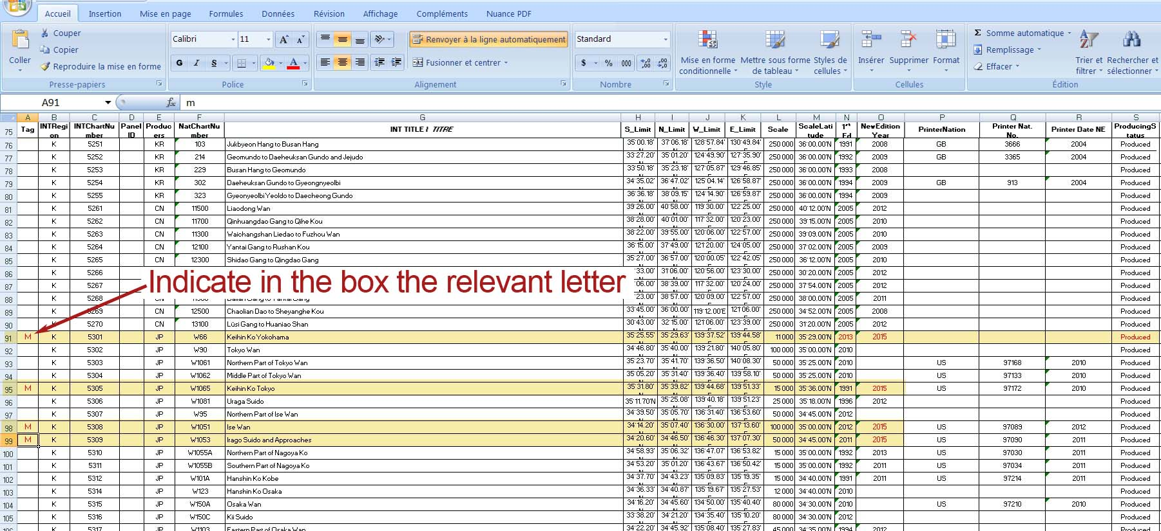
…and enter your changes

Slide 6
Scenario 1: modify an INT Chart(1A/2)

Slide 7
Scenario 1: modify an INT Chart(1B/2)

Slide 8
Scenario 1: modify an INT Chart(2/2)

Slide 9
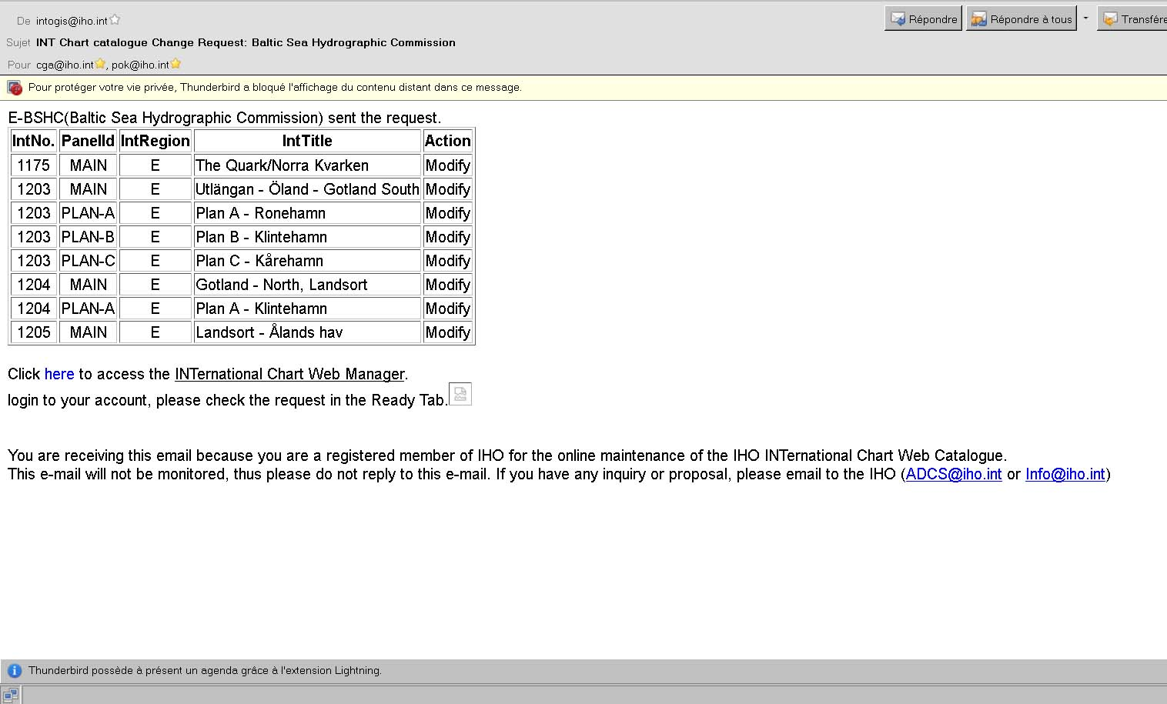
E-mail notification according to the workflow

Slide 10
Practical Exercise Example with Region K
Scenario 1 : Modify an INT Chart
Scenario 2 : Insert a NEW INT chart

Slide 11
Scenario 2: insert a new INT Chart(1/2)

Slide 12
Scenario 2: insert a new INT Chart (2/2)

Slide 13
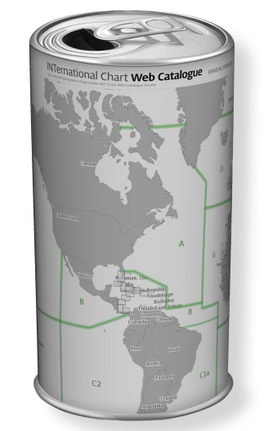
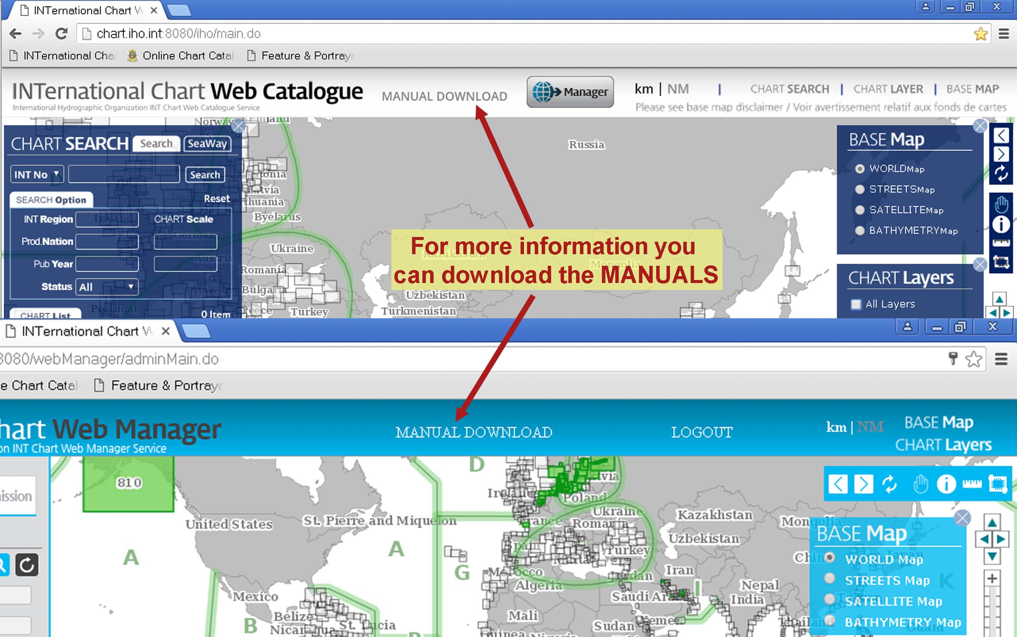
Ready to start again…
Online training video clip is available

Slide 14
Thank you

