Slide 1
Nautical Cartography Working Group
NCWG-5, Stockholm, Sweden, 5-8 November 2019
NCWG5-06.1A (Part 2 of Presentation) Finalizing the
Future of the Paper Nautical Chart Report
Colby Harmon - US (NOAA)
Future of the Paper Nautical Chart Sub-working Group Lead

Slide 2
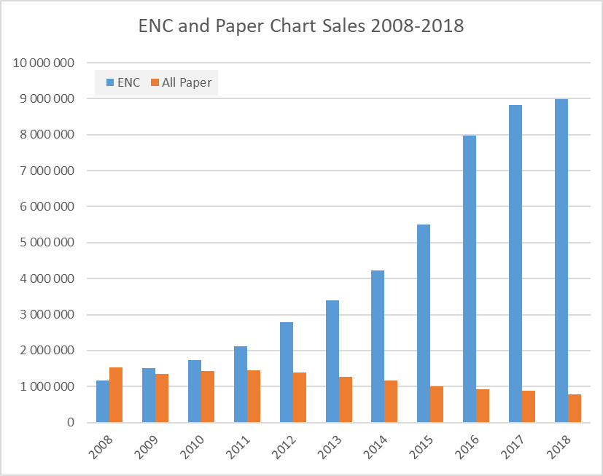
ENC and Paper chart sales compared

Slide 3
Recommendation Topics Based on C-3 Guidance
Production of paper charts from ENCs
Simplified standard for paper charts meeting functional requirements
Future of INT Chart concept
Subsequent alignment of WGs’ program of work
etc.

Slide 4
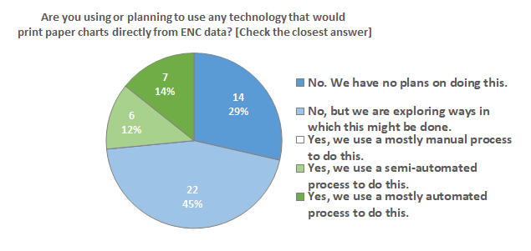
Paper Charts from ENC Data
29% – No
71% – Yes, in some manner or considering doing so

Slide 5
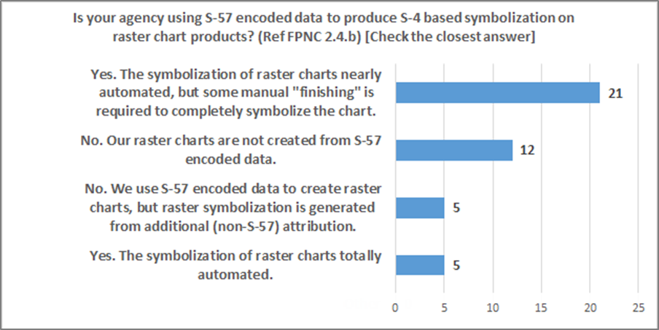
S-4 Symbolized Raster Charts from S-57 Data
No – 17
Yes – 26

Slide 6
Production of Paper Charts from ENCs
HSSC Action 11/47 – NCWG to anticipate the need to consider the proposals made at HSSC-11 [by Aus, Can, Fra, Ger, UK, and US] on the automated production of paper charts from ENCs at its next meeting.
Possible Recommendation:
“Add task to NCWG workplan to develop ways to enable or enhance HO’s ability to produce paper charts or raster chart images from ENC or other S-57 or S-101 encoded data.”
This task could include:
Developing new, or adapting existing, ENC portrayal rules to support production of S-4 based paper charts
Modifying some S-4 symbols and/or guidance to better facilitate use of ENC data to create paper charts
Related to, or could be an effort combined with developing a “Simplified” or “Backup Chart” Spec
Recommendations Based on C-3 Guidance

Slide 7
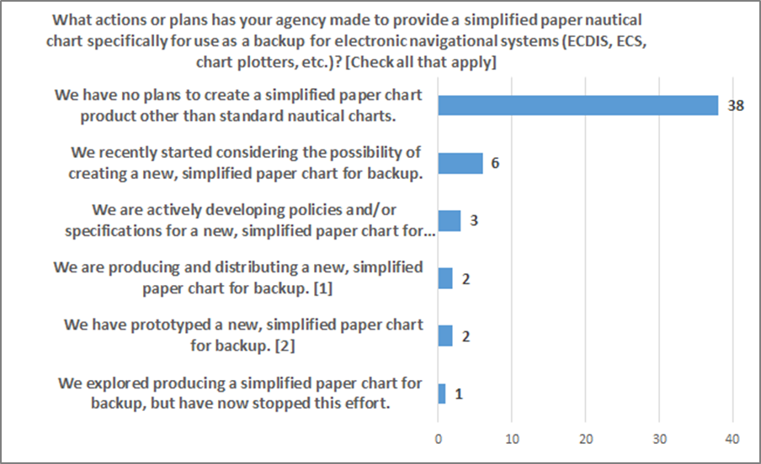
Plans for Developing Simplified Backup
No – 39
Yes – 13

Slide 8
Simplified Standard for Paper Charts
Not a particularly popular concept at the moment, but some simplification may be needed to help create paper charts from ENC data.
Users still want a paper backup, even as some HOs consider ending paper chart production. What is the best way to provide a backup?
Will HO’s provide both “Complete” charts and “Simplified” charts?
Will “Simplified” charts ultimately come to fill the role of “Standard” charts?
FPNC has a section on the idea. Aus has done work in this area
Possible Recommendation:
“Add task to NCWG workplan to develop guidance or a new specification for creating simplified charts, either as a new type of traditional, “standard chart” or as a chart specifically for “backup.”
This task could include specifying:
Features that must be included or may be omitted
Guidance on inclusion of chart marginalia and notes
Recommendations Based on C-3 Guidance

Slide 9
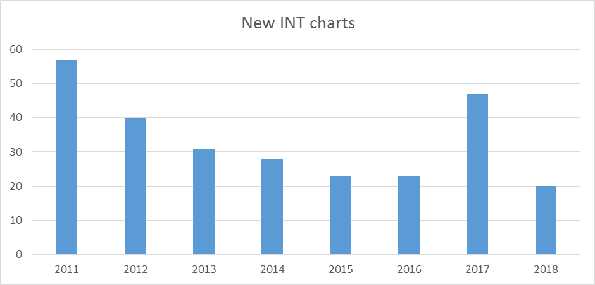
Recent New INT Chart Production
Except for 2017, production has been declining since 2011.
The 2017 S-11 Part B, Catalogue of INT charts, showed 1691 INT charts produced, out of a total of 2086 INT charts schemed.

Slide 10
INT Chart Production by Charting Region

Slide 11
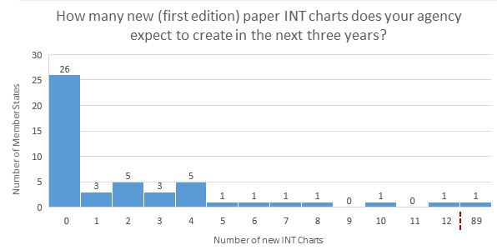
Planned INT Chart Production

Slide 12
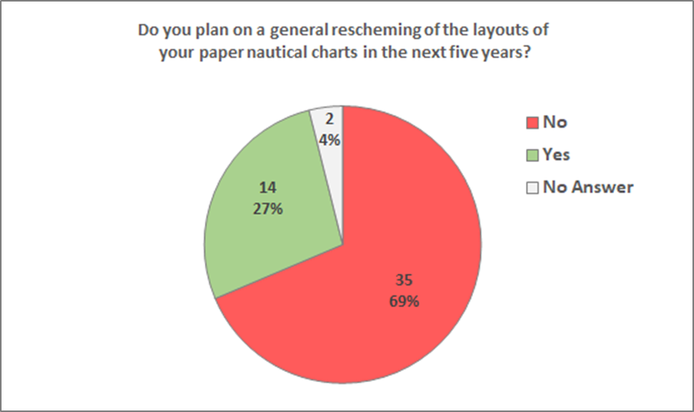
Plans to rescheme paper/raster charts

Slide 13
Future of INT Chart Concept
Are there recommendations regarding:
INT chart production
Purpose and structure of INT Chart Coordinating Committees
Ideas from:
Monday’s charting regions coordinators workshop?
Survey results?
Other sources?
Recommendations Based on C-3 Guidance

Slide 14
Possible recommendations for NCWG activities
S-4 Portrayal Catalogue - Implement S-4 symbology in an S-100 Portrayal Catalogue for raster charts
Freezing S-4 and the S-4 based portions of national INT1 and Chart 1 documents, so that future NCWG efforts can focus exclusively on enhancing the portrayal of S-57 and S-101 ENCs and other S-100 based products.
Enhance ECDIS Portrayal of ENC – Make it a priority to understand users' concerns about issues with the portrayal of ENC data – both S-57 and S-101 – and take actions to improve it.
* Paper/Raster charts from ENC Data - Develop a standard means of generating raster nautical charts from ENC data.
* Backup Chart Specification - Develop a specification for – or general guidelines for – a simplified paper/raster chart that would be suitable as a back-up for ECDIS and ECS.
Chart on Demand / Custom Chart – Coordinate efforts of various HOs that are developing online "Chart on Demand" or bespoke "Custom Chart" capabilities
* INT Chart Production and Coordination – What does NCWG want to recommend regarding ICCWGs coordination of chart or ENC production?
* Discussed in previous slides

Slide 15
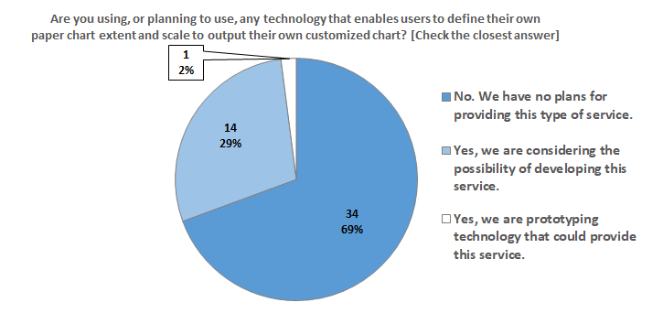
Customized charts
69% – No
31% – Yes or considering doing so

Slide 16
Possible recommendations for HSSC working group organization
NCWG Work Plan – Are there any other work items related to the future of the paper nautical chart that should be added, changed, or removed from NCWG's work plan.
NCWG TORs – Are there revisions to the NCWG Terms of Reference and Objectives that should be made in accordance with decisions made at HSSC?
Disband the NCWG – Is it time to disband the working group and assign its activities to a Project Team under S100WG or ENCWG?
Are there changes that should be made to other HSSC working groups?

