Slide 1
2019 SCUFN
Chair Report
August, 2019
Hyun-Chul Han

Slide 2
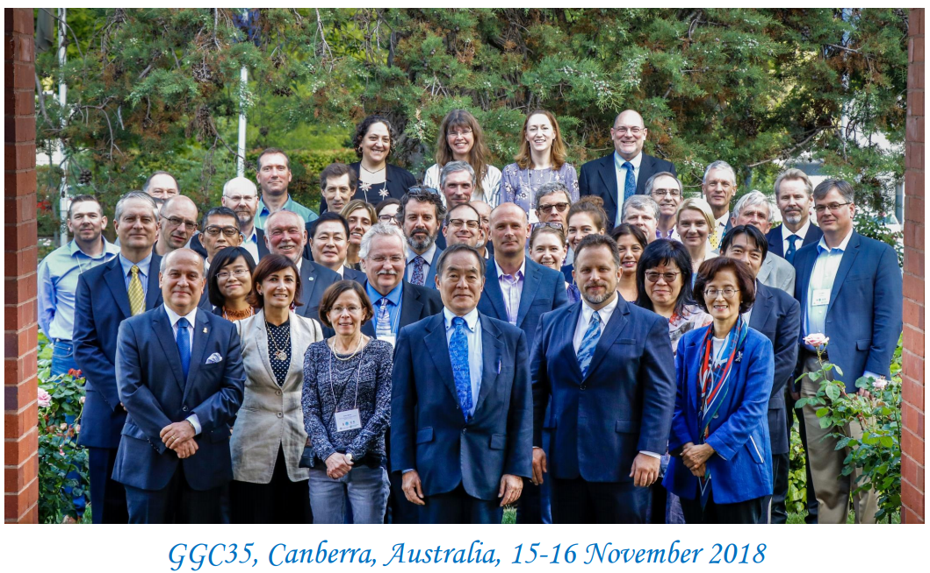
Summary of GGC35
Date: 15 ~ 16 November, 2018
Venue: Canberra, Australia

Slide 3
Issues related to SCUFN
Endorsed by GGC35
- New Chair and Vice Chair
- New version of B-6 (ver. 4.2) / SCUFN32-06.2A
* User’s Guide for preparation of naming proposals (Appendix A)
* Fast Track Procedures (Appendix B)
* Invite to provide the supporting bathymetric data to DCDB

Slide 4
Other Businesses
New SCUFN member
- Elected from IOC side
- Capt. Aleksandr Alekseev from Russia
Gazetteers (refer to SCUFN32-07.3A)
- Two gazetteers; GEBCO and Beta Gazetteers
- What shall we do with these two gazetteers?
* GEBCO Gazetteer: open to the general public
* Beta Gazetteer: for SCUFN members and back-up system

