Slide 1
Report on Marine Regions Activities
Report for SCUFN-32, Kuala Lumpur, August 2019
Britt Lonneville, Paula Oset, Lennert Schepers, Bart Vanhoorne (VLIZ)

Slide 2
Outline
Marine Regions
Undersea features
GEBCO update
ACUF update
New Zealand update
Integration of Canadian Geographical Names Database.
Other gazetteer updates
Short-term planned activities

Slide 3
Marine Regions is a standard list of marine georeferenced place names and areas.
One of the data systems being developed and managed by VLIZ.
Serves as the geographic backbone for large-scale integrated biogeographic databases.

Slide 4
Overview of the system
Marine Regions Geo-object
The identity of each feature or geo-object in the database is given by a unique and persistent Marine Regions Geographic IDentifier: MRGID.
Each geo-object is defined by a place type and its coordinates (vector) but can have multiple synonyms.
Geometry
Point
Line
Polygon

Slide 5
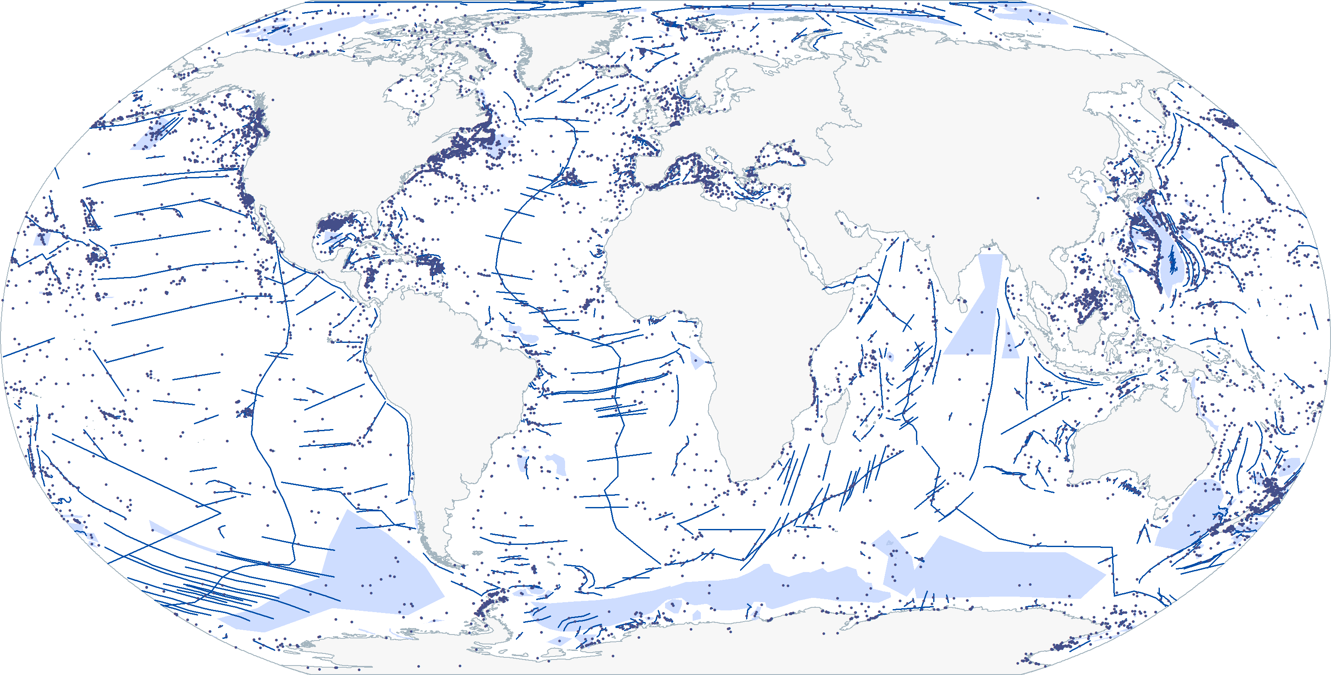
Undersea features

Slide 6
GEBCO update
134 new features added to Marine Regions, mainly from SCUFN-31 but also from SCUFN-15, 18 and 30.
Issues found:
Ewing Seamount: featureId changed from 947 in 2018 to 946 in 2019.
Reinga Ridge (featureId = 2569): because of a macron sign on the “e” letter, the feature is displayed as R¿inga Ridge in the database and in the online viewer.
There are two records for Bounty Trough (featureId = 6160) and Flamingo Hills (featureId = 6325) in the GEBCO gazetteer, with identical coordinates and placetype, but different ID.
Additional information for feature Soseki Ridge (featureId = 6763) mentions this feature was “formerly called Soseki Seamount”. Soseki Seamount is a separate feature in the GEBCO database (featureId = 6245). Should Soseki Ridge be added as the preferred synonym for Soseki Seamount or are these two separate features?

Slide 7
GEBCO update
Issues found (continued):
Foster Seamount (featureId = 1036) has the same coordinates as ACUF’s Forster Seamount (UFI = -153429). ACUF reports this feature is named after USS Forster (DE-334). Is the name of this feature correct in GEBCO or ACUF? (note: there is already another feature named Forster Seamount in the GEBCO gazetteer (featureId = 6029)).
Makarov Basin (featureId = 1832) coordinates are cut off at 180°E. Different maps illustrate that the feature also runs on the Western hemisphere (e.g. Weber, J. (1983). Maps of the Arctic Basin Sea Floor: A History of Bathymetry and Its Interpretation. Arctic, 36(2), 121-142. Retrieved from http://www.jstor.org/stable/40509566, https://www.whoi.edu/beaufortgyre/pdfs/timmermans_deepwater_jpo2006.pdf). Are the GEBCO coordinates correct?
In the following paper, some GEBCO features are identified as synonyms: Weber, J. (1983). Maps of the Arctic Basin Sea Floor: A History of Bathymetry and Its Interpretation. Arctic, 36(2), 121-142. Retrieved from http://www.jstor.org/stable/4050956630056. Is this information still relevant?
Nansen Basin (featureId = 2133) = Barents Abyssal Plain (featureId = 279)

Slide 8
GEBCO update
Issues found (continued):
The location of Explorer Seamount (featureid = 0cc6ab6b849c20c392fc2a48696bc7ba) in the Canada gazetteer differs from the location in the GEBCO (featureId = 951) and ACUF (UFI = -153344) gazetteers, and seems to indicate a different seamount. Could this be a mistake or is there a reason for this?
The location of Oglala Seamount (featureid = 0d01bbe8849c20c3fe51d84f0c589e46) in the Canada gazetteer differs considerably from the location in the GEBCO (featureId = 2283) and ACUF (UFI = -154787) gazetteers, and seems to indicate a different seamount. Could this be a mistake or is there a reason for this?
Coordinates for Heck Seamount (featureId = 1288) seem to indicate Heckle Seamount, as indicated in scientific literature (e.g. . http://www.dfo-mpo.gc.ca/csas-sccs/Publications/ScR-RS/2019/2019_011-eng.pdf, and Leybourne MI, Van Wagoner NA (1991) Heck and Heckle Seamounts, northeast Pacific Ocean: high extrusion rates of primitive and highly depleted mid-ocean ridge basalts on offridge seamounts. J Geophys Res 96:16275–16294). Could this be a mistake?

Slide 9
GEBCO update
Issues found (continued):
For some features from the Canada gazetteer, it is not entirely clear if the placetype of the given feature can be considered similar to the placetype in the GEBCO gazetteer, and if the features are the same. For now, we have integrated them under the same MRGID. Could you please have a look at the list in the file placetype_tocheck.xlsx (tab mainsourceGEBCO)?

Slide 10
ACUF update
26 new features added to Marine Regions.
Issues found:
Mendeleev Plain (UFI = -154415) changed coordinates from 81, -170 to 80, -178 (GEBCO coordinates 80.6, -167)
Fiordland Basin and Fiordland Trough (UFI = -153398) are synonyms in the ACUF gazetteer. Fiordland Basin (feat_id = 40173) and Fiordland Trench (feat_id = 40174) are separate features in the New Zealand gazetteer.
The name of Egmont Terrace (UFI = -153274) has been altered in the New Zealand gazetteer to Taranaki Terrace. The name ‘Egmont Terrace’ has been indicated as ‘unofficial’.
Alpha Ridge and Mendeleyev Ridge (UFI = -152294) are represented as the same feature. In the Canada gazetteer, they are represented as two separate features with individual coordinates (featureid = 0d01b956849c20c339fe55d1c9f4e318, featureid = 7c71268eba3611d892e2080020a0f4c9. In scientific literature (e.g. https://mem.lyellcollection.org/content/35/1/751/tab-figures-data, https://www.sciencedirect.com/science/article/pii/S0040195116303304), they are also depicted separately. Is there a reason for combining them in the ACUF gazetteer?

Slide 11
ACUF update
Issues found (continued):
In the following paper, some ACUF features are identified as synonyms: Weber, J. (1983). Maps of the Arctic Basin Sea Floor: A History of Bathymetry and Its Interpretation. Arctic, 36(2), 121-142. Retrieved from http://www.jstor.org/stable/4050956630056. Is this information still relevant?
Makarov Basin (UFI = -154297) = Fletcher Abyssal Plain (UFI = -153411)
Nansen Basin (UFI = -153438) = Barents Abyssal Plain (UFI = -152508)
Bank feature Great North/Le Grand Nord (UFI = 213852) also appears in Canadian gazetteer (featureid = 7e2dcabcba3611d892e2080020a0f4c9), but the coordinates are 257 km apart. Could this represent the same feature?
Bank feature Grand Bank/Grand Banc (UFI = -153573) also appears in Canadian gazetteer (featureid = 81493ba4ba3611d892e2080020a0f4c9), but the coordinates are 120 km apart. Could this represent the same feature?
The coordinates for Morris Jesup Ridge (UFI = -154546) seem to be off, compared to the feature observed in the bathymetric chart. Could this be a mistake?

Slide 12
ACUF update
Issues found (continued):
The coordinates for Tingmiark Valley in the Canada gazetteer (featureid = 0cf15652849c20c305dfb75431625013) are the same as the coordinates for Niglik Valley in ACUF gazetteer (UFI = -154665). The coordinates for Niglik Valley in the Canada gazetteer (featureid = 0cf15610849c20c3e9d9c83dc630e2b5) are the same as the coordinates for Tingmiark Valley in ACUF gazetteer (UFI = -155795). Which gazetteer contains the correct representation for each feature?
Northwest Atlantic Mid-Ocean Canyon and Northwest Atlantic Mid-Ocean Channel are represented as the same feature in the ACUF gazetteer (UFI = -154741). The coordinates of the GEBCO feature Northwest Atlantic Mid-Ocean Channel (featureId = 2241) and the Canadian feature Northwest Atlantic Mid-Ocean Canyon (featureid = 0cc5d28c849c20c308dd858584be321e) seem to indicate two separate features. Is there a reason for combining them in the ACUF gazetteer?
Eastern Shoals (featureid = 0cc6bbb8849c20c37c3e20273680d14b) and Roches de l’Est (featureid = 0cf17022849c20c3cec70954a7f35d51) have a different featureid, but the same coordinates and placetype. Are these two separate features or is this the same feature?

Slide 13
ACUF update
Issues found (continued):
For some features from the Canada gazetteer, it is not entirely clear if the placetype of the given feature can be considered similar to the placetype in the ACUF gazetteer, and if the features are the same. For now, we have integrated them under the same MRGID. Could you please have a look at the list in the file placetype_tocheck.xlsx (tab mainsourceACUF)?
See issue GEBCO h
See issue GEBCO i

Slide 14
New Zealand update
19 new features added to Marine Regions and changes made according to 2019-ln2255, 2019-ln2256, 2019-ln2257, 2019-ln2258.

Slide 15
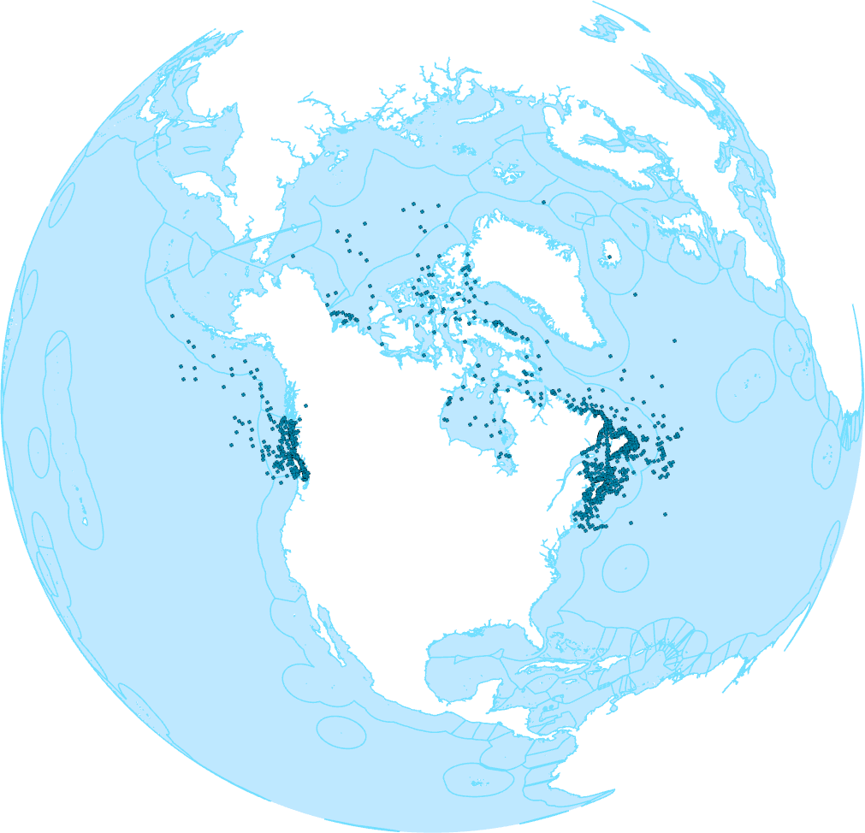
Integration of Canadian Geographical Names Database
3510 features have been integrated, of which 3251 features were new in Marine Regions. This operation includes all features where the province is marked as UF (Undersea Feature).
Issues found:
The coordinates of Baffin Basin (featureid = 0cc72d0b849c20c366db540d0045ba20) indicate a point on land. The ACUF coordinates for the feature with the same name (UFI = -152462) seem correct. Are these two separate features or are the coordinates incorrect in the Canadian gazetteer?
The coordinates for Crowther Canyon (featureid = 0cc6d4f0849c20c346664eb2316ae921) seem more clear in the ACUF gazetteer (UFI = -153067). What are the preferable coordinates for this feature?

Slide 16
Integration of Canadian Geographical Names Database
Issues found (continued):
The coordinates for Baker Fan (featureid = 0cf15e8d849c20c342dee253049ead07) seem more clear in the ACUF gazetteer (UFI = -152472). What are the preferable coordinates for this feature?
The coordinates for the Arctic Mid-Ocean Ridge (featureid = 0d08593a849c20c32075ca150695d9d0) seem substantially different from other gazetteers. Could this be a mistake or is there a reason for it?
The coordinates of Clarence Trough (featureid = 0cf1649b849c20c34234c09faa2d19e1) indicate a point on land. The ACUF coordinates for a feature with the same name (UFI = -152957) seem correct. Are these two separate features or are the coordinates incorrect in the Canadian gazetteer?
The coordinates for Newfoundland Shelf (featureid = 83ac31f2ba3611d892e2080020a0f4c9) seem to indicate a point that is not located on the shelf. Could this be a mistake or is there a reason for it?
The following features cannot be found anymore through the query tool on the website. Have they been removed or renamed?
Baffin Region Lake Trasimeno Navajo Reservoir | Chedabucto Bay Lake Conroe Peshtigo River | Gaspé Bay Muñoz Bay Musquash Estuary Protected Natural Area | Saguenay Fjord Jasper National Park of Canada

Slide 17
Integration of Canadian Geographical Names Database
Issues found (continued):
For some features from the Canada gazetteer, it is not entirely clear if the placetype of the given feature can be considered similar to the placetype that was already in the Marine Regions gazetteer, and if the features are the same. For now, we have integrated them under the same MRGID. Could you please have a look at the list in the file placetype_tocheck.xlsx (tab mainsourceCAN)?
See issue GEBCO h
See issue GEBCO i
See issue ACUF f
See issue ACUF g
See issue ACUF i

Slide 18
General overview Undersea Features in Marine Regions
Total: 10077 undersea features records in Marine Regions

Slide 19
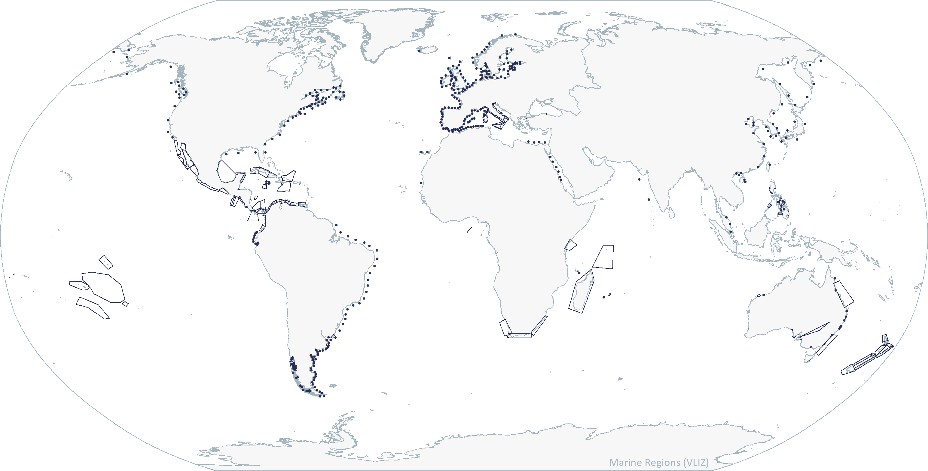
Other gazetteer updates
HAB monitoring grids

Slide 20
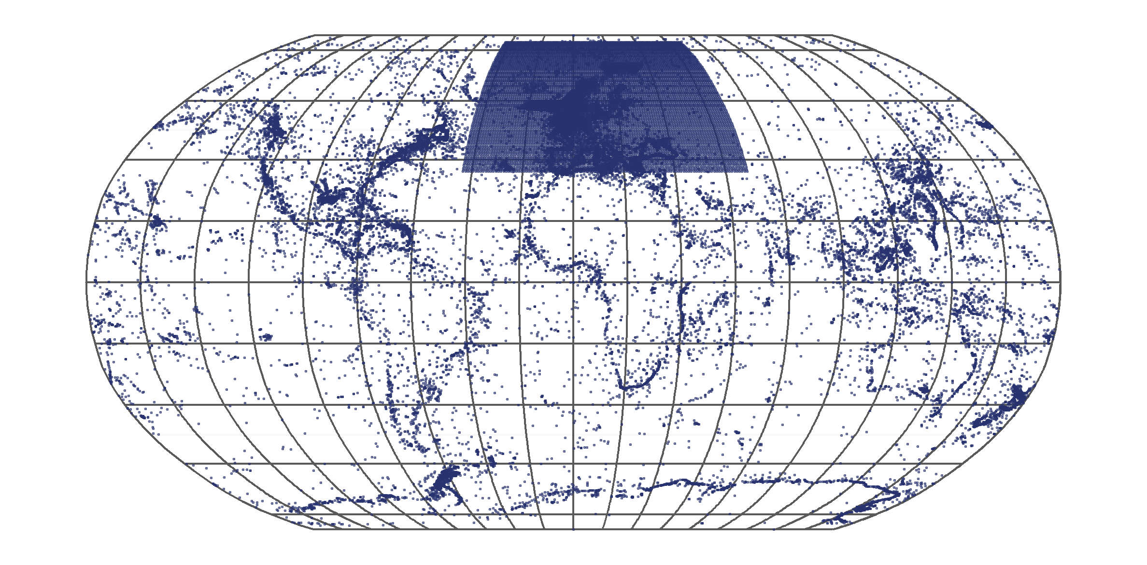
Evolution of records in Marine Regions (2005-present)
integration CGND
integration CGND

Slide 21
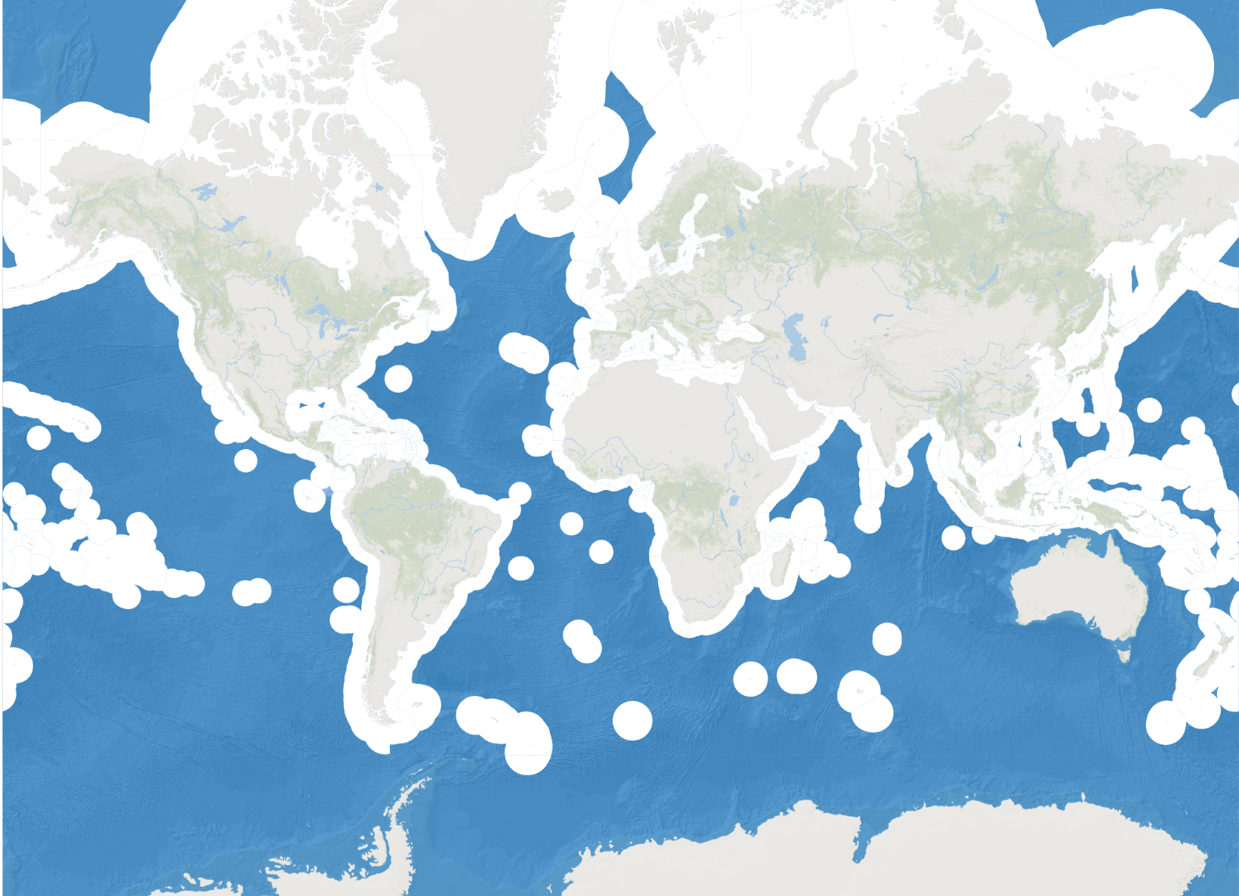
Short-term planned activities for Marine Regions
Maritime Boundaries v11
Areas Beyond National Jurisdiction
Continental shelves
Emission Control Areas

