Slide 1
Progress Report on the Establishment of EA-RECC
Hydrographic Office,
Marine Department
Hong Kong SAR Government
China
The 8th IHO WENDWG
20 - 22 March 2018, Buenos Aires, Argentina

Slide 2
Establishment of EA-RECC
Background
Upon the endorsement given in the last SC meeting in Feb 2017, Hong Kong China had subsequently started the preparatory work for the establishment of EA-RECC in March 2017;
As of March 2018, the key preparatory work included:
Staff recruitment and training
Setting up of office area
Drafting TOR, ROP and Operating Guidelines
Contacting with other RENCs

Slide 3
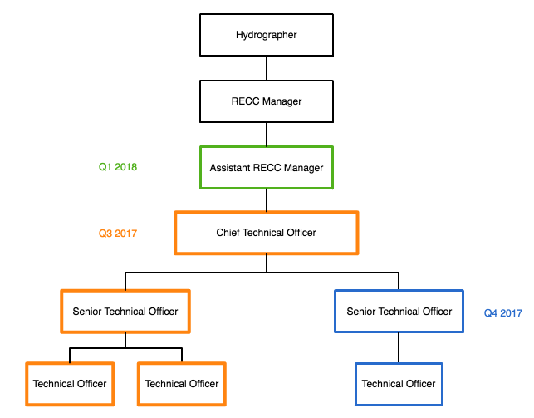
Staff Recruitment
Q2 2017
Clerical Assistant
Q2 2018

Slide 4
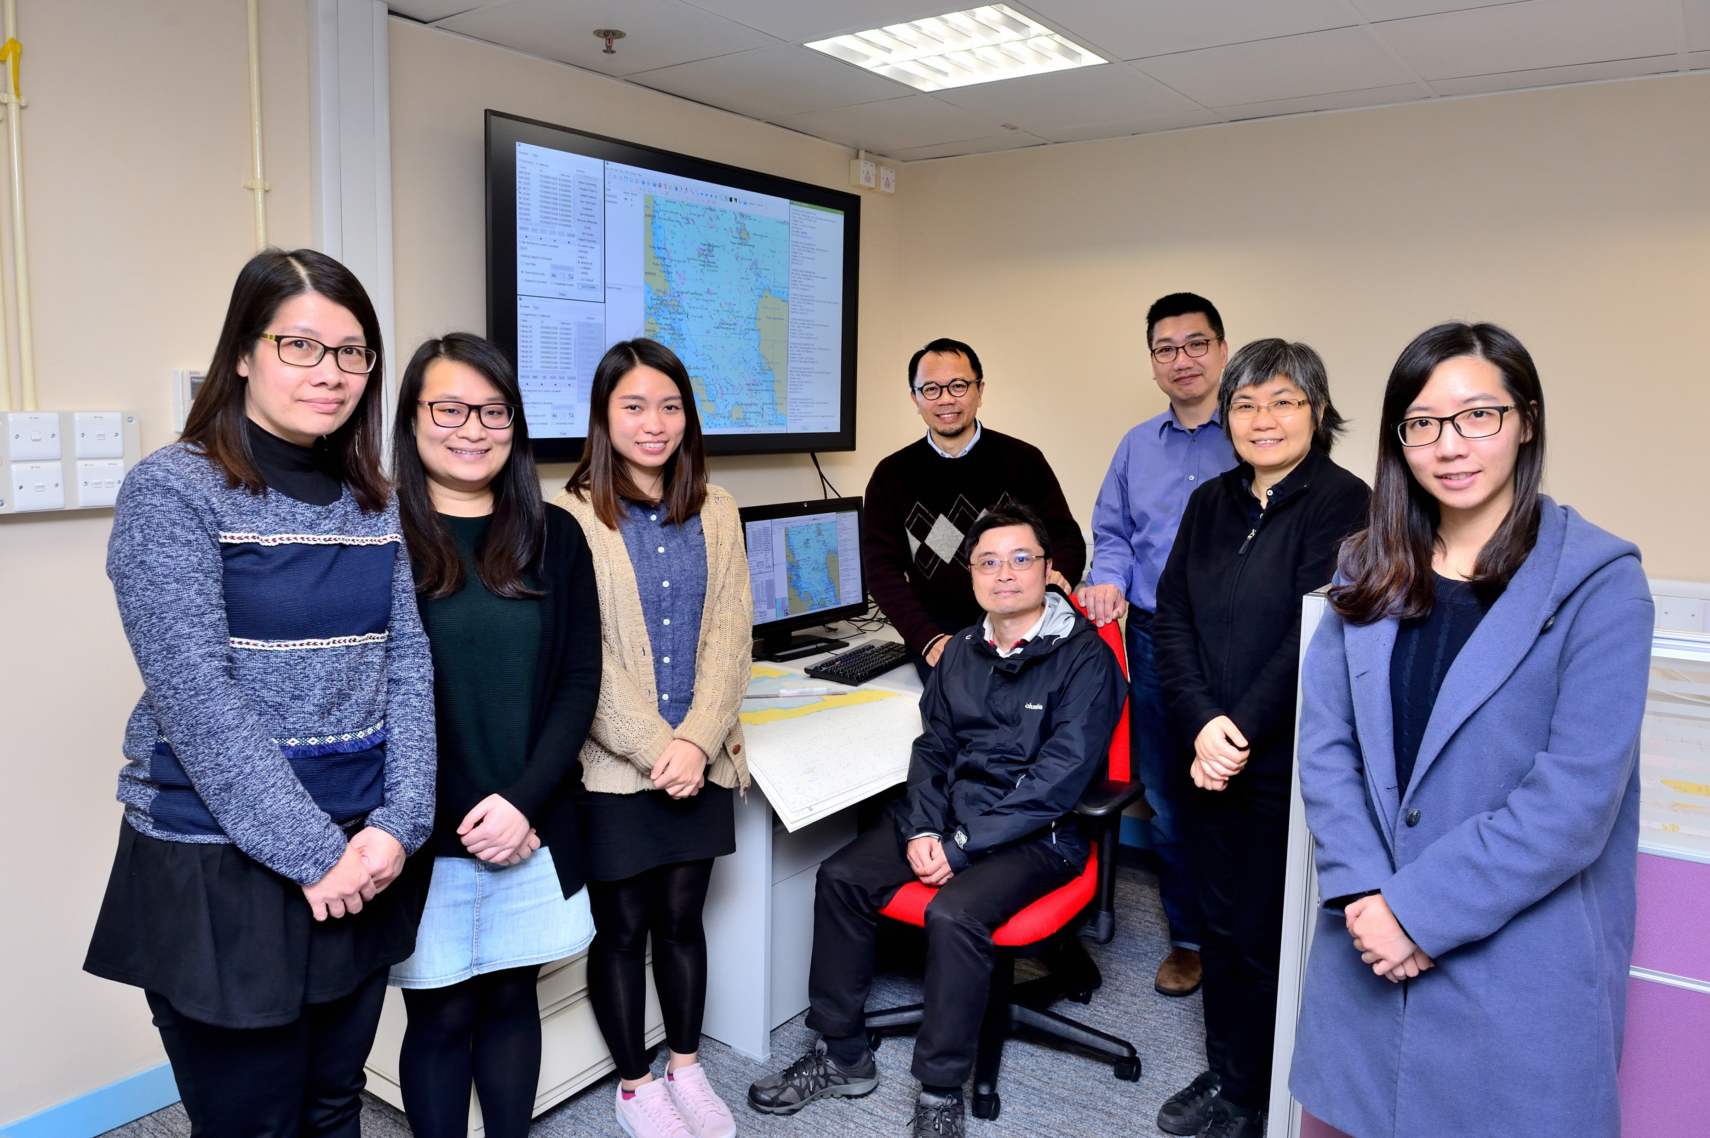
Staff Recruitment
Group Photo
The team of the EA RECC

Slide 5
Staff Training
SevenCs ENC Tools Training (Feb 2018)
IHO Standards (S-57, S-58 and ENC Data Production)
Introduction to ENC Designer
Introduction to ENC Referencer
Introduction to ENC Manager
Introduction to ENC Optimizer
ENC Validation using ENC Analyzer
Source Data Conversion ( focus on FME S-57 Writer)
Introduction to S-100 and latest development

Slide 6
Staff Training
SevenCs ENC Tools Training

Slide 7
Staff Training
EAHC Cat C Charting Training
Conducted by the centre’s Chief Geodata Officer who is a qualified trainer;
EAHC 1.0 Chart Data Assessment
EAHC 1.1 Verification Process and Data Assessment
EAHC 2.0 Paper Chart Compilation
EAHC 3.0 Basic ENC Production
EAHC 3.1 Introduction to ENC
EAHC 3.2 ENC Production
EAHC 4.0 Preparation of chart updating
EAHC 4.1 Notice to Mariners
EAHC 4.2 Chart Maintenance

Slide 8
Staff Training
EAHC Cat C Charting Training

Slide 9
Setting up of office area
The EA-RECC is located in the Hydrographic Office of Hong Kong
Setting up of office area:
By conversion of an existing conference room and some other ancillary area into office area;
Fitting out works and furnishing;
Procurement of Hardware and Software
The works started in August and completed in December 2017;

Slide 10
Setting up of office area
Vacated conference room ready for conversion

Slide 11
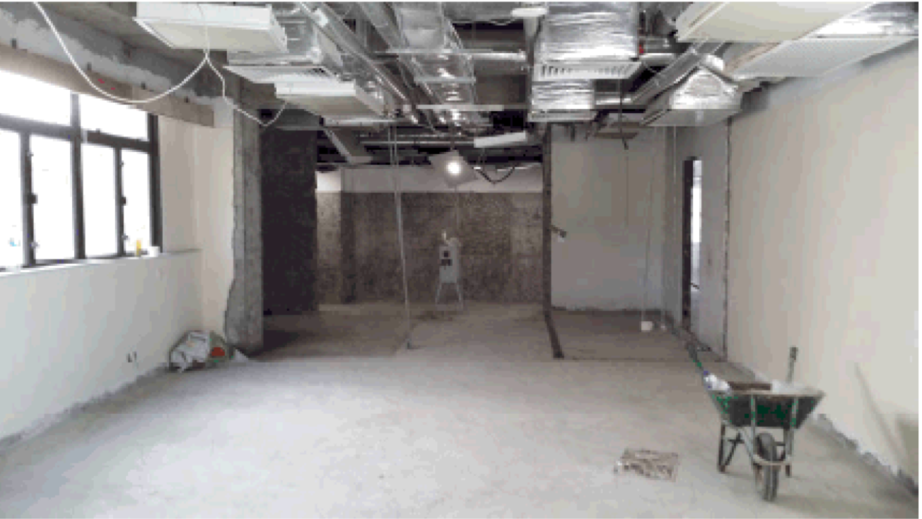
Setting up of office area
Building Works in Progress

Slide 12
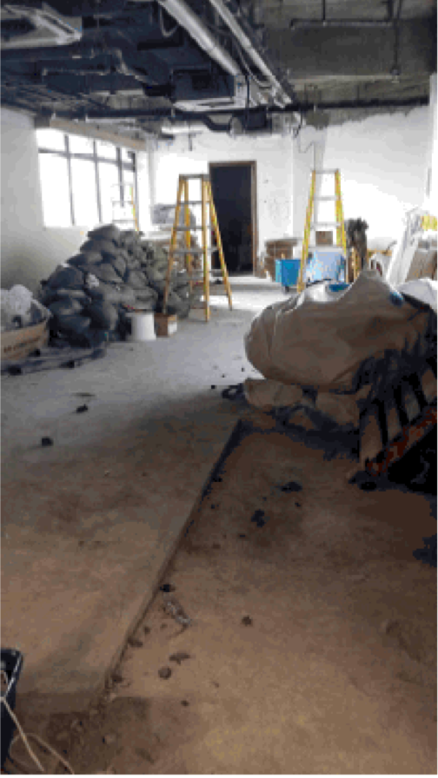
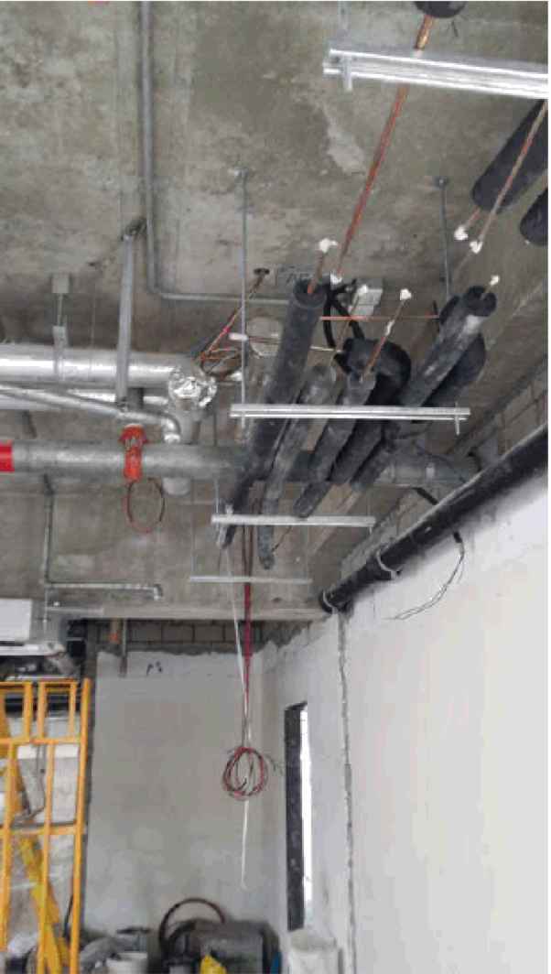
Setting up of office area
Building Works in Progress

Slide 13
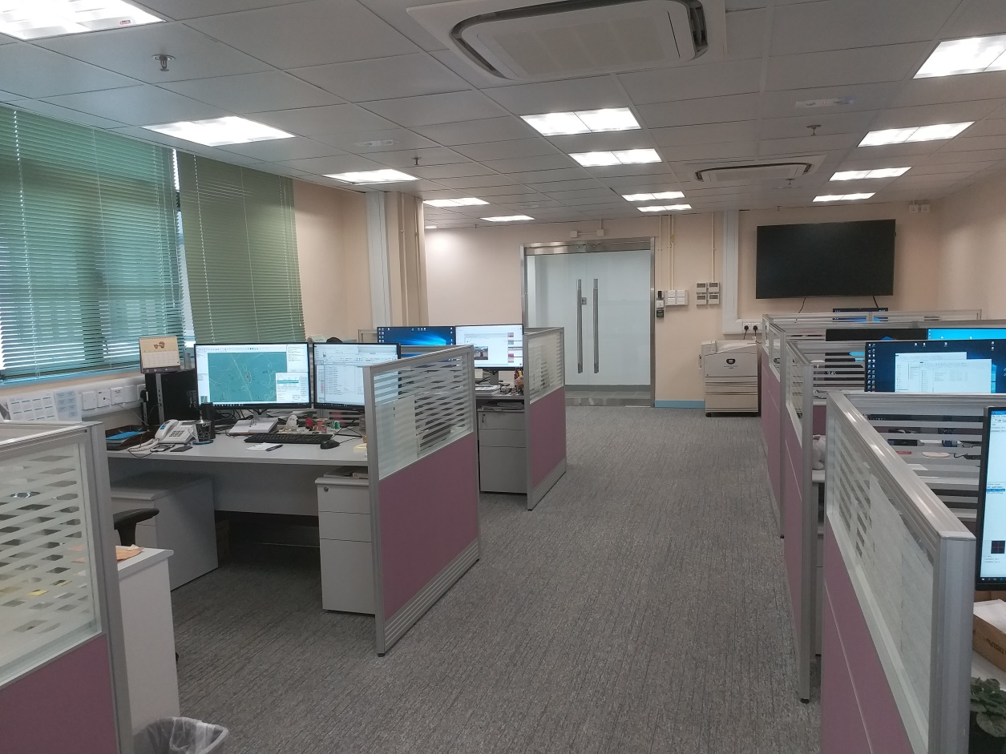
Setting up of office area
The new office area for the EA RECC

Slide 14
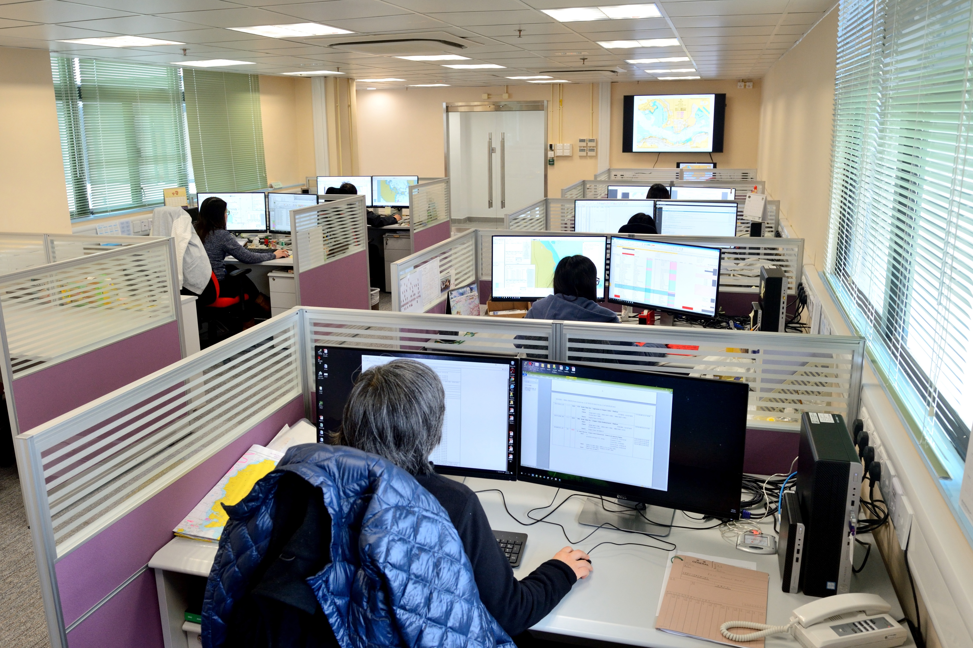
Setting up of office area

Slide 15
Contact with Other RENCs IC-ENC
Attended the 2nd IC-ENC Technical Conference as observer, 22 –24 May 2017, Copenhagen, Denmark
Key areas observed:
Latest development in IC-ENC
Validation Overview
Errors Database update
ENC Validation Training Overview
Data Management Tools
Quality Assurance Issues
Commercial products presentations

Slide 16
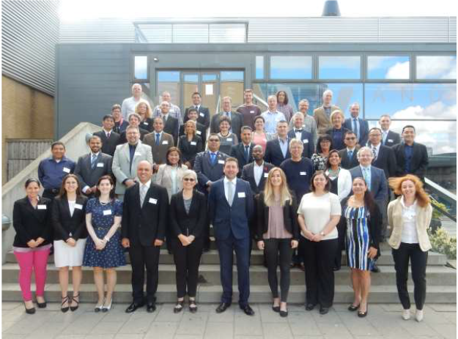
Contact with Other RENCs IC-ENC
Attending (as observer) IC-ENC Technical Conference, TC02, 22 –24 May 2017, Copenhagen, Denmark

Slide 17
Contact with Other RENCs IC-ENC
Workshop on the Implementation and Operation of a Regional ENC Coordination Centre
Conducted in HKHO in July 2017 with guest speaker Mr. James Harper, IC-ENC General Manager;
Attended by the key EA-RECC project staff;
This workshop provided a two-way flow of information:
The EA-RECC goals, purpose, project plan etc,
The IC-ENC global operating model of four core services (production support, validation, distribution and revenue management), financial model and governance.

Slide 18
Contact with Other RENCs IC-ENC
Workshop on the Implementation and Operation
of a Regional ENC Coordination Centre

Slide 19
Contact with Other RENCs IC-ENC
Meeting with Mr. James Harper, General Manager of IC-ENC

Slide 20
Contact with other RENCs PRIMAR
Attended the PRIMAR 15th Technical Expert Working Group Meeting as observer, 28-29 November 2017, Stavanger, Norway
Key areas observed:
Latest development in PRIMAR
RENC-RENC cooperation
Technical issues – S-101, S-102 & S-58
PRIMAR’s Errors Database
T&P Notices
Chart Catalogue on WEB
Commercial products presentations

Slide 21
Contact with other RENCs PRIMAR
Visiting PRIMAR office and meeting with their management staff;
Key issues discussed:
Organisation, status and operations of PRIMAR as a RENC;
Technology and tools applied in daily operations;
Opportunities for RENC-RENC cooperation

Slide 22
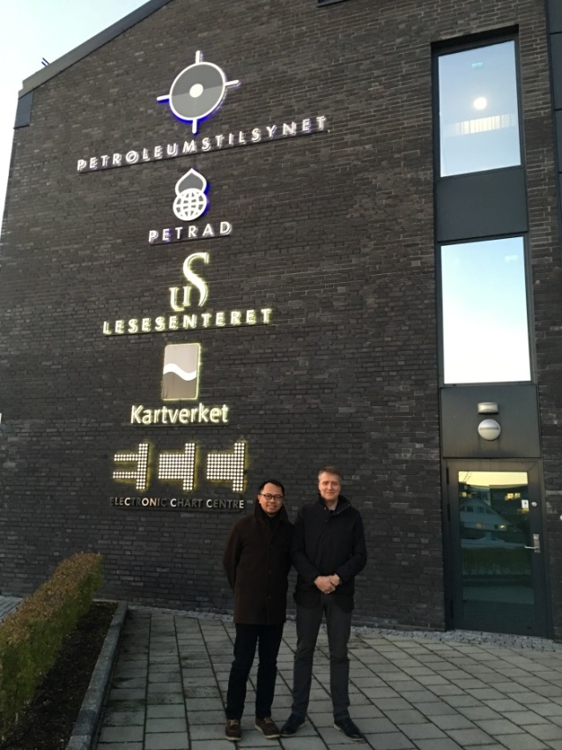
Contact with other RENCs PRIMAR
Visiting PRIMAR office, Stavanger, Norway

Slide 23
Drafting TOR, ROP and other documents for EA-RECC
TOR and ROP for the Board of Directors of EA-RECC;
TOR and ROP for EA-RECC;
Administrative procedures;
Procedure for handling of data flow and sales records;
Staff training plan

Slide 24
Progress Report on the Establishment of EA-RECC
- Thank You -

