Slide 1
Report of the representative of the NSHC on the implementation of ENC Schemes
Nigel Sutton UK
WORLDWIDE ENC DATABASE WORKING GROUP (WENDWG)

Slide 2
Status of the ENC Scheme(s) (UB1, UB2…) in the Region
NSHC32 approved that the development and maintenance of ENC schemes in the region should be coordinated by the NSICCWG, in place of the NSEHWG.

Slide 3
Status of the ENC Scheme UB1 in the Region
15 ENCs
Complete

Slide 4
Status of the ENC Scheme UB2 in the Region
97 ENCs
Complete for Europe
Greenland scheme under consideration

Slide 5
Status of the ENC Scheme UB3 in the Region
243 ENCs
Complete for Europe
Greenland scheme under consideration

Slide 6
Status of the ENC Scheme UB4 in the Region
1,110 ENCs
Complete for Europe
Greenland scheme under consideration

Slide 7
Status of the ENC Scheme UB5 in the Region
834 ENCs
Complete for Europe
Greenland scheme under consideration

Slide 8
Status of UB6 ENC Coverage in the Region
165 ENCs

Slide 9
Existence of overlapping ENCs that may have a possible impact on safe navigation
Using WEND overlap criteria
only minor overlaps identified in the region
No ENCs that may have an impact on safe navigation
19 minor overlaps – all carried over from 2016
4 x UB1, 5 x UB2, 9 x UB3 & 1 x UB4

Slide 10
Existence of overlapping ENCs that may have a possible impact on safe navigation
All ENC overlaps categorised as minor

Slide 11
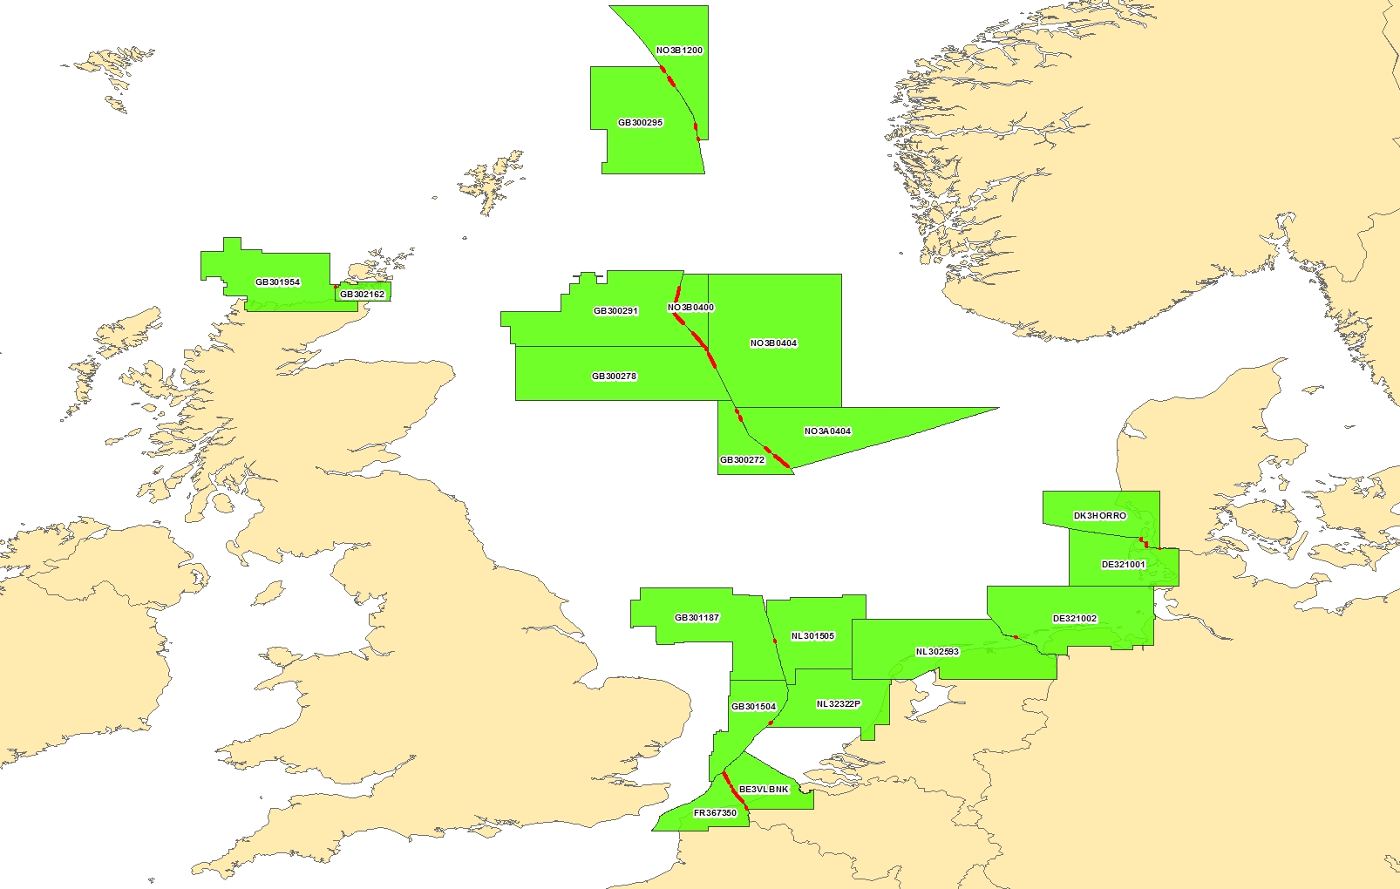
Existence of overlapping ENCs that may have a possible impact on safe navigation
All ENC overlaps categorised as minor

Slide 12
Coverage issues, gaps and risk assessment analysis
Coverage:
ENC scheme User Band 1 coverage complete for Region D
ENC scheme coverage complete in Europe for remaining User Bands 2 to 5
Denmark will be producing ENCs in other Usage Bands for Greenland

Slide 13
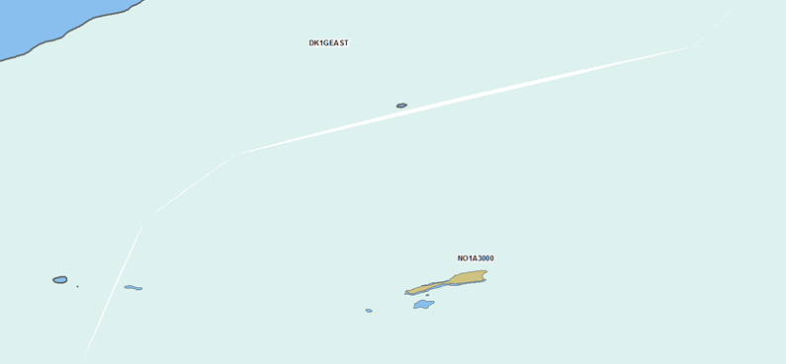
Coverage issues, gaps and risk assessment analysis
ENC User Band 1 gaps identified
Denmark and Norway are looking into the matter

Slide 14
Problems or outstanding issues, Recommendations
The analysis of ENC overlaps highlighted that many minor overlaps were not reconciled within a year.

Slide 15
Actions requested of WENDWG/IRCC
WENDWG is invited to note the report from NSHC

