Slide 1
Report of the representative of the ARHC on the implementation of ENC Schemes in Region N Evert Flier Norwegian Mapping Authority
WORLDWIDE ENC DATABASE WORKING GROUP (WENDWG)

Slide 2
Background
Arctic Regional Hydrographic Commission (ARHC) established in October 2010.
Core Members: Canada, Denmark, Norway, Russian Federation, USA.
Associate Members: Finland, Iceland, Italy.
New INT Charting Region ‘N’ created 2011.
Arctic INT Chart Coordination Working Group (AICCWG) established October 2012.
AICCWG fully manned - Norway acting as regional charting coordinator.

Slide 3
Overview of INT Region N
INT Region N
INT Region N covers the Arctic Ocean and adjacent seas north of the Bering Strait (line joining Mys Dezhneva and Cape Prince of Wales) and north of the 69°N parallel in the Nordic Seas.

Slide 4
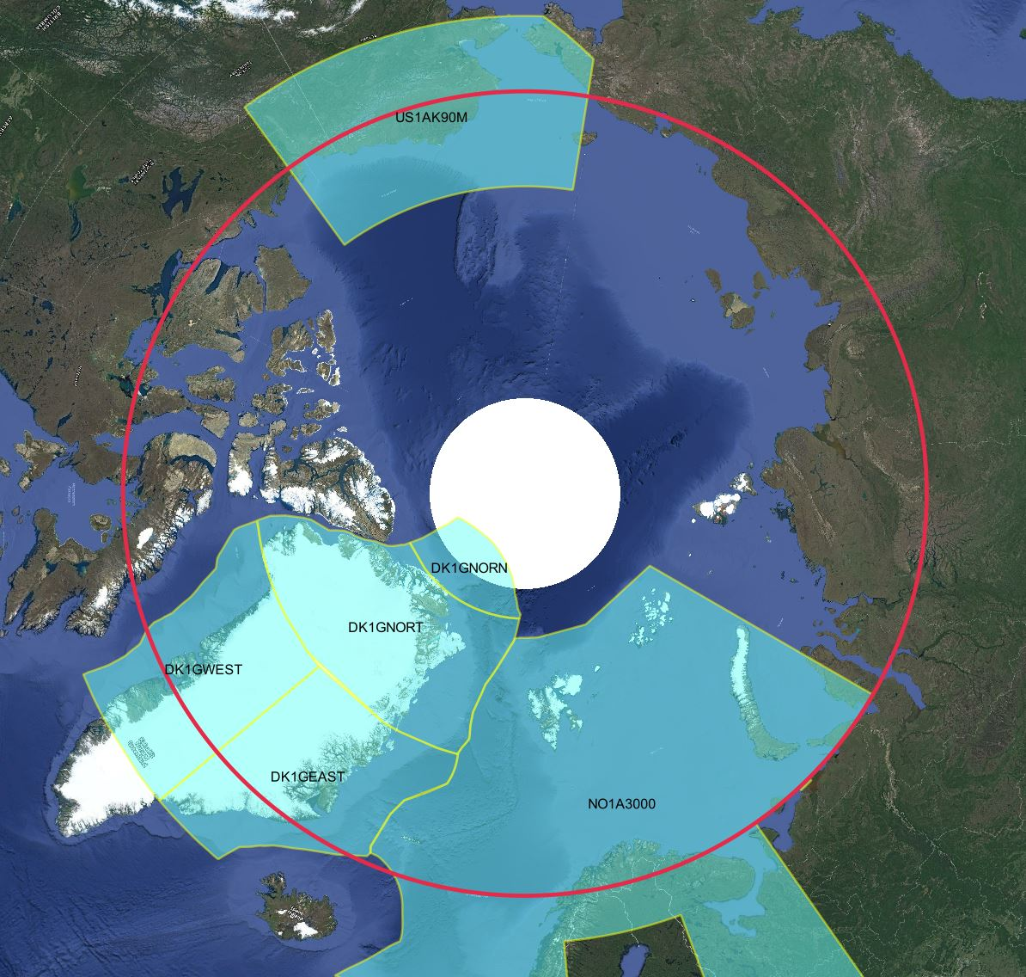
Status of the ENC Scheme UB1 in Region N
Number of ENC’s
UB1 Overview: 6
Figures as of Feb 2018

Slide 5
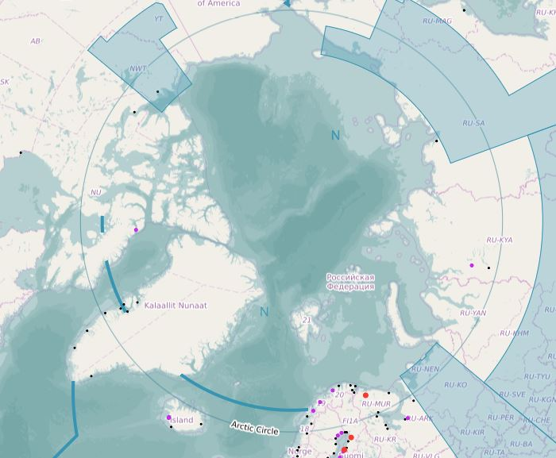
Status of the ENC Scheme UB1 in Region N
And three non-RENC exclusive UB1 ENC’s
Figures as of Feb 2018

Slide 6
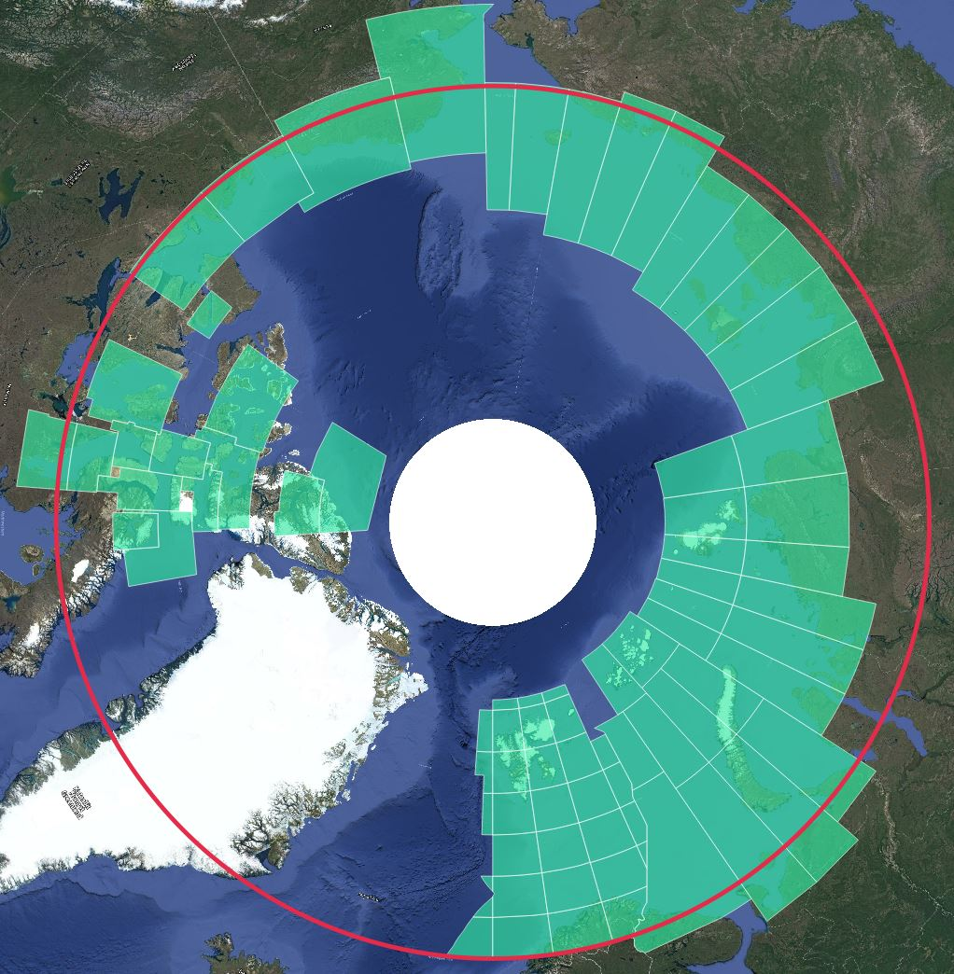
Status of the ENC Scheme UB2 in Region N
Number of ENC’s
UB2 General: 81
Figures as of Feb 2018

Slide 7
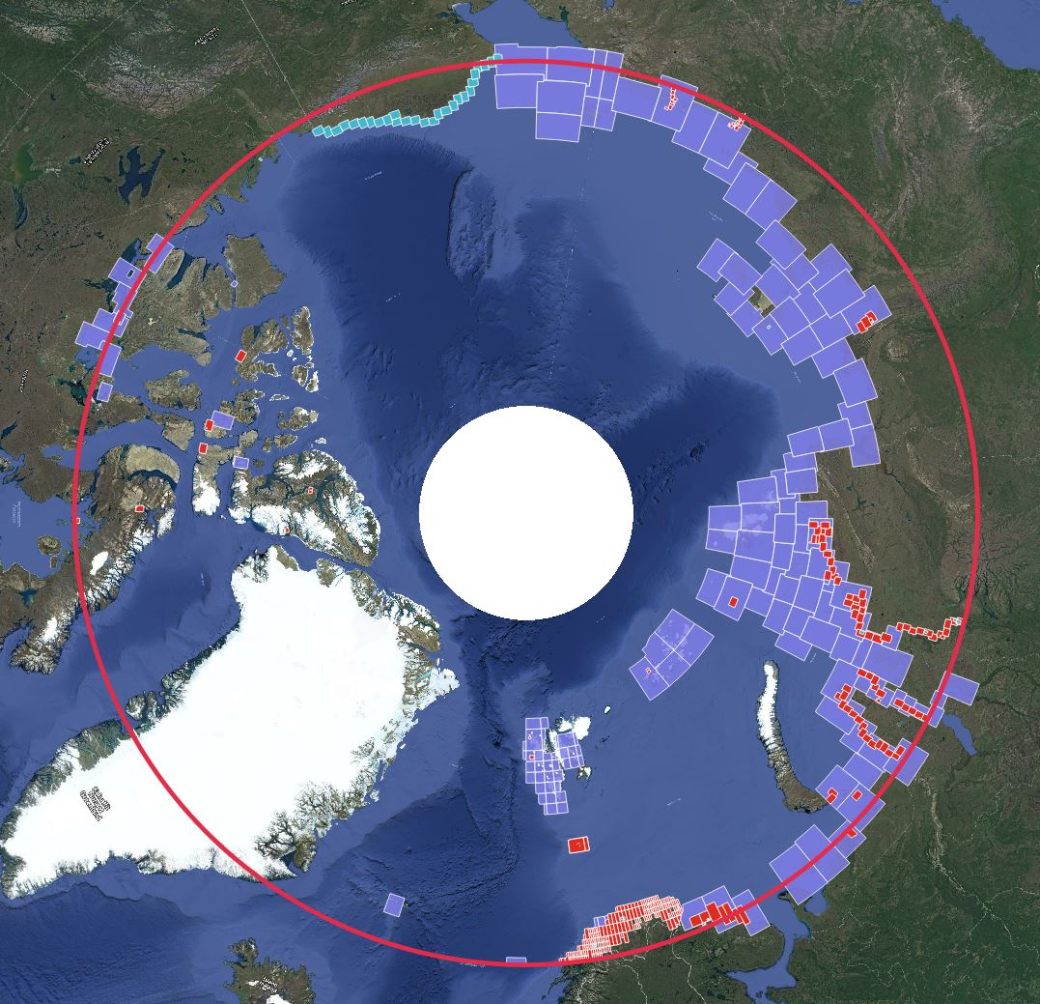
Status of the ENC Schemes UB 3/4/5/6 in Region N
Number of ENC’s
UB3 Coastal: 157
UB4 Approach: 339
UB5 Harbour: 132
UB6 Berthing: 22
Figures as of Feb 2018

Slide 8
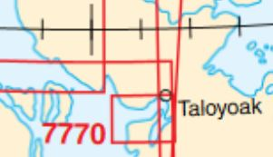
ENC Proposals Region N
Canada – A new UB 3 ENC is under production for chart 7770: Spence Bay and Approaches – due for publication early 2018.
USA – Plan to release two new UB 2 ENC’s by the end of 2018.

Slide 9
Existence of overlapping ENCs that may have a possible impact on safe navigation

Slide 10
Coverage issues, gaps and risk assessment analysis
IC-ENC Overlap Report sent to all HO’s - October 2017.
Relatively small number of overlaps.
All overlaps assessed as ‘LOW’ severity of risk.
HO’s encouraged to consider report and suggest actions aimed at resolving the overlaps.
AICCWG chair coordinating feedback from HO’s.
Norway and Denmark have entered into discussions aimed at resolving the overlap issues between UB 1 ENCs NO1A300 and DK1GEAST/DK1GNORT.

Slide 11
ENC Schemes in Region N : Moving Forward
Importance of ENC scheming in ARHC is acknowledged.
AICCWG to prepare graphic overview of ENC coverage in Region N.
HO’s to provide AICCWG with national ENC production plans.
AIS data to be used to highlight gaps in existing ENC coverage – help direct additional mapping resources in areas of high traffic in The Arctic.
INToGIS Project – Valuable resource for the management and dissemination of ENC data.
Phase II of INToGIS is underway – promises a number of improvements.
Norway has offered to assist with the experimentation phase.

