Slide 1
Report of the representative of the BSHC (Baltic Sea Hydrographic Commission) on the implementation of ENC Schemes in Region E Finland Jarmo Mäkinen
WORLDWIDE ENC DATABASE WORKING GROUP (WENDWG)
WENDWG-9, Brest, France 26 – 28 February 2019

Slide 2
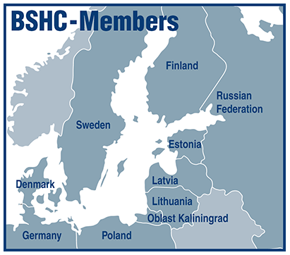
Region E- Baltic Sea- Background
Members: Denmark, Estonia, Finland, Germany, Latvia, Poland, Russian Federation, Sweden
Associate Member: Lithuania
Web site:
http://www.bshc.pro/

Slide 3
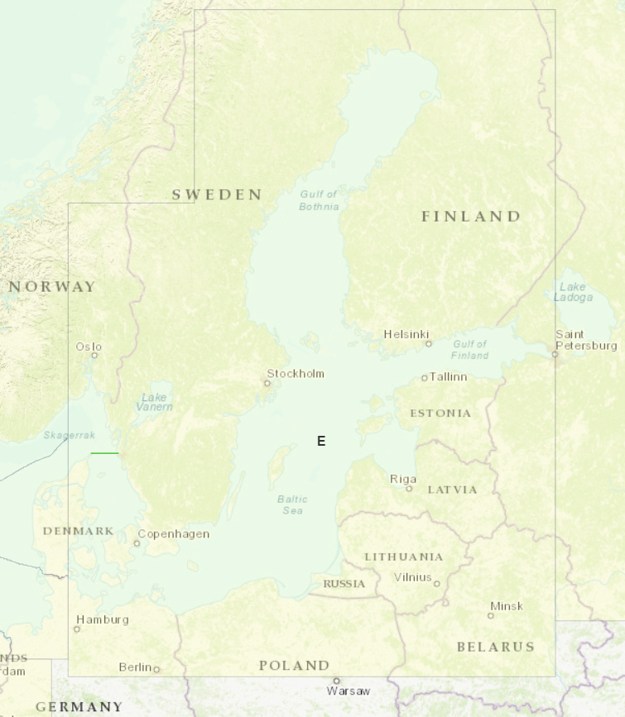
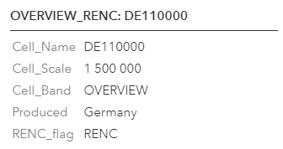
Status of the ENC Scheme in Region E UB1 (Overview)
1 Overview – produced by Germany (agreed by BSHC)

Slide 4
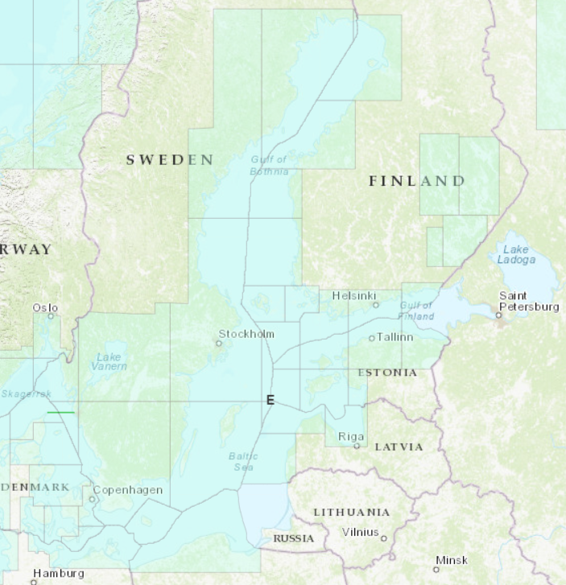
Status of the ENC Scheme in Region E UB2 (General) 42 ENCs

Slide 5
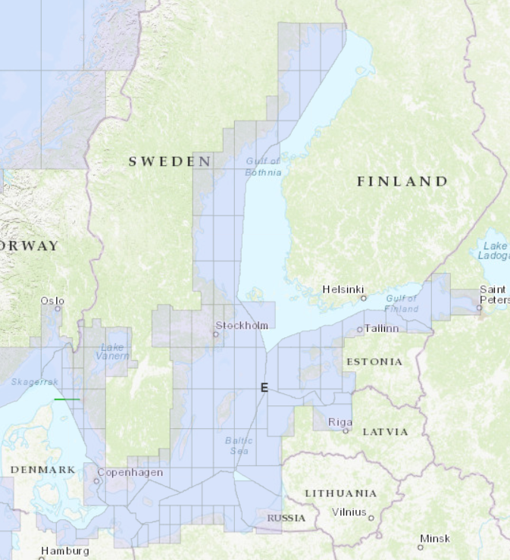
Status of the ENC Scheme in Region E UB3 (Coastal) 132 ENCs
Denmark and Finland are planning extend Coastal coverage.

Slide 6
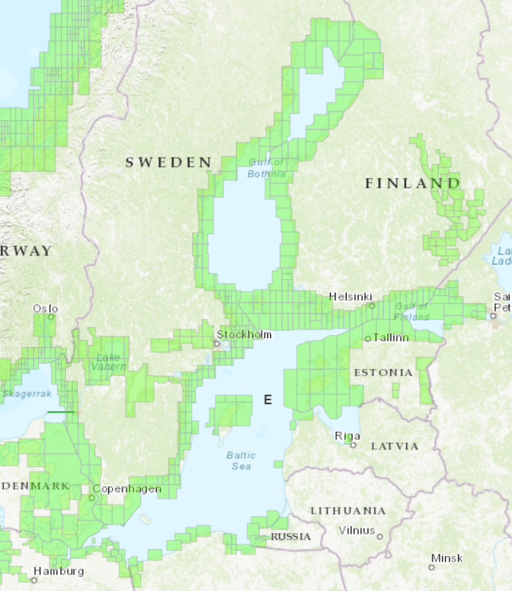
Status of the ENC Scheme in Region E UB4 (Approach) 421 ENCs
Poland is planning to extend its approach coverage to cover the whole coastline
Latvia is planning to extend approach coverrage, starting 2019

Slide 7
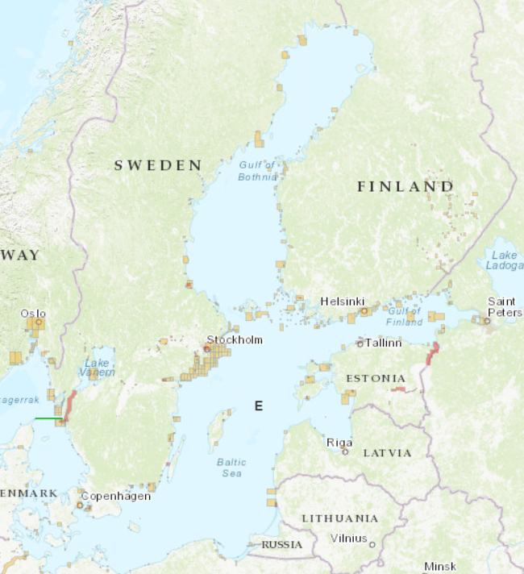
Status of the ENC Scheme in Region E UB5 (Harbour) 488 ENCs UB6 (Berth ) 187 ENCs
Denmark is planning to release many new harbor cells within a couple of years.

Slide 8
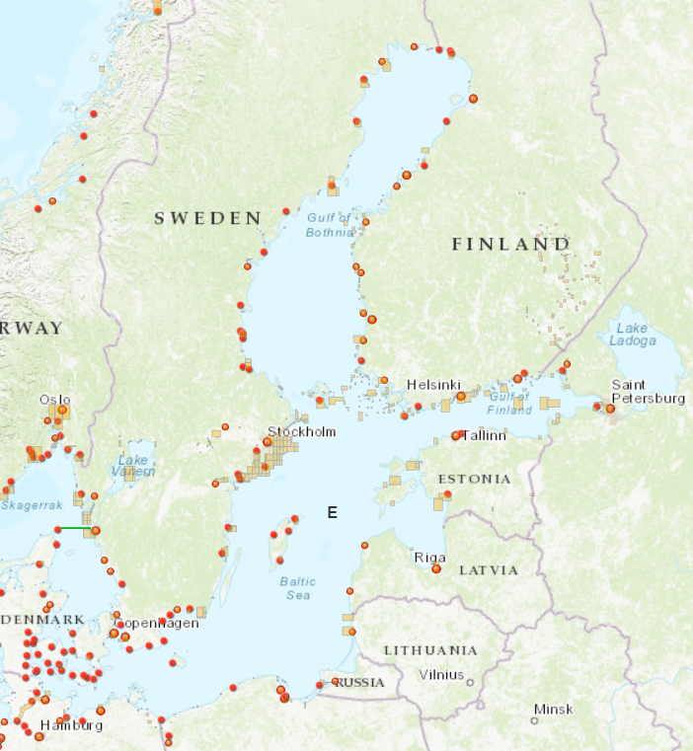
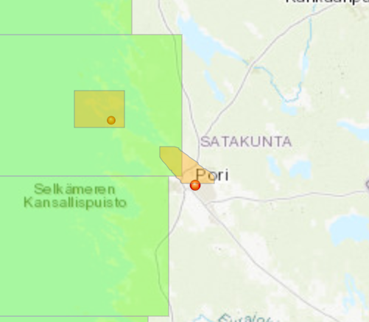
Baltic Sea Ports

Slide 9
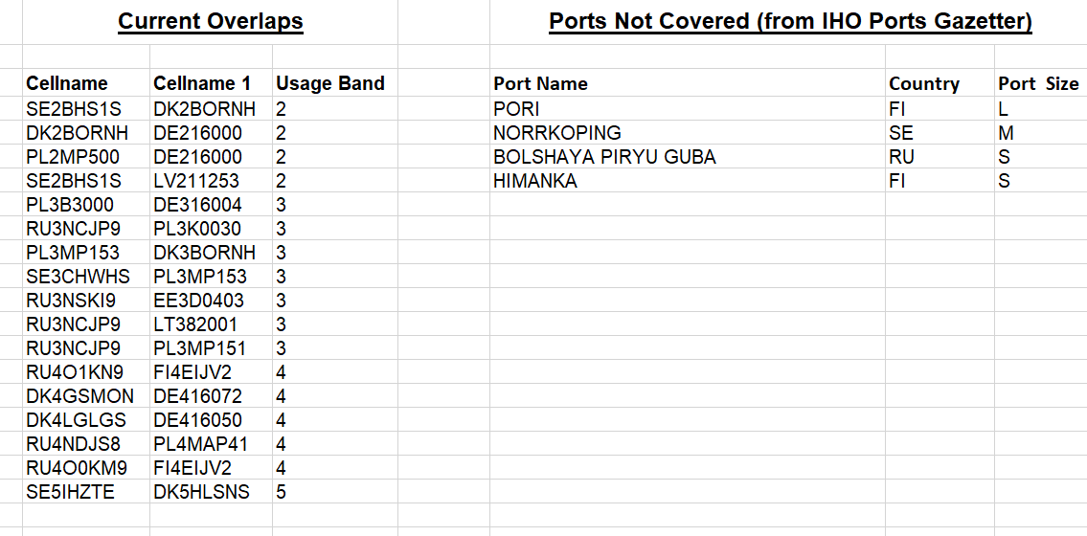
Existence of overlapping ENCs that may have a possible impact on safe navigation
Many of overlaps have not seen as a risk
in a navigational point of view
Member states work to solve overlaps
Some of Baltic Sea overlaps are under NHC,
in report

Slide 10
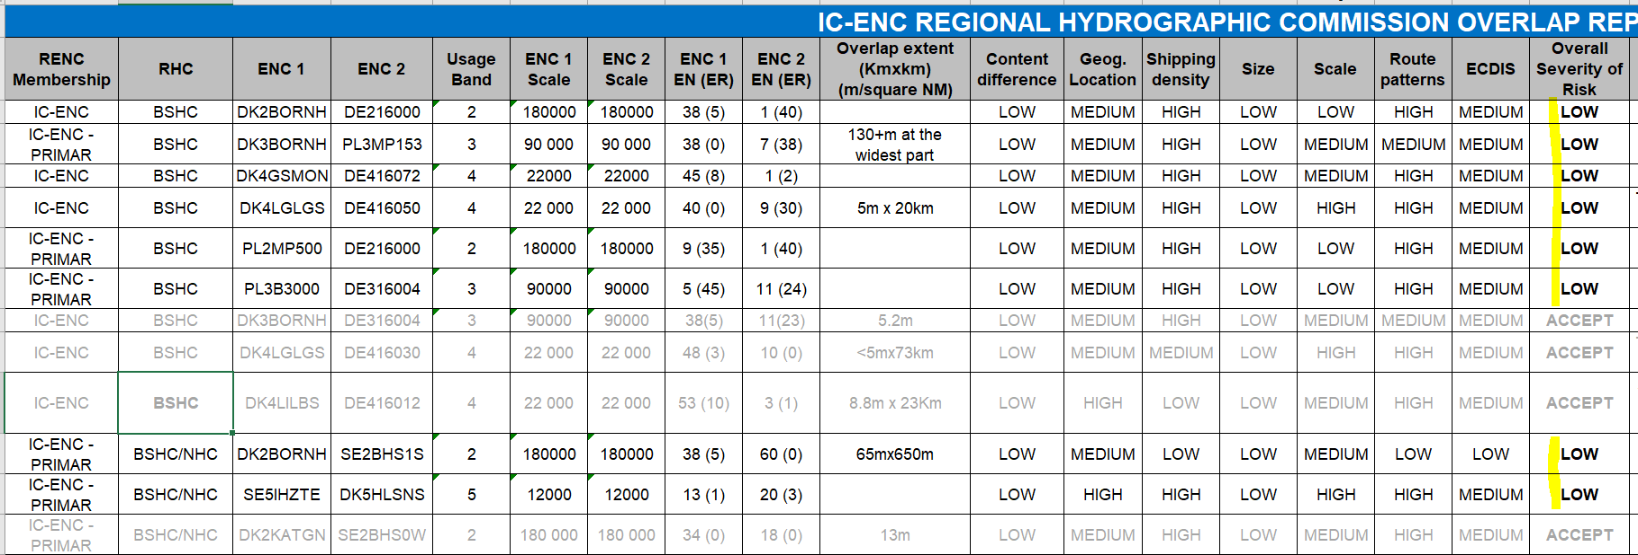
Existence of overlapping ENCs that may have a possible impact on safe navigation
IC-ENC overlapping data policy report has been presented in the BSHC meetings and in the BSICCWG .
IC-ENC Regional Hydrographic Commission Overlap report (Feb 2019). No Medium or High level risk (Overall Severity of Risk) was indicated. One overlap with medium-level overall risk has solved since 2018.

Slide 11
Existence of overlapping ENCs that may have a possible impact on safe navigation
IC-ENC Regional Hydrographic Commission Overlap report (Feb 2019). Example:

Slide 12
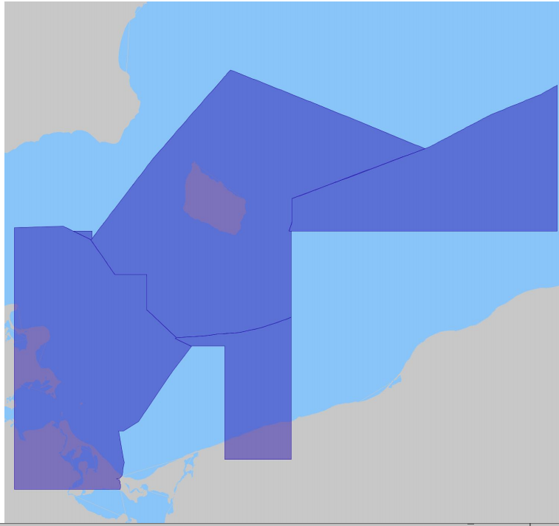
Existence of overlapping ENCs that may have a possible impact on safe navigation
IC-ENC Regional Hydrographic Commission Overlap report (Feb 2019). Example:

Slide 13
Problems or outstanding issues, Recommendations
-
IC-ENC Regional Hydrographic Commission Overlap report (BSHC) will be handled in next BSICCWG –meeting
in April 2019.
All the reported overlaps will be discussed.
IC-ENC will send updated report before the meeting.
Primar overlap checker is used for identifying details.
Member states will inform Chart Coordinator of new cells and major changes in coverage (agreed in BSICCWG)
BSICCWG will report to BSHC (Sept 2019).

Slide 14
Actions requested of WENDWG/IRCC
WENDWG9 is invited to note the report from BSHC

