Slide 1
Development of the IHO ENC Coverage Catalogue (Agenda WENDWG 04.2) IHO Secretariat
WORLDWIDE ENC DATABASE WORKING GROUP (WENDWG)

Slide 2
Background information
Objective of the IHO ENC Catalogue
IMO NCSR 1/WP.8* “ECDIS – Guidance for Good Practice”
“…
The IHO provides an online chart catalogue that details the coverage of ENCs together with references to coastal state guidance on any requirements for paper charts (where this has been provided). The catalogue also provides links to IHO Member States’ websites where additional information may be found. The IHO online chart catalogue can be accessed from the IHO website.
…”
*now superseded by MSC.1/Circ. 1503/Rev.1, 16 June 2017

Slide 3
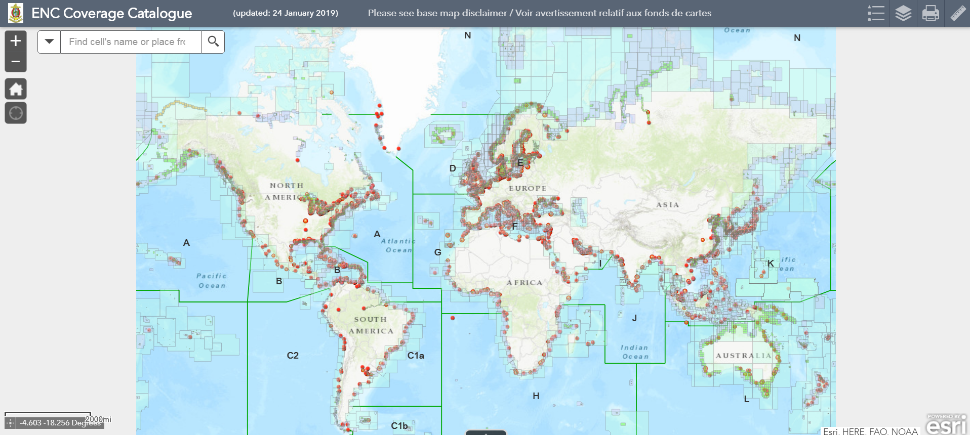
Background information
www.iho.int > ENCs & ECDIS > ENC Availability

Slide 4
Background information
WENDWG8/10
“…
The WENDWG agreed to commission the new and more comprehensive version of the IHO ENC Coverage Catalogue as presented at WENDWG-8. …”

Slide 5
Improvements on IHO ENC Catalogue
More frequent updating (monthly to weekly)
Cells derived from RENC and Non-RENC are integrated.
IC-ENC data and PRIMAR data are used for the updating.
The classification is based on:
“RENC Update of the Data Flow Diagram”
(WENDWG8-04.3D3&J5).
Search function for cell names, attribute table is available
ENC database alignment with INToGIS II is in progress

Slide 6
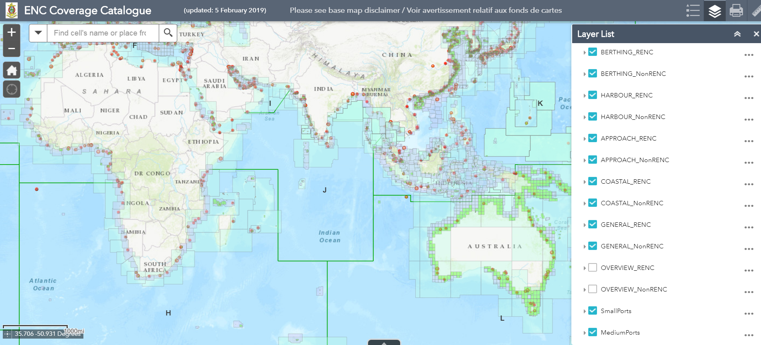
Improvements on IHO ENC Catalogue
Weekly update
Cell name search
RENC/non-RENC
All attribute is available here

Slide 7
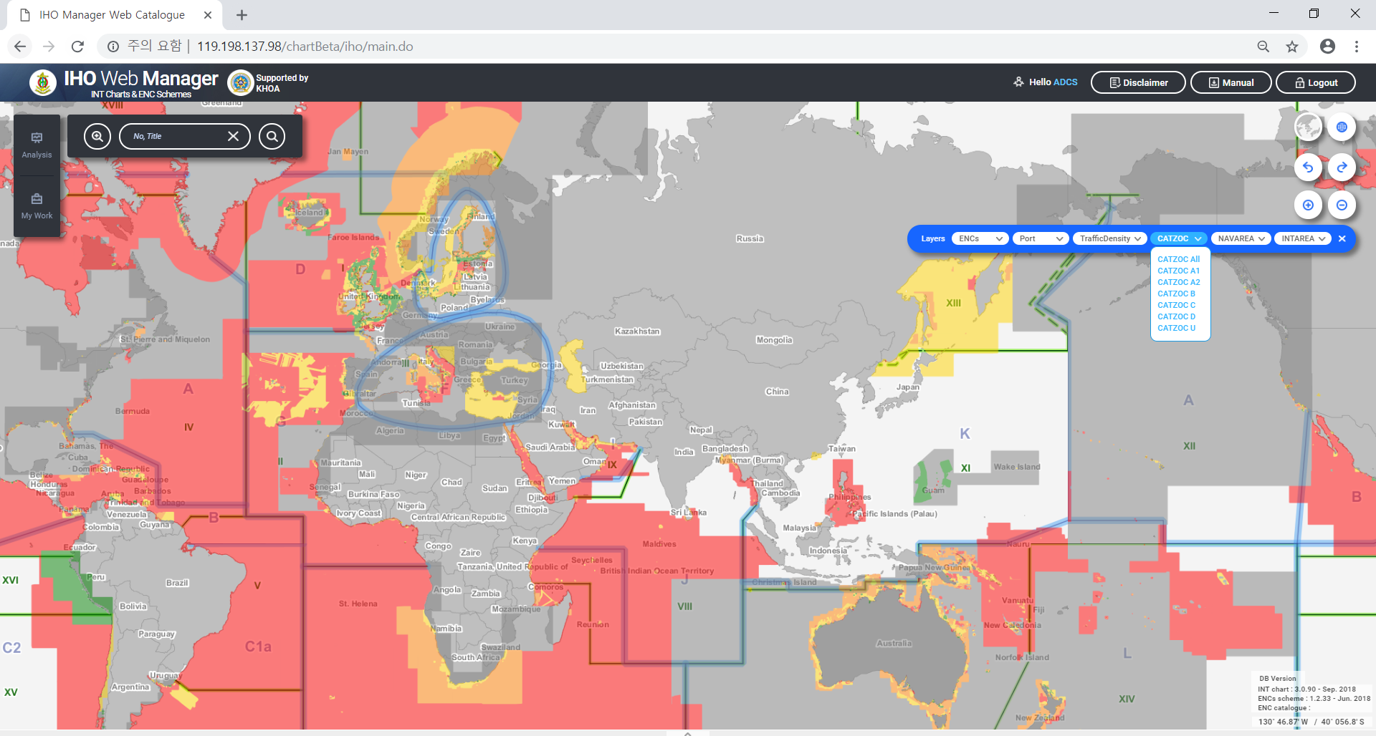
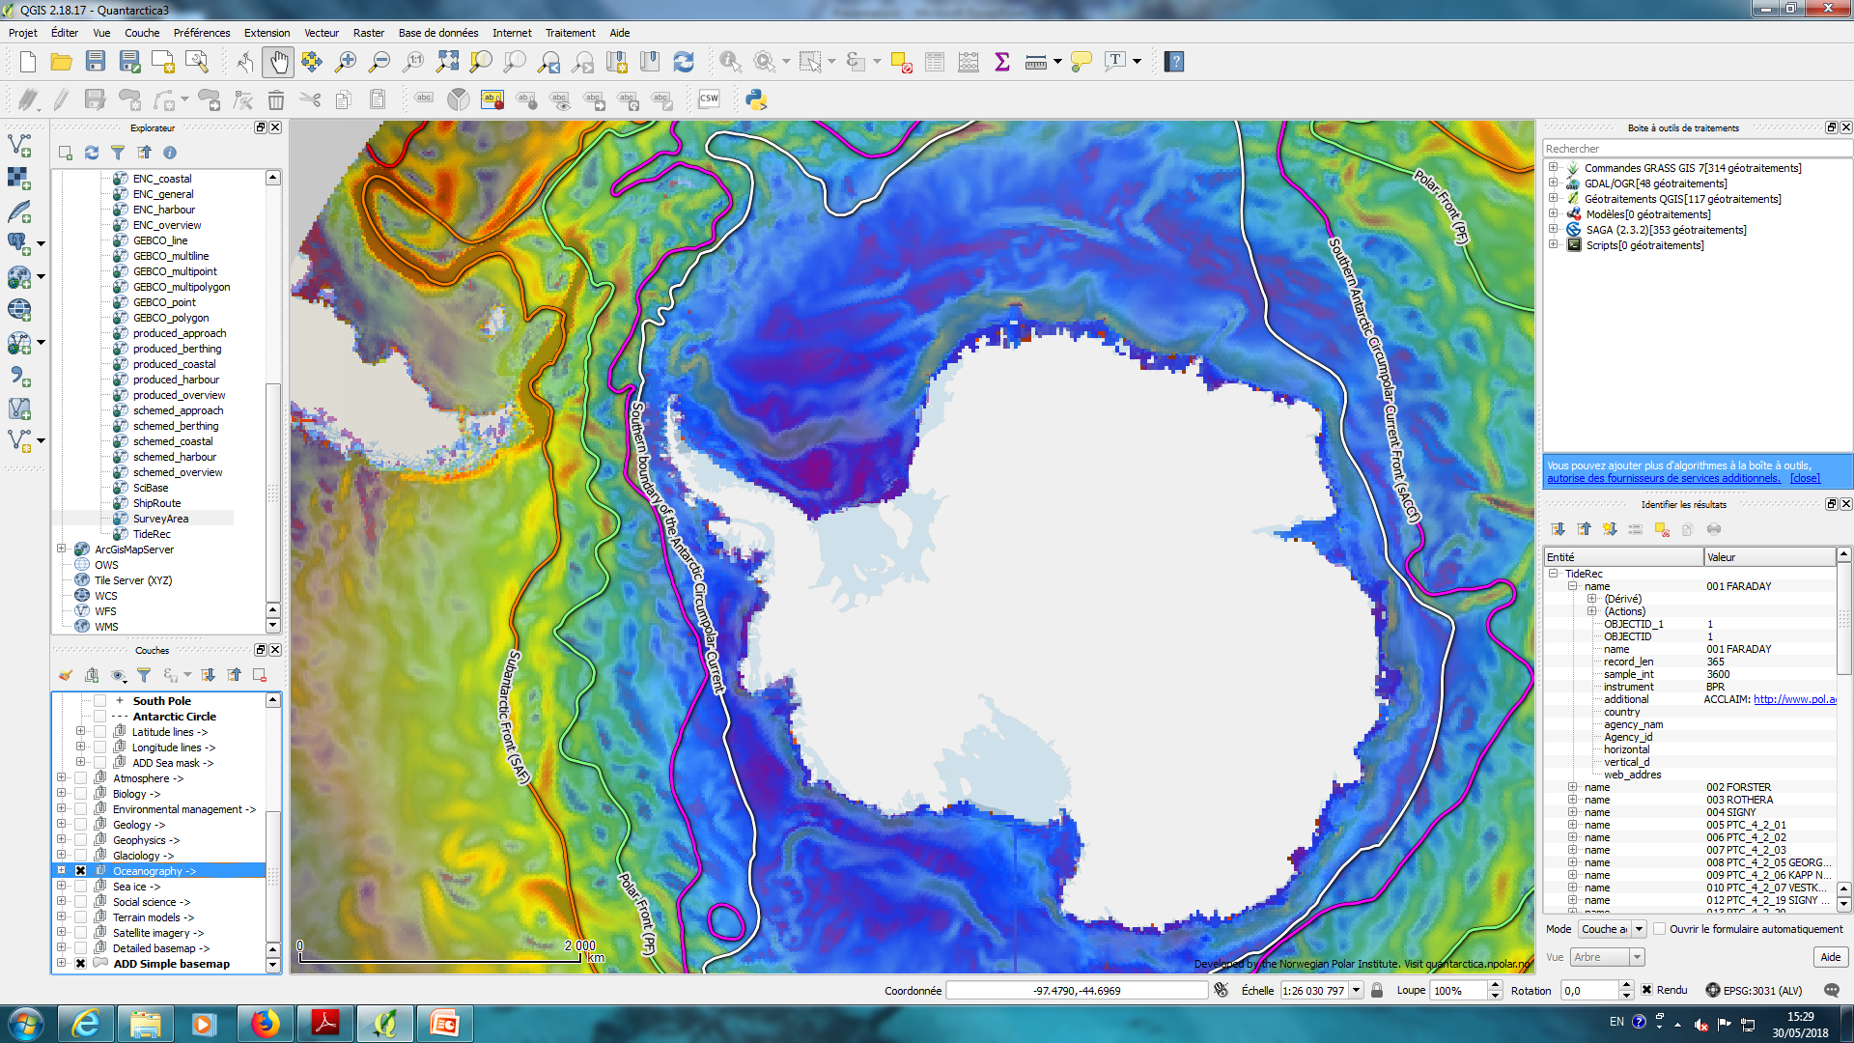
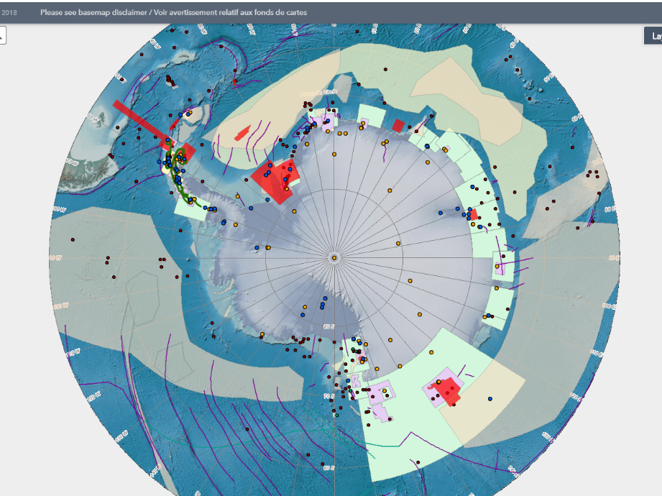
For more connected GIS services
Data provider
?
?
IHO GIS IHO Sec. only
INToGIS II by KHOA
CATZOC
RENC
ENC coverage
ENC availability by IHO Sec.
Quantarctica
by Norwegian Polar Institute
HCA GIS by IHO Sec.

Slide 8
Way ahead
Link the IHO ENC Catalogue and the INT Chart & ENC Schemes Web Catalogue
→ In progress (Reference: INToGIS Phase II Project), Charting Regions, etc.
Improve the automated generation of IHO Performance Indicators and information to be reported to IMO (NCSR)
→ On hold, waiting for outcomes of the Strategic Plan Review WG
Improve display to align with ENC Data Flow Diagram
→ Done, developed by RENCs in liaison with IHO Secretariat

Slide 9
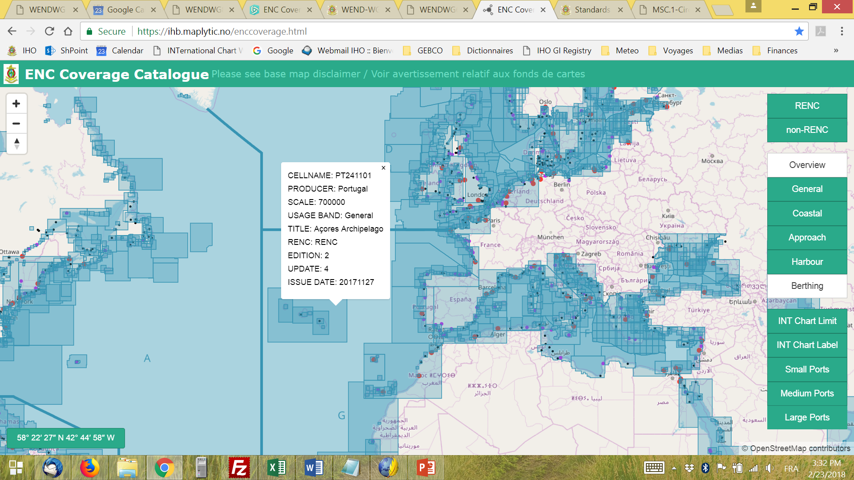
Action to be taken by WENDWG
To note the status report and consider closing this work item in the WENDWG Programme of Work, for now
To consider the way forward for the provision of CATZOC values (on a quarterly basis?) to IHO Secretariat for being used in the Manager Mode of INToGIS Phase II (→ request to IRCC in the WENDWG Report and subsequent actions by RENCs?)

