Slide 1
WORLDWIDE ENC DATABASE WORKING GROUP (WENDWG)
NORTH SEA HYDROGRAPHIC COMMISSION (NSHC)
Membership:
Belgium, Denmark, France, Germany, Iceland, Ireland, Netherlands, Norway, Sweden, United Kingdom.
NSHC Report - REGION D
Implementation of ENC Schemes
Nigel Sutton (UK)

Slide 2
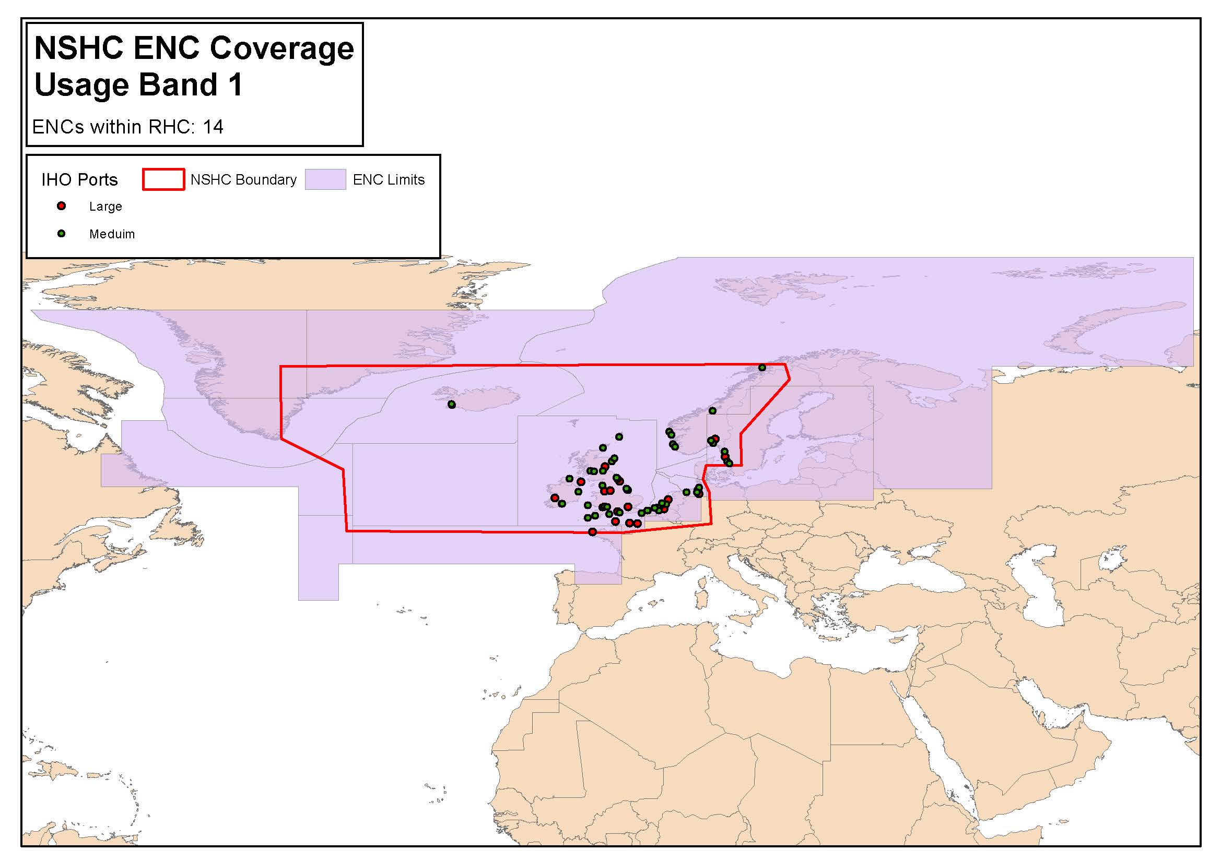
Status of the ENC Scheme in Region D
Overview
NSHC ENC COVERAGE
Usage Band 1
15 ENCs

Slide 3
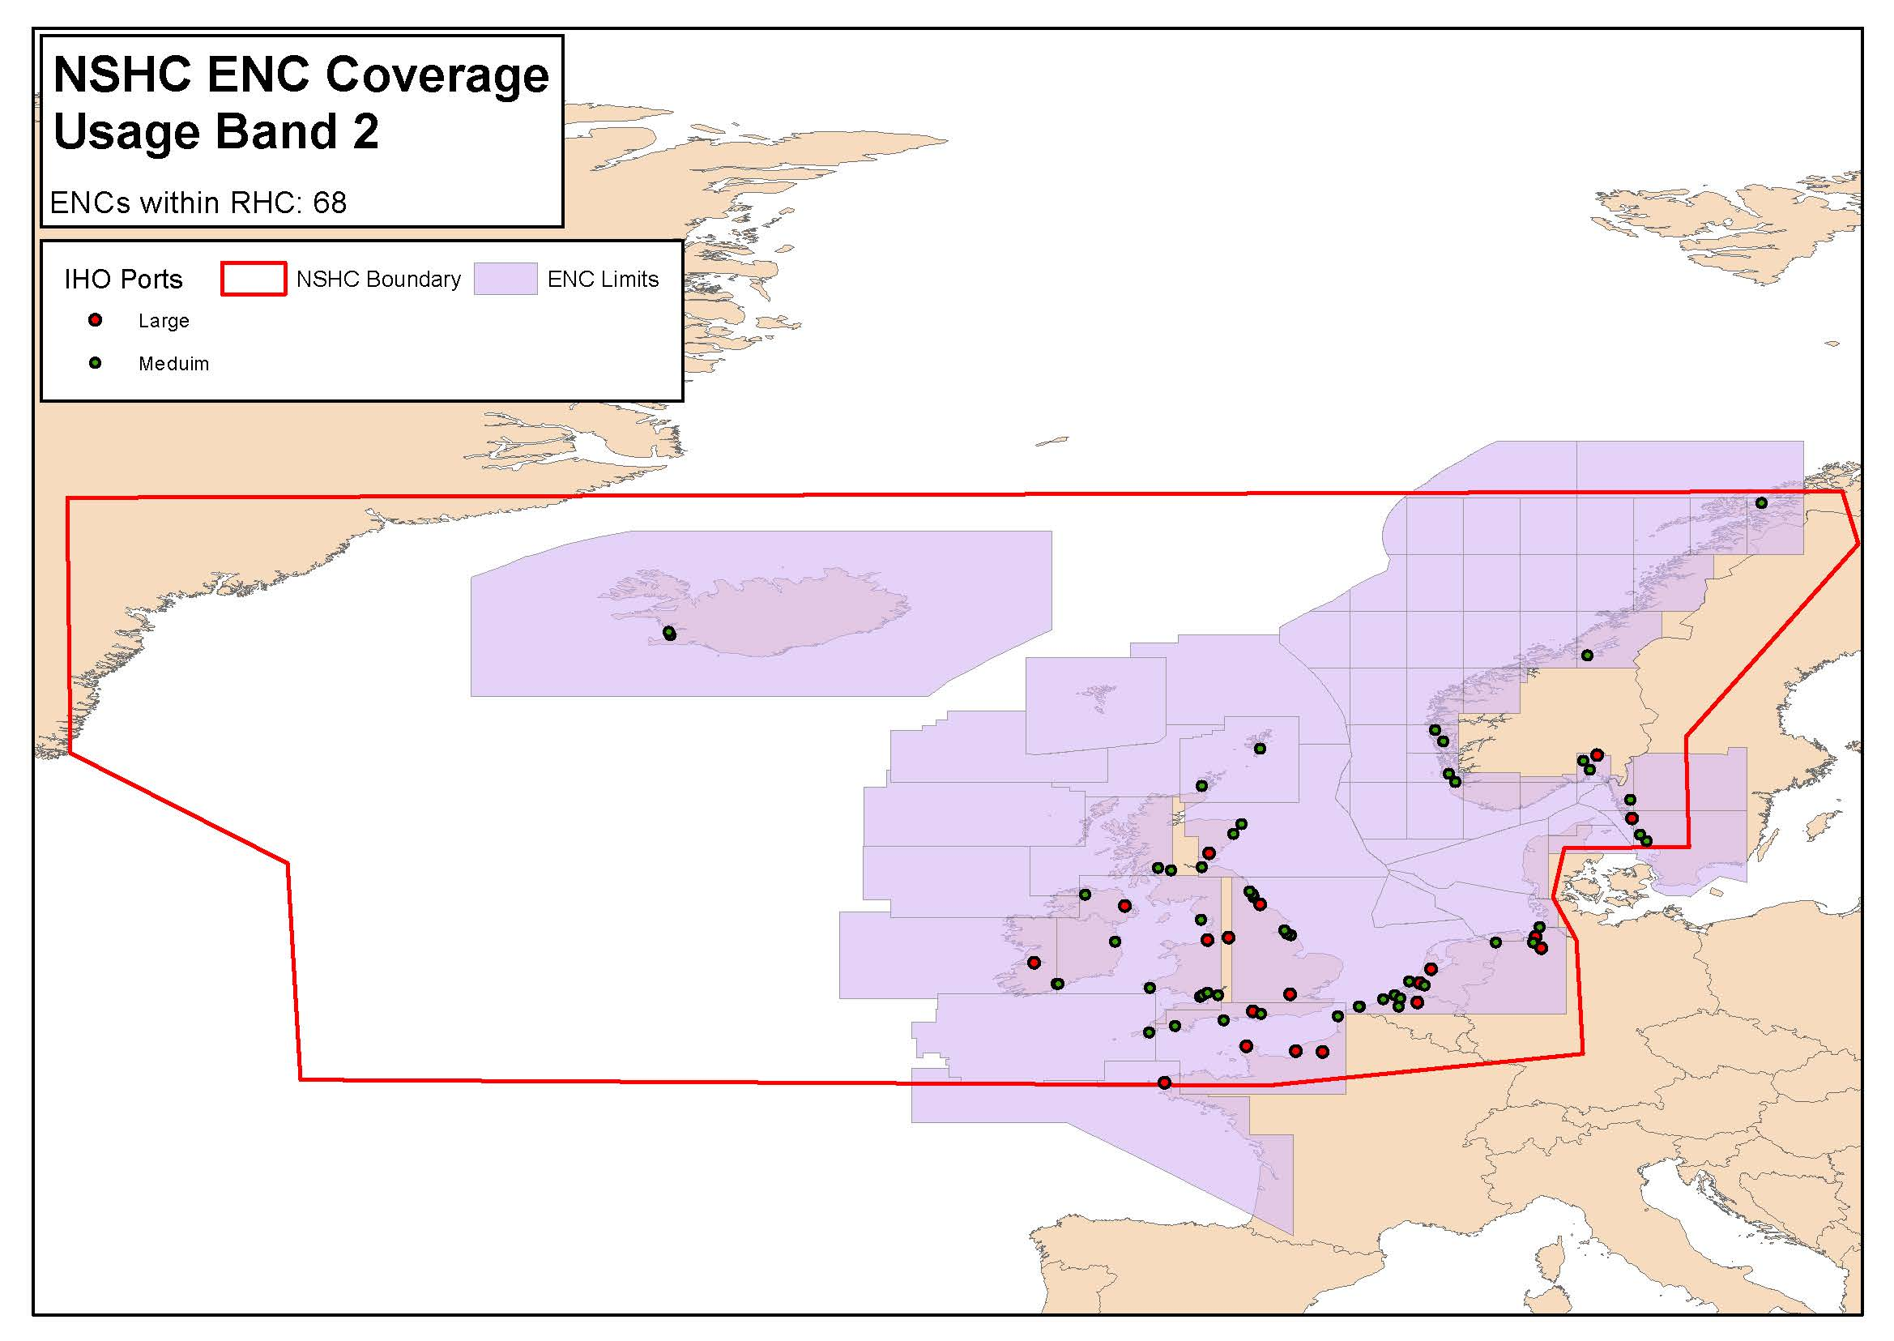
Status of the ENC Scheme in Region D
General
NSHC ENC COVERAGE
Usage Band 2
71 ENCs

Slide 4
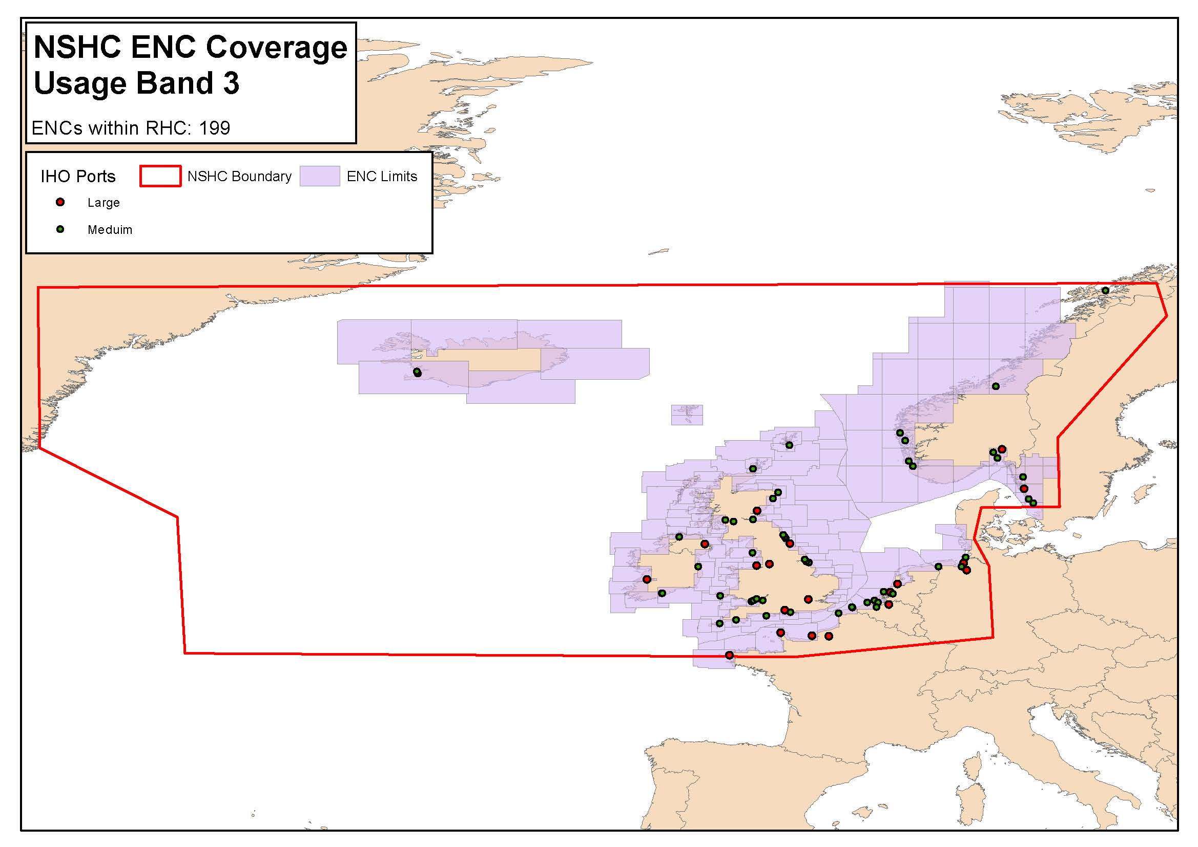
Status of the ENC Scheme in Region D
Coastal
NSHC ENC COVERAGE
Usage Band 3
200 ENCs

Slide 5
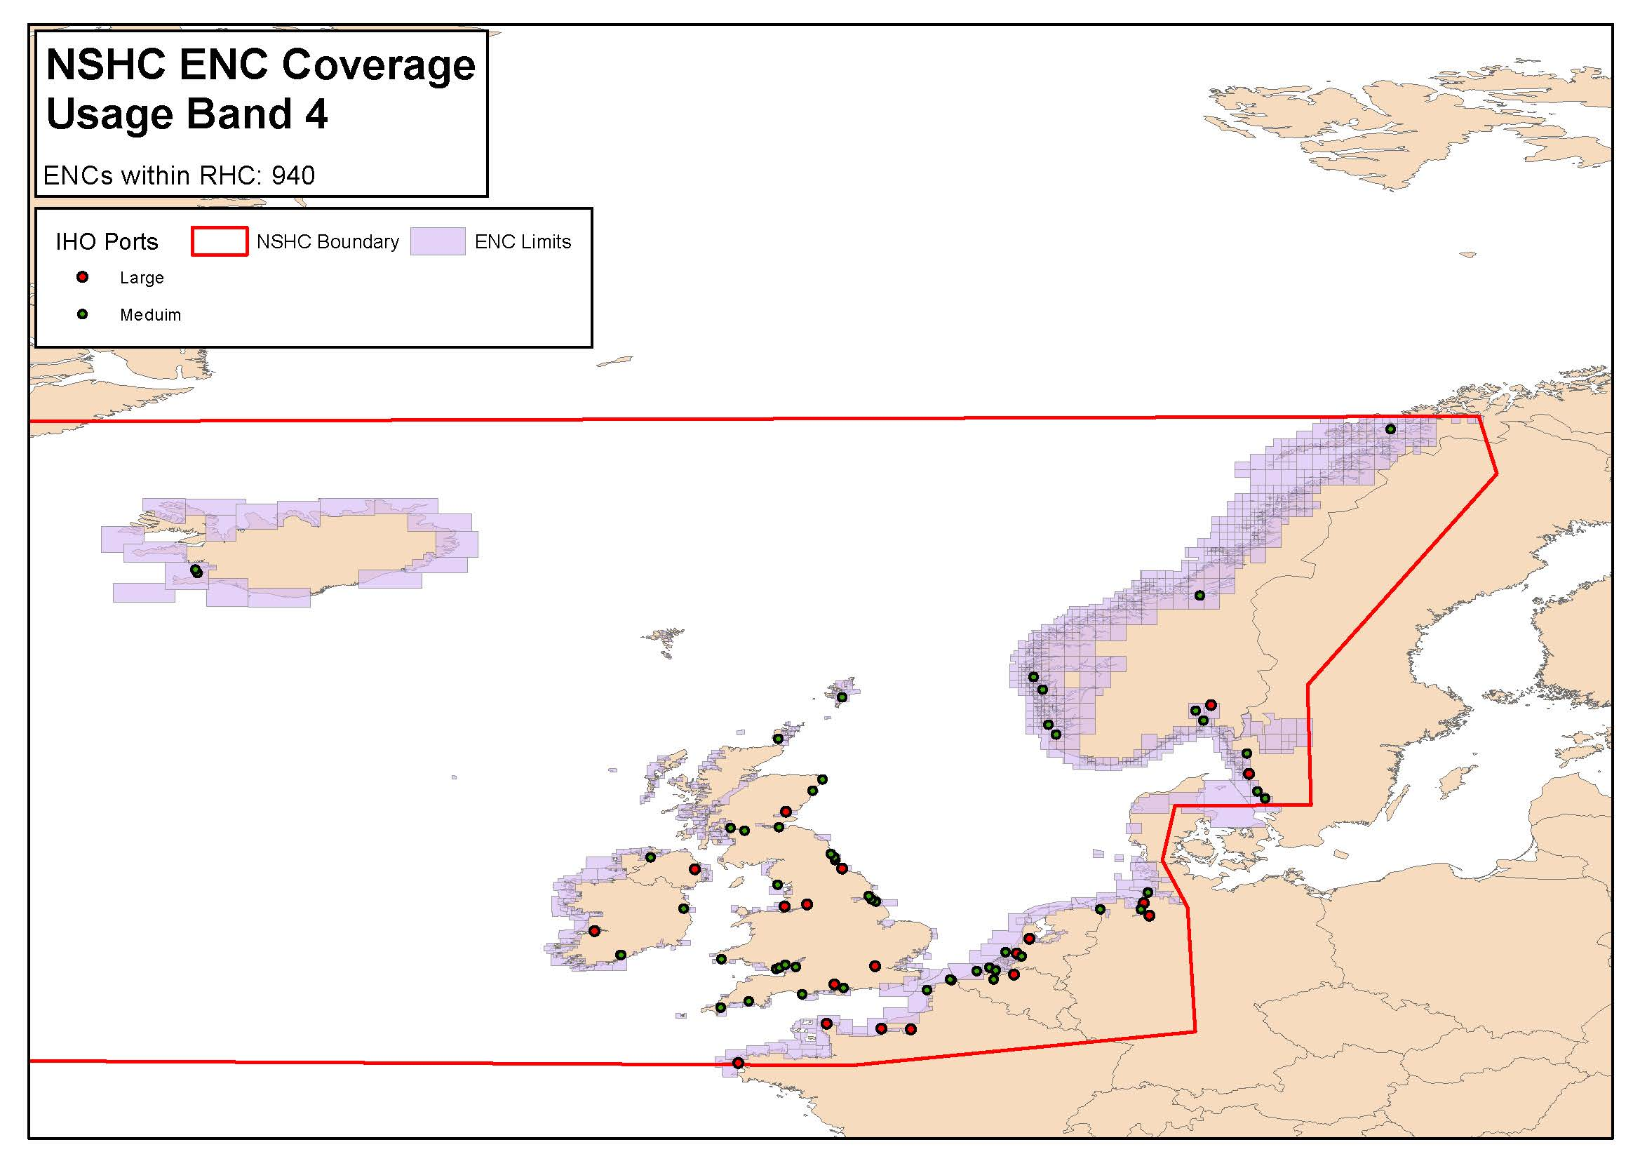
Status of the ENC Scheme in Region D
Approaches
NSHC ENC COVERAGE
Usage Band 4
932 ENCs

Slide 6
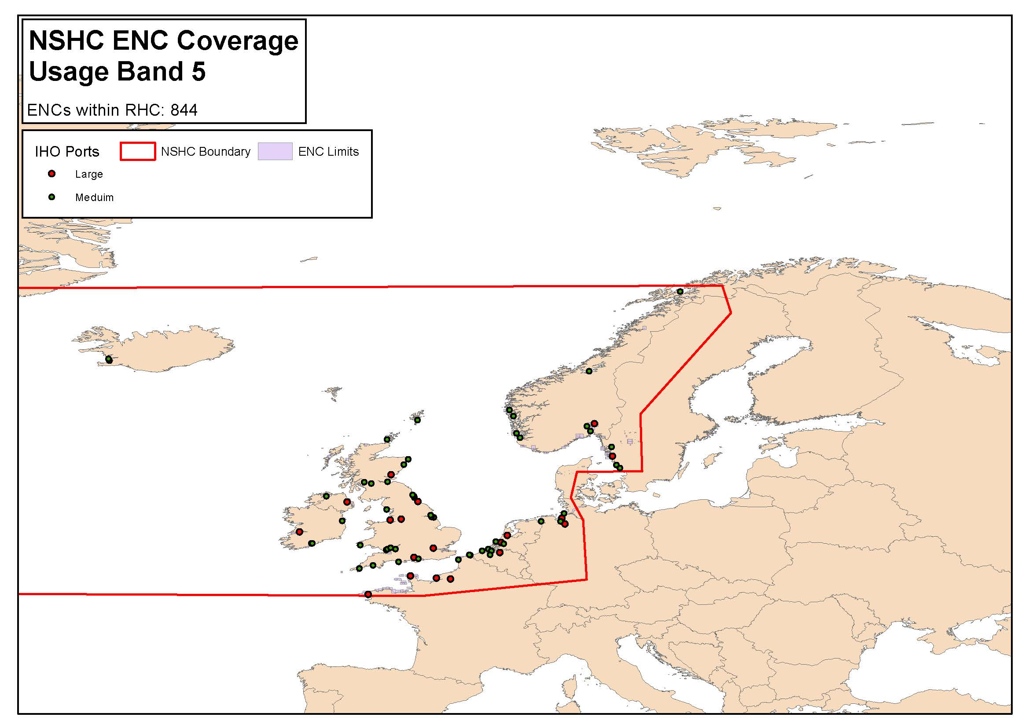
Status of the ENC Scheme in Region D
Harbour
NSHC ENC COVERAGE
Usage Band 5
817 ENCs

Slide 7
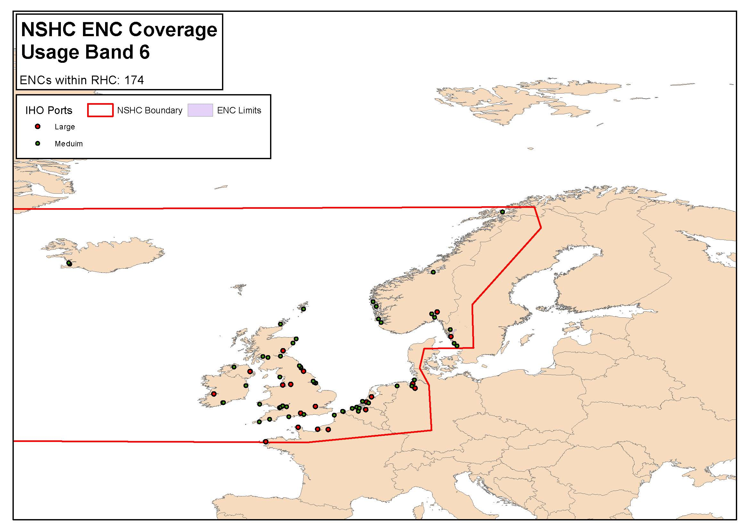
Status of the ENC Scheme in Region D
Berthing
NSHC ENC COVERAGE
Usage Band 6
160 ENCs

Slide 8
Coverage issues
Development of the NSHC ENC scheme
The ENC scheme of Greenland is still being developed by Denmark.

Slide 9
Existence of overlapping ENCs that may have a possible impact on safe navigation
SUMMARY OF OVERLAP REPORTS AS AT DECEMBER 2018
Cellname | Cellname 1 | Usage Band | Risk | ICCWG Status | IC-ENC Status | Current situation
DK1NORSO | DE121000 | 1 | Low | Live | Low risk
GB100160 | DE121000 | 1 | Low | Live | Low risk
NL1NZ100 | GB100160 | 1 | Low | Live | Low risk
DK2NORSO | DE221000 | 2 | Low | Live | Accept
NL21037P | DE221000 | 2 | Low | Live | No record | Requires investigaion
NO2A0404 | GB2C2182 | 2 | Low | Live | Low risk
NO2B0400 | GB2C2182 | 2 | Low | Live | Low risk
NO2B0404 | GB2C2182 | 2 | Low | Live | Low risk
NO2B0412 | DK2NORSO | 2 | Low | Live | Resolved
NO2B0800 | GB2C2182 | 2 | Low | Live | Low risk
NO2B0804 | GB2C2182 | 2 | Low | Live | Low risk
NO2B1200 | GB22182D | 2 | Low | Live | Accept
DK3HORRO | DE321001 | 3 | Low | Live | Accept
FR367350 | BE3VLBNK | 3 | Low | Live | No record | Requires investigaion
NL301505 | GB301187 | 3 | Low | Live | No record | Requires investigaion
NL302593 | DE321002 | 3 | Low | Live | No record | Requires investigaion
NO3A0404 | GB300272 | 3 | Low | Live | Low risk
NO3B0404 | GB300278 | 3 | Low | Live | Low risk
NO3B0404 | GB300272 | 3 | Low | Live | Low risk
NO3B0800 | GB300291 | 3 | Low | Live | Low risk
NO3B1200 | GB300295 | 3 | Low | Live | Low risk
ENC overlaps (2018):
UB 3 = 9
UB 2 = 9
UB 1 = 3
Overlaps are low risk
Notes:
.

Slide 10
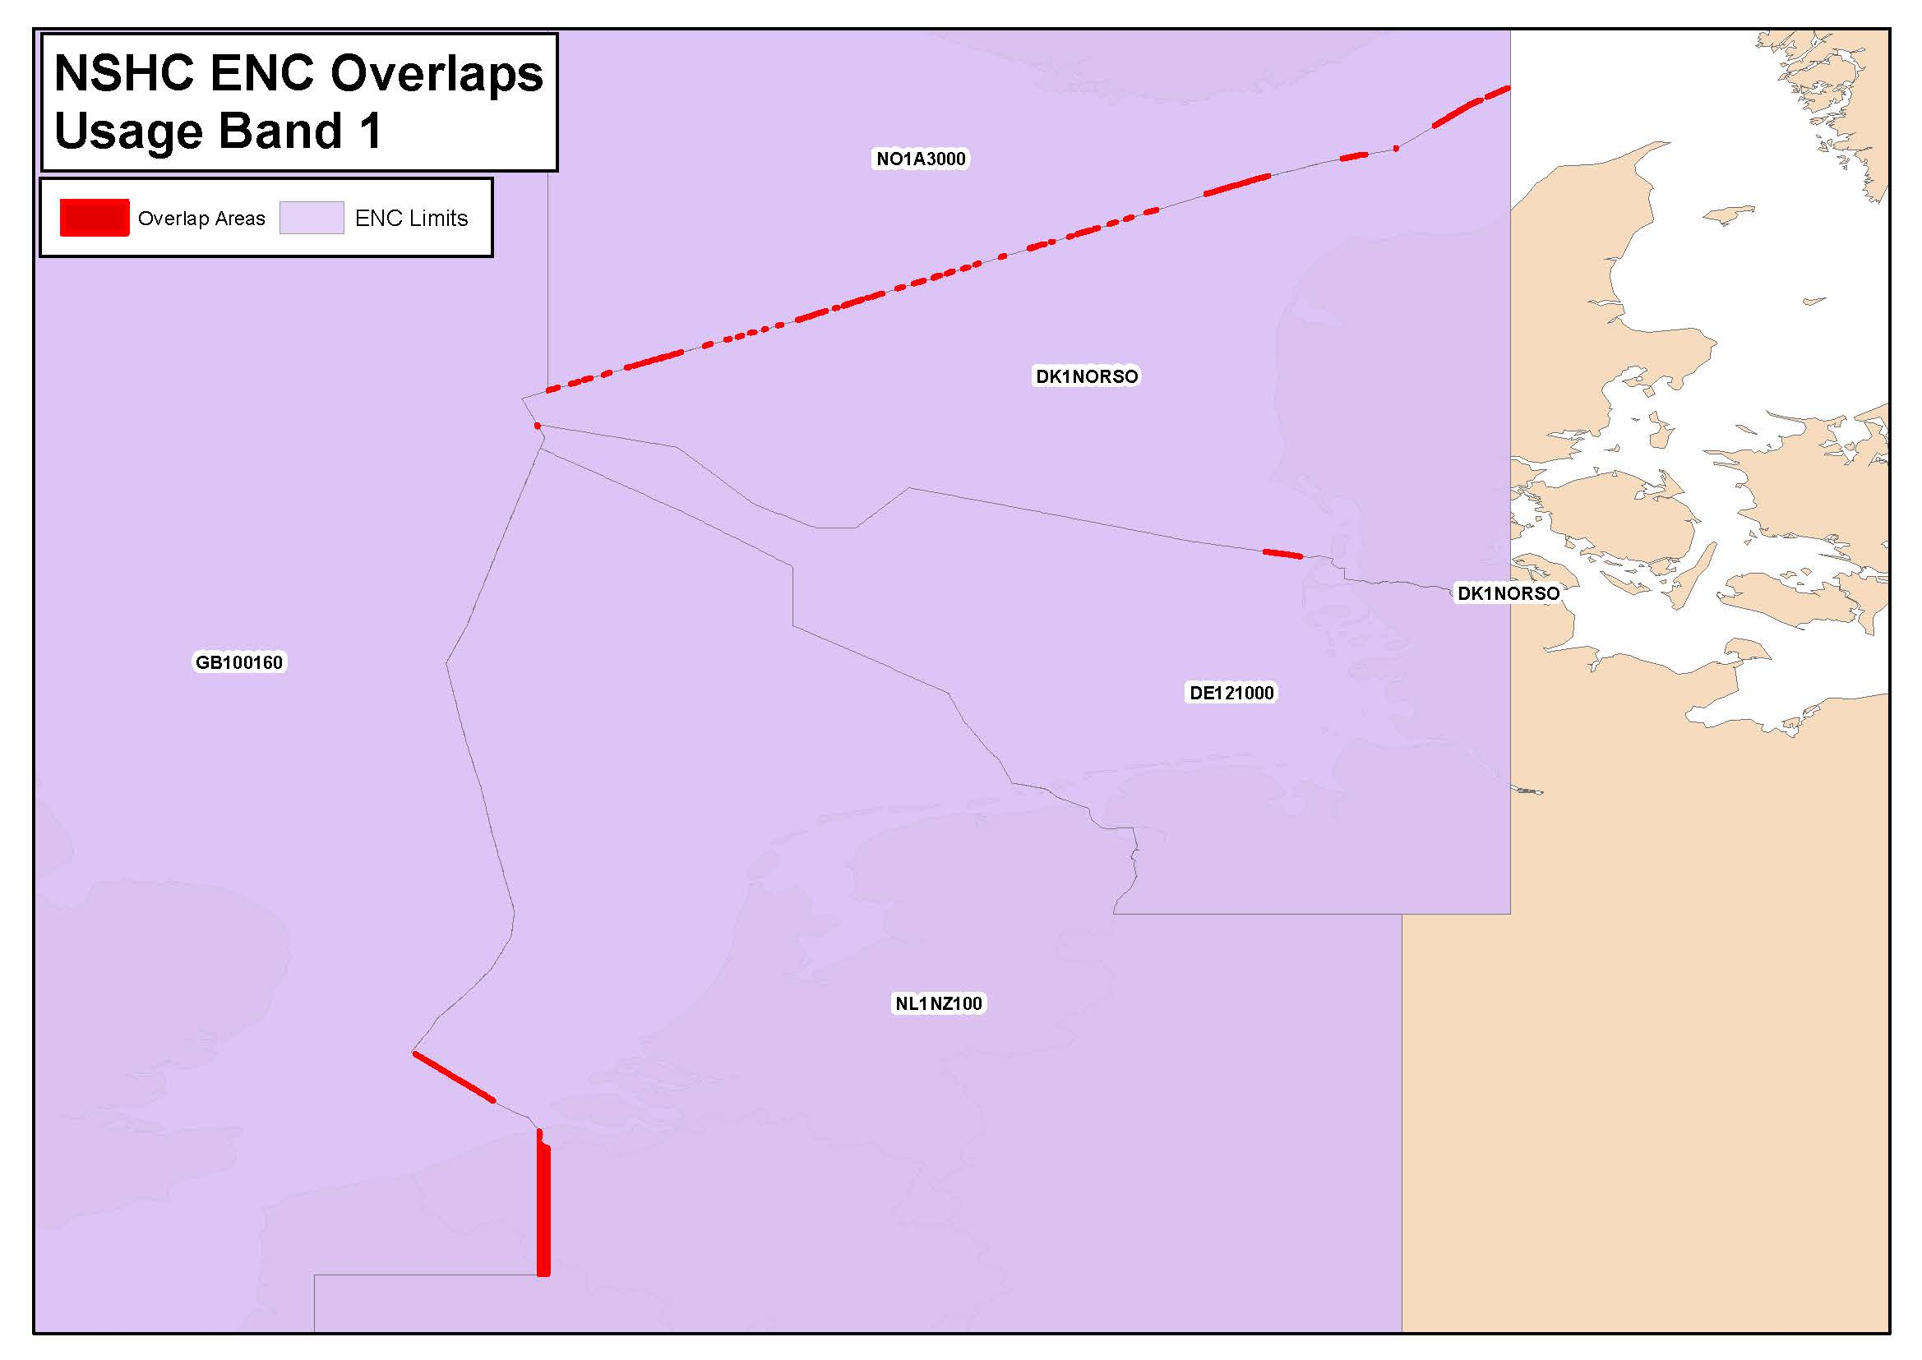
Existence of overlapping ENCs that may have a possible impact on safe navigation
Overview
NSHC ENC OVERLAPS
Usage Band 1
3 ENC overlaps

Slide 11
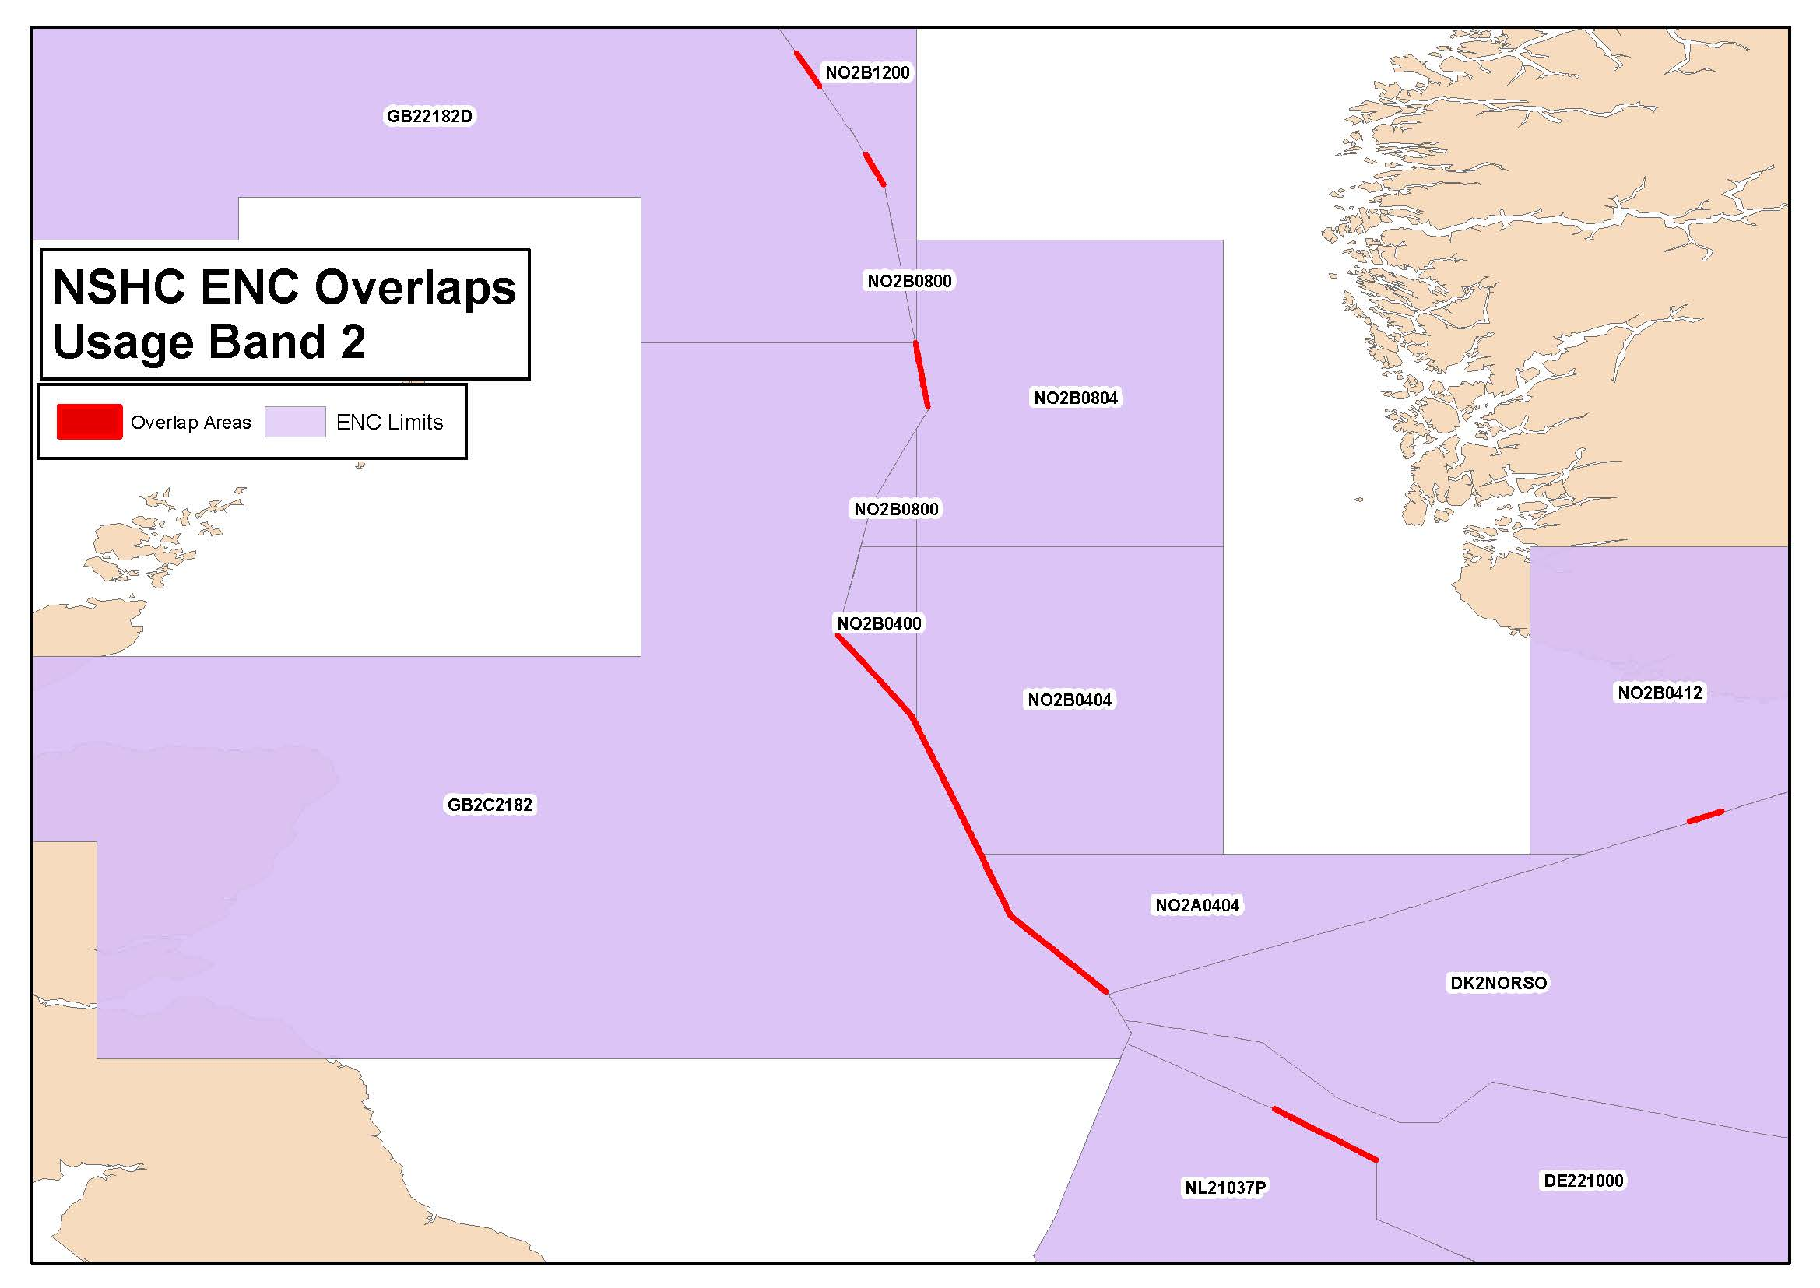
Existence of overlapping ENCs that may have a possible impact on safe navigation
General
NSHC ENC OVERLAPS
Usage Band 2
9 ENC overlaps

Slide 12
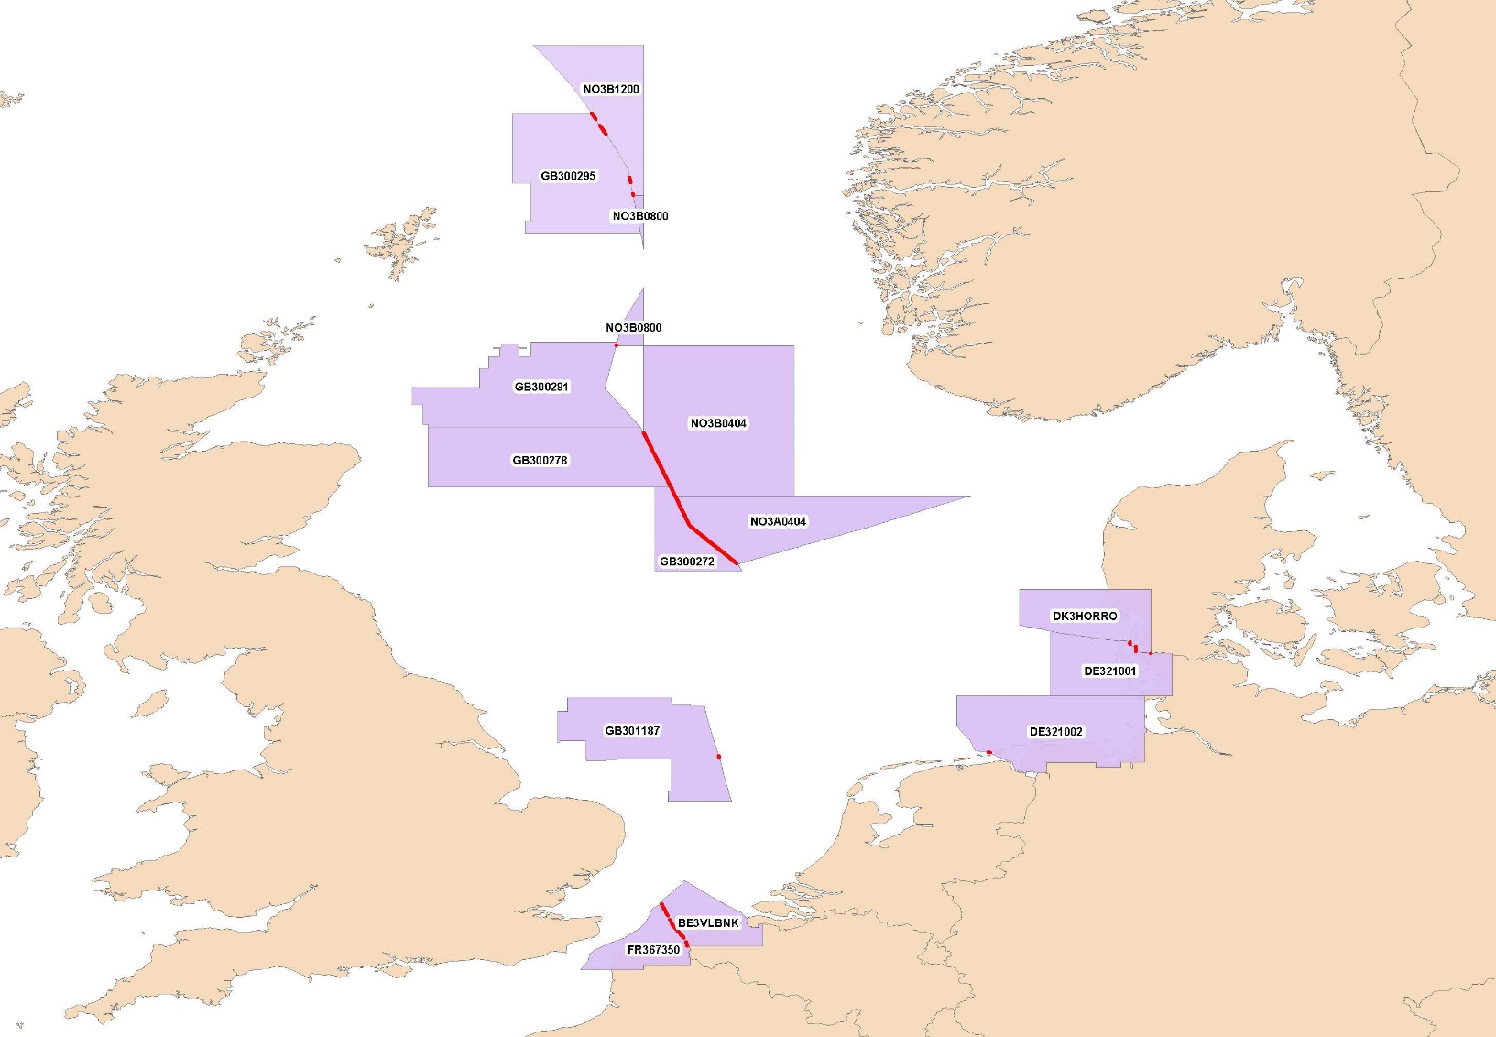
Existence of overlapping ENCs that may have a possible impact on safe navigation
Coastal
NSHC ENC OVERLAPS
Usage Band 3
9 ENC overlaps

Slide 13
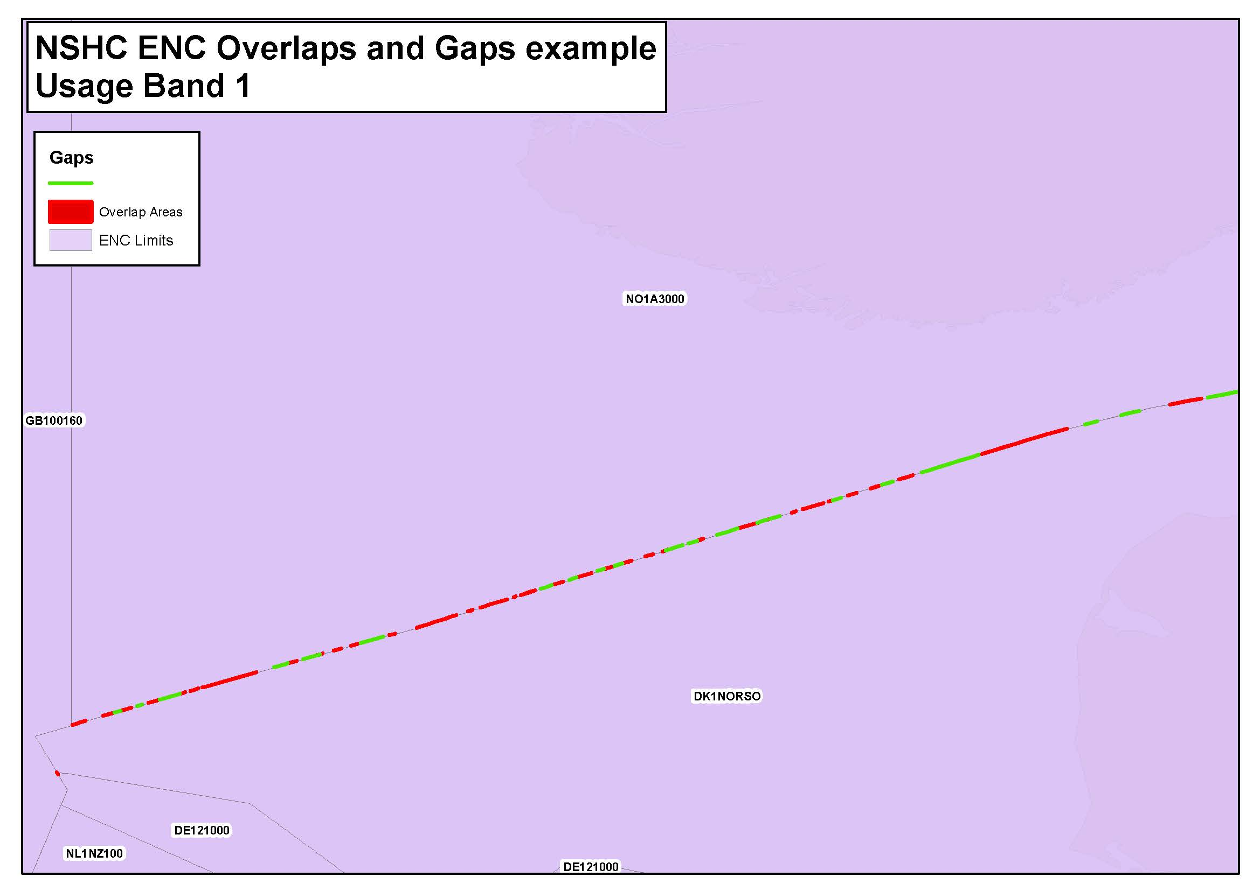
Coverage issues, gaps and risk assessment analysis
Overview
NSHC ENC GAPS
& OVERLAPS
Usage Band 1
Example of gaps and
overlaps on diagonals
Notes:
.

Slide 14
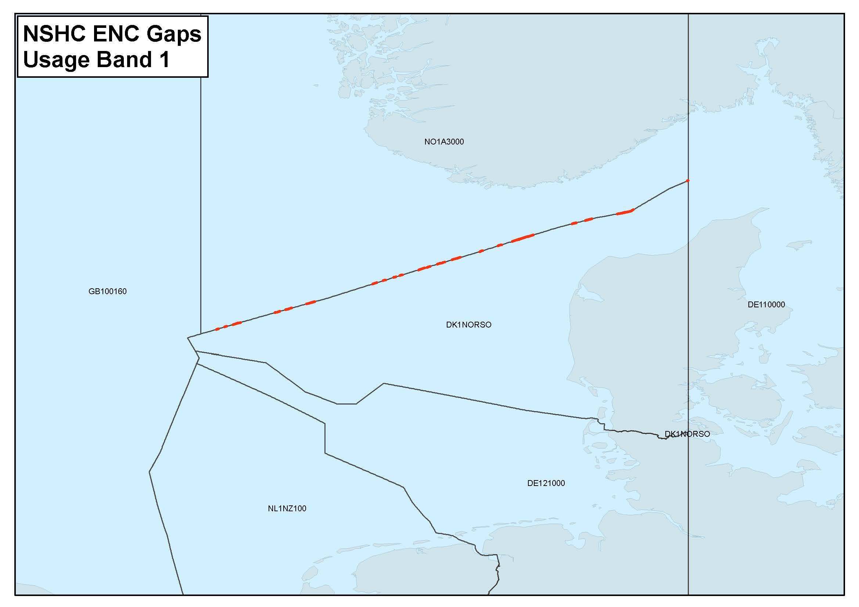
Coverage issues, gaps and risk assessment analysis
Overview
NSHC ENC GAPS
Usage Band 1
2 ENCs

Slide 15
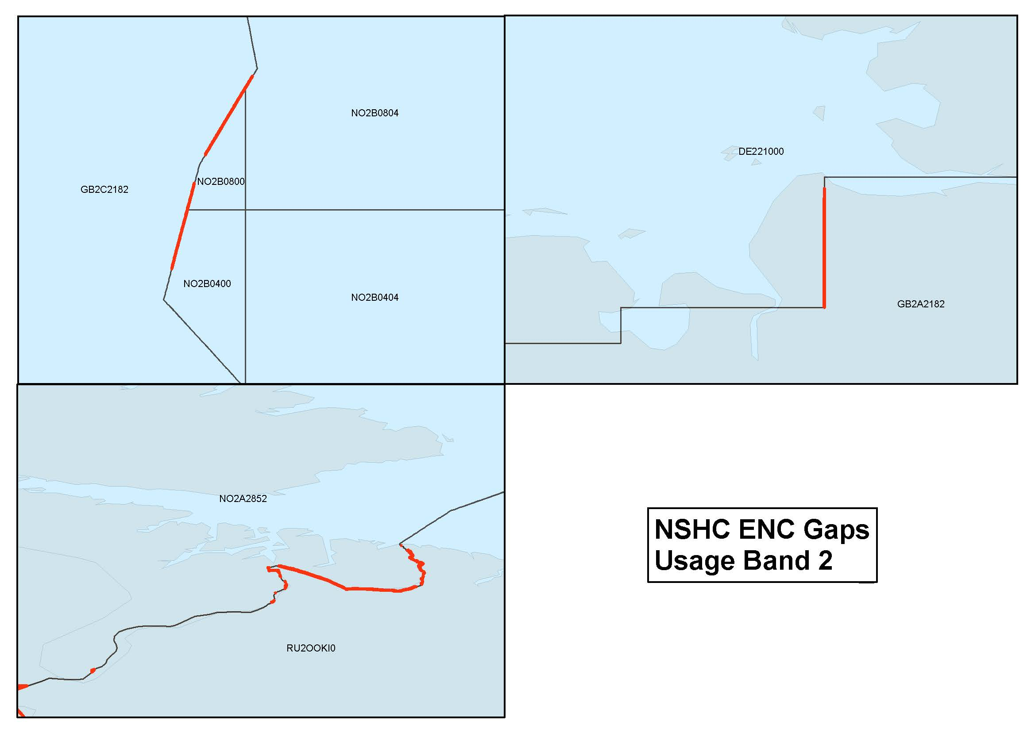
Coverage issues, gaps and risk assessment analysis
General
NSHC ENC GAPS
Usage Band 2
8 ENC gaps

Slide 16
Problems or outstanding issues, Recommendations
All overlaps and gaps occur on diagonals and along national maritime boundaries
Low risk NSHC overlaps and gaps range from 5m to 30m
Challenging process to reduce low risk overlaps and gaps to S-57 guidance of ≤5m (S-57 Appendix B.1 Annex A)
Should the 5m overlapping buffer zone used on adjoining national limits be increased?
Overlaps and gaps on land
S-57 guidance on seamless ENC coverage advises that no overlaps and gaps on land should occur.
Should all low risk overlaps and gaps on land be resolved within a year?

Slide 17
Actions requested of WENDWG
WENDWG is invited to note the report from NSHC.

