Slide 1
Report of the representative of the RSAHC on the implementation of ENC Schemes
Saeid Parizi I.R.of IRAN
WORLDWIDE ENC DATABASE WORKING GROUP (WENDWG)

Slide 2
Background
ROPME Sea Area Hydrographic Commission (RSAHC) established in October 2000.
Core Members: Bahrain, IR of Iran, Kuwait, Oman, Pakistan, Qatar, Saudi Arabia, United Arab Emirates.
Associate Members: France, Iraq, United Kingdom, United States of America.
Observers: Regional Organization for the Protection of the Marine Environment (ROPME), Middle East Navigation Service (MENAS). International Association of Marine Aids to Navigation and Lighthouse Authorities (IALA), Arabian Maritime and Navigation Aids Services LLC (AMNAS)
INT Charting Region ‘I’ created on October 2000 in Tehran, I.R. of IRAN.
RSAHC INT Chart Coordination Working Group (RSAICCWG) established in March 2011.
RSAICCWG fully manned – IR of IRAN acting as regional charting coordinator.
RSAHC approved that the development and maintenance of ENC schemes in the region should be coordinated by the RSAICCWG, in place of the RSAHC.

Slide 3
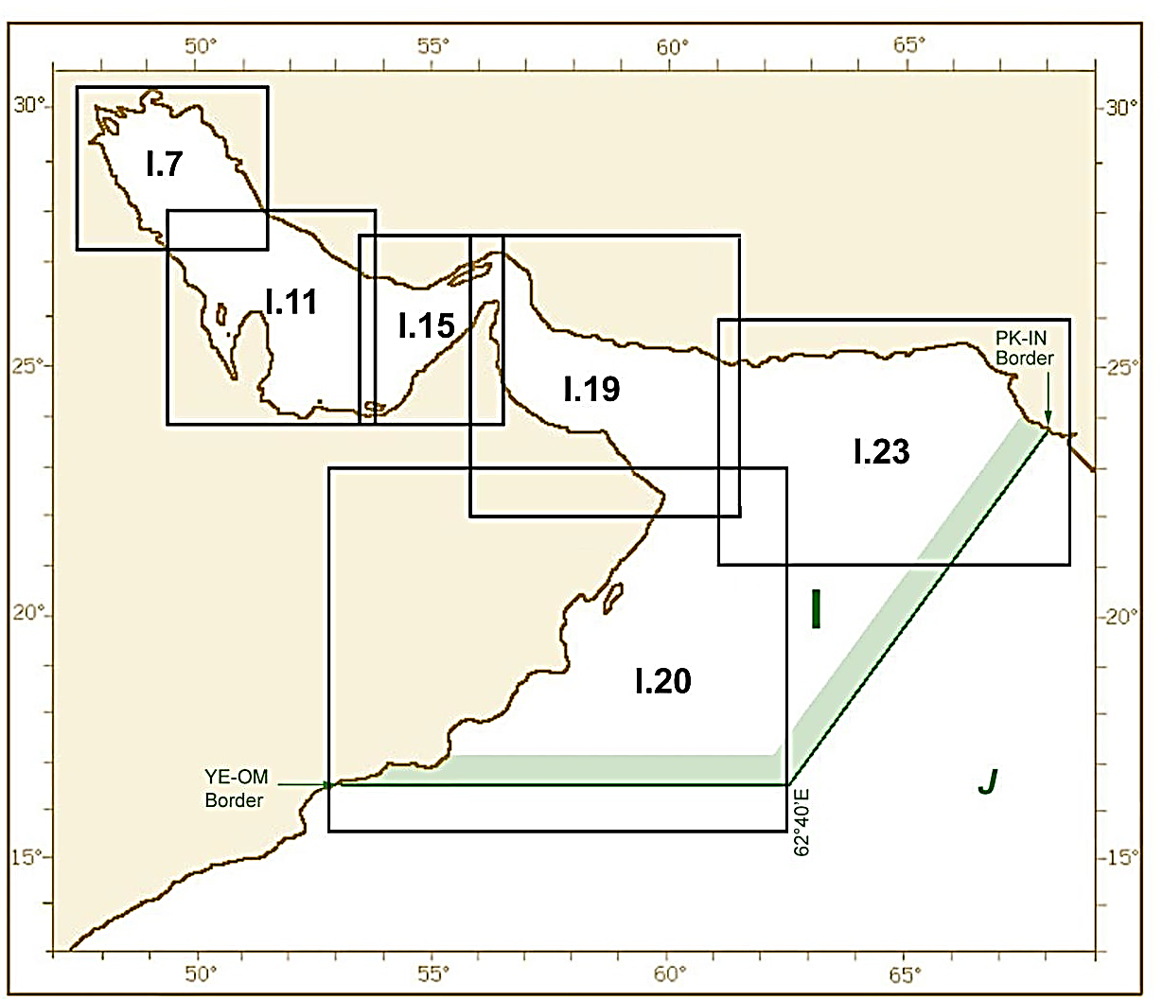
Overview of Region I (Persian Gulf, Oman Sea and Arabian Sea) INT Region IHO COUNCIL

Slide 4
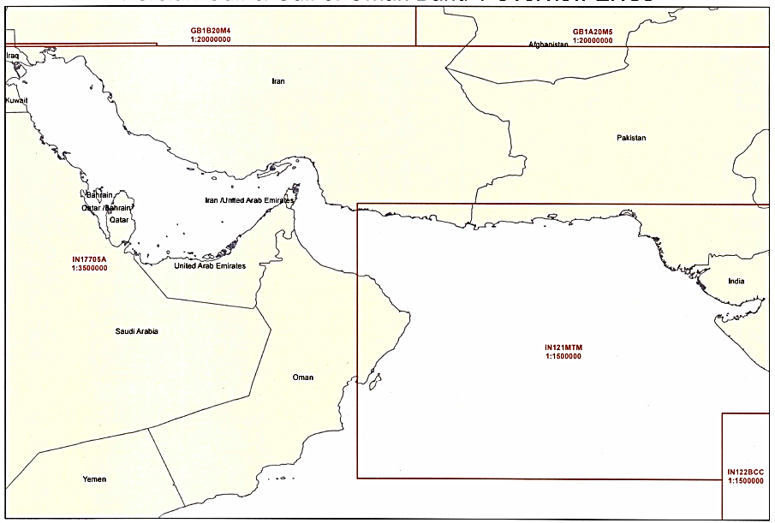
Status of the ENC Scheme UB1 in Region I
Number of ENC Published | Usage Band | Scale
5 | UB 1 | Overview≤ 1:1,500,000

Slide 5
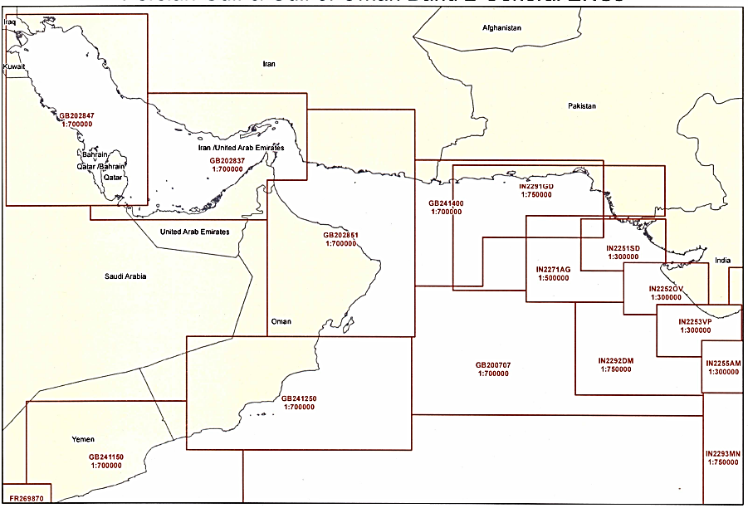
Status of the ENC Scheme UB2 in Region I
Number of ENC Published | Usage Band | Scale
7+6=13 | UB 2 | 1:1,500,000 < General ≤ 1:350,000

Slide 6
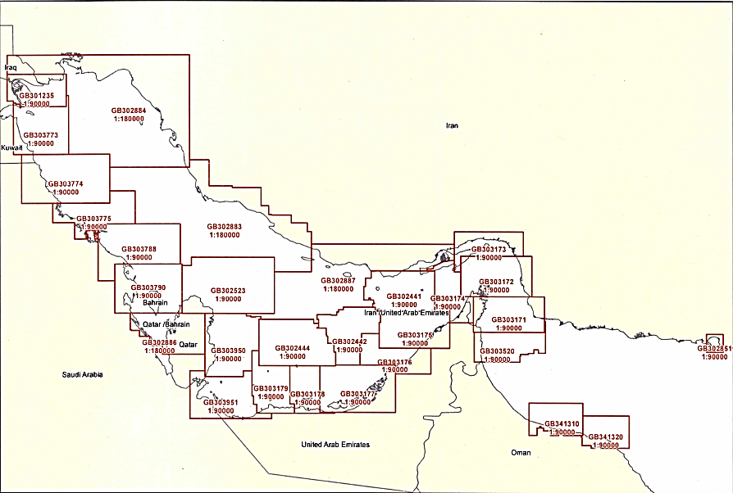
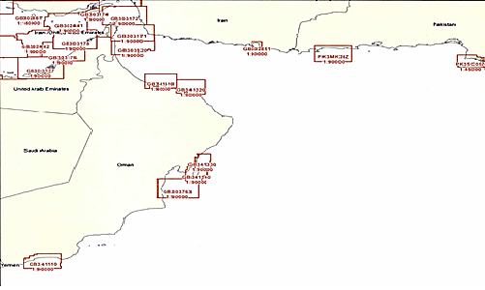
Status of the ENC Scheme UB3 in Region I
Number of ENC Published | Usage Band | Scale
24+11+35= 70 | UB 3 | 1:350,000 < Coastal ≤ 1:90,000

Slide 7
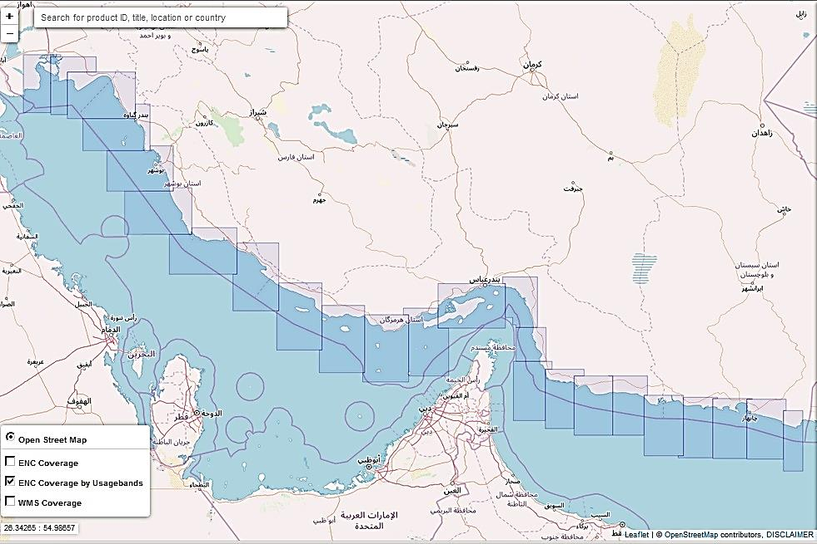
Status of the ENC Scheme UB3 in Region I( I.R. of Iran)
Number of ENC |  |  | Usage Band | Scale
To be Produced |  | Published
2nd Stage | 1st Stage
- | 7 | 24 | UB 3 | 1:350,000 < Coastal ≤ 1:90,000
UB | Scale | Product Title | INt Chart | ENC | No
3 | 1:100000 | Bahregan to Oil Field to Emam Hassan | 7297 | IR303072 | 1
3 | 1:100000 | Bandar-e Genaveh to Jazireh-ye Kharg | 7304 | IR303073 | 2
3 | 1:100000 | Bandar-e Bushehr to Bandar-e Rostami | 7307 | IR303074 | 3
3 | 1:100000 | Bandar-e Rostami to Kangan Oil Field | 7251 | IR303075 | 4
3 | 1:100000 | Kangan Oil Field to Kangan | 7253 | IR303076 | 5
3 | 1:100000 | Bandar-e Pars to Tombak & Teben | 7256 | IR303077 | 6
3 | 1:100000 | Bandar-e Javadol_Aemmeh to Jazireh-ye Lavan | 7242 | IR303078 | 7
3 | 1:100000 | Jazireh-ye Kish to Jazireh-ye Hendurabi | 7221 | IR303079 | 8
3 | 1:100000 | Bandar-e Lengeh to Jazireh-ye Siri | 7217 | IR303080 | 9
3 | 1:100000 | Jazireh-ye Tonb-e Bozorg to Jazireh-ye Abu Musa | 7214 | IR303081 | 10
3 | 1:100000 | Khuran & Jazireh-ye Qeshm (East Part) | 7225 | IR303082 | 11
3 | 1:100000 | Khalij-e Gwater | new | IR308600 | 12
3 | 1:100000 | East of Gulf of Chah Bahar | new | IR308601 | 13
3 | 1:100000 | Khalij-e Cha Bahar | new | IR308602 | 14
3 | 1:100000 | Damagheh- ye Tang | new | IR308603 | 15
3 | 1:100000 | Damagheh- ye Tang to Damagheh-ye Meydan | new | IR308604 | 16
3 | 1:100000 | Gugsar to Gabrik | new | IR308605 | 17
3 | 1:100000 | Jagin to Jask | new | IR308606 | 18
3 | 1:100000 | Jask to Ra’s Al Kuh | new | IR308607 | 19
3 | 1:100000 | Ra’s Al Kuh to Ra’s Osh Shir | new | IR308608 | 20
3 | 1:100000 | Ra’s Osh Shir to Bandar-e Sirik including Musanam Peninsula | new | IR308609 | 21
3 | 1:100000 | Bandar Abas to Jazireh-ye Qeshm | new | IR318610 | 22
3 | 1:100000 | Bahregan | new | IR308755 | 23
3 | 1:100000 | Bandar Imam Khomeyni | New | IR308760 | 24

Slide 8
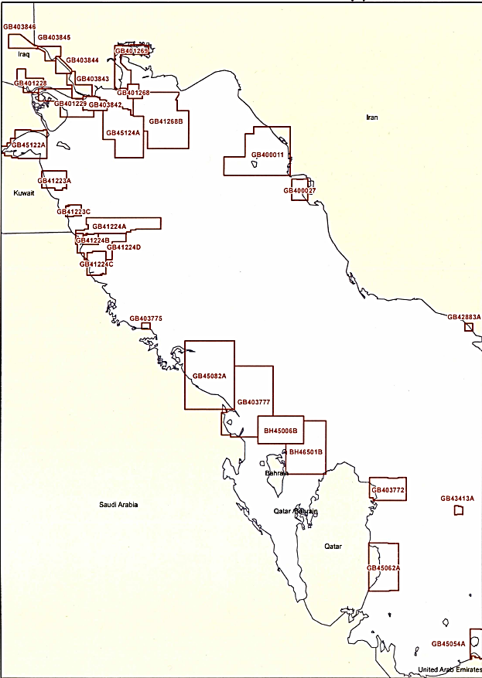
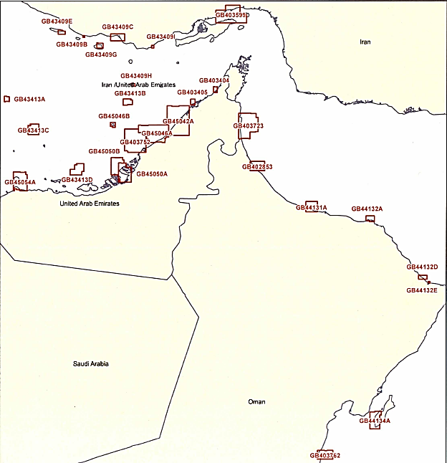
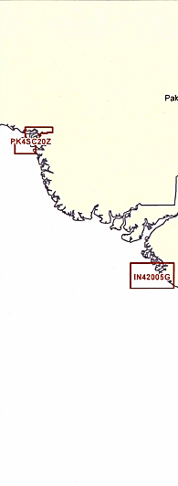
Status of the ENC Scheme UB4 in Region I
Number of ENC Published | Usage Band | Scale
40+29+57= 126 | UB 4 | 1:90,000 <Approach ≤ 1:22,000

Slide 9
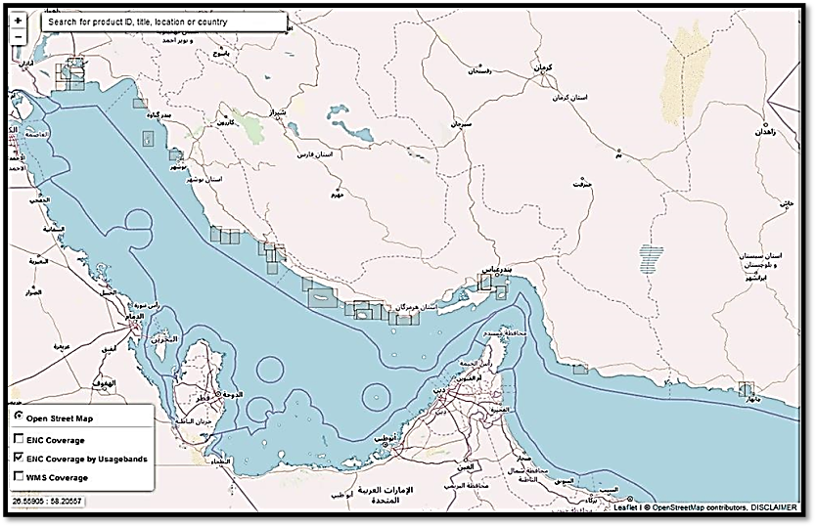
Status of the ENC Scheme UB4 in Region I ( I.R. of Iran)
Number of ENC |  |  | Usage Band | Scale
To be Produced |  | Published
2nd Stage | 1st Stage
15 | 8 | 40 | UB 4 | 1:90,000 <Approach ≤ 1:22,000
Usage Band | Scale | Product Title | INt Chart No. | ENC No. | No.
4 | 1:50000 | Approaches to Bandar-e Shahid Bahonar and Bandar-e Shahid Rajai | 7207 | IR403012 | 1
4 | 1:25000 | Khalij-e Nay Band | 7228 | IR403025 | 2
4 | 1:25000 | Jazire-ye Kharg | 7306 | IR403031 | 3
4 | 1:25000 | Bandar-E Emam Khomeini | 7283 | IR403051 | 4
4 | 1:25000 | Khowr-e- Musa Middle Part | 7280 | IR403052 | 5
4 | 1:30000 | Approaches to Bandar-e Kaveh | 7231 | IR403054 | 6
4 | 1:25000 | Damaghe- ye Motaf | 7257 | IR403056 | 7
4 | 1:25000 | Jazire-ye Kish | 7234 | IR403060 | 8
4 | 1:25000 | Bandar-E Shahid Rajai | 7205 | IR403070 | 9
4 | 1:25000 | Moghuyeh | 7320 | IR403087 | 10
4 | 1:25000 | Hasineh | 7321 | IR403088 | 11
4 | 1:25000 | Bostaneh | 7319 | IR403086 | 12
4 | 1:25000 | Bandar-e Aftab | 7322 | IR403089 | 13
4 | 1:50000 | Bandar-e Charak to Jazire- ye Kish | 7323 | IR403090 | 14
4 | 1:25000 | Bandar-e Chiruye | 7324 | IR403091 | 15
4 | 1:25000 | Jazireh-ye Larak | 7325 | IR403095 | 16
4 | 1:25000 | Damaghe- ye Motaf East | 7269 | IR403111 | 17
4 | 1:25000 | Dayyer- West | 7271 | IR403112 | 18
4 | 1:30000 | Khalij-e Nay Band and Approaches to Bandar-e Pars | 7240 | IR403040 | 19
4 | 1:25000 | Bandare-e Lengeh | 7237 | IR403016 | 20
4 | 1:25000 | Bandare-e Taheri | 7231 | IR403027 | 21
4 | 1:25000 | Khalij-e Nay Band (West) | 7262 | IR403096 | 22
4 | 1:25000 | Approaches to Bandar-E Javadol Aemmeh | 7247 | IR403059 | 23
4 | 1:25000 | Akhtar | new | IR403093 | 24
4 | 1:25000 | Khalij-e Nay Band (South West) | new | IR403097 | 25
4 | 1: 50000 | Jazireh-ye- Lavan | new | IR403110 | 26
4 | 1:25000 | Jask | 7184 | IR405003 | 27
4 | 1:25000 | Khalij-e Chabahar (East Part) | 7184 | IR405001 | 28
4 | 1:25000 | Khalij-e Chabahar (West Part) | 7184 | IR405002 | 29
4 | 1:25000 | Approaches to Fereydunkenar | new | IR404015 | 30
4 | 1:25000 | Approaches to Bandar-e Nowshahr | new | IR404017 | 31
4 | 1:25000 | Approaches to Bandar-e Imam Hasan | new | IR47606E | 32
4 | 1:25000 | Khowr-e Musa (South Part) | new | IR47703A | 33
4 | 1:25000 | Khowr-e Musa (South Part) | new | IR47703B | 34
4 | 1:25000 | Approaches to Bandar-e Sajafi | new | IR47703C | 35
4 | 1:25000 | Khowr-e Musa (South West Part) | new | IR47703D | 36
4 | 1:25000 | Approaches to Bandar-e Bushehr | new | IR47307C | 37
4 | 1:25000 | Imam Khomeyni Port | new | IR47803A | 38
4 | 1:25000 | Khowr-e Musa (North Part) | new | IR47803B | 39
4 | 1:25000 | Khowr-e Musa (North West Part) | new | IR47803C | 40

Slide 10
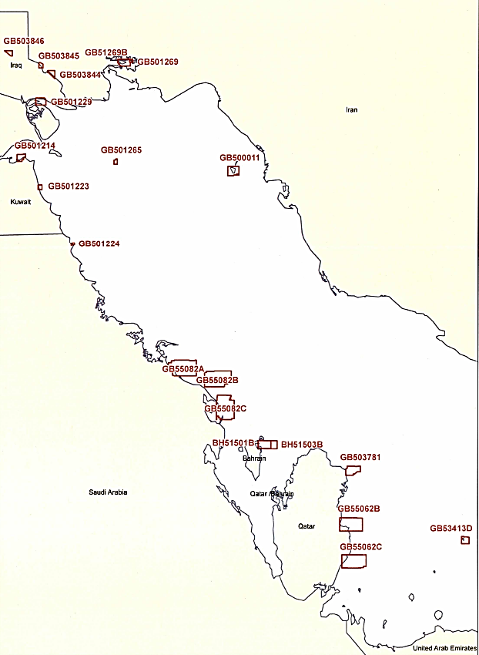
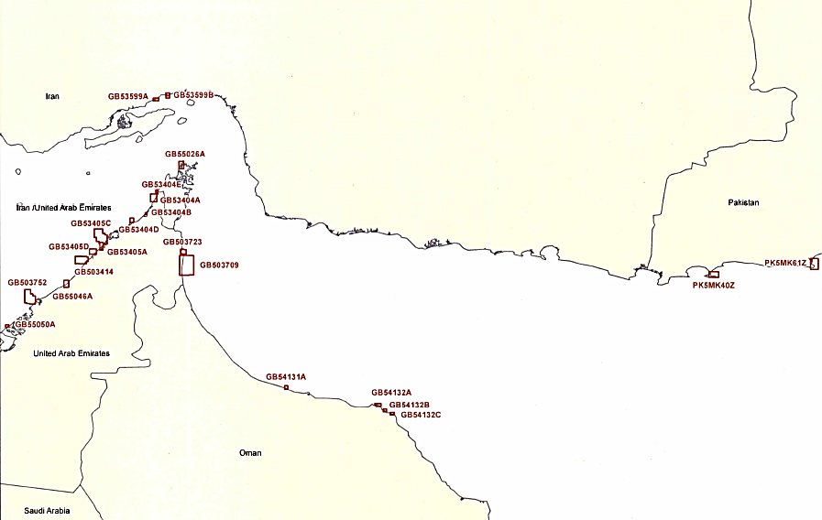
Status of the ENC Scheme UB5 in Region I
Number of ENC Published | Usage Band | Scale
7+1 +43= 51 | UB 5 | 1:22,000 <Harbour ≤ 1:4,000

Slide 11
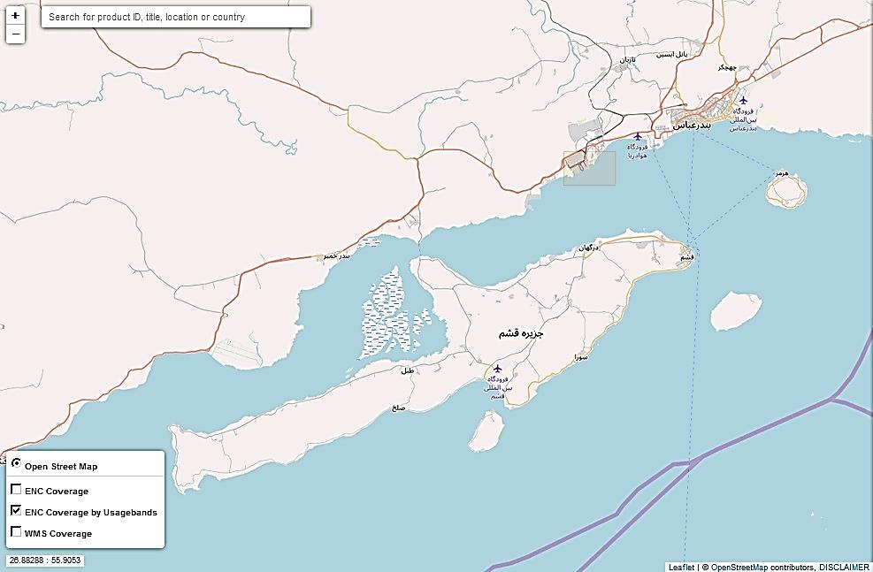
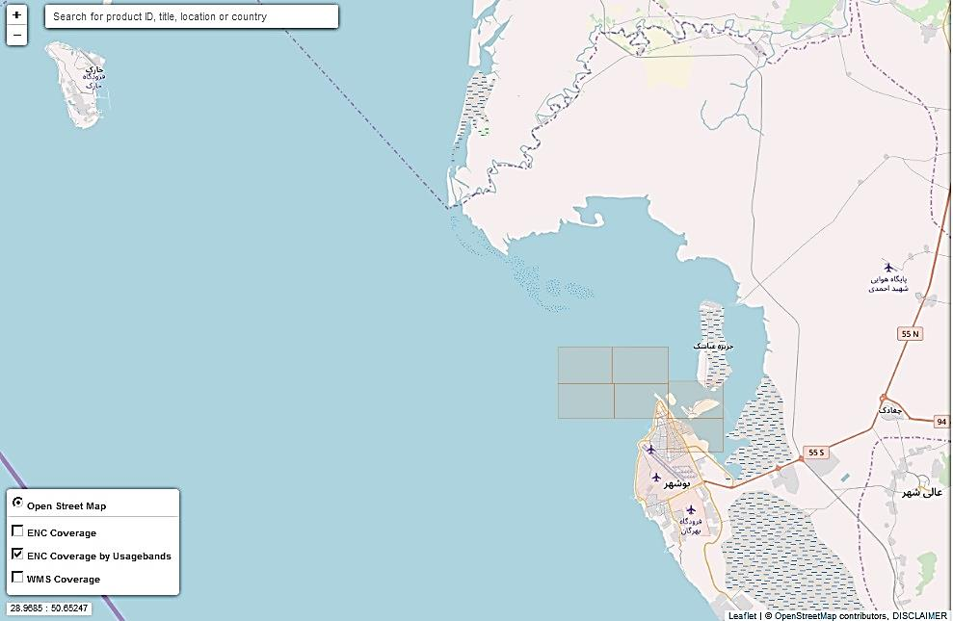
Status of the ENC Scheme UB5 in Region I ( I.R. of Iran)
Usage Band | Scale | Product Title | INt Chart No. | ENC No. | No.
5 | 1:5000 | Gulf Of Bushehr | new | IR5FGC08 | 1
5 | 1:5000 | Gulf Of Bushehr | new | IR5FGC09 | 2
5 | 1:5000 | Gulf Of Bushehr | new | IR5FGC13 | 3
5 | 1:5000 | Gulf Of Bushehr | new | IR5FGC14 | 4
5 | 1:5000 | Gulf Of Bushehr | new | IR5FGC19 | 5
5 | 1:5000 | Gulf Of Bushehr | new | IR5FGC20 | 6
5 | 1:10000 | Bandar-e Shahid Rajaee | 7228 | IR503050 | 7
Number of ENC |  |  | Usage Band | Scale
To be Produced |  | Published
2nd Stage | 1st Stage
11 | 8 | 7 | UB 5 | 1:22,000 <Harbour ≤ 1:4,000

Slide 12
Status of the ENC Scheme UB6 in Region I
Number of ENC Published | Usage Band | Scale
5 | UB 6 | 1:4,000 <Berthing
Status of the ENC Scheme UB6 in Region I ( I.R. of Iran)
Number of ENC |  |  | Usage Band | Scale
To be Produced |  | Published
2nd Stage | 1st Stage
7 | - | - | UB 6 | 1:4,000 <Berthing

Slide 13
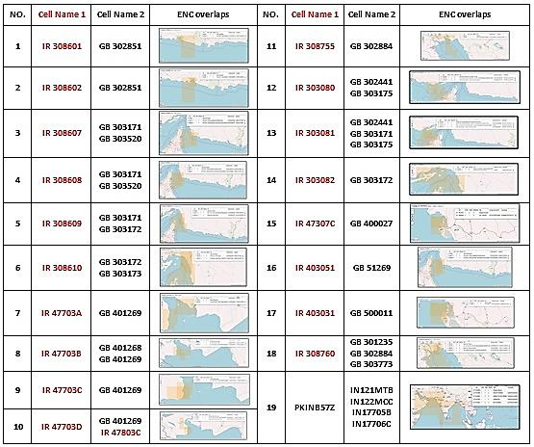
Glance to all the Overlaps in RSAHC Region

Slide 14
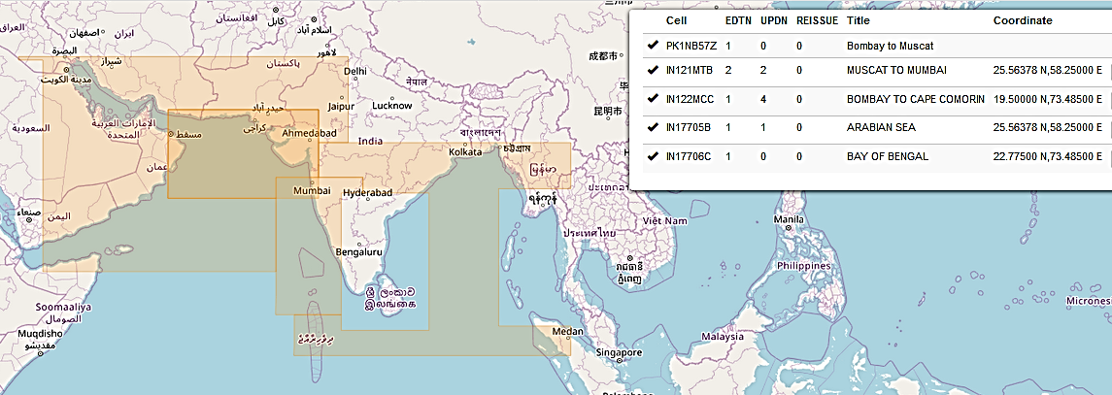
ENC Overlap in RSAHC
ENC Overlaps of Pakistan & India
Extensive correspondence has been made in this regard, and the issue has been considered and analyzed in our different meetings with them, resulting in proposals from the two sides. However, the two sides did not reach an agreement over the issue, which can be considered an example of taking action in accordance with recommendation number 9 of IRCC10 to RHCs, mentioned in previous slides.

Slide 15
ENC Overlap in RSAHC
Iran & Sultanate of Oman
IR 403080, GB 302441 & GB 303175
The scope of Nautical Chart IR 403082 (INT 7225) falls under the agreement between Iran and Oman regarding the continental shelf boundary, and Iran is therefore going to delete its information from the overlap area.
IR 403081, GB 302441, GB 303174 & GB 303175
IR 403082 & GB 303172
Nautical Charts IR 403080 (INT 7217) & IR 403081 (INT 7214) cover some of the Omani waters, since the boundary of the relevant continental shelf has not been determined.
It is worth mentioning, for instance, that the Omani Chart 1219 prepared at 1:125000 for the Strait of Hormuz, overlaps with the Iranian INT 7204, and covers some Iranian waters.

Slide 16
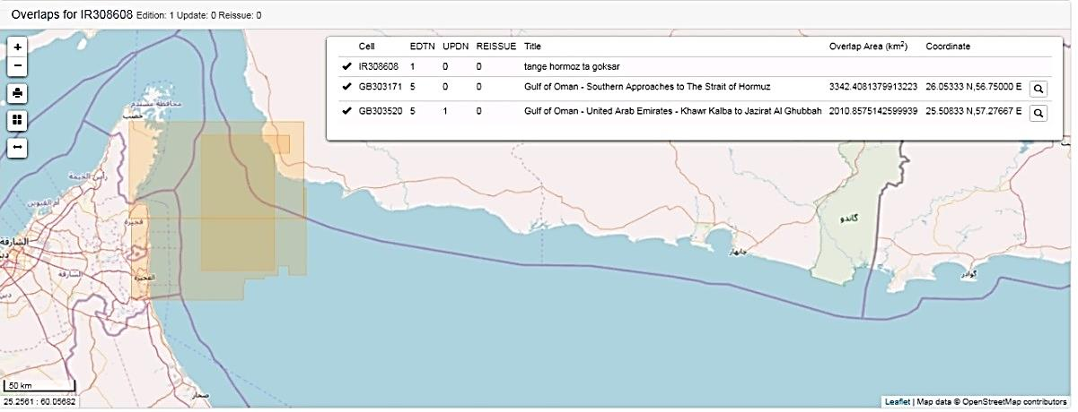
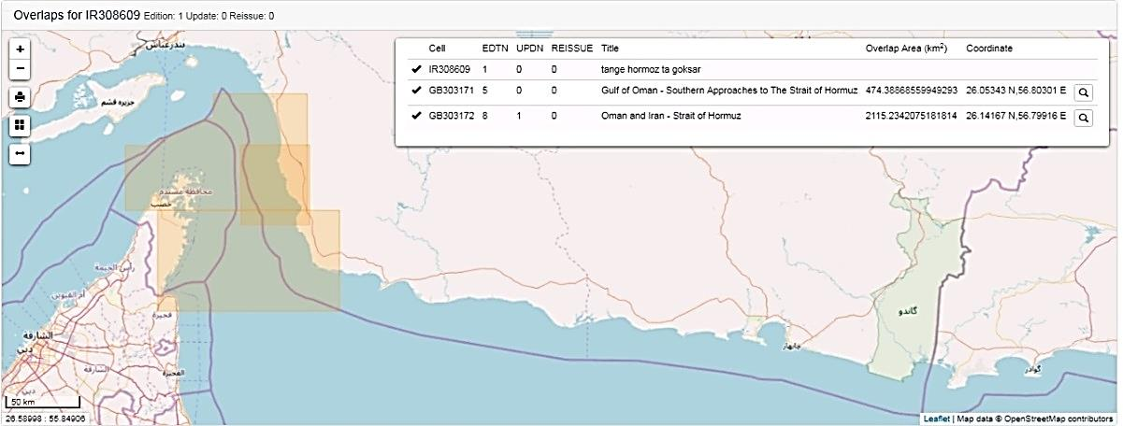
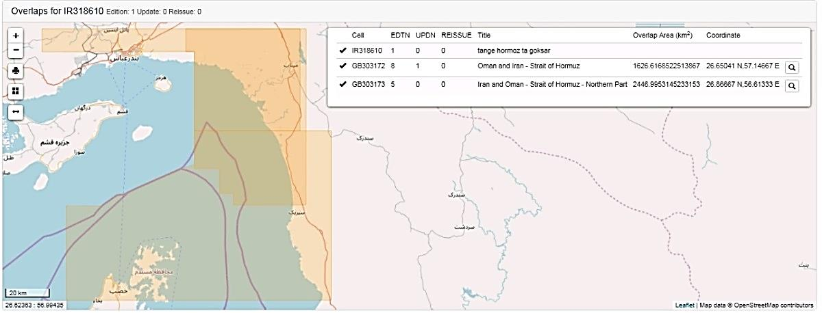
IR 308608 & GB 303171 , GB 303520
Overlaps in RSAHC Region ( I.R. of Iran)
IR 308609 & GB 303171 , GB 303172
IR 308610 & GB 303172 ,GB 303173

Slide 17
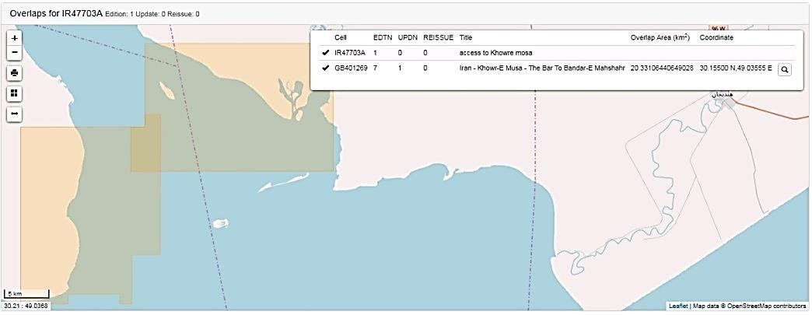
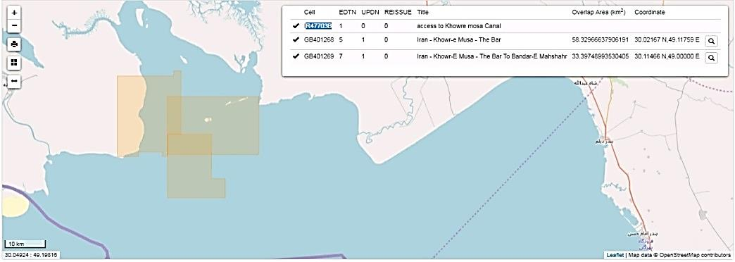
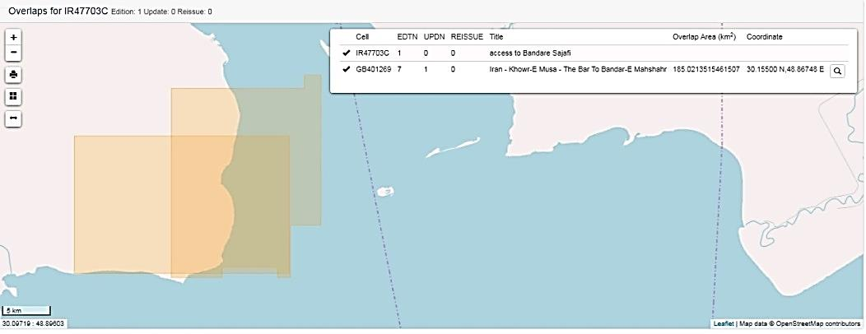
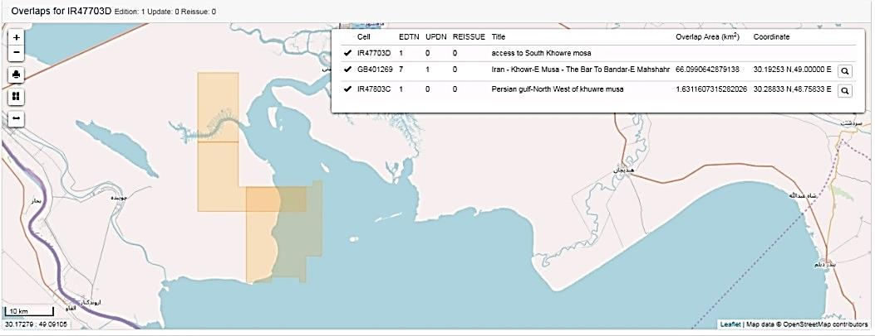
IR 47703A & GB 401269
Overlaps in RSAHC Region ( I.R. of Iran)
IR 477703C & GB 401269
IR 477703B & GB 401268 ,GB 401269
IR 47703D & GB 401269

Slide 18
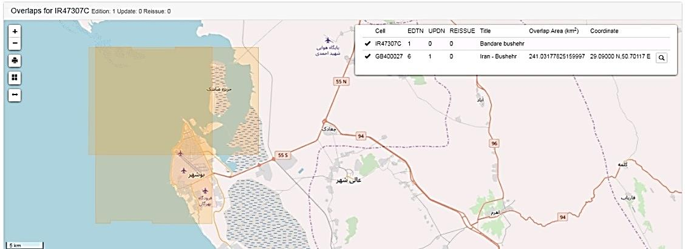
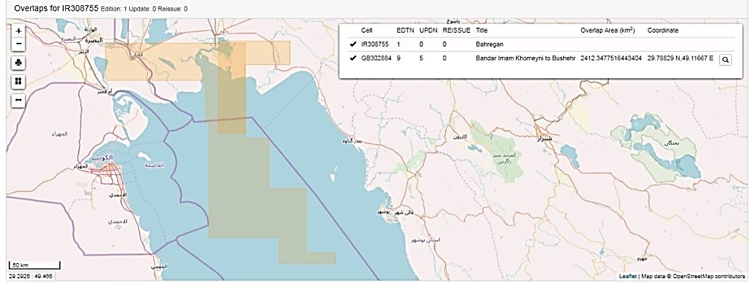
IR 47307C (Bushehr) & GB 400027
Overlaps in RSAHC Region ( I.R. of Iran)
IR 308755 & GB 302884
IR 308760 (BIK Port) & GB 301235, GB 302884 ,GB 303773

Slide 19
Existence of overlapping ENCs that may have a possible impact on safe navigation
Cell Name 1 | Cell Name 2 | UB | Risk | Justification | Action Requested
IR 308601 | GB 302851 | 3 | Low | PRIMAR has agreed to make the required coordination for resolving overlap cases, | UKHO Should Cut the overlap
IR 308602 | GB 302851 | 3 | Low | PRIMAR has agreed to make the required coordination for resolving overlap cases, | Should be replaced with Iranian Chart
IR 308607 | GB 303171 & GB 303520 | 3 | Med | PRIMAR has agreed to make the required coordination for resolving overlap cases, | UKHO Should Cut the overlap
IR 308608 | GB 303171 & GB 303520 | 3 | Med | PRIMAR has agreed to make the required coordination for resolving overlap cases, | Should be replaced with Iranian Chart
IR 308609 | GB 303171 & GB 303172 | 3 | Med | PRIMAR has agreed to make the required coordination for resolving overlap cases, | UKHO Should Cut the overlap
IR 308610 | GB 303172 & GB 303173 | 3 | Med | PRIMAR has agreed to make the required coordination for resolving overlap cases, | UKHO Should Cut the overlap
IR 47703A | GB 401269 | 4 | Low | PRIMAR has agreed to make the required coordination for resolving overlap cases, | UKHO Should Cut the overlap
IR 47703B | GB 401268 & GB 401269 | 4 | Med | PRIMAR has agreed to make the required coordination for resolving overlap cases, | UKHO Should Cut the overlap
IR 47703C | GB 401269 | 4 | Low | PRIMAR has agreed to make the required coordination for resolving overlap cases, | Should be replaced with Iranian Chart
IR 47703D | GB 401269 | 4 | Med | PRIMAR has agreed to make the required coordination for resolving overlap cases, | UKHO Should Cut the overlap
RENC & WENDWG9, Brest, France 26 – 28 Feb. 2019

Slide 20
Existence of overlapping ENCs that may have a possible impact on safe navigation
Cell Name 1 | Cell Name 2 | UB | Risk | Justification | Action Requested
IR 308755 | GB 302884 | 3 | Med
IR 403080 | GB 302441 & GB 303175 | 4 | Low | Nautical Charts IR 403080 & IR 403081 cover some of the Omani waters,. | since the boundary of the relevant continental shelf has not been determined, first the boundaries should be define.
IR 403081 | GB 302441, GB 303174 & GB 303175 | 4
IR 403082 | GB 303172 | 4 | Low | The scope of Nautical Chart IR 403082 falls under the agreement between Iran and Oman regarding the continental shelf boundary, | Iran is going to delete its information from the overlap area.
IR 47307C | GB 400027 | 4 | Med | PRIMAR has agreed to make the required coordination for resolving overlap cases, | Should be replaced with Iranian Chart
RENC & WENDWG9, Brest, France 26 – 28 Feb. 2019

Slide 21
Existence of overlapping ENCs that may have a possible impact on safe navigation
Cell Name 1 | Cell Name 2 | UB | Risk | Justification | Action Requested
IR 403051 | GB 501269 | 4 | Med | ENC cell GB 501269 has the same compilation scale with ENC IR 403051, but in different usage band. | GB 51269B.3.0.0 is in approach user band as compilation scale saying so. Then must be replaced with IR’s cells.
IR 403031 | GB 500011 | 4 | Med | GB 500011 has the same compilation scale with IR 403031, but in different usage band. UK changed it to harbor while compilation scale remained unchanged and set at 1:22000. | GB 500011 is in approach user band as compilation scale saying so. Then must be replaced with IR’s cells.
IR 308760 | GB 301235, GB 302884 & GB 303773 | 3 | Med | PRIMAR has agreed to make the required coordination for resolving overlap cases, | UKHO Should Cut the overlap
PKINB572 | In121MTB &IN122MCC & IN17705B & IN17706C | 1 | Low/Med | Extensive correspondence has been made in this regard, and the issue has been considered and analyzed in our different meetings with them, resulting in proposals from the two sides. The two sides did not reach an agreement over the issue | It can be considered an example of taking action in accordance with recommendation number 9 of IRCC10 to RHCs.
Note: Risk assessments are not according to IC-ENC/PRIMAR guideline.

Slide 22
Problems or outstanding issues, Recommendations
Outstanding Issues:
Continental shelf boundary not determined completely between countries of Region I (Persian Gulf and Gulf of Oman);
Latest status of ENC production unknown, due to insufficient reporting by a number of countries;
Absence of an integrated and systematic structure for registering, validating and uploading ENCs, in a similar manner as INT Charts (INToGIS II); and
Insufficient competence of trained experts in hydrographic centers of some regional countries.
Recommendations:
To create an integrated and systematic structure for registering, validating and uploading ENCs in RSAHC Region;
To report twice a year the latest status of ENC productions and it’s updates to ENC/INT Coordinator.

Slide 23
Actions requested of WENDWG
WENDWG is invited to note the report from the RSAHC.

