Slide 1
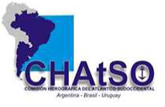
WORLDWIDE ENC DATABASE WORKING GROUP (WENDWG)
Report of the representative of the on the South West Atlantic Hydrographic Commission (SWAtHC)
WENDWG-9, BREST, FRANCE, 26 – 28 February 2019

Slide 2
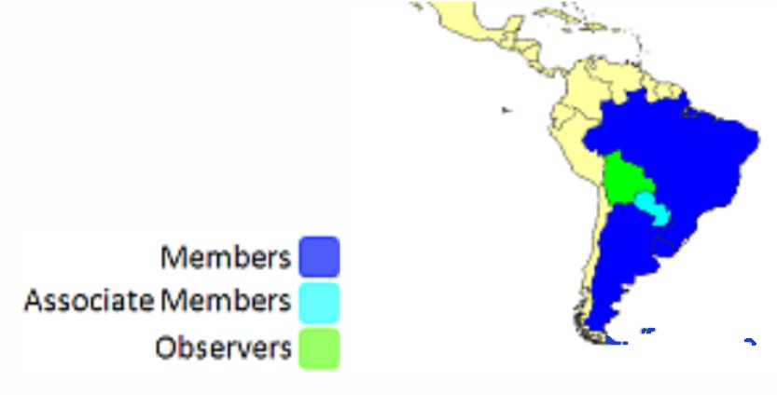
SWAtHC
Members: ARGENTINA
BRAZIL & URUGUAY
Associate Member: PARAGUAY
Observer: BOLIVIA
WENDWG-9

Slide 3
SWAtHC
1-Overlapping issues ENC Coverage
Overlaps
Cellname Cellname U B
UY200001 AR202100 2--------- solved in 2018 (beiing reliased)
UY200001 BR221080 2--------- will be solved in March
UY200001 AR201130 2--------- solved in 2018
WENDWG-9

Slide 4
SWAtHC
WENDWG-9

Slide 5
SWAtHC
WENDWG-9

Slide 6
SWAtHC
WENDWG-9

Slide 7
SWAtHC
NO COVERAGE AREAS
AR4PM540
AR 4PI461
AR402500
AR403600
WENDWG-9

Slide 8
Problems or outstanding issues, Recommendations
List of Ports and Moorings
Ports Not Covered ?????
Port Name Country
CONCEPCION DEL URUGUAY AR (P) (INTENDED 2019)
PAYSANDU UY (P) WP-2019 (SCHEMED)
SANTA FE AR (P) AR4PM540 (EDITED 2018)
TRAMANDAI BR (M) ALREADY (UB3)
PORTO ALEGRE BR (M) ALREADY (UB3)
SAN SEBASTIAN BAY AR (P) AR404600 (2nd EDITION 2016)
WENDWG-9

Slide 9
SWAtHC
SWAtHC-ENC-SCHEME-UB-1-2&3-2018-2020
Working on a possible SCHEME-UB-4- starting on 2020
WENDWG-9

Slide 10
Actions requested of WENDWG/IRCC
Summary:
•ALL ENC overlaps HAVE BEEN RESOLVED even ref : UY200001
•Key 1 port included on ENC SHEME.
•ENC SHEME including UB 3 uncovered areas.
WENDWG is invited to note the report from SWAtHC
WENDWG-9

