Slide 1
Report and Proposals from HSSC
I
2ND MEETING OF THE IHO COUNCIL
London, United Kingdom ( 9-11 October 2018 )
Rear Admiral Luigi Sinapi – HSSC Chair

Slide 2
Introduction
HSSC work is guided by the IHO Work Programme 2 “Hydrographic Services and Standards” and by the Council key Priorities
Meetings since C-1:
HSSC 9 - Ottawa, Canada (6-10 November 2017)
HSSC 10 - Rostock-Warnemünde, Germany (14-17 May 2018) – 6 month earlier due to the decision to adjust the timing of subsequent meetings in order to provide timely input to the IHO Council
Next Meeting:
HSSC 11 - Cape Town, South Africa (6-10 May 2019)
Rear Admiral Luigi Sinapi – HSSC Chair

Slide 3
Introduction
Difficulties and challenges yet to be addressed :
There is no significant change to the difficulties and challenges reported to
C-1 apart from the shortened time window between HSSC-9 and HSSC-10. Most of the actions agreed in November 2017 at HSSC-9 have progressed normally.
Rear Admiral Luigi Sinapi – HSSC Chair

Slide 4
Items
C2-4.1A1&A2 - Revision process of IHO Resolution 2/2007
C2-4.1B - Amendments to the HSSC ToRs and RoPs
C2-4.1.C - HSSC key priorities of the IHO Work Programme 2 for 2019-2020
C2-4.1 Par.19 - Request for the use of the IHO Fund for Special Projects
C2-4.1.D - Top-3 work items of the HSSC WGs and PTs work programme for 2019-2020
Rear Admiral Luigi Sinapi – HSSC Chair

Slide 5
C2-4.1A1&A2 - Revision process of IHO Resolution 2/2007
HSSC initiated the revision of the IHO Resolution 2/2007 in accordance with Decision A1/12 (guidance for impact assessment) and Action C1/05 (endorsement/approval procedure of standards and publications listed in Appendix to IHO Resolution 2/2007).
Rear Admiral Luigi Sinapi – HSSC Chair

Slide 6
C2-4.1A1&A2 - Revision process of IHO Resolution 2/2007
Two steps:
Creation of a “Guidance on conduction of an Impact Study” (endorsed at HSSC10);
Development of the endorsement/approval procedure of the relevant standards taking into account the role of the Council in the approval process (Target HSSC11).
Rear Admiral Luigi Sinapi – HSSC Chair

Slide 7
C2-4.1A1&A2 - Revision process of IHO Resolution 2/2007
STEP 1
Guidance On Conduction Of An Impact Study
Description of the purpose of the study (testable hypotheses)
Specification of the result assessment methods
Identification of a minimum of measurable indicators
Suitability of impact study questions
Rear Admiral Luigi Sinapi – HSSC Chair

Slide 8
C2-4.1A1&A2 - Revision process of IHO Resolution 2/2007
STEP 1
Guidance On Conduction Of An Impact Study
Identification of potential stakeholders
Identification of appropriate survey tools and methods
Specification of the survey duration
Specification of requested actions and dissemination of the findings
Rear Admiral Luigi Sinapi – HSSC Chair

Slide 9
C2-4.1A1&A2 - Revision process of IHO Resolution 2/2007
Current Review Cycle for S-100 Based Prod Specs
…. principles and procedures are intended to be applied to all proposals for changes to IHO technical standards and for new work items that will require significant resources to resolve or will potentially impact on those who need to apply the standards.
Res. 2/2007
Stakeholder Implementation
PT / WG Approval
HSSC Endorsement
Council Endorsement
MS Approval
Approval Process
Submit to HSSC or Circulate by HSSC Letter
Submit as Council Document
Issues CL
Release Edition 1.0.0
Rear Admiral Luigi Sinapi – HSSC Chair

Slide 10
C2-4.1A1&A2 - Revision process of IHO Resolution 2/2007
WG/PT submit for
HSSC Approval
WG /PT Activity
Stakeholder (OEM, industry) Testing, Evaluation and System Implementation
Publish Edition 1.0.0
Stakeholder feedback
Stakeholder feedback
…….
New Development Cycle
Stakeholder feedback
Stakeholder feedback
…….
Stakeholder feedback
Prepare new Edition
Publish Edition 1.n.n
Stakeholder (OEM, Industry, MS & End user)
feedback
Conduct Impact Assessment
Publish Edition 2.0.0
Provide Impact Assessment Report
HSSC, then …MS Approval (Res 2/2007) Process
Rear Admiral Luigi Sinapi – HSSC Chair

Slide 11
C2-4.1A1&A2 - Revision process of IHO Resolution 2/2007
STEP 2
Proposal to divide the Appendix 1 into two parts:
Standards and Publications (including Guidance) to follow the full process of IHO Resolution 2/2007
Standards and Publications (including Guidance) to be developed and maintained without following the full process
Rear Admiral Luigi Sinapi – HSSC Chair

Slide 12
C2-4.1A1&A2 - Revision process of IHO Resolution 2/2007
Actions required of the Council :
Endorse the revision process of IHO Resolution 2/2007:
New Review Cycle for WG/PT Development Phase of Prod Specs (Annex A1)
Guidance on conduction of an Impact Study (Annex A2)
Rear Admiral Luigi Sinapi – HSSC Chair

Slide 13
C2-4.1B - Amendments to the HSSC ToRs and RoPs
Main amendments to the current HSSC TORs and ROPs reflect:
The presence and the role of the COUNCIL
The possibility for the HSSC to decide on the need to go through the Council for recommendations on standards and publications before submitting them to Member States for approval
Rear Admiral Luigi Sinapi – HSSC Chair

Slide 14
C2-4.1B - Amendments to the HSSC ToRs and RoPs
Main changes proposed in HSSC TORs and ROPs:
1.8 Consider and decide upon proposals for new work items under the Committee Work Programme, taking into account the financial, administrative and wider stakeholder consequences and the IHO Strategic Plan and Work Programme and report to each meeting of the Council.
Rear Admiral Luigi Sinapi – HSSC Chair

Slide 15
C2-4.1B - Amendments to the HSSC ToRs and RoPs
Main changes proposed in HSSC TORs and ROPs:
2.9 Recommendations of possible strategic importance made by the Committee shall be submitted to IHO Member States for adoption through the Council to the Assembly. The Committee should appreciate and determine the need to go through the Council for recommendations. If prior endorsement of the Council is not deemed necessary by the Committee, the recommendations on standards and publications can be submitted directly to the IHO Member States for approval, once endorsed by the Committee.
Rear Admiral Luigi Sinapi – HSSC Chair

Slide 16
C2-4.1B - Amendments to the HSSC ToRs and RoPs
Actions required of the Council :
Endorse the amendments to the HSSC TORs
Rear Admiral Luigi Sinapi – HSSC Chair

Slide 17
C2-4.1.C - HSSC key priorities of the IHO WP for 2019-2020
C-1 endorsed the proposals made by the Secretary-General and two Directors on the key priorities in the IHO 2018 work programme
For the HSSC a set of priorities from Work Programme 2 were identified
Rear Admiral Luigi Sinapi – HSSC Chair

Slide 18
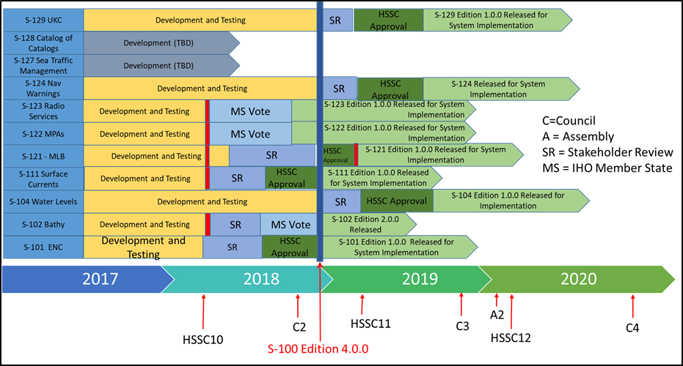
Notional S-100 Timeline
C2-4.1.C - HSSC key priorities of the IHO WP for 2019-2020
Rear Admiral Luigi Sinapi – HSSC Chair

Slide 19
C2-4.1.C - HSSC key priorities of the IHO WP for 2019-2020
Notional S-100 timeline: results achieved
HSSC endorsed the S-100 Product Specification Guidebook and agreed to include it within the S-100 work plan. HSSC assigned S-97 to the product specification guidebook.
HSSC endorsed S-122 Edition 1.0.0 and S-123 Edition 1.0.0; IHO Secretariat issued CL 45/2018 to seek MSs approval (deadline 30 November 2018).
Rear Admiral Luigi Sinapi – HSSC Chair

Slide 20
C2-4.1.C - HSSC key priorities of the IHO WP for 2019-2020
Notional S-100 timeline: results achieved
S100 Ed. 4.0.0: endorsed by HSSC Members and ready for IHO CL seeking for Member States approval
S-102 Ed. 2.0.0: S-100WG and S-102PT to address consistent comments by some HSSC Members, before IHO issues CL seeking for Member States approval
Rear Admiral Luigi Sinapi – HSSC Chair

Slide 21
C2-4.1.C - HSSC key priorities of the IHO WP for 2019-2020
Notional S-100 timeline: results achieved
HSSC agreed to the publication timeline of the following S100 based Product Specifications, under the conditions proposed by the IHO Secretariat for the new Review Cycle for WG/PT Development Phase of Prod Specs that were also endorsed with immediate effect:
S-101 Edition 1.0.0
S-111 Edition 1.0.0
S-121 Edition 1.0.0
Rear Admiral Luigi Sinapi – HSSC Chair

Slide 22
C2-4.1.C - HSSC key priorities of the IHO WP for 2019-2020
Current HSSC key priorities of IHO Work Programme 2 for 2018
Develop an S-100 Interoperability Specification;
Develop all the components needed to make S-101 a reality;
Develop S-121 Product Spec for Maritime Limits and Boundaries;
Consolidation and clarification of standards in relation to ECDIS/ENC;
Consider data quality aspects in an appropriate and harmonized way for all S-100 based product spec;
Prepare Ed. 6.0.0 of S-44;
Develop initial guidance on definition and harmonization of Maritime Service Portfolios.
Rear Admiral Luigi Sinapi – HSSC Chair

Slide 23
C2-4.1.C - HSSC key priorities of the IHO WP for 2019-2020
Develop an S-100 Interoperability Specification :
The development of an S-100 interoperability Specification is in progress (target HSSC11);
HSSC assigned number S-98, approved the title “S-98 Specification for Data Product Interoperability in S-100 Navigation Systems” and tasked S-100WG to consider how to incorporate generic interoperability into future editions of S-100;
The deadline for the presentation of S-98 has been established by HSSC11. S100WG has elaborated a first draft of S-98.
Rear Admiral Luigi Sinapi – HSSC Chair

Slide 24
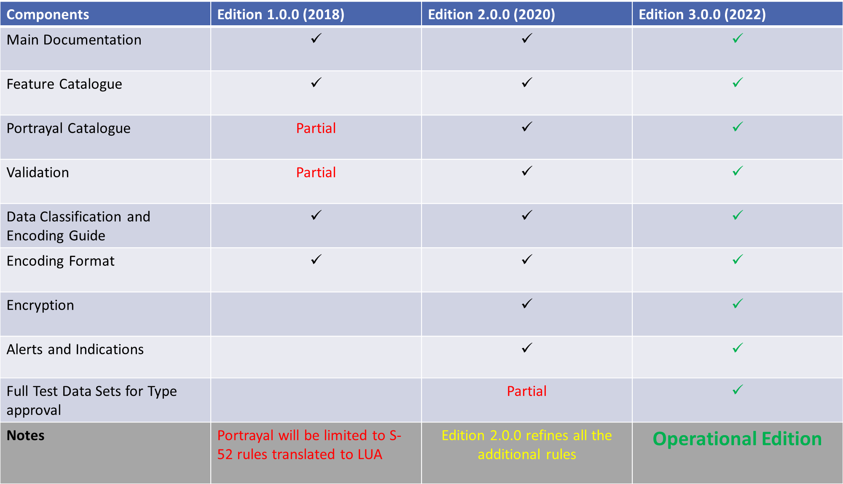
C2-4.1.C - HSSC key priorities of the IHO WP for 2019-2020
Develop all the components needed to make S-101 a reality:
Rear Admiral Luigi Sinapi – HSSC Chair

Slide 25
C2-4.1.C - HSSC key priorities of the IHO WP for 2019-2020
Develop S-121 Product Spec for Maritime Limits and Boundaries:
S-121 Project Team, under S-100WG umbrella, finalized the draft of S-121 Product Spec;
HSSC agreed to the publication timeline of S-121 Edition 1.0.0 under the conditions depicted by the IHO Secretariat for the new Review Cycle;
S-121 Edition 1.0.0 is planned to be published in March 2019 (After S100WG4).
Rear Admiral Luigi Sinapi – HSSC Chair

Slide 26
C2-4.1.C - HSSC key priorities of the IHO WP for 2019-2020
Consolidation and clarification of standards in relation to ECDIS/ENC:
HSSC endorsed Ed. 6.1.0 of S-58 and the IHO CL 38/2018 to IHO Member States seeking their approval was issued. Now adopted IHO CL 47, will enter into force 1 Sep 2019;
HSSC (ENCWG) is working in order to identify the individual components in S-57 (file size, etc.) that prevent ENC Producers from providing high density contour lines;
HSSC tasked the ENCWG to liaise with the CIRM and IEC for further investigations and risk assessment before considering the need for updating S-63.
Rear Admiral Luigi Sinapi – HSSC Chair

Slide 27
C2-4.1.C - HSSC key priorities of the IHO WP for 2019-2020
Consider data quality aspects in an appropriate and harmonized way for all S-100 based product spec:
DQWG has been reinvigorated through the approval of new TORs which consider and ensure that data quality aspects are addressed in an appropriate and harmonized way for all S-100 based Product Specifications;
A data quality checklist for product specification developers has been developed and will be included in the S-100 Product Specification Guidebook (S-97);
HSSC agreed that the level of authority of Data Quality Checklist for Product Specifications is a recommendation, which can be adapted as necessary by WGs, under the condition that it will not create any potential interoperability issue.
Rear Admiral Luigi Sinapi – HSSC Chair

Slide 28
C2-4.1.C - HSSC key priorities of the IHO WP for 2019-2020
Dilemma between harmonized encoding of quality information and the allowable input into a data model;
HO’s use workarounds in current S-57 model;
Harmonized encoding is a common effort (HSSC and IRCC).
FUTURE
S-57, encoding is harmonized
S-101, encoding is harmonized
S-57, encoding not harmonized
S-101, encoding not harmonized
NOW
Rear Admiral Luigi Sinapi – HSSC Chair

Slide 29
C2-4.1.C - HSSC key priorities of the IHO WP for 2019-2020
Prepare Ed. 6.0.0 of S-44:
A questionnaire has been circulated to the members of the International Hydrographic Community;
The replies to the questionnaire identified the need for guidelines;
HSPT tasked to continue its work, with the view of submitting a draft 6TH Edition of S-44 for endorsement (Target date 2019).
Rear Admiral Luigi Sinapi – HSSC Chair

Slide 30
C2-4.1.C - HSSC key priorities of the IHO WP for 2019-2020
Develop initial guidance on definition and harmonization of Maritime Service Portfolios:
The first HGDM meeting proposed to review the definition of Maritime Service Portfolios as a set of operational Maritime Services;
Following Maritime Services have been identified as relevant for the IHO:
No. 5 - Maritime Safety Information Service (MSI),
No. 11 - Nautical Chart Service,
No. 12 - Nautical Publications Service
No. 15 - Real-time hydrographic and environmental information Service.
HSSC tasked NIPWG to coordinate the provision of the Maritime Services definition under IHO remit and invited IHO Member States to consider their attendance to the forthcoming HGDM meeting.
No. 5 - Maritime Safety Information Service (MSI),
No. 12 - Nautical Publications Service,
No. 15 - Real-time hydrographic and environmental information Service.
Rear Admiral Luigi Sinapi – HSSC Chair

Slide 31
C2-4.1.C - HSSC key priorities of the IHO WP for 2019-2020
HSSC key priorities of IHO WP with the proposed amendsments for 2019-2020
Develop “S-98 - Specification for Data Product Interoperability in S-100 Navigation Systems” an S-100 Interoperability Specification
Develop S-121 Product Spec for Maritime Limits and Boundaries
Consolidate Product Spec Timeline in accordance with the new simplified S-100 Master Plan, with particular attention to S-101 Develop all the components needed to make S-101 a reality
Consolidation and clarification of standards in relation to ECDIS/ENC
Submit Prepare Ed. 6.0.0 of S-44
Consider data quality aspects in an appropriate and harmonized way for all S-100 based product spec and the development of a Minimum Standard for Data Validation
Contribute to the development of an Develop initial guidance on definition and harmonization of Maritime Services Portfolios
Rear Admiral Luigi Sinapi – HSSC Chair

Slide 32
C2-4.1.C - HSSC key priorities of the IHO WP for 2019-2020
Actions required of the Council :
Approve the HSSC key priorities of the IHO Work Programme 2 (as decided at C-1) with the amendments suggested for 2019-2020 (Annex C, red-line)
Rear Admiral Luigi Sinapi – HSSC Chair

Slide 33
C2-4.1 Par.19 - Request for the use of the IHO Fund for Special Projects
Priority | Work item | Budget (in €) | Performance Period (in months)
1 | Incremental updates of S-100 GML datasets | 20 K | 3-6
2 | Experimental production tool and viewer on the web | 40 K | 6-9
3 | Prototyping system for vector S-100-based data | 42 K | 6-9
Rear Admiral Luigi Sinapi – HSSC Chair

Slide 34
C2-4.1 Par.19 - Request for the use of the IHO Fund for Special Projects
Special Project 1 - Incremental updates of S-100 GML datasets: (Priority 1)
To test the possibility to manage incremental updates using radiocommunication equipment, without replacing the whole database.
Rear Admiral Luigi Sinapi – HSSC Chair

Slide 35
C2-4.1 Par.19 - Request for the use of the IHO Fund for Special Projects
Special Project 2 - Experimental production tool and viewer on the web : (Priority 2)
To develop an experimental production tool and viewer for S-100 based product specification development on the web.
Rear Admiral Luigi Sinapi – HSSC Chair

Slide 36
C2-4.1 Par.19 - Request for the use of the IHO Fund for Special Projects
Special Project 3 - Prototyping system for vector S-100-based data : (Priority 3)
To develop a general-purpose toolkit that can be used for rapid setup of web application(s) for dataset and exchange set creation for S-100 vector product specifications.
Rear Admiral Luigi Sinapi – HSSC Chair

Slide 37
C2-4.1 Par.19 - Request for the use of the IHO Fund for Special Projects
Actions required of the Council :
Approve the request for funding (from 2019) from the IHO Special Projects Fund for the work items listed in Paragraph 19 of the HSSC Report to the Council
Rear Admiral Luigi Sinapi – HSSC Chair

Slide 38
C2-4.1.D - Top-3 work items of the proposed work plans for 2019-2020
In accordance with the Work Programme 2 priorities indicated by the COUNCIL, HSSC identified the top-3 work items for each subordinate WG/PT
Rear Admiral Luigi Sinapi – HSSC Chair

Slide 39
C2-4.1.D - Top-3 work items of the proposed work plans for 2019-2020
S-100 WG
Publication of S-101 Edition 1.0.0 (end of 2018);
Continue to investigate how to include S-100 into the IMO ECDIS Performance Standards (2019);
3. Continued development of the S-98 Interoperability Specification (2019).
Rear Admiral Luigi Sinapi – HSSC Chair

Slide 40
C2-4.1.D - Top-3 work items of the proposed work plans for 2019-2020
ENCWG
Maintain IHO Publications (S-52, S-57, S-58, S-63, S-64, S-65, S-66);
Consider the development of high density contour lines related to ENCs;
Conduct an impact assessment on the new edition of the S-63 in relation to the Cyber Security risk.
Rear Admiral Luigi Sinapi – HSSC Chair

Slide 41
C2-4.1.D - Top-3 work items of the proposed work plans for 2019-2020
NCWG
Maintain IHO Publication S-4 as the foundation document for all nautical charts (both paper and electronic);
Develop discussion paper on the Future of the Paper Chart.
Rear Admiral Luigi Sinapi – HSSC Chair

Slide 42
C2-4.1.D - Top-3 work items of the proposed work plans for 2019-2020
NIPWG
Develop S-12n - Nautical Information Product Specifications;
Coordinate the IHO contribution to the definition and harmonization of IMO Maritime Services within IHO’s remit.
Rear Admiral Luigi Sinapi – HSSC Chair

Slide 43
C2-4.1.D - Top-3 work items of the proposed work plans for 2019-2020
DQWG
Develop and maintain a data quality checklist for product specification developers;
Provide guidance on data quality aspects to Hydrographic Offices, in particular to ensure harmonized implementation;
Periodically review S-100 based product specifications to ensure the data quality aspects have been taken into consideration and provide input papers for WGs and PTs consideration if deemed necessary.
Rear Admiral Luigi Sinapi – HSSC Chair

Slide 44
C2-4.1.D - Top-3 work items of the proposed work plans for 2019-2020
TWCWG
Develop, maintain and extend a Product Specification for digital tide and tidal current tables;
Develop, maintain and extend a Product Specification for dynamic surface currents in ECDIS (S-111) and for dynamic tides water level in ECDIS (S-104);
Maintain and extend the relevant IHO standards, specifications and publications as required.
Rear Admiral Luigi Sinapi – HSSC Chair

Slide 45
C2-4.1.D - Top-3 work items of the proposed work plans for 2019-2020
HDWG
Maintain and extend the definitions in the IHO S-32 Hydrographic Dictionary Registry;
Liaise with other IHO bodies and other organizations preparing publications containing glossaries;
Develop a digital structure and database application to support the IHO S-32 Hydrographic Dictionary Registry on-line version.
Rear Admiral Luigi Sinapi – HSSC Chair

Slide 46
C2-4.1.D - Top-3 work items of the proposed work plans for 2019-2020
ABLOS
Maintain IHO Publication C-51 “Technical Aspects of the Law of the Sea (TALOS) Manual”;
Deliver a standard training program on the hydrographic aspects of maritime delimitation;
Provide advice and guidance on the technical aspect of the Law of the Sea to relevant organizations, bodies and Member States.
Rear Admiral Luigi Sinapi – HSSC Chair

Slide 47
C2-4.1.D - Top-3 work items of the proposed work plans for 2019-2020
HSPT
Review the existing edition of S-44 (5th edition) and identify any deficiencies in either the standards or explanatory content;
2. Following review, update the content and structure of S-44 to the extent identified during the review, with the intention of publishing revisions as a 6th edition of S-44;
3. On completion of publication of a 6th edition of S-44, submit a proposal and recommendation to the Hydrographic Services and Standards Committee (HSSC) on whether the PT should continue as a standing working group and, if so, what tasks have been identified to justify transition to a standing working group.
Rear Admiral Luigi Sinapi – HSSC Chair

Slide 48
C2-4.1.D - Top-3 work items of the proposed work plans for 2019-2020
Actions required of the Council :
Note the list of the top-3 work items of HSSC WG/PTs proposed work plans for 2019-2020 (Annex D)
And to conclude with the actions required:
Take any other action as it may consider appropriate
Rear Admiral Luigi Sinapi – HSSC Chair
Notes:
Due riche di chiosa finale

