Slide 1
Minimum Resources needed to support a sustainable level of CB activities

Slide 2
Aim of presentation
CBSC was tasked to propose to the Council via IRCC to provide information on the minimum resources needed to support a sustainable level of CB activities.
Seek guidance on the way ahead to address the resource shortage and ensure a sustainable flow of resources.

Slide 3
Capacity Building Supporting IHO Strategic Plan
Under strategic direction 4.4 of 2017 IHO Strategic Plan, the CBSC’s task is:
to better support the needs of Member States, especially those developing their capabilities from MSI through surveying to nautical charting and MSDI.

Slide 4
two Sources of Funding for CB activities
IHO budget - regular annual contributions and possibly from IHO’s overall annual budget surplus.
Donations - by governments, other international organizations, funding agencies, public or private institutions, associations or private individuals.

Slide 5
how CB Funds allocated
ALLOCATION OF FUNDS
IHO Funds towards provision of MSI, surveying and charting trainings.
Donations generally earmarked by the benefactors for designated projects according to their priorities.
APPROVED 3 –YEAR BUDGET (2018 TO 2020)
The three-year IHO Capacity Building Fund share as proposed in 2016 and approved by the first IHO Assembly in 2017 is a follows:
• 2018: 206 k€ (added by 100k€ from the accumulated surplus of 2017 – FCCL01/2018 refers)
• 2019: 116 k€
• 2020: 86 k€
The projected IHO share of 86 k€ for 2020 stems from the estimate made in 2016.
IHO Secretariat working on proposal of an updated annual budget for 2020 for approval by Council.
Based on above, an IHO Capacity Building Fund share less than 200 k€ puts the planned delivery of the approved CB programme work at considerable risk.

Slide 6
Estimated Minimum FundS Required to support CB Programmes
Phase 0 and Phase 1
Estimated 200k€ to cover expenses with Technical and High-Level Visits, Seminars/Workshops and MSI training courses.
Excludes following In-Kind contributions:
- Training facilities and/or trainers by Member States.
- Experts for High Level and Technical Visits.
Phase 2 and 3 - for most needy countries
To ensure the CB provision for surveying, data management and nautical products, it is estimated to need:
- In-kind contribution of training facilities, training material and/or trainers by Member State and/or industry.
- Estimated another 200 k€ - Can be reduced to 100 k€ with In-Kind support of training materials, TFT courses and e-learning materials
Additional Funds or In-Kind Contributions for consulting, investments in comprehensive projects
To attract funding from other organizations for comprehensive projects,
May need funds for consultants or to have a commitment from MSs to provide resources within their government to develop appropriate submissions to national, regional or international donor funding programmes.
MSs may take the lead using their national expertise, resources and knowledge to develop such projects and get other MSs involved via RHC.
With sufficient commitment from Member States it is expected that this item has no impact on the CB fund.

Slide 7
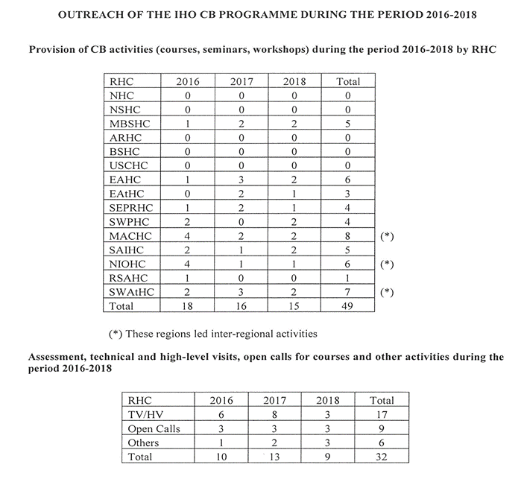
Overview of CB Work Programmes 2016 to 2018

Slide 8
Recommendations
It is recommended that :
Council endorses the amount of 300 k€ as guaranteed minimum level of IHO Capacity Building Fund
share to be incorporated into the annual budget of 2020 and the three-years-budget proposal 2021 – 2023;
submit it for Assembly approval.
The proposed provisions for Phase 2/3 and Additional Funds enable the delivery of the approved CB Strategy and CB Programme.
Can be regarded as an incentive to attract potential new IHO Member States.

Slide 9
Justification and Impacts
Securing a guaranteed minimum level of IHO Capacity Building Fund share is necessary to fulfil the CB Programme according to IHO´s Capacity Building Strategy, which is a core part of the overall IHO Strategy and a major incentive for new Member States to join the IHO.
This proposal has an impact on the IHO annual budget and three years budget. It is assumed to have a high priority.

Slide 10
Action Required of the Council
The Council is invited to:
a) endorse the proposal of a guaranteed minimum level of IHO Capacity Building Fund share as part of the IHO overall annual and three-year budget;
b) consider additional contributions beyond Member States contributions to the IHO budget to cover this request;
c) confirm the intention to seek a potential increase of Member States contributions if there is no other option to cover the current proposal;
d) task the Secretariat to incorporate this proposal in the preparation of the drafting of the annual budget proposal for 2020 and the three years budget for 2021-2023 and seek approval by the Assembly; and
e) take any other action seen appropriate.

