Slide 1
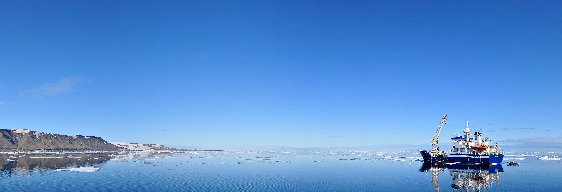
Status
AICCWG
ARHC9:Murmansk, Russian Federation

Slide 2
AICCWG
AICCWG is fully manned.
Norway continues as chair.
No formal meetings – work done by correspondence.
Good level of engagement between the representatives.
ToR for AICCWG revised to reflect Action ARHC8-04
The draft ToR are given in Annex A and B of the AICCWG report and are submitted for approval by ARHC.

Slide 3
ToR Amendments

Slide 4
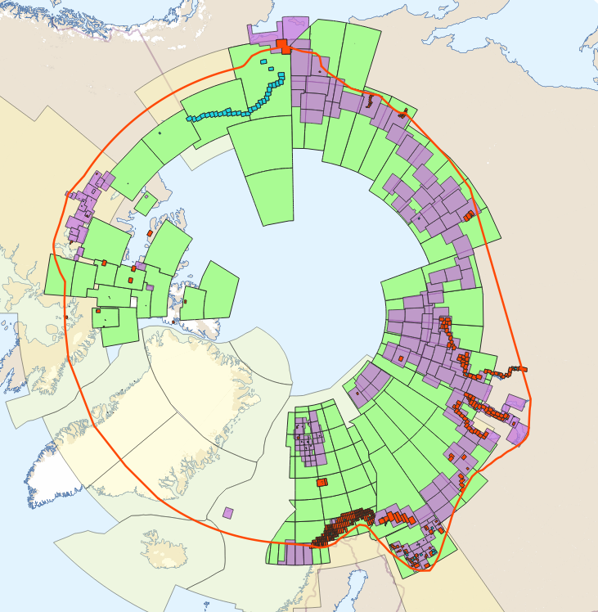
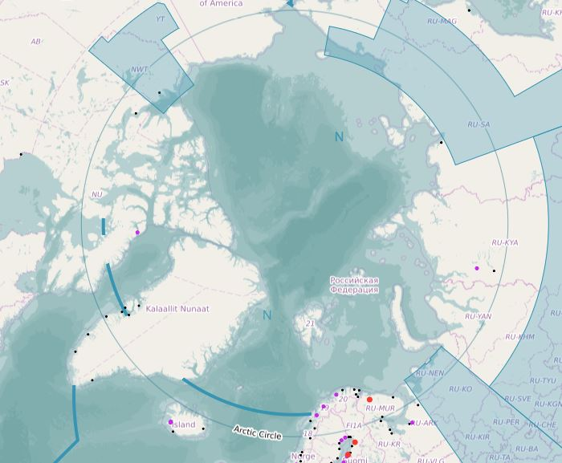
Status of The ENC Scheme in Region N
RENC ENC’s
UB1 Overview: 8
UB2 General: 96
UB3 Coastal: 203
UB4 Approach: 410
UB5 Harbour: 182
UB6 Berthing: 33
+ 3 non-RENC exclusive UB1 ENC’s

Slide 5
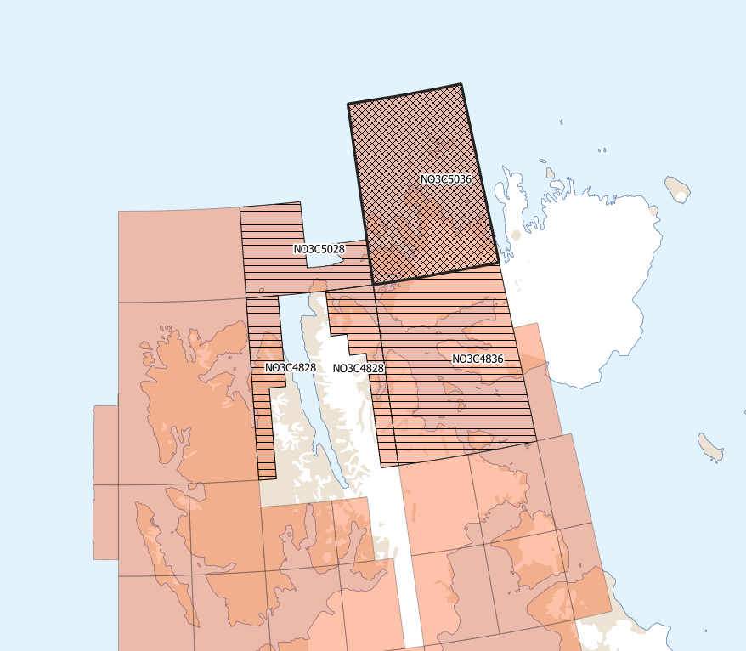
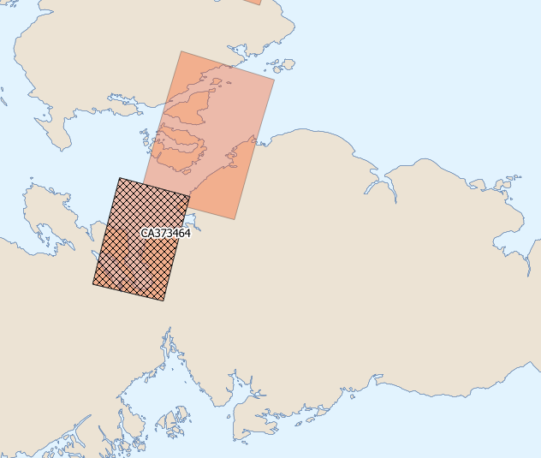
New UB3 ENCs in Region N
Norway:
1 New UB3 ENC – NO3C5036
Coverage extended on 3 UB 3 ENC’s:
- NO3C5028
- NO3C4836
- NO3C4828
Canada:
1 New UB3 ENC – CA373464
Spence Bay

Slide 6
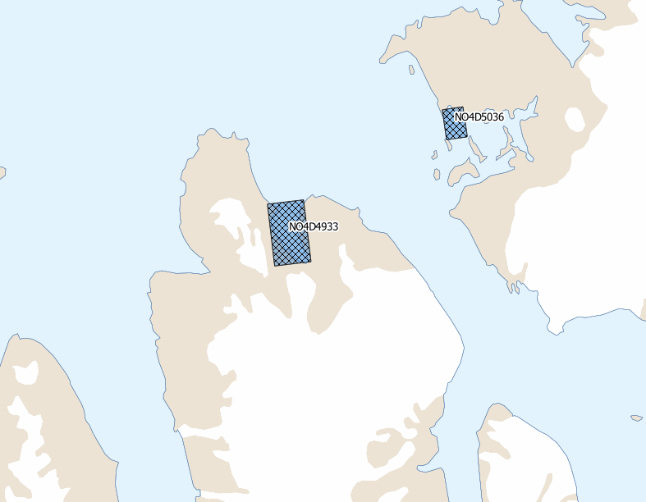
New UB4 ENCs in Region N
Norway:
2 New UB3 ENCs :
- NO4D4933
- NO4D5036

Slide 7
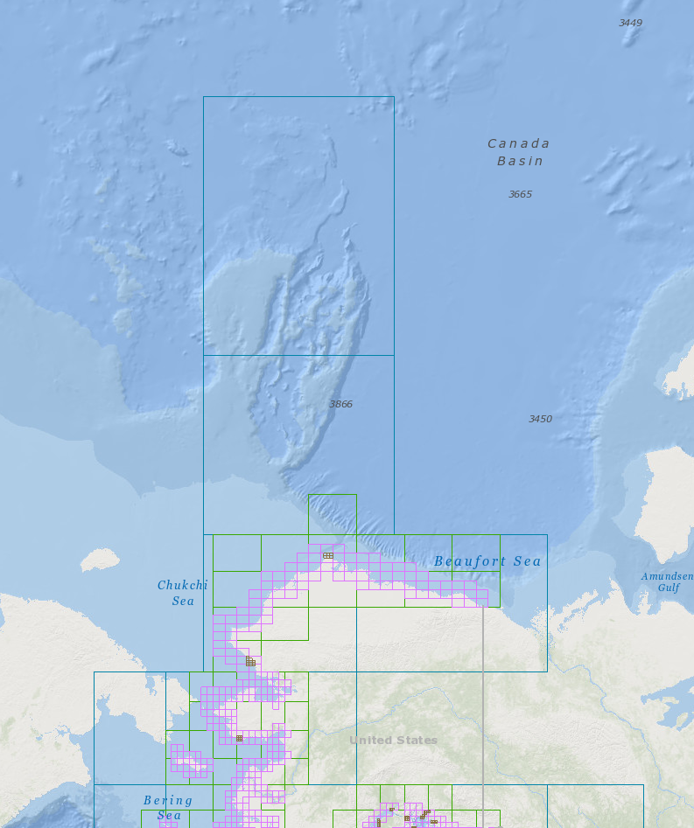
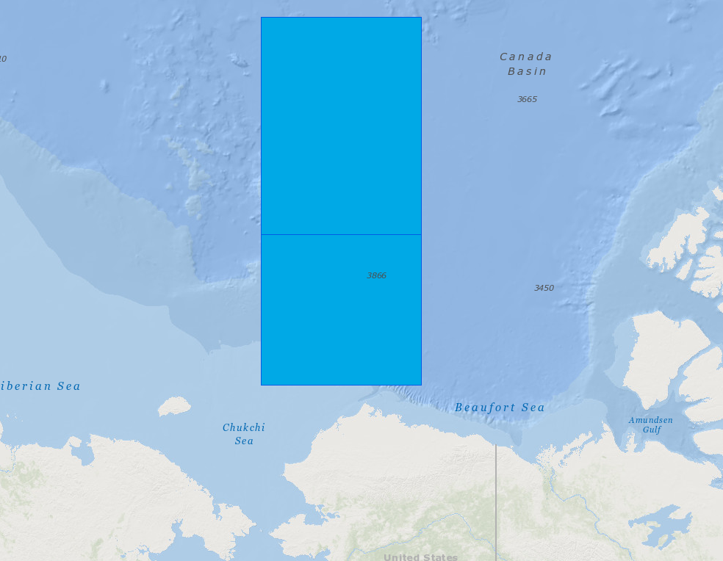
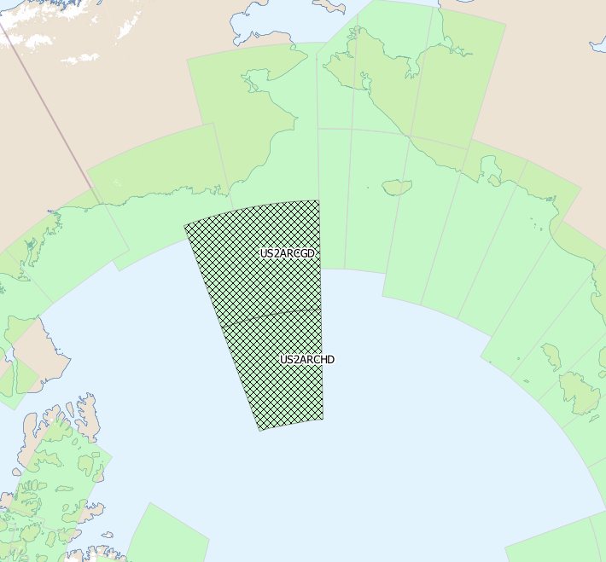
NOAA ENC Rescheme Status
Propsosed
Completed
The extents of all NOAA ENC charts are being reschemed into a gridded layout.
A planned scheme for all charts in usage band 2 through 5 has been proposed and the process of producing the new ENCs is gaining momentum.
Two new ENCs in Usage band 2 have already been produced:
-US2ARCGD
-US2ARCHD

Slide 8
ENC Coverage Issues
IC-ENC Overlap report – All overlaping issues assessed as ‘low’risk.
Significant progress has been made in eliminating overlaps.
Work complete on all but three overlapping issues.

Slide 9
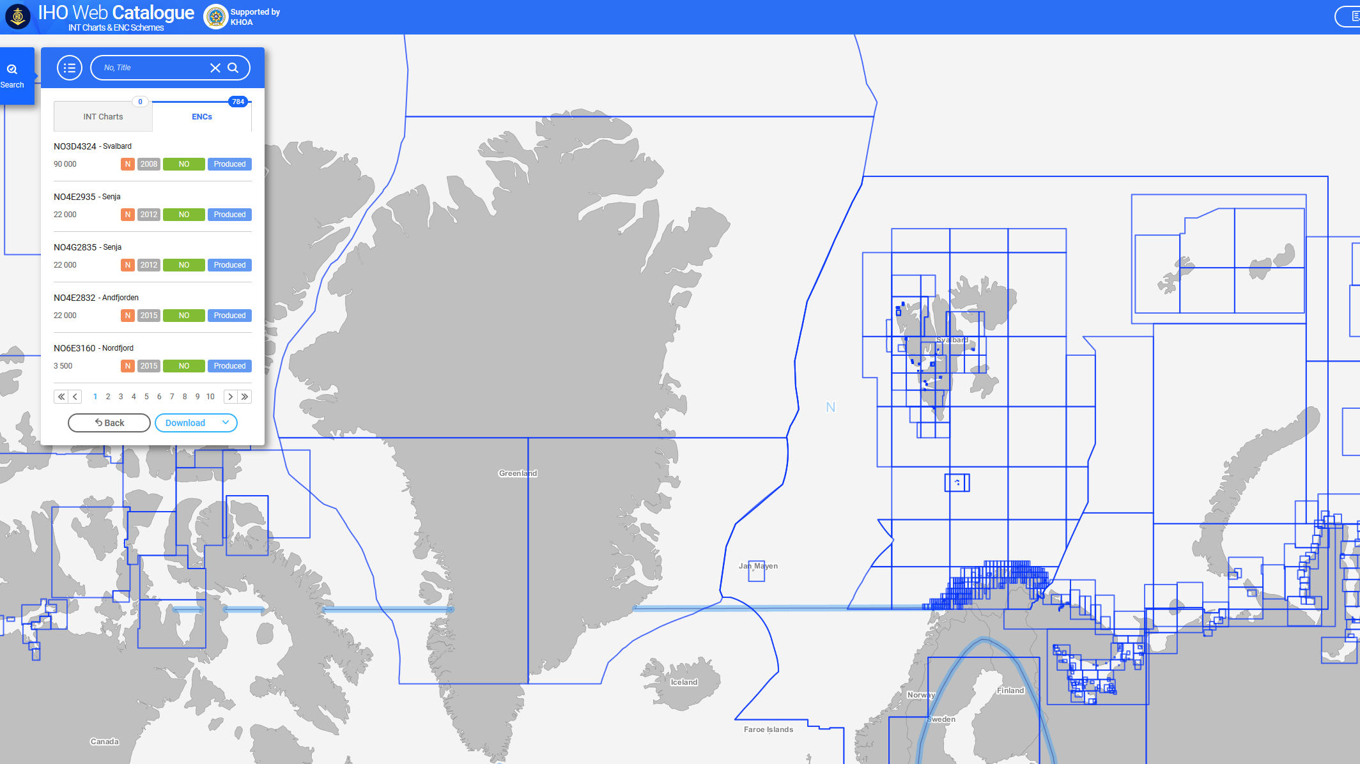
INToGIS II
The AICCWG coordinator has been involved in testing of INToGIS II and has provided user feedback ahead of its release.
Many improvements in functionality.
Once commissioned INToGIS II will be an incredible useful tool.
Workshop later this year – AICCWG Coordinator will attend.
User information will be disseminated to all other representatives and its use encouraged.

