Slide 1
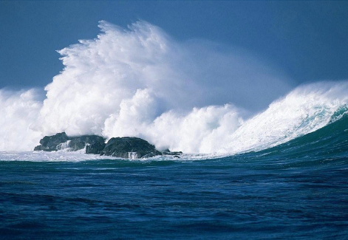


9th ARHC Conference
Murmansk, Russian Federation
17-19 September 2019
Report of the IHO MSDI Working Group

Slide 2
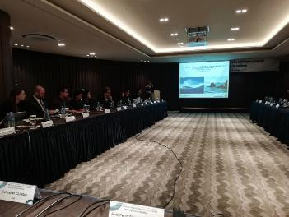
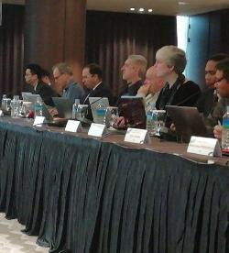
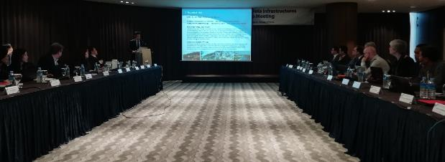
Meetings since last ARHC8 meeting
Meetings:
The MSDIWG10 meeting of IHO Marine Spatial Data Infrastructures Working Group (MSDIWG) took place in Busan, Republic of Korea, 4 - 5 March 2019. The meeting was followed by the OGC Marine DWG Meeting, 6 March 2019 and the UN-GGIM Working Group on Marine Geospatial Information (WGMGI1) Meeting, 7 - 9 March 2019.
Dates and venue for next meeting.
The IHO/MSDIWG will arrange a MSDI Open Forum meeting, the MSDIWG11 meeting with an integrated OGC Marine Domain WG part in 2020 in Rostock, Germany 24-27 February.

Slide 3
New Terms of Reference of MSDIWG.
The IRCC10 meeting agreed that the IHO MSDIWG should follow the development in MSP implementation worldwide and focus on the following topics:
• establish a list of relevant MS National MSP Data Contact Points
and contact persons
• establish a list of additional relevant institutions,
contact person/data experts
• study the most relevant MSP issues in a cross-border / trans-boundary
context in relation to data and information seen from a MS perspective
• compile minimum requirements for Hydrographic data for MSP Data and
recommendations of distribution/sharing of this data
• provide an overview on (national / regional) MSP best practice
• establish MSP on the IHO website under body of knowledge.
Consequently, the MSDIWG Terms of Reference and Rules of Procedures has been adjusted to address these topics (Annex C).
The MSDIWG Terms of Reference and Rules of Procedures has also been adjusted to be aligned with the other IRCC WGs.

Slide 4
The main subjects dealt with during the reporting period:
Information on MSDI implementation from MSDIWG members
MSDI training and e-learning
Maturity Assessment template to RHC
Update of C 17
The IHO/OGC conceptual study
Cooperation with OGC
Cooperation with UN-GGIM
Communication
The MSDIWG to focus on “security”
IHO strategic plan and establishing a draft IHO MSDIWG input
Spatial Data Quality
S-100
Cooperation with the International Cable Protection Committee

Slide 5
RHC MSDI Ambassadors
IRCC9/18. RHC Chairs to encourage Member States in the region to nominate RHC MSDI
Ambassadors to promote MSDI and to help Member States to prepare the national reports with respect
to the status of MSDI.
A vital element of this work would be to collect and collate responses from Member State on MSDI prior to each RHC meeting. It is becoming more important to consider taking MSDI as a RHC agenda item, therefore we hope to see a National MSDI report prepared by each Member State for submission to every RHC. The report should incorporate the status of MSDI, plans for involvement in MSDI and challenges facing the HO.
It is recommended that the National Reports include the topics from C-17, item 2.1 on what constitutes a MSDI:
• Policy and Governance
• People & Organizations
• Enablers (the framework for data acquisition, management, updating and dissemination)
o Standards
o Technology
o Metadata
• IHO S-100 Universal Hydrographic Data Model
• Content
• Education and Learning

Slide 6
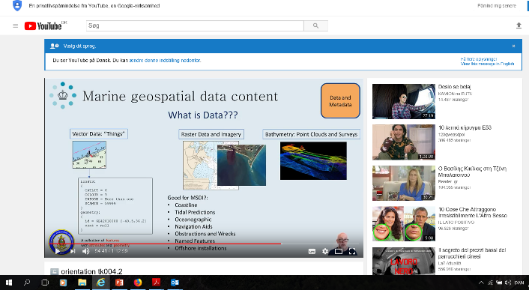
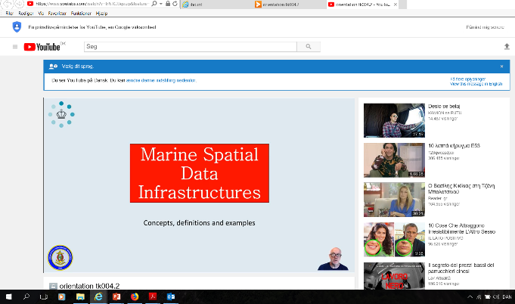
The MSDI eLearning course
Two MSDI courses
Orientation eLearning course
Fundamentals eLearning course

Slide 8

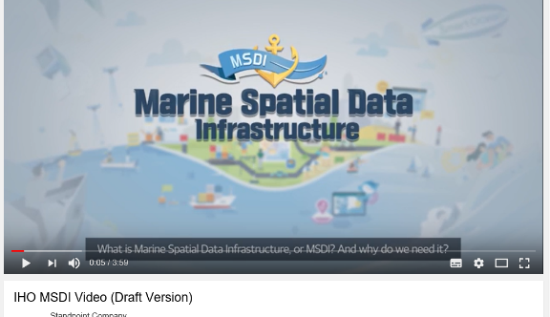
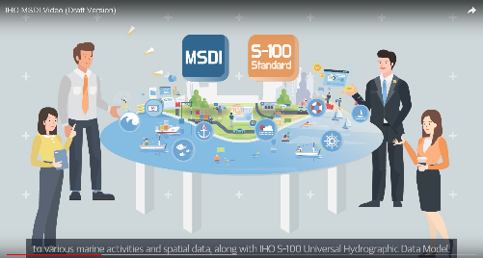
Communication and dissemination

Slide 9
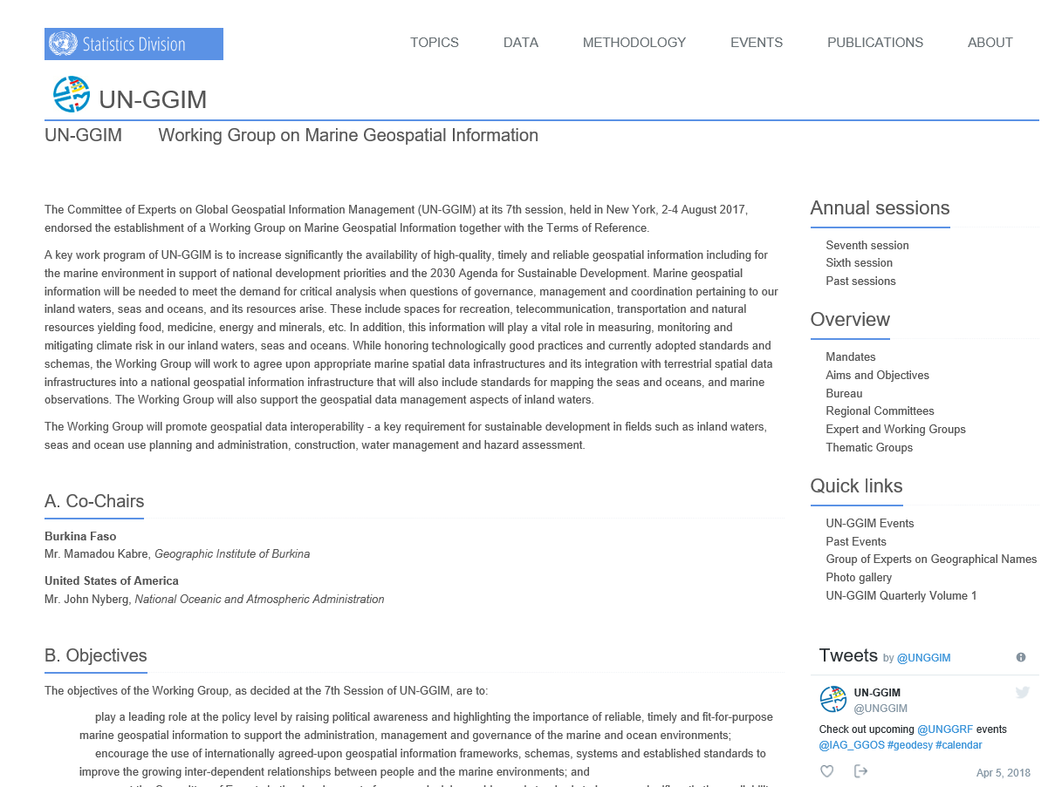
UN-GGIM - Working Group on Marine Geospatial Information
http://ggim.un.org/UNGGIM-wg8/

Slide 10
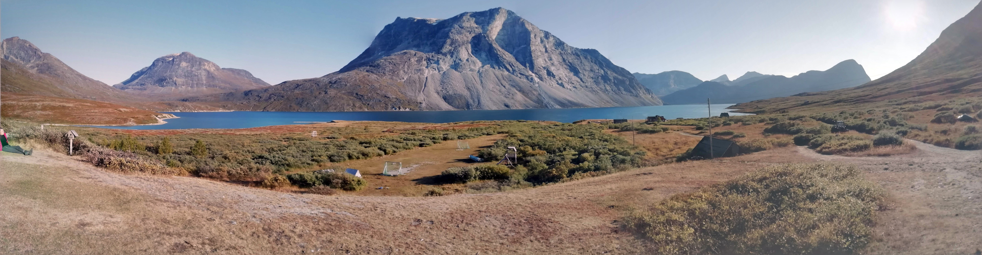
Recommendations for the ARHC 9 Conference.
The ARHC9 is invited to:
a. Note the report;
b. Take any other action as appropriate.

