Slide 1
Arctic Regional Hydrographic Commission
6th Conference – Iqaluit, Nunavut (Canada)
3 & 6 October 2016
IHO / IHB Matters
Yves Guillam

Slide 2
IHO / IHB Matters
    IHO Administration
    IHO GIS and Databases
    INT Charts and ENC Issues
    Current issues
    IHO Outreach
    Actions requested of ArHC

Slide 3
IHO Administration
Approval of the Protocol of Amendments to the IHO Convention
  Ratification of the Protocol on 8 August 2016 (48th approval)
  Entry into force on 8 November 2016 - new basic documents
  First Assembly (A-1) 24-28 April 2017

Slide 4
IHO Administration
Main changes introduced by the Protocol
  Conference => Assembly
  Establishment of a Council
  5-year cycle => 3-year cycle
  Simplified accession procedure for UN Member States
  IHB => Secretariat
  Directing Committee => SG +
  subordinate Directors

Slide 5
IHO Administration
Status of IHO membership
  New Member States
    83 Georgia
    84 Viet Nam
    85 Brunei Darussalam
  3 suspended MS
    Democratic Rep. of the Congo
    Dominican Republic
    Serbia
  Majority
    simple = 42
    2/3 = 55

Slide 6
IHO Administration
Consultation by correspondence
    Current regime
      The majority is calculated on the basis of the total membership
      Abstention = NO
    New regime (from 8 Nov 2016)
      The decisions (when endorsed by the Council) shall be taken by a majority of the Member States who cast a vote, with the minimum number of affirmative votes being at least one-third of all Member States.

Slide 7

    IHO GIS and Databases
Further development of the IHO GIS
  Improvement of the country information database
  Implementation of an Esri-based solution for the regional information database
  IHO ENC Catalogue
  IHO Antarctic GIS
  C-55 (inclusion of CATZOC polygons)
P-5

Slide 8
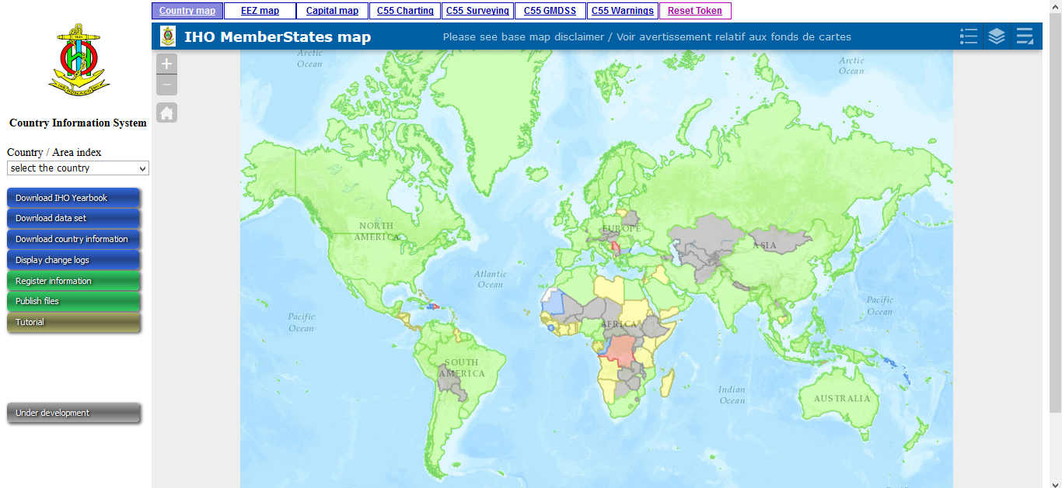
    Country Information Database

Slide 9
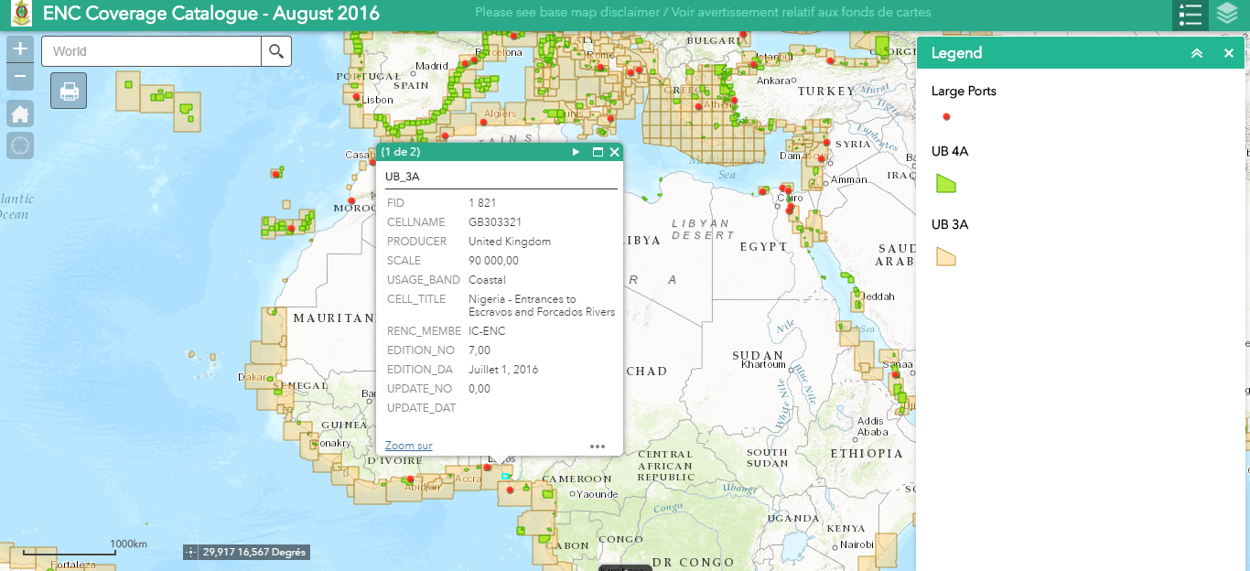
    IHO ENC Catalogue

Slide 10
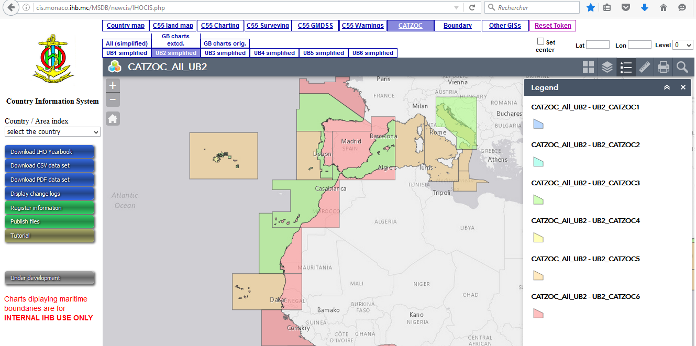
    C-55 Developments

Slide 11
    IHO GIS and Databases
  Status of the information provided by ArHC countries
  Territory C-55
Canada - Arctic Sep 2013
Denmark - Faeroe Is. Apr 2015
Denmark - Greenland Oct 2013
Norway Area N Oct 2013/Dec 2015
Russian Federation Jul 2004
USA - Alaska&Arctic Apr 2012

Slide 12
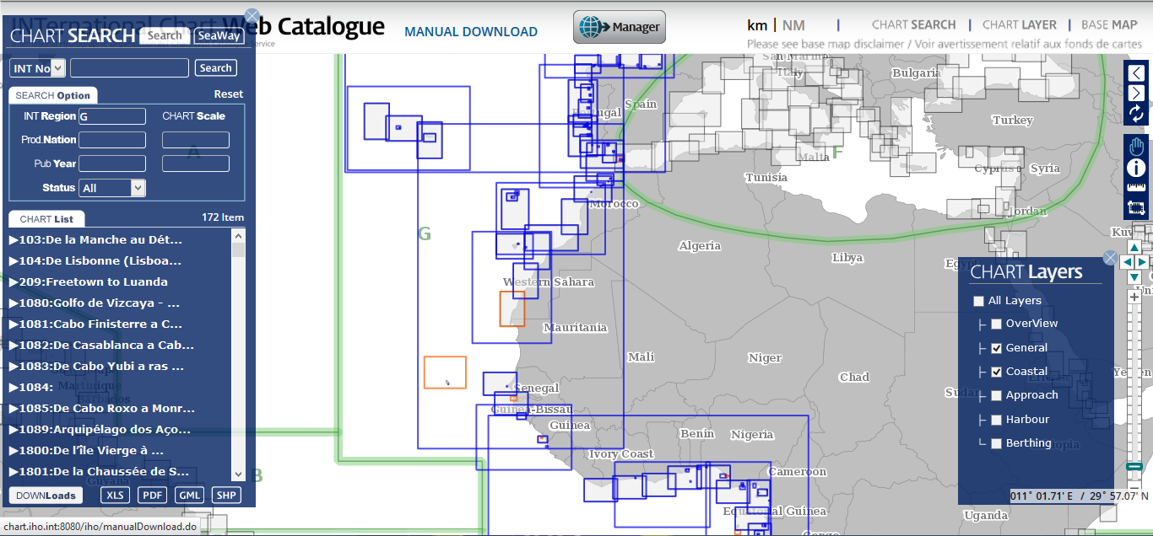
    IHO GIS and Databases
GIS/S-100 based “INToGIS” Project with the support of ROK
INT Chart Web Catalogue
INT Chart on-line Web Manager Services

Slide 13
    IHO GIS and Databases
GIS/S-100 based “INToGIS” Project with the support of ROK
Maintenance of the pdf version of S-11 Part B - Catalogue of INT Charts discontinued on 1 April 2016
Workshop for Regional INT Chart / ENC Coordinators at the IHB on 25 April 2016 (Review of the feedback and lessons learned)
Login information requested by, and provided to: FI, NO, US

Slide 14
INT Charts and ENC issues
ENC Production Coordination
WENDWG Actions (ARHC represented by CA)
  RHCs invited to define and adopt ENC schemes and provide basic metadata to the IHO Secretariat
  Secretariat invited to include a layer of approved ENC Schemes in the ENC or INT Chart Catalogue of the IHO

Slide 15
INT Charts and ENC issues
    Information on ECDIS back-up arrangements using paper charts

Slide 16
Status of the Work Programme
EIHC-5 introduced a biennial assessment based on summary reports from all IHO organs
Four successive assessments reported in IHO CLs …
... 17/2015, 66/2015, 14/2016, 48/2016
6 RHCs submitted at least one report; 3 RHCs submitted 4 reports
  Lack of awareness of the importance of hydrography and the under-development of hydrographic capabilities are the main issues reported by RHCs

Slide 17
IHO Assembly A-1
Dates : 24 - 28 April 2017
On-line registration from 1 Sep. 2016
Agenda items
  Reports on the intersessional period 2012-2016
  Revision of the IHO Strategic Plan
  Adoption of the IHO Work Programme and Budget for 2018-2020
  Establishment of the Council
  Election of the Secretary-General and two Directors
  Proposals

Slide 18
IHO Assembly A-1
Estblishment of the Council
  Reminder of the procedure
    30 seats
    20 (2/3) allocated on a regional basis
      Allocate Member States to one and only one RHC
      Apportion seats in accordance with the number of MS allocated to each RHC
    10 (1/3) allocated in accordance with tonnage*
  RHCs are expected to agree before October 2016 on the process by which they will allocate their seat(s) in the Council, and possibly instruct, the relevant representative(s)
  → Member States (for ARHC: CA, DK, FI, IS, NO, RU, US) to declare in which RHC they wish to be counted by 30 Nov (IHO CL 46/2016)
  * Provisional indicator of the “hydrographic interests”

Slide 19
IHO Assembly A-1
PROPOSAL No. | OBJECT OF THE PROPOSAL | SUBMITTED BY | WORK PROGR.
1 | Discuss a way forward for the publication of a 4th Edition of IHO Publication S-23 and include it in the next “3-Year Work Programme” | DPRK | 1
2 | Development of IHO E-Learning Capacity | France | 3
3 | Revision of the Resolution on Response to Disasters | Japan | 3
4 | Rewrite of the IHO Strategic Plan | UK | 1
5 | Development of an IHO Satellite-Derived Bathymetry Assessment and Charting Programme for as yet Uncharted or Poorly Charted Areas | Canada, France, USA | 3
6 | Proposed Amendment to the IHO Resolution 2/2007 for Improving the Validation Procedure of Making Changes to Specifications Based on S-100 | Republic of Korea | 2
7 | National Hydrographic Office implications regarding the United Nations Committee of Experts on Global Geospatial Information Management (UN-GGIM) Shared Guiding Principles for Geospatial Information Management | USA | 3
8 | Revise the Standards of Competence for Hydrographic Surveyors | Italy | 3
9 | Revise IHO Publication M-3 – Repertory of IHO Resolutions | IHO Secretariat | 1

Slide 20
Action requested of ARHC
→ Review entries related to IHO C-55, P-5 (Yearbook) and ECDIS back up arrangements at least annually
→ Provide continuous updates to S-11 Part B for INT Region N through the INToGIS tool
→ Report to the IHO Secretariat on the status and description of the ENC schemes in the Region N
  → Consider appropriate arrangements to prepare the 1st IHO Assembly to be held in April 2017, and ARHC MS and relevant Observer States to respond to IHO CL 46/2016 as soon as practicable (deadline 30 Nov.)
→ MS to lobby their Arctic Council Rep. for supporting IHO Application and ARHC to consider if supplement document is needed
→ Take any other action as considered appropriate

Slide 21

Any questions ? - Secretariat Contact
info@iho.int

