Slide 1
6th EAHC Steering Committee Meeting 20-22 February 2019, Bali, Indonesia Terms of Reference and Rules of Procedure for the EA-RECC Governing Body (Board of Directors)
Michael CM CHAU
Hydrographic Office
Marine Department
Hong Kong SAR Government, China

Slide 2
Terms of Reference and Rules of Procedure for the EA-RECC Governing Body (Board of Directors)
Background
During the EAHC SC4 Meeting in February 2017, approval was given to Hong Kong to host the EA-RECC. The meeting also discussed the government body of the EA-RECC and requested “Hong Kong (CN) to draft the Governing Board’s TOR for the SC’s approval”.
In February 2018, Hong Kong (CN) prepared and circulated a draft TOR and ROP for the EA-RECC Governing Body (Board of Directors) to EAHC MSs for comment.
In July 2018, Hong Kong (CN) sent out an invitation letter to MSs, also with the draft BOD TOR/ROP for their consideration.
On 24th January 2019, Hong Kong (CN) sent out a paper to the EAHC Chair Office, including the draft EA-RECC BOD TOR/ROP, for discussion during the 6th EAHC SC Meeting.

Slide 3
Terms of Reference and Rules of Procedure for the EA-RECC Governing Body (Board of Directors)
Analysis/Discussion
The BOD’s TOR/ROP has been drafted to specifically cater to the objectives and functions of the Centre as set out in the said proposal submitted to the SC4 Meeting.
In addition, the drafting of the document has made reference to the setup and operations of the other organs of the Commission such as the EAHC Charting and Hydrography Committee, EAHC Training Research and Development Centre.

Slide 4
Terms of Reference and Rules of Procedure for the EA-RECC Governing Body (Board of Directors)
Conclusion/Recommendation
The TOR and ROP would set the scope of duties and the operations of the BOD of the EA-RECC.
The EAHC SC is invited to discuss its contents and also take note the consequential changes to the TOR and ROP of the EA-RECC arising from the approval of the TOR and ROP of the BOD of the EA-RECC.

Slide 6
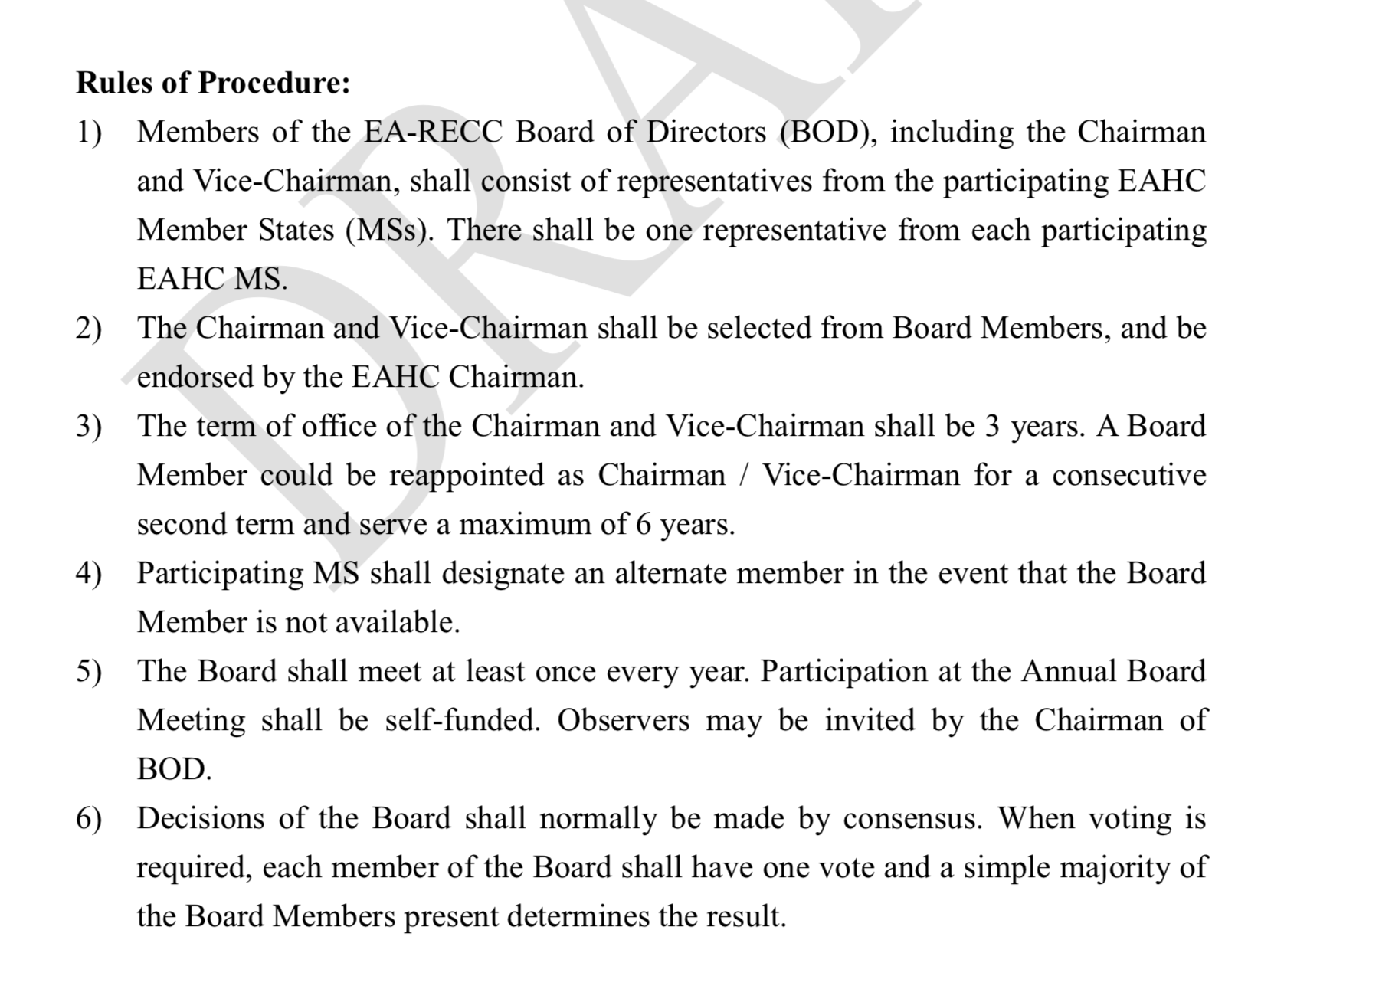

Slide 9
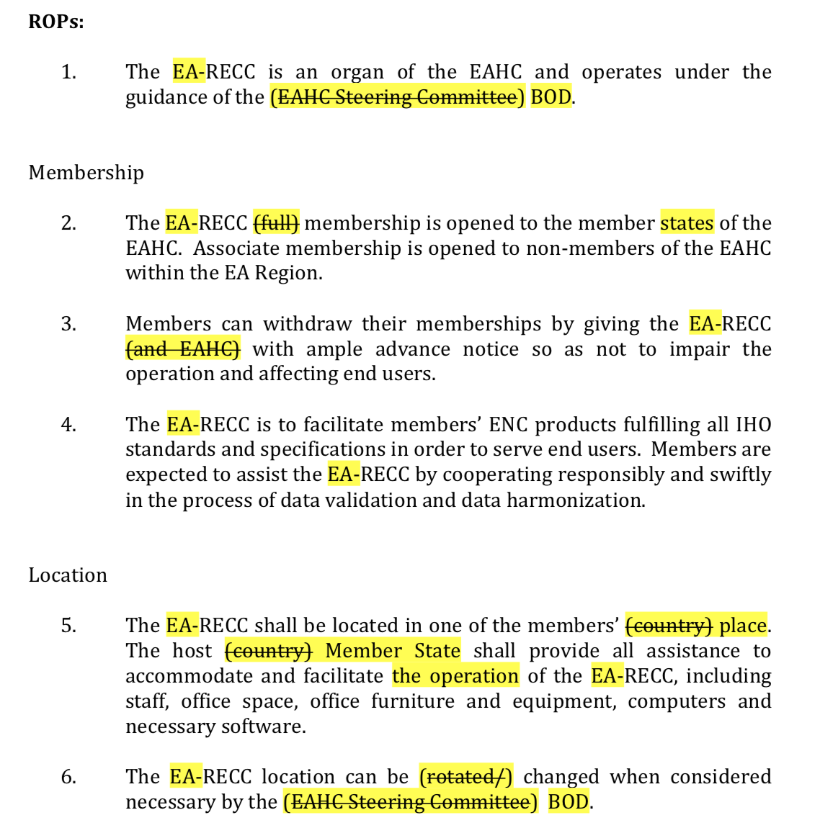

Slide 10
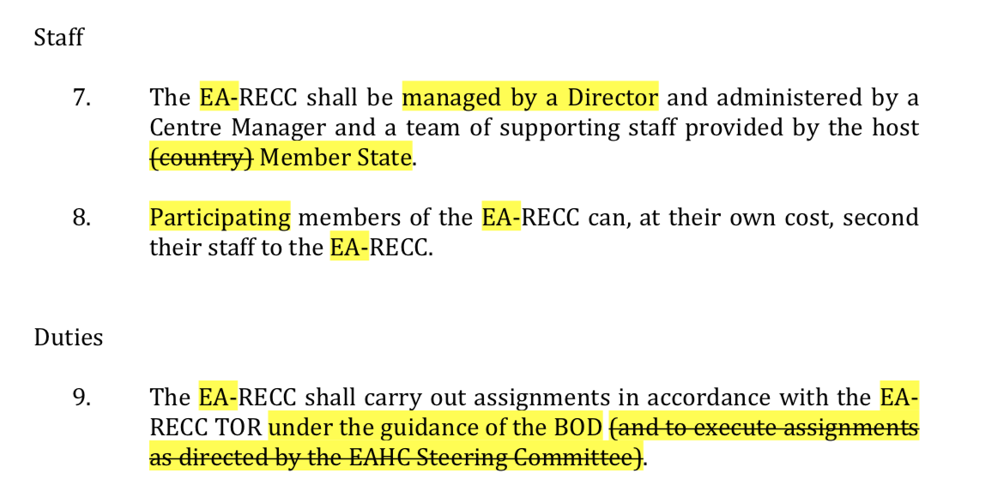

Slide 12
Terms of Reference and Rules of Procedure for the EA-RECC Governing Body (Board of Directors)
-END-

