Slide 1
EAHC-MSDIWG1 Report
EAHC SC6
BALI, INDONESIA
20-22 February 2019
Presented by Dr. Jung Hyun KIM, Chair of EAHC-MSDIWG
Notes:
Good morning everyone,
My name is Junghyun Kim, Chair of EAHC-MSDI Working Group.
Today, I’d like to present the 1st EAHC MSDIWG meeting report.

Slide 2
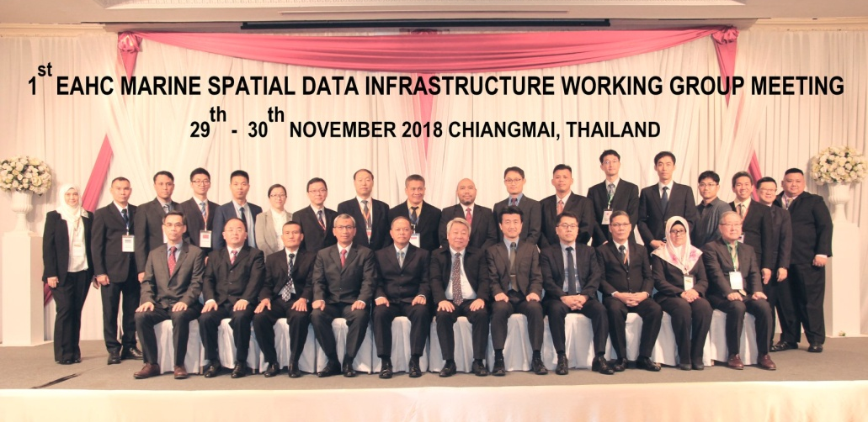
01
1st EAHC-MSDIWG Meeting
Meeting place
The 1st EAHC-MSDIWG meeting was held in Chiang Mai, Thailand in November 2018.
Participants
30 participants from 9 countries (Brunei Darussalam, China, Japan, Indonesia, Singapore, Republic of Korea, Malaysia, Philippines, Thailand)
Main Agenda
EAHC-MSDIWG Progress and TOR
Country Reports on National MSDI
MSDI Concept and Importance
MSDI Trend Report
WG Work Plan
Notes:
The 1st EAHC-MSDIWG meeting was held in Chiang Mai, Thailand in November 2018.
30 participants from 9 member states attended.
Mainly 5 agenda items were discussed at the meeting.
The meeting discussed EAHC-MSDI WG Progress and TOR, Country reports on MSDI, MSDI concept and importance, MSDI trend report, and WG work plan.

Slide 3
02
EAHC-MSDIWG Progress
Membership
Nation | Position | Name
Republic of Korea | Chair | Dr. Jung Hyun KIM
Japan | Vice-Chair | -
Republic of Korea | Member | Mr. Jun-Shik LEE
Philippines | Member | Lt. Romel Correa
Indonesia | Member | Cdr. Qisthi Amarona
 | Member | Lt. Andry Novianto
Japan | Member | Mr. Takeharu Miyake
Thailand | Member | Cdr. Rachot Osiri
China | Member | Mr. Dongli Sun
Brunei Darussalam | Member | Mr. Abdul Malik Hj Abdul Hamid
Malaysia | Member | Cdr. Kamaruddin bin Yusof
Singapore | Member | Mr. Jamie Chen
DPRK |  | -
Vietnam |  | -
Notes:
It was the first working group meeting, so the membership was reviewed.
All member states have a member in the working group except the DPRK.
Since the position of the Vice-chair is vacant, I’d like to ask Japan to nominate a candidate.
Then I hope this Steering Committee can confirm the vice-chair according to the TOR of the Working Group.

Slide 4
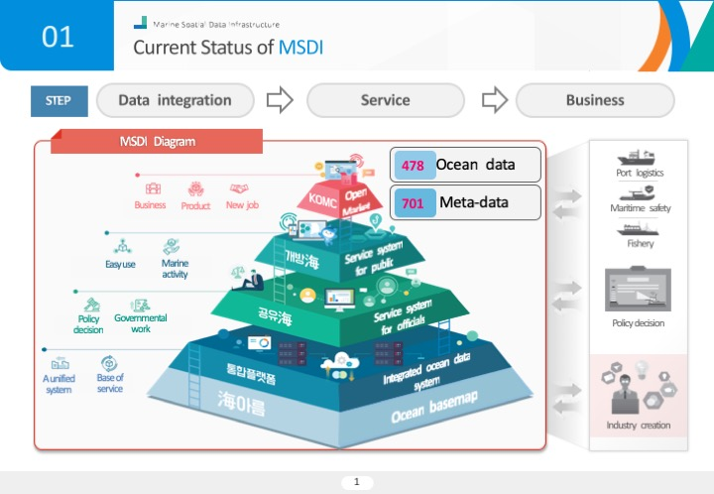
03
Country Reports on National MSDI [1/2]
MSDI Country Report
Brunei
Japan
ROK
Notes:
For the country report, five member states, Brunei, Japan, ROK, Singapore and Malaysia, presented their country reports on national MSDI.
Brunei introduced its Survey Spatial Data Infrastructure.
Japan developed the MSIL, where real time WebGIS would be part of the Japan’s Maritime Domain Awareness.
Japan will share its experience on data harmonization and interoperability at the next Working Group meeting.
ROK presented the status of MSDI. ROK integrates and provides ocean spatial information within the Ministry of Oceans and Fisheries.

Slide 5
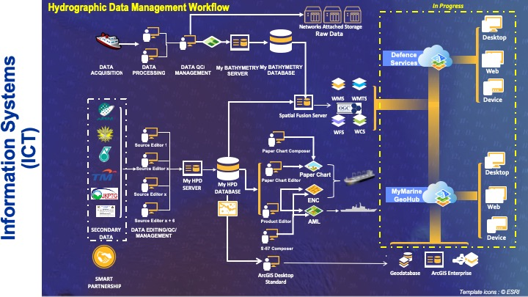
03
Country Reports on National MSDI [2/2]
MSDI Country Report
Singapore
Malaysia
Notes:
Singapore presented a single integrated data platform “GeoSpace-Sea” for seamless access to quality marine information for various national projects.
Finally, Malaysia explained its involvement on marine spatial infrastructure in Malaysia.

Slide 6
04
MSDI Concept and Importance
Marine SDI
Functions
Environmental protection and regional marine planning
Offshore oil, gas and minerals exploration and industry
Submarine cable and pipeline protection
Defense, border protection and customs
Transport and post security
Fisheries management
Indigenous interests
Maritime safety
Standards
User
Policies
ISO 19115-Metadata
ISO 19119-Services
ISO 19127-Geodecy
ISO 19128-WMS
ISO 19136-GML
ISO 19138-Quality
ISO 19139-Metadata
Web Browser
Legislation
IMO
IHO
UNCLOS
MARPOL
Proposed Solution
OGC Services
Metadata and Data
Data Custodians
5
Notes:
Next, we shared information on the concept and importance of MSDI at the meeting.
We looked at why we need to establish marine spatial data infrastructure.
The major issues can be grouped by standards, user, and policies.
Thus, MSDI can provide effective marine and coastal management to meet the economic, social and environmental objectives of sustainable development.

Slide 7
05
MSDI Trends Report [1/3]
IHO MSDI WG Objective
Support the activities of the IHO related to Spatial Data Infrastructures (SDI) and/or Marine Spatial Data Infrastructures (MSDI)
Functions
Monitor national, regional and international SDI activities and trends.
Promote the use of IHO standards and member state marine data in SDI activities.
Liaise, as appropriate, with other relevant bodies to increase the visibility of marine spatial data.
Identify actions and procedures that the IHO might take to contribute to the development of Spatial Data Infrastructure (SDI) and / or MSDI in support of MSs.
Determine any actions that the IHO and individual Member State might take to forge links with other bodies (e.g. OGC, ISO TC211, IOC).
Identify and recommend possible solutions to any significant technical issues related to interoperability between maritime and land based inputs to SDI
Notes:
Furthermore, the meeting reviewed the international MSDI trends.
Firstly, we looked at the IHO MSDIWG.
The objective of the WG is to support the activities of the IHO related to SDI and MSDI.
The WG has been operating since 2008 and they handle data, data sharing system, standards, strategies and policies.

Slide 8
05
MSDI Trend Report [2/3]
UN-GGIM MGIWG Objectives
Play a leading role at the policy level by raising political awareness and highlighting the importance of marine geospatial information
Encourage the use of internationally agreed-upon geospatial information frameworks, schemas, systems and established standards
Support the Committee of Experts in the development of norms, principles, guides and standards
The WGMGI supports global development agendas
The WGMGI supports global development agendas, notably the 2030 Agenda for Sustainable Development
Goal 6 from the Agenda for Sustainable Development
Marine geospatial information supports sustainable development Goal 6 (Clean Water and Sanitation) by measuring and monitoring water
Notes:
One of important trends on MSDI is the establishment of the WG on Marine Geospatial Information under the UN-GGIM.
The WG was established in 2017.
Its objectives are to play a leading role at the policy level by raising political awareness and highlight the importance of marine geospatial information.

Slide 9
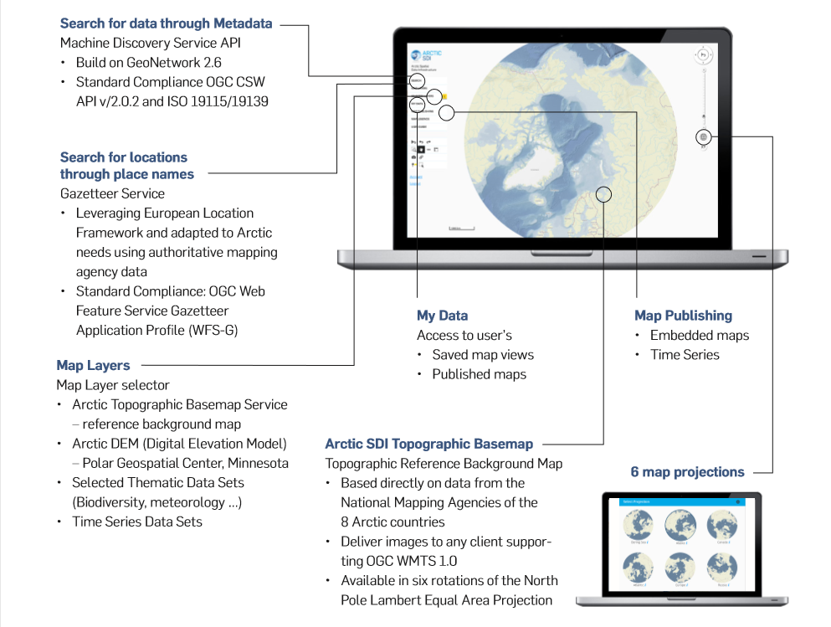
05
MSDI Trend Report [3/3]
Arctic SDI Portal (http://geopotal.arctic-sdi.org)
Notes:
Similar to the EAHC-MSDIWG, the Arctic RHC and the Baltic Sea HC run MSDIWGs.
We introduced the activities of the MSDIWG of the Arctic RHC in Chiang Mai.
The Arctic countries established MSDI and share a variety of data on a website.
We can refer to this case if we were to develop an MSDI system in the EAHC.

Slide 10
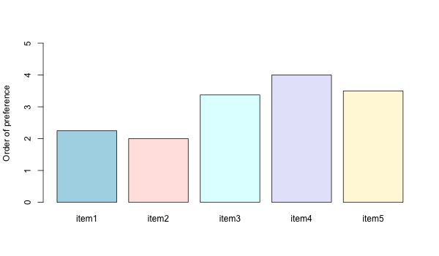
06
WG Workplan [1/2]
Please indicate which tasks should be first dealt with at the WG
by marking 1 to 5 in the brackets in order of importance, 1 being the highest.
Item 1: Develop a roadmap for the EAHC.
Item 2: Identify user’s needs and end user applications.
Item 3: Governance structure to coordinate work, data standards, applications, etc.
Item 4: Draft guidelines for developing national MSDIs.
Item 5: Capacity building.
Identify user’s needs and end user applications
Develop a roadmap
for the EAHC
Governance structure to coordinate work, data standards, applications, etc.
Capacity building
Draft guidelines for developing national MSDIs.
9
Notes:
Prior to the 1st EAHC-MSDIWG meeting, ROK distributed a questionnaire to MSs to identify the status, requirements and future role of the WG.
There are nine questions in the questionnaire and I received 8 responses.
For example, this slide shows one of questions which asks each member to indicate the priority of tasks.
The response was used to make a work plan in the next slide.

Slide 11
06
WG Workplan [2/2]
EAHC-MSDIWG Work Plan
Task A (Leadership and coordination)
Task B (Operational data sharing and management)
Task C (Policies and governances)
Task D (Standards)
Task E (Training and education)
Notes:
The work plan was drafted based on the IHO MSDIWG plan.
It has five parts: Leadership and Coordination, Operational – Data Sharing and Management, Policies and Governances, Standards, and Training and Education.
There was detailed discussion in Chiang Mai but the meeting was closed without finalizing it.
Later I made some amendments to it and circulated it to MSs by correspondence last week.
Please refer to the Work Plan we printed out on your desk.

Slide 12
07
Future meeting
IHO-MSDIWG10 & UN-GGIM WGMGI1 meeting
IHO-MSDIWG10, 4-5 March 2019, Busan, ROK
OGC Marine DWG, 6 March 2019, Busan, ROK
UN-GGIM WGMGI1, 7-9 March 2019, Busan, ROK
2nd Meeting of the EAHC-MSDIWG
October / November 2019, Singapore
Notes:
This year, there are several meetings regarding the MSDI in our region.
KHOA will host the 10th IHO MSDI Working group meeting in Busan from 4 to 5 March back to back with the first UN-GGIM working group on marine geospatial information.
Singapore will host the 2nd MSDIWG meeting in October or November 2019 back to back with the CHC meeting.

Slide 13
08
Action requested by the SC6
Take note of this report
Review the draft EAHC-MSDIWG Work Plan
Discuss the appointment of the Vice-Chair
Notes:
To conclude,
The EAHC-MSDI WG requests the Steering Committee to take note of this report.
And please review the draft EAHC-MSDIWG Work Plan. It can be further developed and amended at the next WG meeting.
Lastly there was a decision on the chairmanship of the WG, “The appointment of the Vice Chair would be Personal to Holder” from the last WG meeting. So we need to discuss it in this meeting.

Slide 14
Thank you
Notes:
Thank you for your attention.

