Slide 1
Agenda-18
Report on 9th TRDC-BOD Meeting
Jamie Chen - Chair (TRDC)
Peter You - Vice Chair (TRDC)

Slide 3
Key Reports and Actions Required
1. Report on 2018 CB Courses
2. Update on 2019 CB Courses
3. Proposed 2020 CB Courses
4. Review of Basic Hydro & Carto Courses
5. Review of 5-Year Workplan
6. Election of Chair and Vice-Chair
7. Actions required by the SC

Slide 4
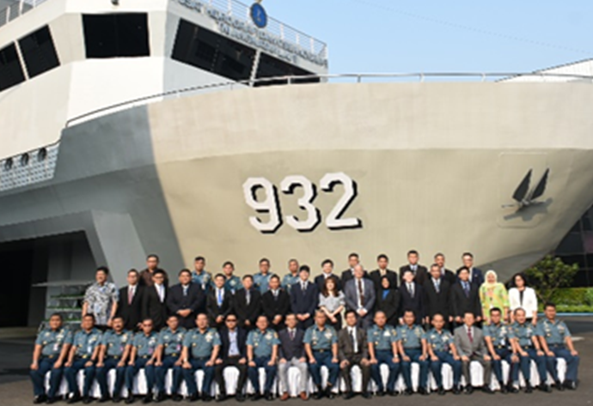
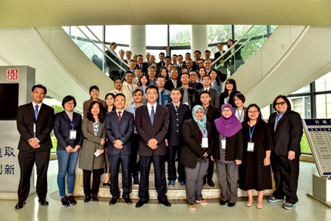
1. Report on 2018 CB Courses
Courses | Date / Venue / Participants
1. Use of GNSS for Tide Correction for Survey | • 9 - 13 July 2018 • Jakarta, Indonesia • 9 MSs, 18 trainees
2. Carto Production DB System Development Workshop | • 22- 26 October 2018 • Shanghai, China • 11 MSs, 46 trainees

Slide 5
3. 2019 CB Courses
Courses | Date / Venue
1. Maritime Safety Information (MSI) Course | Aug. / Indonesia
2. Management of MSI DB Workshop | Aug. / Indonesia
3. Risk Assessment for Hydrographic Surveys and Charting Management for the Safety of Navigation | Oct. / Brunei Darussalam
4. Technical Visit to Cambodia | TBD /EAHC Chair Office

Slide 6
4. Review of Basic Hydro & Carto Courses - Key points
MSs have continued to implement these Basic Courses.
Basic Carto - to include ENC production and S-100 modules.
Hydro survey to include practical components.
Implement a review framework to jointly update course syllabi, content, assessment question bank – Master Trainers
“Basic Cartography and Hydrography Courses” shall be used. “Cat C”
Request by IHO CBSC for Basic Course syllabi and training content – sharing with RHCs
Item 6 - For SC’s consideration and approval.

Slide 7
5. Proposed 2020 CB Courses
Priority | Courses
P-1 | Hydrographic Survey and Data Management for Disaster Relief
P-2 | Seminar on S-100 Migration
P-3 | Workshop on the Regional MSDI
For SC’s consideration and approval.

Slide 8
6. Review of 5 year CB Programme (2021 - 2025)
Need for a major joint review to :
Better align TRDC CB Strategy with IHO and EAHC Strategic Goals. References : SPRWG, STAR.
Assess technology from data acquisition to processing to data mgt.
Review of methods of learning and access to resources
eg. e-learning, review of TRDC website, etc
Users demands – hydrographic and non-hydrographic - MSDI
To hold 1 day meeting to review its CB Strategy and 5 year CBP.
Meeting to be held back to back with the next CHC (Jun/Jul 2019)

Slide 9
7. Election of Chair and Vice-Chair
(2019 – 2022)
TRDC BOD RoP: Chair and Vice Chair maximum 2 terms of max 6 years.
Nominees are :
Chairman - ROK (Mr. Peter You)
Vice Chairman - Indonesia (Capt. Yanur Handwiono)
For SC’s consideration and approval of their appointment.

Slide 10
6. Actions required by SC
Take note of this report.
Approve to share the Basic Carto and Hydro Course syllabi and materials with IHO CBSC – RHCs.
Approve proposed 2020 CBP:
Hydrographic Survey and Data Management for Disaster Relief
Seminar on S-100 Migration
Workshop on the Regional MSDI
Approve the appointment of the Chair and Vice Chair TRDC-BOD (tenure from 2019 – 2022).

