Slide 1
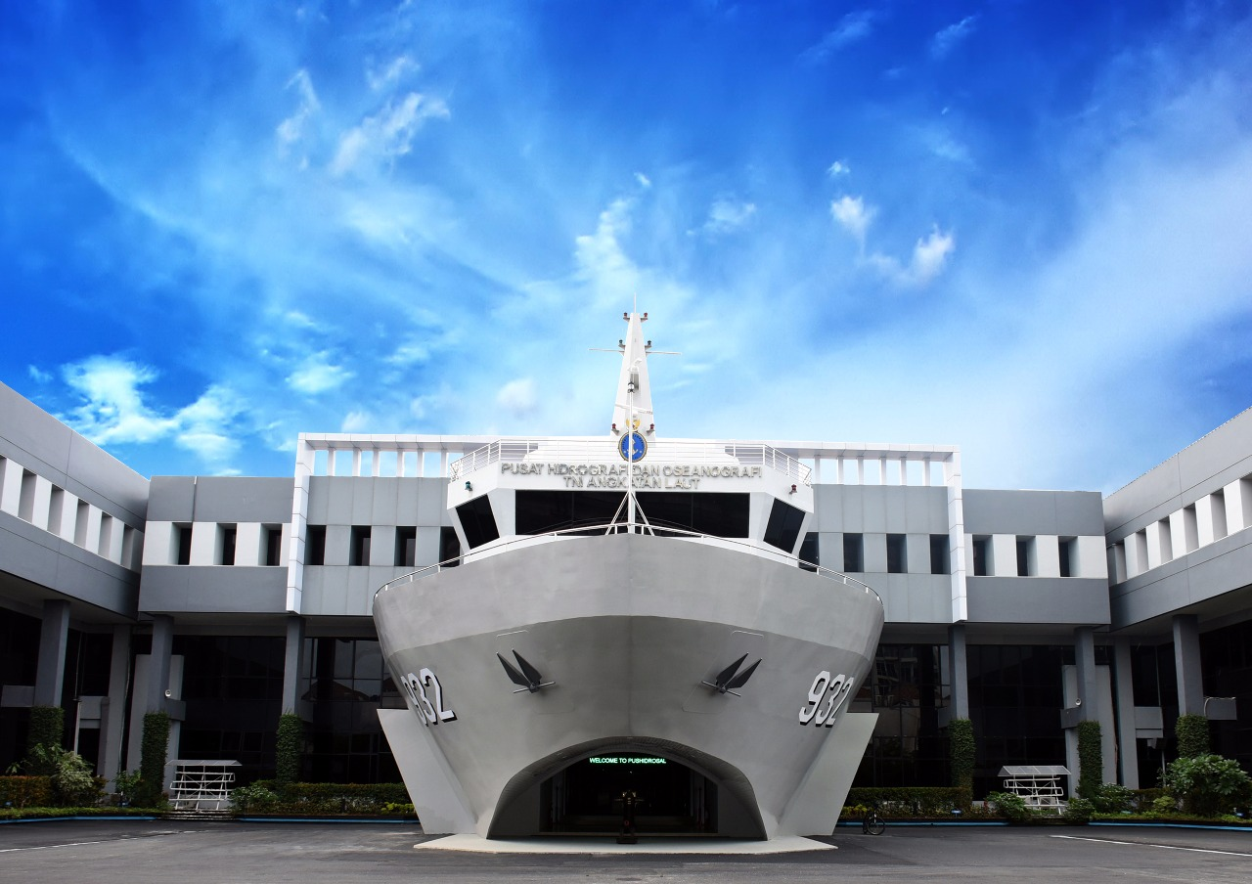
6TH EAHC STEERING COMMITTEE
Establishment of Traffic Separation Schemes
and Associated Routeing Measures
in Sunda and Lombok Straits
Bali, 21st of February 2019
Notes:
Thank you for this opportunity.
It is indeed an honor for me to deliver issue concerning Routeing Measures proposed to be adopted in Sunda Strait.
Hence, I’d like to convey my highest appreciation and thanks to the all members of the Expert Group.

Slide 2
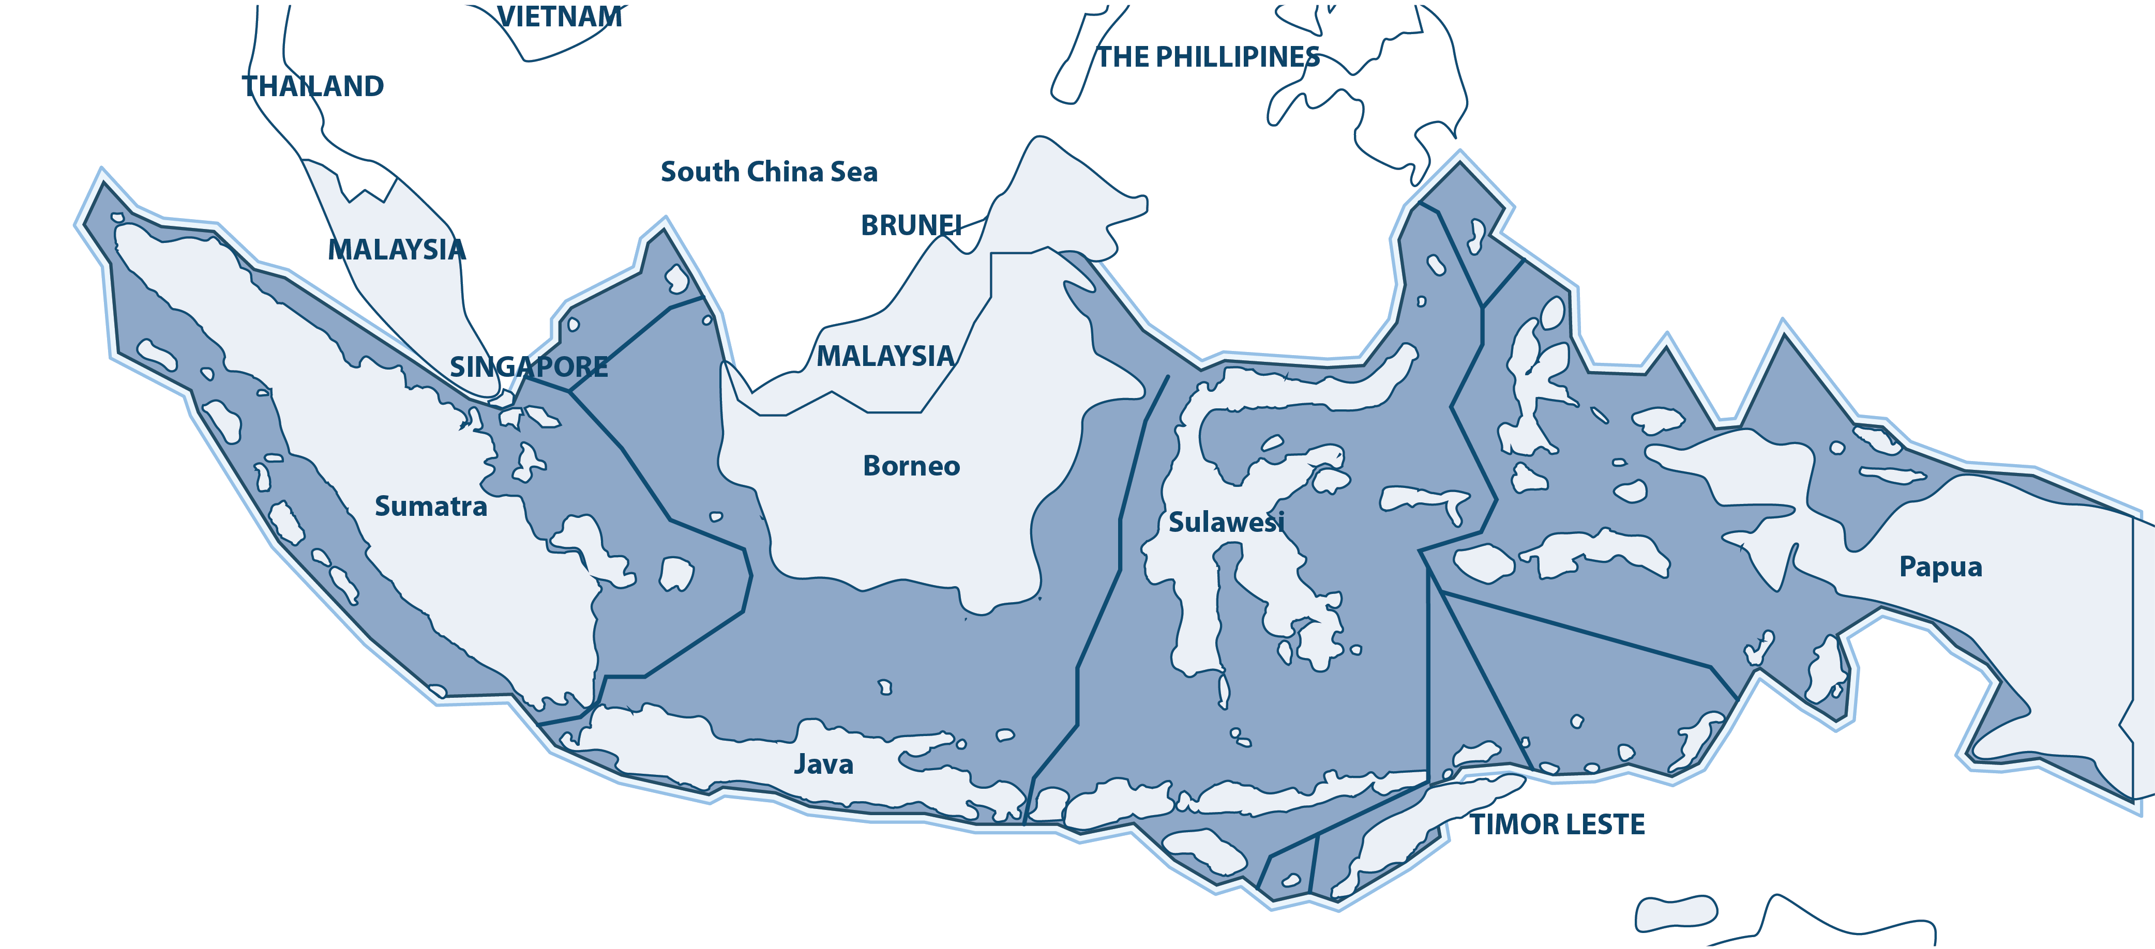
INTERNATIONAL SHIPPING ROUTES IN INDONESIAN WATERS
UNCLOS
UNCLOS
ART.53
ART.54
Right ASL Passage
Duties of Ship at ASL
IMO RES
IMO RES
COLREG
SOLAS 1974
A.572(14)
MSC.72(69)
RULE.10
CH.5 REG.10
General Provision ASL
Adoption ASL
TSS
Ship Routeing
Notes:
Article 53 UNCLOS which regulate the Right of Archipelagic Sea Lanes Passage where foreign ships could exercise their rights of to have continuous and expeditious transit between one part of high sea to another high seas.
Article 54 UNCLOS which regulate :
Duties of Ships and aircraft during their passage, research and survey activities
Duties of the archipelagic State and Laws and Regulations of the Archipelagic State Relating to the ASL.
IMO Resolution A. 572(14) as Amended, on General Provisions for the Adoption, Designation and Substitution of ASL.
IMO Resolution MSC. 72(69) adopted on 19 May 1998 on Adoption, Designation and Substitution of Archipelagic Sea Lanes.
Rules 10 COLREG that regulate the guidelines for vessel navigating the TSS
Regulation 10 Chapter V SOLAS 74 regulate the General Provision of Ships’ Routeing
IMO SN Circ 181 / 1996 regarding the Compliance with Ships Routeing Measures
These instruments along with other regulations provide a clear guideline for in designating routes and measures to ensure safety passage for international navigation and marine environmental protection in Indonesian waters.

Slide 3
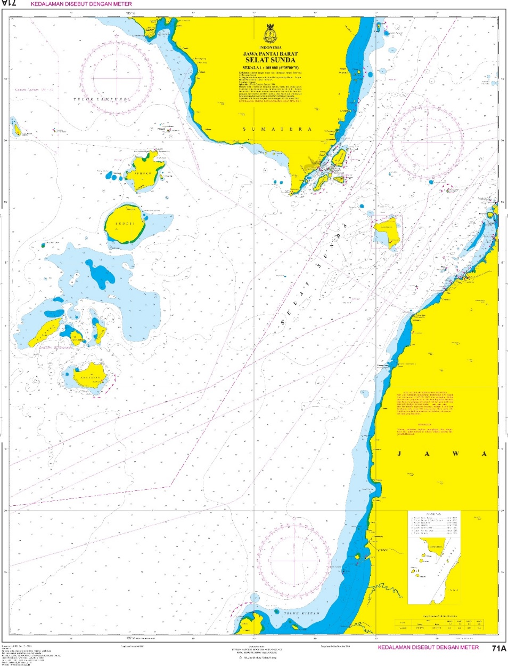
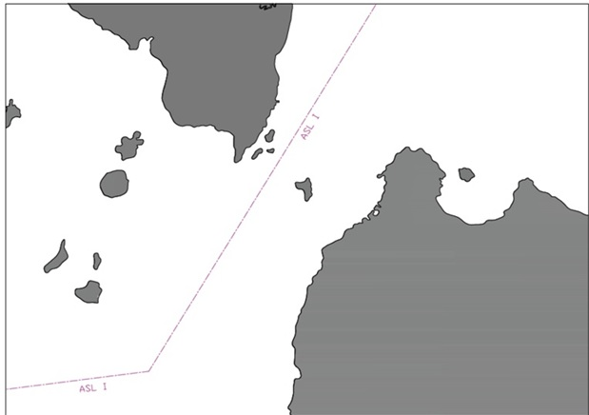
SUNDA STRAIT | IASL-I
Notes:
THIS IS THE IASL-I IN SUNDA STRAIT

Slide 4
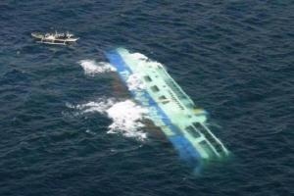
MAJOR INCIDENTS in SUNDA STRAIT
Source : National Transport Safety Committee
Collision between MT Norgas Cathinka and MV Bahuga Jaya in 2012
Notes:
This several example of major incidents occurred in Sunda Straits
MT Norgas Cathinka was collided with MV Bahuga Jaya in Sunda Straits (4 Nautical miles east of Rimau Balak Island), Indonesia 26 September 2012.
In addition to 7 casualties, this incident also caused serious damages on the Norgas Cathinka and sunk of MV. Bahuga Jaya.

Slide 5
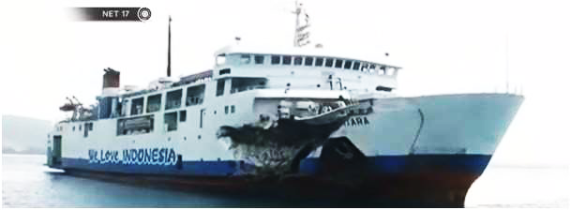
MAJOR INCIDENTS in SUNDA STRAIT
Source : National Transport Safety Committee
Impact of collision on the hull of Passenger Ship MARISA NUSANTARA after collided with a general cargo QIHANG ship in 2014 at Sunda Strait
Notes:
In 2014, again a collision between Passenger Ship MARISA NUSANTARA and General Cargo QIHANG that cause severe damage on the hull of the passenger ship.

Slide 6
MAJOR INCIDENTS in SUNDA STRAIT
Grounded of Container ship MV Hanjin Aqua to Koliot Reefs in 2015
Source : National Transport Safety Committee
Grounding of HANJIN AQUA (IMO Nr. 9632480) at Koliot Reefs, Sunda Strait, Merak Republic of Indonesia, 4 December 2015
Notes:
In 4th December 2015, MV Hanjin Aqua was grounded to Koliot Reef that need a costly & time consuming of cargo transferring before it is released.

Slide 7
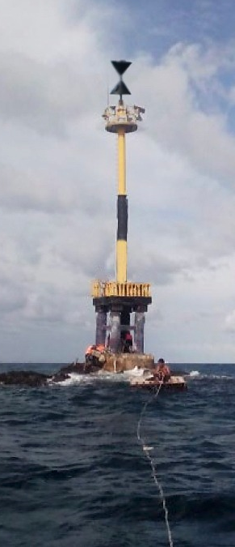
ISOLATED DANGER - KOLIOT REEF
KOLIOT REEF
LIGHT BEACON
Notes:
This is one of the concerned isolated danger found in Sunda Strait that could endanger the passing vessel. For example the MV Hanjin Aqua that I’ve mentioned before. This reefs is one of important aspects that would be addressed through the proposed TSS and Routeing Measures.
Effort to prevent accident has been carried out by installing a beacon. However, the danger is still possibly threating the safety of the ship in particular during the low visibility condition.

Slide 8
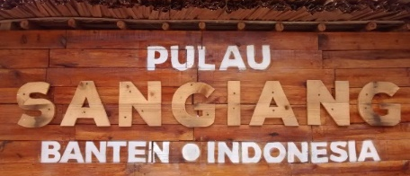
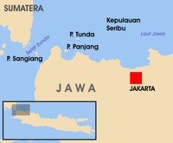
SANGIANG NATURAL TOURISM PARK AS MARINE PROTECTED AREA
2.8 NM from IASL-I
720 HA Island
Natural Tourism Park
Coral reefs & Marine Biota
Source : Indonesiakaya.com
Notes:
This is the beautiful 720 HA Sangiang Island, located 2.8 NM from IASL-I
It was designated as Natural Tourism Park through he Minister of Forestry Decision Nr. SK Menhut No. 689/Kpts-11/1991 dated 12 October 1991.
It is featured with rich Coral Reefs and Marine Biota

Slide 9
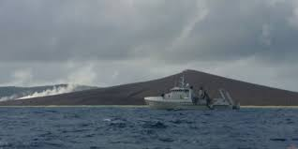
IMPACT OF KRAKATAU ERUPTION
MOUNT KRAKATAU
Eruption Dec 2018
Minor impact to navigation activities
Landslide of Seabed away from the IASL-I and the proposed TSS
Continuously Observed & Monitored
SOUTH
ENTERANCE
OF THE
PROPOSEDTSS
23 NM AT 247⁰
± 1 NM
MT. ANAK
KRAKATAU
IASL - I
12 NM AT 118⁰
Notes:
We all might notice that on 22 December 2018, Mount Krakatau erupted and caused a tsunami of 2 Metres height surged some coast area in West Java where hundreds of casualties, injured and missing person were reported.
In addition to the quick response on the disaster taken by the government and other bodies, a hydrographic survey was conducted to investigate the impact of the eruption and the tsunami to the seabed.
According to its result, impact of the disaster to the seabed was only found within 1 NM from the Karakata.
No marine incident was reported for the said disaster, and the proposed TSS area was not affected.
The IASL-I lies about 12NM off Mount Anak Krakatau, and the South Entrance of the proposed TSS is located 23NM away NE of the Mount Anak Krakatau.
With this, it is likely that the activity of the Mount Krakatau, would only have minor impact to the proposed Routeing Measures.
However, we aware that none of us could predict the nature wills. Therefore, monitoring & warning system have been setup to enable early warning to the concerned parties including the marine traffic.

Slide 10
HYDROGRAPHYC SURVEY WAS DONE BY PUSHIDROSAL

Slide 11
HYDROGRAPHIC SURVEY IN SUNDA STRAIT

Slide 12
OBJECTIVES OF ESTABLISHMENT OF TSS
1
Reduce the number of head-on situations to increase the safety of navigation, by separating opposing traffic streams in the area
2
Reduce, if not eliminate, the risk of accidental ship grounding by keeping ships well away from the coral reef atolls
3
Reduce, if not eliminate, the risk of collision between ships by recommending one precautionary area
4
Ensure that ships follow the routes that are absolutely free from the known dangers posed by the coral reef atolls of Terumbu Koliot by AtoN.
Notes:
By all those important considerations, and after completed relevant Survey & study, Indonesia is now proposing the establishment of new TSS and Associated Routeing Measure in Sunda Straits for the following objectives :
To reduce the number of head-on situations in order to to increase the safety of navigation, by separating opposing traffic streams in the area
To reduce, if not eliminate, the risk of accidental ship grounding by keeping ships well away from the coral reef atolls
To reduce, if not eliminate, the risk of collision between ships by recommending one precautionary area
To ensure that ships follow the routes that are absolutely free from the known dangers posed by the coral reef atolls of Terumbu Koliot by AtoN.

Slide 13
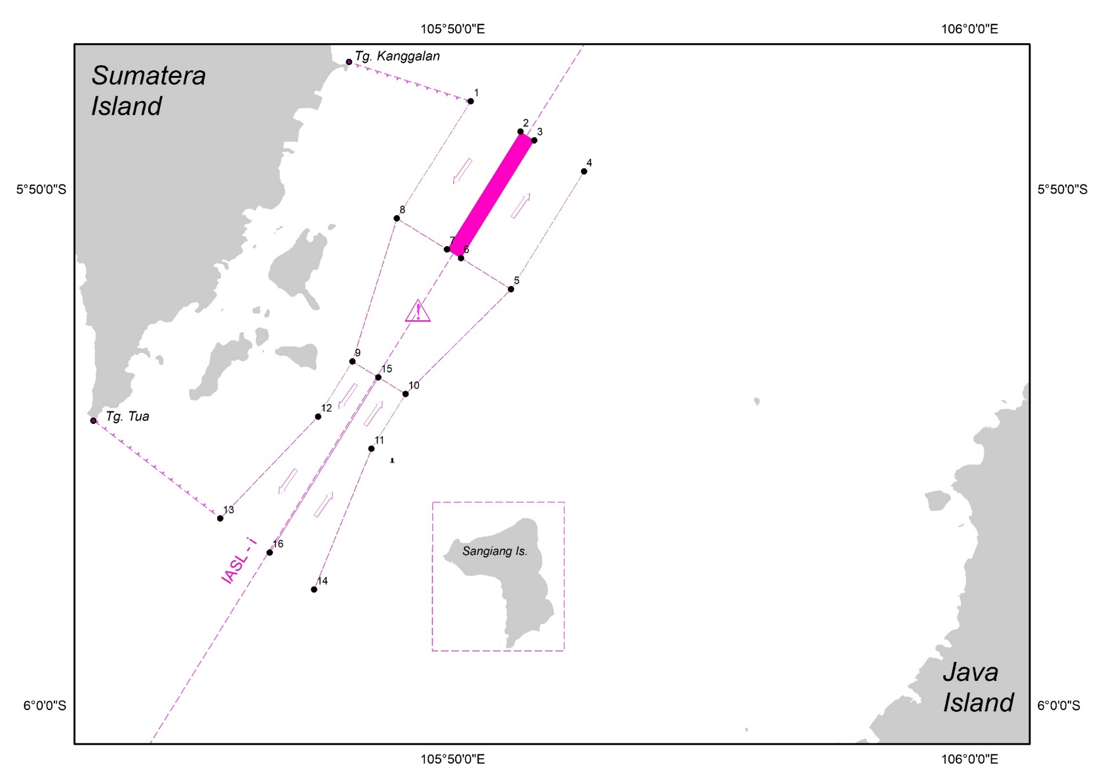
THE TRAFFIC SEPARATION SCHEME IN SUNDA STRAIT PROPOSED IN NCSR-6

Slide 14
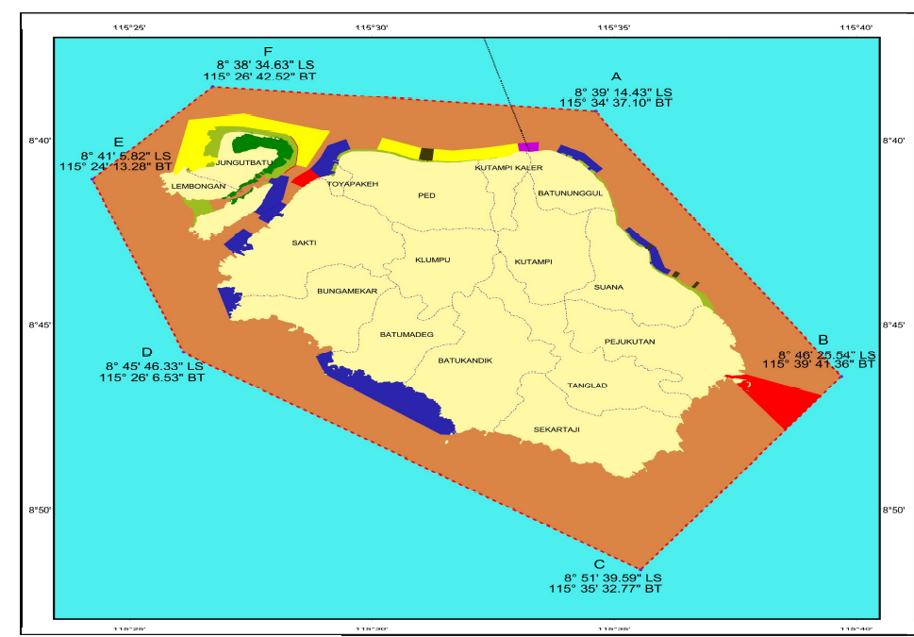
KEY ENVIRONMENT ATTRIBUTES
DESIGNATED CONSERVATION AREA
20057.1 HA
Decision of the Indonesian Minister for Ocean Affairs and Fisheries
No.24/2014
sub zone of sea weed cultivation
mangroves
sub zone of special marine tourism
sub zone of maritime port
35.15 HA
464.25 HA
905.24 HA
spiritual area
576 fish species
296 coral species
265.000 Tourists
NUSAPENIDA ISLAND
sub zone of traditional fishing
sub zone of marine tourism
core zone
16916 HA
1221.28 HA
35.15 HA
Source : Ministry of Ocean & Fisheries Affairs
Notes:
The area of Lombok Strait is well known for its rich environmental features in particular in Nusa Penida and Gili Islands.
This is some KEY ENVIRONMENT OF NUSAPENIDA ISLAND
It was designated as MARINE CONSERVATION AREA in 2014 based on the Decree of Indonesian Minister for Ocean Affairs & Fisheries No.24.
It Contains rich bio-diversity and about 149,05 HA coral-reef and more.
Its Tourism Park contains a lot of potential coral-reef, mangrove, sea grass, and almost all important fisheries resources including sea mammals like whales and dolphins.
There is only a small area allocated for port and shipping activities which would be limited by the size of the vessel.

Slide 15
DESIGNATED CONSERVATION AREA 2273.56 HA
Decision of the Indonesian Minister for Ocean Affairs & Fisheries No.57/2014
KEY ENVIRONMENT ATTRIBUTES | GILI ISLANDS
GILI AYER
GILI MENO
GILI TRAWANGAN
511 FISH SPECIES
Allen & Werner Calculation Formula 2002
surrounded by
rich type of
coral reef ecosystem
296 CORAL SPECIES
101.27 HA
GILI TRAWANGAN
58.14
HA
GILI MENO
76.84
HA
GILI AYER
MARINE TOURISM PARK
445.000 TOURISTS
Notes:
This is the Gili Island Area.
Designated as Conservation Area & Marine Tourism Park
It is surrounded by coral reef ecosystem which according to the research, it consists of approximately 511 species of fish.
There are 296 different types of corals which constitue as fringing reef with potential wide spread of coral reef covered more than 290 HA area.

Slide 16
HYDROGRAPHIC SURVEY IN SUNDA STRAIT

Slide 17
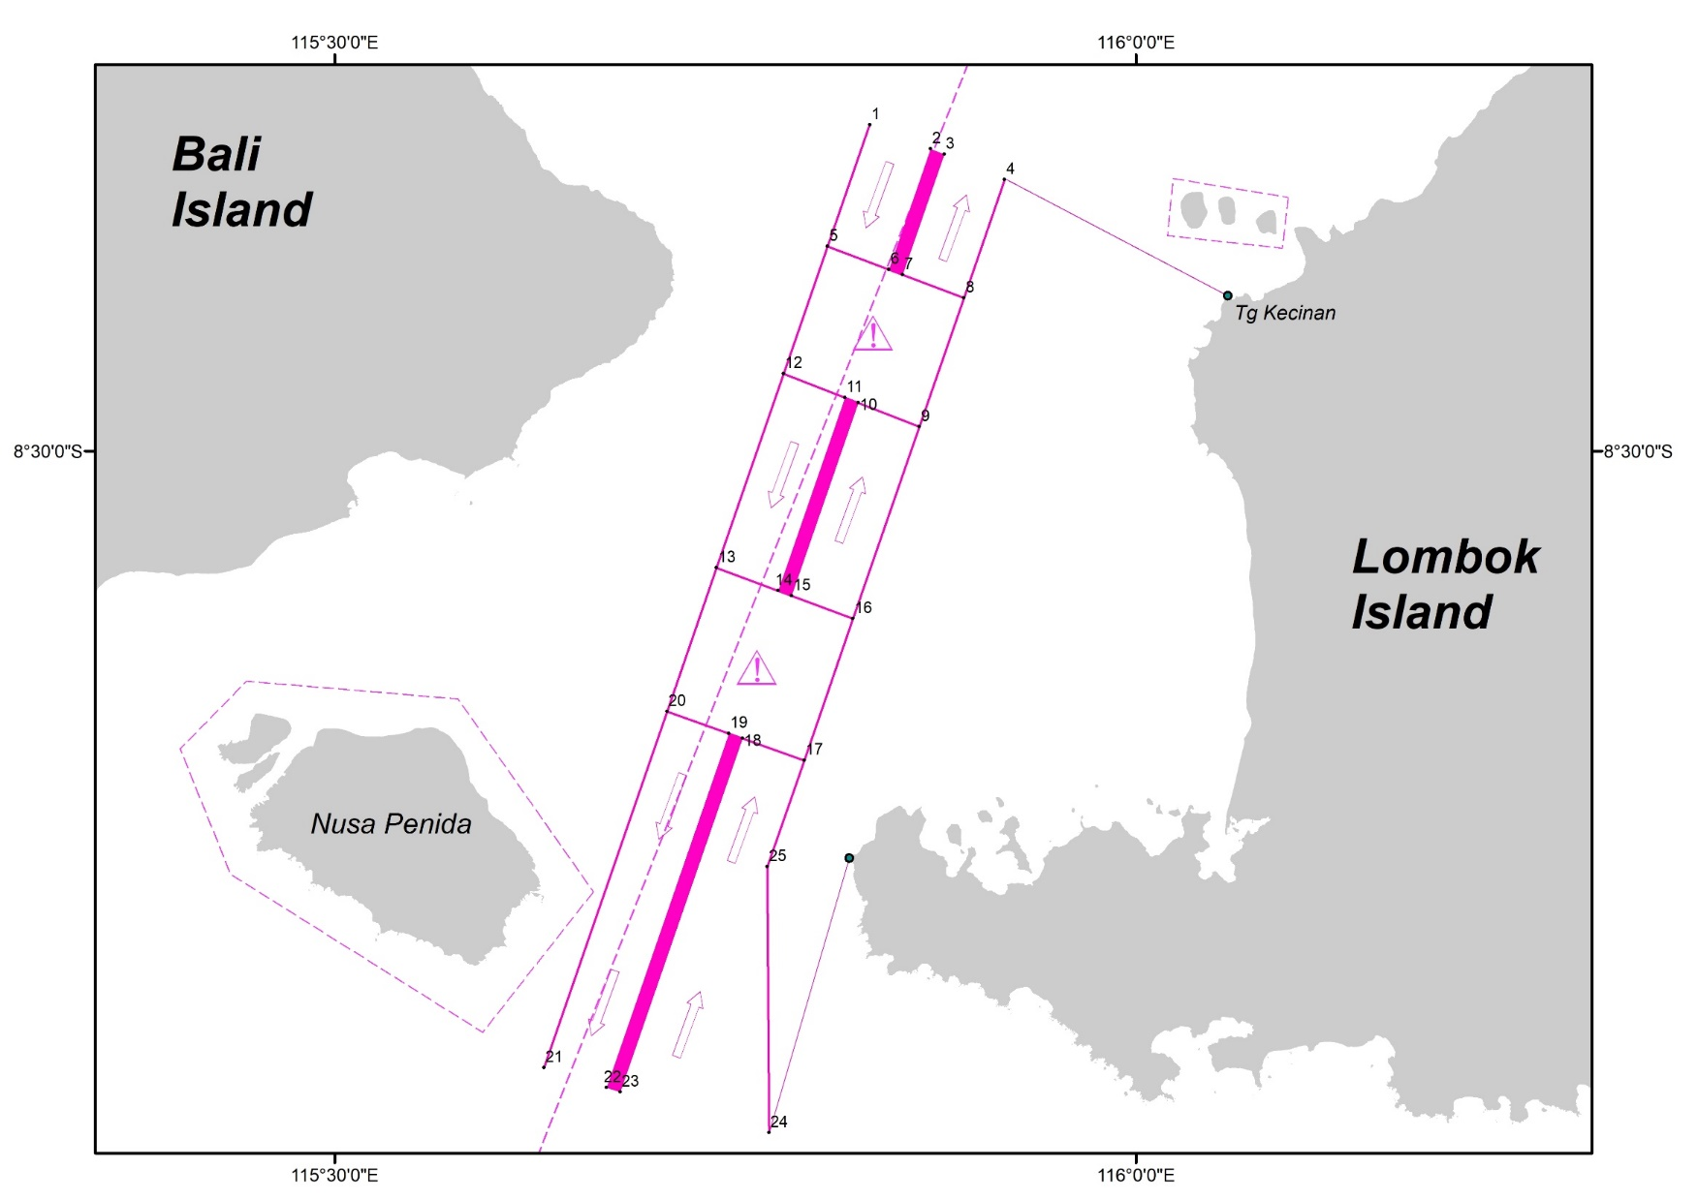
THE TRAFFIC SEPARATION SCHEME IN SUNDA STRAIT PROPOSED IN NCSR-6

Slide 18
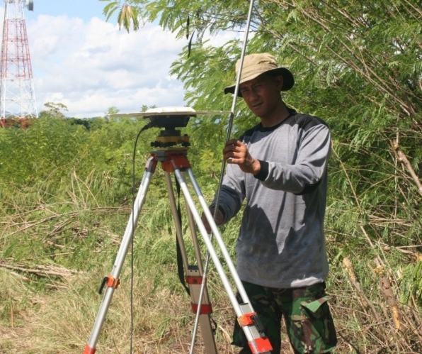
Thank you
&
Terima Kasih

