Slide 1
6th East Asia Hydrographic Commission Steering Committee Meeting
National Report by
United States of America
International Hydrograph Organization
Organisation Hydrographique International
East Asia Hydrographic Commission
Commission Hydroraphique de l’ Asie l’est

Slide 2
U.S. Hydrographic Leadership
NOAA
Director, Office of Coast Survey
Rear Admiral Shep Smith
Deputy Director, Office of Coast Survey
Katie Ries
NGA
Senior GEOINT Authority-Maritime
John Lowell
Director, Maritime Office
Captain Richard Kennedy (replaced Brian Connon)
NAVY
Commander Naval Meteorological and Oceanography Command (CNMOC)
Oceanographer of the Navy, Hydrographer of the Navy, and Navigator of the Navy
Rear Admiral John Okon
Deputy Hydrographer of the Navy (Acting)
Mathew Borbash (replaced Stan Harvey)

Slide 3
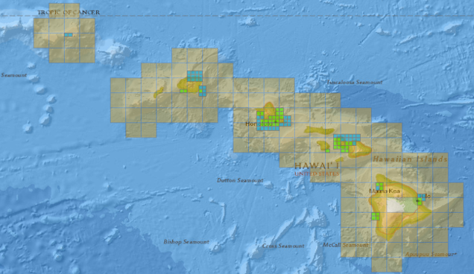
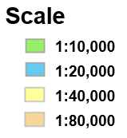
New Directions
U.S. Charting Plan – an ENC product rationalization effort and data clean up effort to improve U.S. nautical chart products, coverage and distribution
Within EAHC; U.S produces complete suite of nautical products over Guam, Northern Marianas, Wake island
U.S. produces ENCs in areas where the U.S. functions as the Primary Charting Authority
Within the EAHC; Palau, FSM and Marshal Islands building ENC portfolio
Create an Orderly Layout

Slide 4
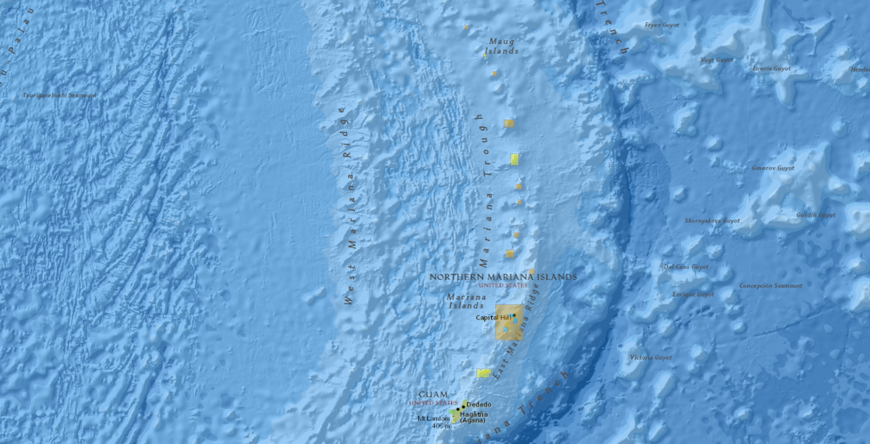
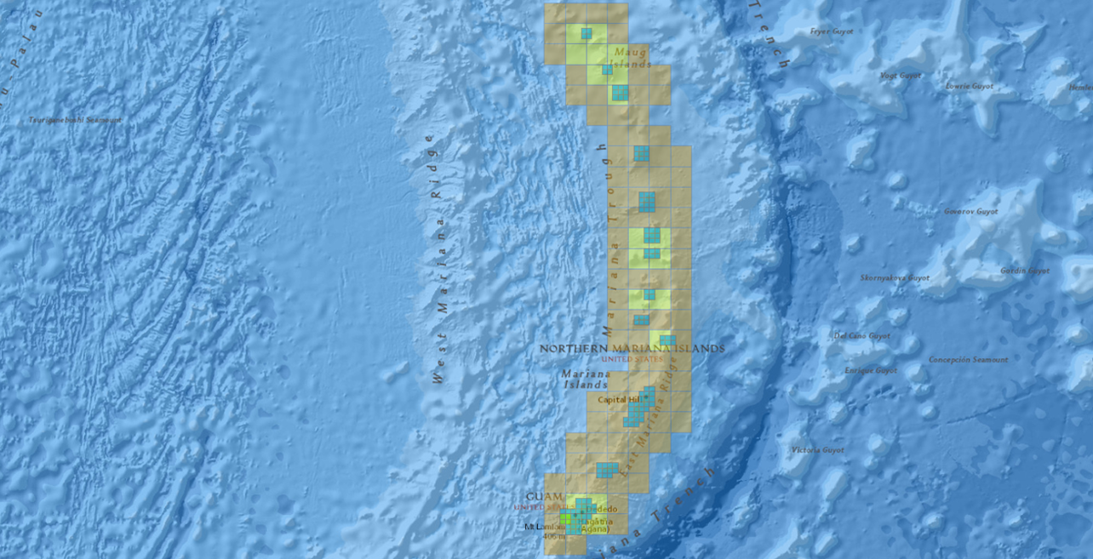
U.S. Charting Plan - Products
Create an
Orderly Layout

Slide 5
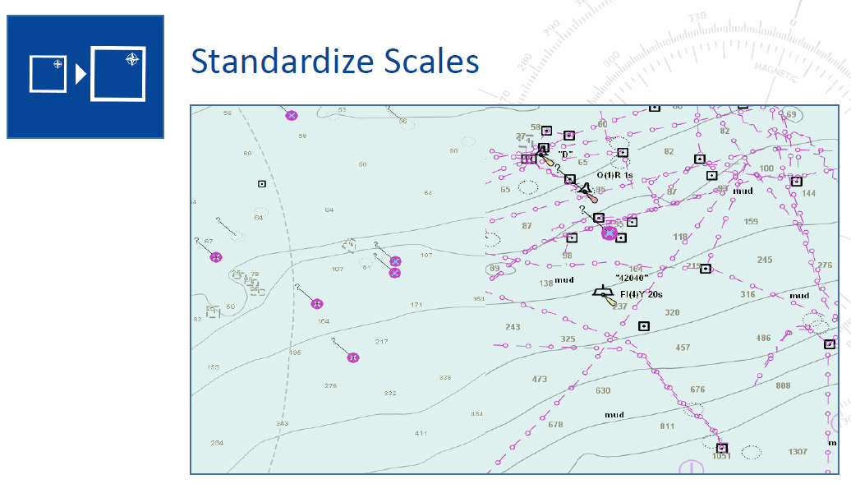
U.S. Charting Plan - Data

Slide 6
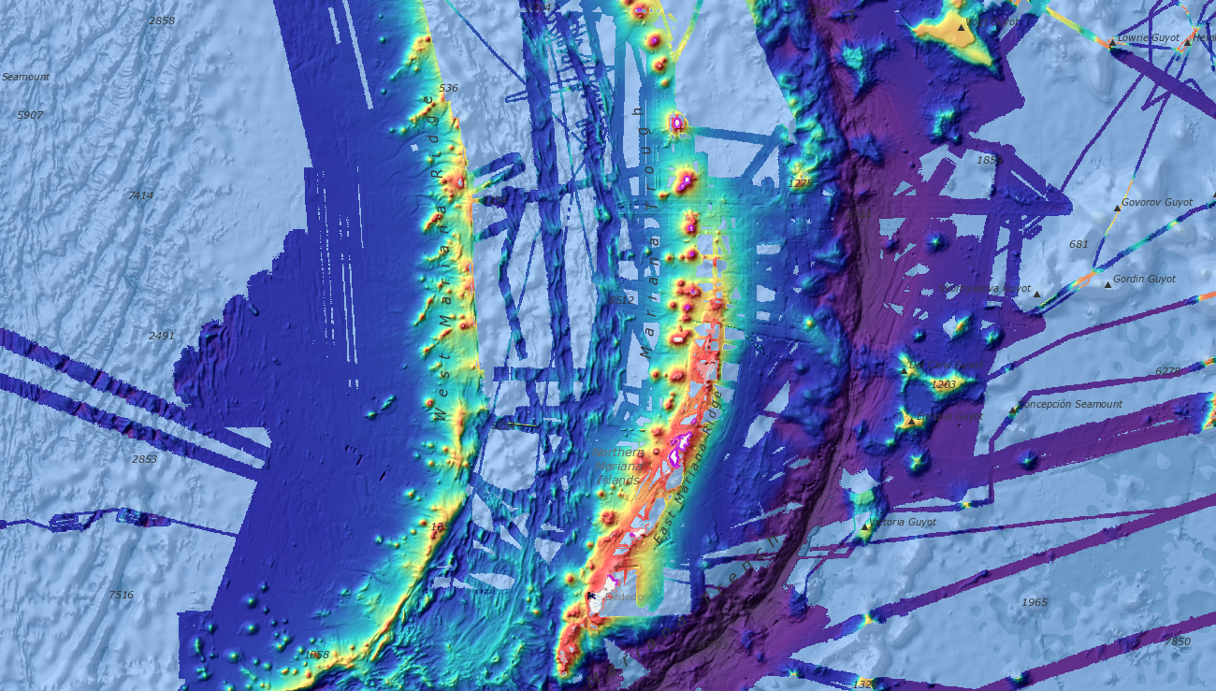
Best Available Data

Slide 7
Marine Spatial Data Infrastructure
U.S. Open Data Policy
Principles: Discoverable, Accessible, Described, Reusable, Complete, Timely, Managed Post Release
Supporting non-traditional users of nautical chat information – ENC Direct to GIS
ENC and other derived theme layers are distributed via OGC Compliant Web Services
Open Geospatial Consortium (OGC) Marine Spatial Data Infrastructure – Concept Development Study
Marine Data Users
Other Marine Spatial
Databases
Data
Access
Data
Interoperability
(standardized data)
Marine Spatial Data
Web Services
(standardized distribution)
Marine Spatial
Database
Policy,
Procedure,
Documentation

Slide 8
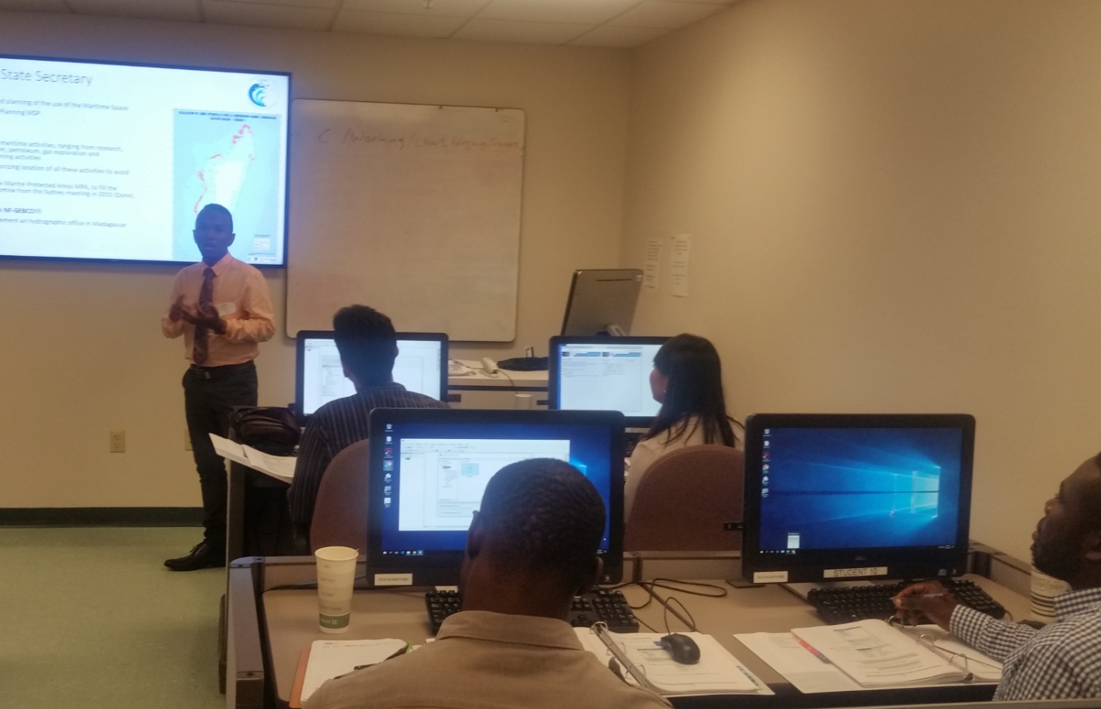
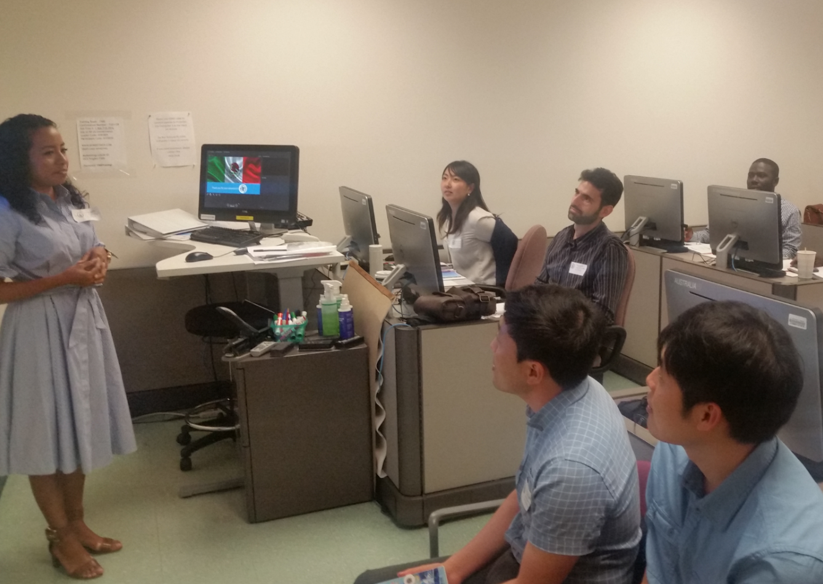
Capacity Building
U.S. supports the IHO Maritime Safety Information training courses
NGA - S-8 Category-B Competence for Nautical Cartography
NOAA – S-8 Category-B Competence for Nautical Cartography, Chart Adequacy Workshop
U.S. Navy – S-5 Category-B International Hydrographic Management and engineering Program
S-5 Category A
University of Southern Mississippi
University of New Hampshire

Slide 9
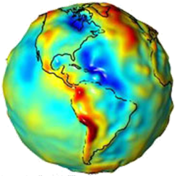
Geodesy Update
New Earth Gravity Model (EGM)
in 2020, important for MSL and WGS
The Earth Gravity Model is updated to reflect the variance in gravity based on the uneven mass distributions found across the irregular shaped Earth

Slide 10
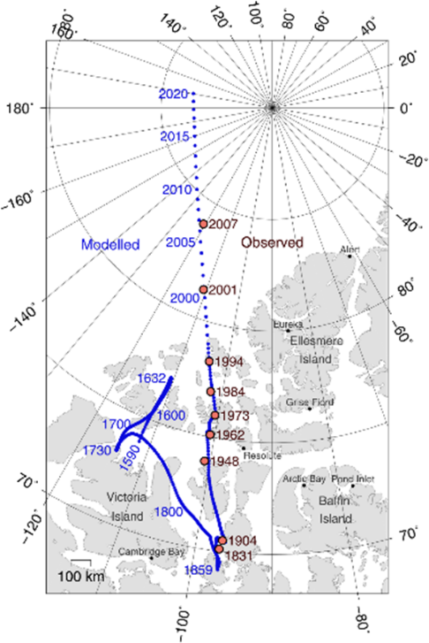
Geodesy Update
The World Magnetic Model (WMM) helps define the difference between true north and magnetic north, and predicts the change over time.
This correction is required to safely navigate
across the Earth surface.
Out of cycle version of the WWM was released in February 4, 2019 due to increasing inaccuracies
Current plan to is to release the regular 5 year release of the WMM in 2020 on schedule

Slide 11
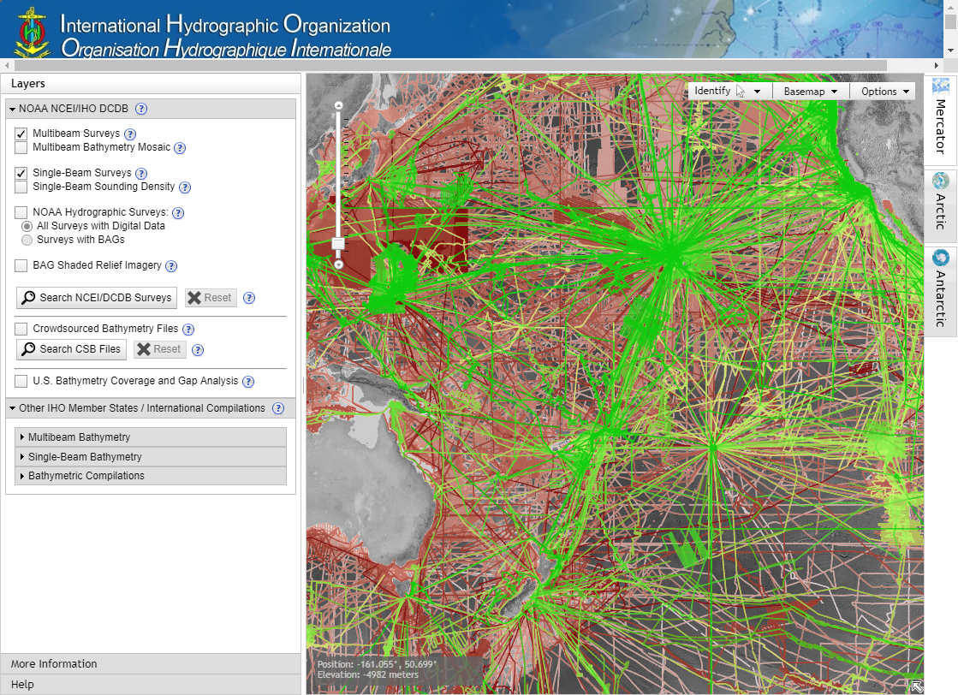
GEBCO Seabed 2030
https://seabed2030.gebco.net/
https://maps.ngdc.noaa.gov/viewers/iho_dcdb/
Bring together available bathymetric data to produce the definitive map of the world ocean floor
Encourage data collectors and data managers of governmental, academic and private inters to work together to improve the quality of publicly available data and grid of the ocean floor.
Create partnerships and cooperation between Interested parties
Empower sustainable ocean management

