Slide 1

National Report by the Russian Federation
IHO Hydrographic Commission on Antarctica (HCA)

Slide 2
Survey and charting progress in Antarctica since HCA-14 (June 2016)
new charts produced (INT, national, ENC)
There is no information to report
risk assessment studies
There is no information to report
impact of Polar Code on your activities
There is no information to report
areas surveyed
During the period from 2013 to 2016 the research vessel «Akademik Fedorov» ran a line of soundings while delivering of cargo and personnel of expeditions to the polar Antarctic stations. In 2016 the resesarch vessel «Admiral Vladimirsky» took a sounding in Prydz Bay and Lützow-Holm Bay.

Slide 3
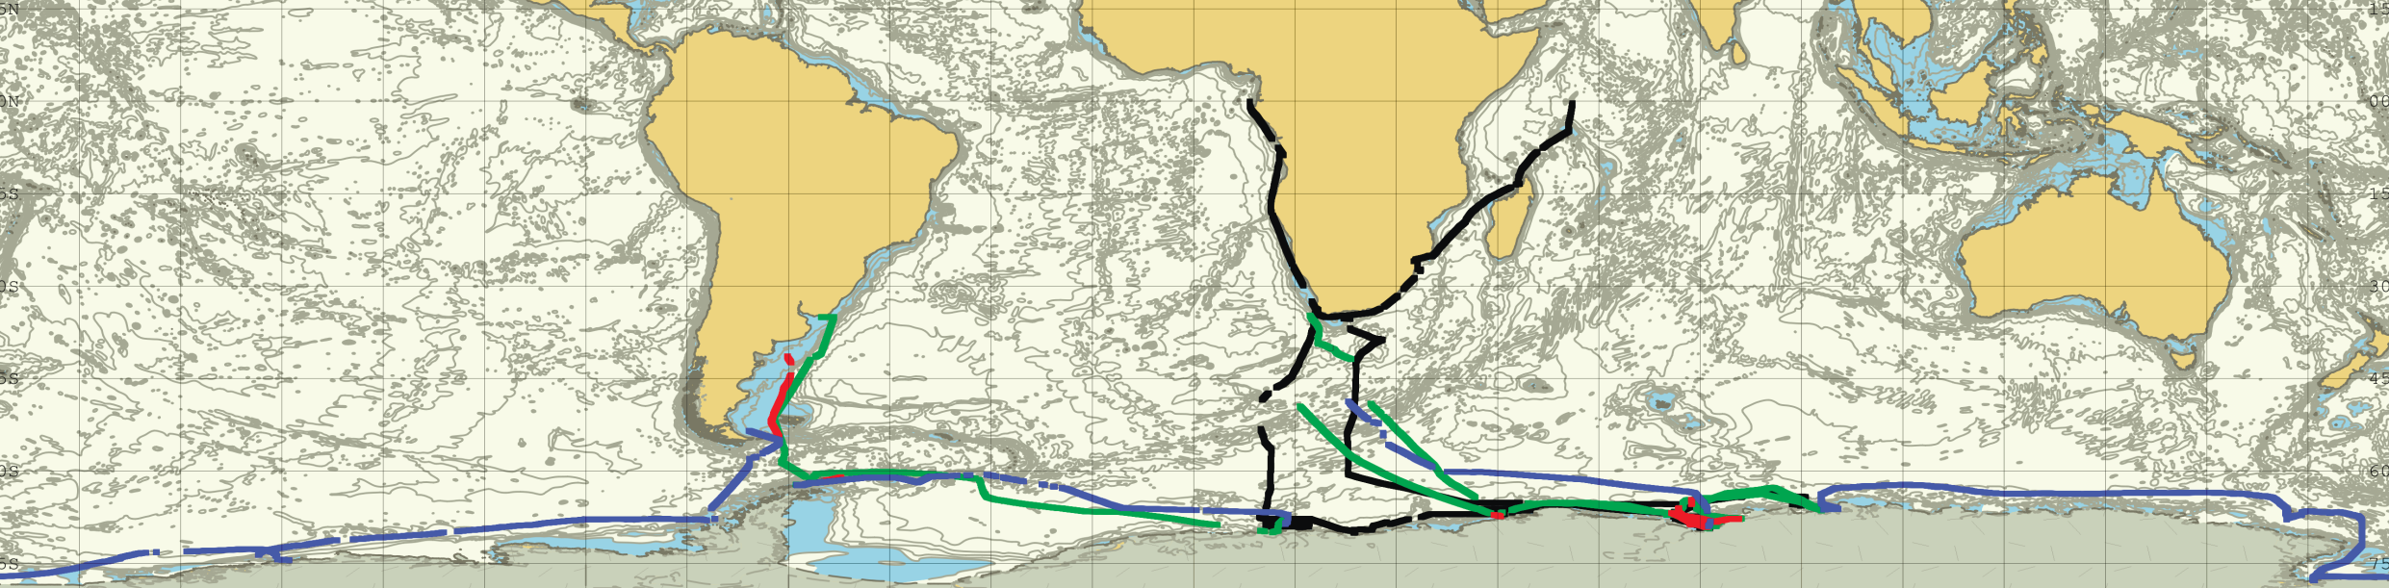
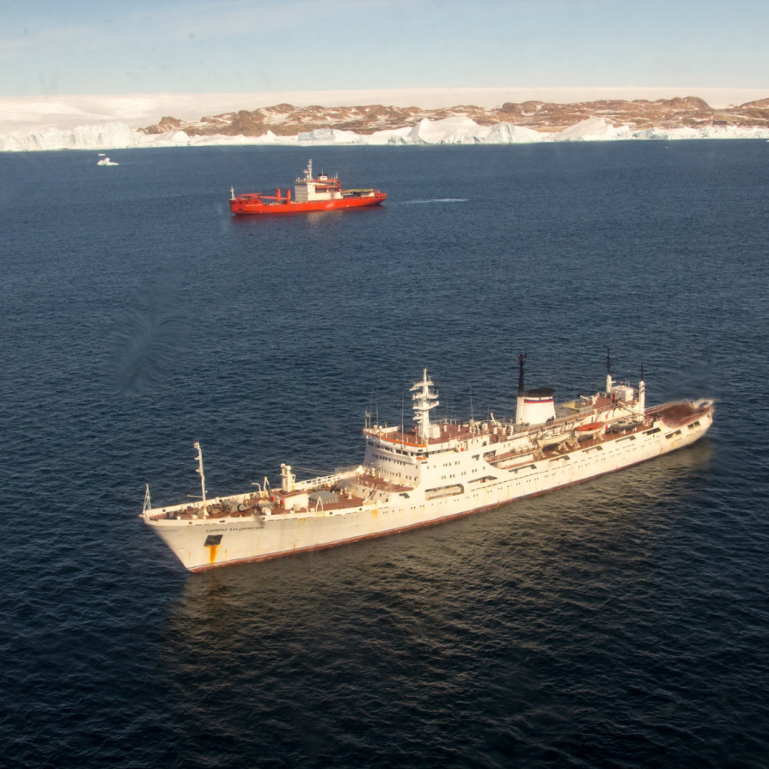
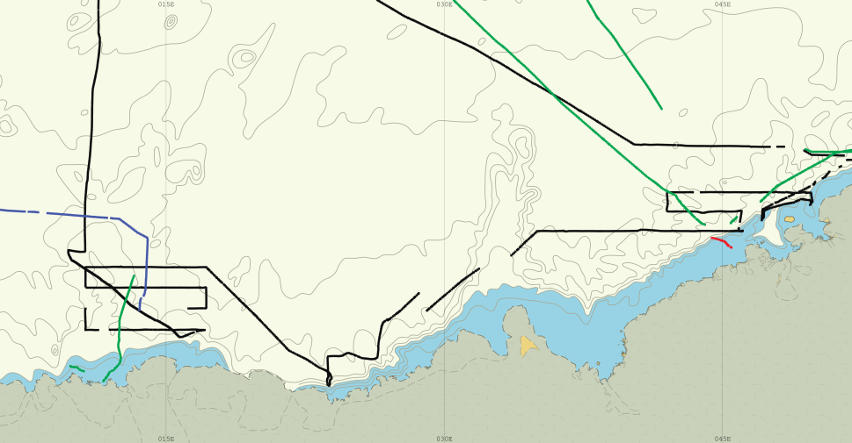
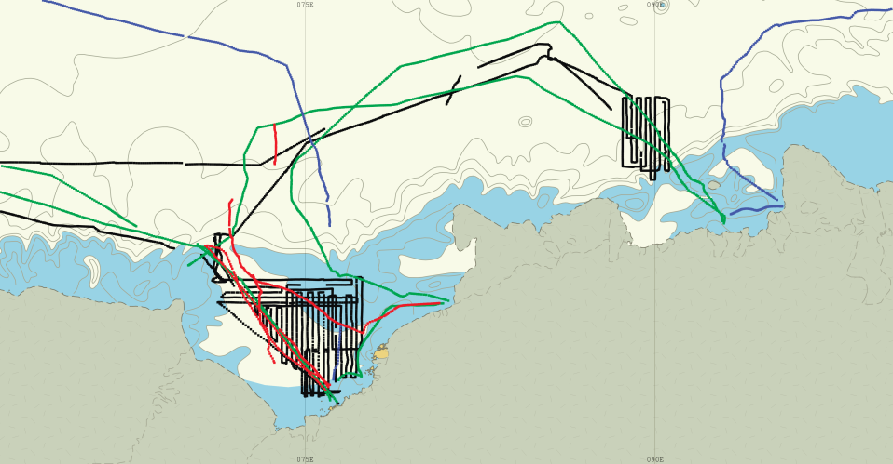
Survey progress in Antarctica since 2013
«Akademic Fedorov» 2013
«Akademic Fedorov» 2015
«Akademic Fedorov» 2016
«Admiral Vladimirsky» 2016
Lutzow Holm Bay
Prudz Bay

Slide 4

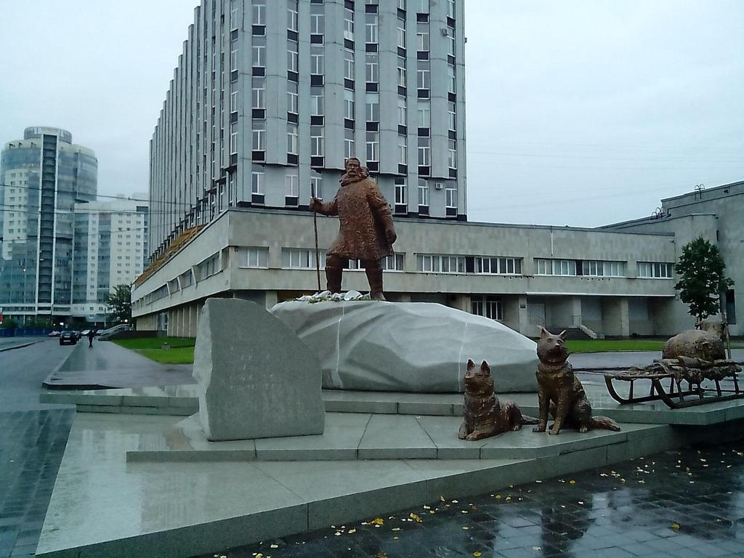
Status of Relations with Other Organizations
3.Research and polar institutes
The structural units of the Hydrographic service of The Russian Navy and Roshydromet of Russia are engaged in conducting researches in the Antarctic region. The leading research organization is the Arctic and Antarctic research Institute. The Central Navy's cartographic production produces nautical charts, both paper and electronic.

Slide 5
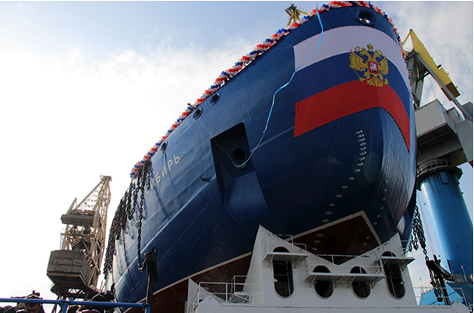
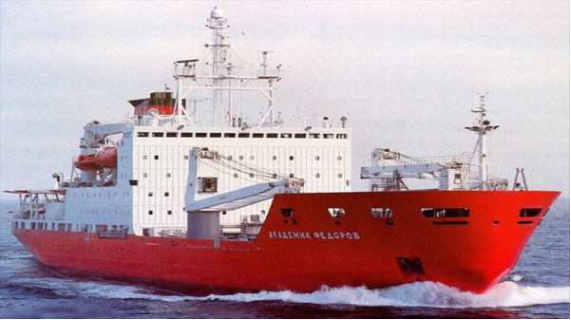
Status of Relations with Other Organizations
In November 2018, from the port of Saint-Petersburg the research vessel «Akademik Fedorov» is setting sail under the program of the 64th Russian Antarctic expedition. The vessel is owned by the Ministry of Natural Resources and Environment of the Russian Federation and is equipped with modern hydrographic and oceanographic equipment.
22-09-2017, the nuclear icebreaker «Sibir’» («Siberia») was launched, commissioning is planned in 2021.

Slide 6
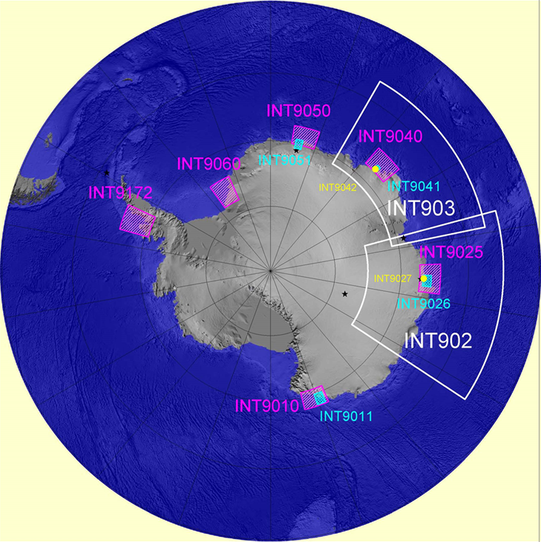
Planned Activities for 2018-20
In 2018-2019 it is planned only running a line of sounding on the route of the research vessels delivering personnel and supplies to polar Antarctic stations.
In 2019-20 years it is planned to take soundings within the borders of the chart INT9172 assigned to the Russian Federation. A specific research Plan is currently being developed.

Slide 7
Any other matters of relevance to HCA
The information about the Hydrographic service of The Russian Navy is available on the official website of the Ministry of Defence of the Russian Federation
http://structure.mil.ru/structure/forces/hydrographic/about.htm
There are also electronic versions of the editions of Notices to mariners and Navigational warnings bulletins in pdf format
https://structure.mil.ru/structure/forces/hydrographic/info/notices.htm

Slide 8
IHO Hydrographic Commission on Antarctica (HCA)
Thank you for attention

