Slide 1
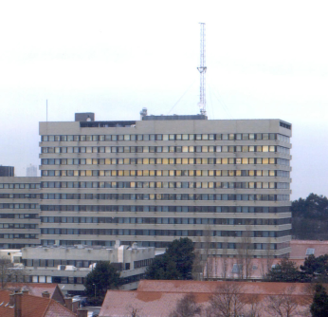
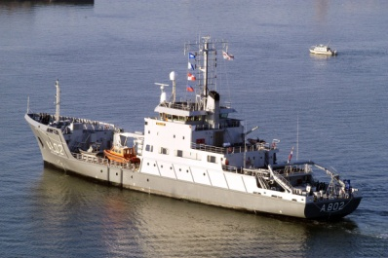
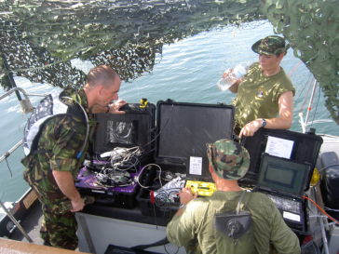
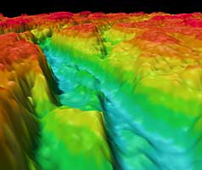

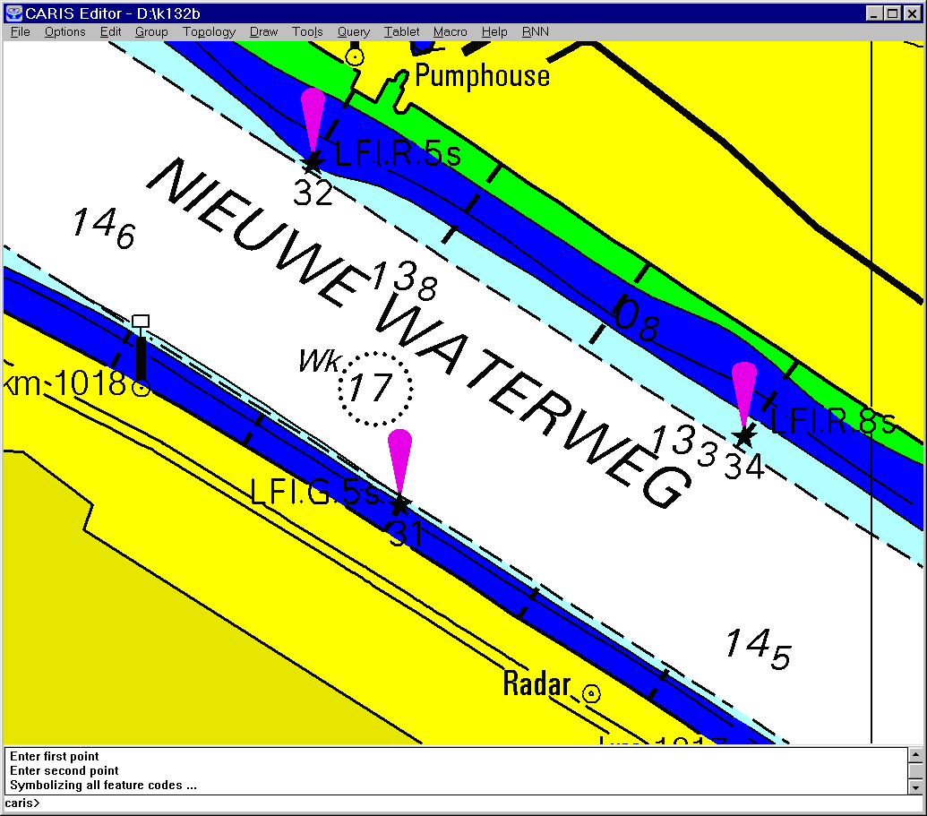
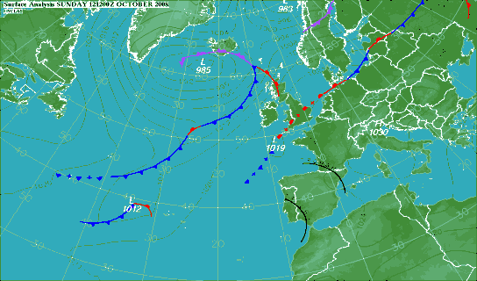
National report
Puerto Rico
B
O
V
MACHC 14
E
N
W
CARAIBISCHE ZEE
Dominica
I
N
D
S
E
E
s
I
d
L
N
n
A
E
a
N
L
l
D
s
E
L
I
St. Vincent
Barbados
I
d
N
T
r
N
a
Aruba
A
w
I
N
E
d
K
L
E
n
i
Cura
çao
B
E
N
E
D
E
N
E
I
L
A
N
D
E
N
W
Grenada
W
IND
E
S
Margarita
Tobago
r
i
n
o
c
o
o
O
i
R
b
o
R
R
i
q
u
a
e
r
s
s
r
a
E
e
e
m
D

Slide 2
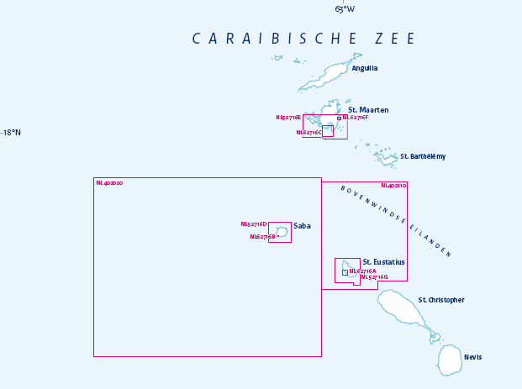

Highlights: coverage (1)
ENC coverage
    Windward Islands complete coverage all usage bands

Slide 3
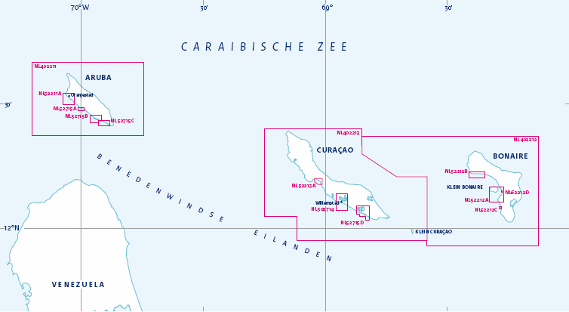
Highlights: coverage (2)
ENC coverage
    Leeward Islands complete coverage all usage bands

Slide 4
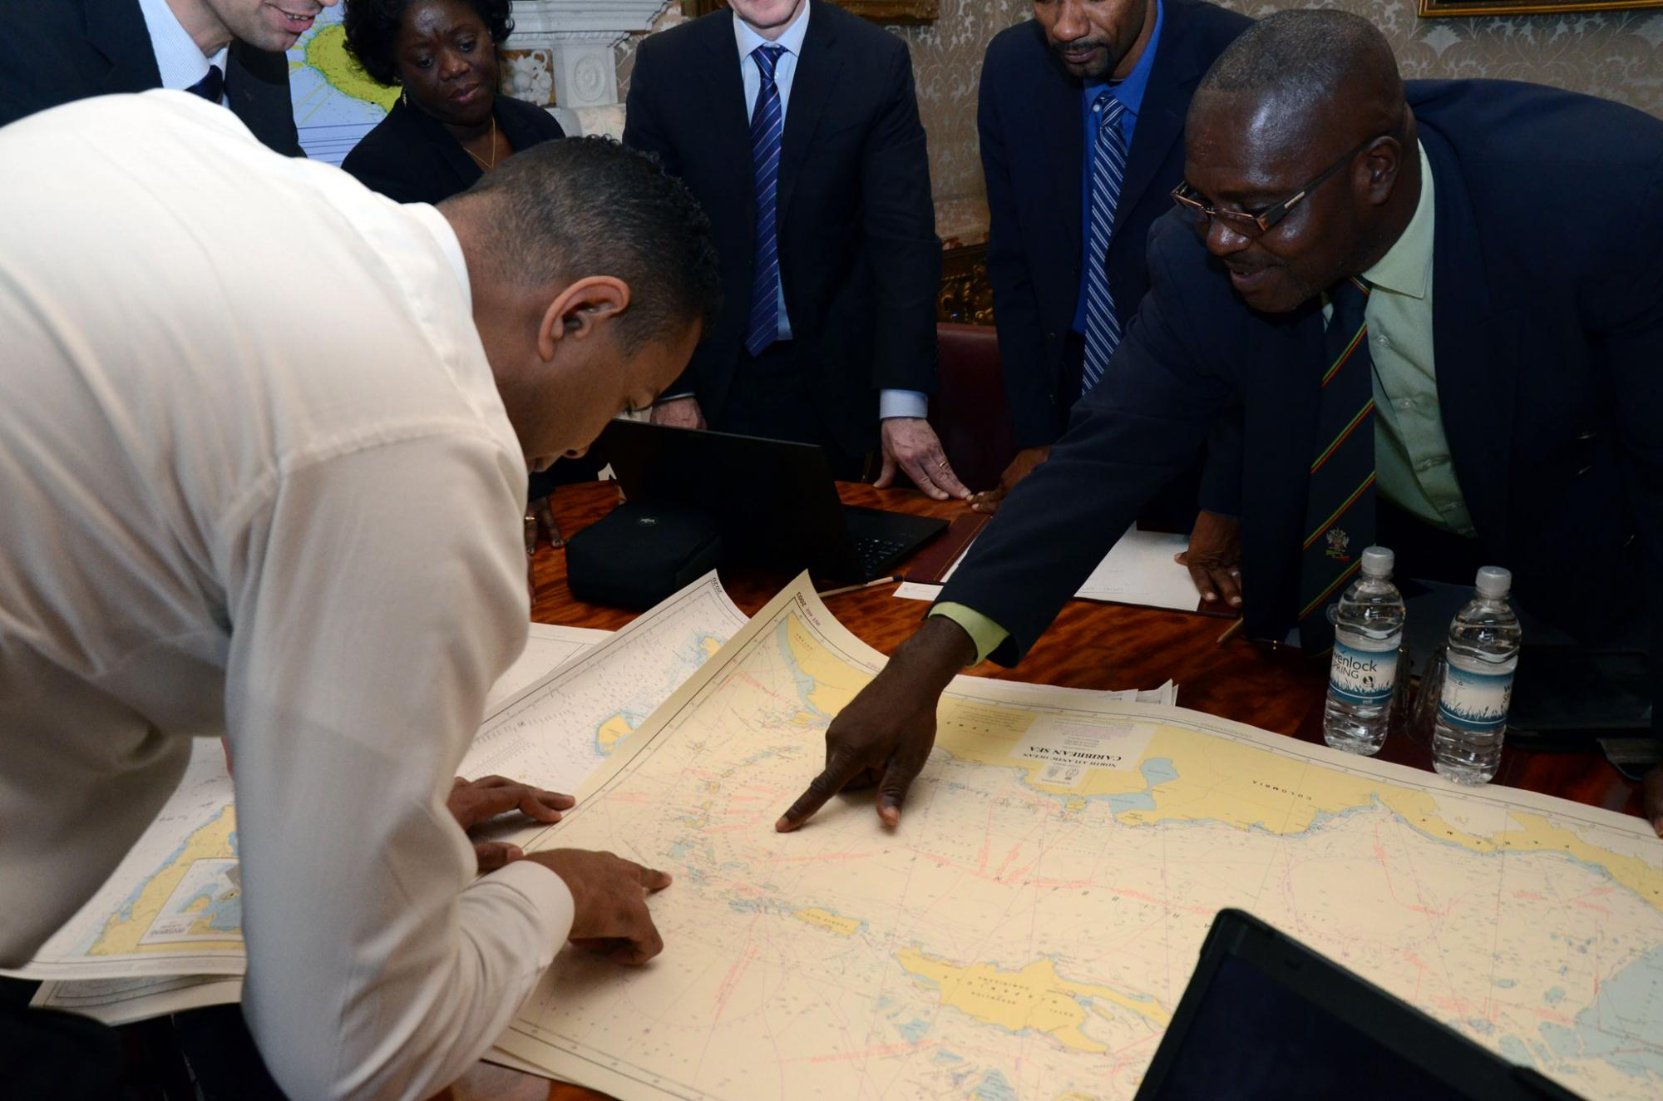
Maritime Borders (1) St Kitts & Nevis

Slide 5
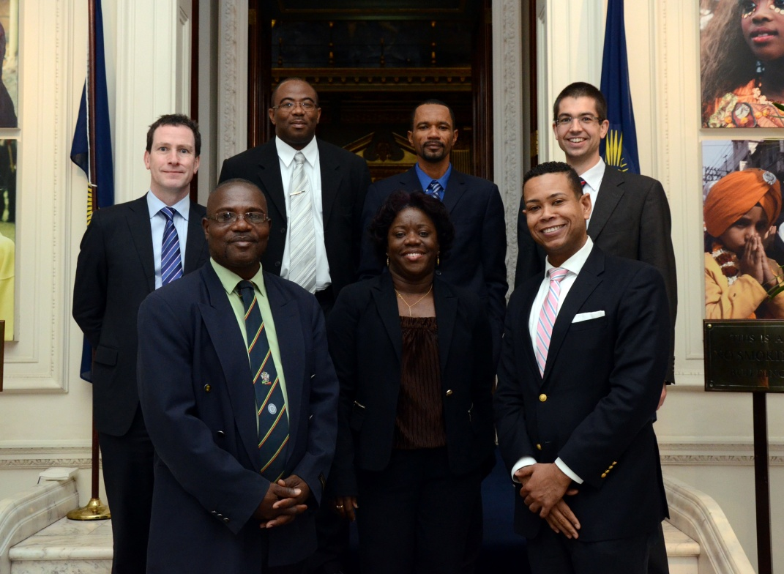
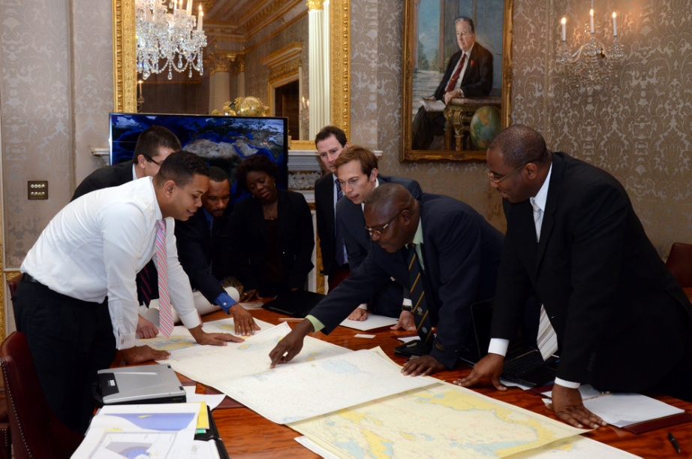
Maritime Borders (2) St Kitts & Nevis
Progress with St Kitts&Nevis:
  Base points St Kitts&Nevis, Saba and St Eustatius
  Productive technical meeting in London, High Commission at Commonwealth (29th October)
  Final round mid 2014

Slide 6
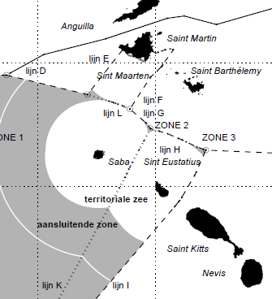
Maritime Borders (3) St Kitts & Nevis
Future steps:
Three-lateral-point with France, St Kitts&Nevis and NL

Slide 7

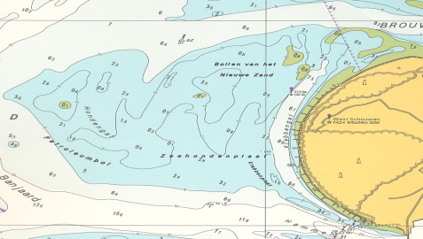
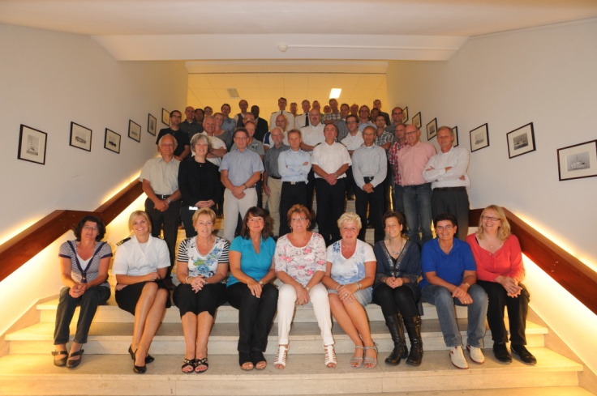
Capacity building Offering
Practical traineeship on board
Practical support with deployable teams:
    knowledge
    equipment MBES, post processing
    local tug boats as platform
Practical traineeship at the office
Coproduction program Suriname in
nautical charting and hydrography

Slide 8
Room for improvement (1)
Evaluation of systematic resurvey needs Leeward Islands
Shipping analyses based on AIS-like monitoring
Changed constitution of the 6 Islands:
      from unwritten law to Act on Hydrography
      closer look at additional needs and developments
      development of a Netherlands Caribbean geo portal

Slide 9
Room for improvement (2)
Emphasis on formalised technical cooperation (bilaterals):
    Venezuela:
        good cooperation on working level
        bilat in progress
    focus at:
        exchange of validated source data i.s.o. products only
        continuous exchange of NTM and source data changes
        combined effort in validation of ENC and paper charts

Slide 10
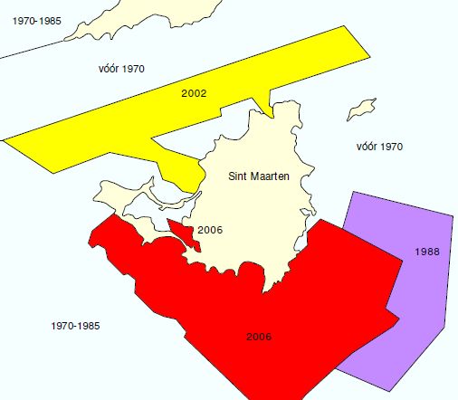
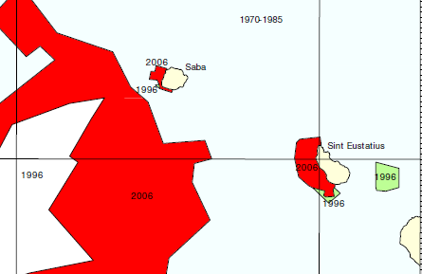
Room for improvement (3)
Harmonisation of resurvey plans between Member States:
      Based on best practices in other Regional Commissions IHO

Slide 11
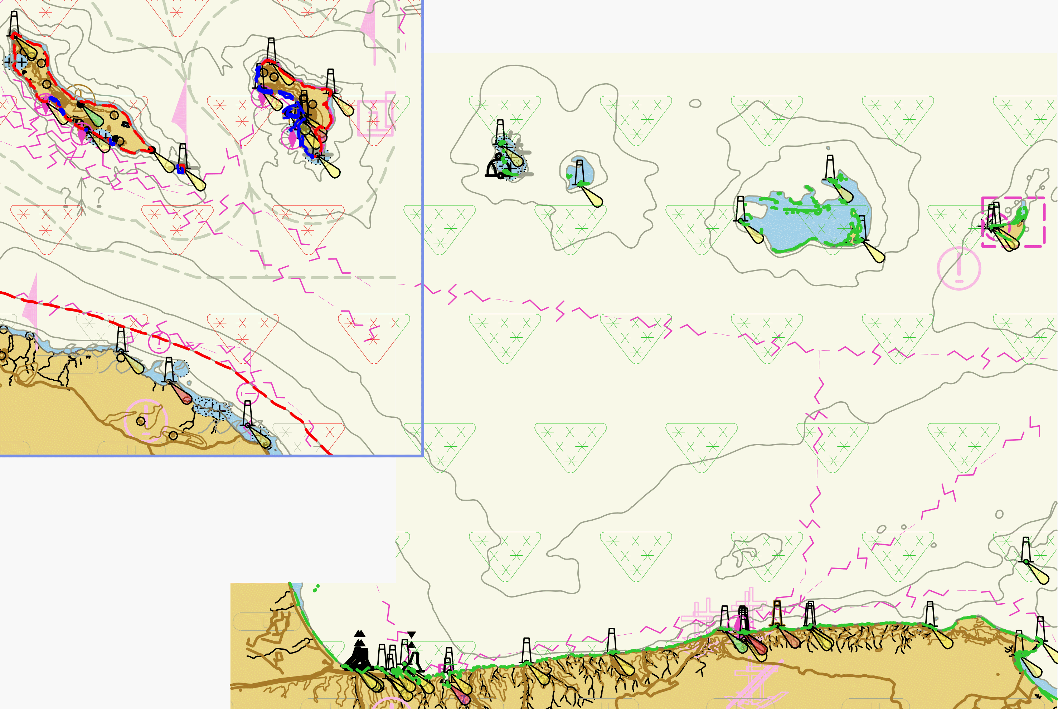
Room for improvement (4)
Harmonisation of CATZOC (bathymetry confidence level) in cross border area’s
6 stars: CATZOC A1
full area search +
high accuracy +
systematic resurvey
4 stars: CATZOC B
no full area search +
uncharted features may exist

Slide 12



