Slide 1
IALA and The World-Wide Academy
Stephen Bennett; Programme Manager IALA WWA

Slide 2
IALA – Headquarters in Paris
International Association (NGO for now)
Not-for-profit
Non political
Created in 1957 (but with origins from the 1800’s)
Special Observer Status with the International Maritime Organization 1961
A number of Memoranda of Understanding with other international organisations
Likely to upgrade to international Inter-Governmental Organisation (IGO) by 2016

Slide 3
IALA – The Aim
To harmonise Aids to Navigation worldwide and….
to ensure that the movement of vessels are safe, expeditious, cost effective and…
harmless to the environment

Slide 4
Organization and Membership
General Assembly
24 Member Council
Council Working Groups
Strategy Group
Legal Advisory Panel (LAP)
Over 80 National Members (Coastal States)
50 Associated Members (Organisations with related maritime activities such as Port Authorities)
110 Industrial Members
45 Honorary Members – Individuals who have made a significant contribution to navigation safety and IALA

Slide 5
SOLAS V Regulation 13
Chapter V Regulation 13.1 requires a Contracting Government to provide “as it deems practical and necessary” by itself or with other Governments “such AtoN as the volume of traffic justifies and the degree of risk requires”
Ch V Reg 13.2: AtoN should conform to international standards (IALA recommendations and guidelines)
Ch V Reg 13.3 information about AtoN must be given to all concerned (mariners; stakeholders etc).

Slide 6
Obligations of the Competent Authority
Provide as many AtoN are required based on a risk assessment
Guarantee the reliability of each AtoN
Update the AtoN service as maritime traffic, environmental patterns, technology and resources change
Set up a formal method of informing mariners about existing AtoN, new AtoN, and AtoN failures
Decide who will provide the AtoN service

Slide 7
Volume of Traffic
IMAGE TO FOLLOW

Slide 8
IALA Risk Management Toolbox
Three Risk Management Tools :
PAWSA: Qualitative (graphical or diagrammatic) aiming to find acceptable and cost effective solutions
IWRAP Mk2: Quantitative (numerical or tabular) aiming to identify average number of annual collisions and groundings
Simulation techniques (examine effectiveness of risk control options)
Annual Risk Management Workshop – Sydney 2012; Madrid 2013; Istanbul 2014
New simplified qualitative tool for developing nations under development

Slide 9
IALA Publications, Recommendations and Guidelines
Publications (NAVGUIDE; MBS; VTS Guide)
Recommendations advise what should be done
Guidelines advise how to implement the recommendations as “best practice”
Contracting Governments should implement them (SOLAS V.13.2)
Recs and GL are available free from www.iala-aism.org
Delivered by the IALA World-Wide Academy during model courses, seminars and workshops

Slide 10
IALA Committees
Committees draft IALA Publications, Recommendations and Guidelines for Council approval
Aids to Navigation Management
Engineering, Environment and Preservation (EEP)
Vessel Traffic Services
e-Navigation
which are then delivered by the Academy

Slide 11
The World-Wide Academy
“The IALA World-Wide Academy (WWA) is the vehicle by which IALA delivers training and capacity building”
Started in January 2012 – independently funded

Slide 12
The Academy’s Task
78 States
In 7 Regions

Slide 13
Meso-American and Caribbean Region
19 Target States
Regional Point of Contact Brazil
Antigua & Barbuda | Grenada
Bahamas | Guatemala
Barbados | Guyana
Belize | Haiti
Bermuda | Honduras
Costa Rica | Nicaragua
Dominica | Saint Lucia
Dominican Republic | St. Vincent & Grenadines
El Salvador | Suriname
 | Trinidad & Tobago

Slide 14
First Deliverable - Training
Training delivered by an Approved Training Organization or the Academy itself:
Four VTS model courses – V-103 series
Four Aids to Navigation courses E-141 series
E141/1 – Level 1 AtoN Managers
Senior Manager – Level 1+
Risk Management Workshops (IALA WWA.L1.3)
Introduction to e-Navigation (IALA WWA.L1.4)
IALA WWA.L2.0 – Level 2 Technicians (33 specialist modules)

Slide 15
Second Deliverable - Capacity Building - the “4As”
Joint IHO/IALA WWA strategy
Stage 1: Raising AWARENESS through targeted “Level 1+” seminars using a pre-seminar questionnaire
Stage 2: Request by newly aware States for ASSESSMENT of needs leading to…..
Stage 3: ….. ANALYSIS of requirements including the use of available AIS data from all sources to give……..
Stage 4: …..recommended ACTIONS to achieve full compliance

Slide 16
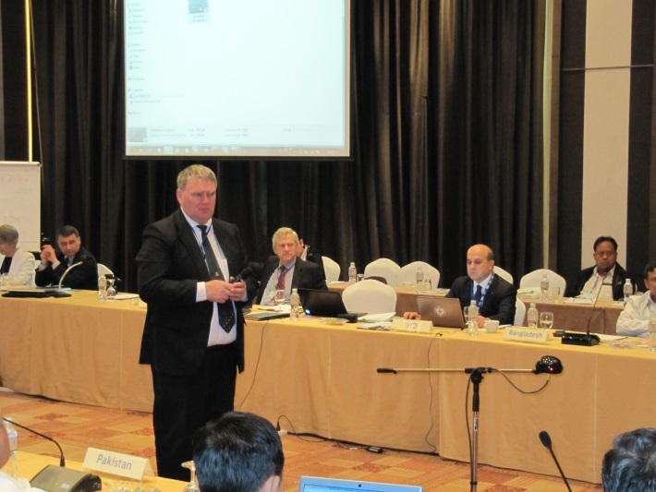
The Academy Strategy to deliver Committee Outputs
Target senior management in Competent Authorities
Use the IALA toolbox to deliver the message

Slide 17
The IALA Toolbox
Council
Bulletin
Seminars
Workshops
Symposia
Academy
Website
Conference
Committees

Slide 18
Capacity Building Deliverables – 2012-14
 | Category | 2012 | 2013 | 2014
Stage 1 | Awareness | Bahrain Cape Town Mauritius Thailand Sydney E Atlantic (Portugal) Guatemala | Mauritania Myanmar Riyadh Mombasa Indonesia - VTS Bangkok Singapore Vanuatu St Maarten | SW Pacific East Asia S. Africa India – VTS Caribbean
Stage 2 | Assessment |  | Mauritius Cameroon | East Asia Fiji/SW Pac N. India
Level 1 | AtoN manager |  | Papua New Guinea | IALA HQ France
Risk | Workshops | Sydney | Madrid | Istanbul

Slide 19
Level 1 AtoN Manager Course
International Certification
IALA Headquarters – St Germain en Laye, France
17th March to 11 April 2014
Six sponsorships may be available

Slide 20
18th IALA Conference 2014
Pre-Conference Seminar Saturday 24 May 2014
Possible sponsorship for 5 Spanish-speaking delegates

Slide 21
IALA and other Organizations
IALA
IMO
IHO
IEC
PIANC
ITU
ILO
WMO

Slide 22
“Delivering as One”
Academy capacity-building forms part of the United Nations “Delivering as One” initiative
Aim to achieve compliance by National Authorities with international obligations
Improvement in safety of navigation and the protection of the marine environment on a global basis
Joint IMO/IHO/IALA seminar being considered for Meso American and Caribbean region in 2014

Slide 23
IALA WWA
Questions?

