Slide 1
The sixth meeting of the Hydrographic Services and Standards Committee (HSSC) took place in Viña del Mar, Chile, hosted by the Hydrographic Office of Chile (Servicio Hidrográfico y Oceanográfico de la Armada - SHOA), from 10 to 14 November 2014. Rear Admiral Patricio Carrasco, Hydrographer of Chile and Director of SHOA, welcomed delegates at the meeting which was chaired by Dr Mathias Jonas, Hydrographer of Germany. 44 representatives - from 18 Member States, the IHB, and six international organizations accredited as observers - were present. Director Gilles Bessero and Assistant Directors Yves Guillam and Tony Pharaoh represented the IHB.

Slide 2
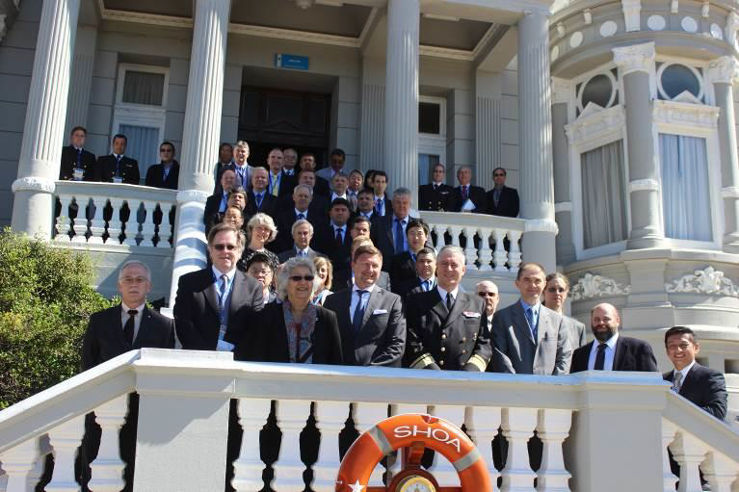

Slide 3
1 Implementation of Programme Performance Indicators The Committee agreed to retain the current HSSC Working Level Performance Indicators (WPIs) until the next Conference/Assembly in 2017 when there will be reconsidered as part of the revision of the IHO Strategic Plan.

Slide 4
2 Outcome of EIHC-5 affecting HSSC
- The Committee further noted that the IHB Directing Committee will invite the Chair of HSSC and the Chairs of HSSC WGs and subordinate bodies to report, twice annually at year-end and mid-year, on the overall status of their respective work programmes by completing a simple, two-part template that requests brief lists of a) current goals and priorities, and b) current or expected gaps and needs.

Slide 5
3 Restructuring of HSSC Working Groups
The Committee agreed on the following arrangements:
1 establishment of the S-100WG, ENCWG, NIPWG and TWCWG and endorsement of the TORs proposed in Annex H of the report of the CGHR and attached in Annex B;
2 CSPCWG renamed NCWG and review of the continuance of NCWG on an annual basis;
3 annual review of the continuance of DPSWG, DQWG and HDWG;
4 transfer of MSDIWG under IRCC
5 further investigations of the possible establishment of a Hydrographic Surveys WG and of its scope;
6 endorsement of the new structure and transition arrangements

Slide 6
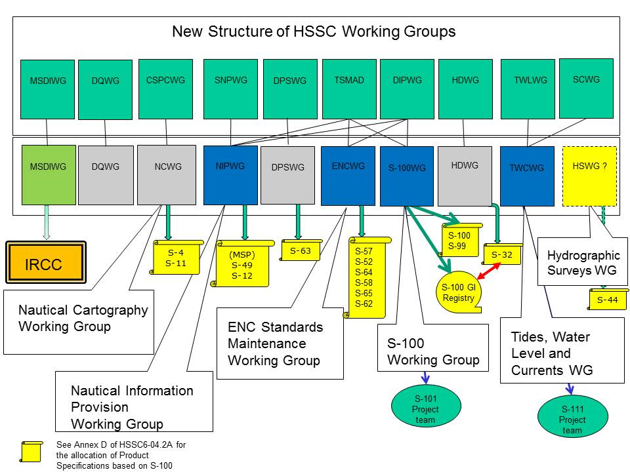
ARRANGEMENTS FOR THE TRANSITION TO THE NEW STRUCTURE OF HSSC WGs

Slide 7
New WG Title | Current WG | Last meeting of Current WG | Transition Coordinator | First meeting of New WG | Comments
S-100WG | TSMAD | (31 Mar - 4 Apr 2014) | Chair TSMAD | 2-6 Feb 2015 | Joint meeting aligned with planned dates for TSMAD29 & DIPWG7
 | DIPWG
ENCWG | TSMAD |  | Chair DIPWG
 | DIWPG
TWCWG | TWLWG | (25-28 Mar 2014) | Chair TWLWG | 21-24 Apr 2015
 | SCWG | (28-30 May 2014)
NIPWG | SNPWG | 1-4 Dec 2014 | Chair SNPWG | June 2015
 | DPSWG |  |  |  | Review of the continuation at HSSC-7
 | DQWG
 | HDWG
 | NCWG
New WG | Current WG | Last meeting Current WG | Transition Coordinator | First meeting New WG | Comments
Note: MSDIWG will report to IRCC from 1 January 2015

Slide 8
5 Transfer Standard Maintenance and Application Development (TSMAD)
- The Committee invited the S-100WG to consider the need for creating an S-101 Project Team
- The Committee noted with satisfaction the progress in developing the draft edition 1.0.0 of S-101 - ENC Product Specifications, the S-100 Feature Catalogue Builder, the S-100 Portrayal Catalogue Builder, and an S-100/S-101 Viewer
- The Committee endorsed the draft Edition 2.0.0 of S-100 for submission to the IHO Member States seeking their approval.
The Committee approved the consideration of the preparation of a new edition of IHO S-102 - Bathymetric Surface Product Specification.
- The Committee agreed on the way forward to ensure the continuity of the administration of the S-100 GI Registry and Registers under IHO responsibility, in the perspective of the retirement of the current Registry Manager planned at the end of Feb. 2015.

Slide 9
6 Data Protection Scheme Working Group (DPSWG)
The Committee endorsed the draft Annex C to Edition 1.2.0 of S-63 - IHO Data Protection Scheme and agreed on the way forward for finalizing and approving the new Edition.
7 Digital Information Portrayal Working Group (DIPWG)
-- The Committee approved the publication of
Edition 6.1.0 of S-52 - Specifications for Chart Content and Display Aspects of ECDIS,
Edition 4.0.0 of S-52 Annex A - IHO ECDIS Presentation Library and
Edition 3.0.0 of S-64 - IHO Test Data Sets for ECDIS, subject to final checks in liaison with IEC.

Slide 10
Chart Standardization and Paper Chart Working Group (CSPCWG)
- The Committee endorsed the proposal of the CSPCWG related to the use of seals of non-IHO Member States on INT charts and agreed to include the relevant work item into the work plan.
The Committee endorsed the proposal of IHB related to the consideration of standardization issues associated with information overlay services and agreed to include the relevant work item into the work plan.
- The Committee acknowledged the completion of the revision of
S-4 - IHO Regulations for INT Charts and IHO Chart Specifications,

Slide 11
9 Standardization of Nautical Publications WG (SNPWG)
The Committee endorsed the transfer of its activities to the Nautical Information Provision WG (NIPWG) in accordance with the new structure of HSSC WGs
The Committee considered that the proposal to develop a unique light identifier was premature and invited NIPWG to monitor IALA activities on Aids-to-Navigation
Data Quality Working Group (DQWG)
The Committee noted the report of the DQWG, endorsed its continued activity and approved its work plan, subject to review in 2015.
The Committee noted the need to develop the portrayal of data quality categories and invited NIPWG to stand up a Project Team in collaboration with S-100WG and NCWG.

Slide 12
11 Marine Spatial Data Infrastructure Working Group (MSDIWG)
- The Committee approved the transfer of this group under IRCC from 1 Jan. 2015, and agreed on the draft work plan for 2015-16 for further consideration by IRCC.
- The Committee agreed to include a specific agenda item on MSDIWG activities affecting HSSC.
12 Tidal and Water Level Working Group (TWLWG)
- The Committee endorsed the transfer of its activities to the Tides, Water Level and Currents WG (TWCWG) in accordance with the new structure of HSSC WGs.
- The Committee invited TWCWG to:
a/ consider the need for creating an S-111 Project Team on Surface Currents;
e/ consider the IOC Special Tide Course material for progressing work item M.1;
f/ consider the need to add of a new task in its future programme of work on the applications of water level and current products for non-navigation purposes.

Slide 13
13 Surface Current Working Group (SCWG)
The Committee endorsed the transfer of its activities to the TWCWG and/or to a dedicated project team under TWCWG, in accordance with the new structure of HSSC WGs.
14 Hydrographic Dictionary Working Group (HDWG)
The Committee invited the HDWG to consider the structure of the ISO/TC211 Multi-Lingual Glossary of Terms to evolve the IHO On-line Hydrographic Dictionary.

Slide 14
15 DATE & LOCATION OF THE NEXT MEETINGS
The Committee welcomed the offer of the Republic of Korea to host the next meeting (HSSC-7) early November 2015 in Busan.
- The Committee thanked Canada for its offer to host HSSC-9 in 2017 and agreed on the proposal from the IHB to host HSSC-8 in 2016 in Monaco.

