Slide 1
Education & Training in Nautical Charting IIC Academy
Derrick R. Peyton
IIC Academy
15th MACHC 2014

Slide 2
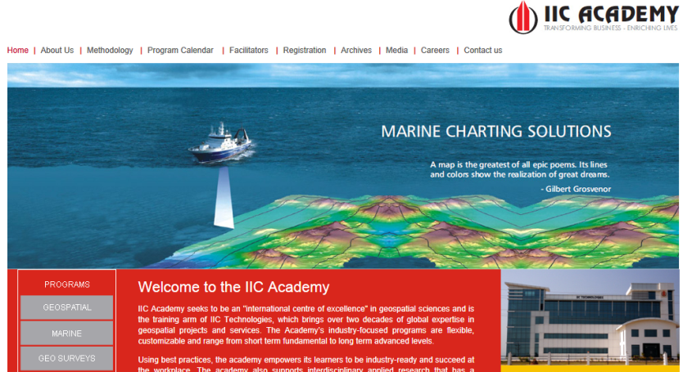
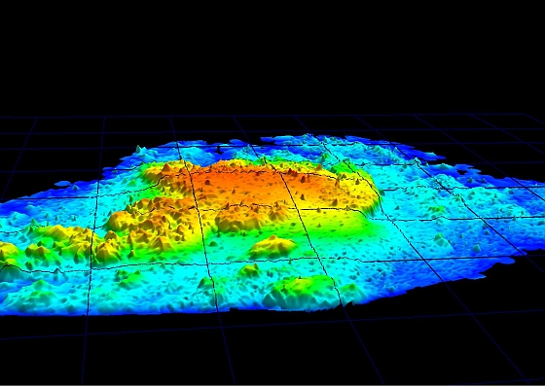
Training: IIC Academy

Slide 3
IIC Academy Cat B S5 & S8
Category A
S5 (Hydrographic Operations)
S8 (Nautical Cartography)
Category B
S5 (Hydrographic Operations)
S8 (Nautical Cartography)
Portable
S8 (Nautical Cartography)

Slide 4
#1 Case Study: Cat B S8 Course
International Board on Standards of Competence for Hydrographic surveyors and nautical cartographers (IBSC)
revision of the standards
3.3.9 IBSC to develop a new Standards framework to separate competency requirements for Cat A and Cat B hydrographers and nautical cartographers by developing two discrete parts in the standards S-5 and S-8 and update their content to comply with the scientific and technological developments in the fields of Hydrography and Nautical Cartography.
The influence of blended, direct and distance learning initiatives is beginning to have an impact. The growing perception now is that modular, educational courses coupled with intensive time on practical and field work may offer a solution that combines the desires of individual and course providers through a flexible approach to the selection, completion and assessment of course elements making up. For the Board these must be of adequate time and rigour as well as accumulating into a comprehensive cover of any minimum Standards.

Slide 5
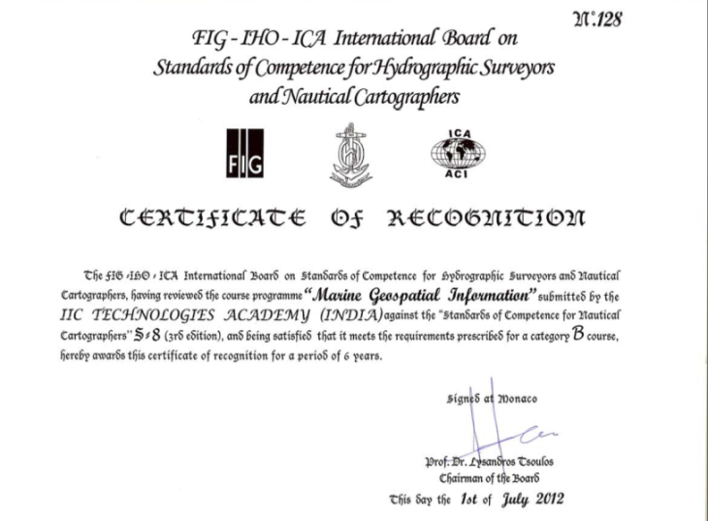
#1 Case Study: Cat B S8 Course
Notes:
Staff member on the ICA

Slide 6
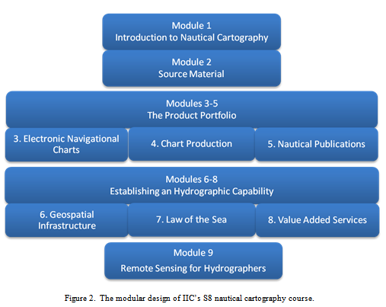
#1 Case Study: Cat B S8 Course
15 week course plus 11 weeks of practical work - Flexible delivery

Slide 7
Thank You
www.iictechnologies.com

