Slide 1
National report of the Kingdom of the Netherlands

Slide 2
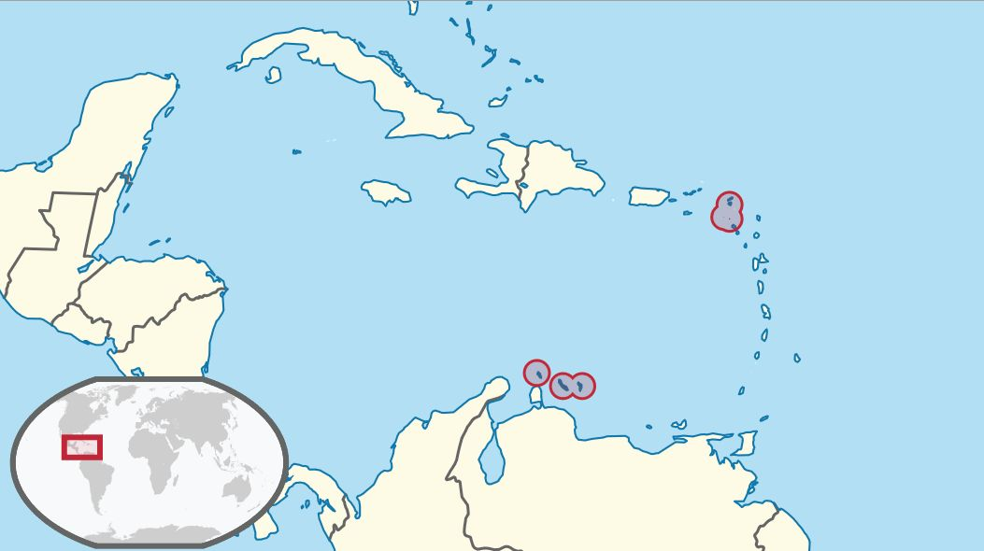
A quick recap: responsibilities of NLHO in Caribbean
windward islands
leeward islands

Slide 3
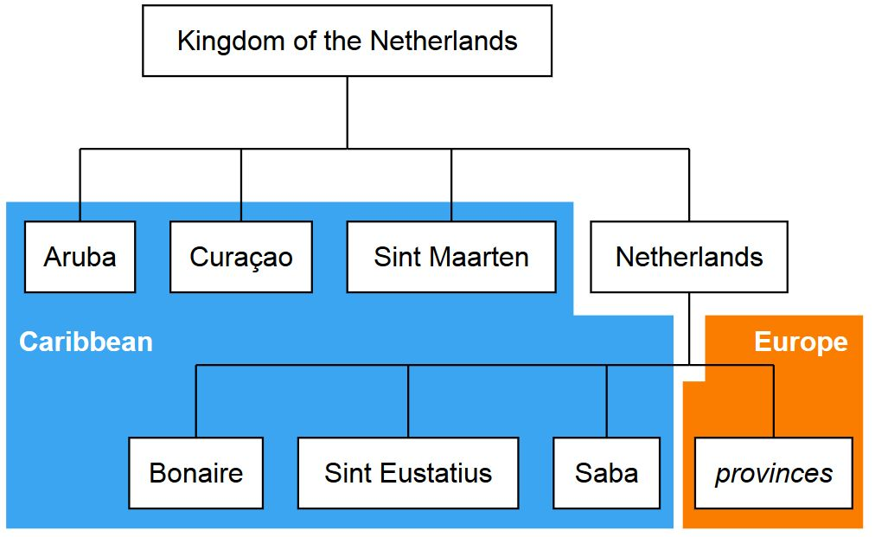
A quick recap: responsibilities of NLHO in Caribbean
leeward islands
windward islands

Slide 4
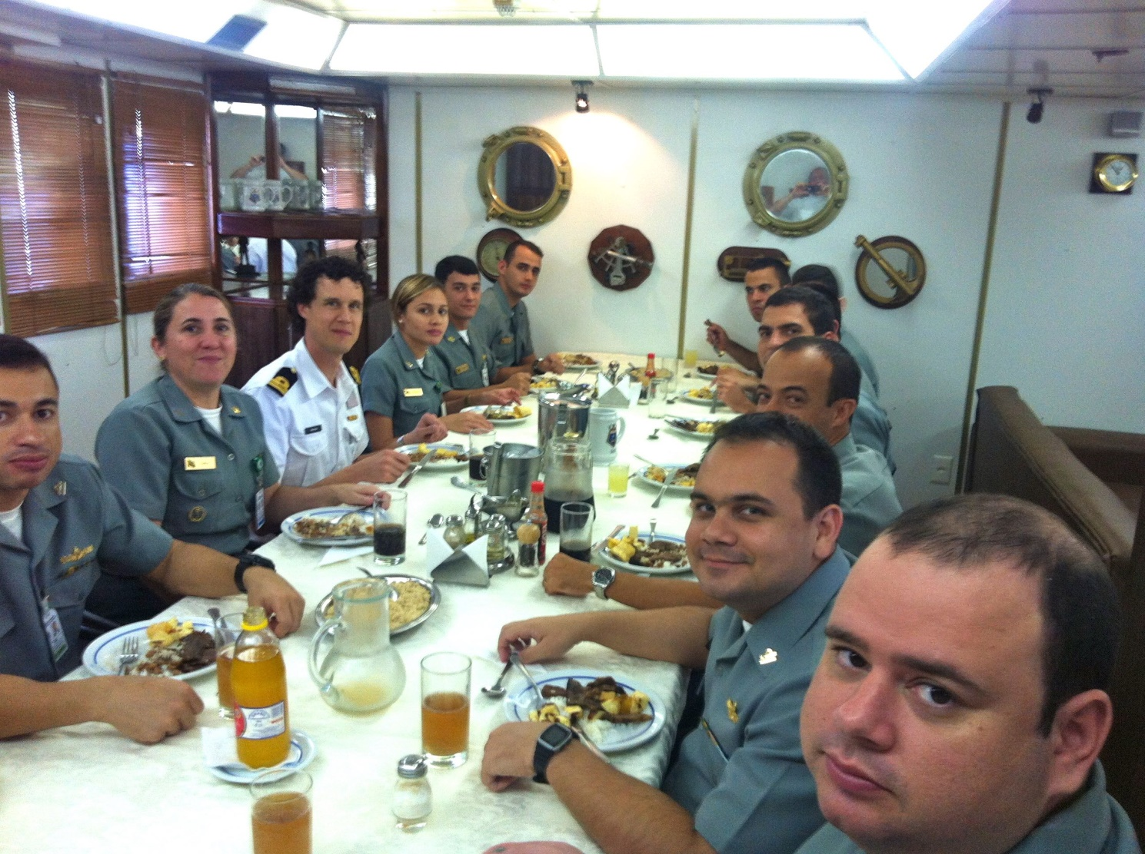
Result from MACHC2013: exchange with Brazil

Slide 5
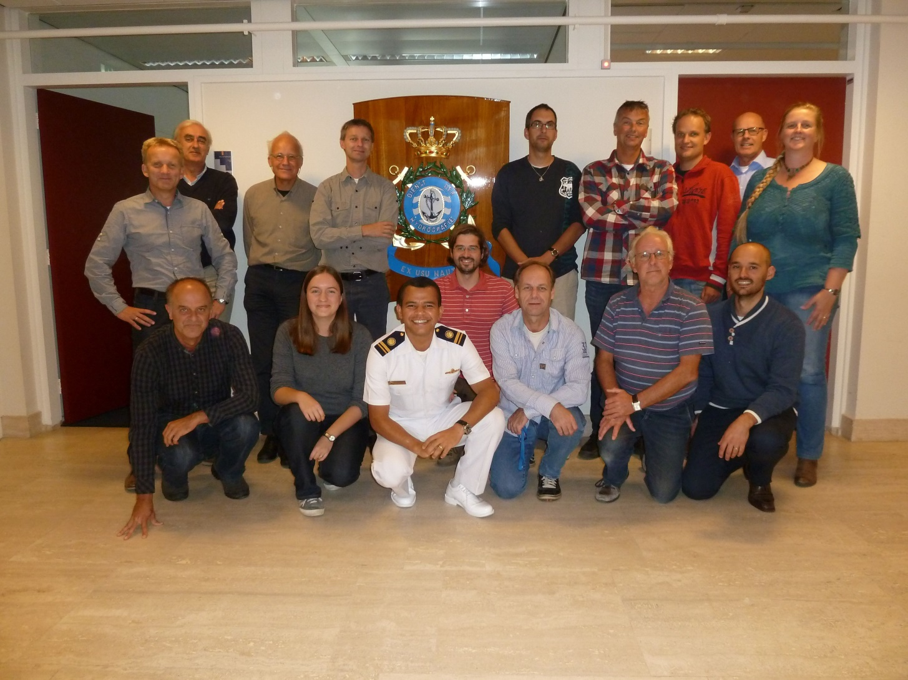
Result from MACHC2013: exchange with Brazil

Slide 6
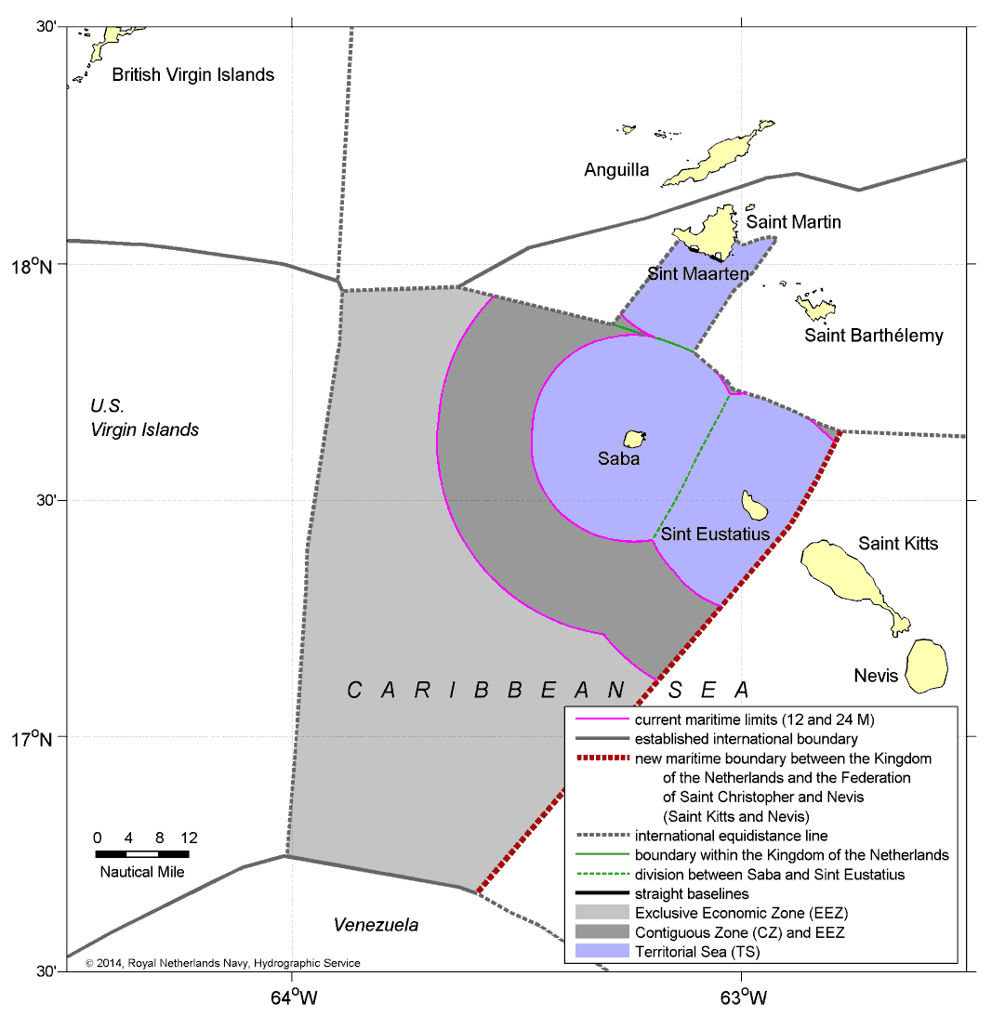
Agreement on new Caribbean all-purpose boundary

Slide 7
Continued cooperation on tidal predictions with Suriname

Slide 8
C-55 status of hydrographic surveying
Leeward Islands (Aruba, Curaçao, Bonaire)
Adequately surveyed (<200m / >200m): 14% / 40%
Required re-survey (<200m / >200m): 86% / 60%
Never systematically surveyed (<200m / >200m): 0 / 0
Windward Islands (Sint Maarten, Saba, Sint Eustatius)
Adequately surveyed (<200m / >200m): 90% / 98%
Required re-survey (<200m / >200m): 10% / 02%
Never systematically surveyed (<200m / >200m): 0 / 0

Slide 9
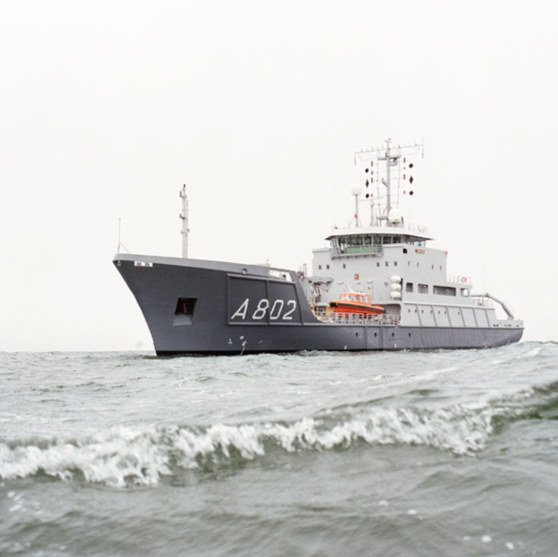
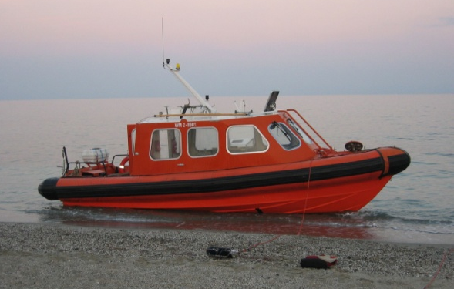
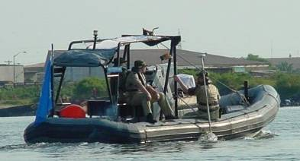
Survey capacity for deployment in 2016

Slide 10
Conclusion
Satisfactory status for surveying and nautical charting in the MACHC area.
The 2016 survey campaign will improve the status of surveying of the Leeward Islands.
Cooperation with other MS will lead to a new maritime boundary with Saint Kitts & Nevis and better tidal predictions for Suriname.

