Slide 1


15th Meso American-Caribbean Sea Hydrographic Commission Conference
10 – 13 December 2014
Paramaribo, Suriname
Suriname
National Report
By
Freddy Delchot
Manager Nautical Affairs
Maritime Authority Suriname

Slide 2
Table of Contents
Introduction
Hydrographic Office Service
Surveys
New charts & updates
New publications & updates
MSI
S-55
Capacity building
Oceanographic activities
Other activities
Conclusions

Slide 3
Introduction
Hydrographic Office/Services
- Hydrographic division of the
the Maritime Authority Suriname

Slide 4
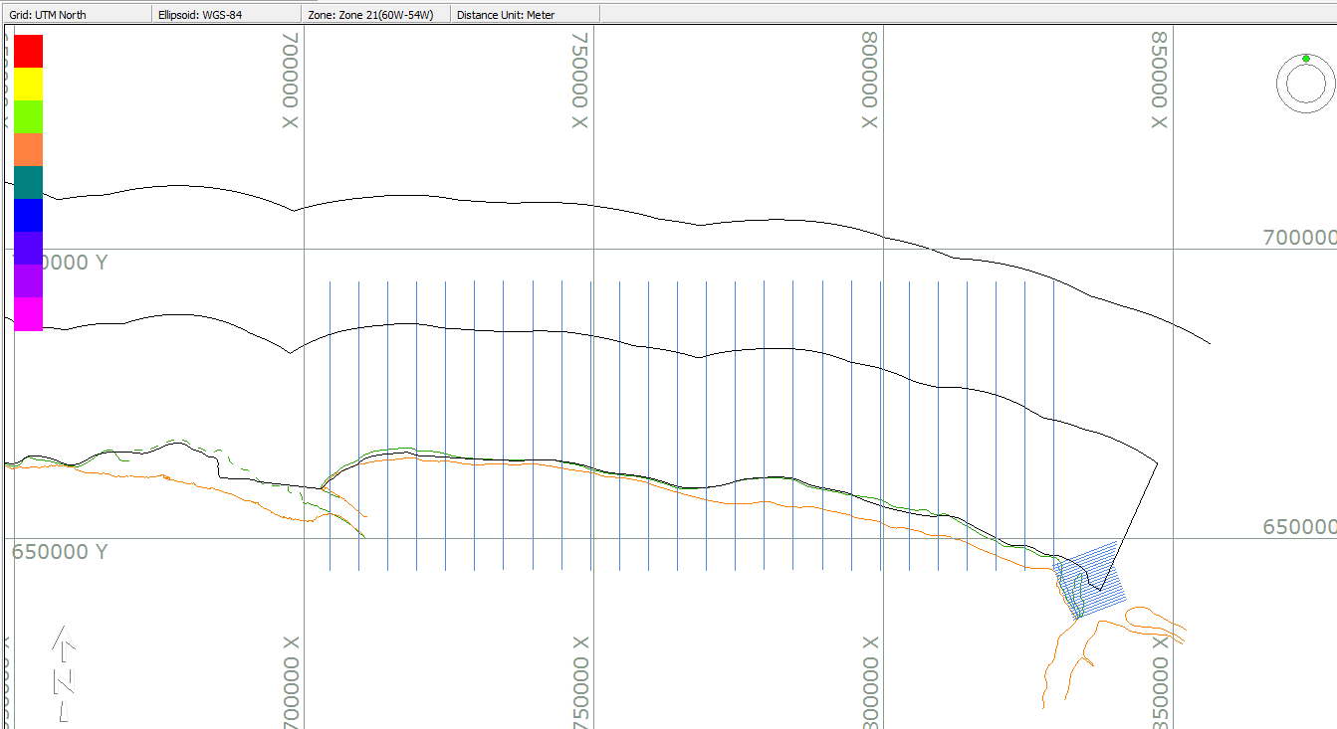
Surveys 2014
Near shore survey and Mud bank monitoring

Slide 5
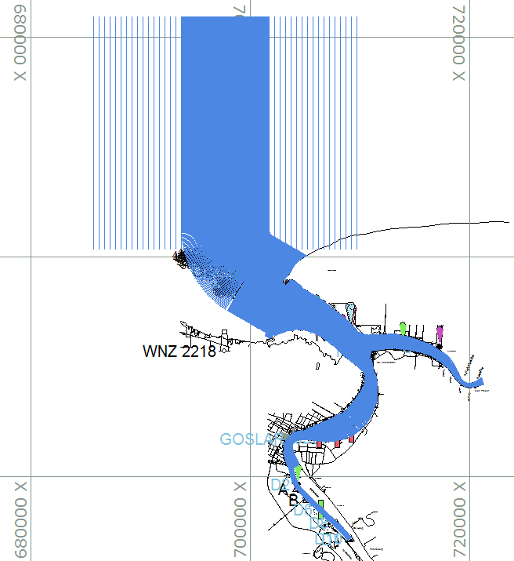
Surveys 2014
Survey for updating ENC SR402218 and SR302014 and national paper charts 2014 and 2218/ BA 99

Slide 6
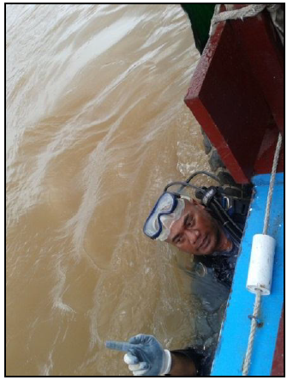
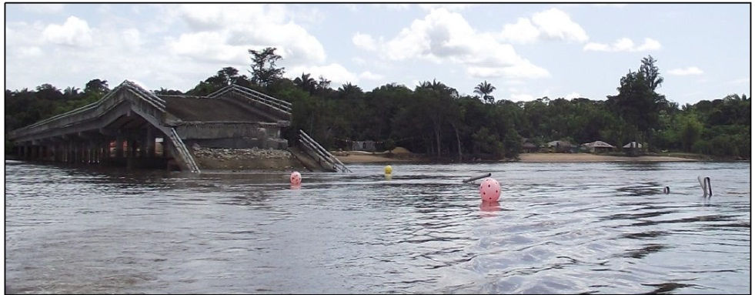
Surveys 2014
Investigation passage Carolina bridge

Slide 7
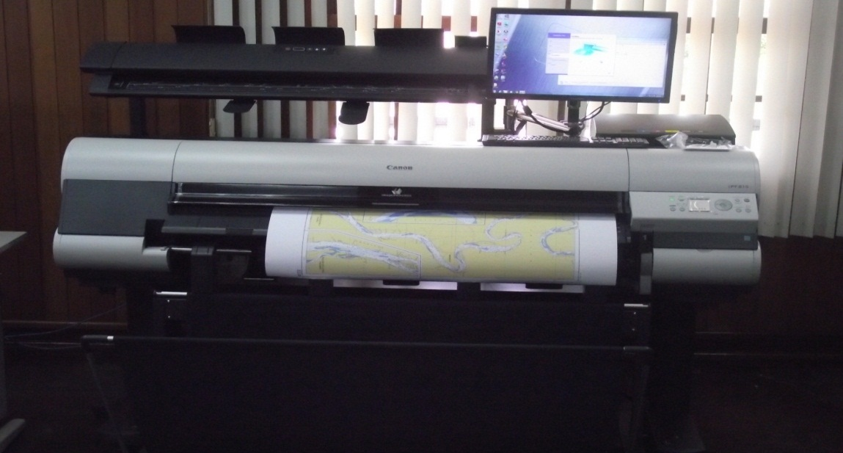
New technologies and /or equipment
Single beam echo sounder : ODOM CV200 – frequency 24/200 kHz
HP design Jet T 2500 multi function printer- max size A0 format

Slide 8
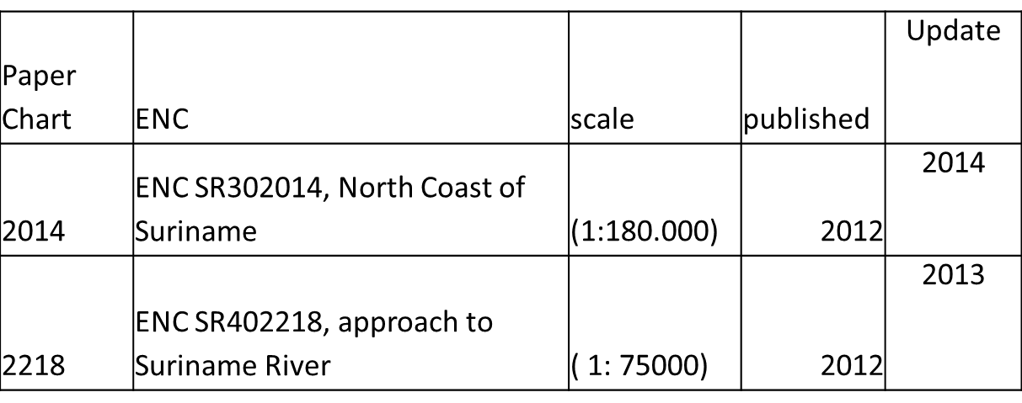
New charts & updates

Slide 9
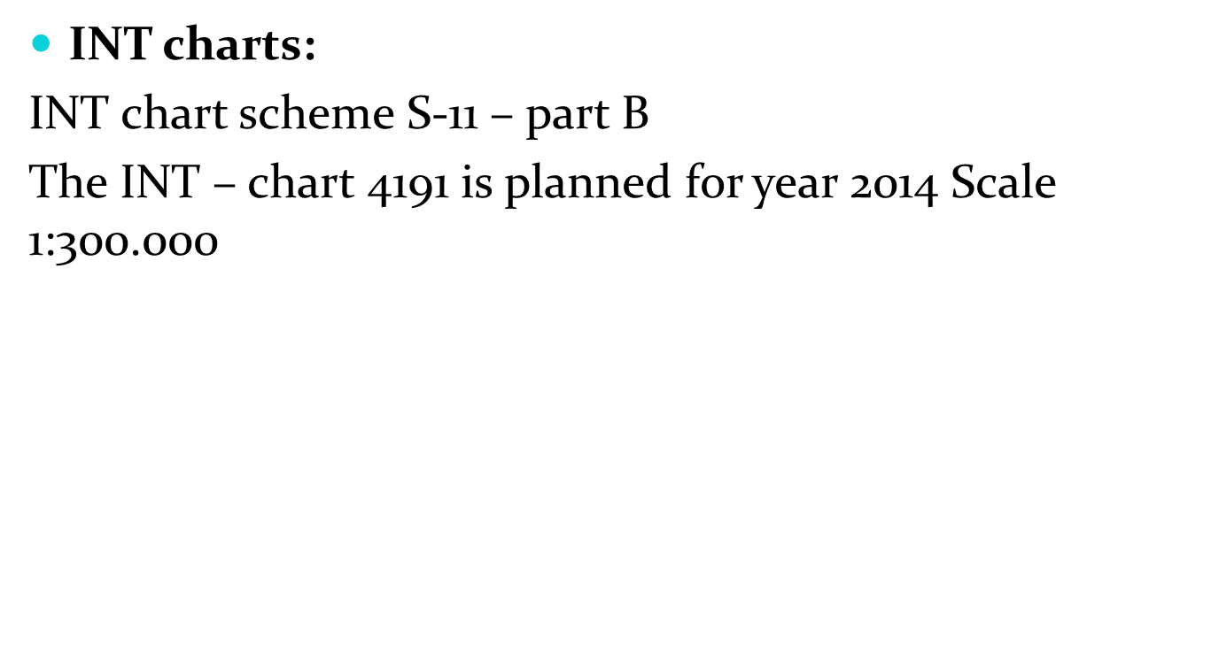
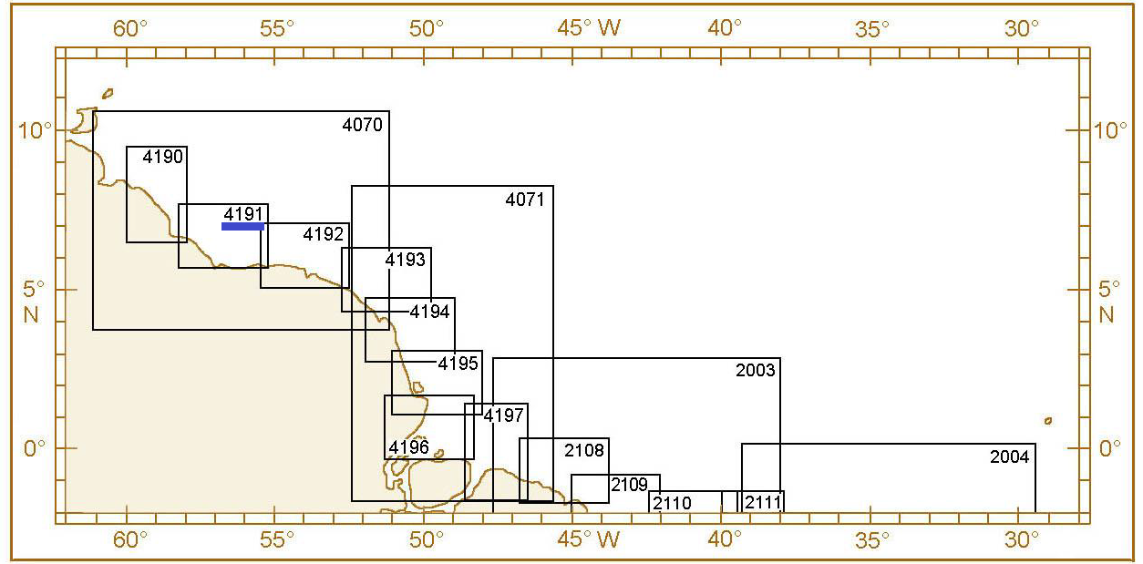
New charts & updates

Slide 10
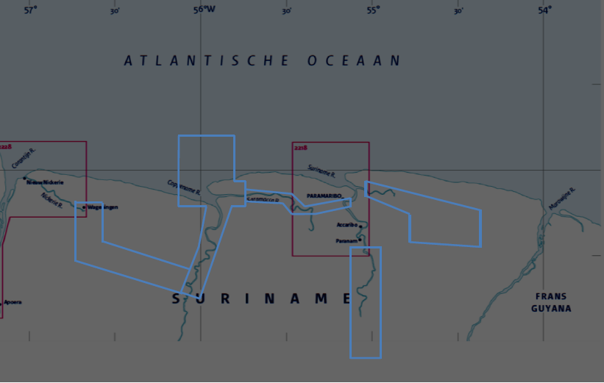
National paper charts:
Updates planned in 2015 -2016 (blue)

Slide 11
ENC Distribution method
IC-ENC and UKHO
Problems encountered
No certified Cartographer
Delay in ENC and paper Chart updates

Slide 12
MSI
Existing infrastructure for transmission
NtM published in local papers and website, emailed to mariners.
NtM submitted to the Nav Area coordinator
Plans
Fase 1: VHF coverage Area A1 :currently VHF channel 16 communication for 3NM in approaches to ports
Fase 2: MF coverage Area A2

Slide 13
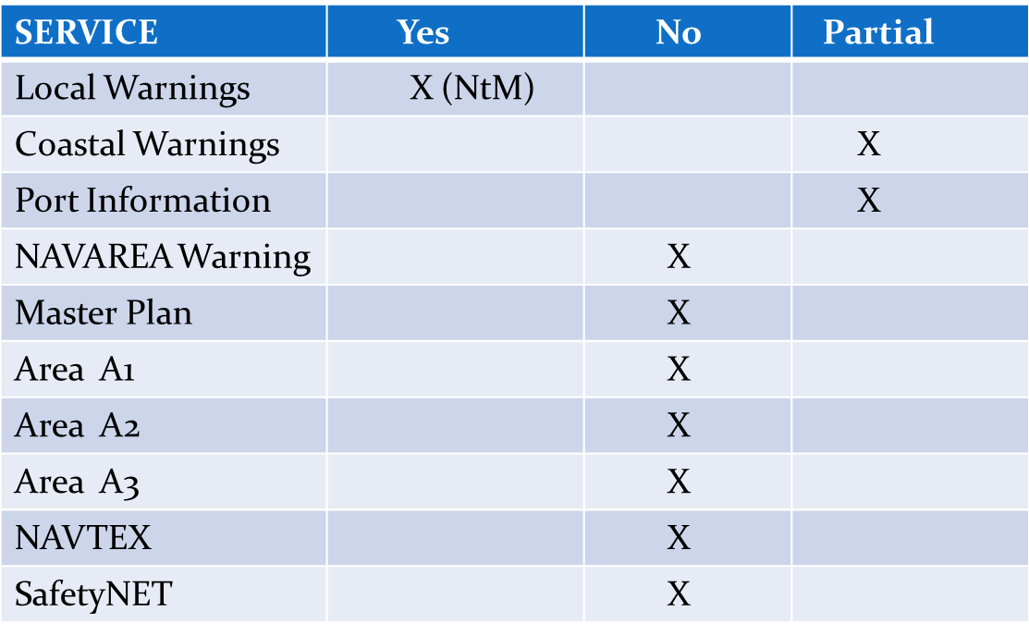
Marine Sefety Information

Slide 14
S-55
Status of hydrographic surveys
A = percentage which is adequately surveyed.
B = percentage which requires re-survey at larger scale or to
modern standards.
C = percentage which has never been systematically surveyed
 | A | B | C
Depths 0-200m | 3 | 100 | 0
Depths >200m | 0 | 5 | 95

Slide 15
Capacity building
Training received
THE IHO - NIPPON FOUNDATION CHART PROJECT
6th Course in Marine Cartography and Data Assessment
UKHO, Taunton, UK, 1 September – 12 December.
Technical Workshop on Hydro/ Cartography river Survey ( 22-24 October, 2014)
WORKSHOP IN IQUITOS, PERU- DNH
IALA AtoN Manager Course, IALA Headquarters in Paris from 17 March to 11 April 2014

Slide 16
Capacity building
Needed
Nautical Cartography Level A and B
Hydrography level A and B
Required Intern ship;
Tidal analysis
Side Scan Sonar operation and interpretation
Paper Chart and ENC production
SB and MB Back Scatter processing

Slide 17
Bilateral projects with hydrographic component
MoU Suriname – Brazil DNH
MoU Suriname – UKHO- ENC and paper Chart production
MoU Suriname – France
Member of IC-ENC for ENC validation and distrubution

Slide 18
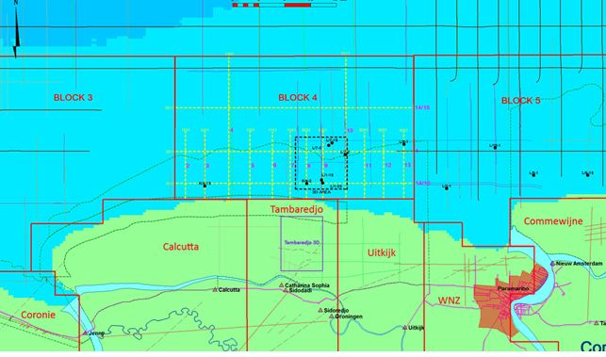
National project with hydrographic component
ESIA and Near shore seismic project and mapping sensitivity areas along the coast of Suriname by the National State oil Company ( block 1 – 8)

Slide 19
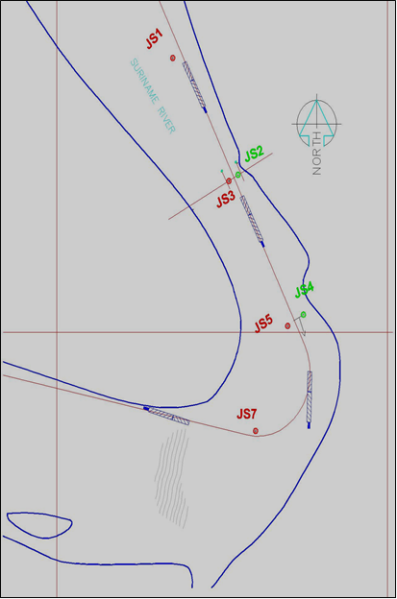
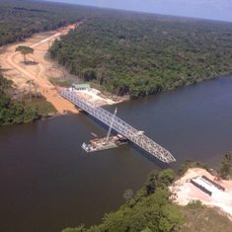
National project with hydrographic component
Bridge over the Suriname river

Slide 20
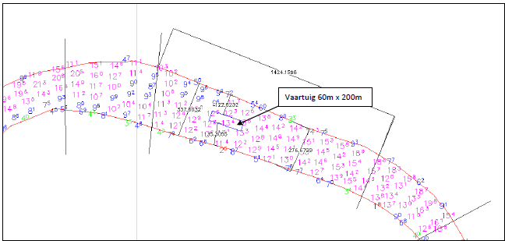
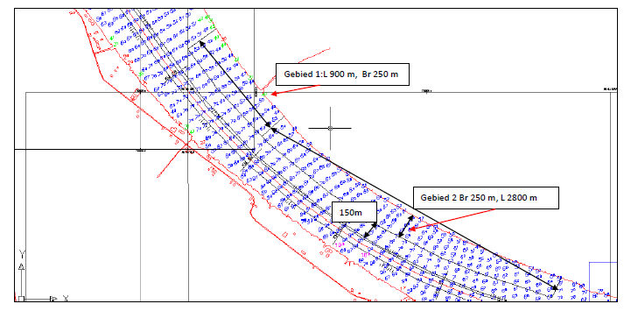
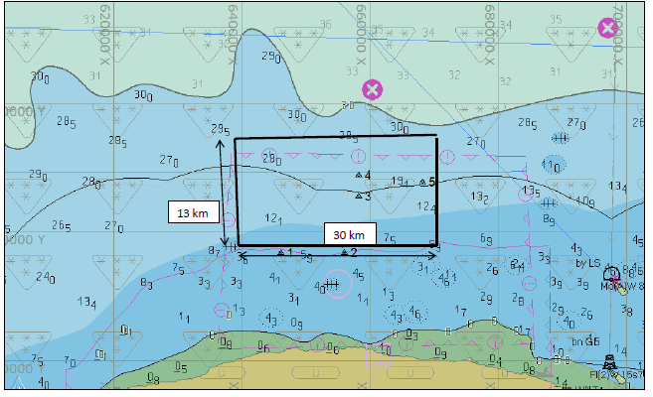
National project with hydrographic component
Establishment of STS ( Ship To Ship) cargo transfer locations in the river and along the coast.

Slide 21
Oceanographic activities
Tide gauge network
Project : Support for improving integrated disaster risk management for climate
Objective: Flood Early Warning System ( FEWS)

Slide 22
Other activities
Participation in MACHC Working Groups
MEIP
MICC
Geospatial studies
mapping sensitivity areas along the coast of Suriname by the National State oil Company ( block 1 –7)
Disaster prevention
National and regional Oil spill contingency plan for oil exploration

Slide 23
Conclusions
Most of the objectives that we have planned for 2014, are achieved.

Slide 24
THANK YOU

