Slide 1
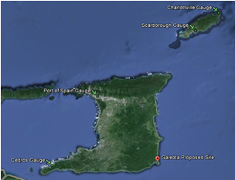
National Report of
Trinidad and Tobago
December 2014
Hydrographic Unit
Land and Surveys Division
Ministry of Land and Marine Resources

Slide 2
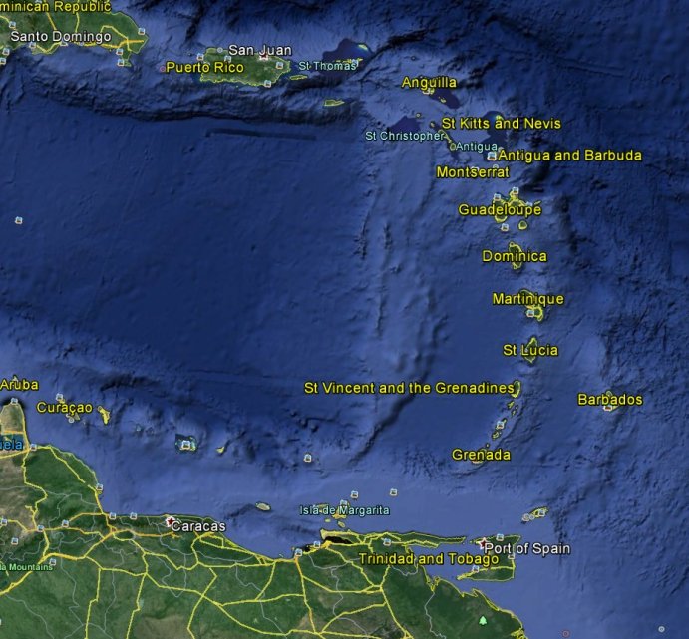
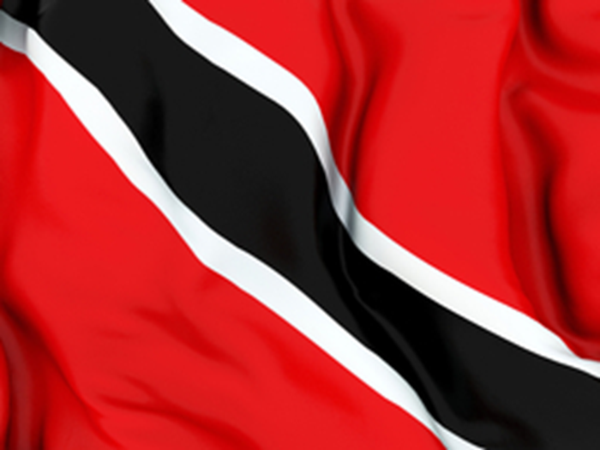
Introduction- Location of Trinidad and Tobago
Twin island country off the northern edge of South America
Off the coast of northeastern Venezuela and south of Grenada in the Lesser Antilles

Slide 3

Introduction- Hydrographic Unit
Obligations are:
Hydrographic Unit – provision of hydrographic data outside of port boundaries which include; water depths, tides, obstructions and currents.

Slide 4
Reorganization- Hydrographic Unit
Hydrographic Unit – Surveys and Mapping, Ministry of Land and Marine Resources (September 2013)
IHO- Member State
MACHC- Member State

Slide 5
Surveys
Coverage of new surveys
Since our last MACHC report, no hydrographic surveys have been conducted by the Hydrographic Unit.
New Technologies and/or equipment
Trinidad and Tobago is at the stage of procurement of a Multibeam echo sounder system, to allow the unit to conduct hydrographic surveys.
New Ships
Trinidad and Tobago has recently re furbished a 28ft fiber glass vessel in order to conduct near shore surveys. We are also looking to purchase a larger vessel to conduct offshore surveys.

Slide 6
Charts and Publications
Charts
Charts for Trinidad and Tobago are produced by the United Kingdom Hydrographic Office (UKHO), under cooperative arrangements.
Publications
New Publications
Tidal prediction booklets are made available to the public by the Hydrographic Unit of Trinidad and Tobago.
The UKHO produces the sailing directions and list of lights for Trinidad and Tobago.

Slide 7
MSI
The Maritime Division of the Ministry of Transport is responsible for the dissemination of Trinidad and Tobago’s MSI.

Slide 8
Capacity Building
Training Received
One Member of the Hydrographic Unit participated in the IHO through the Nippon Foundation, Cat B cartography training course in 2013 conducted by the UKHO.
Training Required
There is a great need for members of staff of the Hydrographic Unit to be trained in both Cat B Hydrography and Cat A Hydrography.

Slide 9
C-55 Latest Update
There has been no change to the status of Trinidad and Tobago’s hydrographic coverage and the C-55 database reflects the currents status

Slide 10
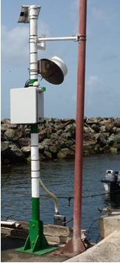
Oceanographic Activities
The Hydrographic unit current operates four tidal gauges at; Port of Spain, Cedros, Scarborough and Charlottville. We have also recently procured two radar sensors to improve the reliability of the gauges.
No. | Tide Gauge | Latitude | Longitude
1 | Port of Spain | 10°38'48.00"N | 61°30'46.59"W
2 | Scarborough | 11°10'42.61"N | 60°44'6.69"W
3 | Cedros | 10° 5'35.74"N | 61°51'56.46"W
4 | Charlotteville | 11°19'24.67"N | 60°32'57.59"W

Slide 11
Other
UKHO has recently conducted a technical visit to Hydrographic Unit of Trinidad and Tobago. The report would be sent to the Line Minister of the Hydrographic Unit for his consideration and execution to improve the efficiency and effectiveness of the Unit.

Slide 12
Conclusion
They Hydrographic Unit of Trinidad and Tobago continues to play a role in providing hydrographic data to facilitate safe navigation in the terrestrial waters of Trinidad and Tobago. We have made a great deal of progress within the last few years towards providing more comprehensive hydrographic data sets.

Slide 13


Questions?
Presented by:
Dwight Nanan
dwightnanan@hotmail.com
Trinidad and Tobago

