Slide 1
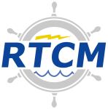
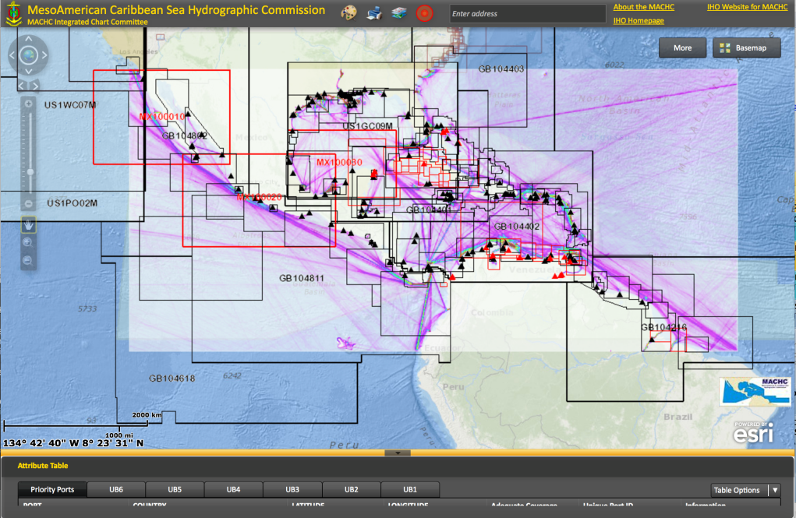
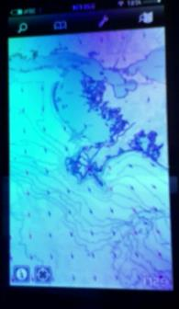
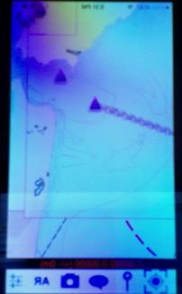
The Radio Technical Commission for Maritime Services
Report to
MACHC-15
Manzanillo, Mexico
Rafael Ponce
rponce@esri.com

Slide 2
Quick facts about RTCM
More than 130 member organizations
Involvement with
International Maritime Organization (IMO)
Cospas-Sarsat
International Electro-technical Commission (IEC)
International Organization of Standards (ISO)
European Telecommunication Standards (ETSI)
International Loran Association
Contribute to relevant work of:
The International Hydrographic Organization (IHO)
The International Telecomunications Union (ITU)
The International Association of Aids to Navigation and Lighthouses Authorities (IALA)
The Comité International Radio-Maritime (CIRM)
The National Marine Electronics Association (NMEA)
The Mobile Satellite Users Association (MSUA)
15 Special Committees
5 different “Mailing Lists” (subject-specific interest groups)

Slide 3
Some activities relevant to IHO

Slide 4
The e-Navigation Steering Committee
Evaluation of mobile platform technology
The use of ENCs combined with AIS and other information
Runtime technology
Addressing recreational boaters mainly
Perhaps also some commercial uses – unregulated Portable Pilot Units (PPUs) and handhelds for Masters and Mates
Influenced by the US e-Navigation Strategic Action plan
Focus areas:
Improved connectivity
Seamless data exchange
System integration
Human-machine interface
Standards for components supporting the eNavigation framework
Position, Navigation and Timing

Slide 5
Special Committee 104 Differential Global Navigation Satellite Systems (DGNSS)
Newly created Joint RTCM/NMEA Working Group
For the development of new GPS/GNSS data messages
It has 11 of the total SC 104 members
Working Group tasks that can be beneficial to hydrographic surveys:
PBV Position: Extend (GGA – fix information) sentence with covariance information (accuracy)
PBV Baseline vector: Develop a new baseline vector sentence with covariance information (accuracy)

Slide 6
Thank you
Rafael Ponce
rponce@esri.com

